Slide 1

Covid-19
MARCH 2020

Slide 2
Continue with our commitment to offer products with the highest quality and safety food standards

Slide 3
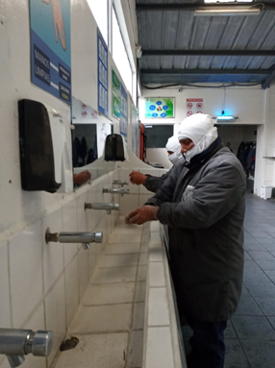
ECOFROZ S.A.
Reinforce the hygiene measures for the personnel entrance to the plant “3 circuits”
Restrict visits and trips to areas with COVID 19 as much as possible
Control measures to enter the facilities (temperature capture and questionnaire)
If there is a positive indicator, the person must be evaluated by the medical service and follow the procedure established by the MSP

Slide 4

PREVENTIVE MEASURES
Limit visitors to the plant and fields
Limit Ecofroz personnel assistance to public meetings of any kind
If returning from affected country must comply with surveillance procedure
Strengthen compliance with the protocol for respiratory diseases

Slide 5
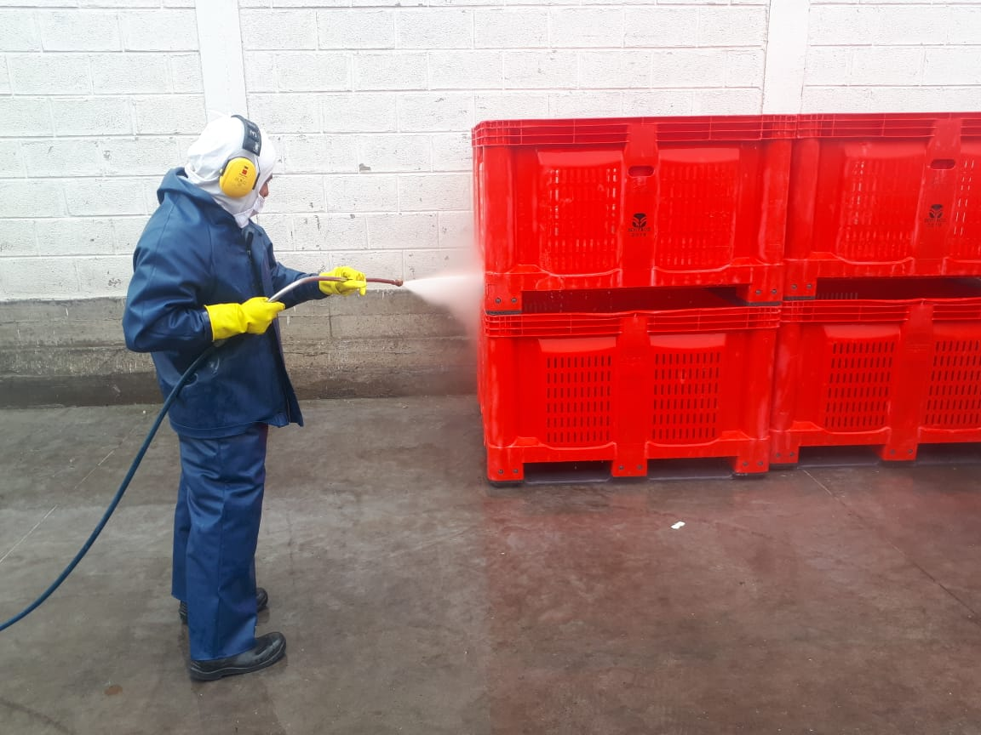
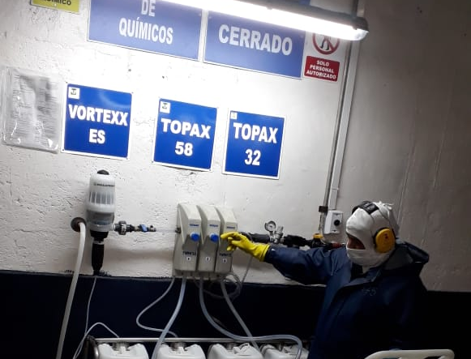
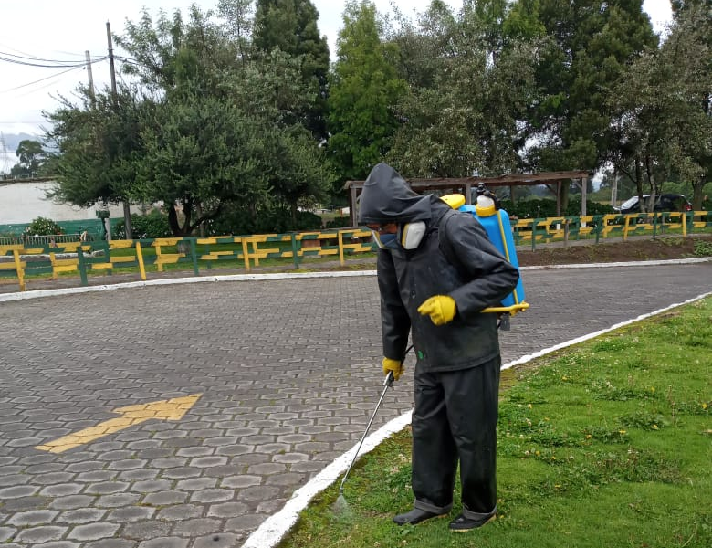
Strengthen compliance with the protocol for plant´s hygiene:
In addition to the existing cleaning and disinfection procedures:
Disinfect contact surfaces such as the phone or others that are shared and often used.
Strengthen disinfection points in places where it is deemed necessary.
The disinfection protocol and certificate will be requested to the shipping companies for each containers.
Strengthen cleaning of common areas.
Strengthen disinfection points in key places.

Slide 6
In suspicion of the presence of CODIV- 19:
Most important warning signs and symptoms
Fever greater than 38° C
Dry cough
Respiratory distress

Slide 7
If you are not in the company
Do not go to your job and go to the nearest MSP Medical Center
Comply with the recommendations given
Contact your immediate boss and request the MSP certificate
If you are at work:
Communicate to supervisor
Go to the doctor's office Stay in designated isolation
Your status will be evaluated and if required, contact 171.
Follow instructions given by the MSP

Slide 8
If positive case is detected:
Human Resources and área management will lift the epidemiological fence
The Crisis Committee, the actions to be taken according to the risk and continuity plan

Slide 9
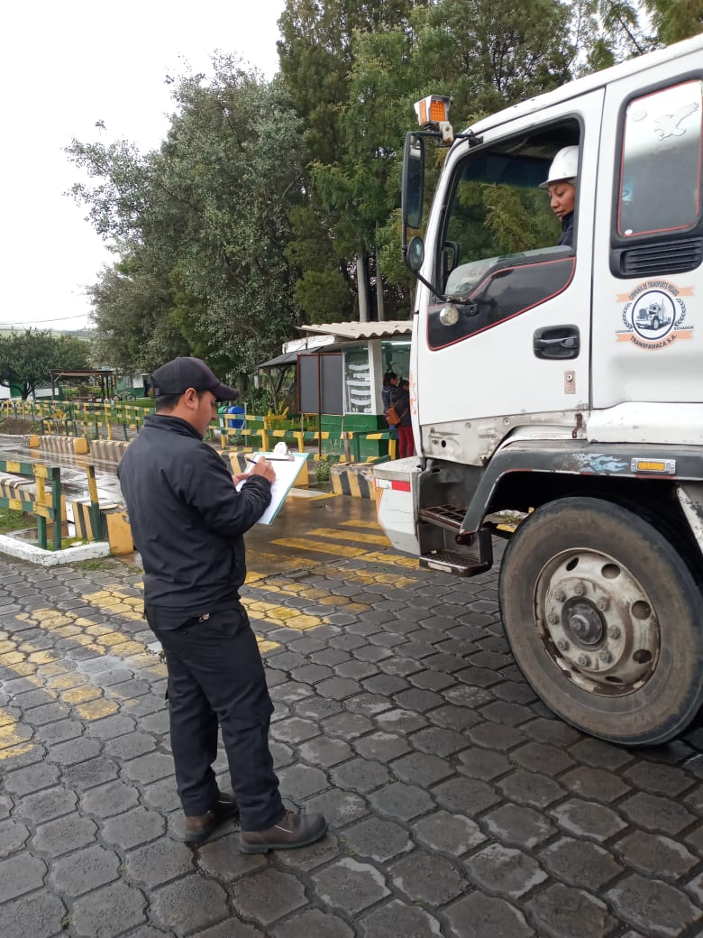
Visitors and Staff traveling to zones with COVID – 19 (CONFIRMED)
Restrict visits and trips to areas with COVID 19 as much as possible
Control measures to enter the facilities (temperature capture and questionnaire)
If there is a positive indicator, the person must be evaluated by the medical service and follow the procedure established by the MSP

Slide 10

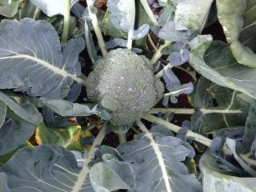
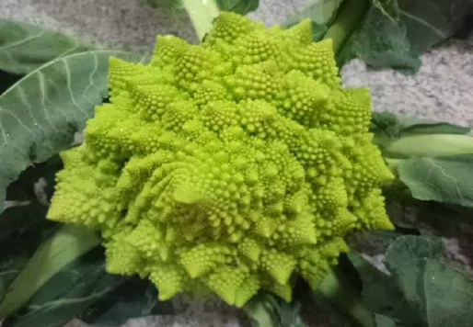
ECOFROZ S.A.
Frozen vegetables from Ecuador
www.ecofroz.com

