Slide 1

TERMINAL_v4.2 // NYC_NODE_01
THE ETHICS OF THE METAVERSE WORKPLACE
Examining Labor Issues, Data Extraction, and Privacy in Virtual Corporate Environments
USER: Luis Couttolenc
ORG: University of Hartford | UIST
TIMESTAMP: 2026.04.27_09:00:00_EST
>> ACCESS_GRANTED... >> LOADING_ETHICS_MODULE... >> WARNING: SURVEILLANCE_ACTIVE
STATUS: ENCRYPTED // SESSION_ID: NYC_7782
Notes:
Alright, let's jack in. We're here to talk about the metaverse workplace, not as some futuristic fantasy, but as a present-day battleground. This isn't just about new tech; it's about the old fight for rights in a new, digital arena. We'll dissect the raw code of labor issues, the relentless data extraction, and the chilling privacy implications. Get ready to see how the virtual world is reshaping our reality.

Slide 2


FILE: intro_metaverse.sh
NODE: NYC_CORE_02
root@nyc_node:~# cat definition.txt
root@nyc_node:~# ./check_status.sh
Digital Workspace
Corporate Adoption
A virtual reality environment where corporate operations, communication, and collaboration are digitized into immersive 3D spaces.
Major firms are transitioning to virtual offices for global teamwork, training, and client interaction, often outpacing existing labor protections.
SYSTEM_ALERT
"The rapid expansion of virtual work creates a regulatory vacuum where corporate policy becomes the law."
[SECTION_01] // [METAVERSE_INIT] // [PAGE_02]
Notes:
So, what exactly is this metaverse workplace we're talking about? It's a digital frontier where work, communication, and collaboration happen in immersive virtual spaces. Companies are already leveraging these platforms for everything from global meetings to intensive training simulations. But here's the catch: this technological leap is creating a regulatory vacuum, where corporate policy often becomes the de facto law. This sets the stage for the core problem we face.

Slide 3

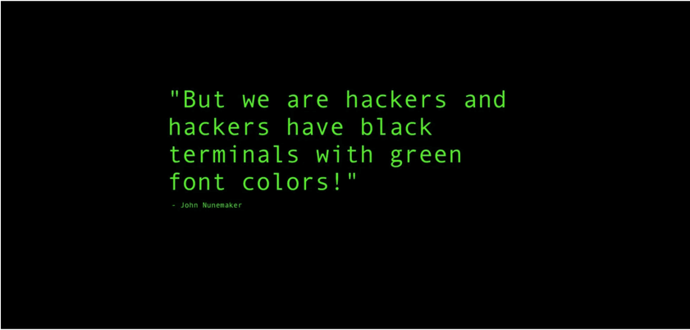
FILE: core_problem.log
NODE: NYC_CORE_03
root@nyc_node:~# grep "LAG" analysis.txt
root@nyc_node:~# view image.png
Regulatory Lag
Technological advancement in the metaverse is moving at light speed, while legal frameworks remain stuck in the analog era. This creates a massive gap in worker protections.
> [SYSTEM_SCAN] DETECTING_REGULATORY_GAP... > [WARNING] LAW_VERSION: 1.0 (LEGACY_SYSTEM) > [WARNING] TECH_VERSION: 4.0 (BETA_PHASE) > [RESULT] COMPATIBILITY_ERROR: RIGHTS_NOT_FOUND
Ethical Vacuum
In this vacuum, corporate interests dictate the rules of engagement, often at the expense of individual privacy and labor rights.
[SECTION_02] // [REGULATORY_GAP] // [PAGE_03]
Notes:
The problem is stark: technology is outpacing law. We're building these metaverse workspaces at breakneck speed, far faster than our legal frameworks can adapt. This creates a massive regulatory gap, leaving us with gray areas where existing labor and privacy laws simply don't apply. Without clear legal guidelines, accountability becomes a ghost in the machine. This regulatory void directly impacts the most vulnerable: the workers.

Slide 4

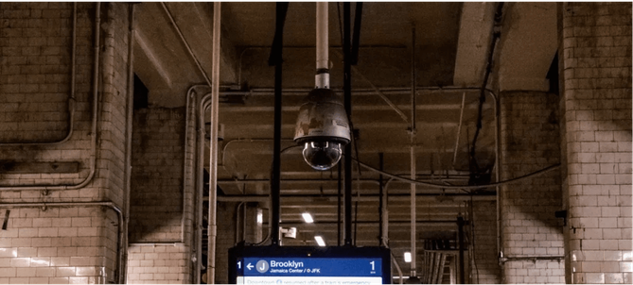
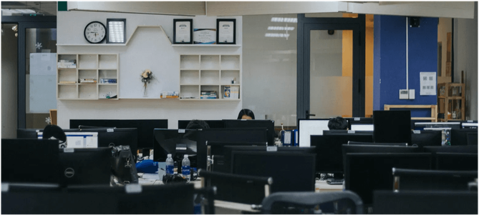
FILE: labor_issues.sh
NODE: NYC_CORE_04
ISSUE_01: EMPLOYMENT
ISSUE_02: OPERATIONS
ISSUE_03: RIGHTS
Gig Precarity
Moderation
Unionization
Virtual environments exacerbate unstable employment, where workers lack traditional benefits and face increased exploitation.
Outsourced labor forces handle high-stress content moderation under poor conditions, often hidden from the public eye.
Collective bargaining faces new hurdles in virtual spaces where physical proximity and traditional labor laws are absent.
> [ALERT] UNION_BLOCK_DETECTED > [STATUS] RIGHTS_SUSPENDED > [ACTION] UPDATE_LABOR_CODE
[SECTION_03] // [LABOR_EXPLOITATION] // [PAGE_04]
Notes:
This regulatory vacuum we just discussed leads directly to significant labor issues, creating precarity in the virtual realm. We're seeing an exacerbation of gig work instability, where virtual environments amplify exploitation and strip away traditional benefits. Think about content moderation: a hidden, outsourced workforce doing the metaverse's dirty work under brutal conditions. And unionization? Collective bargaining faces entirely new hurdles when physical proximity is gone. But the exploitation doesn't stop there; it extends to our very data.

Slide 5

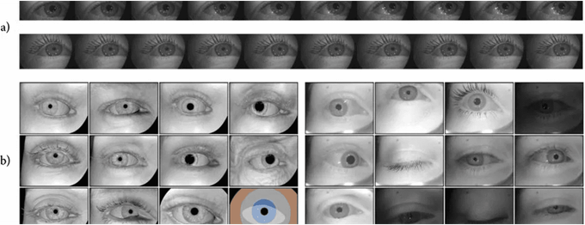
FILE: data_extraction_v3.log
NODE: NYC_CORE_05
root@nyc_node:~# ./deep_scan
Kinematic Fingerprinting
VR headsets must track physical motion to function. Head and hand movement data can identify a user with high accuracy, turning the body itself into a source of information.
20M+
DATA POINTS / 20 MIN
Involuntary Bio-Feedback
Sensors capture physiological responses that users cannot consciously control, revealing emotional states, focus levels, and behavioral data that is being harvested.
The 'Always-On' Panopticon
The power imbalance strengthens because technology collects more information than ever before. Movements, attention, and behavior are now data points for corporate control.
PUPIL_DILATION_LOGGED
> [ANALYSIS] DATA_DENSITY: EXTREME > [IMPLICATION] BODY_DATA_HARVESTING_ACTIVE
GAZE_DWELL_TIME_TRACKED
BODY_AS_INFORMATION_SOURCE
[SECTION_04] // [DEEP_DATA_EXTRACTION] // [PAGE_05]
Notes:
Beyond labor precarity, we face the new frontier of monitoring: relentless data extraction. VR systems are biometric goldmines, logging everything from pupil dilation to micro-expressions. Your unique movement patterns, your kinematic fingerprint, can identify you with chilling accuracy. This isn't just about what you type; it's about involuntary bio-feedback, revealing your emotional state, your focus, even early signs of medical conditions. This creates an 'always-on' panopticon, a level of surveillance impossible in the physical world. And this constant oversight raises profound privacy concerns.

Slide 6


FILE: privacy_deep_dive.log
NODE: NYC_CORE_06
root@nyc_node:~# ./analyze_ethics
root@nyc_node:~# view shield.jpg
DILEMMA: INFORMED CONSENT
Coerced Participation
When VR is a job requirement, 'consent' is a legal fiction. Employees cannot opt-out of biometric tracking without risking their livelihood, creating a systemic power imbalance.
DILEMMA: SECONDARY USE
The Insurance Threat
> [QUERY] DATA_RETENTION_PERIOD > [RESULT] INDEFINITE > [QUERY] USER_DELETION_RIGHTS > [RESULT] LIMITED_BY_PLATFORM_POLICY
Biometric data collected for 'productivity' could be sold to health or life insurance companies to profile users based on involuntary physiological markers.
"Privacy is not just about hiding; it's about the power to control your own narrative."
DILEMMA: OWNERSHIP
Digital Self-Sovereignty
Who owns the 'digital twin' of your body? Current EULAs often grant platforms perpetual rights to your behavioral data and avatar likeness.
[SECTION_05] // [ETHICAL_DEEP_DIVE] // [PAGE_06]
Notes:
Alright, let's talk about the real cost of this digital frontier: your privacy. We've seen how data gets extracted; now, who owns that digital ghost of you? When VR is a job requirement, consent becomes a legal fiction; you can't truly opt out without risking your livelihood. That biometric data, collected for 'productivity,' could easily be sold to insurance companies, profiling you based on involuntary physiological markers. And who owns that digital twin of your body? Current EULAs often grant platforms perpetual rights to your behavioral data and avatar likeness. This isn't just about hiding; it's about controlling your own narrative. So, how does this play out in the real world? Let's look at Meta.

Slide 7

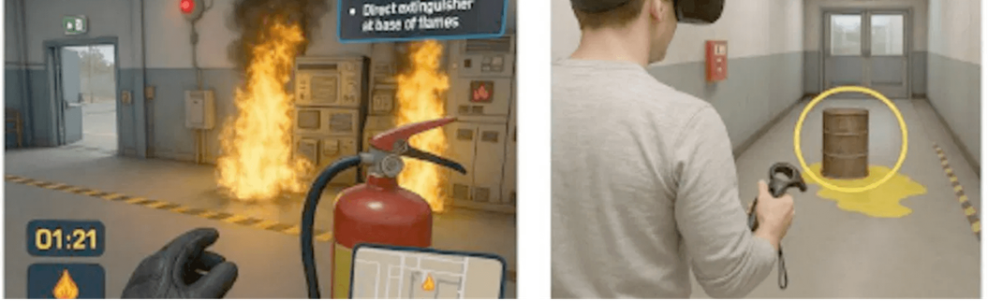
FILE: case_study_v3.sh
NODE: NYC_CORE_07
root@nyc_node:~# ./fetch_case_meta
root@nyc_node:~# ./fetch_case_kenya
SUBJECT: BUSINESS EXPERIMENT
SUBJECT: LABOR ORGANIZING
Horizon Workrooms
Kenyan Court Ruling
Meta discontinued 'Horizon Workrooms' as a standalone app during 'Reality Labs' cuts. This proves the Metaverse is a real business experiment with direct effects on workers and companies.
Courts ruled Meta broke the law by firing content moderators who attempted to unionize. Big tech uses outsourced labor to avoid direct responsibility for working conditions.
> [VERDICT] ILLEGAL_TERMINATION_CONFIRMED
> [STATUS] UNION_RIGHTS_PROTECTED
> [IMPACT] OUTSOURCED_LABOR_ACCOUNTABILITY
"The Metaverse workplace is not just about new technology; it's about how society chooses to treat workers."
[SECTION_06] // [CASE_STUDY_V3] // [PAGE_07]
Notes:
Building on those privacy concerns, Meta offers a stark case study in the volatility and ethical quagmires of virtual work. In January 2026, Meta's decision to decommission its VR workplace app, amidst Reality Labs layoffs, left thousands of virtual workers in a state of 'digital homelessness' with no legal recourse. But there's a glimmer of hope: the Kenyan High Court ruled that Meta can't hide behind third-party contractors to block content moderators from unionizing. This establishes a critical precedent: 'virtual' labor is still 'physical' labor, and the psychological toll demands the same protections. This case highlights the urgent need for global labor shifts. Now, let's zoom out and consider the broader societal impact of these trends.

Slide 8

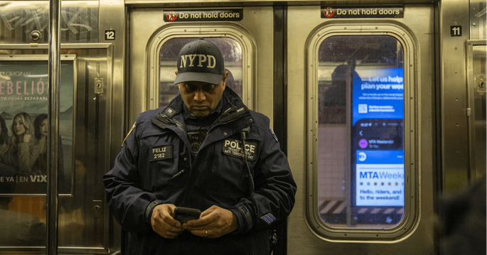
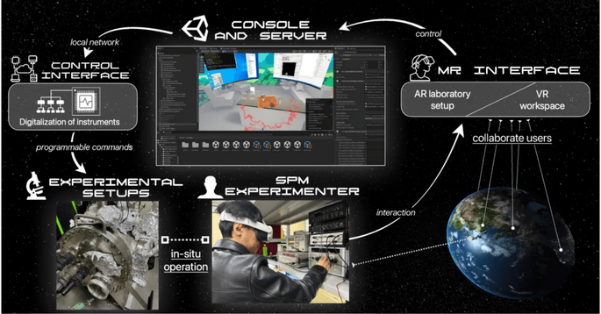
FILE: societal_impact.sh
NODE: NYC_CORE_08
root@nyc_node:~# ./analyze_norms
root@nyc_node:~# ./analyze_rights
root@nyc_node:~# ./forecast_future
PRIVACY NORMS
WORKER RIGHTS
FUTURE OUTLOOK
The normalization of constant surveillance in the workplace may bleed into broader societal expectations, eroding personal freedom.
Without urgent regulation, the metaverse could deepen existing inequalities and create a new class of "virtual laborers" with zero protections.
The metaverse has the potential to fundamentally redefine the relationship between employer and employee.
SOCIETAL_RISK: CRITICAL
> [THREAT] PERSONAL_FREEDOM_EROSION
[SECTION_07] // [SOCIETAL_IMPACT] // [PAGE_08]
Notes:
So, what happens when these individual privacy breaches and corporate power plays scale up? The normalization of constant surveillance in the workplace will inevitably bleed into broader societal expectations, eroding personal freedom. Without urgent regulation, the metaverse could deepen existing inequalities, creating a new class of 'virtual laborers' with zero protections. This isn't just about a new way to work; it's about fundamentally redefining the relationship between employer and employee. The societal risk here is critical: we face a threat to personal freedom. But researching these complex issues presents its own set of challenges.

Slide 9

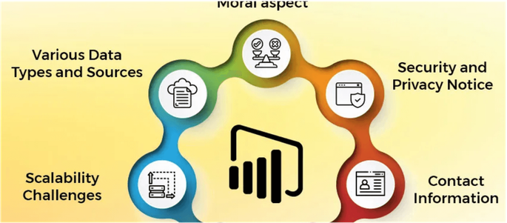
FILE: research_challenges.log
NODE: NYC_CORE_09
root@nyc_node:~# ./check_volatility
root@nyc_node:~# ./check_access
root@nyc_node:~# ./check_complexity
CHALLENGE_01: VOLATILITY
CHALLENGE_02: ACCESS
CHALLENGE_03: COMPLEXITY
Technological Flux
Hidden Labor
Ethical Nuance
Policies and technology evolve quickly, making long-term data consistency difficult.
Platform maintenance is often outsourced or hidden, reducing firsthand experience.
Explaining biometric surveillance to general audiences remains a major hurdle.
> [DATA_STABILITY] LOW > [UPDATE_FREQ] CRITICAL
> [VISIBILITY] RESTRICTED > [VERIFICATION] FAILED
[SECTION_08] // [RESEARCH_DIAGNOSTICS] // [PAGE_09]
Notes:
And that brings us to the core problem for anyone trying to understand this space: the sheer difficulty of researching the metaverse. First, there's the technological flux; policies and tech evolve so quickly that long-term data consistency is almost impossible. Then, much of the labor maintaining these platforms is outsourced or hidden, making firsthand experience and verification incredibly difficult. Finally, explaining the ethical nuances of something like biometric surveillance to a general audience remains a major hurdle. This complexity demands a new approach to understanding the future of work.

Slide 10
FILE: final_conclusion.sh
NODE: NYC_CORE_10
root@nyc_node:~# ./summarize_findings
root@nyc_node:~# ./execute_governance
Key Findings
FUTURE MANDATE
The Metaverse workplace is not just about technology; it's about how society treats workers. Companies collect sensitive data while workers lack the power to refuse or negotiate.
Society needs stronger rules about biometric data, employee monitoring, consent, and worker rights in digital environments.
Labor Precarity
"The future of work should balance technology with human dignity, privacy, and fairness."
Labor protections remain unclear, especially for outsourced workers. Innovation should not be an excuse to avoid responsibility for human dignity and fairness.
> [SYSTEM_EXIT] SUCCESSFUL > [STATUS] HUMAN_DIGNITY_PRIORITIZED
[SECTION_09] // [FINAL_VERDICT] // [PAGE_10]
Notes:
We've navigated the digital labyrinth, and here's the hard truth: the metaverse workplace is a double-edged sword. It promises innovation, but it delivers a high cost to privacy and labor rights if we let it run wild. Technology is moving too fast, leaving our legal frameworks in the dust. This creates a dangerous paradox: immersive environments offer incredible collaboration tools, yet they also enable total biometric and behavioral monitoring. We need to act now. Updated labor laws and biometric privacy regulations aren't just suggestions; they're critical to prevent systemic exploitation. Protecting worker rights isn't just a moral imperative; it's essential for the future of work itself. Now, let's look at the intel that got us here.

Slide 11

FILE: works_cited.db
NODE: NYC_CORE_11
root@nyc_node:~# cat works_cited.txt
[SRC_01]
Anthony, Tristan. Meta is closing its VR workplace app amid Reality Labs layoffs. 16 Jan 2026. 30 April 2026. <https://www.businessinsider.com/meta-closing-vr-horizon-workplace-app-reality-labs-layoffs-2026-1>.
[SRC_02]
Daniel Berrick, Jameson Spivack. Unpacking the Privacy Implications of Extended Reality. 4 April 2023. 30 April 2026. <https://www.techpolicy.press/unpacking-the-privacy-implications-of-extended-reality/>.
[SRC_03]
Jang, Eric. Ready Employee One: Data Privacy Within the Metaverse. 24 June 2022. 30 April 2026. <https://onlabor.org/ready-employee-one-data-privacy-within-the-metaverse/>.
[SRC_04]
Ray, Jody. Kenyan Courts Keep Telling Meta to Let Workers Unionize. 14 February 2024. 30 April 2026. <https://jacobin.com/2024/02/kenya-courts-meta-content-moderation-union>.
> [ARCHIVE] STATUS_COMPLETE > [VERIFICATION] ALL_SOURCES_VALIDATED
[SECTION_10] // [WORKS_CITED] // [PAGE_11]
Notes:
This isn't just theory; it's built on solid intel. These are the key sources that informed our deep dive into the metaverse's ethical quagmire. Each one offers a critical piece of the puzzle, from Meta's volatile VR ventures to the legal battles defining virtual labor rights. We've pulled from the front lines, from the Future of Privacy Forum to the courts in Kenya. This isn't just academic; it's real-world data shaping our understanding of this evolving landscape. And with that, we open the floor.

Slide 12

THANK YOU
Questions & Discussion
USER: Luis Couttolenc
MAIL: couttolen@hartford.edu
root@nyc_node:~# logout
> [SESSION_TERMINATED] 2026.04.27
SYSTEM_STATUS: OFFLINE // LOG_SAVED
Notes:
That's the intel. We've laid out the risks, the challenges, and the urgent need for governance in this new digital frontier. Now, the conversation shifts to you. Your questions, your insights, your challenges to the data. Let's discuss how we navigate this complex terrain together. Don't hesitate to reach out if you want to continue the dialogue. Thank you.

