Slide 1
PROBLEM
How can we provide more accessibility on public spaces for people with vision impairment?

Slide 2
Smart Cane
Created a smart cane that will assist the user by taking pictures of their surroundings and feedback information to the user of the objects in front of them, with a voice assistant.
Users will have the choice to select the language of the voice assistant.

Slide 3
Tech Stack
Google Firebase Database
Google Vision API
Android

Slide 4
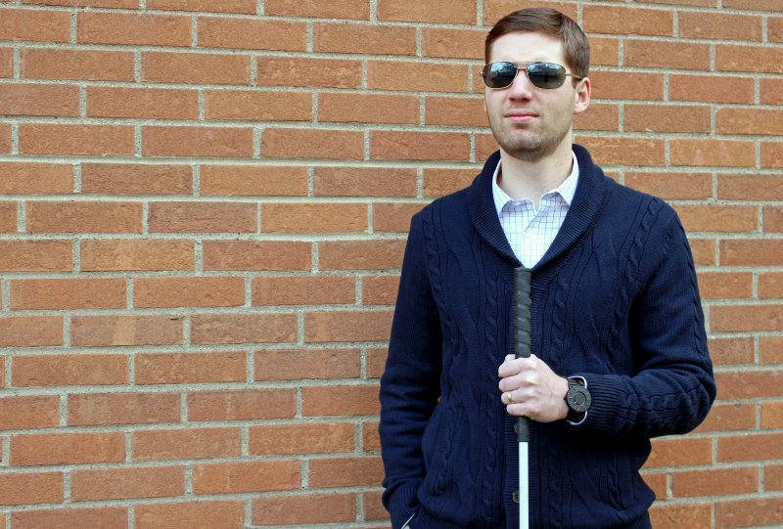

Slide 5
What’s Next?
Features that we want to implement in the future are:
Make a bot access information from the database and relay back thats information if the user has seen that person before and including the date that the picture was taken.
Giving the user choices s to select their prefered language.

Slide 6
By
Luis Manon
Ehson Assani
Stanley pena
Junior perez
Starlyn Reyes

