Slide 1
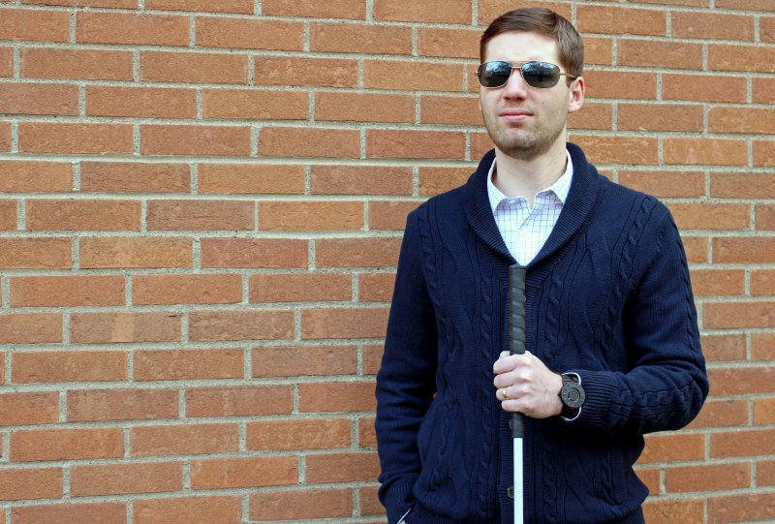
PROBLEM
How can we provide more accessibility on public spaces for people with vision impairment?

Slide 2
Smart Cane
Created a smart cane that will assist the users by taking pictures of their surroundings and provide feedback information to the user of the objects in front of them, with a voice assistant.
Users will have the choice to select the language of the voice assistant.

Slide 3
Tech Stack
Google Firebase Database
Google Vision API
Android

Slide 4
What’s Next?
Features that we want to implement in the future are:
Make a bot access information from the database and relay back that information to the user.
Bot will use artificial intelligence to remember people that they met before.
Giving the user choices to select their language preferences, the bot will translate instruction on real time .
Since we are dealing with disable personal the cane will also implement an emergency functionality in case of any problem arise.

Slide 5
Roles
By
Luis Manon – google vision API implementation
Ehson Assani – firebase database implementation
Stanley Pena – text to speech implementation
Junior Perez – camera implementation
Starlyn Reyes – PowerPoint designer and GitHub guru

