Slide 1
Progress
Searching for Datasets
Downloading all samples
Trimming (fastp)
FastQC and MultiQC
Kallisto for single and paired
tximport
Gene filtering, VST and PCA
WGCNA – network construction
WGCNA – trait matching
WGCNA – target gene identification
Functional annotation & enrichment analysis

Slide 2
Collecting RNA-Seq data sets on A. thaliana infection with biotrophic pathogens
Downloading samples with sratoolkit
Basic quality trimming with fastp
Quality control with FastQC and MultiQC
Including gene counts from unpublished dataset
Pseudo-alignment and quantification with kallisto
Importing raw gene counts and abundance (tpm) counts with tximport
Filtering low expressed genes with tpm counts
Variance stabilzation transformation on raw counts with DESeq2
PCA to identify potential outliers using stats
WGCNA – network construction and module detection
Module trait matching and hub gene selection
Functional annotation and enrichment analysis of module genes with clusterProfiler

Slide 3
Datasets
Biotrophic pathogens:
Golovinomyces orontii
Erysiphe cichoracearum
Hyaloperonospora arabidopsidis (2 Datasets)
Plasmodiophora brassicae (2 Datasets)
Turnip mosaic virus (TuMV) (2 Datasets)
Heterodera schachtii
Turnip yellows virus (TuYV)
Cauliflower mosaic virus (CaMV)
Meloidogyne javanica
Erysiphe cruciferarum (unpublished dataset)
Control:
Drought
Botrytis cinerea (necrotrophic)
Alternaria brassicae (necrotrophic)
Altogether:
283 samples
141 single-end, 142 paired-end

Slide 4
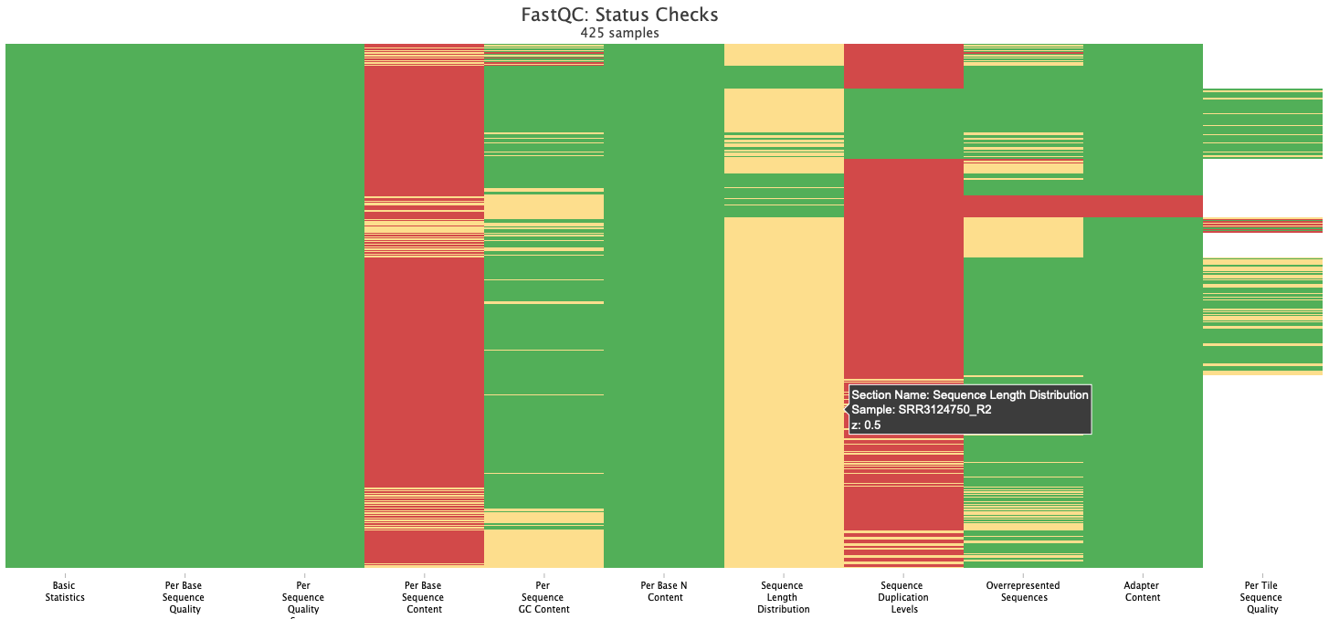
FastQC on trimmed samples with default fastp trimming
Failed adapter content in Hpa2 Experiment

Slide 5
A.Brassicae (necrotroph) - infected
Hpa2
G.orontii
Hpa3 - very few reads

Slide 6
Signed hybrid networks—
Added Stegmann Dataset on Erysiphe cruciferarum

Slide 16
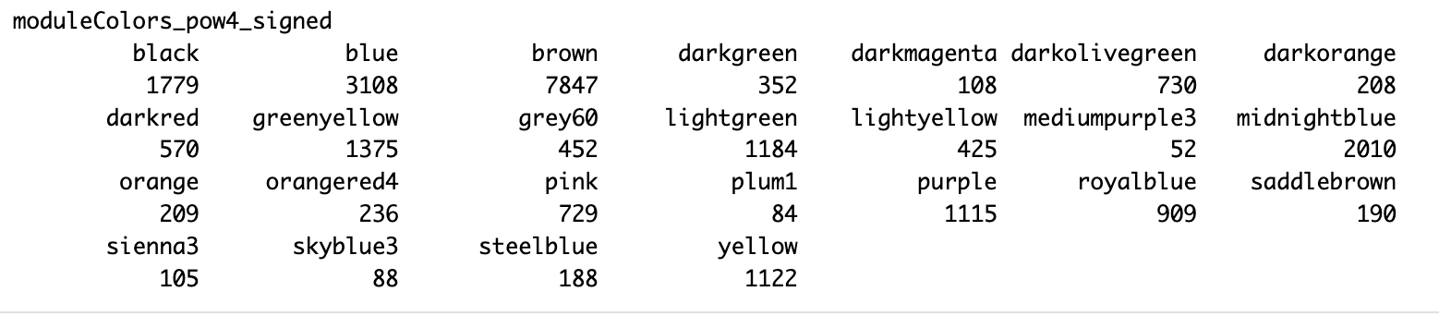

Slide 18
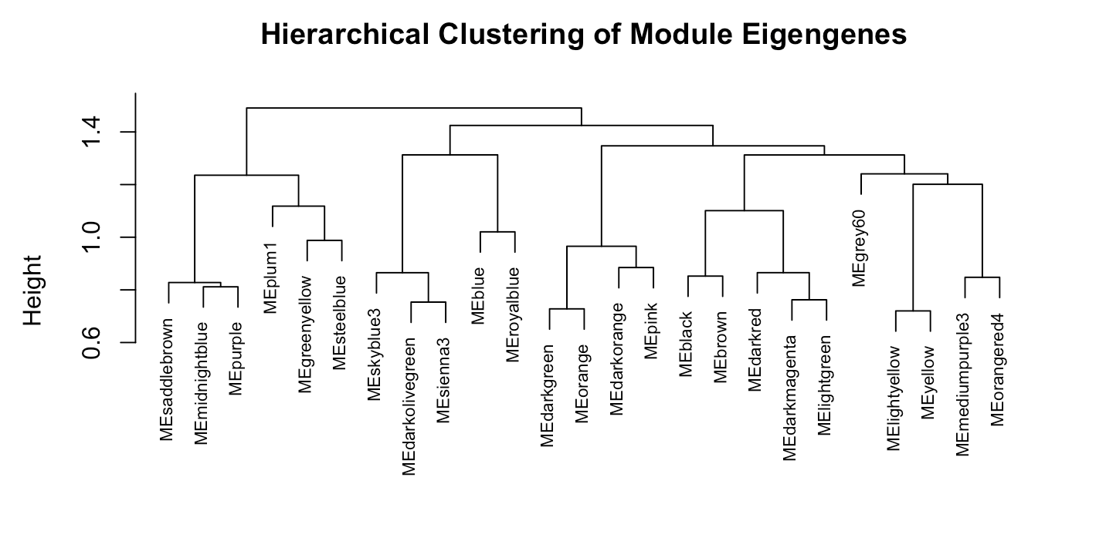

Slide 19
Immune (defense) response:
royalblue: enriched in Plant-pathogen interaction, environmental adaptation → immune system process, immune response, response to salicylic acid, plant-type hypersensitive response, defense response to symbiont
darkred: enriched in Plant-pathogen interaction (environmental adaptation), MAPK signaling pathway, Glycerolipid metabolism → response to fungus, defense response to bacterium, cellular response to hypoxia, regulation of response to stress
lightgreen: enriched in Sphingolipid metabolism → response to fungus, defense response to bacterium, organic hydroxy compound metabolic process, response to oxidative stress, immune response
darkmagenta: alpha-amino acid biosynthetic process, defense response to symbiont, immune response, immune system process
→ Downregulated in control samples, and upregulated in several pathogen samples

Slide 21
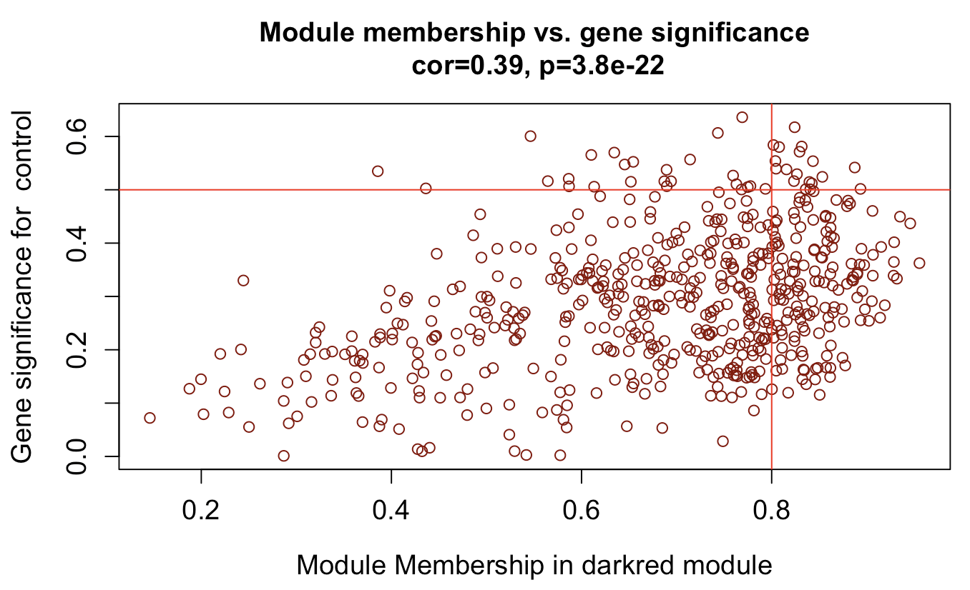
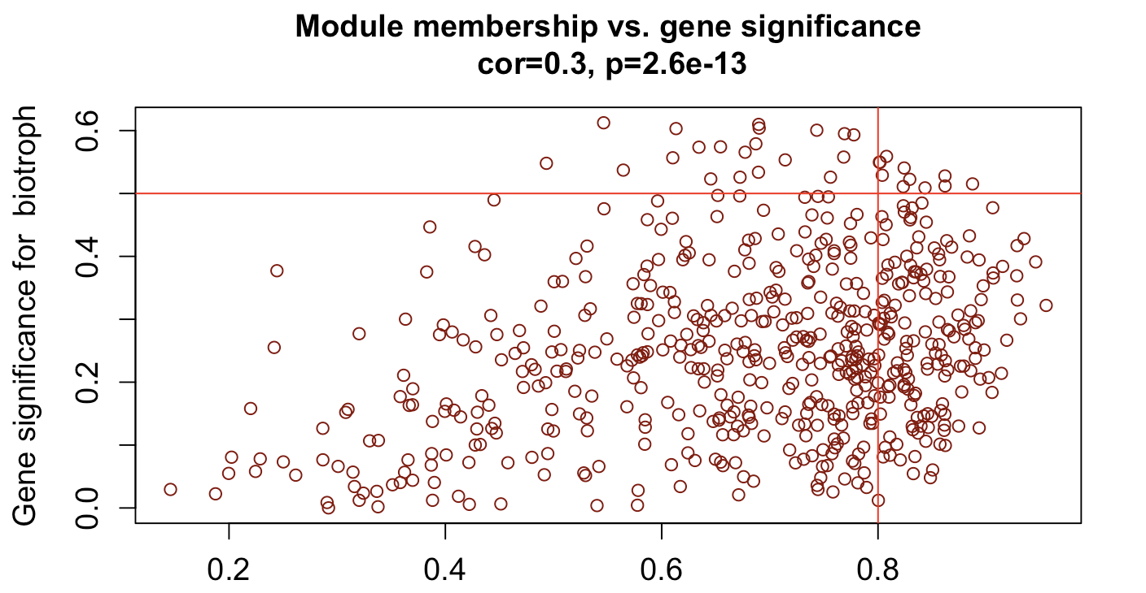
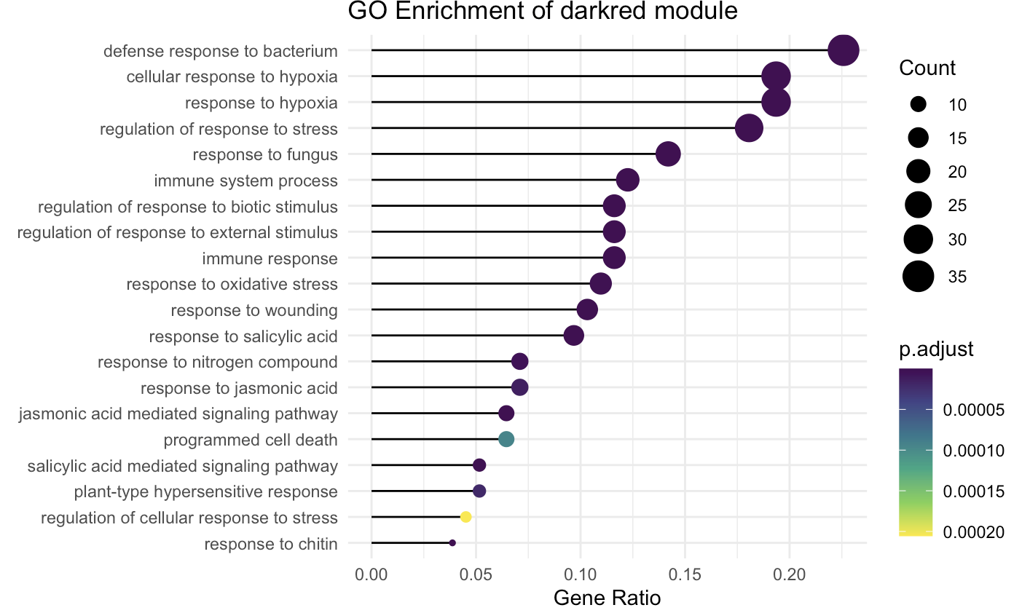

Slide 22
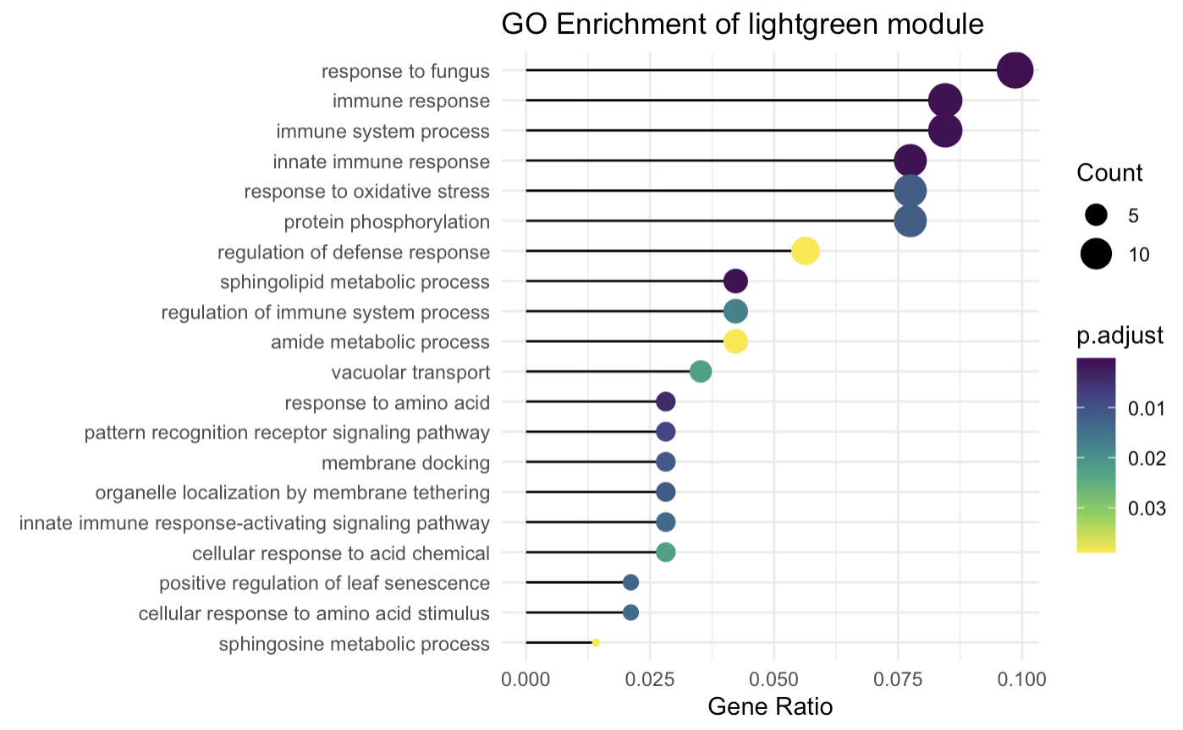
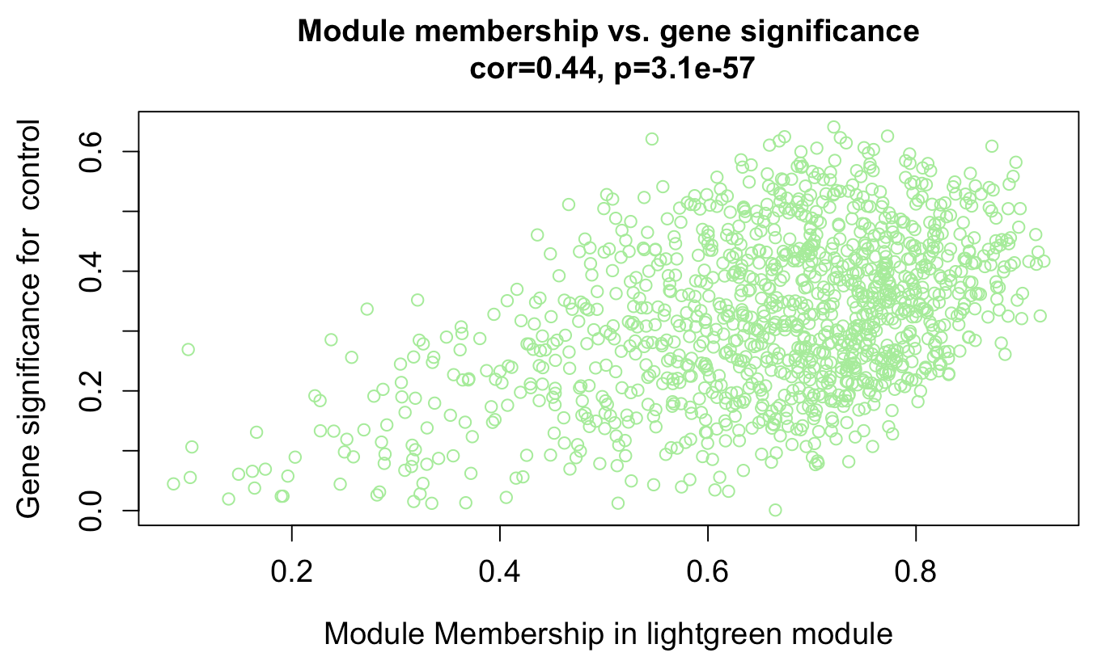
Control - Negatively correlated

Slide 23
Modules positively correlating with control samples:
steelblue: enriched in monocarboxylic acid metabolic process and nucleoside phosphate biosynthetic process. Fatty acid biosyntheses and metabolism, Citrate cycle → downregulated in Hpa, E.cichorerarum (maybe pathogen specific) → monocarboxylic acids play crucial roles in energy metabolism, redox balance, and cellular respiration. Pathogen infection often leads to metabolic reprogramming, where the plant shifts resources from growth and maintenance towards defense.The downregulation of these genes during infection suggests that pathogen attack suppresses primary metabolismto favor stress responses. Synthesis of nucleotides, fundamental for cell growth and normal function (surpressed during infection), plant prioritizing defense response over growth
greenyellow: enriched in starch and sucrose metabolism, flavanoid metabolic, pigment biosynthetic process and biosynthetic process, response to red or far red light or UV. This module represents genes involved in normal metabolic and light-regulated processes, which decline upon infection.The suppression of starch/sucrose metabolism suggests a metabolic shift, where the plant diverts energy from growth to defense.The downregulation of flavonoids and pigment biosynthesis indicates that infection might suppress protective secondary metabolites and photosynthesis.The disruption of light signaling suggests that pathogens may be interfering with light-mediated defense pathways. → positively correlated with G.orontii, but negatively correlated with Hpa → pattern? → This module suggests that G. orontii allows host metabolic and light responses to persist, while Hpa strongly suppresses them. The differences in sugar metabolism, flavonoid biosynthesis, and light signaling between these infections may reflect different pathogen strategies. (possible source: https://academic.oup.com/plcell/article/23/7/2788/6097211)

Slide 26
Specific modules for pathogens – nematodes (cyst nematode H.schachtii and root-knot nematode M.javanica):
brown: enriched in energy and carbohydrate metabolism, photosynthesis, etc. Hub genes enriched in positive regulation of DNA-templated transcription, lateral root morphogenesis, post-embryonic plant morphogenesis, root morphogenesis, plant-type cell wall organization → CN and RKN invade the plant root near the tip and move through different tissue layers to reach the vascular cylinder, where CNs induce the formation of a syncytium (a multinucleate fusion of cells resulting from partial cell wall dissolution), Root-knot and cyst nematodes manipulate lateral root development to create feeding structures (giant cells or syncytia) that support their survival, Plant-parasitic nematodes (e.g., Heterodera or Meloidogyne species) secrete effectors that modulate host transcription factors, promoting susceptibility.The plant may also activate its own transcriptional networks in response to stress and infection.
darkgreen: enriched in translation, ribosome biogenesis, cytoplasmic translation, rRNA processing, etc. → Increased protein synthesis demand: More ribosomes mean enhanced translation capacity, which is often associated with rapid growth, stress responses, or metabolic shifts; for nematodes: If this module is associated with nematode infection, it could suggest that the nematode is inducing high protein production to maintain feeding sites (permanent feeding site is names syncytium)
→ host invation by cyst nematodes involves piercing of plant cell walls, once inside the root cortex, migration towards the vascular cylinder, while causing extensive tissue damage. After arriving at the vascular cylinder, they deliver stylet secreted effectors into a host cell to initiate the formation of a permanent feeding site by manipulating plant cell differentiation and growth

Slide 27
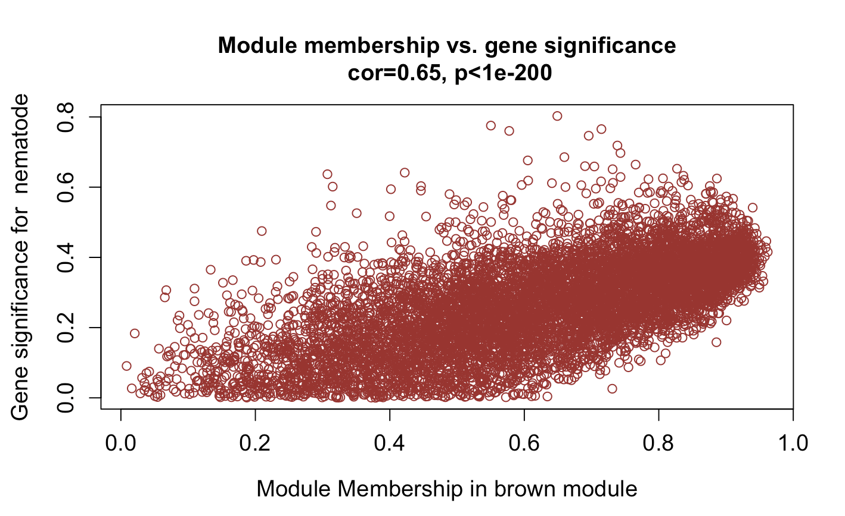
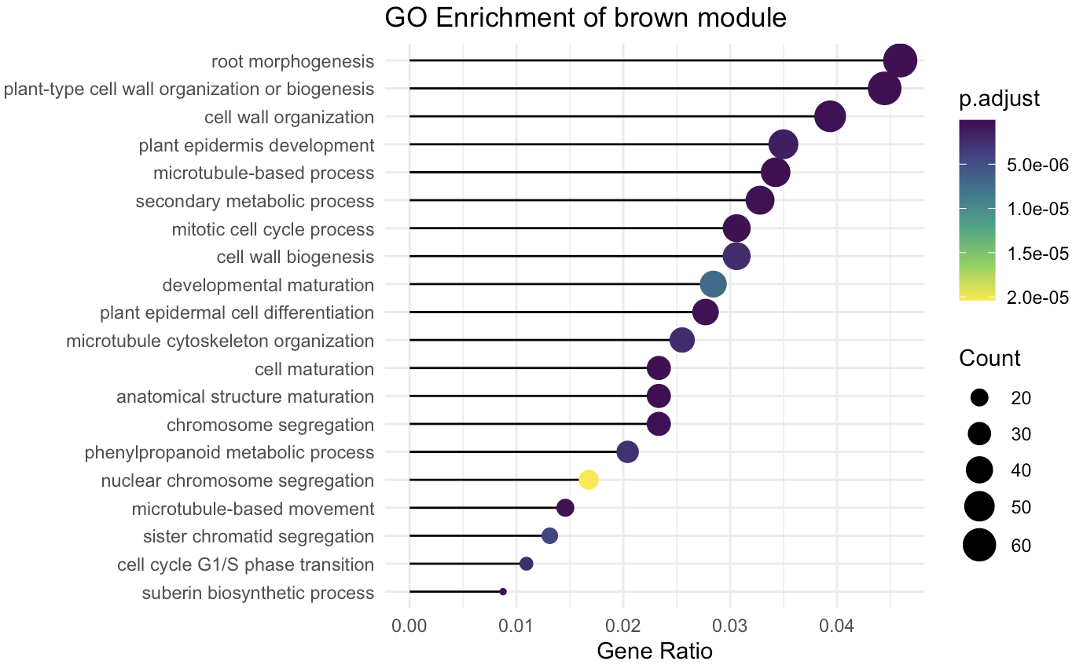
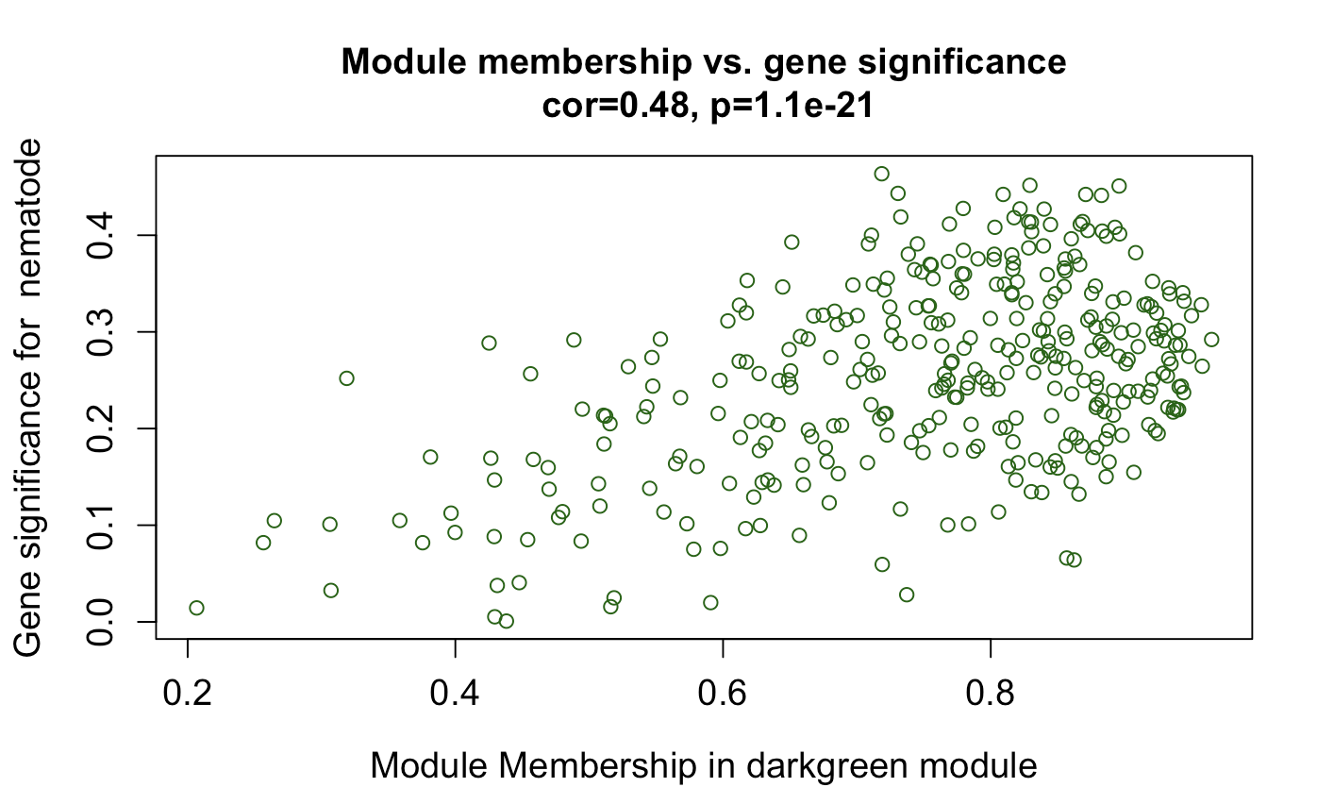
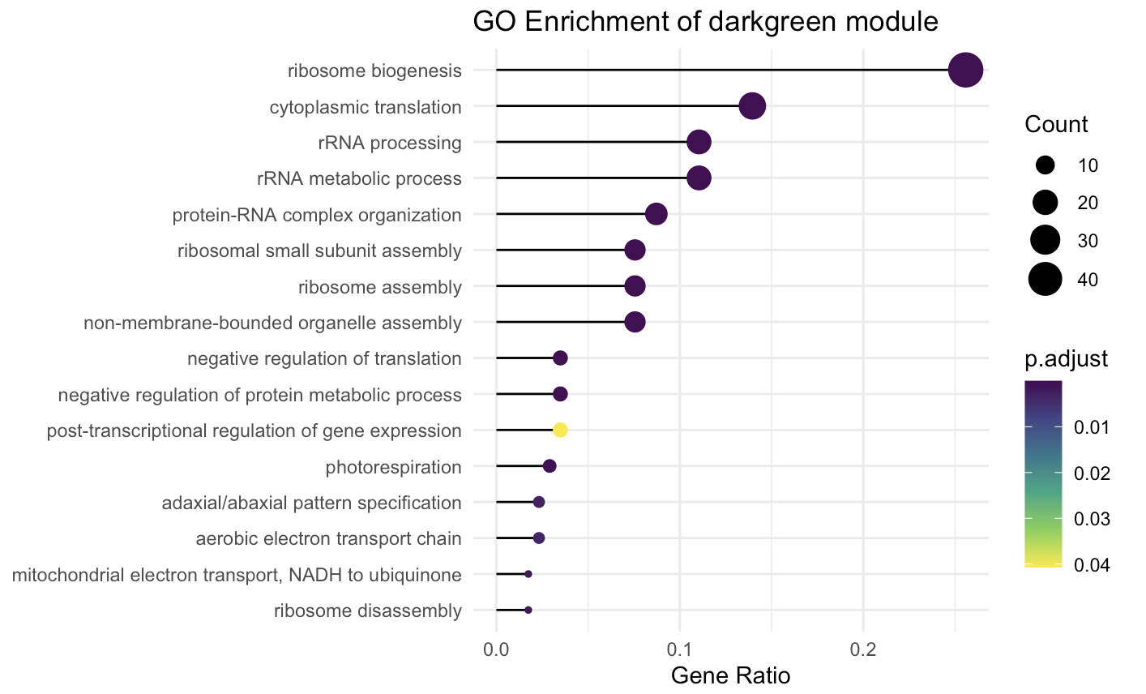

Slide 28
Specific modules for pathogens – protiste biotrophs (P.brassicae)
Black:

Slide 29
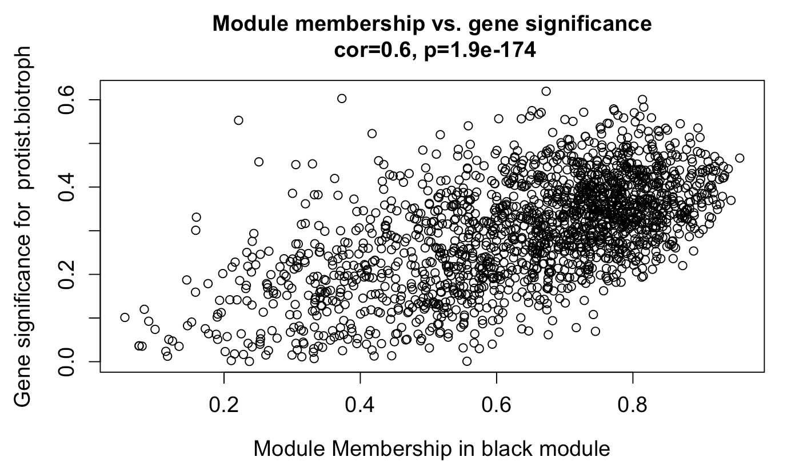
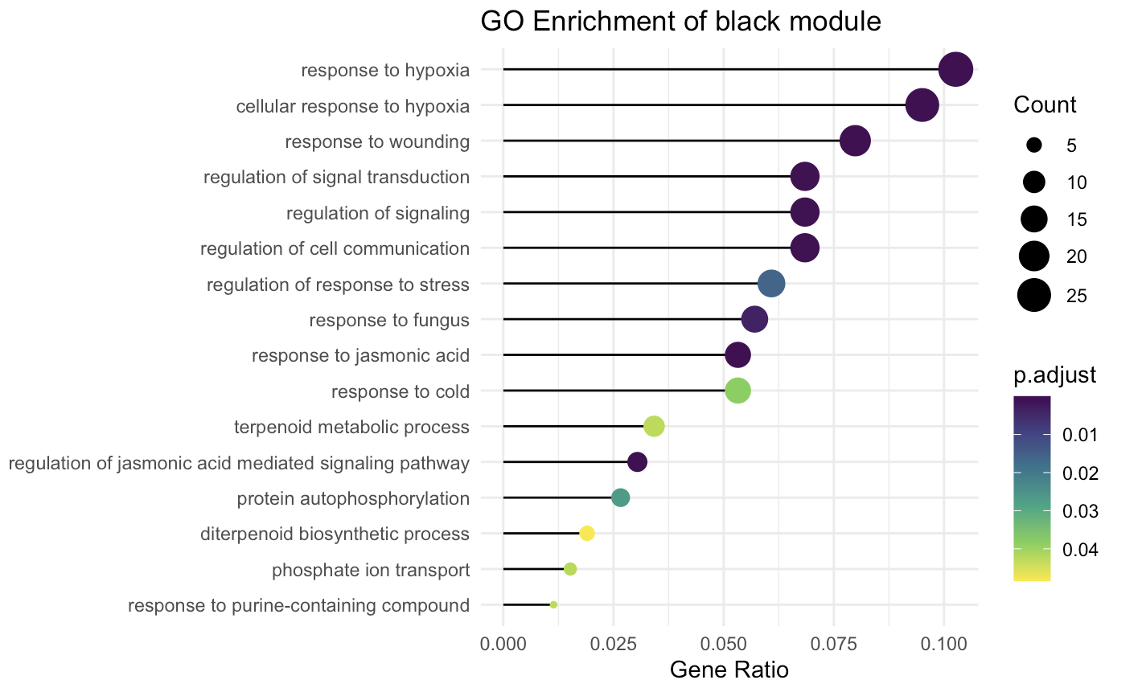

Slide 31
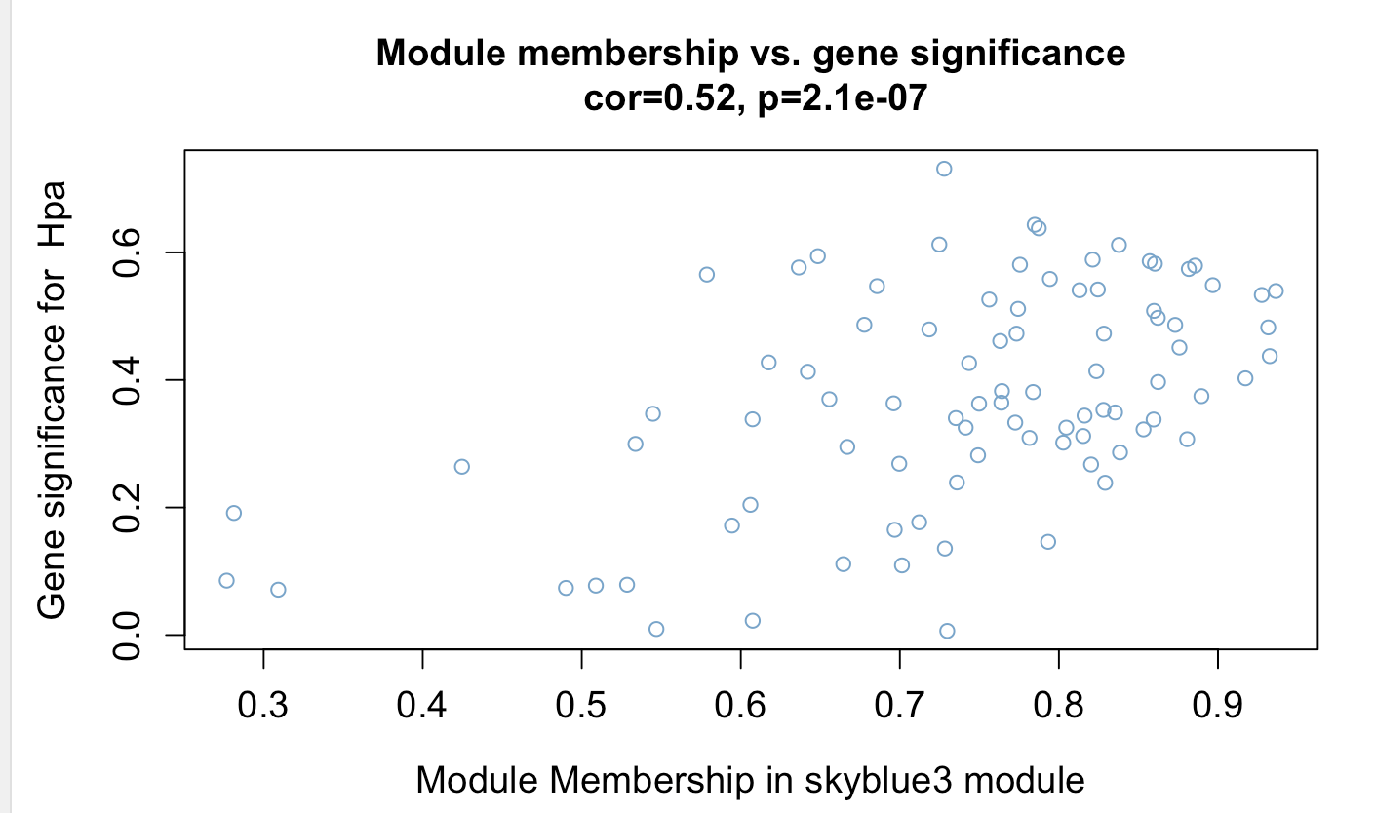
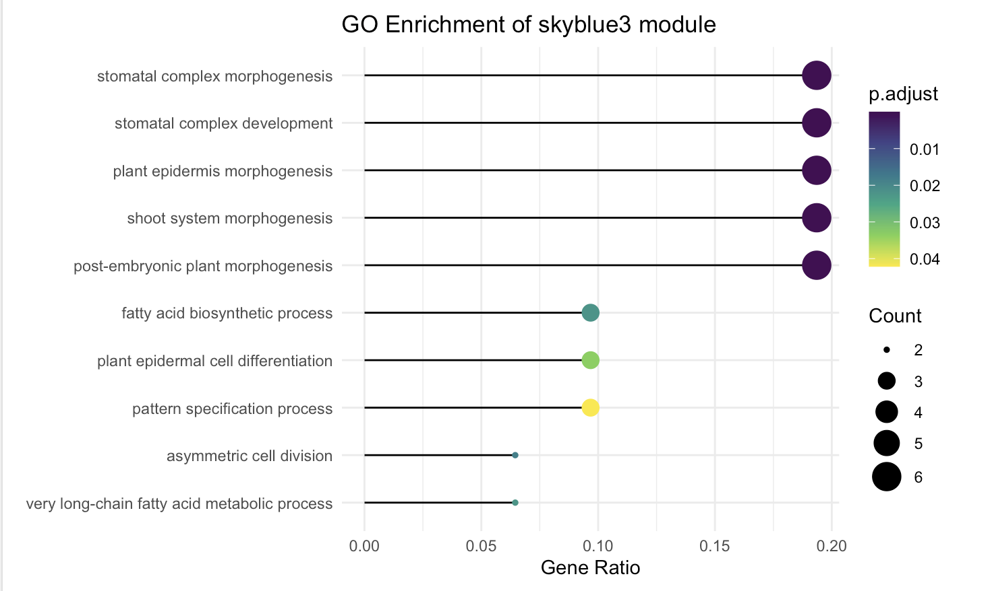
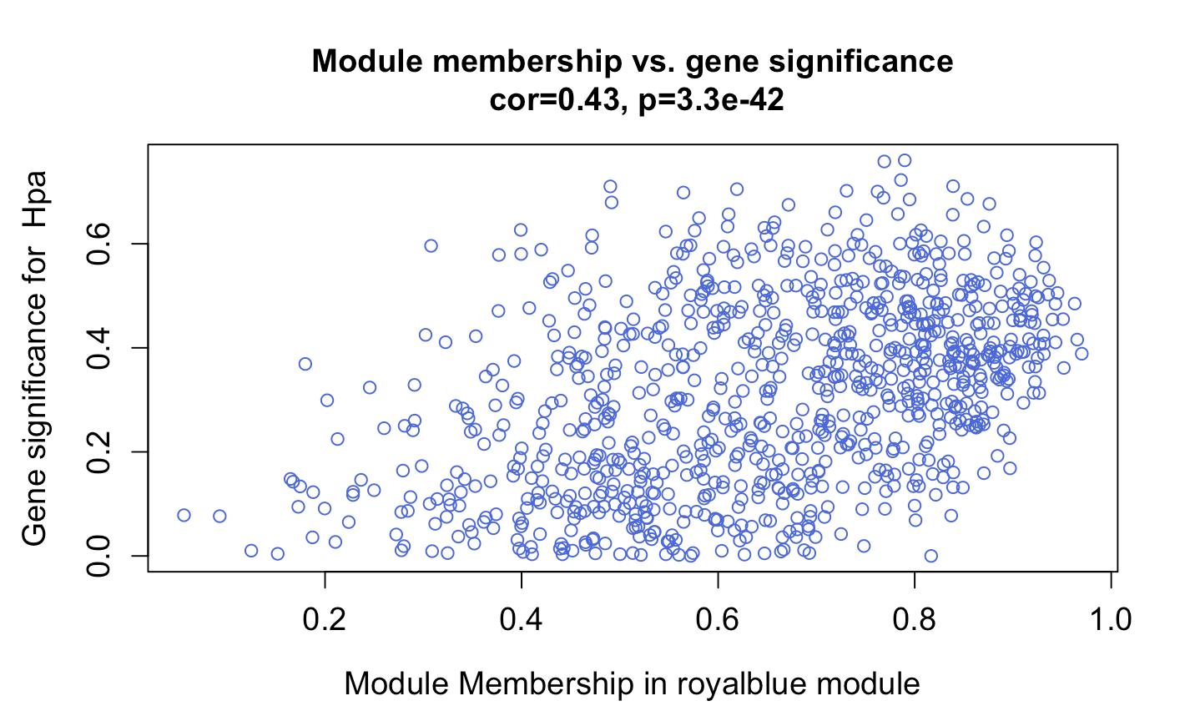

Slide 32
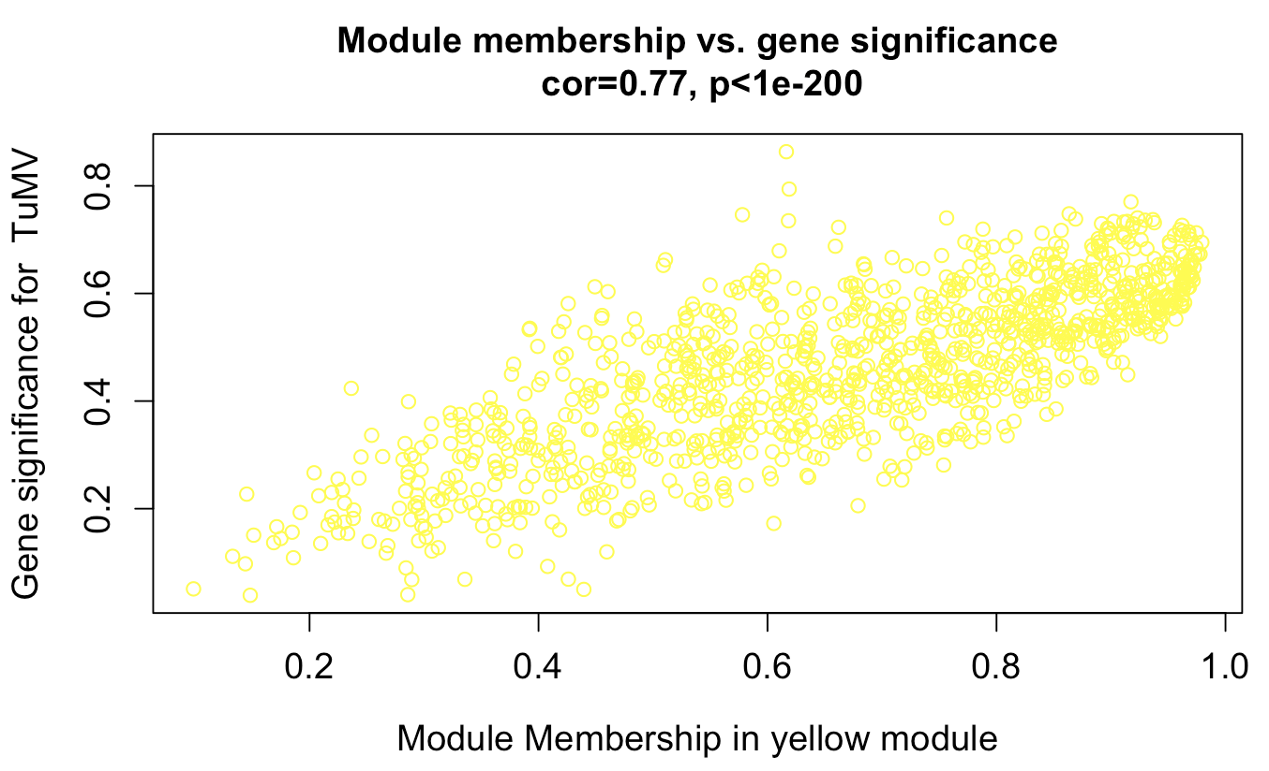
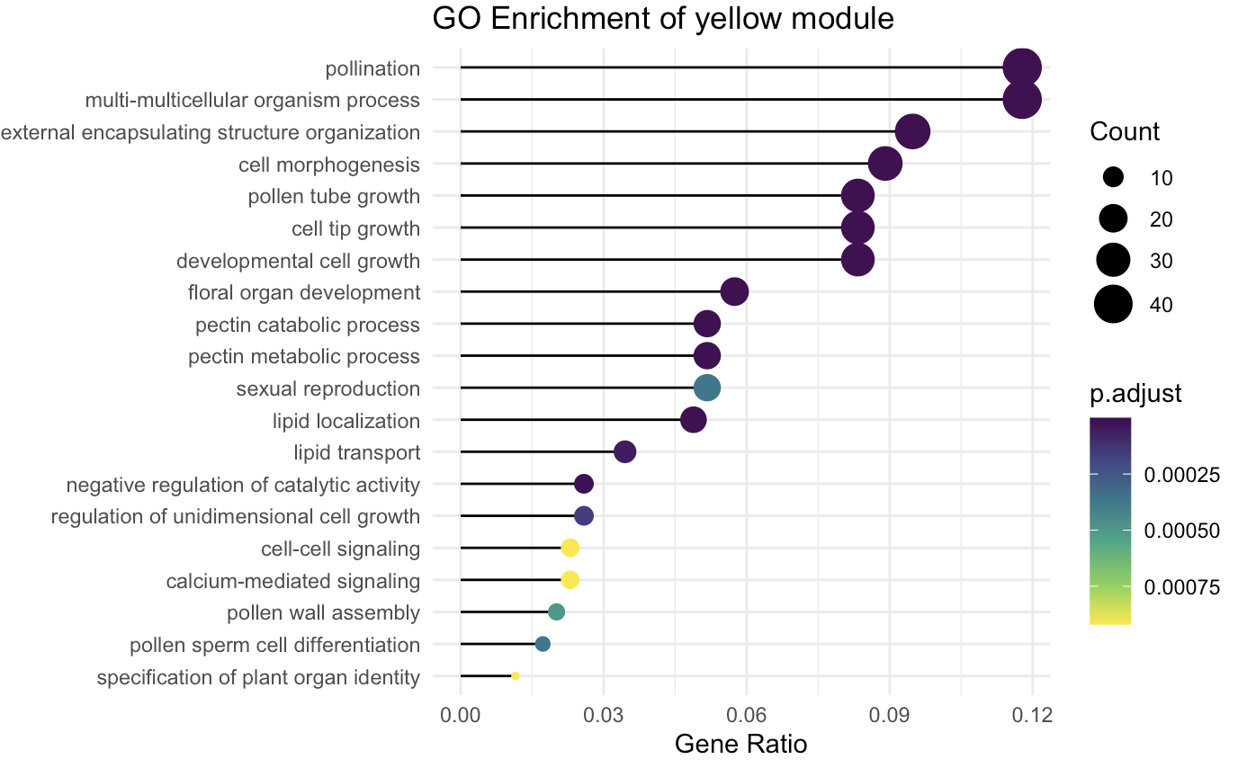
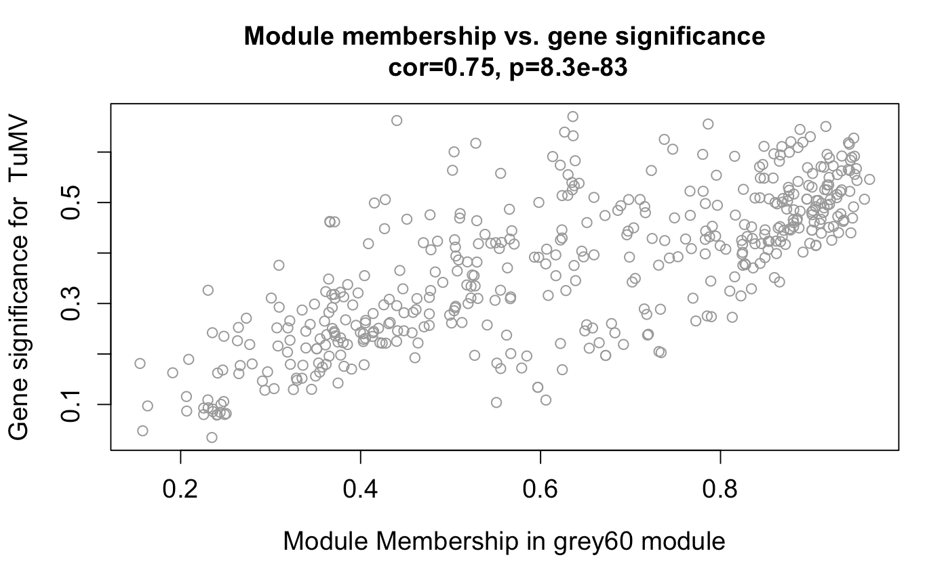
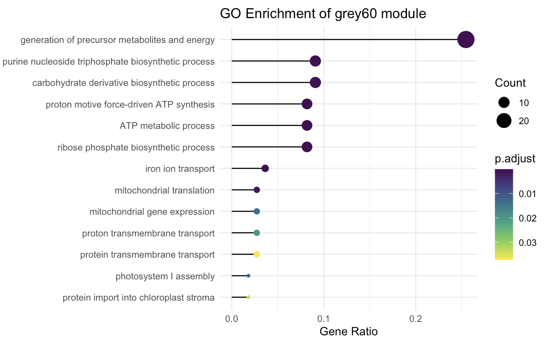

Slide 33
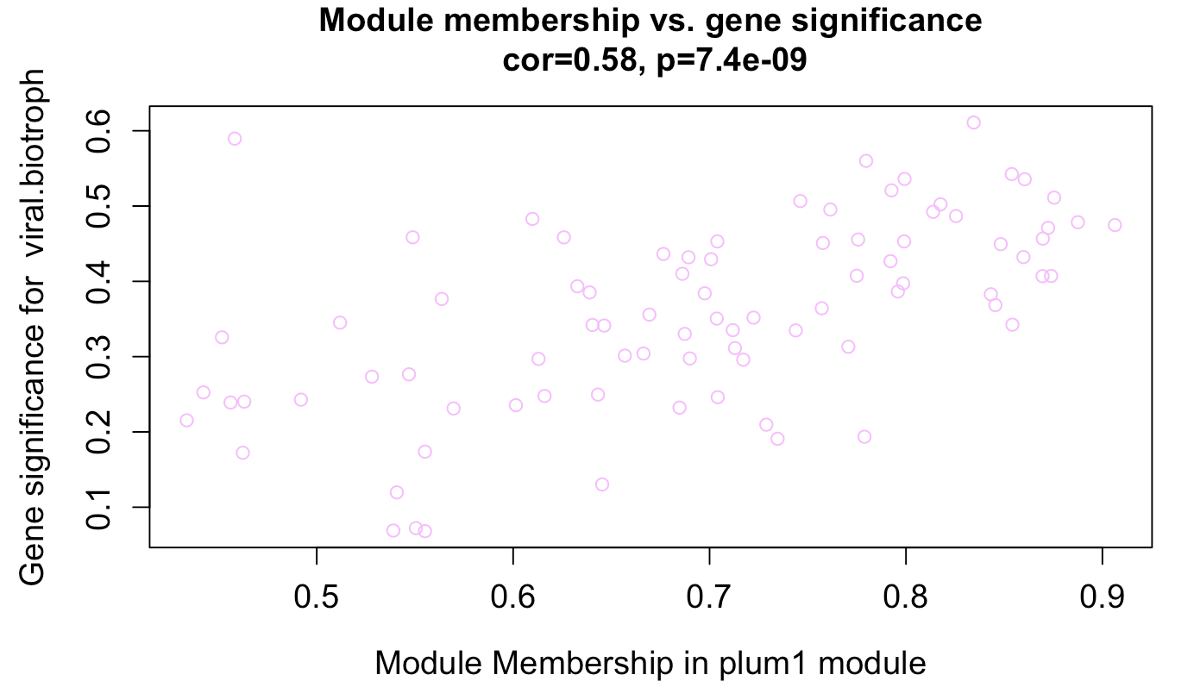
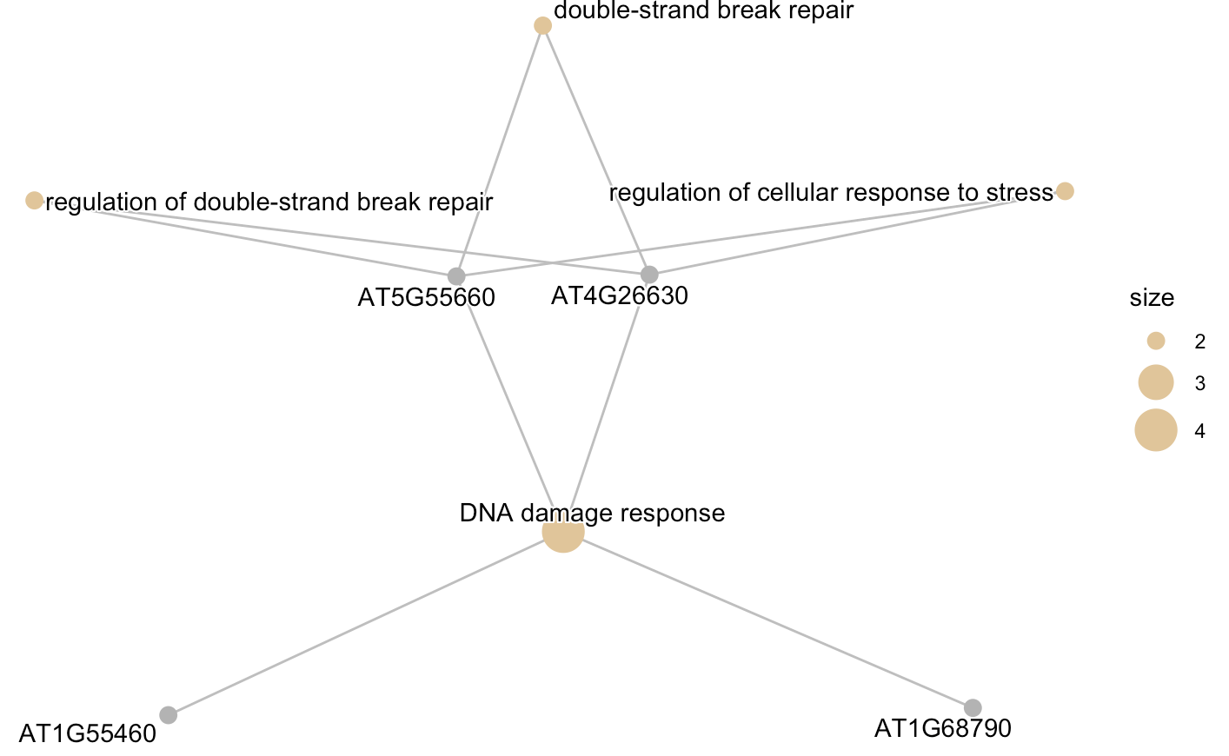

Slide 34
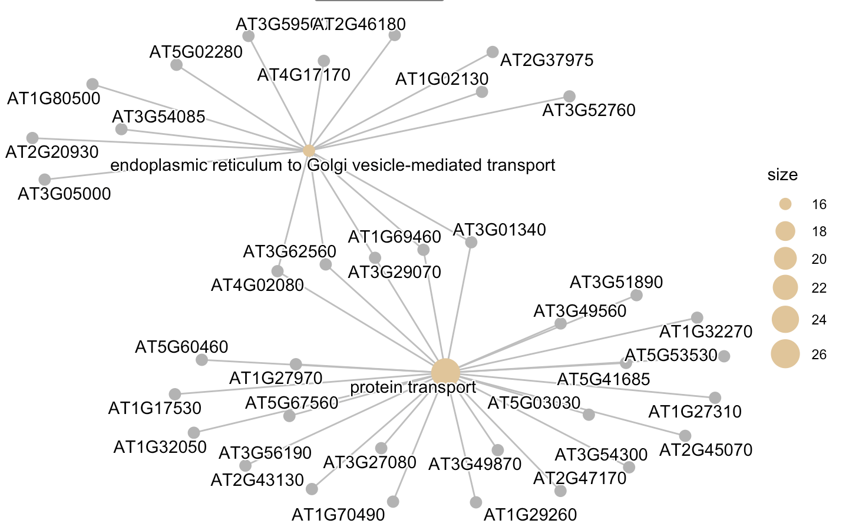
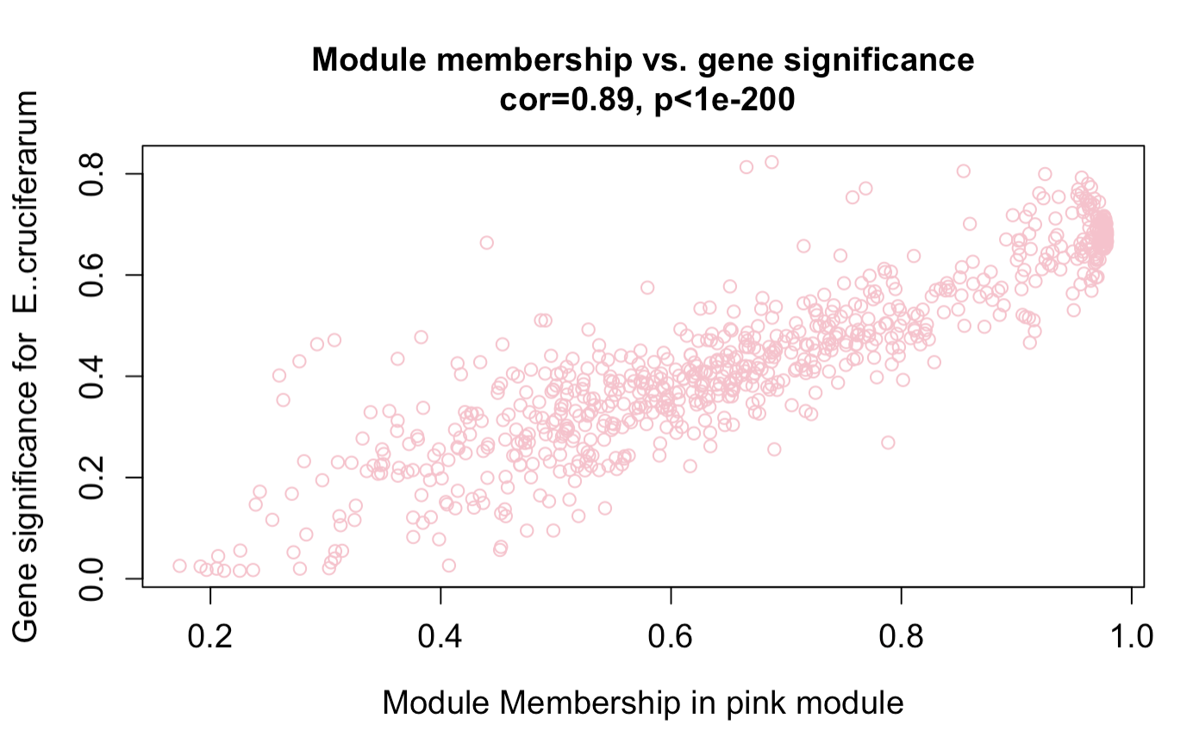
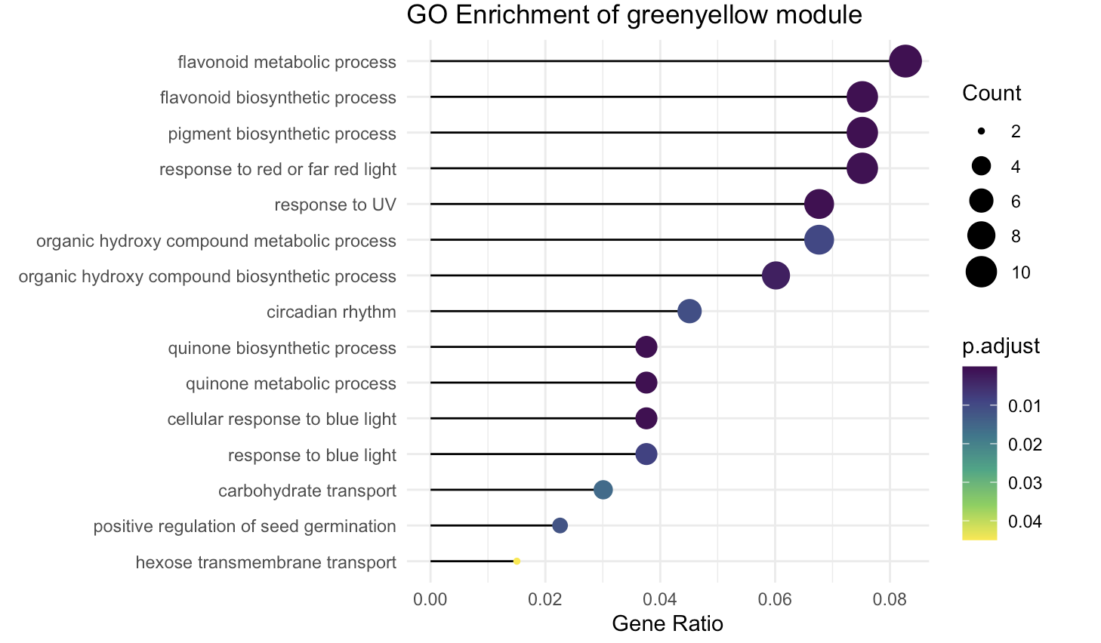
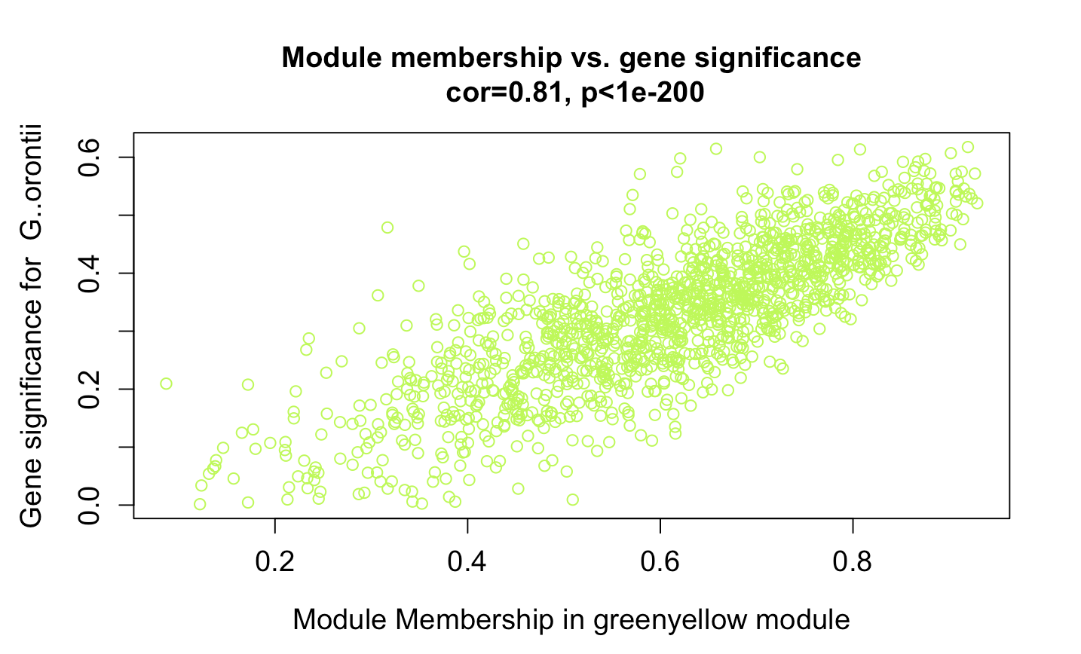

Slide 37
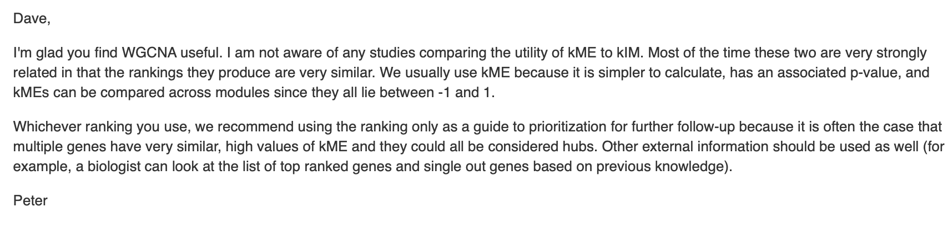
Correlation of 0.59
Very significant p-value
Choose hub genes?
With GS and MM cutoff?
Calculate module membership with signedkME and choose a cutoff
Based on highest connectivity and module membership?
kWithin (softConnectivity) and kME (geneModuleMembership)
kME: maximum module membership score
kWithin: Intramodular connectivity, measures how connected a gene is within its module.
https://support.bioconductor.org/p/72377/

Slide 40
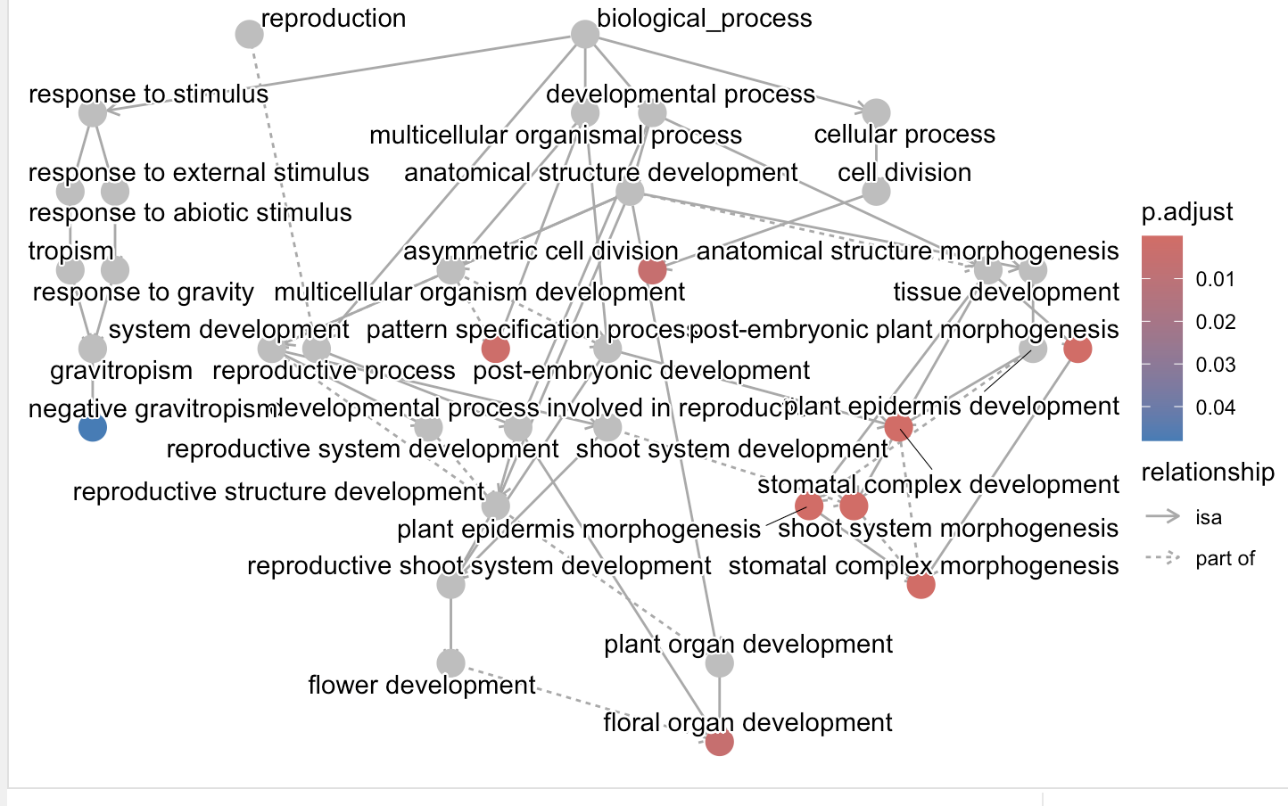
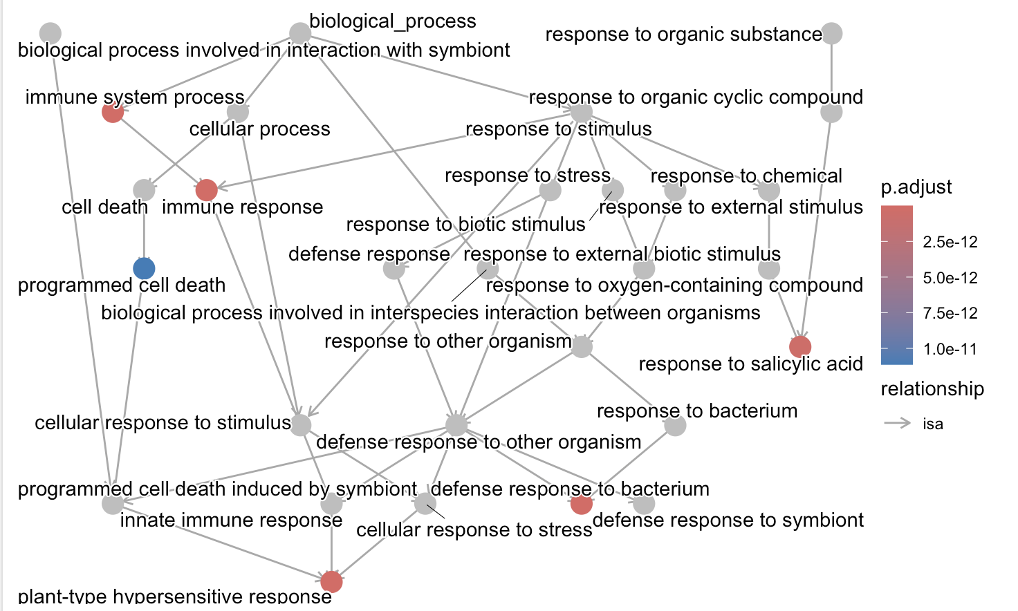
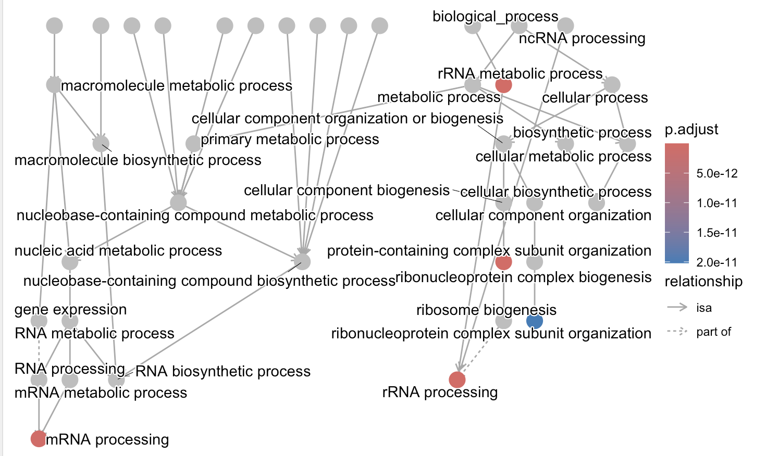
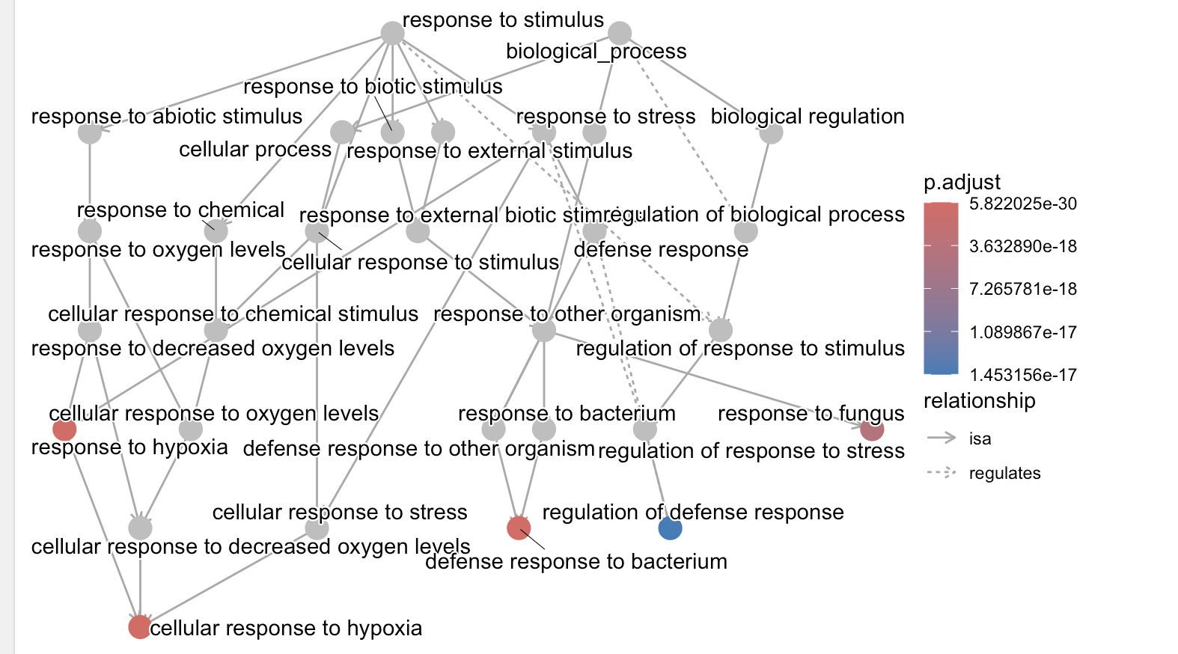
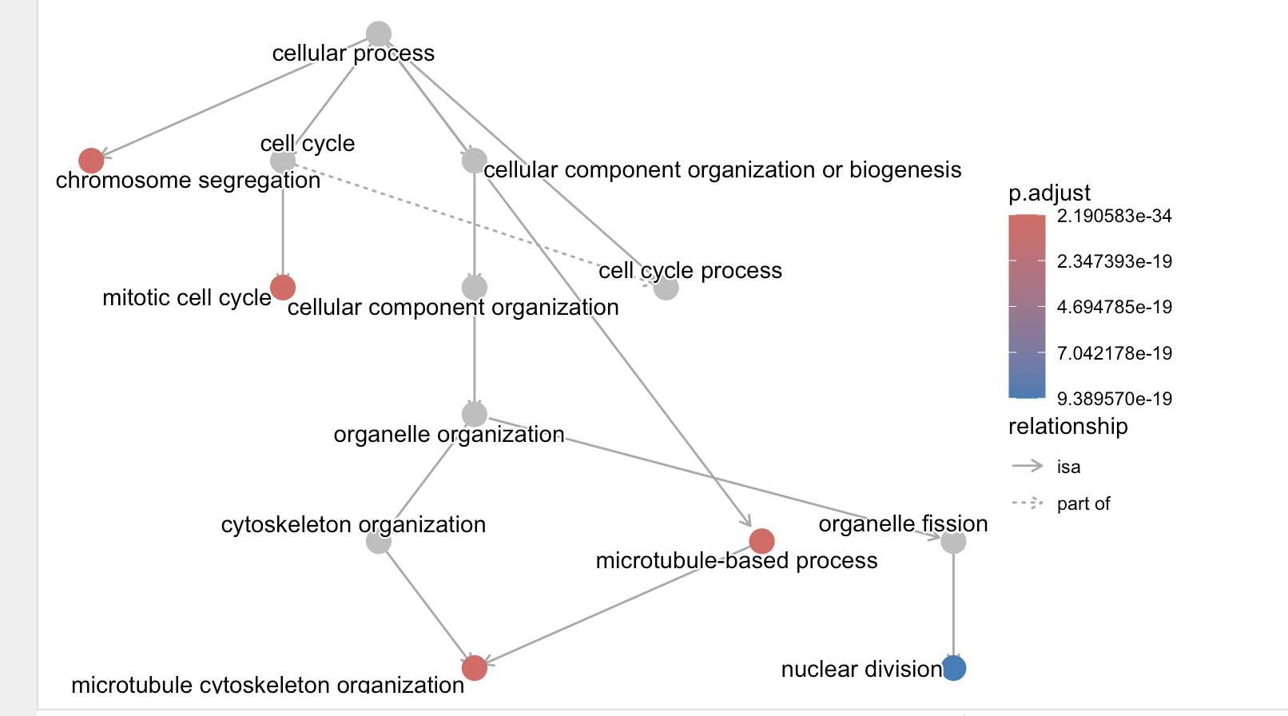
MEskyblue3 MEpurple Meroyalblue MEsteelblue MEbrown MEdarkred 1.916527 1.725647 1.700804 1.692676 1.686188 1.619301

