Slide 1
Unveiling Commonalities and Divergences in Biotrophic Plant-Microbe Interactions using Gene Co-Expression Networks in Arabidopsis thaliana
Professorship for Computational Plant Biology
TUM School of Life Sciences
Technical University of Munich
Bachelor thesis
Luisa Bender
Freising, 10. März 2025

Slide 2
Collecting RNA-Seq datasets on A. thaliana infection with biotrophic pathogens
Downloading samples with sratoolkit
Basic quality trimming with fastp
Quality control with FastQC and MultiQC
Mapping reads with kallisto
Including gene counts from unpublished dataset
Importing raw gene counts and abundance (tpm) counts with tximport
PCA to identify potential outliers using stats
Filtering low expressed genes with tpm counts
Variance stabilzation transformation on raw counts with DESeq2
WGCNA – network construction and module detection
Module trait matching and hub gene selection
Functional annotation and enrichment analysis of module genes with clusterProfiler
2

Slide 3
About the pathogens
Fungal biotrophs (powdery mildew disease)
Oomycete biotroph (downy mildew)
Root and cyst nematodes
Protist biotroph
Viral biotrophs
Control samples:
Necrotrophic pathogens
Drought

Slide 4
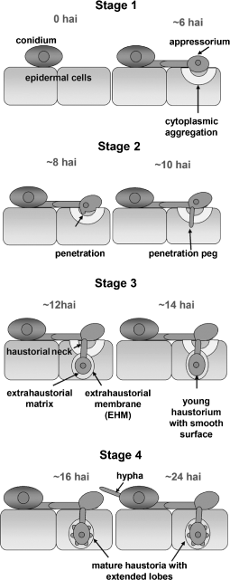
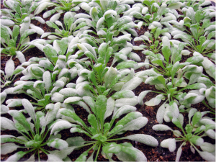
Fungal biotrophs
Golovinomyces orontii
Erysiphe cichoracearum
Erysiphe cruciferarum
Causing foliar powdery mildew disease
Powdery mildews rely on living plant tissue for growth and reproduction
Life cycle begins with landing of a condiospore on the leaf surface
Formation of a haustorium → serves as „feeding“ organ for nutrient uptake
Arabidopsis infected with G.orontii
Infection stages of E.cichoracearum on Arabidopsis
1.) https://campuspress.yale.edu/claylab/, 2.) Koh et. Al (2005), Arabidopsis thaliana subcellular responses to compatible Erysiphe cichoracearum infections

Slide 5
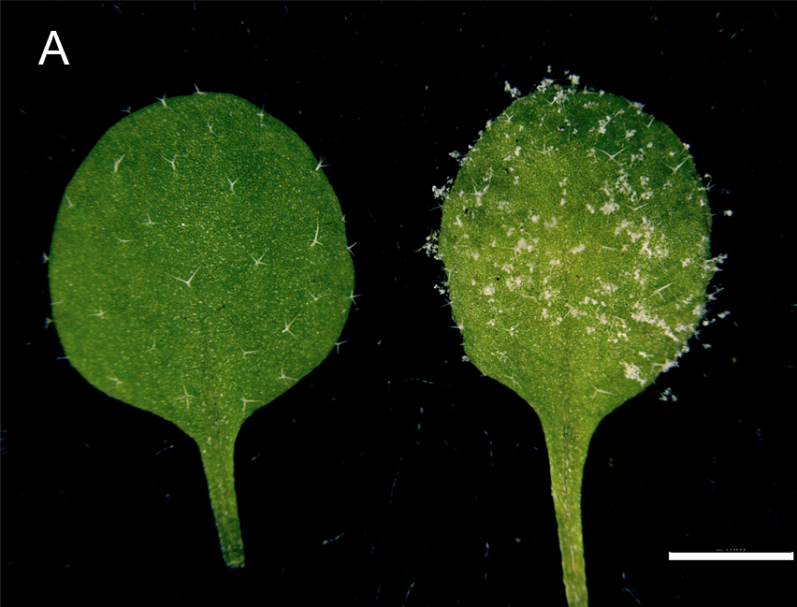
Oomycete biotroph
Hyaloperonospora arabidopsidis
causing downy mildew disease
shares common infection process with fungi causing powdery mildew disease
formation of haustoria
Oomycetes are phylogenetically close brown algae (distinct from true fungi)
Obligate biotrophs → cannot live without their host

Slide 6
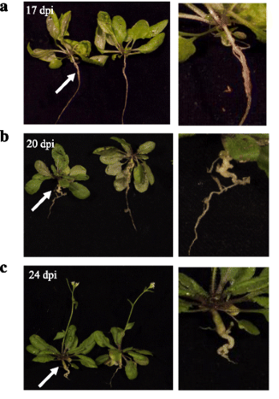
Protist biotroph
Plasmodiophora brassicae
Clubroot pathogen
Modulates host root development
Initiating formation of nutrient-replete galls within the root systems
Root infection negatively affects the uptake of water and nutrients in host plants
→ Reducing growth and productivity

Slide 7
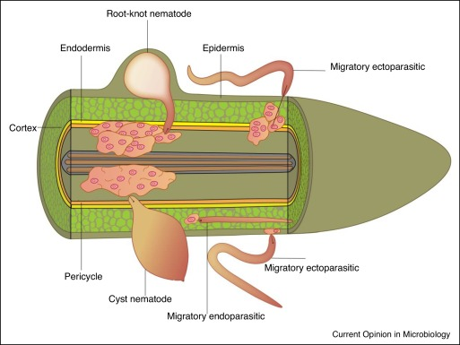
Nematodes
endoparasitic
Cyst nematode (CN): Heterodora schachtii
Root-knot nematode (RKN): Meloidogyne javanica
Invasion of plant root
Move through different tissue layers to reach vascular cylinder
Formation of feedings sides:
CN: syncytium (fusion of cells)
RKN: several giant cells
uptake nutrients from the plant
Induce pathologically disturbed allocation of photosynthetic products that reduces plant growth and yield

Slide 8
Viral biotrophs
Turnip mosaic virus (TuMV) – potyvirus
Enters cells and begins replication in the cytoplasm
forming viral replication complexes on the ER
uses host translation machinery to produce viral proteins
Moves intracellularly to reach plasmodesmata
Eventually reaching the phloem allowing systemic infection throughout the plant
Turnip yellows virus (TuYV) – polerovirus
Replicates only in phloem companion cells
More specialized than TuMV

Slide 15
25 Modules
No grey module

Slide 16
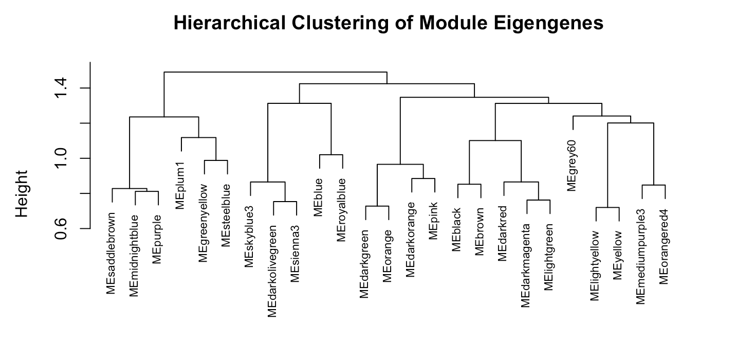

Slide 19
Methods for analyzing modules
Module Membership (MM) / kME (signedKME()): correlation between each gene and each module eigengene
describes the connectivity of a gene inside a module
Gene Significance (GS): correlation between each gene and a given trait
Helps identify genes with a high significance for a pathogen infection
Hub gene: important gene that has a high connectivity inside a module
Genes with kME > 0.8 considered as hub genes
Functional enrichment of modules and hub genes with clusterProfiler
Gene Ontology (GO) overrepresentation analysis, mostly biological processes
KEGG pathway enrichment

Slide 20
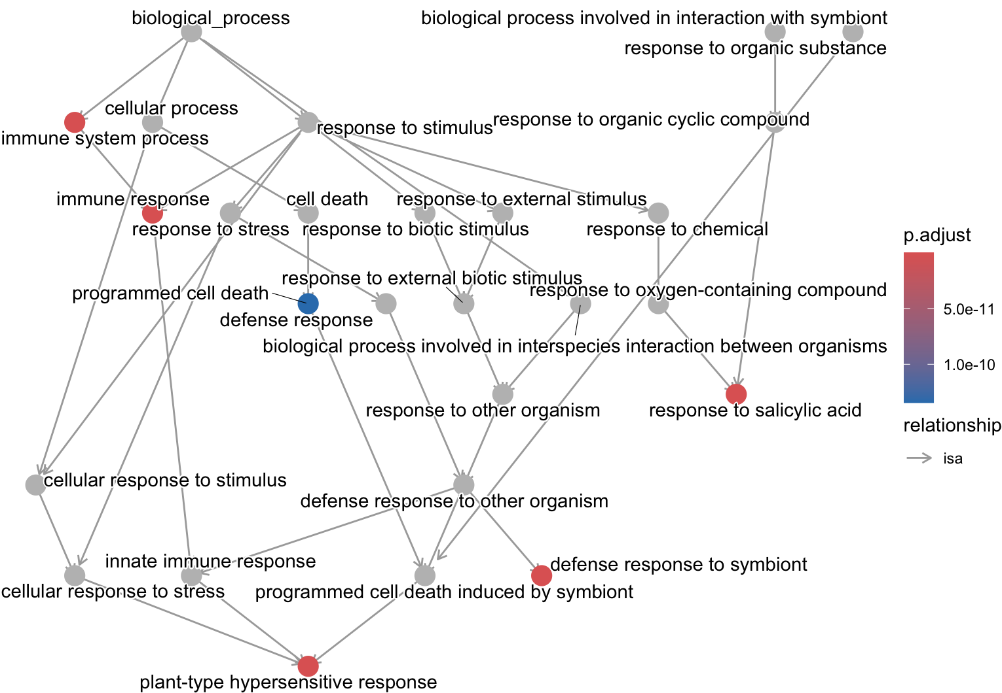
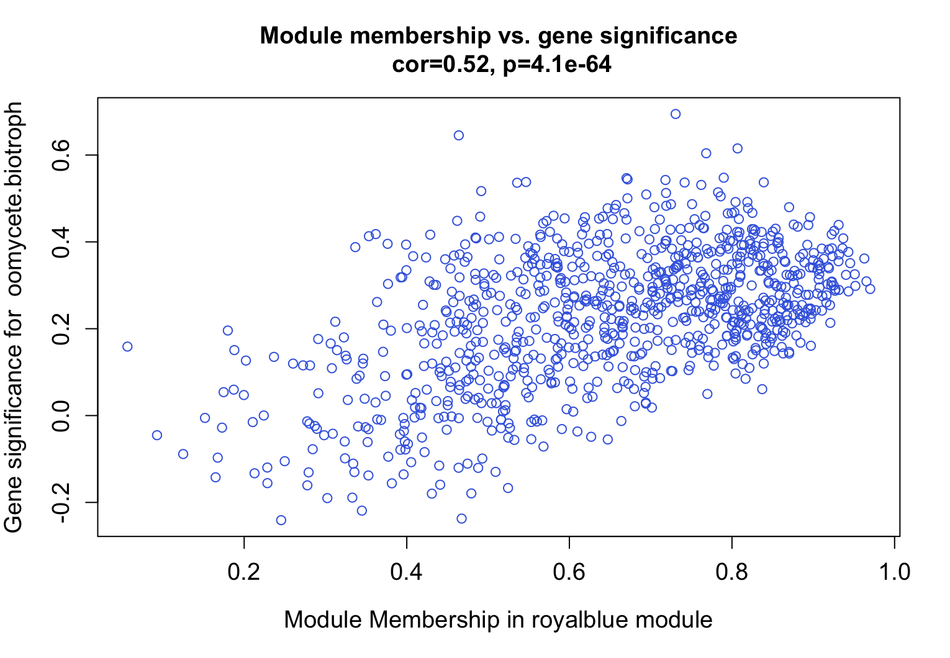
Oomycete biotroph - Hyaloperonospora arabidopsidis

Slide 21
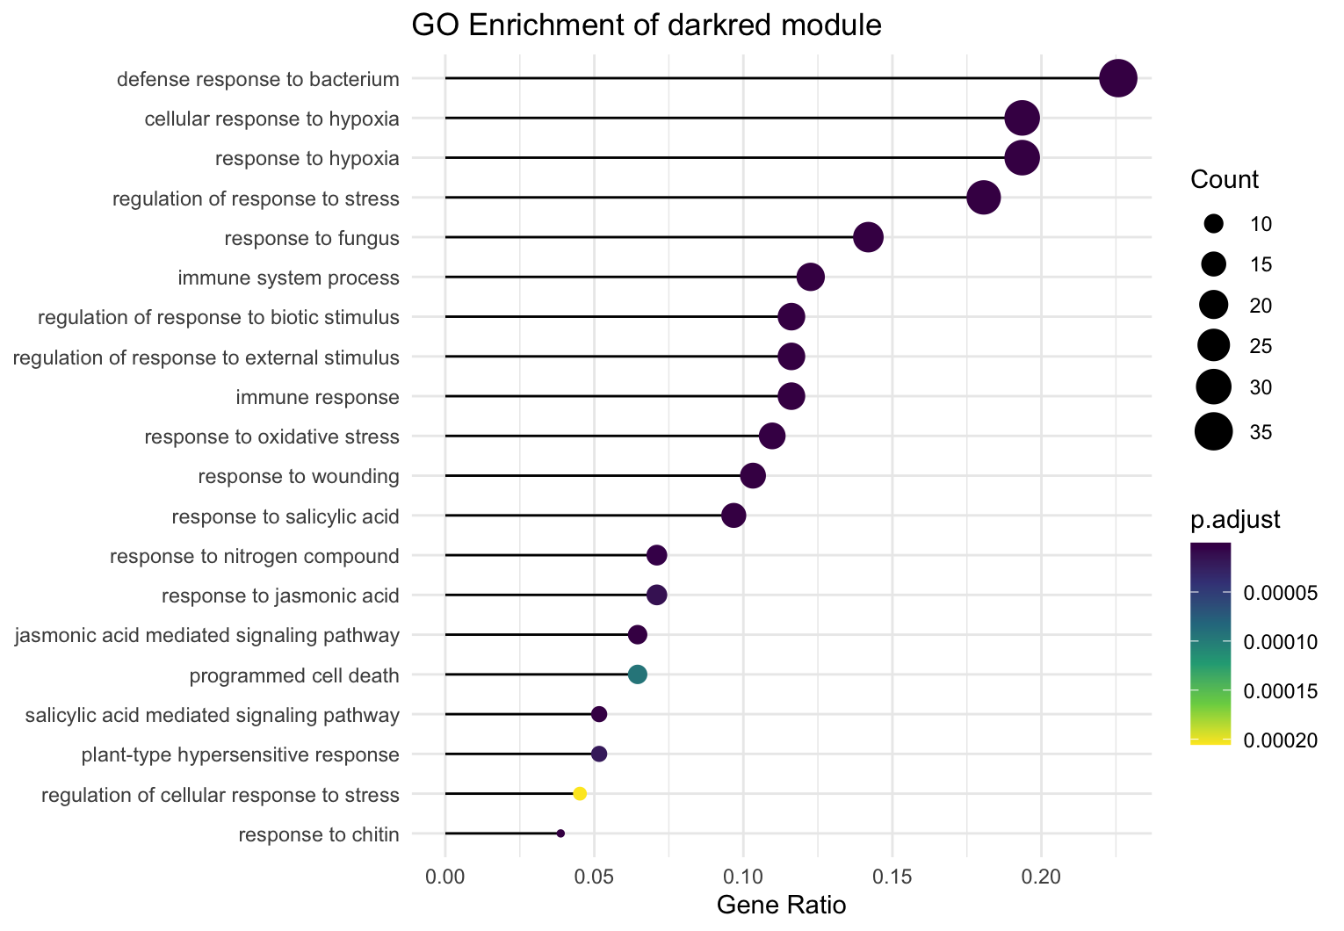
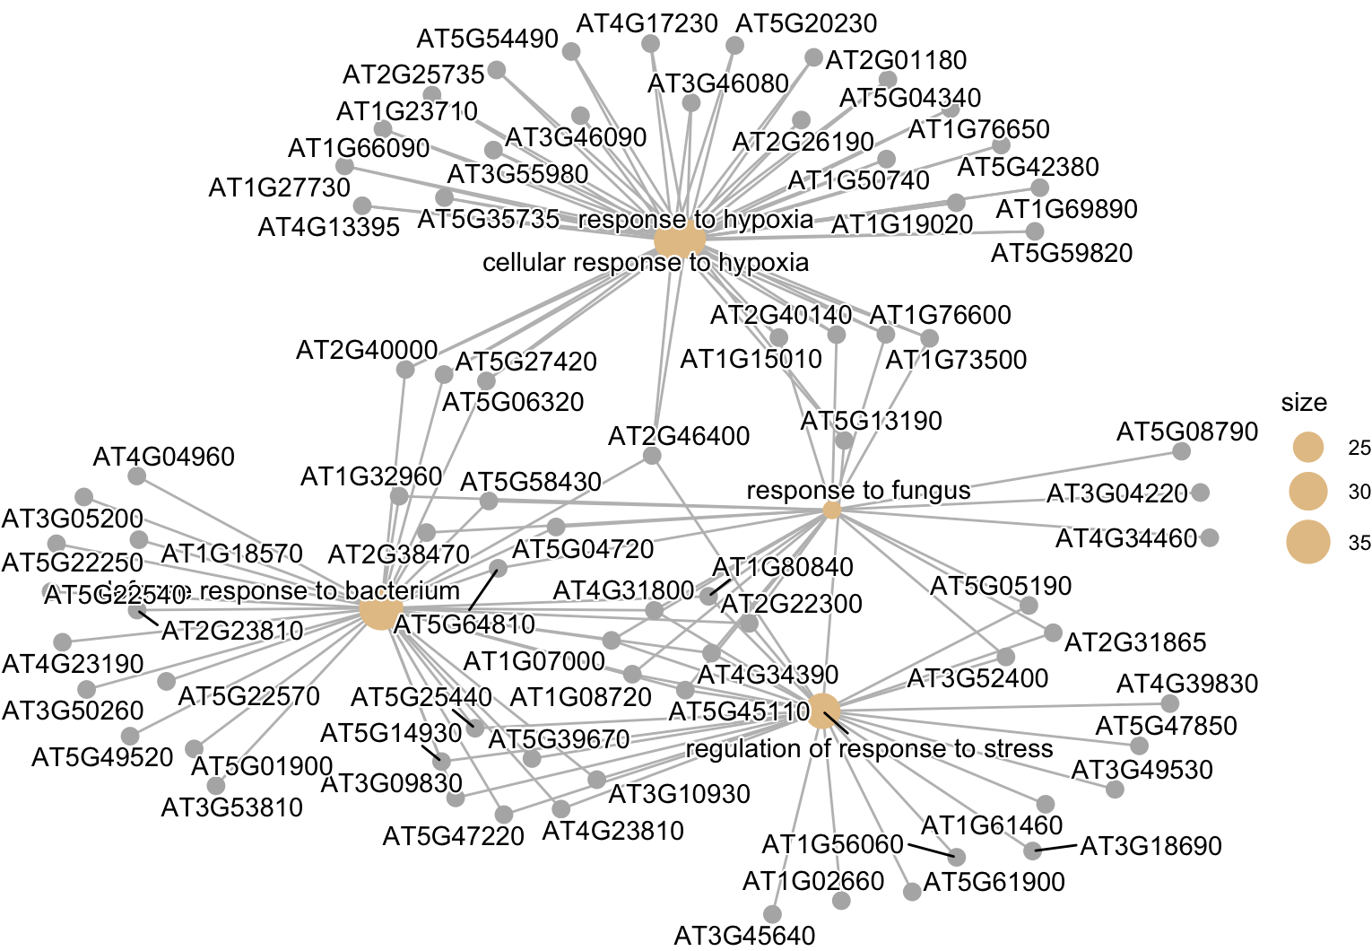
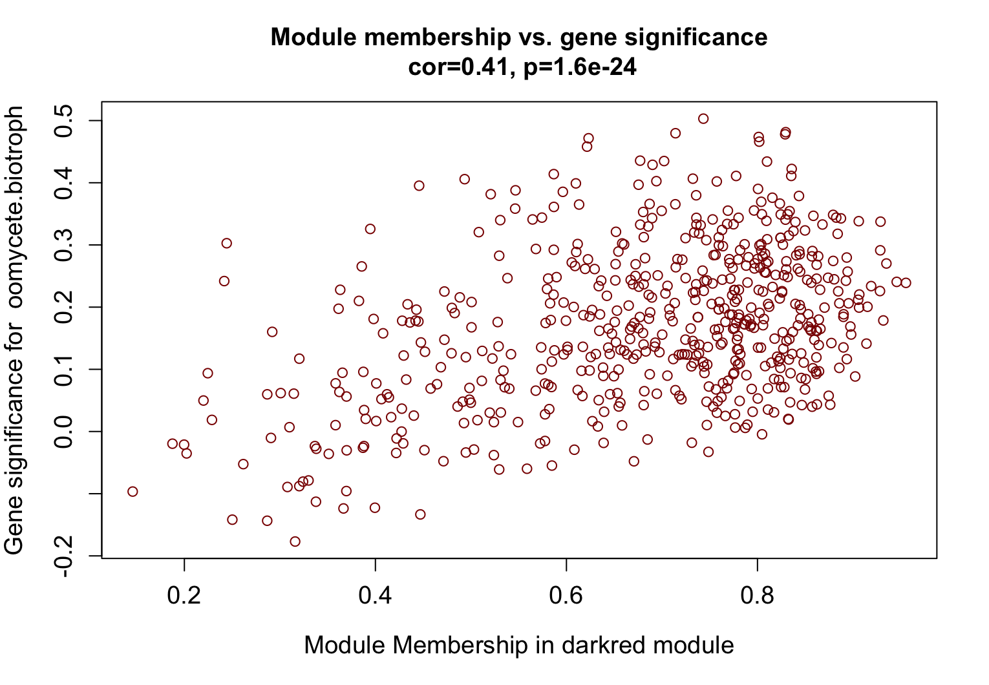
Oomycete biotroph - Hyaloperonospora arabidopsidis
darkred: enriched in plant-pathogen interaction, MAPK signaling pathway, Glycerolipid metabolism
Single-gene multifunctions: genes could play roles in hypoxia or pathogen responses at the corresponding stress → WRKYs

Slide 22
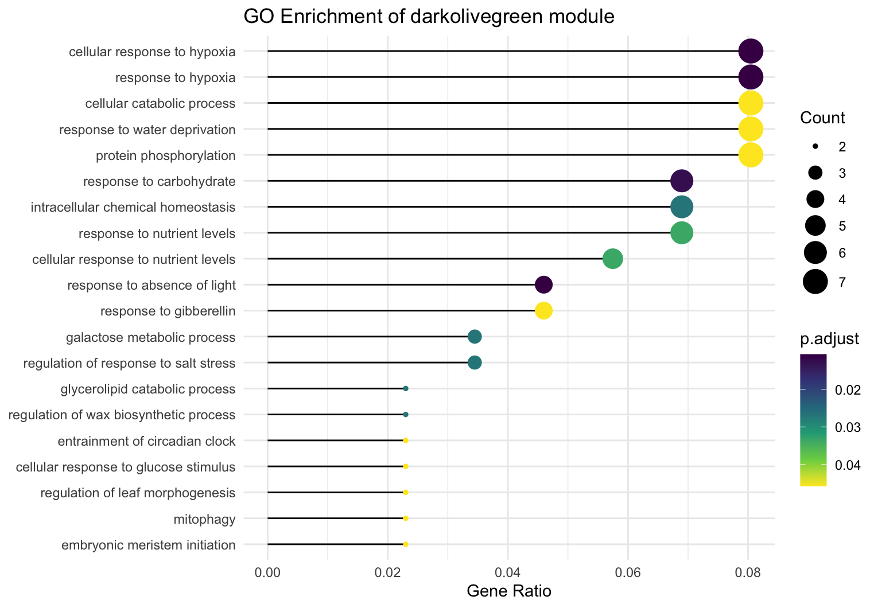
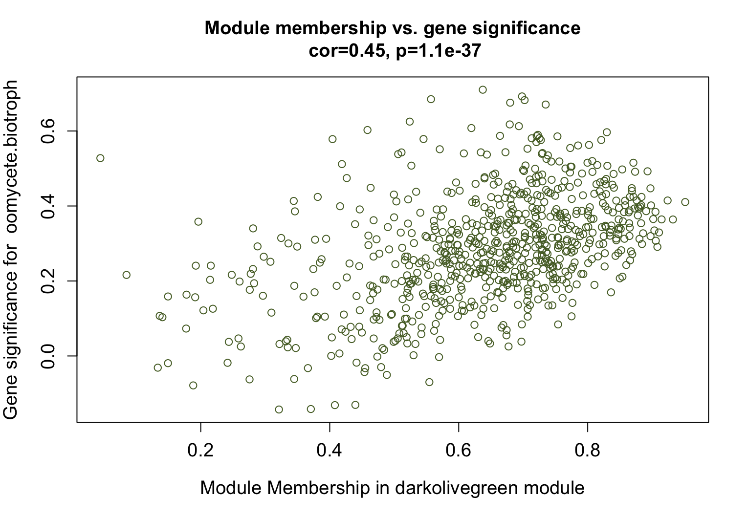
Oomycete biotroph - Hyaloperonospora arabidopsidis

Slide 23
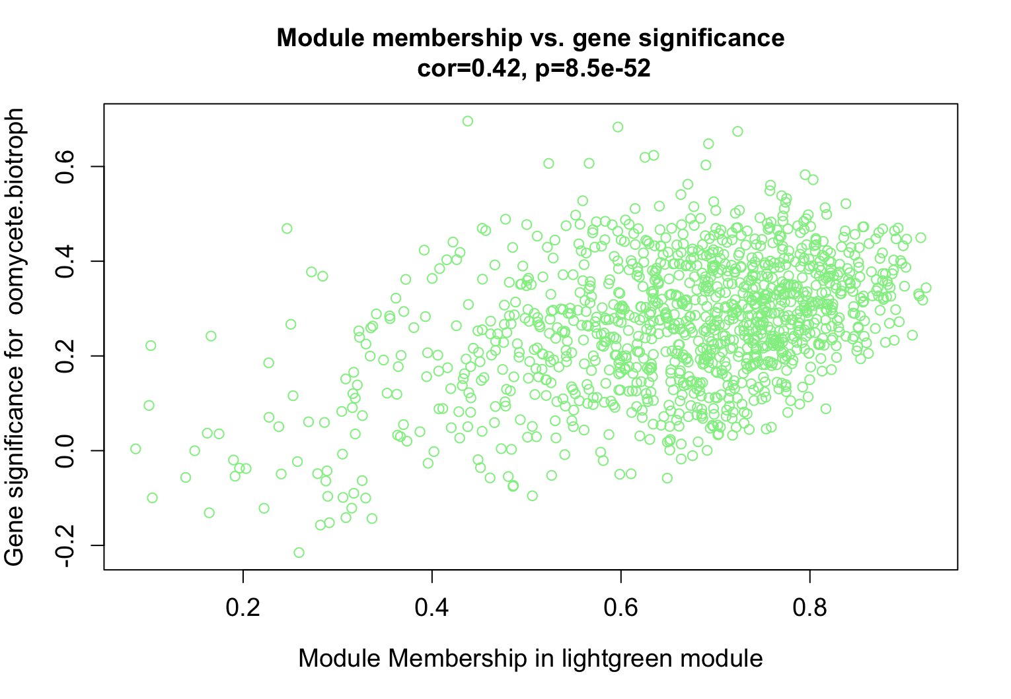
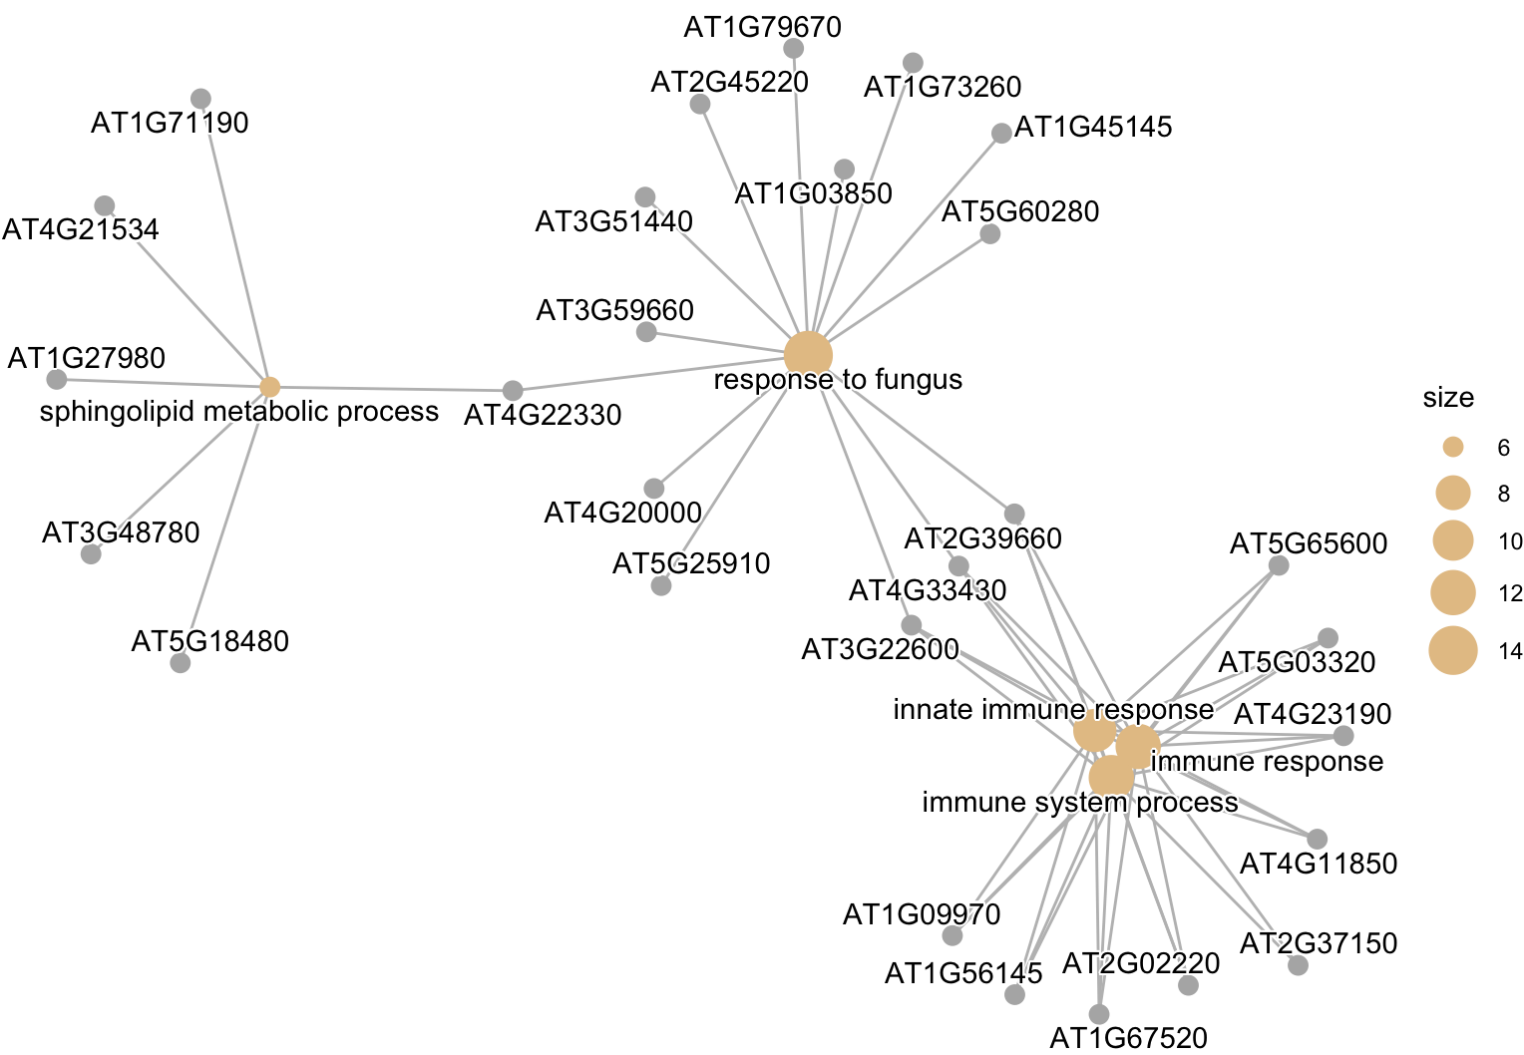
Oomycete biotroph - Hyaloperonospora arabidopsidis

Slide 24
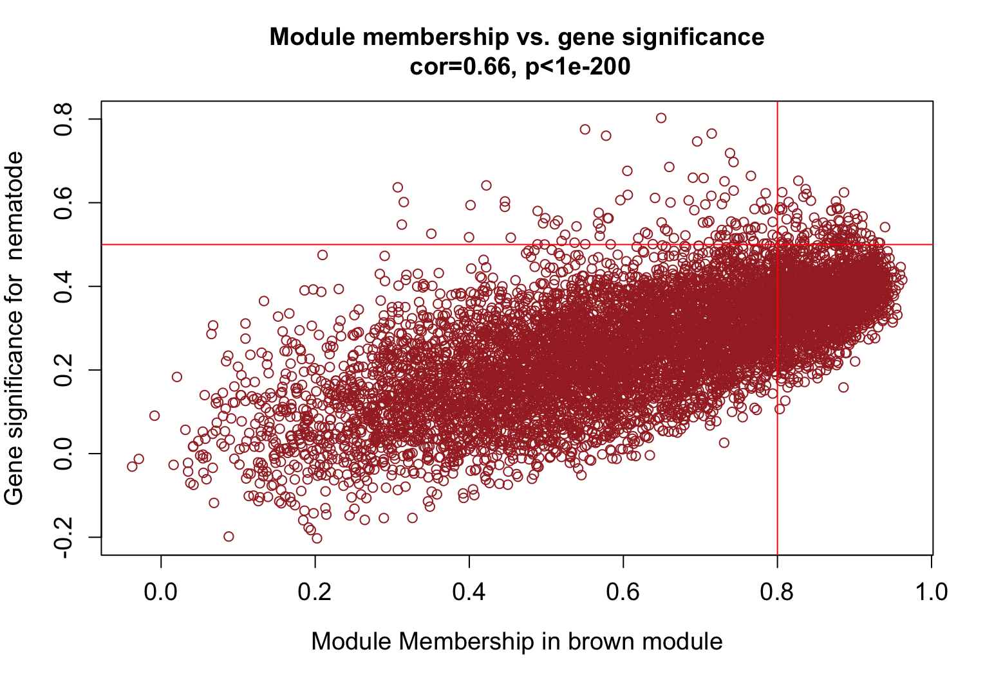
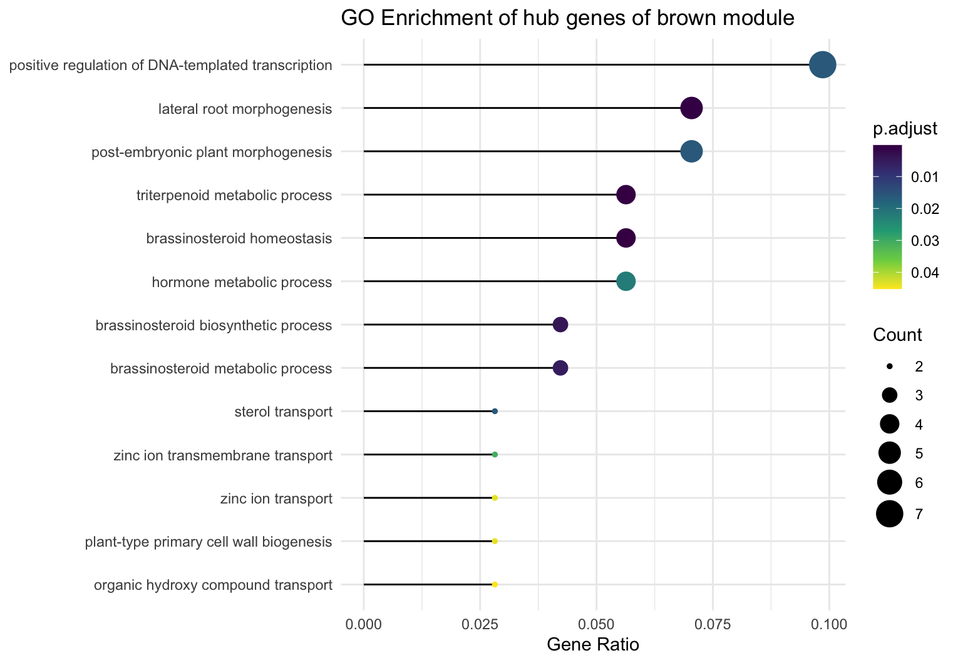
Nematodes – M. javanica and H. schachtii
brown module:
→ enriched in root morphogenesis, plant-type cell wall organization, plant epidermis development
Significant for nematodes: postive regulation of DNA-templates transcription and lateral root morphogenesis
Nematodes manipulate lateral root development to create feeding structures (synctia)
Secrete effectors that modulate host transcription factors
Plant may activate its own transcriptional networks in response to stress and infection

Slide 25
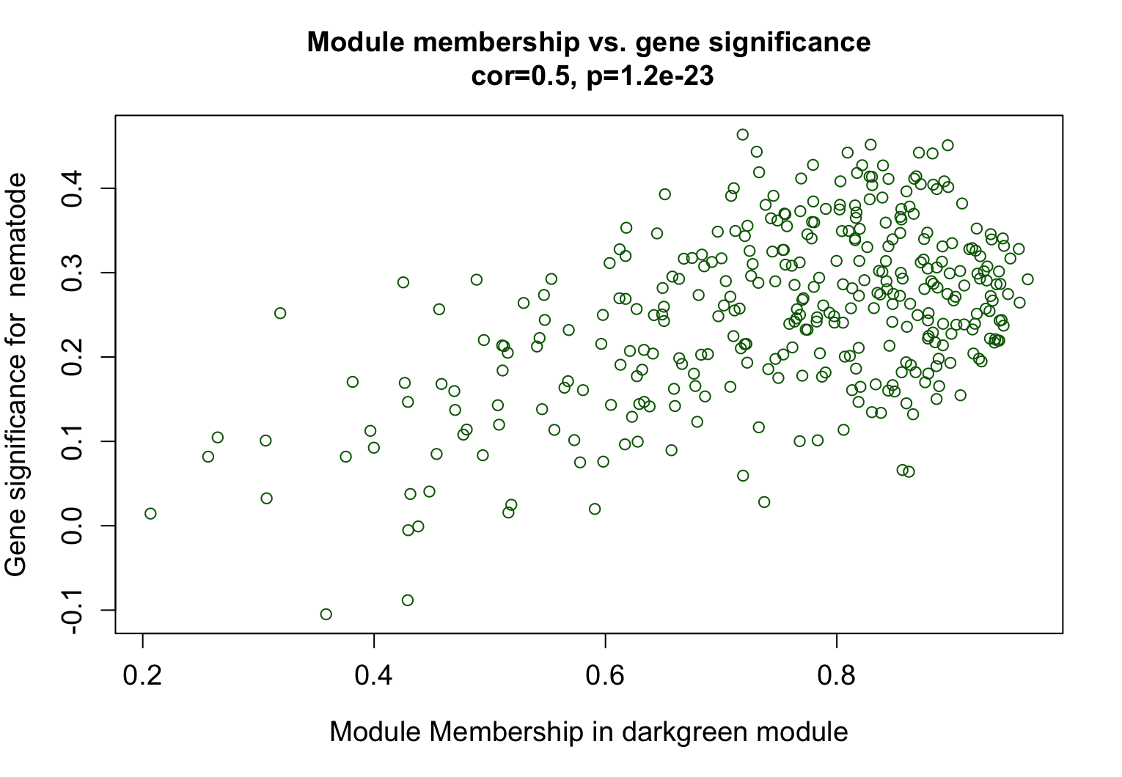
Nematodes – M. javanica and H. schachtii
darkgreen: enriched in translation, ribosome biogenesis, cytoplasmic translation, rRNA processing
Increased protein synthesis demand
Often associated with rapid growth, stress responses or metabolic shifts
For nematodes: could suggest that the nematode is inducing high protein production to maintain feeding sites

Slide 26
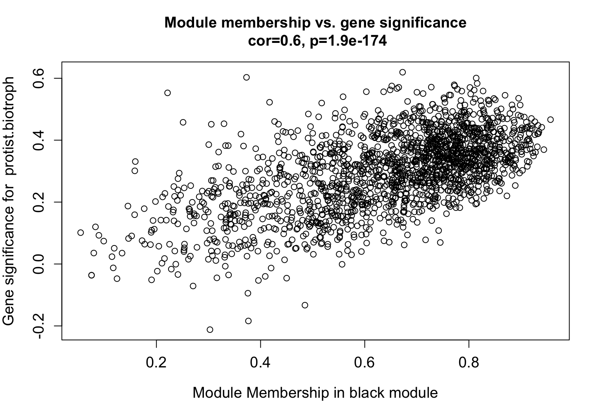
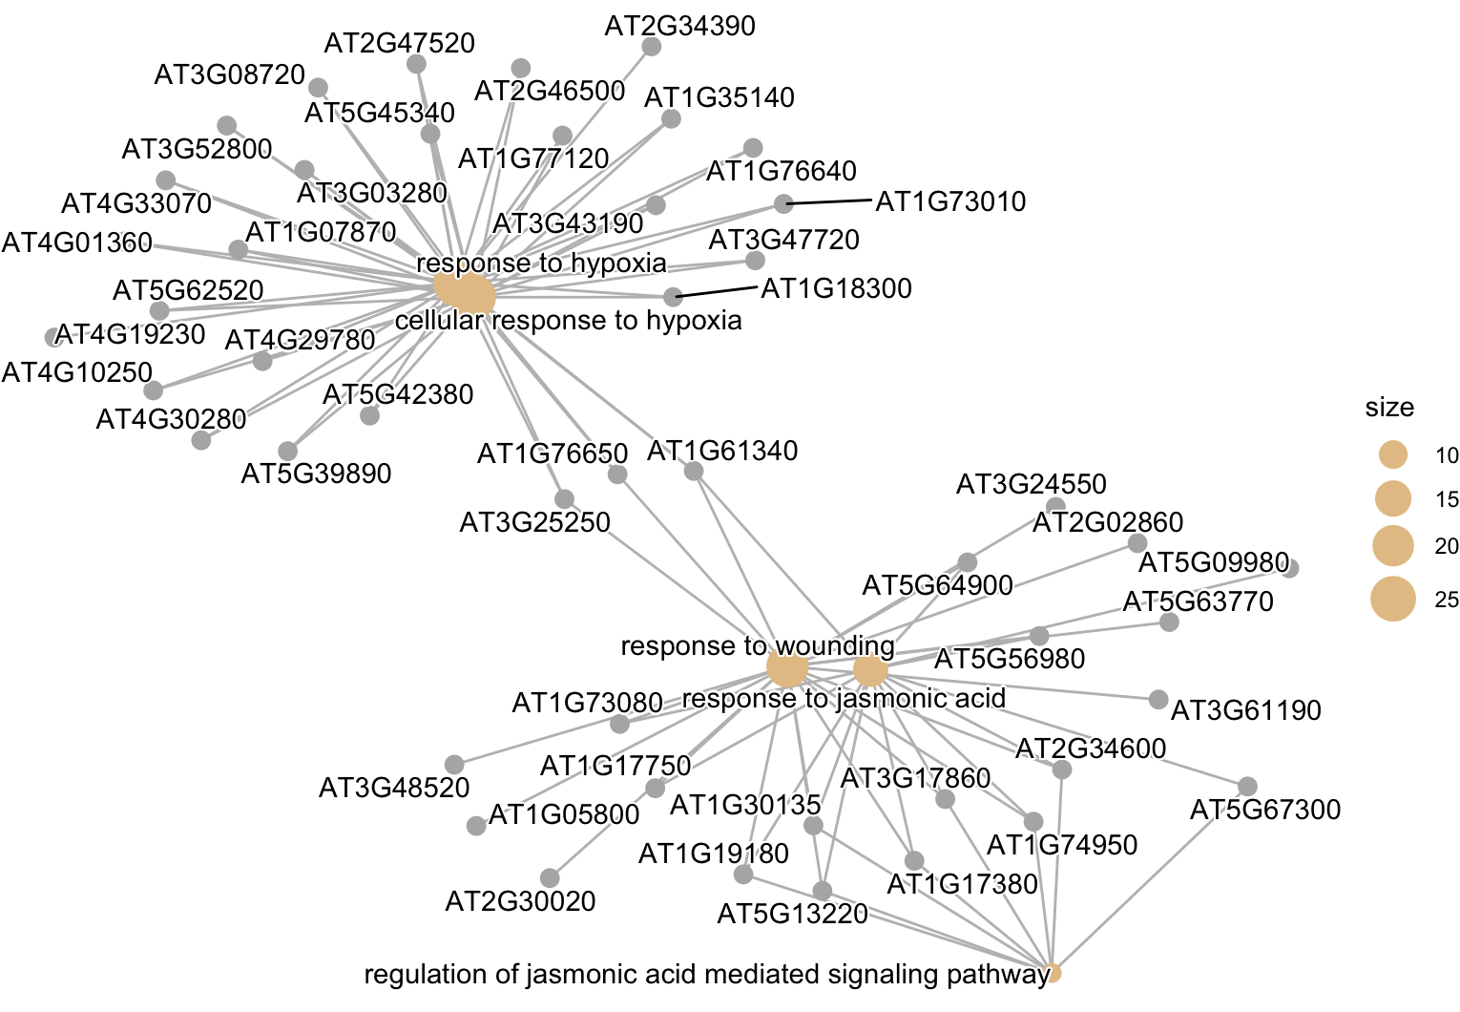
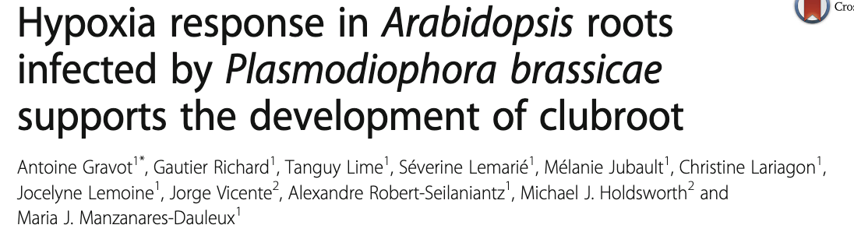
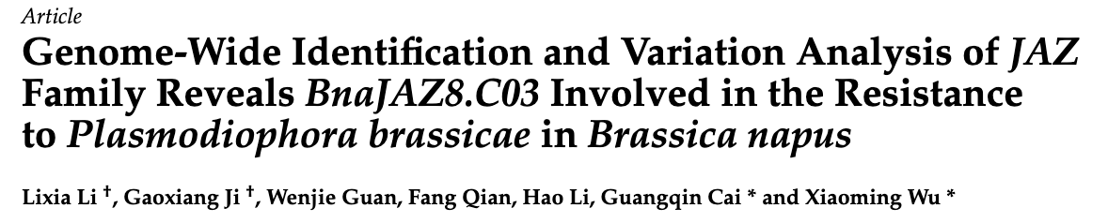
Protist biotroph – P. brassicae
enriched in plant-pathogen interaction pathway
hypoxia response: contributes positively to clubroot development
jasmonic acid signaling: part of defense response
hub genes also belong to JAZ or TIFY family
13 JAZ genes have been reported in A.thaliana
participate in plant development and defense reactions

Slide 27
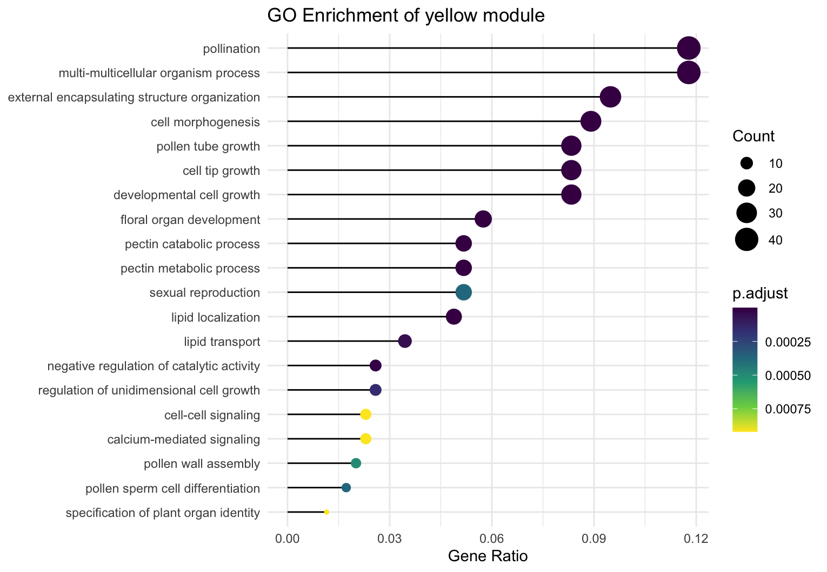
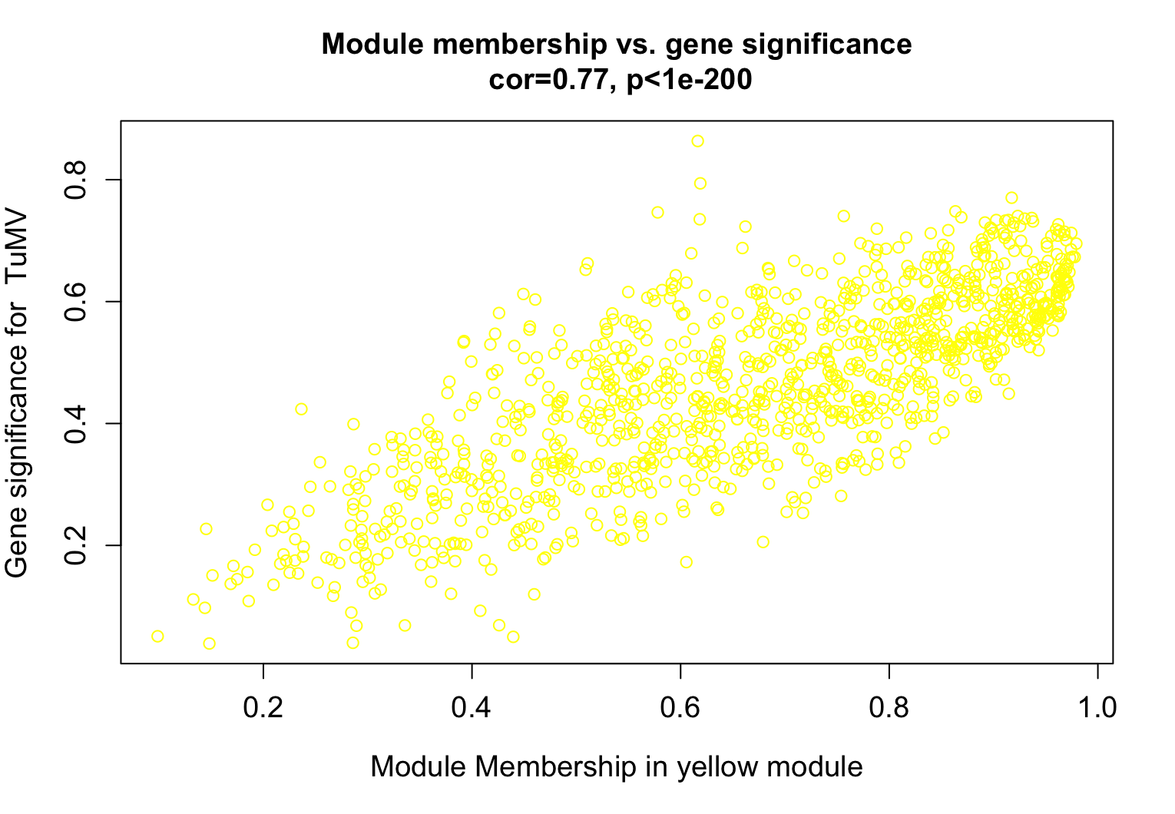
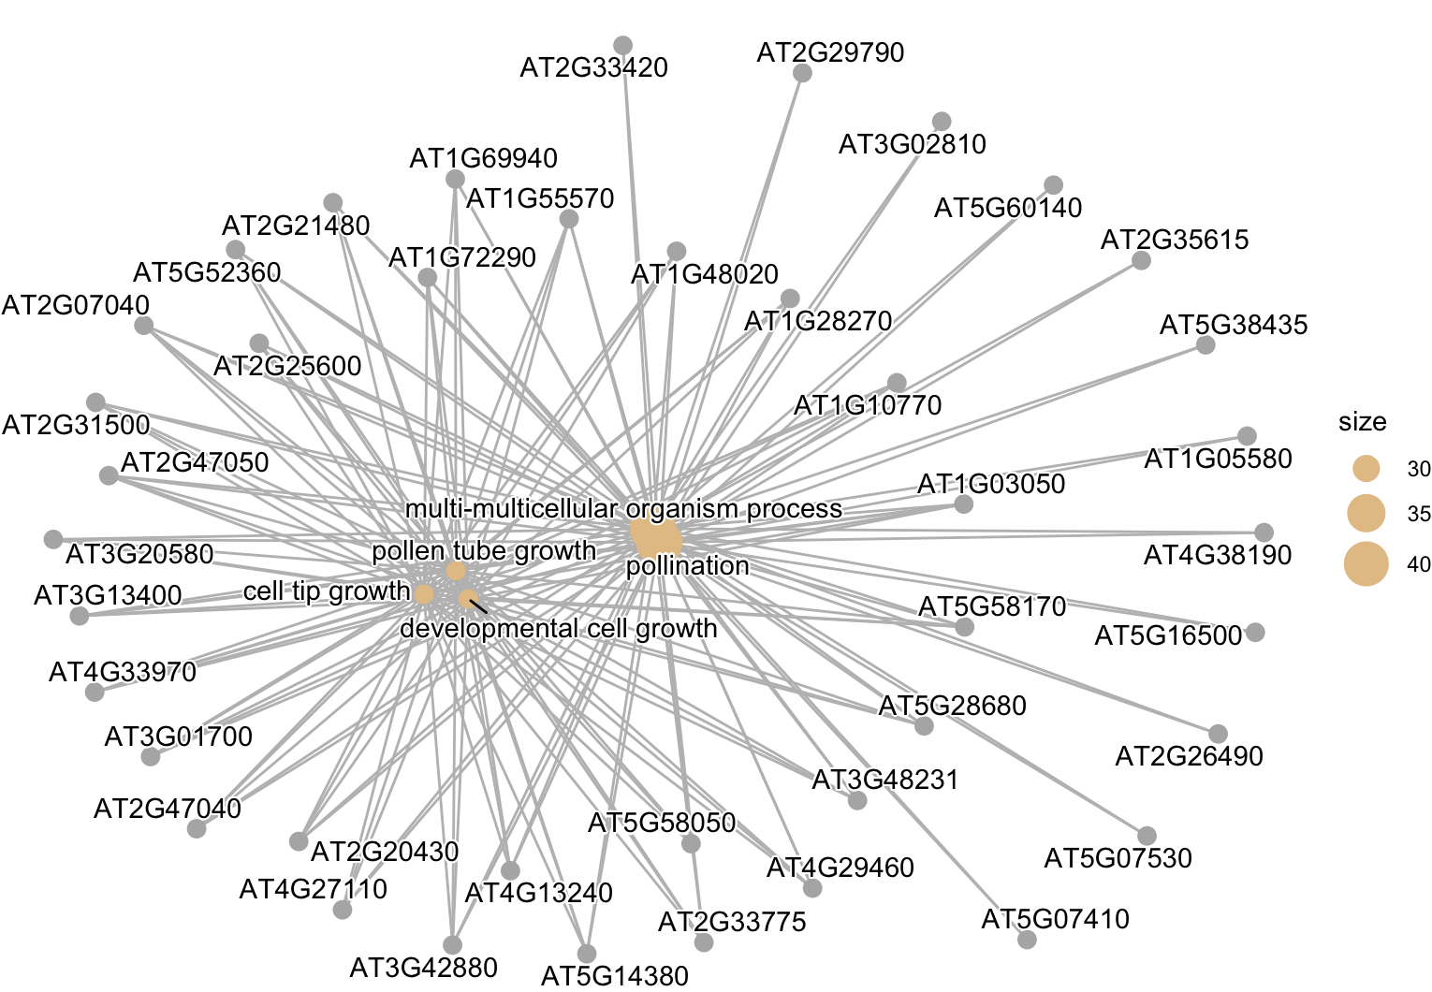
Viral biotroph – Turnip mosaic virus
Enriched in following pathways:
Pentose and glucoronate interconversion
Cutin, suberine and wax biosynthesis

Slide 28
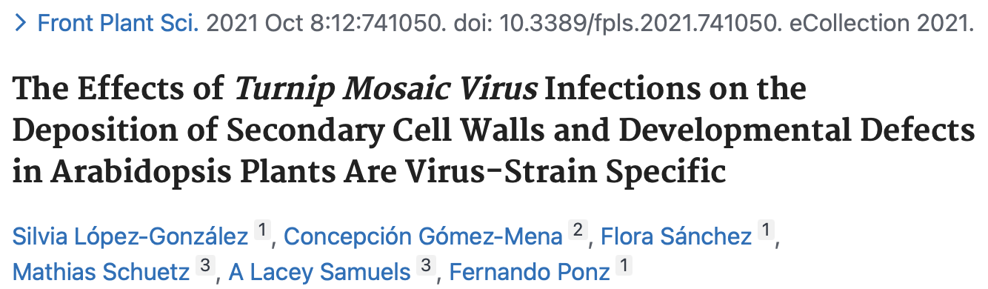
Viral biotroph – Turnip mosaic virus
Very specific pathways and biological processes
could suggest changes in cell wall and reproductive development of the plant
Cutin, suberine and wax are components of cell wall and protective barriers
Defense mechanism of the plant trying to build mechanical barriers against the invasion of the virus
Viral strains of TuMV disrupt secondary cell wall deposition
Interfere with plant development
Developmental alterations could maybe lead to dysregulation of reproducitve pathways

Slide 29
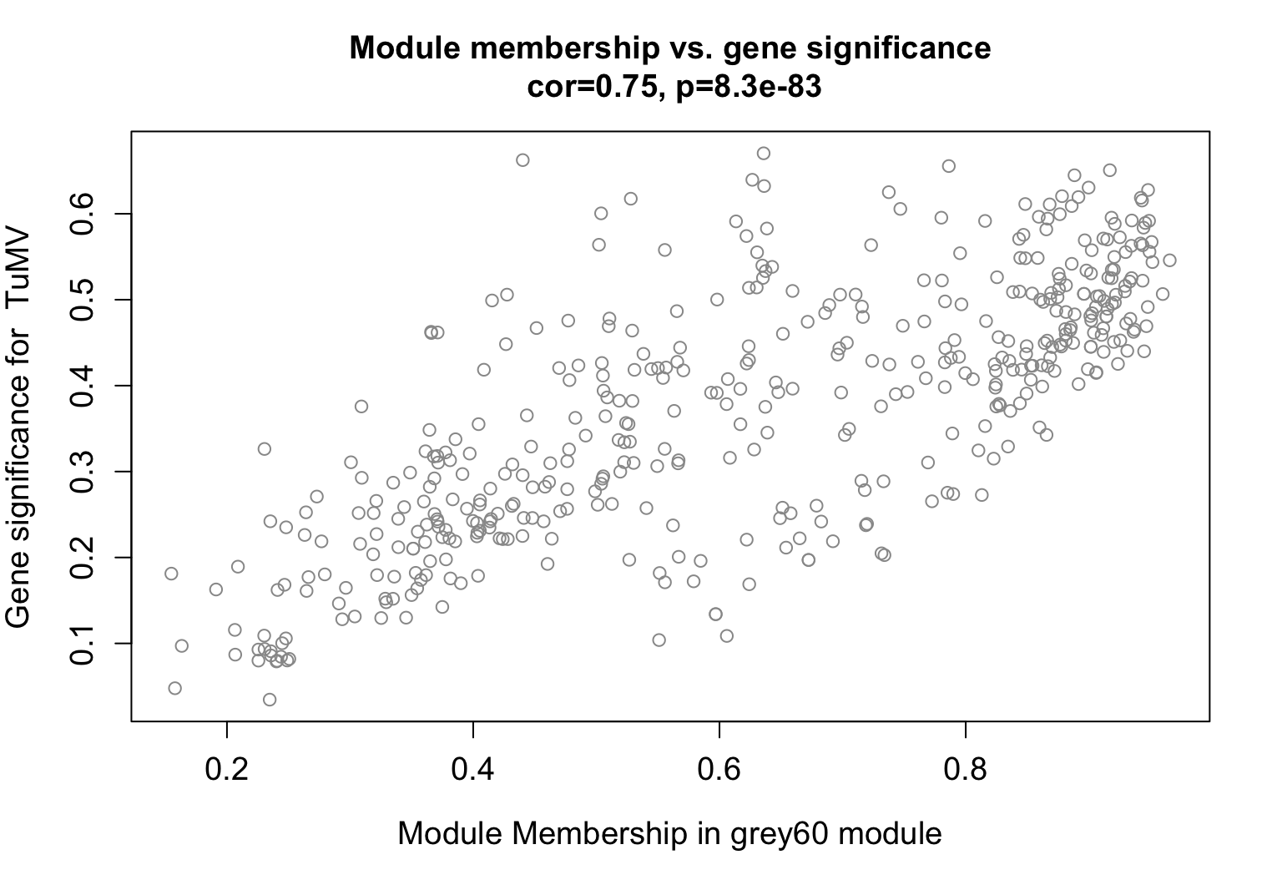
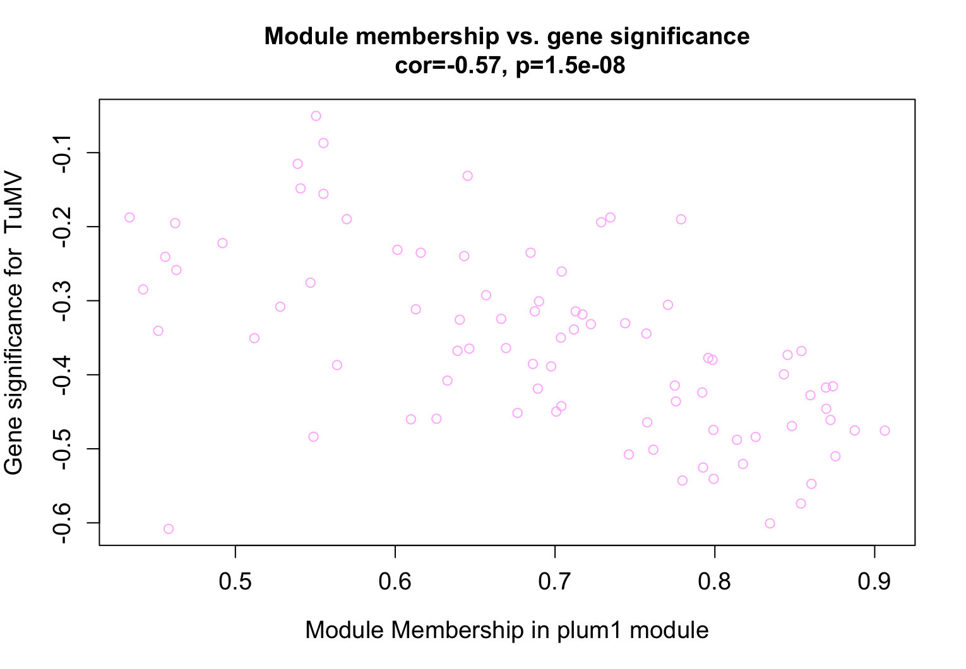
Viral biotroph – Turnip mosaic virus
Grey60: enriched in oxidative phosphorylation, purine nucleoside triphosphate biosynthetic process
Indicate changes in mitochondrial energy production
Manipulation of host cellular metabolism
Plum1: enriched in DNA damage response, double strand break repair

Slide 30
Fungal biotrophs
Different modules correlating with all three fungal biotrophs
Maybe different infection strategies?
Genetic differences between fungal species?
G.orontii
E.cichoracearum
E.cruciferarum

Slide 32
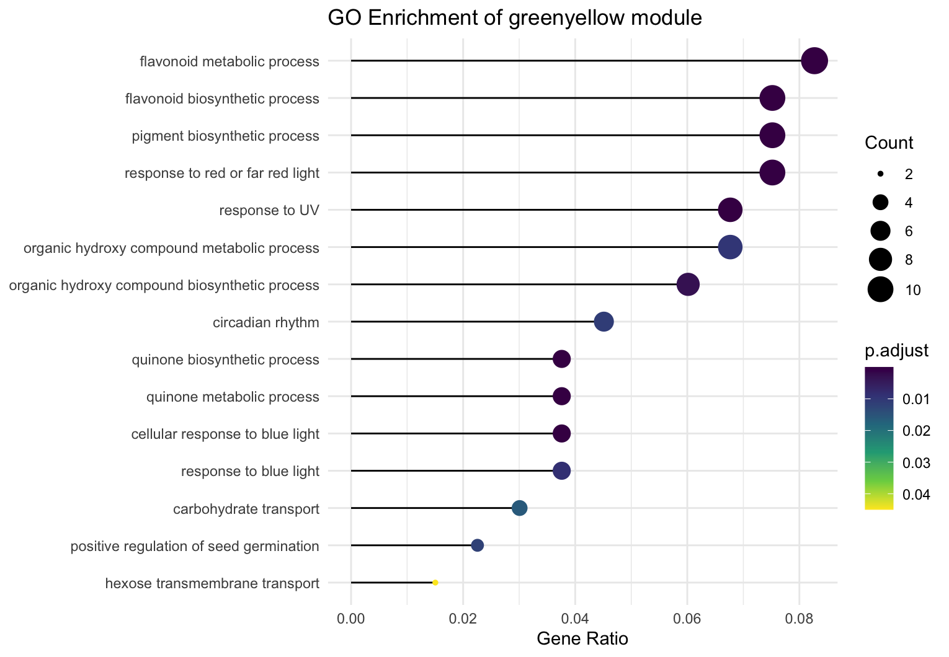
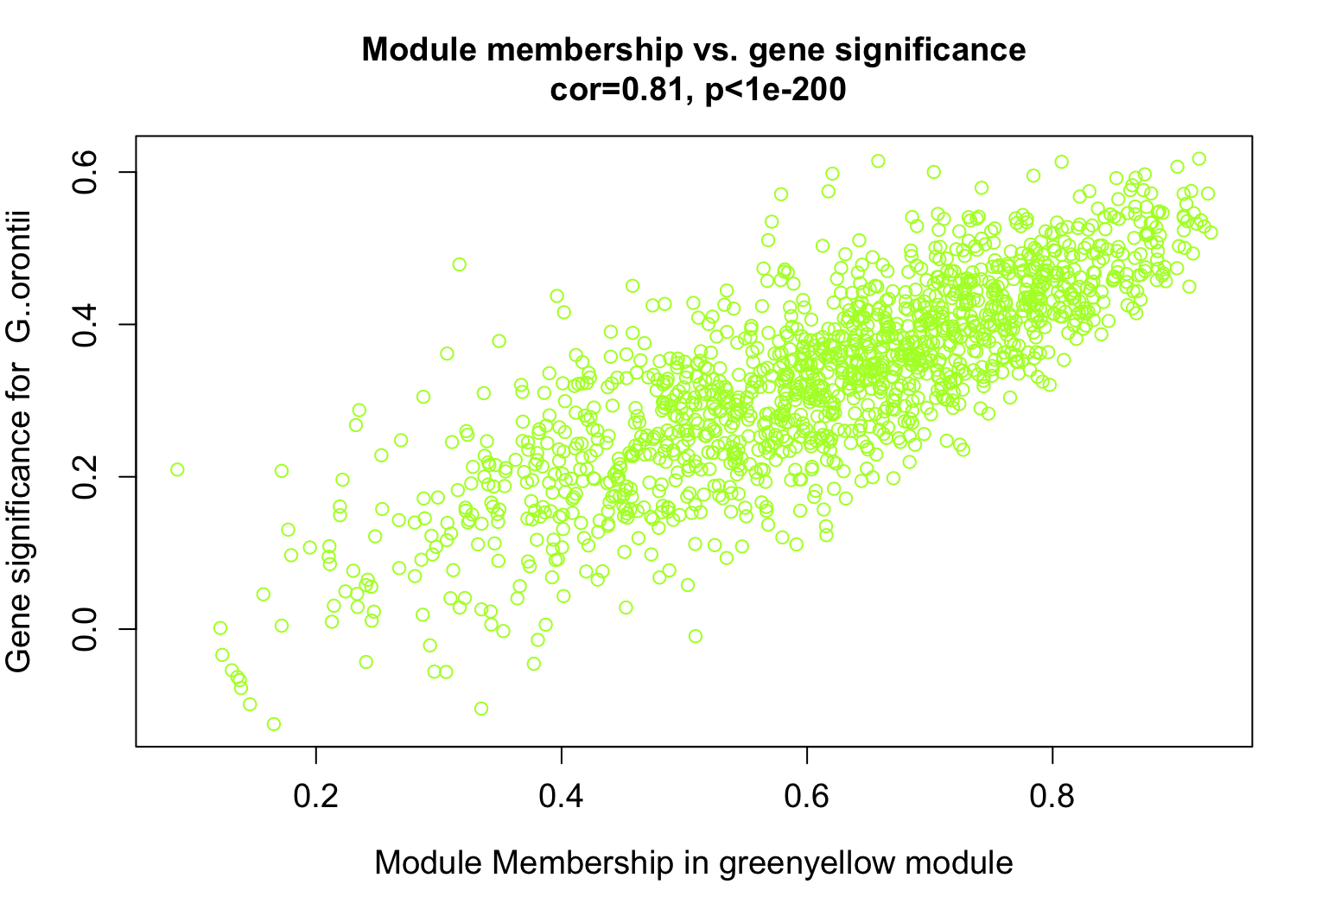
Golovinomyces orontii
enriched in flavonoid biosynthesis pathway, starch and sucrose metabolism, nicotinate and nicotinamide metabolism
→ Flavonoids as defense mechanism against biotrophic pathogens

Slide 33
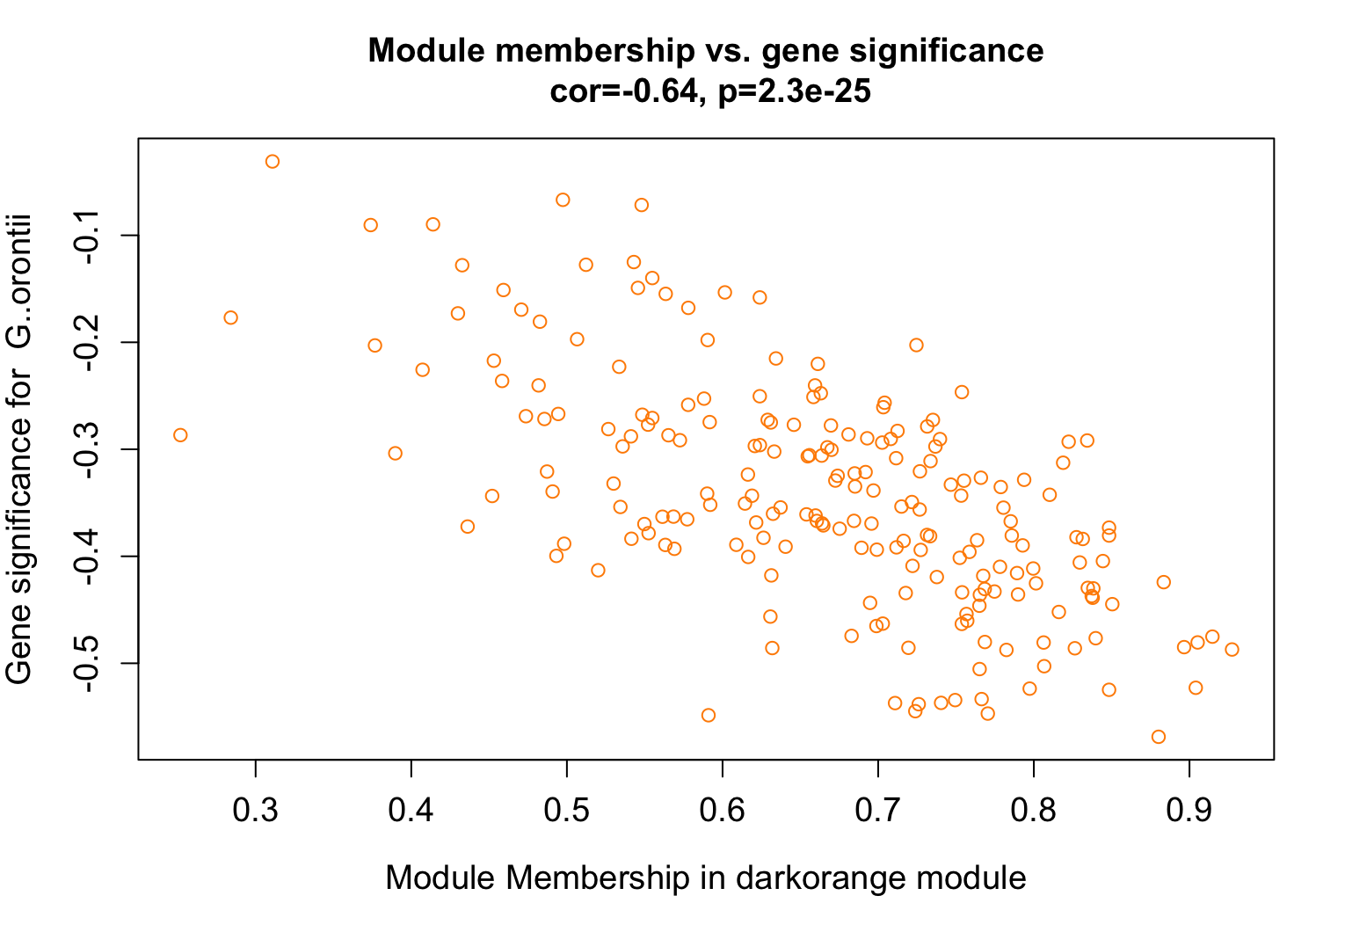
Golovinomyces orontii
Downregulation of protein export, protein localization to ER
Response to hypoxia and to carbohydrate

Slide 34
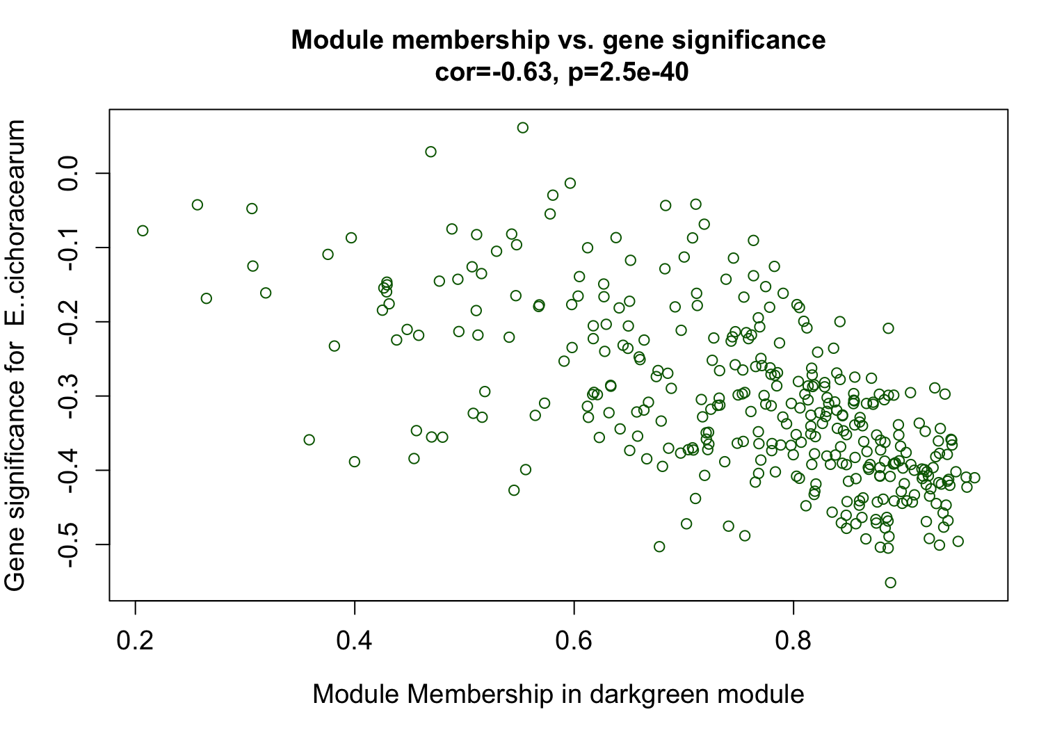
Erysiphe cichoracearum
Darkgreen module: enriched in Translation (Ribosome)
→ downregulated during infection

Slide 35
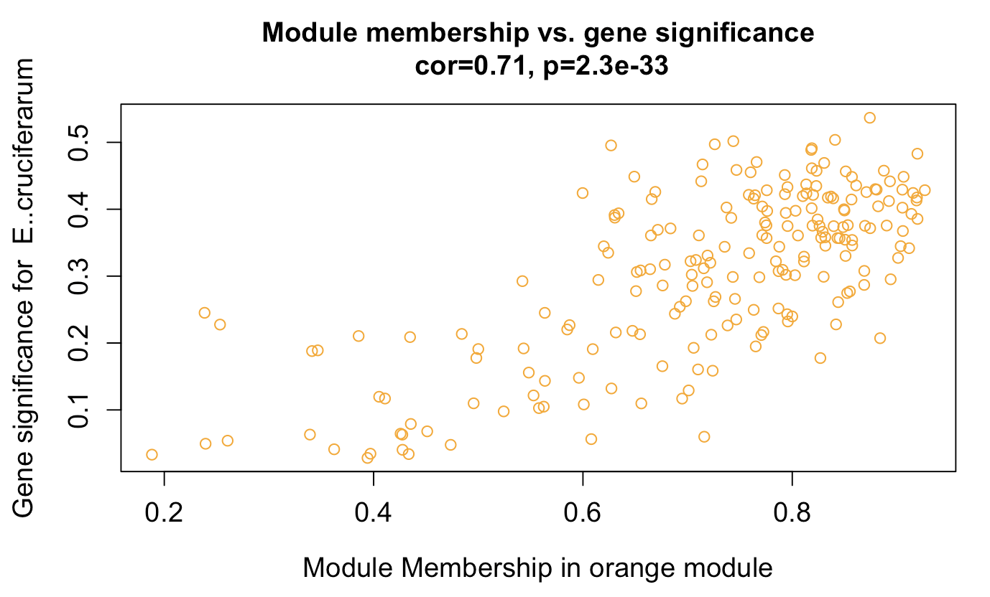
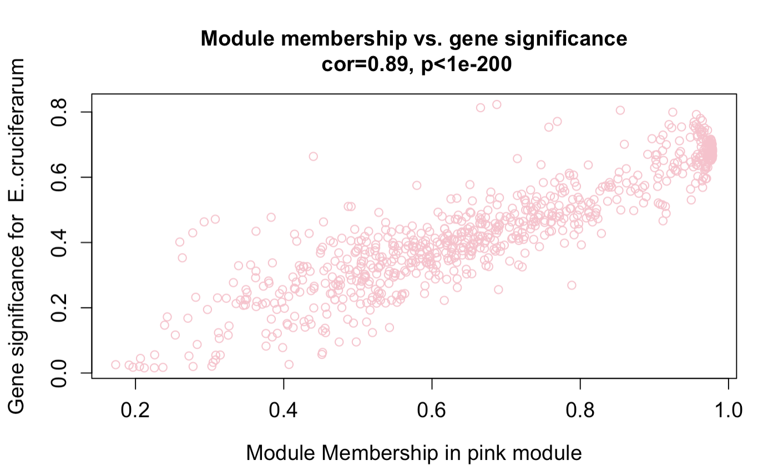
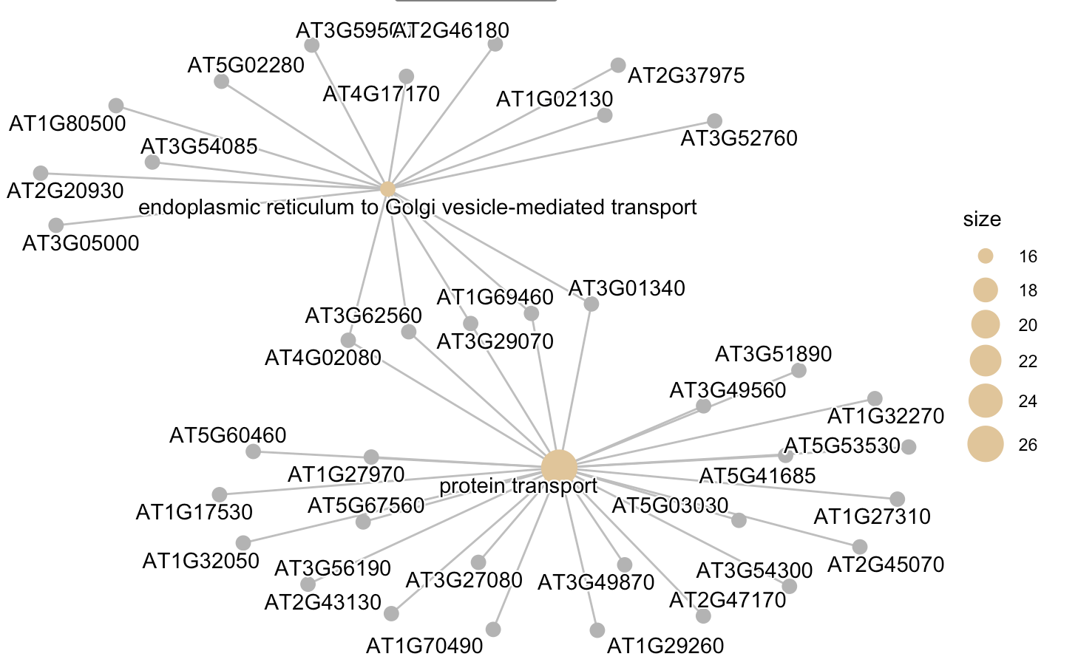
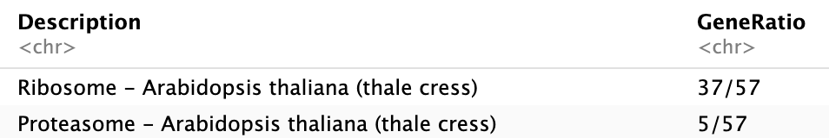
Erysiphe cruciferarum
unpublished dataset: E.cruciferarum
→ Strongly upregulated in pink and orange module

Slide 36
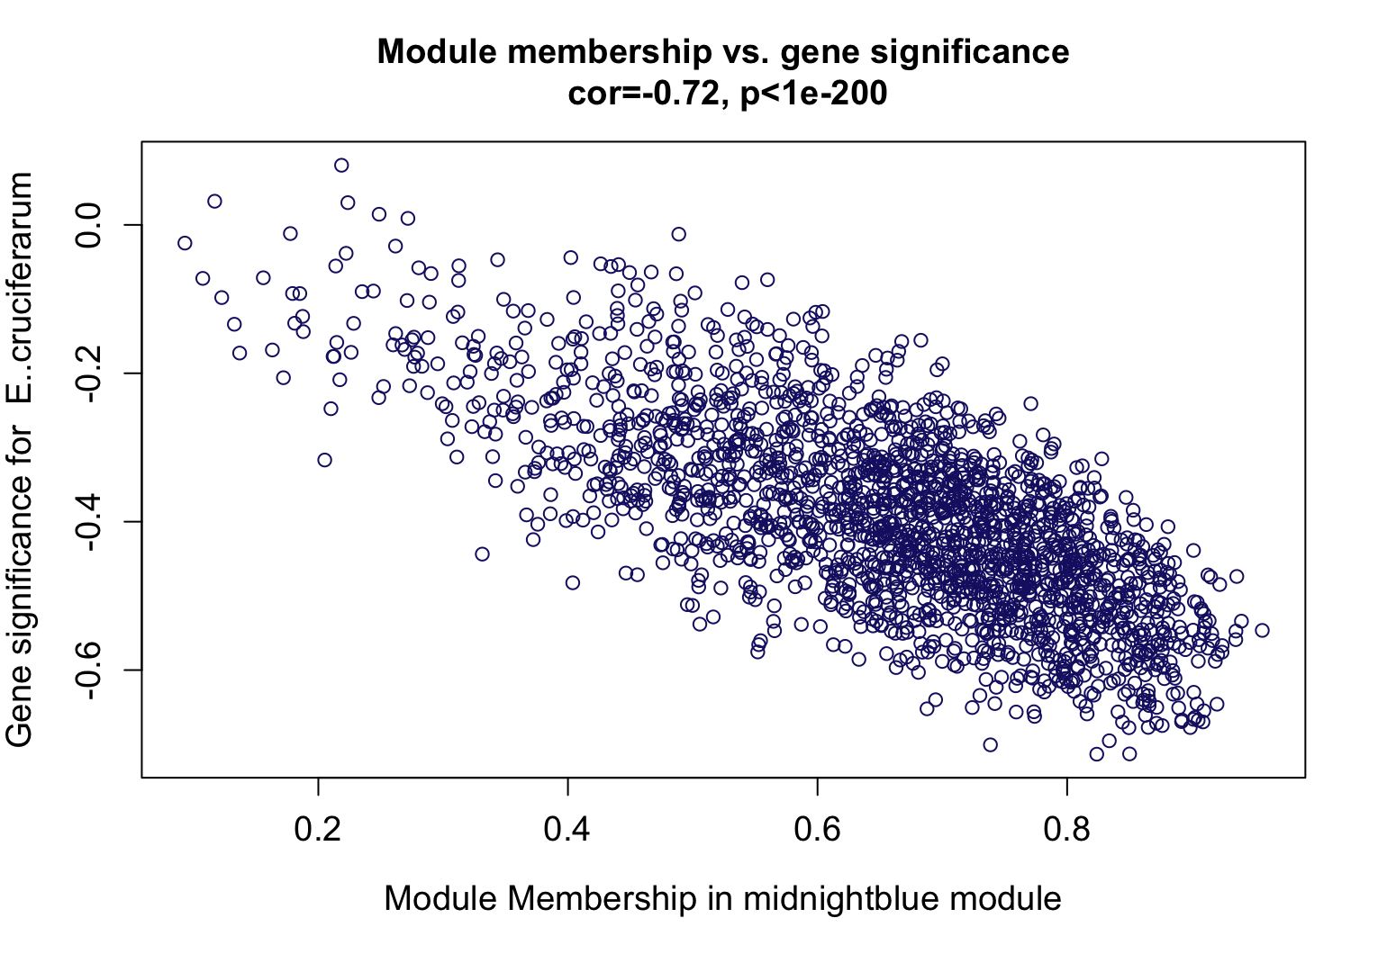
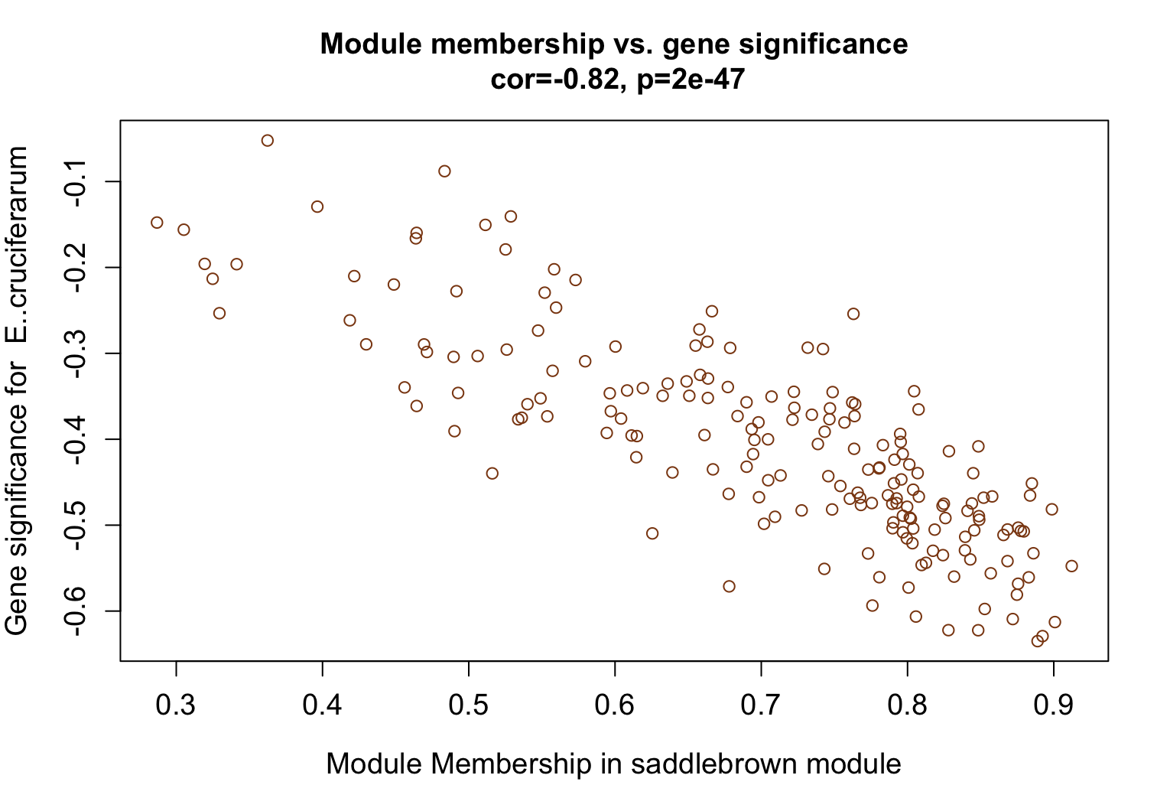
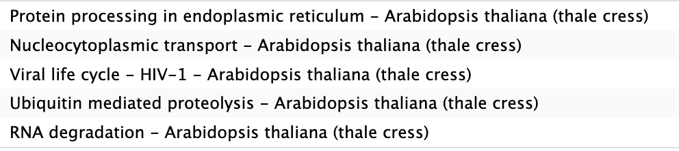
Erisyphe cruciferarum

Slide 38
Commonalities and Divergences in Biotrophic Plant-Microbe Interactions
Each biotroph seems to have its own strategy
Manipulation of plant’s metabolisms for nutrient uptake
Some biotrophs suppress plant defense
Some biotrophs actively use plant defense mechanisms to their advantage
A lot of different modules could also result from the way the dataset is build

