Slide 1
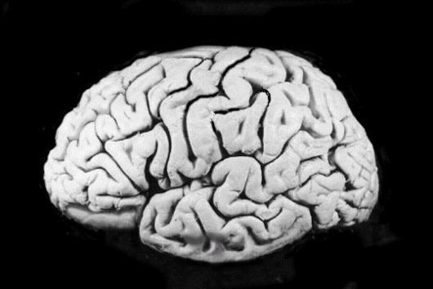
Introduction To Neural Networks
Dr Luisa Cutillo
Source Material from: Graham Kendall and Sagar Sharma

Slide 2
The origin
McCulloch & Pitts (1943) are generally recognised as the designers of the first neural network
Many of their ideas still used today (e.g. many simple units combine to give increased computational power and the idea of a threshold)

Slide 3
Neural Networks
Hebb (1949) developed the first learning rule (on the premise that if two neurons were active at the same time the strength between them should be increased)

Slide 4
Neural Networks
During the 50’s and 60’s many researchers worked on the perceptron amidst great excitement.
1969 saw the death of neural network research for about 15 years – Minsky & Papert
Only in the mid 80’s (Parker and LeCun) was interest revived (in fact Werbos discovered algorithm in 1974)

Slide 5
What the heck is a
Perceptron
Perceptron is a linear classifier (binary). Also, it is used in supervised learning. It helps to classify the given input data. But how does it work ?
The perceptron consists of 4 parts:
Input values or One input layer
Weights and Bias
Net sum
Activation Function

Slide 6
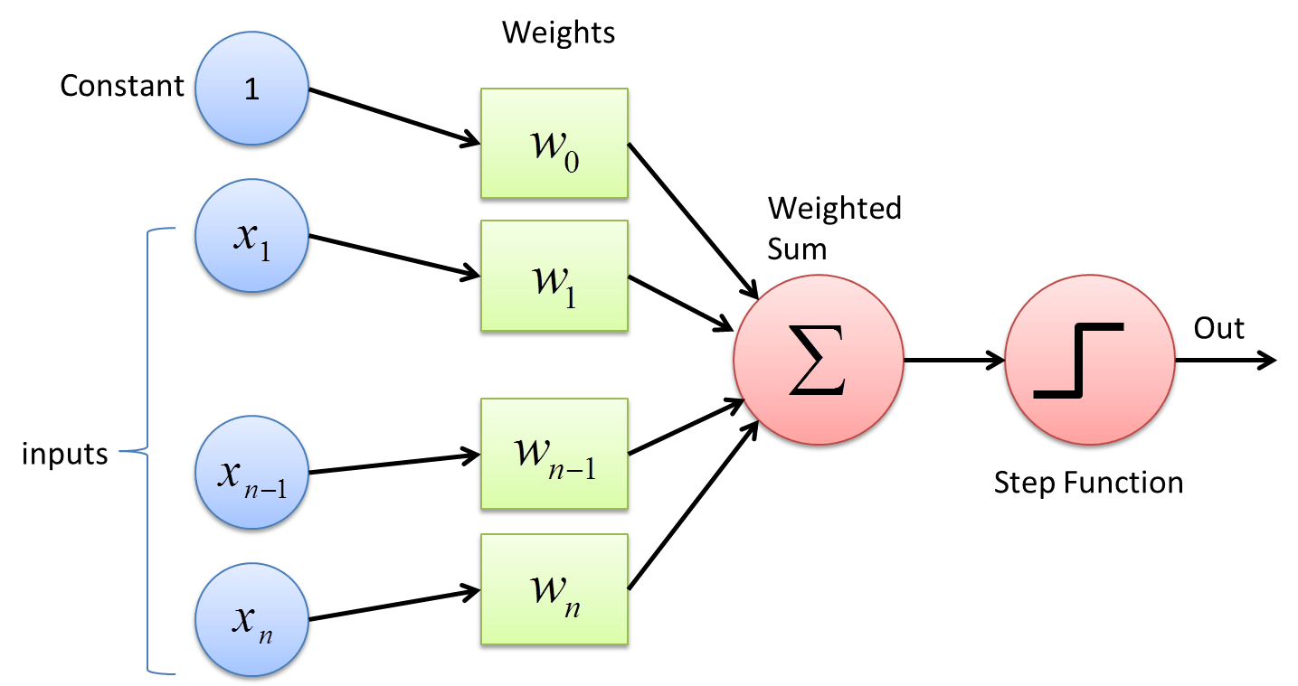
What the heck is a
Perceptron

Slide 7
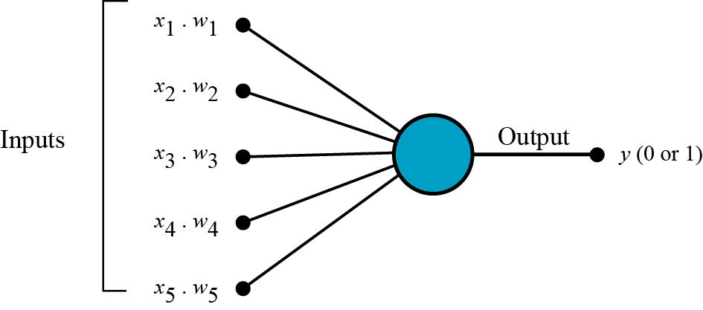
How does a Perceptron work? Simple steps a-b-c
a. All the inputs x are multiplied with their weights w. Let’s call it k.

Slide 8
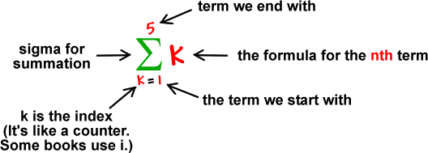
How does a Perceptron work? Simple steps: a-b-c
b. Add all the multiplied values and call them Weighted Sum.

Slide 9
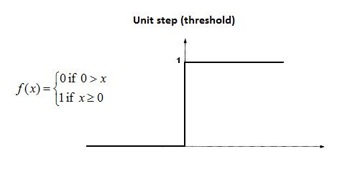
How does a Perceptron work? Simple steps a-b-c
c. Apply that weighted sum to the correct Activation Function. For example the unit step function:

Slide 10
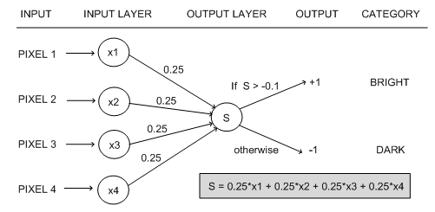
Why do we need weights and Bias?
Weights shows the strength of the particular node.
A bias value allows you to shift the activation function curve up or down.

Slide 11
Why do we need activation functions?
The activation functions are used to map the input between the required values like (0, 1) or (-1, 1).

Slide 12
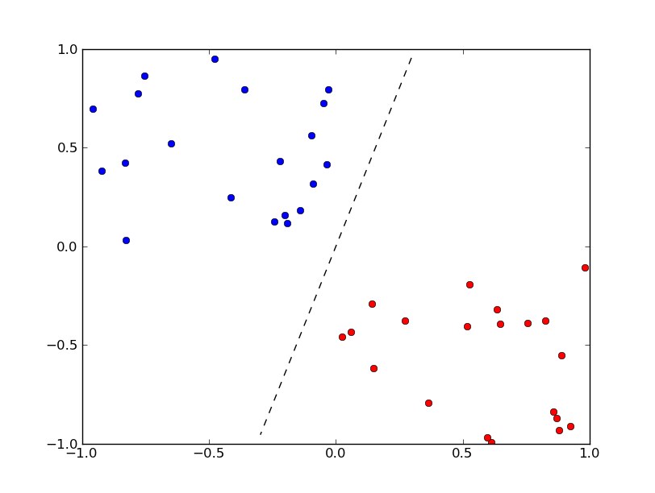
Where do we use perceptron?
Perceptron is usually used to classify the data into two parts. Therefore, it is also known as a Linear Binary Classifier.

Slide 13
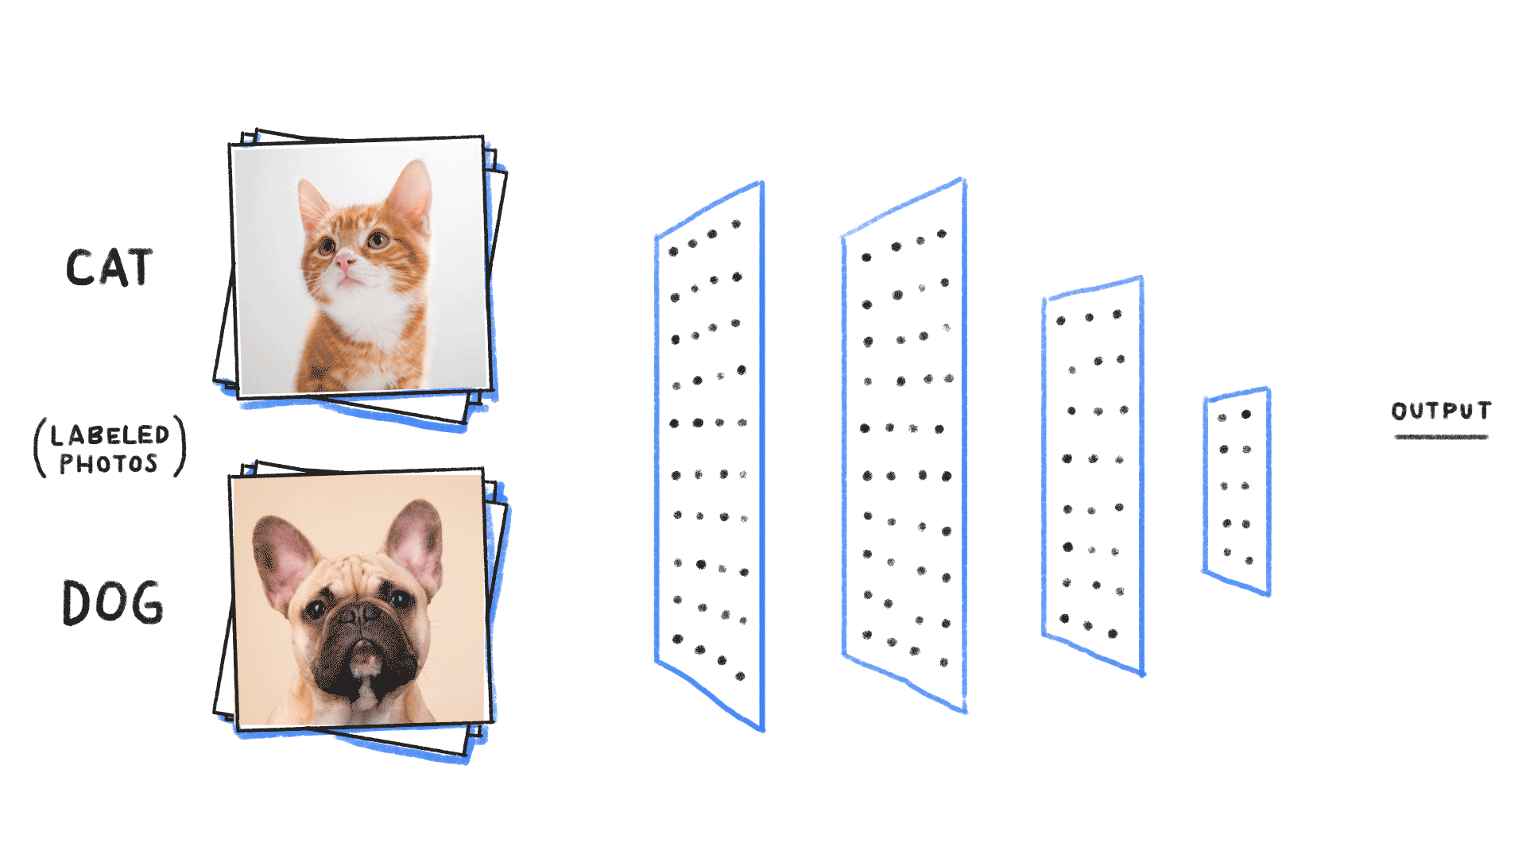
A Neural Network has multiple layers

Slide 14
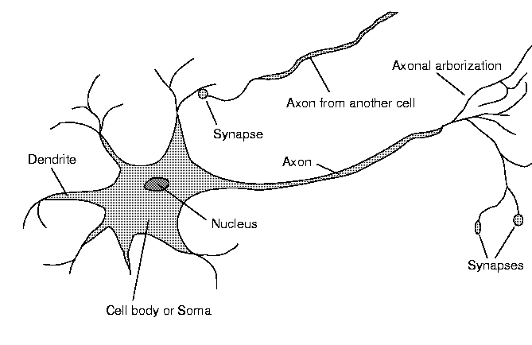
In our Brain

Slide 15
Neural Networks
We are born with about 100 billion neurons
A neuron may connect to as many as 100,000 other neurons

Slide 16
Neural Networks
Signals “move” via electrochemical signals
The synapses release a chemical transmitter – the sum of which can cause a threshold to be reached – causing the neuron to “fire”
Synapses can be inhibitory or excitatory

Slide 17
The First Neural Neural Networks
McCulloch and Pitts produced the first neural network in 1943
Many of the principles can still be seen in neural networks of today

Slide 18
The First Neural Neural Networks
X₁
2
X₂
2
Y
-1
X₃
The activation of a neuron is binary. That is, the neuron either fires (activation of one) or does not fire (activation of zero).

Slide 19
The First Neural Neural Networks
X₁
2
X₂
2
Y
-1
X₃
For the network shown here the activation function for unit Y is
f(y_in) = 1, if y_in >= θ else 0
where y_in is the total input signal received
θ is the threshold for Y

Slide 20
The First Neural Neural Networks
X₁
2
X₂
2
Y
-1
X₃
Neurons is a McCulloch-Pitts network are connected by directed, weighted paths

Slide 21
The First Neural Neural Networks
X₁
2
X₂
2
Y
-1
X₃
If the weight on a path is positive the path is excitatory, otherwise it is inhibitory

Slide 22
The First Neural Neural Networks
X₁
2
X₂
2
Y
-1
X₃
All excitatory connections into a particular neuron have the same weight, although different weighted connections can be input to different neurons

Slide 23
The First Neural Neural Networks
X₁
2
X₂
2
Y
-1
X₃
Each neuron has a fixed threshold. If the net input into the neuron is greater than the threshold, the neuron fires

Slide 24
The First Neural Neural Networks
X₁
2
X₂
2
Y
-1
X₃
The threshold is set such that any non-zero inhibitory input will prevent the neuron from firing

Slide 25
The First Neural Neural Networks
X₁
2
X₂
2
Y
-1
X₃
It takes one time step for a signal to pass over one connection.

