Slide 1
Classification (Discrimination, Supervised Learning)
Luisa Cutillo
Most of Slides Adapted from
http://statwww.epfl.ch/davison/teaching/Microarrays/
by Darlene Goldstein

Slide 2
Example: Gene expression data
mRNA samples
Normal Normal Normal Cancer Cancer
sample1 sample2 sample3 sample4 sample5 …
1 0.46 0.30 0.80 1.51 0.90 ...
2 -0.10 0.49 0.24 0.06 0.46 ...
3 0.15 0.74 0.04 0.10 0.20 ...
4 -0.45 -1.03 -0.79 -0.56 -0.32 ...
5 -0.06 1.06 1.35 1.09 -1.09 ...
Genes
Gene expression level of gene i in mRNA sample j
Notes:
3

Slide 3
Classification
Y Normal Normal Normal Cancer Cancer unknown =Y_new
sample1 sample2 sample3 sample4 sample5 … New sample
1 0.46 0.30 0.80 1.51 0.90 ... 0.34
2 -0.10 0.49 0.24 0.06 0.46 ... 0.43
3 0.15 0.74 0.04 0.10 0.20 ... -0.23
4 -0.45 -1.03 -0.79 -0.56 -0.32 ... -0.91
5 -0.06 1.06 1.35 1.09 -1.09 ... 1.23
X X_new
Each object (e.g. arrays or columns)associated with a class label (or response) Y ∈ {1, 2, …, K} and a feature vector (vector of predictor variables) of G measurements: X = (X₁, …, X_{G})
Aim: predict Y_new from X_new.

Slide 4
Classifiers
A predictor or classifier partitions the space of gene expression profiles into K disjoint subsets, A₁, ..., A_{K}, such that for a sample with expression profile X=(X₁, ...,X_{G}) ∈ A_{k} the predicted class is k.
Classifiers are built from a learning set (LS)
L = (X₁, Y₁), ..., (X_{n},Y_{n})
Classifier C built from a learning set L:
C( . ,L): X → {1,2, ... ,K}
Predicted class for observation X:
C(X,L) = k if X is in A_{k}

Slide 5
Classification Methods
Fisher Linear Discriminant Analysis.
Maximum Likelihood Discriminant Rule.
  Quadratic discriminant analysis (QDA).
  Linear discriminant analysis (LDA, equivalent to FLDA for K=2).
  Diagnal quadratic discriminant analysis (DQDA).
  Diagnal linear discriminant analysis (DLDA).
Nearest Neighbor Classification.
Classification and Regression Tree (CART).
Aggregating & Bagging.

Slide 6
Fisher Linear Discriminant Analysis
-- M.Barnard. The secular variations of skull characters in four series of egyptian skulls. Annals of Eugenics, 6:352-371, 1935.
-- R.A.Fisher. The use of multiple measurements in taxonomic problems. Annals of Eugenics, 7:179-188, 1936.

Slide 7
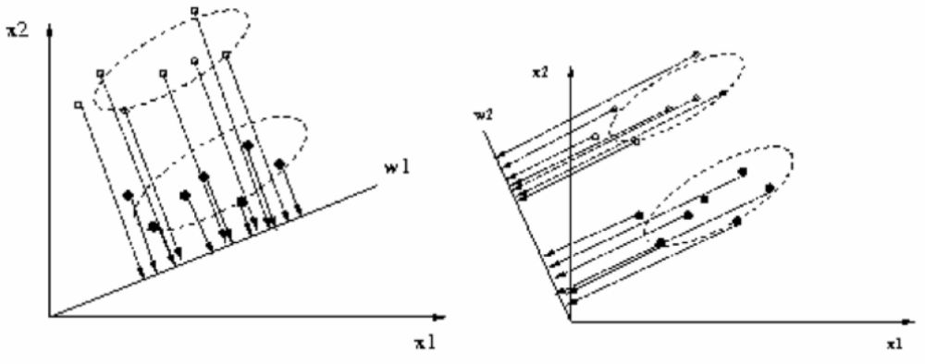
Fisher Linear Discriminant Analysis
In a two-class classification problem, given n samples in a d-dimensional feature space. n1 in class 1 and n2 in class 2.
Goal: to find a vector w, and project the n samples on the axis y=w’x, so that the projected samples are well separated.

Slide 8
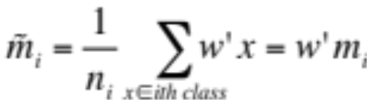
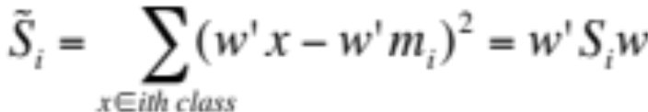
Fisher Linear Discriminant Analysis
The sample mean vector for the ith class is mi and the sample covariance matrix for the ith class is Si.
The between-class scatter matrix is:
  SB=(m1-m2)(m1-m2)’
The within-class scatter matrix is:
        Sw= S1+S2
The sample mean of the projected points in the ith class is:
The variance of the projected points in the ith class is:

Slide 9
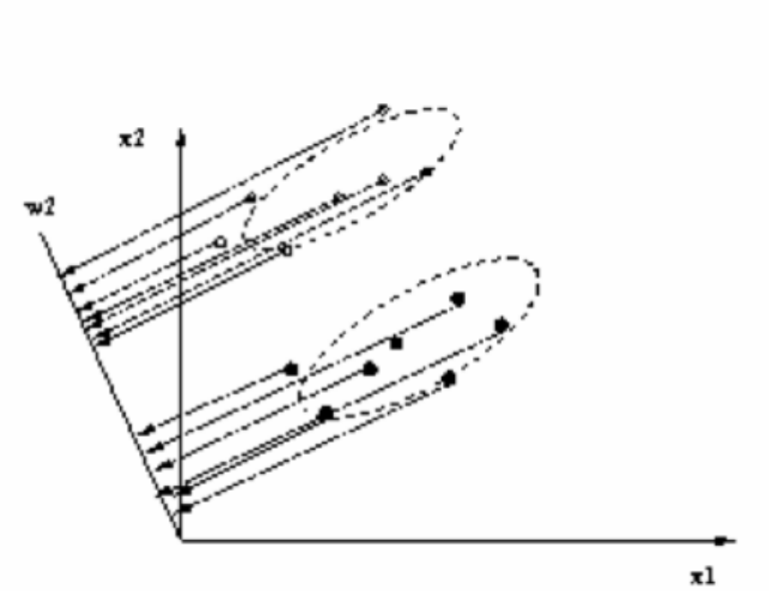

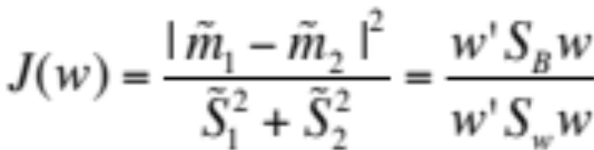

Fisher Linear Discriminant Analysis
The fisher linear discriminant analysis will choose the w, which maximize:
i.e. the between-class distance should be as large as possible, meanwhile the within-class scatter should be as small as possible.

Slide 10
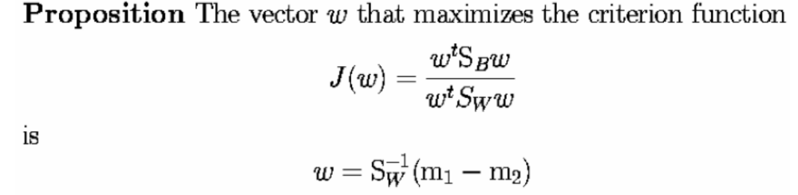
Fisher Linear Discriminant Analysis
For K=2, FLDA yields the same classifier as the Lear maximum likelihood discriminant rule.

Slide 11

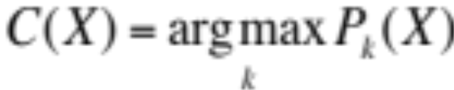
Maximum Likelihood Discriminant Rule
A maximum likelihood classifier (ML) chooses the class that makes the chance of the observations the highest
Assume the condition density for each class is
the maximum likelihood (ML) discriminant rule predicts the class of an observation X by that which gives the largest likelihood to X, i.e., by

Slide 12
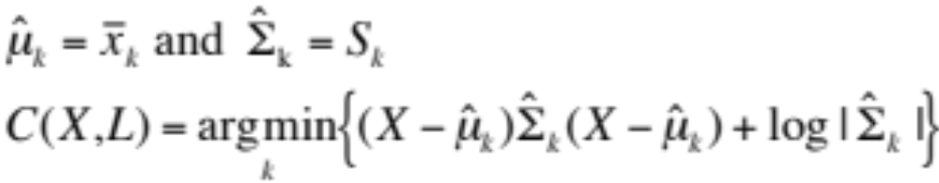
Gaussian ML Discriminant Rules
Assume the conditional densities for each class is a multivariate Gaussian (normal), P(X|Y= k) ~ N(μ_{k}, Σ_{k}),
Then ML discriminant rule is
C(X) = argmin_{k} {(X - μ_{k}) Σ_{k}⁻¹ (X - μ_{k})’ + log| Σ_{k} |}
In general, this is a quadratic rule (Quadratic discriminant analysis, or QDA in R)
In practice, population mean vectors μ_{k} and covariance matrices Σ_{k} are estimated from learning set L.

Slide 13
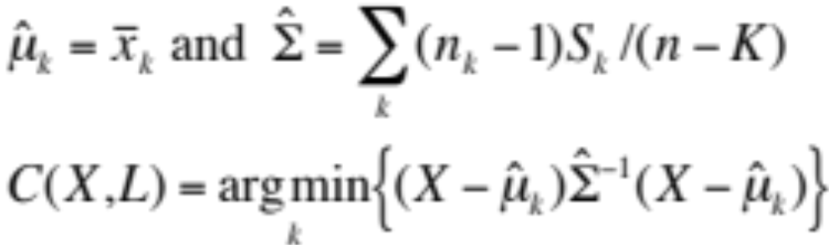
Gaussian ML Discriminant Rules
When all class densities have the same covariance matrix, Σ_{k} = Σ , the discriminant rule is linear (Linear discriminant analysis, or LDA in R; FLDA for k = 2):
C(X) = argmin_{k} (X - μ_{k}) Σ⁻¹ (X - μ_{k})’
In practice, population mean vectors μ_{k} and constant covariance matrices Σ are estimated from learning set L.

Slide 14

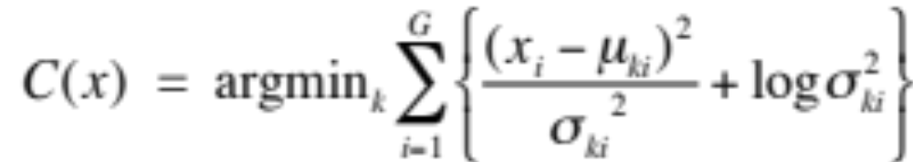
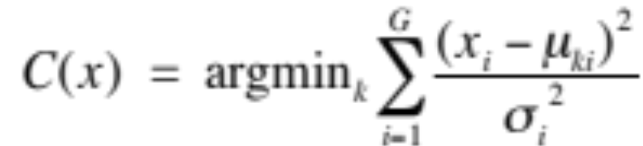
Gaussian ML Discriminant Rules
When the class densities have diagonal covariance matrices,
, the discriminant rule is given by additive quadratic contributions from each variable (Diagonal quadratic discriminant analysis, or DQDA)
When all class densities have the same diagonal covariance matrix Δ=diag(σ₁²… σ_{G}²), the discriminant rule is again linear (Diagonal linear discriminant analysis, or DLDA in R)

Slide 15
Application of ML discriminant Rule
Weighted gene voting method. (Golub et al. 1999)
  One of the first application of a ML discriminant rule to gene expression data.
  This methods turns out to be a minor variant of the sample Diagonal Linear Discriminant rule.
  Golub TR, Slonim DK, Tamayo P, Huard C, Gaasenbeek M, Mesirov JP,Coller H, Loh ML, Downing JR, Caligiuri MA, Bloomfield CD, Lander ES. (1999).Molecular classification of cancer: class discovery and class prediction bygene expression monitoring. Science. Oct 15;286(5439):531 - 537.

Slide 16
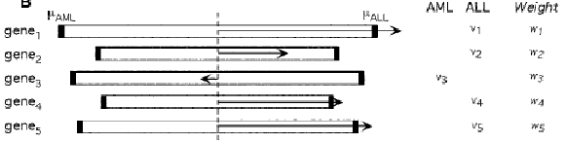
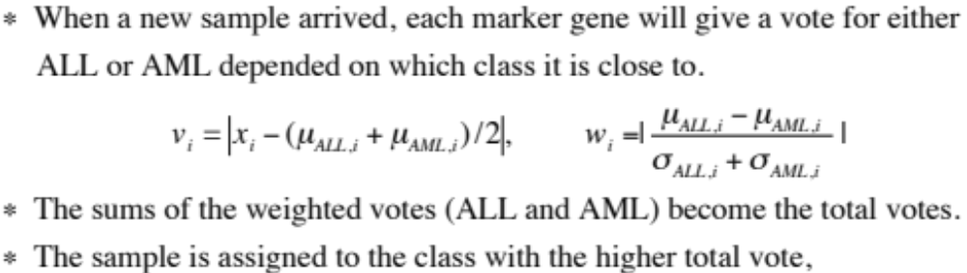
Example: Weighted gene voting method
Weighted gene voting method. (Golub et al. 1999)
Notes:
Golub et al. (1999) first introduce a ranking criterion for each gene in a two-class classification. The criterion is :

Slide 17
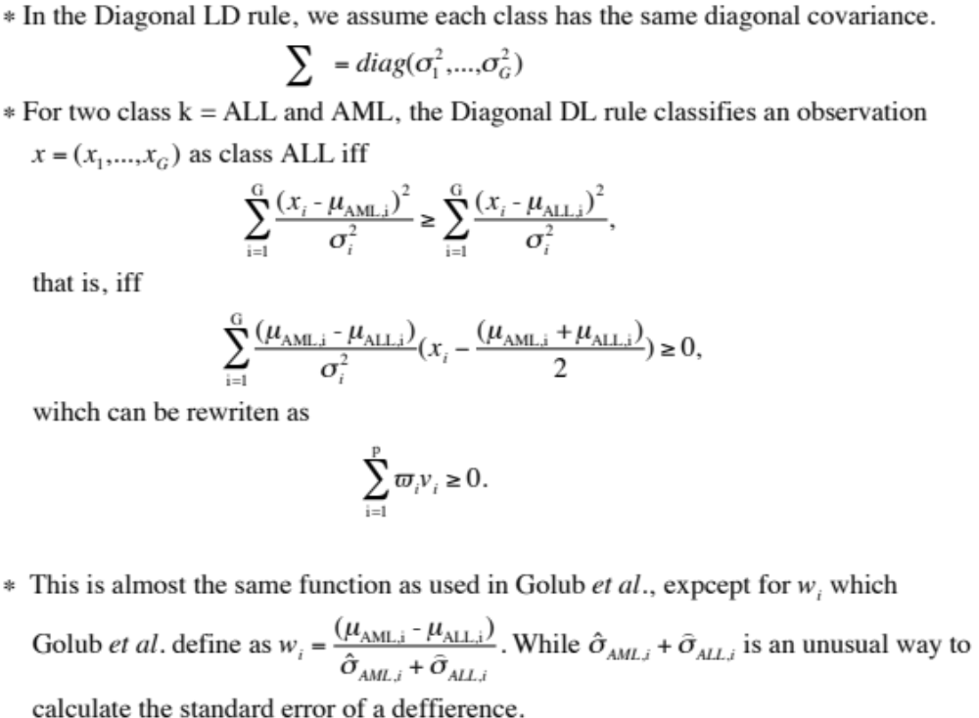
Example: Weighted Voting method vs Diagonal Linear discriminant rule

Slide 18
Nearest Neighbor Classification
Based on a measure of distance between observations (e.g. Euclidean distance or one minus correlation).
k-nearest neighbor rule (Fix and Hodges (1951)) classifies an observation X as follows:
  find the k closest observations in the training data,
  predict the class by majority vote, i.e. choose the class that is most common among those k neighbors.
  k is a parameter, the value of which will be determined by minimizing the cross-validation error later.
  E. Fix and J. Hodges. Discriminatory analysis. Nonparametric discrimination: Consistency properties. Tech. Report 4, USAF School of Aviation Medicine, Randolph Field, Texas, 1951.

Slide 19
CART: Classification Tree
BINARY RECURSIVE PARTITIONING TREE
Binary
  -- split parent node into two child nodes
Recursive
  -- each child node can be treated as parent node
Partitioning
  -- data set is partitioned into mutually exclusive subsets in each split
  -- L.Breiman, J.H. Friedman, R. Olshen, and C.J. Stone. Classification and regression trees. The Wadsworth statistics/probability series. Wadsworth International Group, 1984.
Notes:
To summarize what we just talk about. There are three key words for CART construction…….

Slide 20
Classification Trees
Binary tree structured classifiers are constructed by repeated splits of subsets (nodes) of the measurement space X into two descendant subsets (starting with X itself)
Each terminal subset is assigned a class label; the resulting partition of X corresponds to the classifier
RPART in R or TREE in R

Slide 21
Three Aspects of Tree Construction
Split Selection Rule
Split-stopping Rule
Class assignment Rule
Different tree classifiers use different approaches to deal with these three issues, e.g. CART( Classification And Regression Trees)

Slide 22
Three Rules (CART)
Splitting: At each node, choose split maximizing decrease in impurity (e.g. Gini index, entropy, misclassification error).
Split-stopping: Grow large tree, prune to obtain a sequence of subtrees, then use cross-validation to identify the subtree with lowest misclassification rate.
Class assignment: For each terminal node, choose the class with the majority vote.

Slide 23
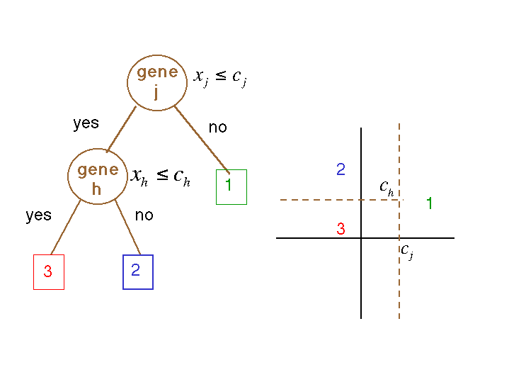
CART

Slide 24
Comparison
Iris Data
  Y: 3 species,
    Iris setosa (red), versicolor (green), and virginica (blue).
  X: 4 variables
    Sepal length and width
    Petal length and width (ignored!)

Slide 25
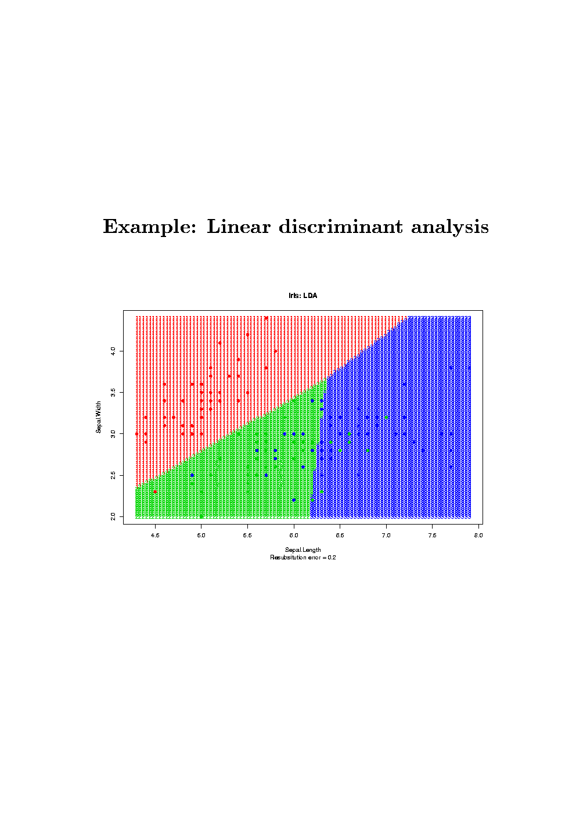

Slide 26
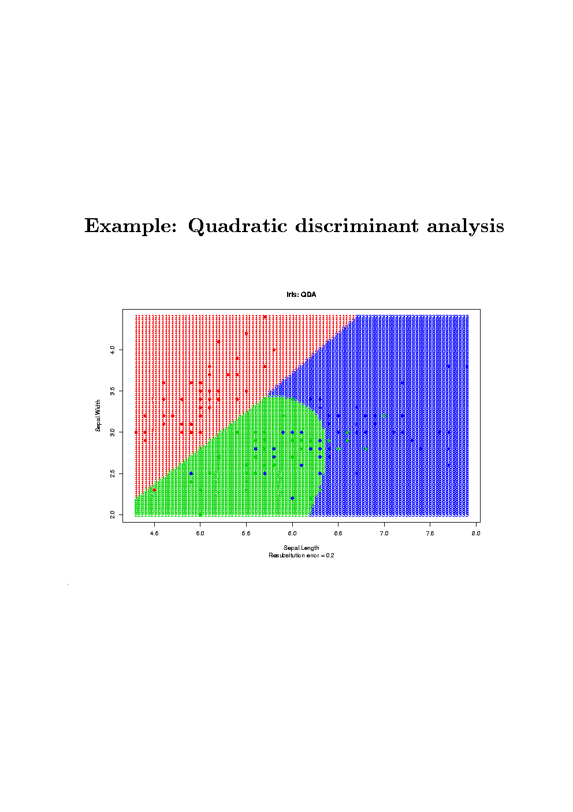

Slide 27
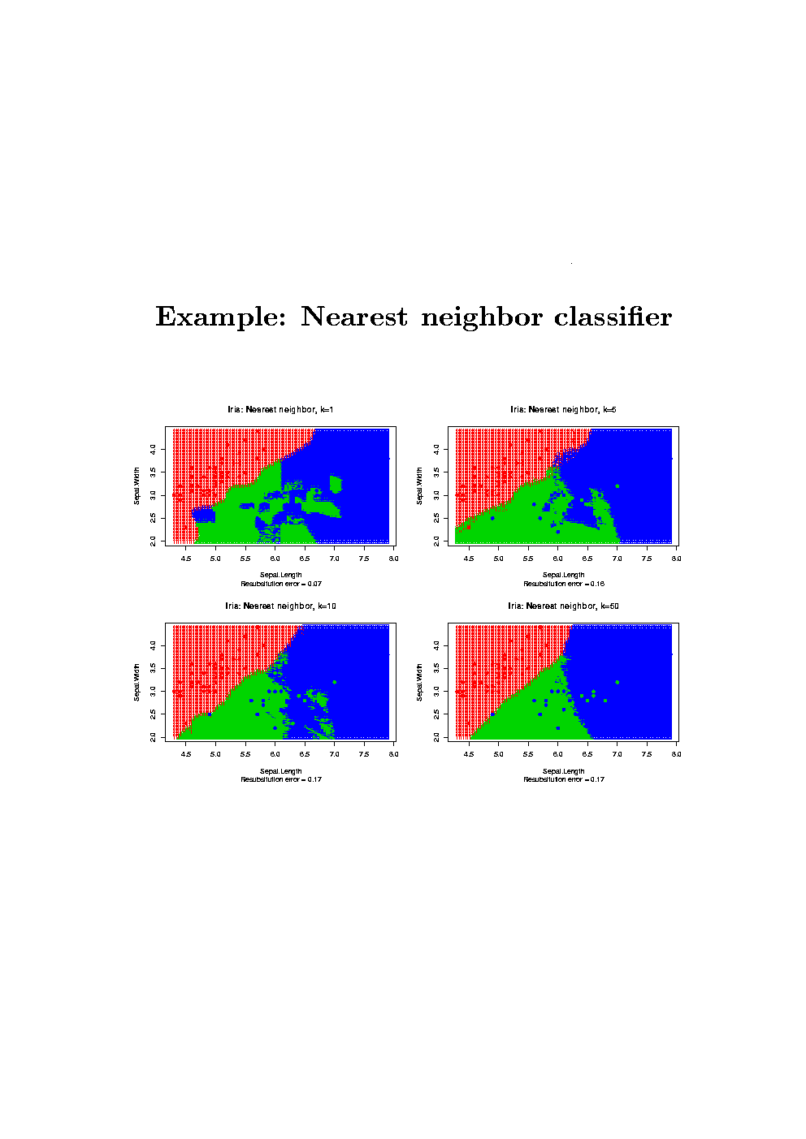

Slide 28
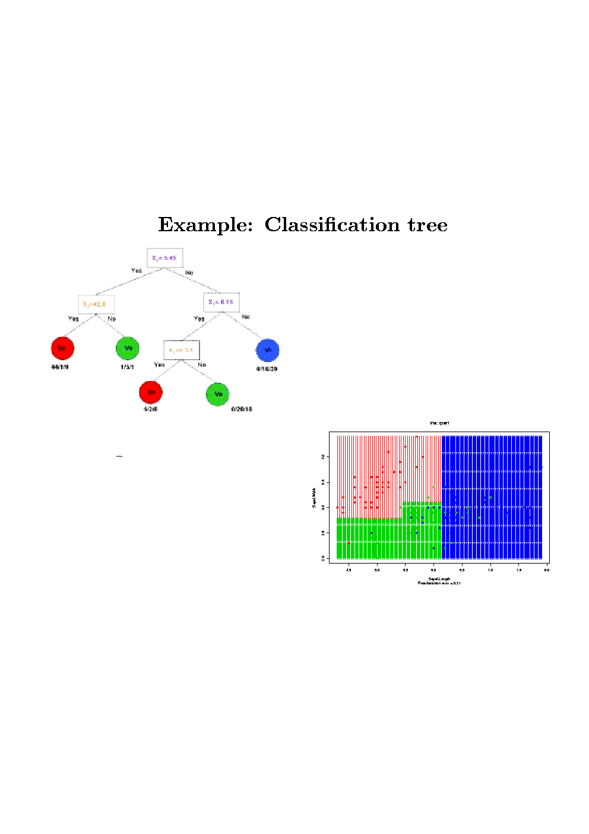

Slide 29
Other Classifiers Include…
Support vector machines (SVMs)
Neural networks
HUNDREDS more…
The Best Reference: Google

Slide 30
Aggregating classifiers
Breiman (1996, 1998) found that gains in accuracy could be obtained by aggregating predictors built from perturbed versions of the learning set; the multiple versions of the predictor are aggregated by weighted voting.
Let C(., L_{b}) denote the classifier built from the b-th perturbed learning set L_{b}, and let w_{b} denote the weight given to predictions made by this classifier. The predicted class for an observation x is given by
argmax_{k} ∑_{b} w_{b}I(C(x,L_{b}) = k)
-- L. Breiman. Bagging predictors. Machine Learning, 24:123-140, 1996.
-- L. Breiman. Out-of-bag eatimation. Technical report, Statistics Department, U.C. Berkeley, 1996.
-- L. Breiman. Arcing classifiers. Annals of Statistics, 26:801-824, 1998.

Slide 31
Aggregating Classifiers
The key to improved accuracy is the possible instability of the prediction method, i.e., whether small changes in the learning set result in large changes in the predictor.
Unstable predictors tend to benefit the most from aggregation.
  Classification trees (e.g.CART) tend to be unstable.
  Nearest neighbor classifier tend to be stable.

Slide 32
Bagging & Boosting
Two main methods for generating perturbed versions of the learning set.
  Bagging.
    -- L. Breiman. Bagging predictors. Machine Learning, 24:123-140, 1996.
  Boosting.
    -- Y.Freund and R.E.Schapire. A decision-theoretic generalization of on-line learning and an application to boosting. Journal of computer and system sciences, 55:119-139, 1997.

Slide 33
Bagging= Bootstrap aggregating
I. Nonparametric Bootstrap (BAG)
Nonparametric Bootstrap (standard bagging).
  perturbed learning sets of the same size as the original learning set are formed by randomly selecting samples with replacement from the learning sets;
Predictors are built for each perturbed dataset and aggregated by plurality voting plurality voting (w_{b}=1), i.e., the “winning” class is the one being predicted by the largest number of predictors.

Slide 34
Bagging= Bootstrap aggregating
II. Parametric Bootstrap (MVN)
Parametric Bootstrap.
  Perturbed learning sets are generated according to a mixture of multivariate normal (MVN) distributions.
  The conditional densities for each class is a multivariate Gaussian (normal), i.e., P(X|Y= k) ~ N(μ_{k}, Σ_{k}), the sample mean vector and sample covariance matrix will be used to estimate the population mean vector and covariance matrix.
  The class mixing probabilities are taken to be the class proportions in the actual learning set.
  At least one observation be sampled from each class.
Predictors are built for each perturbed dataset and aggregated by plurality voting plurality voting (w_{b}=1).

Slide 35
Bagging= Bootstrap aggregating
III. Convex pseudo-data (CPD)
Convex pseudo-data. One perturbed learning set are generated by repeating the following n times:
  Select two samples (x,y) and (x’, y’) at random form the learning set L.
  Select at random a number of v from the interval [0,d], 0<=d<=1, and let u=1-v.
  The new sample is (x’’, y’’) where y’’=y and x’’=ux+vx’
  Note that when d=0, CPD reduces to standard bagging.
Predictors are built for each perturbed dataset and aggregated by plurality voting plurality voting (w_{b}=1).

Slide 36
Boosting
The perturbed learning sets are re-sampled adaptively so that the weights in the re-sampling are increased for those cases most often misclassified.
The aggregation of predictors is done by weighted voting (w_{b} != 1).

Slide 37
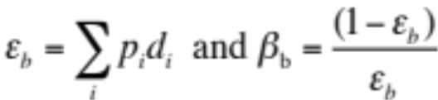
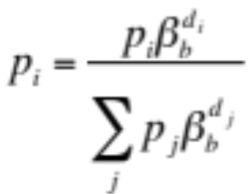

Boosting
Learning set: L = (X₁, Y₁), ..., (X_{n},Y_{n})
Re-sampling probabilities p={p₁,…, p_{n}}, initialized to be equal.
The bth step of the boosting algorithm is:
  Using the current re-sampling prob p, sample with replacement from L to get a perturbed learning set L_{b.}
  Build a classifier C(., L_{b}) based on L_{b.}
  Run the learning set L through the classifier C(., L_{b}) and let d_{i}=1 if the ith case is classified incorrectly and let d_{i}=0 otherwise.
  Define
  and update the re-sampling prob for the (b+1)st step by
The weight for each classifier is

Slide 38
Comparison of classifiers
Dudoit, Fridlyand, Speed (JASA, 2002)
FLDA (Fisher Linear Discriminant Analysis)
DLDA (Diagonal Linear Discriminant Analysis)
DQDA (Diagonal Quantic Discriminant Analysis)
NN (Nearest Neighbour)
CART (Classification and Regression Tree)
Bagging and boosting
  Bagging (Non-parametric Bootstrap )
  CPD (Convex Pseudo Data)
  MVN (Parametric Bootstrap)
  Boosting
  -- Dudoit, Fridlyand, Speed: “Comparison of discrimination methods for the classification of tumors using gene expression data”, JASA, 2002

Slide 39
Comparison study datasets
Leukemia – Golub et al. (1999)
  n = 72 samples, G = 3,571 genes
  3 classes (B-cell ALL, T-cell ALL, AML)
Lymphoma – Alizadeh et al. (2000)
  n = 81 samples, G = 4,682 genes
  3 classes (B-CLL, FL, DLBCL)
NCI 60 – Ross et al. (2000)
  N = 64 samples, p = 5,244 genes
  8 classes

Slide 40
Procedure
For each run (total 150 runs):
  2/3 of sample randomly selected as learning set (LS), rest 1/3 as testing set (TS).
  The top p genes with the largest BSS/WSS are selected using the learning set.
    p=50 for lymphoma dataset.
    p=40 for leukemia dataset.
    p=30 for NCI 60 dataset.
  Predictors are constructed and error rated are obtained by applying the predictors to the testing set.

Slide 41
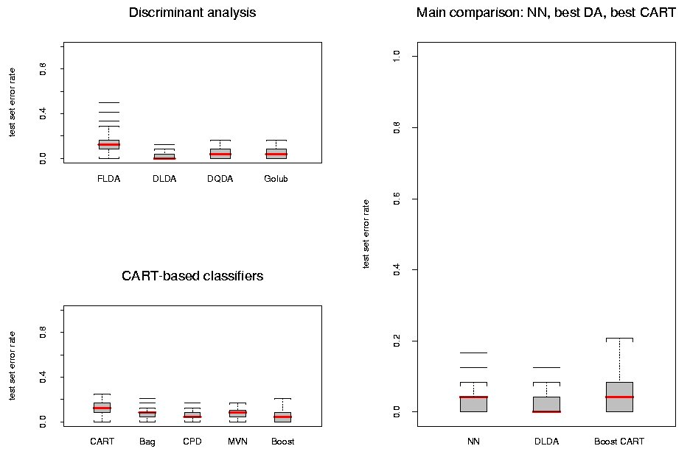
Leukemia data, 2 classes: Test set error rates;150 LS/TS runs

Slide 42
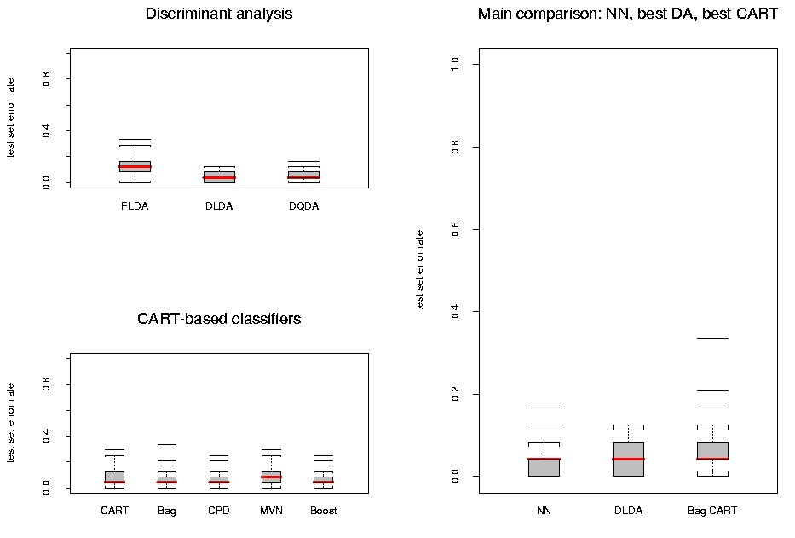
Leukemia data, 3 classes: Test set error rates;150 LS/TS runs

Slide 43
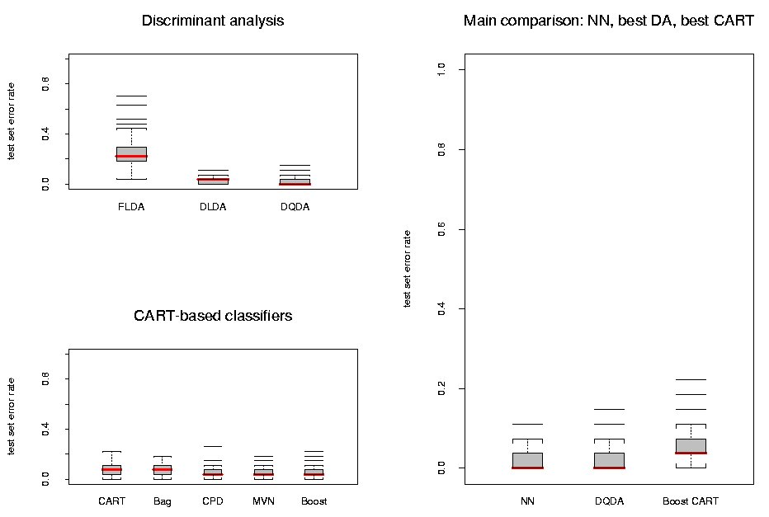
Lymphoma data, 3 classes: Test set error rates; N=150 LS/TS runs

Slide 44
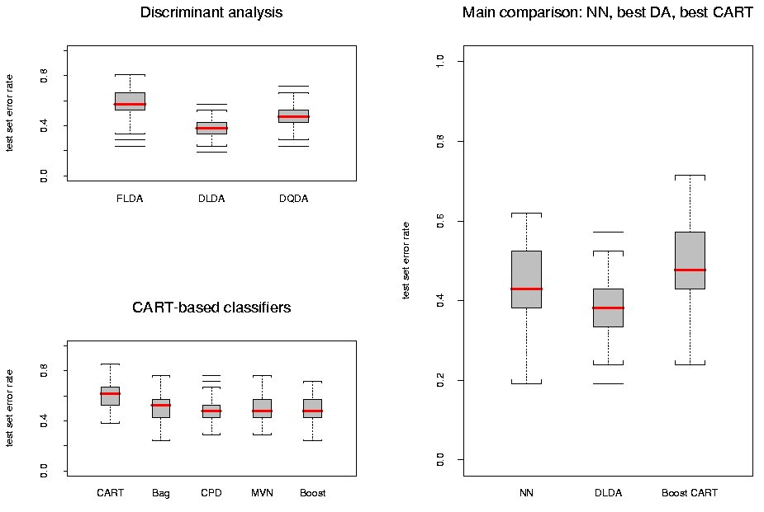
NCI 60 data :Test set error rates;150 LS/TS runs

Slide 45
Results
In the main comparison of Dudoit et al, NN and DLDA had the smallest error rates, FLDA had the highest
For the lymphoma and leukemia datasets, increasing the number of genes to G=200 didn't greatly affect the performance of the various classifiers; there was an improvement for the NCI 60 dataset.
More careful selection of a small number of genes (10) improved the performance of FLDA dramatically

Slide 46
Comparison study – Discussion (I)
“Diagonal” LDA: ignoring correlation between genes helped here. Unlike classification trees and nearest neighbors, LDA is unable to take into account gene interactions
Although nearest neighbors are simple and intuitive classifiers, their main limitation is that they give very little insight into mechanisms underlying the class distinctions

Slide 47
Comparison study – Discussion (II)
Variable selection: A crude criterion such as BSS/WSS may not identify the genes that discriminate between all the classes and may not reveal interactions between genes
With larger training sets, expect improvement in performance of aggregated classifiers

Slide 48
Acknowledgements
Some of slides adapted form http://statwww.epfl.ch/davison/teaching/Microarrays/ by Darlene Goldstein
Thank you!

