Slide 1
Business Intelligence and Decision Support Systems
(9th Ed., Prentice Hall)
Chapter 6:
Artificial Neural Networks for Data Mining

Slide 2
Learning Objectives
Understand the concept and definitions of artificial neural networks (ANN)
Know the similarities and differences between biological and artificial neural networks
Learn the different types of neural network architectures
Learn the advantages and limitations of ANN
Understand how backpropagation learning works in feedforward neural networks

Slide 3
Learning Objectives
Understand the step-by-step process of how to use neural networks
Appreciate the wide variety of applications of neural networks; solving problem types of
  Classification
  Regression
  Clustering
  Association
  Optimization

Slide 4
Opening Vignette:
“Predicting Gambling Referenda with Neural Networks”
Decision situation
Proposed solution
Results
Answer and discuss the case questions

Slide 5
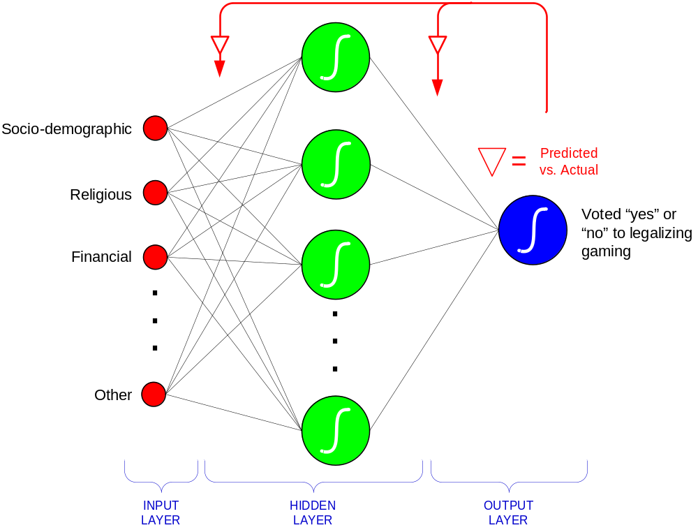
Opening Vignette:
Predicting Gambling Referenda…

Slide 6
Neural Network Concepts
Neural networks (NN): a brain metaphor for information processing
Neural computing
Artificial neural network (ANN)
Many uses for ANN for
  pattern recognition, forecasting, prediction, and classification
Many application areas
  finance, marketing, manufacturing, operations, information systems, and so on

Slide 7
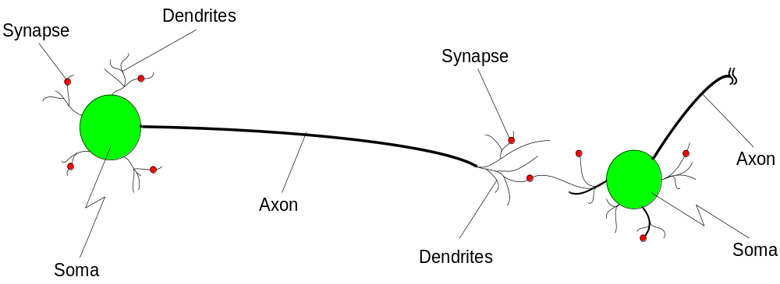
Biological Neural Networks
Two interconnected brain cells (neurons)

Slide 8
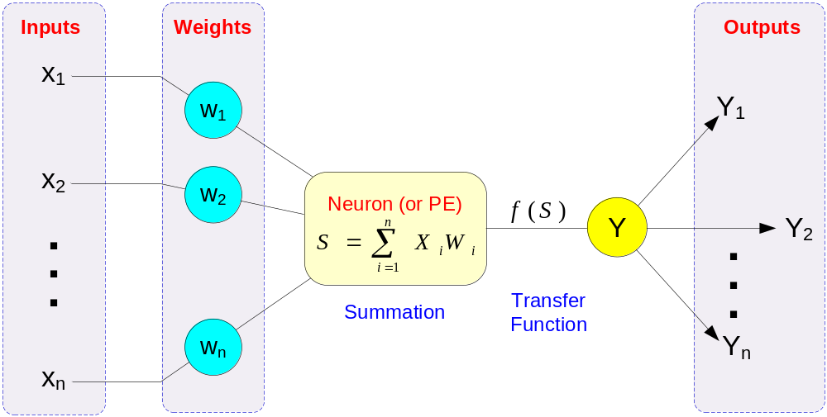
Processing Information in ANN
A single neuron (processing element – PE) with inputs and outputs

Slide 9
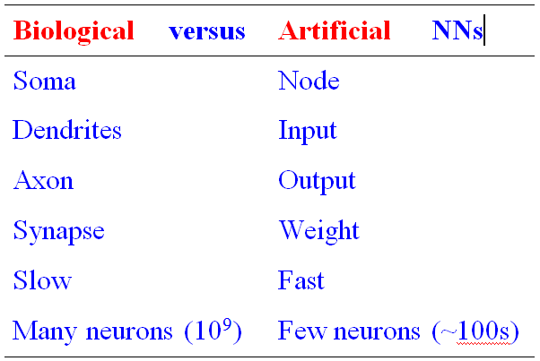
Biology Analogy

Slide 10
Elements of ANN
Processing element (PE)
Network architecture
  Hidden layers
  Parallel processing
Network information processing
  Inputs
  Outputs
  Connection weights
  Summation function

Slide 11
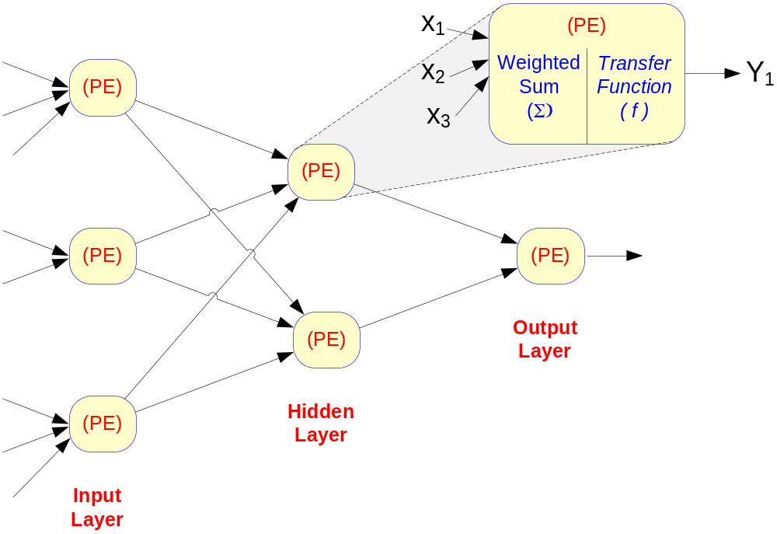
Elements of ANN
Neural Network with One Hidden Layer

Slide 12
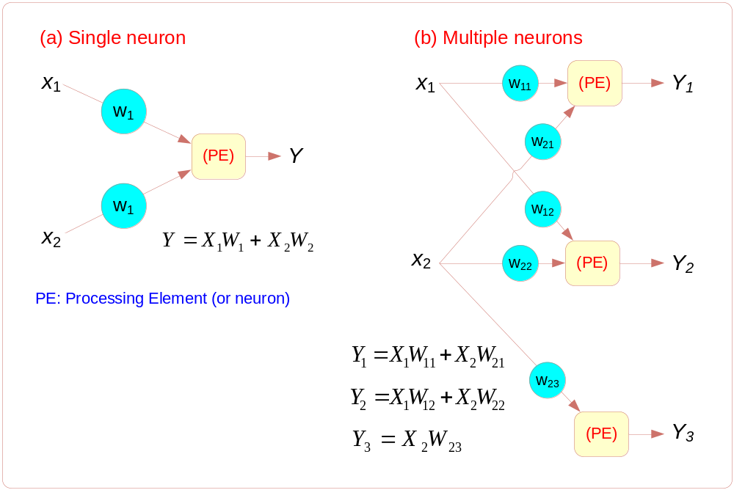
Elements of ANN
Summation Function for a Single Neuron (a) and Several Neurons (b)

Slide 13
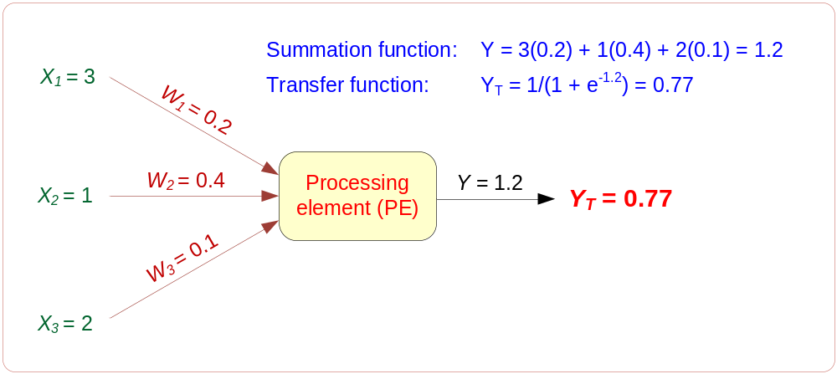
Elements of ANN
Transformation (Transfer) Function
  Linear function
  Sigmoid (logical activation) function [0 1]
  Tangent Hyperbolic function [-1 1]
Threshold value?

Slide 14
Neural Network Architectures
Several ANN architectures exist
  Feedforward
  Recurrent
  Associative memory
  Probabilistic
  Self-organizing feature maps
  Hopfield networks
  … many more …

Slide 15
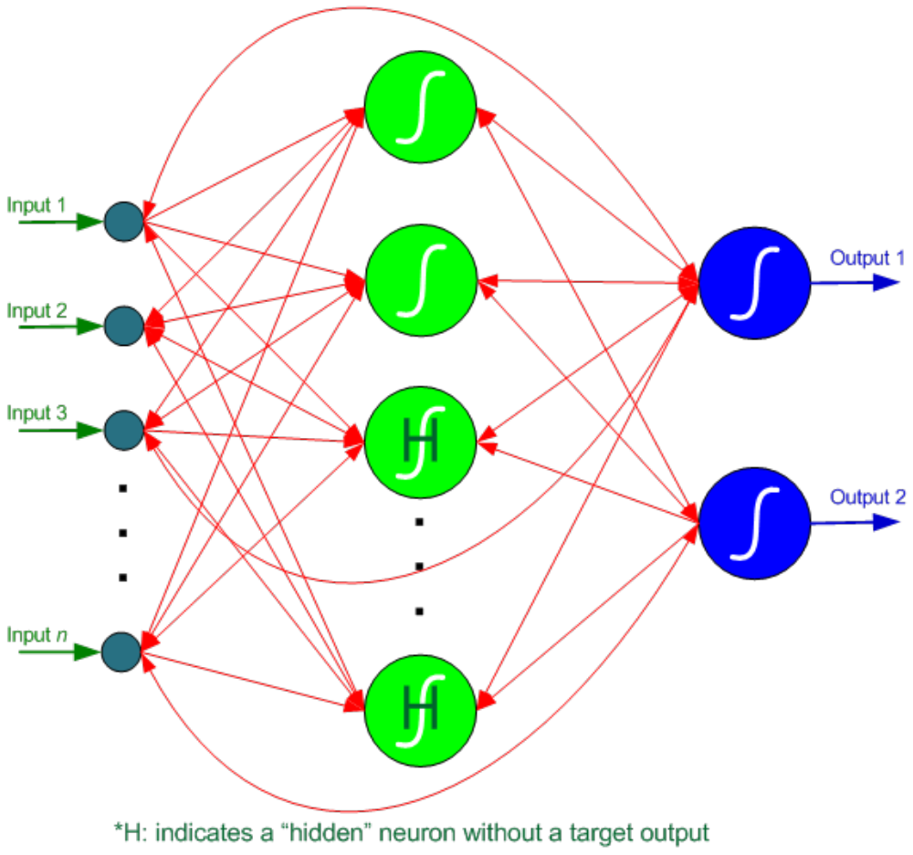
Neural Network Architectures
Recurrent Neural Networks

Slide 16
Neural Network Architectures
Architecture of a neural network is driven by the task it is intended to address
  Classification, regression, clustering, general optimization, association, ….
Most popular architecture: Feedforward, multi-layered perceptron with backpropagation learning algorithm
  Used for both classification and regression type problems

Slide 17
Learning in ANN
A process by which a neural network learns the underlying relationship between input and outputs, or just among the inputs
Supervised learning
  For prediction type problems
  E.g., backpropagation
Unsupervised learning
  For clustering type problems
  Self-organizing
  E.g., adaptive resonance theory

Slide 18
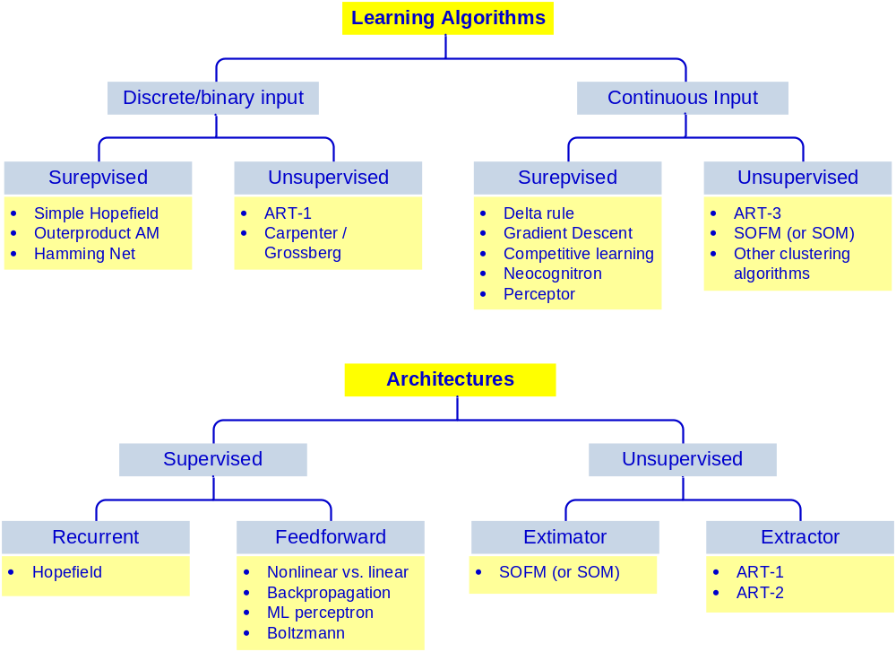
A Taxonomy of ANN Learning Algorithms

Slide 19
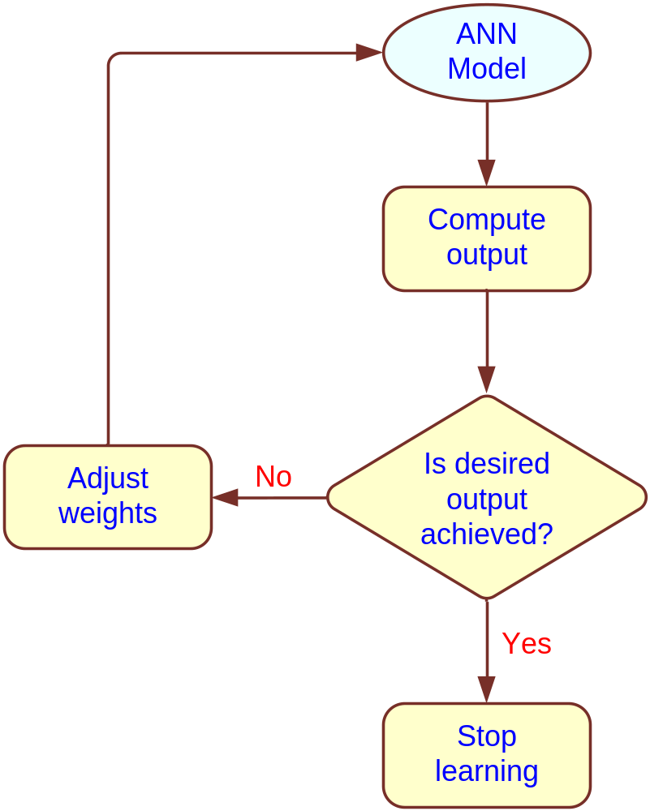
A Supervised Learning Process
Three-step process:
1. Compute temporary outputs
2. Compare outputs with desired targets
3. Adjust the weights and repeat the process

Slide 20
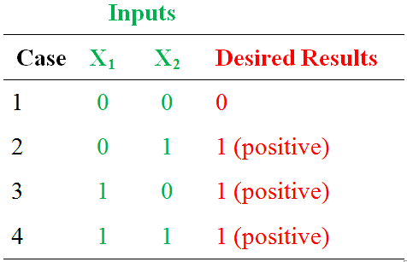
How a Network Learns
Example: single neuron that learns the inclusive OR operation
Learning parameters:
Learning rate
Momentum
* See your book for step-by-step progression of the learning process

Slide 21
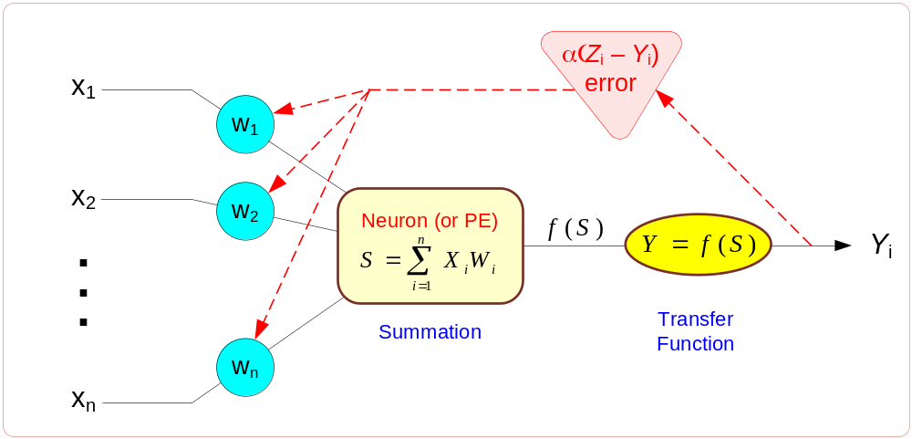
Backpropagation Learning
Backpropagation of Error for a Single Neuron

Slide 22
Backpropagation Learning
The learning algorithm procedure:
  Initialize weights with random values and set other network parameters
  Read in the inputs and the desired outputs
  Compute the actual output (by working forward through the layers)
  Compute the error (difference between the actual and desired output)
  Change the weights by working backward through the hidden layers
  Repeat steps 2-5 until weights stabilize

Slide 23
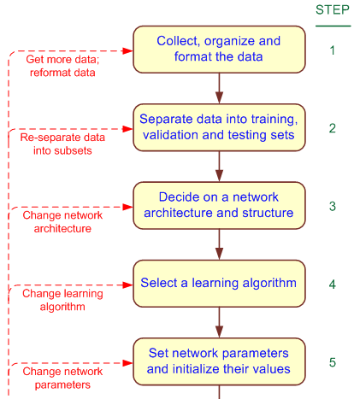
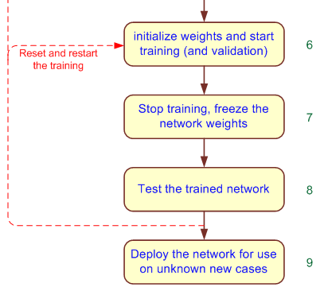
Development Process of an ANN

Slide 24
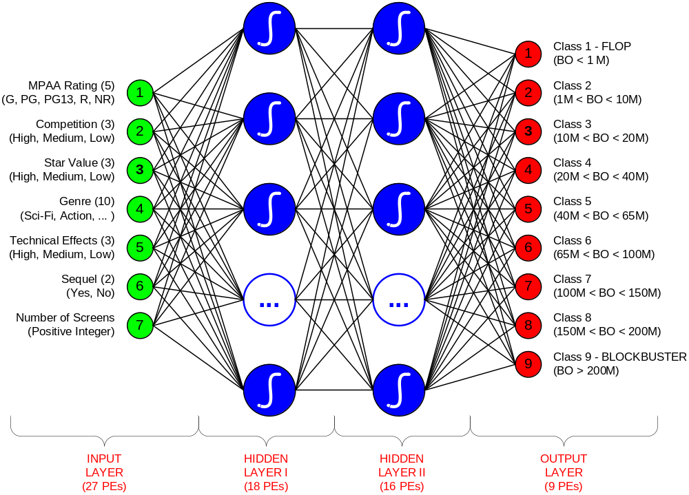
An MLP ANN Structure for the Box-Office Prediction Problem

Slide 25
Testing a Trained ANN Model
Data is split into three parts
  Training (~60%)
  Validation (~20%)
  Testing (~20%)
k-fold cross validation
  Less bias
  Time consuming

Slide 26
Sensitivity Analysis on ANN Models
A common criticism for ANN: The lack of expandability
The black-box syndrome!
Answer: sensitivity analysis
  Conducted on a trained ANN
  The inputs are perturbed while the relative change on the output is measured/recorded
  Results illustrates the relative importance of input variables

Slide 27
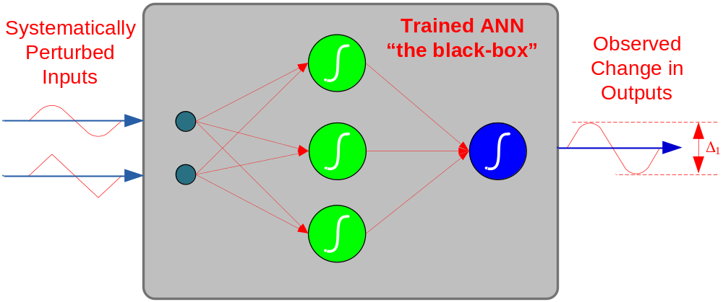
Sensitivity Analysis on ANN Models
For a good example, see Application Case 6.5
  Sensitivity analysis reveals the most important injury severity factors in traffic accidents

Slide 28
A Sample Neural Network Project
Bankruptcy Prediction
A comparative analysis of ANN versus logistic regression (a statistical method)
Inputs
  X1: Working capital/total assets
  X2: Retained earnings/total assets
  X3: Earnings before interest and taxes/total assets
  X4: Market value of equity/total debt
  X5: Sales/total assets

Slide 29
A Sample Neural Network Project
Bankruptcy Prediction
Data was obtained from Moody's Industrial Manuals
  Time period: 1975 to 1982
  129 firms (65 of which went bankrupt during the period and 64 nonbankrupt)
Different training and testing propositions are used/compared
  90/10 versus 80/20 versus 50/50
  Resampling is used to create 60 data sets

Slide 30
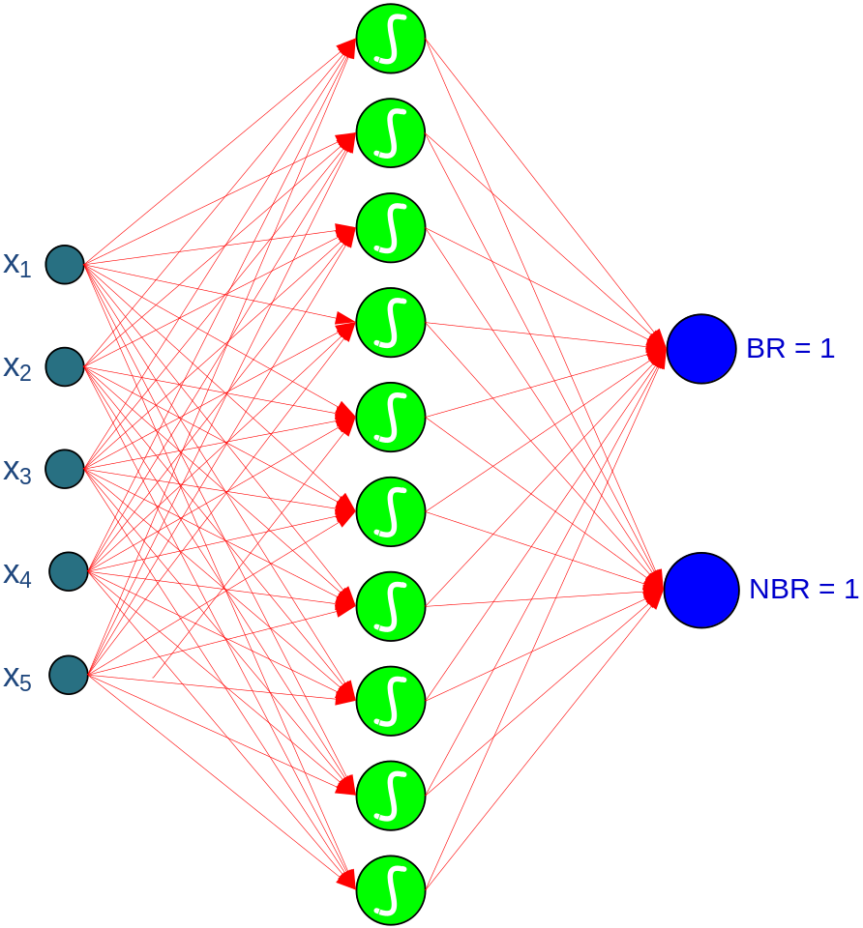
A Sample Neural Network Project
Bankruptcy Prediction
Network Specifics
Feedforward MLP
Backpropagation
Varying learning and momentum values
5 input neurons (1 for each financial ratio),
10 hidden neurons,
2 output neurons (1 indicating a bankrupt firm and the other indicating a nonbankrupt firm)

Slide 31
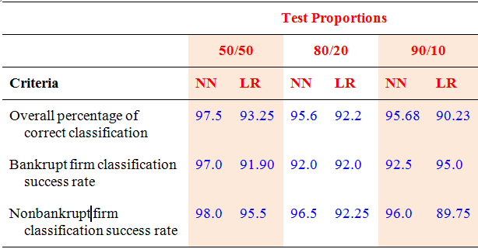
A Sample Neural Network Project
Bankruptcy Prediction - Results

Slide 32
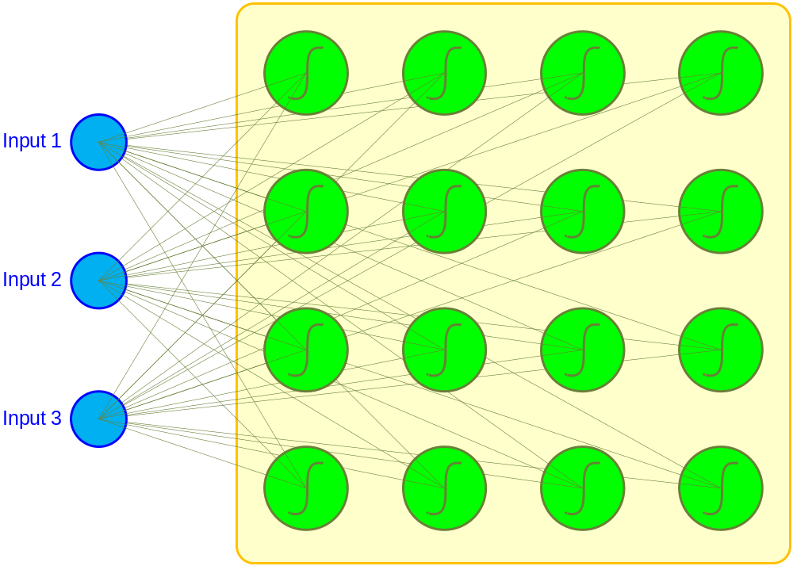
Other Popular ANN Paradigms
Self Organizing Maps (SOM)
First introduced by the Finnish Professor Teuvo Kohonen
Applies to clustering type problems

Slide 33
Other Popular ANN Paradigms
Self Organizing Maps (SOM)
SOM Algorithm –
  Initialize each node's weights
  Present a randomly selected input vector to the lattice
  Determine most resembling (winning) node
  Determine the neighboring nodes
  Adjusted the winning and neighboring nodes (make them more like the input vector)
  Repeat steps 2-5 for until a stopping criteria is reached

Slide 34
Other Popular ANN Paradigms
Self Organizing Maps (SOM)
Applications of SOM
  Customer segmentation
  Bibliographic classification
  Image-browsing systems
  Medical diagnosis
  Interpretation of seismic activity
  Speech recognition
  Data compression
  Environmental modeling, many more …

Slide 35
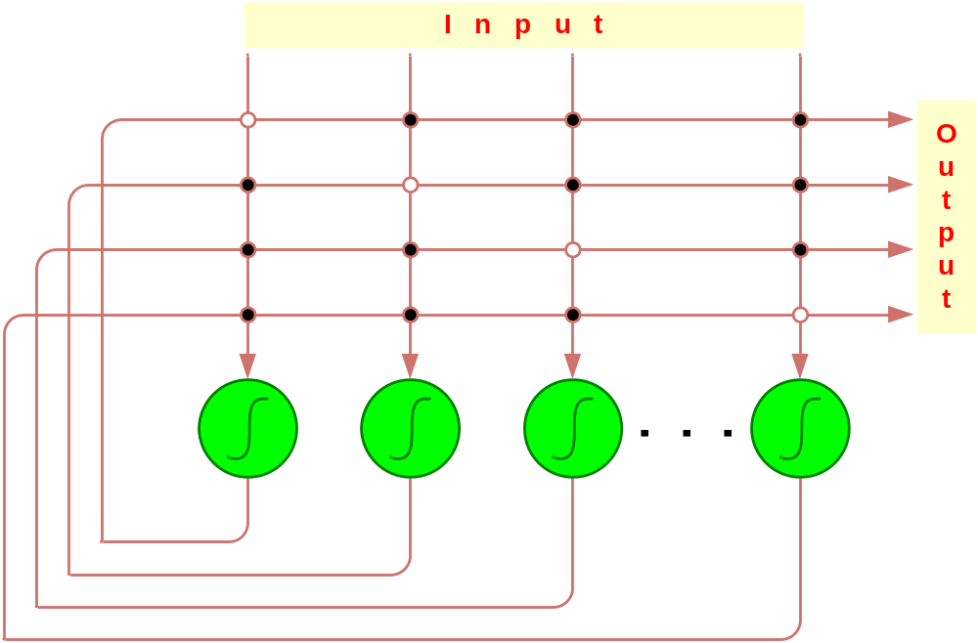
Other Popular ANN Paradigms
Hopfield Networks
First introduced by John Hopfield
Highly interconnected neurons
Applies to solving complex computational problems (e.g., optimization problems)

Slide 36
Applications Types of ANN
Classification
  Feedforward networks (MLP), radial basis function, and probabilistic NN
Regression
  Feedforward networks (MLP), radial basis function
Clustering
  Adaptive Resonance Theory (ART) and SOM
Association
  Hopfield networks
Provide examples for each type?

Slide 37
Advantages of ANN
Able to deal with (identify/model) highly nonlinear relationships
Not prone to restricting normality and/or independence assumptions
Can handle variety of problem types
Usually provides better results (prediction and/or clustering) compared to its statistical counterparts
Handles both numerical and categorical variables (transformation needed!)

Slide 38
Disadvantages of ANN
They are deemed to be black-box solutions, lacking expandability
It is hard to find optimal values for large number of network parameters
  Optimal design is still an art: requires expertise and extensive experimentation
It is hard to handle large number of variables (especially the rich nominal attributes)
Training may take a long time for large datasets; which may require case sampling

Slide 39
ANN Software
Standalone ANN software tool
  NeuroSolutions
  BrainMaker
  NeuralWare
  NeuroShell, … for more (see pcai.com) …
Part of a data mining software suit
  PASW (formerly SPSS Clementine)
  SAS Enterprise Miner
  Statistica Data Miner, … many more …

Slide 40
End of the Chapter
Questions / comments…

Slide 41

All rights reserved. No part of this publication may be reproduced, stored in a retrieval system, or transmitted, in any form or by any means, electronic, mechanical, photocopying, recording, or otherwise, without the prior written permission of the publisher. Printed in the United States of America.
Copyright © 2011 Pearson Education, Inc.
Publishing as Prentice Hall

