Slide 1
Efficient Algorithm for Finding all Minimal Path Vectors in Two-terminal Flow Network
Marija Mihova, Faculty of computer sciences and engineering, Ss. Cyril and Methodious, Skopje

Slide 2
Introduction
A two-terminal flow network is usually defined as a directed graph G(V, E) with capacity function c: E → R, but, there are many flow problems that can be modeled by undirected graphs.
One of the most important problems in multi-state network reliability is the problem of searching for all d-MCs or d-MPs.
Several algorithms have been proposed as a solution to this problem, but all of them deal with oriented networks – this approach works for undirected networks as well
Precise theoretical relationship between d-MPs and flow.
Efficient approach to check whether some vector is a d-MP
Algorithms that compute the set of all d-MPs for directed and undirected networks

Slide 3
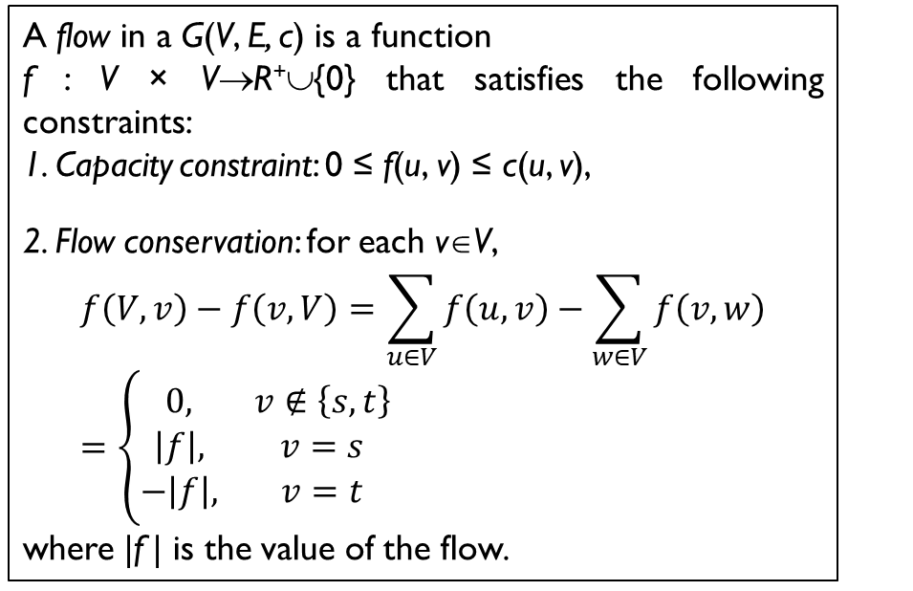
Flow Function
A flow in a G(V, E, c) is a function
f : V × V→R⁺∪{0} that satisfies the following constraints:
1. Capacity constraint: 0 ≤ f(u, v) ≤ c(u, v),
2. Flow conservation: for each v∈V,
$$f\left(V, v\right)−f\left(v, V\right)=\sum_{u∈V}{f\left(u,v\right)}−\sum_{w∈V}{f\left(v,w\right)}=\left\{\begin{matrix}0, & v∉\left\{s, t\right\} \\ \left|f\right|, & v=s \\ −\left|f\right|, & v=t\end{matrix}\right.$$
where |f | is the value of the flow.
2
c
1
3
3
3
4
а
4
b
e
4
f
2
g
2
h
4
t
s
2
1
1
3
3
4
1
d
i
Flow out of s
Flow to t
c
1
3
3
4
а
4
b
e
4
f
2
g
2
h
4
t
s
1
1
4
1
d
3
i
A pseudoflow is a function f: E →R⁺∪{0}defined on arcs that satisfies only the capacity constraints;
In flow = out flow
Notes:
The interesting feature of such graphs is that for any inner node the in flow is equal to the out flow. <>
The best representation is ordering the nodes in a straight line, such that to minimize the total weight of all feedback arcs.

Slide 4
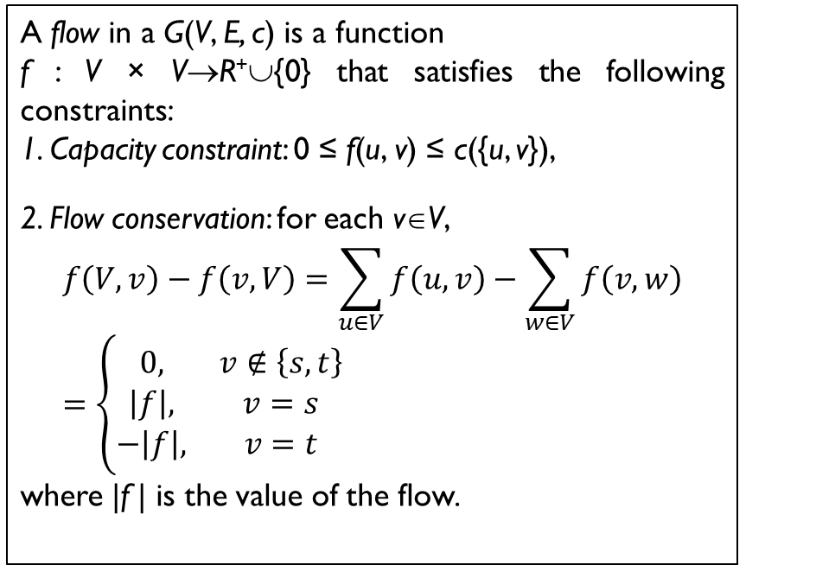
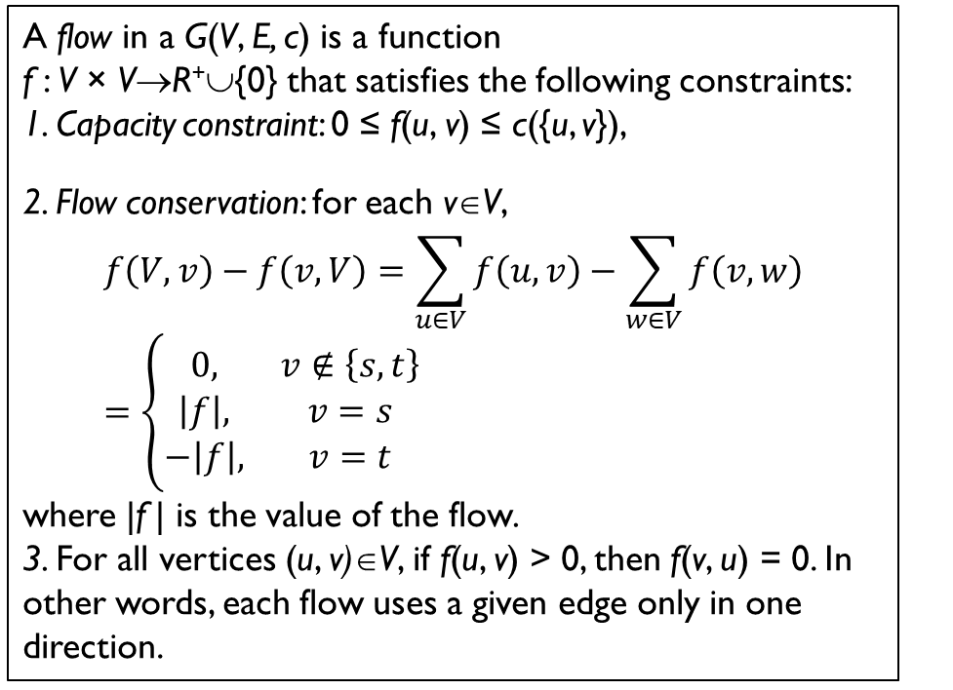
Flow function for undirected network
Directed
Undirected
A flow in a G(V, E, c) is a function
f : V × V→R⁺∪{0} that satisfies the following constraints:
1. Capacity constraint: 0 ≤ f(u, v) ≤ c({u, v}),
2. Flow conservation: for each v∈V,
$$f\left(V, v\right)−f\left(v, V\right)=\sum_{u∈V}{f\left(u,v\right)}−\sum_{w∈V}{f\left(v,w\right)}=\left\{\begin{matrix}0, & v∉\left\{s, t\right\} \\ \left|f\right|, & v=s \\ −\left|f\right|, & v=t\end{matrix}\right.$$
where |f | is the value of the flow.
A flow in a G(V, E, c) is a function
f : V × V→R⁺∪{0} that satisfies the following constraints:
1. Capacity constraint: 0 ≤ f(u, v) ≤ c({u, v}),
2. Flow conservation: for each v∈V,
$$f\left(V, v\right)−f\left(v, V\right)=\sum_{u∈V}{f\left(u,v\right)}−\sum_{w∈V}{f\left(v,w\right)}=\left\{\begin{matrix}0, & v∉\left\{s, t\right\} \\ \left|f\right|, & v=s \\ −\left|f\right|, & v=t\end{matrix}\right.$$
where |f | is the value of the flow.
3. For all vertices (u, v)∈V, if f(u, v) > 0, then f(v, u) = 0. In other words, each flow uses a given edge only in one direction.
Notes:
Opposite -спротивни

Slide 5
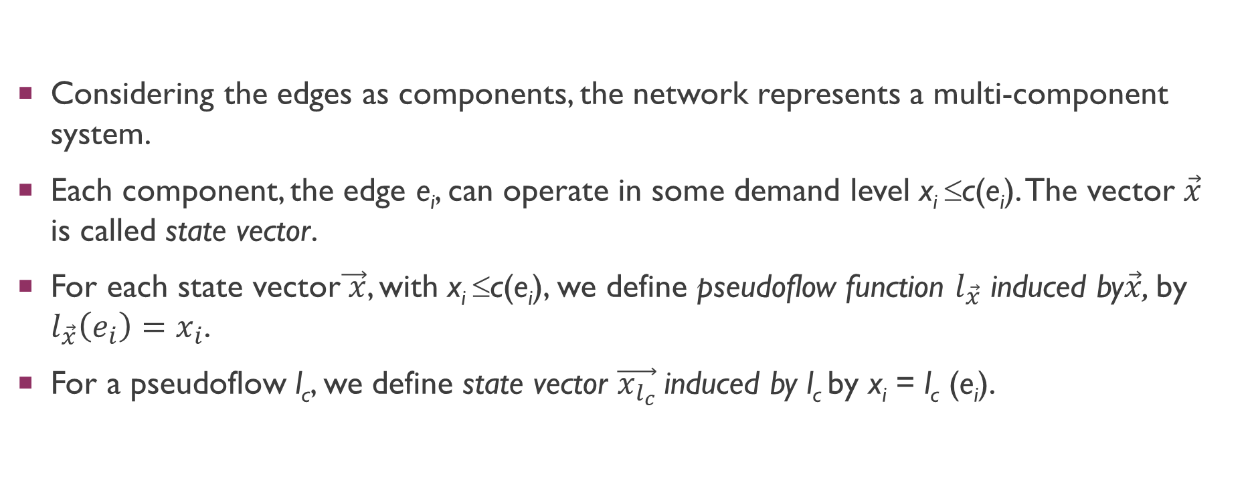
Network as a multi-state system
Considering the edges as components, the network represents a multi-component system.
Each component, the edge e_{i}, can operate in some demand level x_{i} ≤c(e_{i}). The vector $\vec{x}$ is called state vector.
For each state vector$\vec{ x}$, with x_{i} ≤c(e_{i}), we define pseudoflow function $l_{\vec{x}}$ induced by$\vec{x}$, by $l_{\vec{x}}\left(e_{i}\right)=x_{i}$.
For a pseudoflow l_{c}, we define state vector $\vec{x_{l_{c}}}$induced by l_{c} by x_{i} = l_{c} (e_{i}).

Slide 6
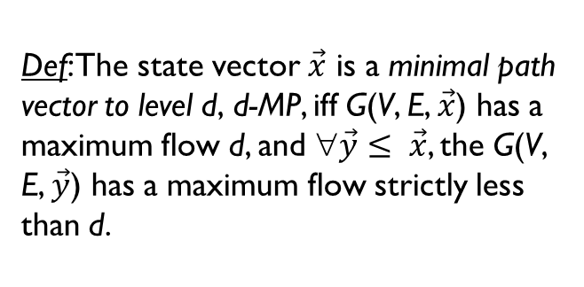
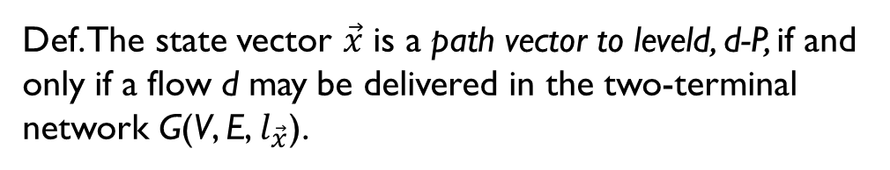
Minimal path vector
Def. The state vector $\vec{x}$ is a path vector to leveld, d-P, if and only if a flow d may be delivered in the two-terminal network G(V, E, $l_{\vec{x}}$).
2
b
1
Def: The state vector $\vec{x}$ is a minimal path vector to level d, d-MP, iff G(V, E, $\vec{x}$) has a maximum flow d, and ∀$\vec{y}≤ \vec{x}$, the G(V, E, $\vec{y}$) has a maximum flow strictly less than d.
1
1
3
1
c
3
s
a
t
3
1
3
d
2
How to know whether one d-P is a d-MP?
Notes:
In order to see what we can expect about minimal weight of feedback edges, we will analyze minimal path vectors of level equal to the max flow- minimal weight function that allow flow d.

Slide 7
The bigger challenge in finding d-MP
All algorithms produce candidates for minimal vectors, which are path vectors, but not necessarily minimal path vectors.
Usually, the candidates are flow vectors.
All algorithms produce some candidates more than once
Checking whether one candidate for d-MP is a d-MP in O(E).
Reduction of the number of candidates that are not d-MP

Slide 8
Characteristics of a minimal path vector
2
b
1
1
3
1
Lemma. Each minimal path vector corresponds to a flow function
1
a
c
3
t
s
3
1
3
2
d
b
2
b
2
1
2
1
3
2
a
c
3
t
s
a
c
t
s
2
2
1
1
1
1
d
Not minimal to level 3
d
Minimal to level 3

Slide 9
Characteristics of a minimal path vector
2
b
1
1
3
1
Corollary. Flow function is not a sufficient condition for minimal path vector
1
a
c
3
t
s
3
1
3
2
d
2
b
1
2
b
1
1
2
1
3
1
1
a
c
3
t
1
a
c
3
t
s
s
1
3
1
3
1
1
2
d
Minimal flow to level 4
d
Flow function to level 4

Slide 10
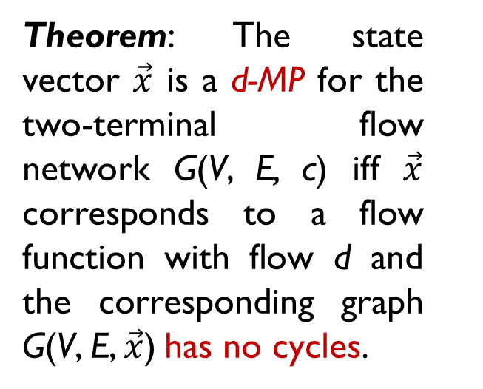
Connection between d-MP and flow function
Theorem: The state vector $\vec{x}$ is a d-MP for the two-terminal flow network G(V, E, c) iff $\vec{x}$ corresponds to a flow function with flow d and the corresponding graph G(V, E, $\vec{x}$) has no cycles.
2
b
1
1
1
3
1
c
3
s
a
t
3
1
3
d
2

Slide 11
Connection between d-MP and flow function
Theorem: The state vector $\vec{x}$ is a d-MP for the two-terminal flow network G(V, E, c) iff $\vec{x}$ corresponds to a flow function with flow d and the corresponding graph G(V, E, $\vec{x}$) has no cycles.
2
b
1
1
1
3
2
1
c
3
s
a
t
3
1
1
3
2
d
2
Notes:
Broken lines

Slide 12
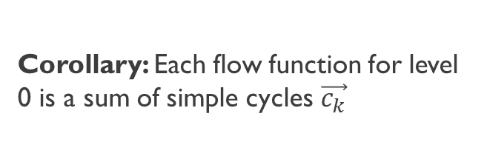
Connection between d-MP and flow function
Corollary: Each flow function for level 0 is a sum of simple cycles $\vec{c_{k}}$
b
1
1
2
s
a
c
t
1
2
d
2
Notes:
The interesting feature is that the rest of the graph is a collection of simple cycles <>

Slide 13
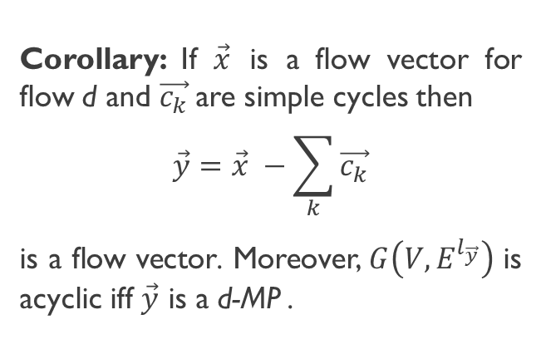
Connection between d-P/D-MP and flow function
Corollary: Each flow function for level 0 is a sum of simple cycles $\vec{c_{k}}$
2
b
1
1
1
Corollary: If $\vec{x}$ is a flow vector for flow d and $\vec{c_{k}}$are simple cycles then
$$\vec{y}=\vec{x} −\sum_{k}{\vec{c_{k}}}$$
is a flow vector. Moreover, $G\left(V,E^{l_{\vec{y}}}\right)$ is acyclic iff $\vec{y}$ is a d-MP .
3
2
1
c
3
s
a
t
3
1
3
d
2
Notes:
And if we delete that cycles we will obtain min path

Slide 14
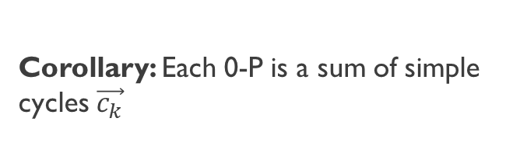
Connection between d-P/D-MP and flow function
Corollary: Each 0-P is a sum of simple cycles $\vec{c_{k}}$
2
b
1
1
Corollary: If $\vec{x}$ is a flow vector for flow d and $\vec{c_{k}}$are simple cycles then
$$\vec{y}=\vec{x} −\sum_{k}{\vec{c_{k}}}$$
is a flow vector. Moreover, $G\left(V,E^{l_{\vec{y}}}\right)$ is acyclic iff $\vec{y}$ is a d-MP .
1
2
1
1
c
3
s
a
t
3
1
2
3
d
2
1
Notes:
And if we delete that cycles we will obtain min path

Slide 15
Connection between d-P/D-MP and flow function
Corollary: Each 0-P is a sum of simple cycles $\vec{c_{k}}$
2
b
1
1
Corollary: If $\vec{x}$ is a flow vector for flow d and $\vec{c_{k}}$are simple cycles then
$$\vec{y}=\vec{x} −\sum_{k}{\vec{c_{k}}}$$
is a flow vector. Moreover, $G\left(V,E^{l_{\vec{y}}}\right)$ is acyclic iff $\vec{y}$ is a d-MP .
1
1
1
c
3
s
a
t
3
2
1
2
1
d
1
Notes:
And if we delete that cycles we will obtain min path

Slide 16
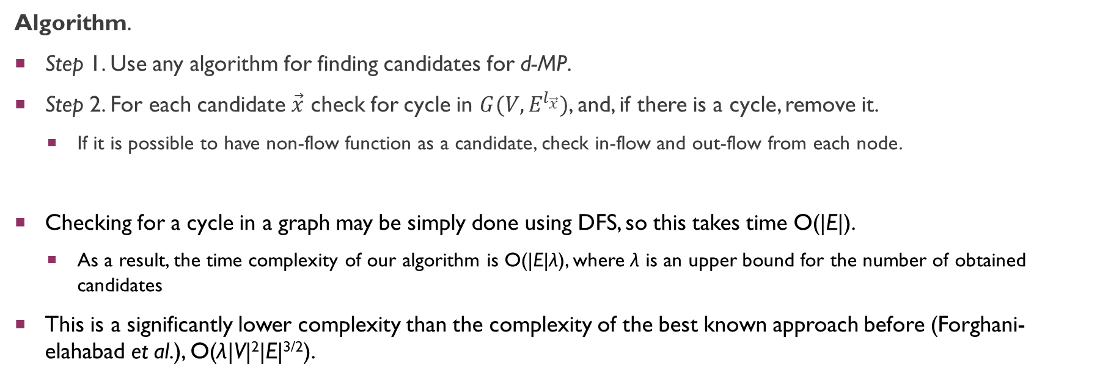
Algorithm 1
Algorithm.
Step 1. Use any algorithm for finding candidates for d-MP.
Step 2. For each candidate $\vec{x}$ check for cycle in $G(V,E^{l_{\vec{x}}})$, and, if there is a cycle, remove it.
If it is possible to have non-flow function as a candidate, check in-flow and out-flow from each node.
Checking for a cycle in a graph may be simply done using DFS, so this takes time O(|E|).
As a result, the time complexity of our algorithm is O(|E|λ), where λ is an upper bound for the number of obtained candidates
This is a significantly lower complexity than the complexity of the best known approach before (Forghani-elahabad et al.), O(λ|V|²|E|^{3/2}).

Slide 17
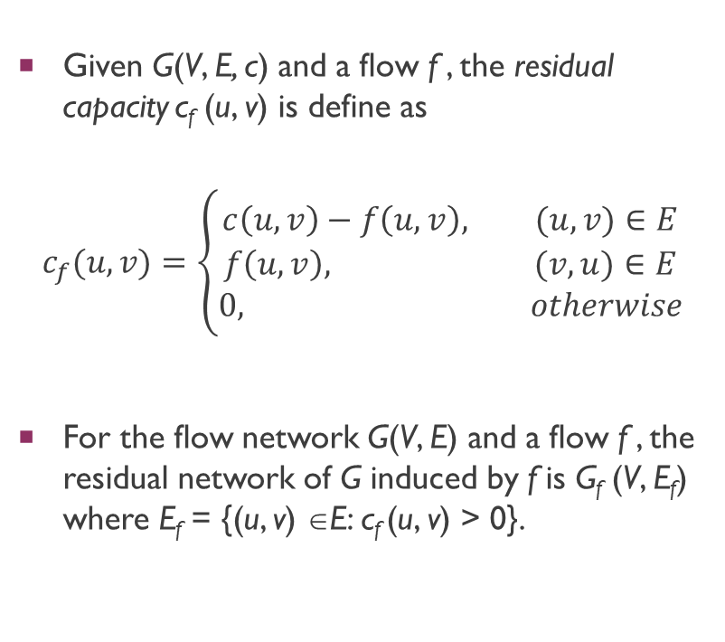
Residual graph
Given G(V, E, c) and a flow f , the residual capacity c_{f} (u, v) is define as
$$c_{f}(u,v)=\left\{\begin{aligned}c\left(u,v\right)−f\left(u,v\right), (u,v)∈E \\ f\left(u,v\right), (v,u)∈E \\ 0, otherwise\end{aligned}\right.$$
For the flow network G(V, E) and a flow f , the residual network of G induced by f is G_{f} (V, E_{f}) where E_{f} = {(u, v) ∈E: c_{f} (u, v) > 0}.
Residual graph

Slide 18
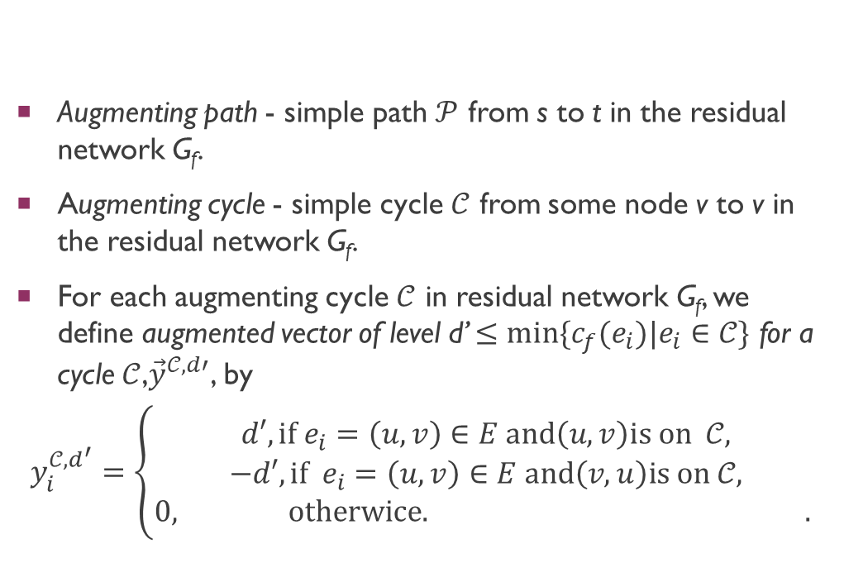
Augmented path and augmented cycle
Augmenting path - simple path $𝒫$ from s to t in the residual network G_{f}.
Augmenting cycle - simple cycle $𝒞$ from some node v to v in the residual network G_{f}.
For each augmenting cycle $𝒞$ in residual network G_{f}, we define augmented vector of level d’ $≤min\{c_{f}(e_{i})|e_{i}∈𝒞\}$ for a cycle $𝒞$,${\vec{y}}^{𝒞,d′}$, by
$$y_{i}^{{𝒞,d}^{′}}=\left\{\begin{aligned}d′, {if e}_{i}=\left(u, v\right)∈E and\left(u, v\right)is on 𝒞, \\ −d′,{if e}_{i}=\left(u, v\right)∈E and\left(v, u\right)is on 𝒞, \\ 0, otherwice. . \end{aligned}\right.$$

Slide 19
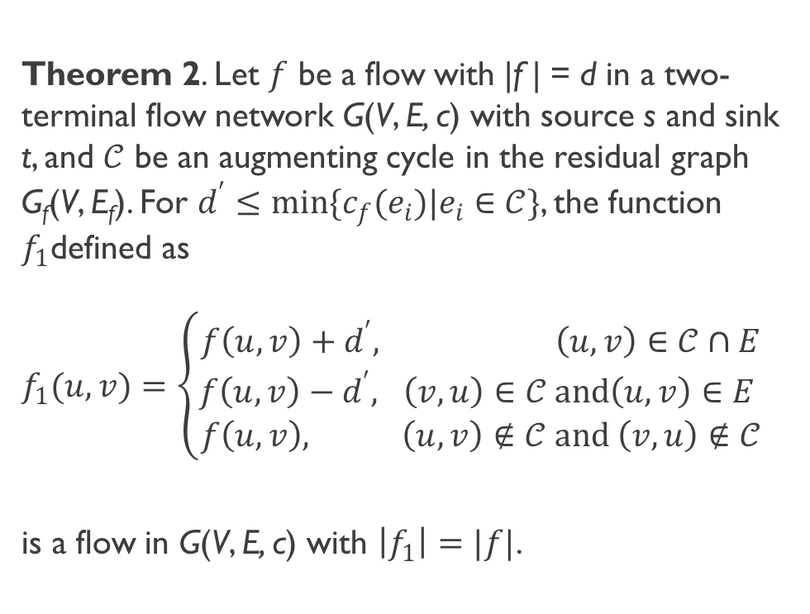
The correlation between two flow vectors
Theorem 2. Let $f$ be a flow with |f | = d in a two-terminal flow network G(V, E, c) with source s and sink t, and $𝒞$ be an augmenting cycle in the residual graph G_{f}(V, E_{f}). For $d^{′}≤min\{c_{f}(e_{i})|e_{i}∈𝒞\}$, the function $f_{1}$defined as
$f_{1}(u,v)=\left\{\begin{aligned}f\left(u,v\right)+d^{′}, \left(u,v\right)∈𝒞∩E \\ f\left(u,v\right)−d^{′}, \left(v,u\right)∈𝒞 and\left(u,v\right)∈E \\ f\left(u,v\right), \left(u,v\right)∉𝒞 and \left(v,u\right)∉𝒞\end{aligned}\right.$
is a flow in G(V, E, c) with $\left|f_{1}\right|=|f|$.
flow
+ cycle in residual graph
= flow

Slide 20
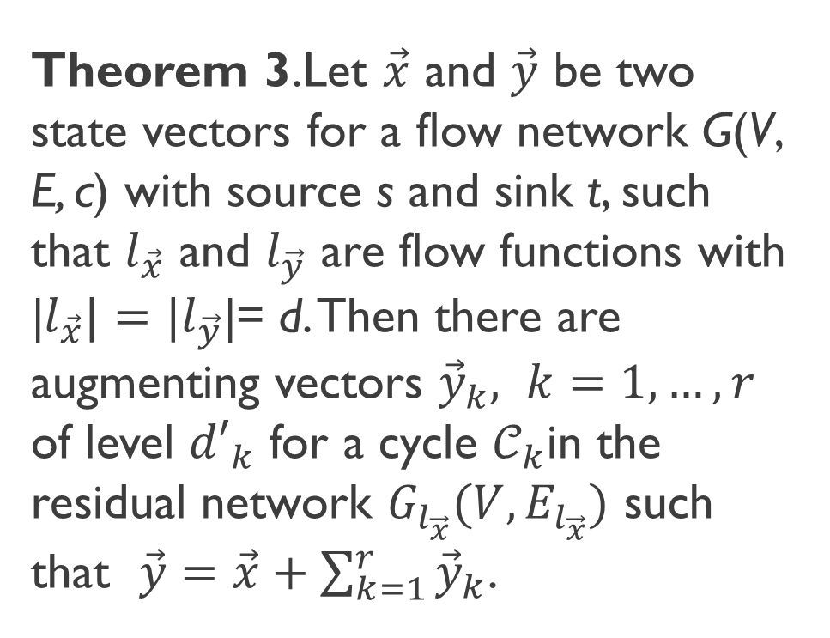
The correlation between two minimal path vectors
Theorem 3.Let $\vec{x}$ and $\vec{y}$ be two state vectors for a flow network G(V, E, c) with source s and sink t, such that $l_{\vec{x}}$ and $l_{\vec{y}}$ are flow functions with |$l_{\vec{x}}|=|l_{\vec{y}}$|= d. Then there are augmenting vectors ${\vec{y}}_{k}, k=1, …, r$ of level ${d′}_{k}$ for a cycle $𝒞_{k}$in the residual network $G_{l_{\vec{x}}}(V, E_{l_{\vec{x}}})$ such that $\vec{y}=\vec{x}+\sum_{k=1}^{r}{{\vec{y}}_{k}}$.

Slide 21
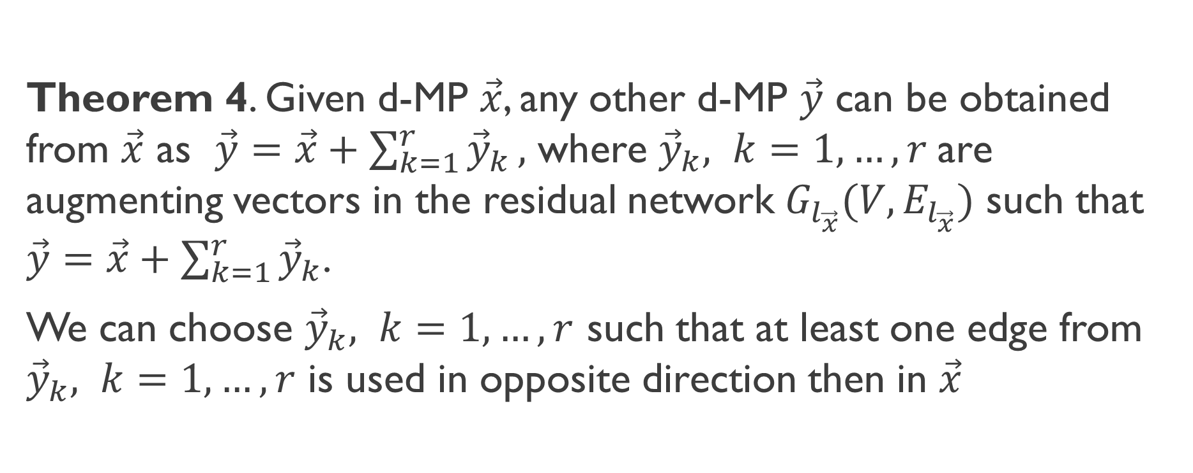
The correlation between two minimal path vectors
Theorem 4. Given d-MP $\vec{x}$, any other d-MP $\vec{y}$ can be obtained from $\vec{x}$ as $\vec{y}=\vec{x}+\sum_{k=1}^{r}{{\vec{y}}_{k}},$ where ${\vec{y}}_{k}, k=1, …, r$are augmenting vectors in the residual network $G_{l_{\vec{x}}}(V, E_{l_{\vec{x}}})$ such that $\vec{y}=\vec{x}+\sum_{k=1}^{r}{{\vec{y}}_{k}}$.
We can choose ${\vec{y}}_{k}, k=1, …, r$ such that at least one edge from ${\vec{y}}_{k}, k=1, …, r$ is used in opposite direction then in $\vec{x}$

Slide 22
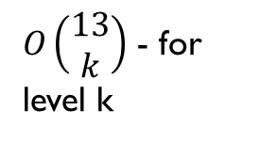
Strategy for small levels – Example
Simple s-t paths
2
b
d
b
d
b
d
b
d
2
3
s
t
s
t
s
t
1
1
1
a
c
a
c
a
c
s
t
b
d
b
d
b
d
2
Different topological sort – can be obtained on another way
3
s
t
s
t
s
t
a
2
c
a
c
a
c
a
c
Adding vectors that can have same topological sort.
b
d
b
b
d
s
t
s
t
s
t
a
c
a
c
a
c
$O\left(\begin{matrix}13 \\ k\end{matrix}\right)$ - for level k
b
d
b
d
b
d
b
d
Property. Each candidate for flow vector that is obtained by addition of vectors that have corresponding coordinates with opposite signs can be also obtained in ‘non-opposite-signs’ way.
s
t
s
t
s
t
s
t
a
c
a
c
c
a
c

Slide 23
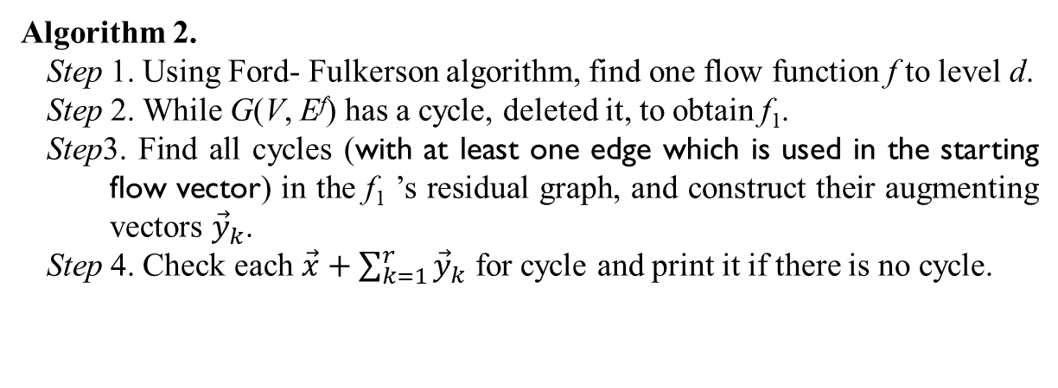
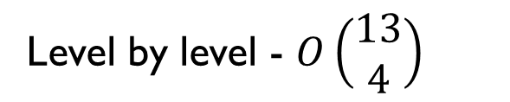
Strategy for levels near to the maximal one – Example d=4
2
Algorithm 2.
Step 1. Using Ford- Fulkerson algorithm, find one flow function f to level d.
Step 2. While G(V, E^{f}) has a cycle, deleted it, to obtain f₁.
Step3. Find all cycles (with at least one edge which is used in the starting flow vector) in the f₁ ’s residual graph, and construct their augmenting vectors ${\vec{y}}_{k}$.
Step 4. Check each $\vec{x}+\sum_{k=1}^{r}{{\vec{y}}_{k}}$ for cycle and print it if there is no cycle.
b
d
2
3
1
1
1
s
t
3
2
a
2
c
3
2[1]
b
d
b
d
3
1
Level by level - $O\left(\begin{matrix}13 \\ 4\end{matrix}\right)$
3[2]
1
2[1]
1
5
1
1
2
1
1
1[0]
1[1]
1[0]
s
t
s
t
6
4
3[3]
2[2]
4
a
c
flow
a
c
2[2]
Residual graph

Slide 24
Strategy for levels near to the maximal one – Example d=4
3
We have 8 cycles that have at least one edge which is used in the starting flow vector
b
d
3
1
1
1
5
1
1
2
1
1
b
d
b
d
b
d
s
t
b
6
4
s
s
a
4
c
s
a
a
a
c
a
Combining those with same topological sort (after deleting the appropriate edge) we will obtain all 12 minimal path vectors to level 4
b
d
b
d
d
b
d
t
t
s
t
a
c
a
c
a
c
c

Slide 25
On graph strategy
3
b
d
Label the edges that are used in a starting d-MP (red edges)
Find one edge that is used with all its capacity
3
1
1
1
5
1
1
2
1
1
s
t
6
4
a
4
c

Slide 26
On graph strategy
3
Label the edges that are used in a starting d-MP (red edges)
Take one of these edges – if it is possible take one that is used with all its capacity
Find all cycles that used that edge – all paths from its in-node to its out-node
Construct new graphs…
b
d
3
1
1
1
5
1
1
2
1
1
s
t
4
4
b
0
d
6
3
4
1
5
1
a
c
0
2
1
s
1
1
t
3
6
4
4
All d-MPs that use that edge
b
d
All d-MPs that do not use that edge or use it in the opposite direction, f(a, d)≤0
a
c
3
1
1
5
1
1
1
1
1
4
b
4
d
s
t
0
1
6
0
5
4
1
1
a
4
c
s
1
1
1
t
Cycles y_{k} do not consist that edge
5
All graphs that use (a, d) with full capacity, f(a, d)=1
The yellow edge can be used only from d to a
4
1
4
a
c

Slide 27
On graph strategy
3
5. In order to avoid unnecessary appearance of a same d-MP multiple times, for the edges lying on the cycle we allow only the direction used in the cycle
Label the edges that are used in a starting d-MP (red edges)
Take one of these edges – if it is possible take one that is used with all its capacity
Find all cycles that used that edge – all paths from its in node to its out node
Construct new graphs…
b
d
3
1
1
1
5
1
1
2
1
1
s
t
4
6
4
b
0
d
4
3
a
c
1
5
1
0
2
1
3
s
1
1
t
b
d
6
4
4
3
1
a
c
1
5
1
s
1
1
1
1
t
4
b
4
d
6
0
0
1
4
5
a
4
c
1
1
1
1
1
s
t
5
f(a, d)=1
4
1
4
a
c

Slide 28
On graph strategy
3
5. In order to avoid unnecessary appearance of a same d-MP multiple times, for the edges lieing on the cycle we allow only the direction used in the cycle
Label the edges that are used in a starting d-MP (red edges)
Take one of these edges – if it is possible take one that is used with all its capacity
Find all cycles that used that edge – all paths from its in node to its out node
Construct new graphs…
b
d
3
1
1
1
5
1
1
2
1
1
s
t
6
4
b
d
4
3
a
c
1
5
1
1
3
s
1
1
t
b
d
6
4
4
3
1
a
c
1
5
1
Each obtained graph gives one d-MP candidate (flow)
The procedure is repeated on each of obtained graphs
s
1
1
1
1
t
b
d
6
4
1
4
5
a
c
s
1
1
1
1
1
t
5
f(a, d)=1
4
a
4
c

Slide 29
Conclusion
An extended theory that connects the multi-state reliability theory with the theory for flow in two-terminal directed and undirected networks.
The relation between d-MPs and flow functions
The relation between two d-MPs
Given results lead to a more efficient approach for calculating all d-MPs

