Slide 1
Capstone Project: Predicting Career Domain and Seniority from LinkedIn Profiles
02. February 2026 – Practical Data Science
Laura Hüsam, Luisa Dosch, Sonia Bronner

Slide 2
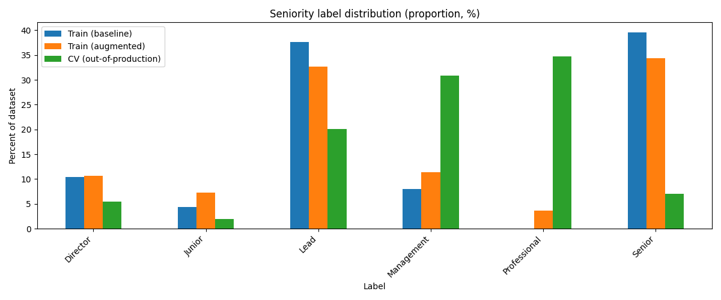
Seniority Data

Slide 3
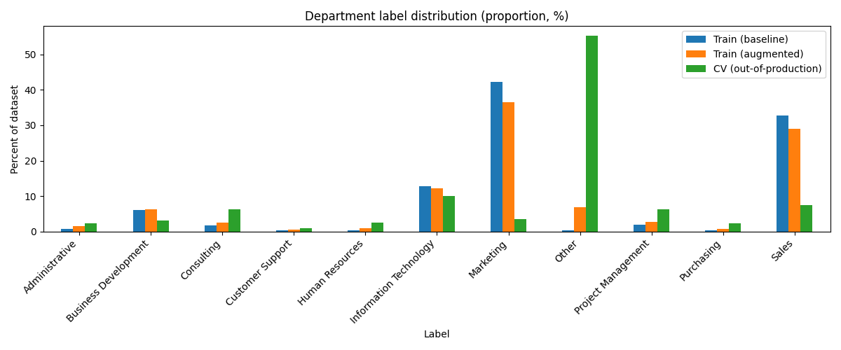
Department Data

Slide 4
Our Approaches
Baseline
Prompt Engineering
Bag of Words/TF-IDF & Logistic Regression
Fine Tuning of Huggingface Transformer Model
Embedding Based Labeling

Slide 5
Experiments
All our approaches were trained in 3 experiments:
    Only training data
    Augmented data
    Oversampling

Slide 6


Dashboard
Link: prediction-prototype.streamlit.app/
Notes:
-> Here we show a result summary of our approaches and prediction prototype

Slide 7
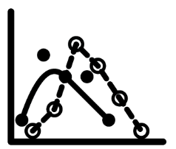
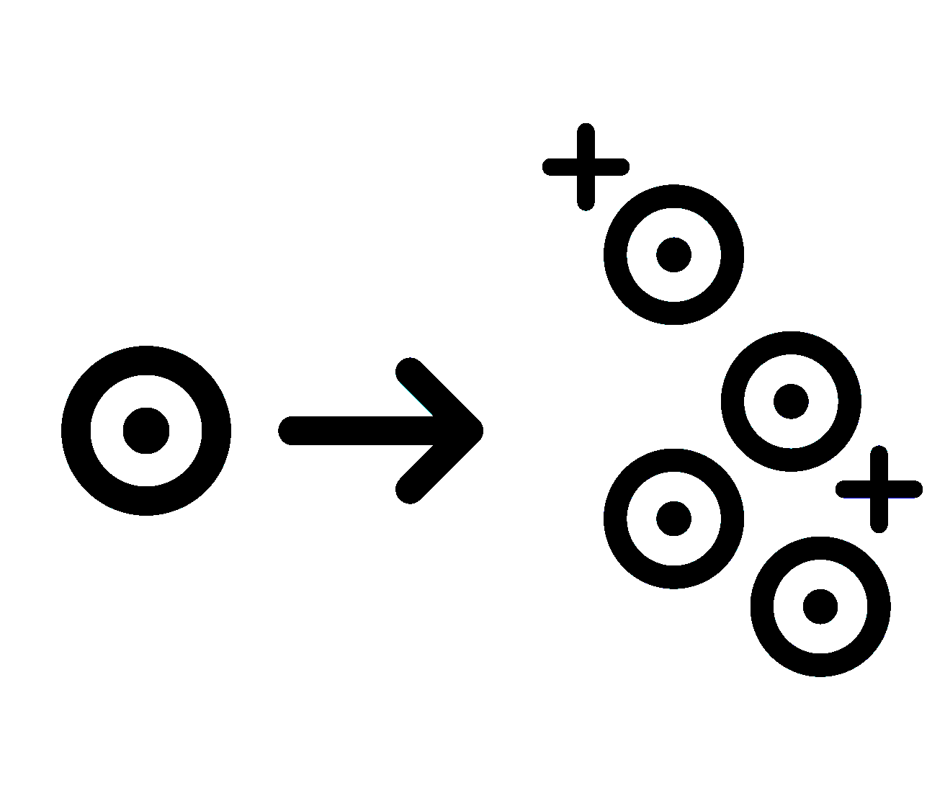
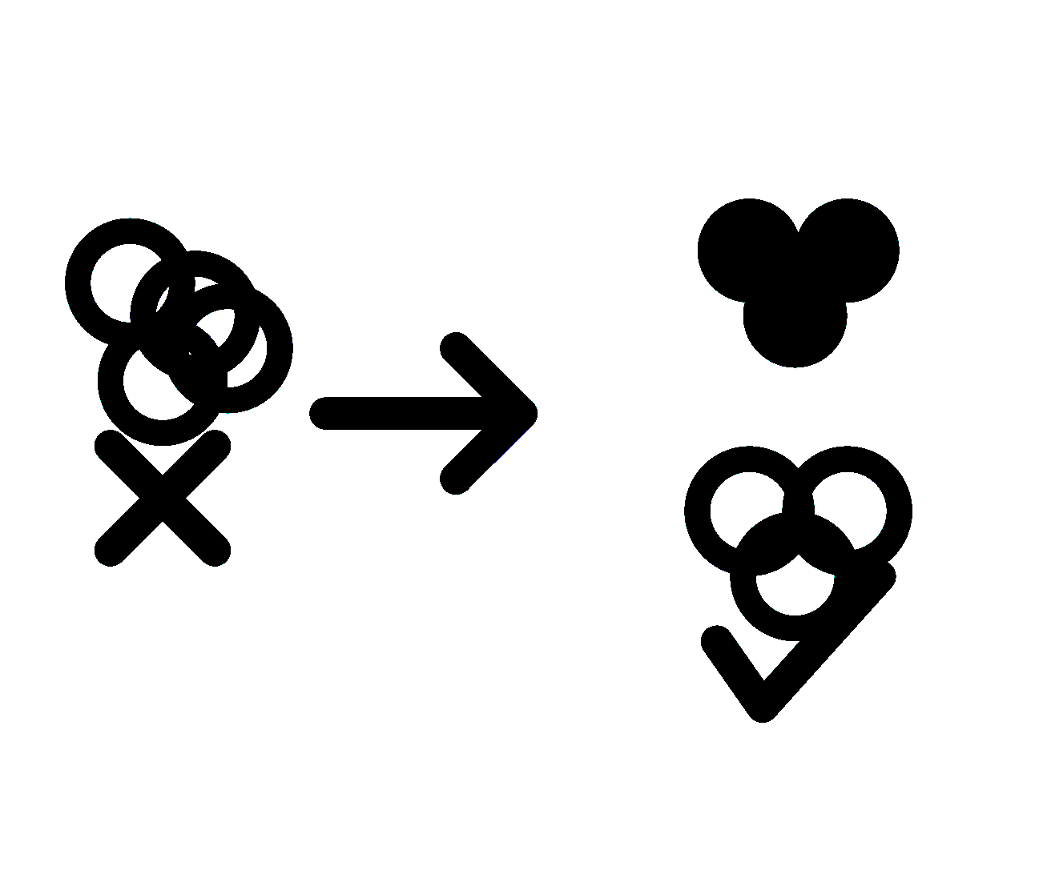
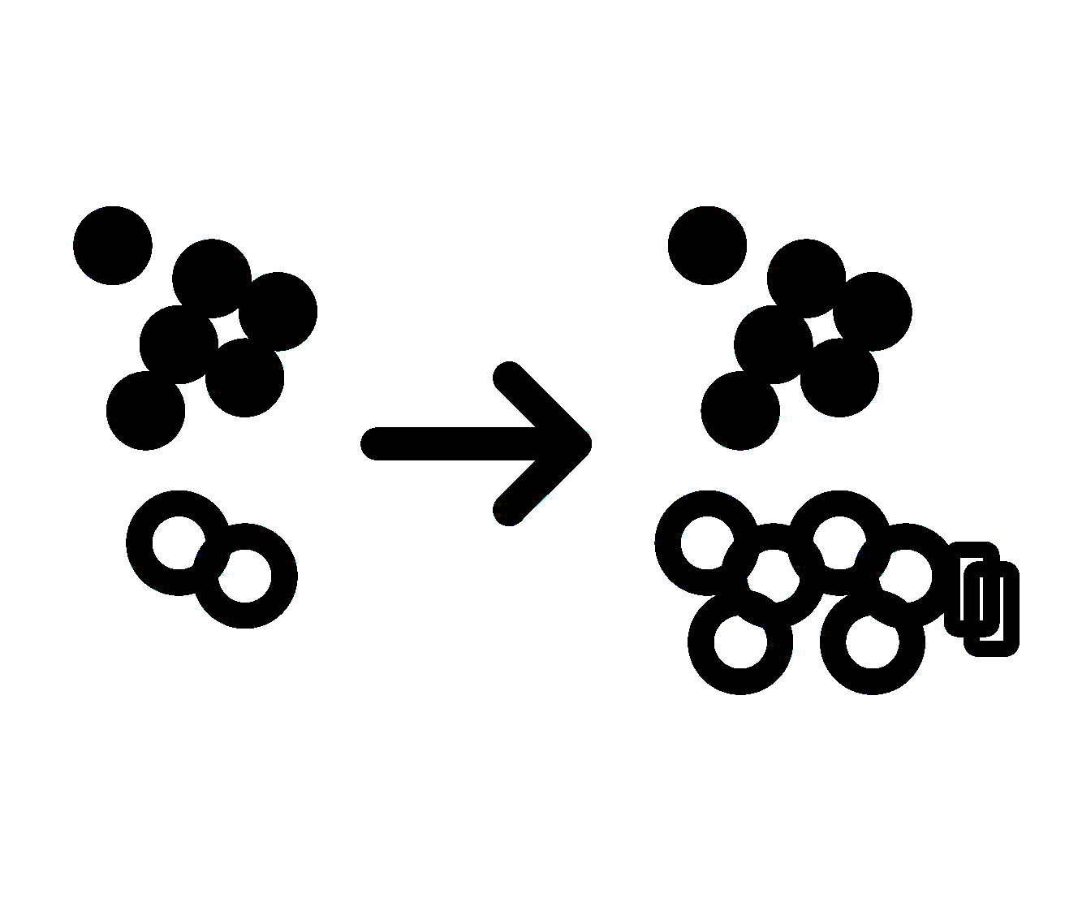
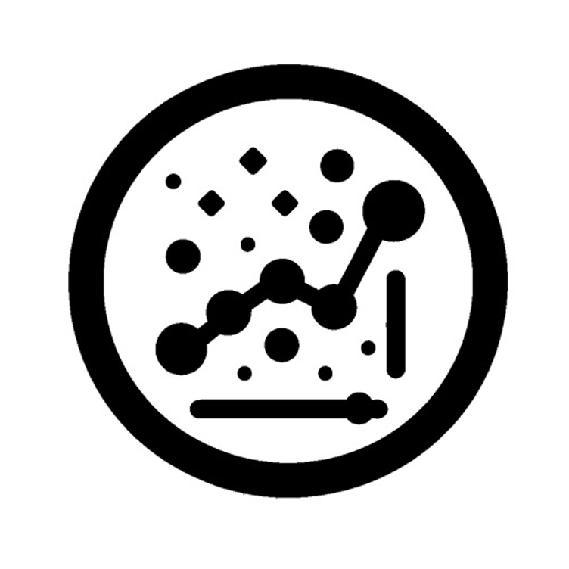
Conclusion
Strong distribution shift
Near-perfect performance in-distribution
Strong drop on real CV job titles
Synthetic Data Improves
Clear performance gains for seniority and department
Especially improves robustness on real-world data
Per-class improvements
Seniority: Professional becomes predictable (previous major confusion)
Department: Other is classified more reliably
Oversampling
Helpful in some cases, but not consistently beneficial
Remaining challenges
Seniority: Confusions mainly between neighboring levels
Department: Frequent confusion between Other and Business Development

Slide 8
Thank you!
02. February 2026 – Practical Data Science
Laura Hüsam, Luisa Dosch, Sonia Bronner

