Slide 1

QA TEAM
What do we do? What do we cover?

Slide 2
RELEASE PROCESS
Pre - Release
Testing in STG
Deployment to PROD
General QA Processes
OTHER RELEASES
Regulated Stack
LEApp & Model Runner

Slide 3
General QA Processes
Automated Tests Writing
Continuous Test Runs Results Monitoring
Test Maintenance:
Fix
Adjust to UI changes
Reports and Documentation:
Test Coverage Review
Testing Plans
Test Cycles
PRs doc

Slide 4
PRE-RELEASE
Confirm
New Features
Improvements
Fixes
Feature flags
BI metrics
Understand New
Features
New automated test cases building
Arrange Testing Cycle
FF Preparation

Slide 5
TESTING IN STG
Fast-Forward process
Automated Testing
Manual Testing:
Validate FIXES
BUG detection
ASANA tickets
REVIEW with engineers (when needed)
VALIDATE Hotfixes
Release-status reports on Slack
Cross-team communication

Slide 6
DEPLOYMENT TO PROD
Deploy Meeting and Pipeline Manual Approval
Run Automated Smoke Tests
Manual Sanity Checks
Check Release-Notes Inform Product Managers (feature and f. gates)
Release Completion Updates on Slack

Slide 7
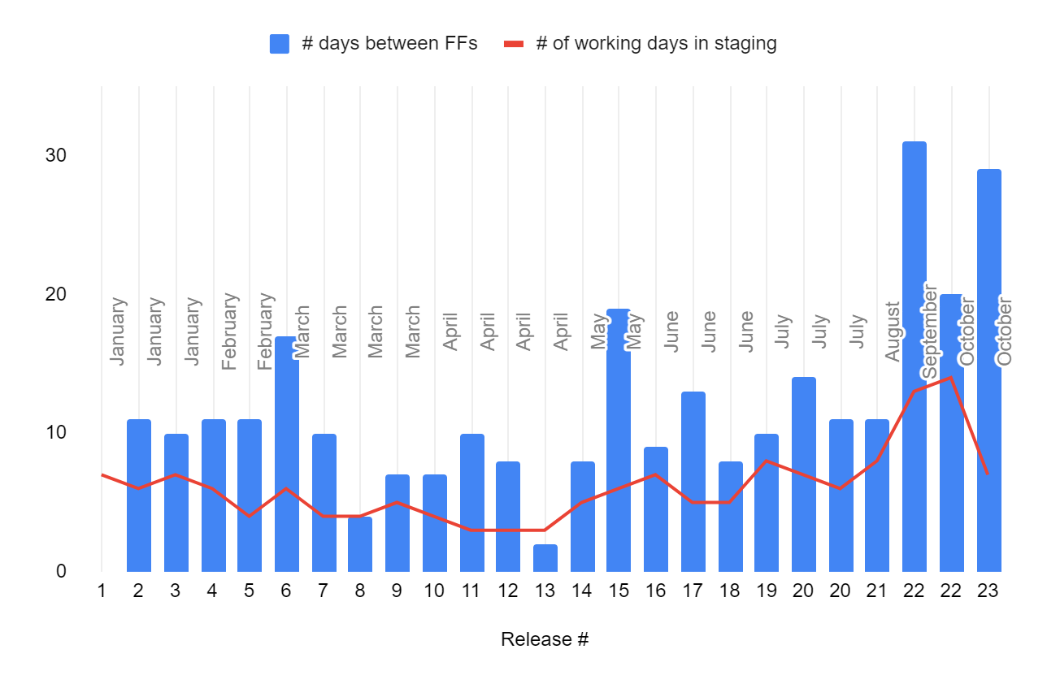
RELEASE METRICS ANALYSIS

