Slide 1
Likely Insertions

Slide 2
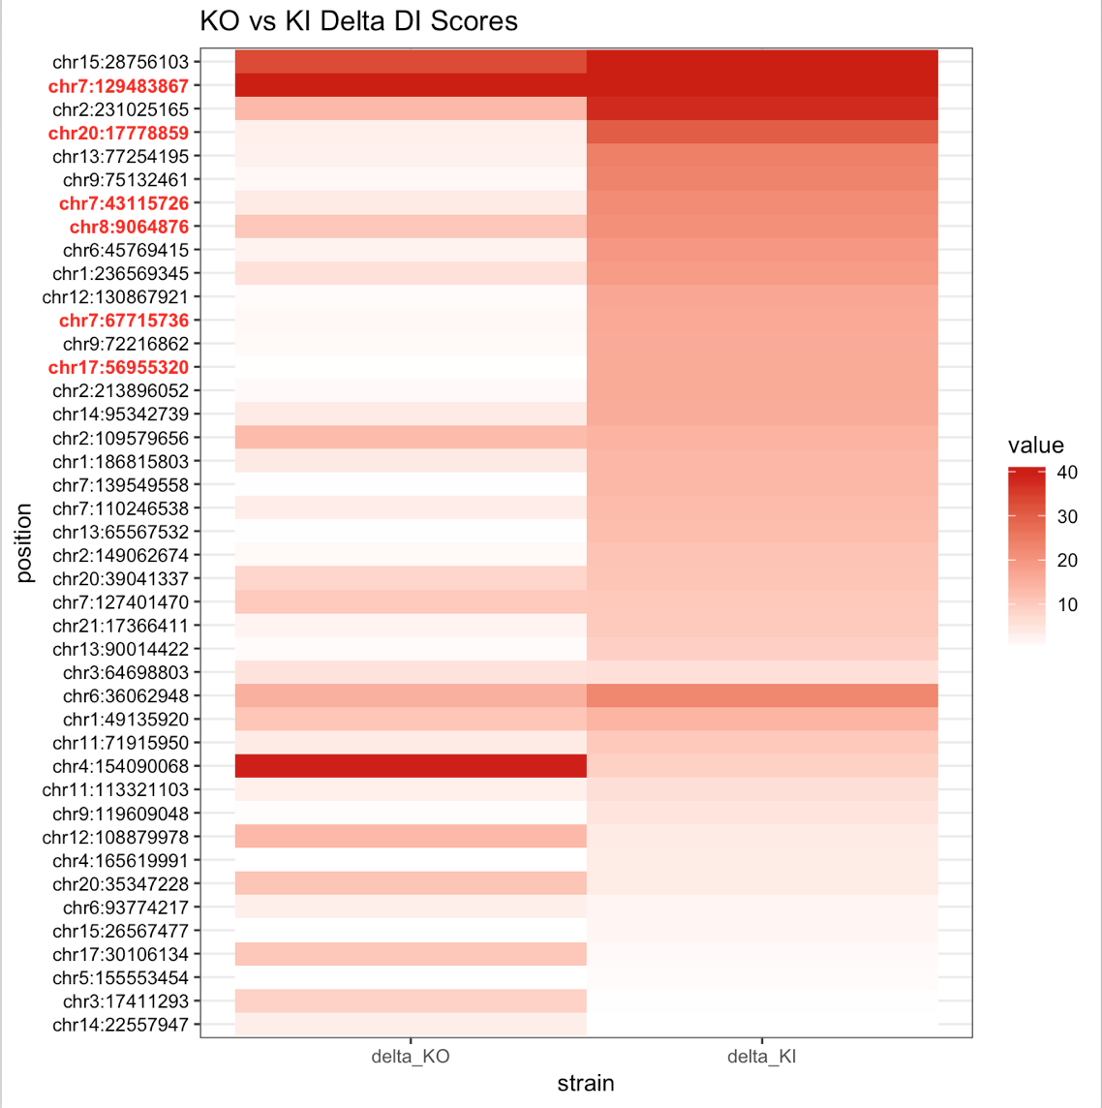
Delta DI
Rest of slides are in order of this heatmap with:
IGV screenshot
HIC images
Interaction plots
Difference of interaction plot

Slide 3
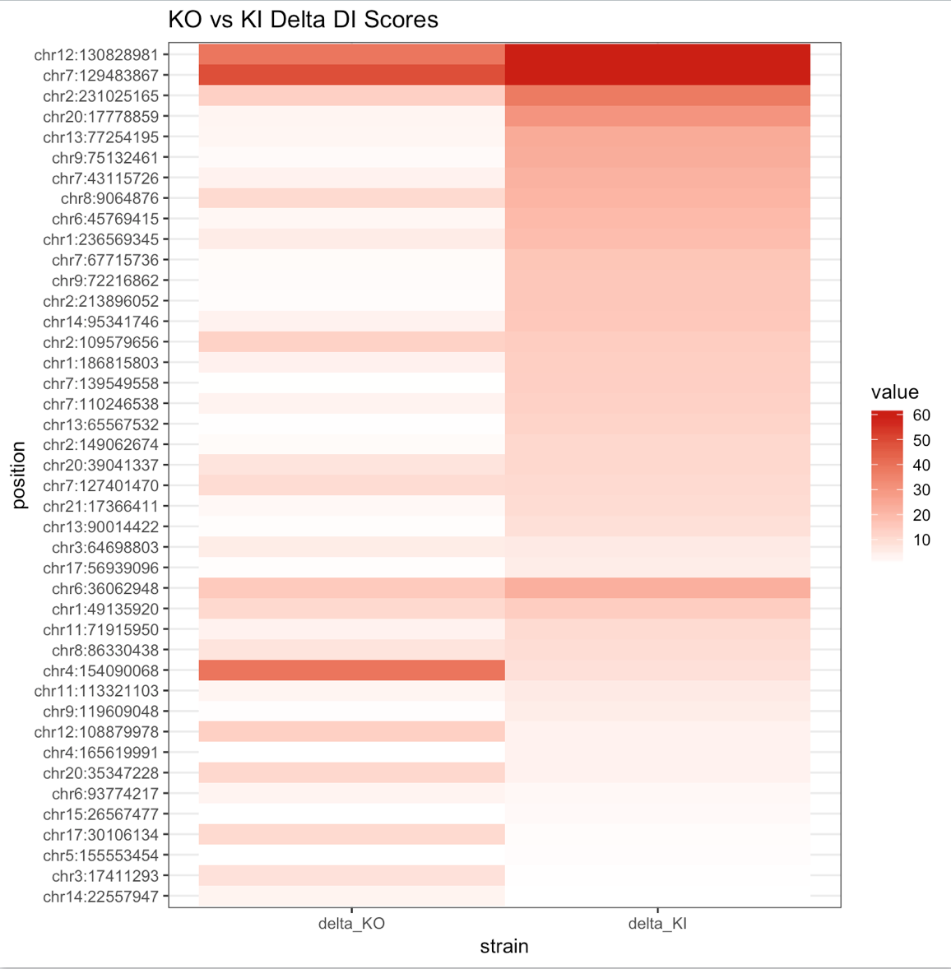
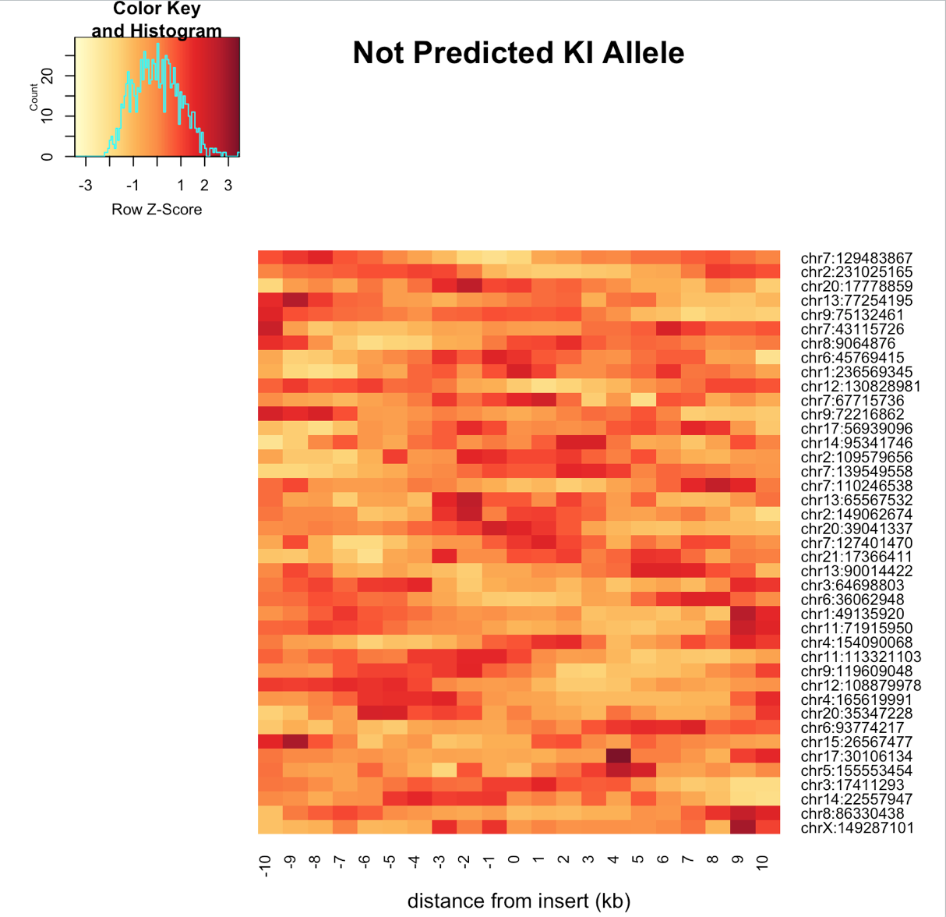
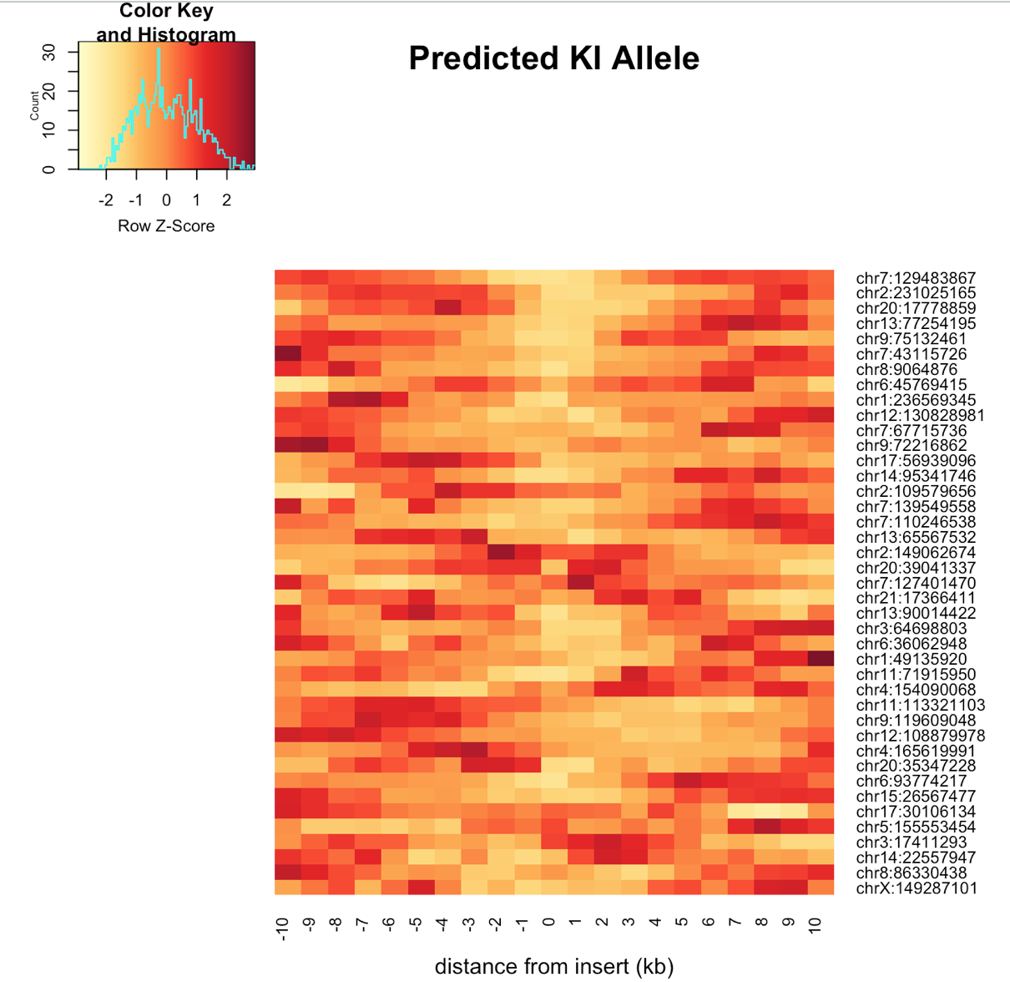
Allele Specific Insulation Scores at Insertions

Slide 4
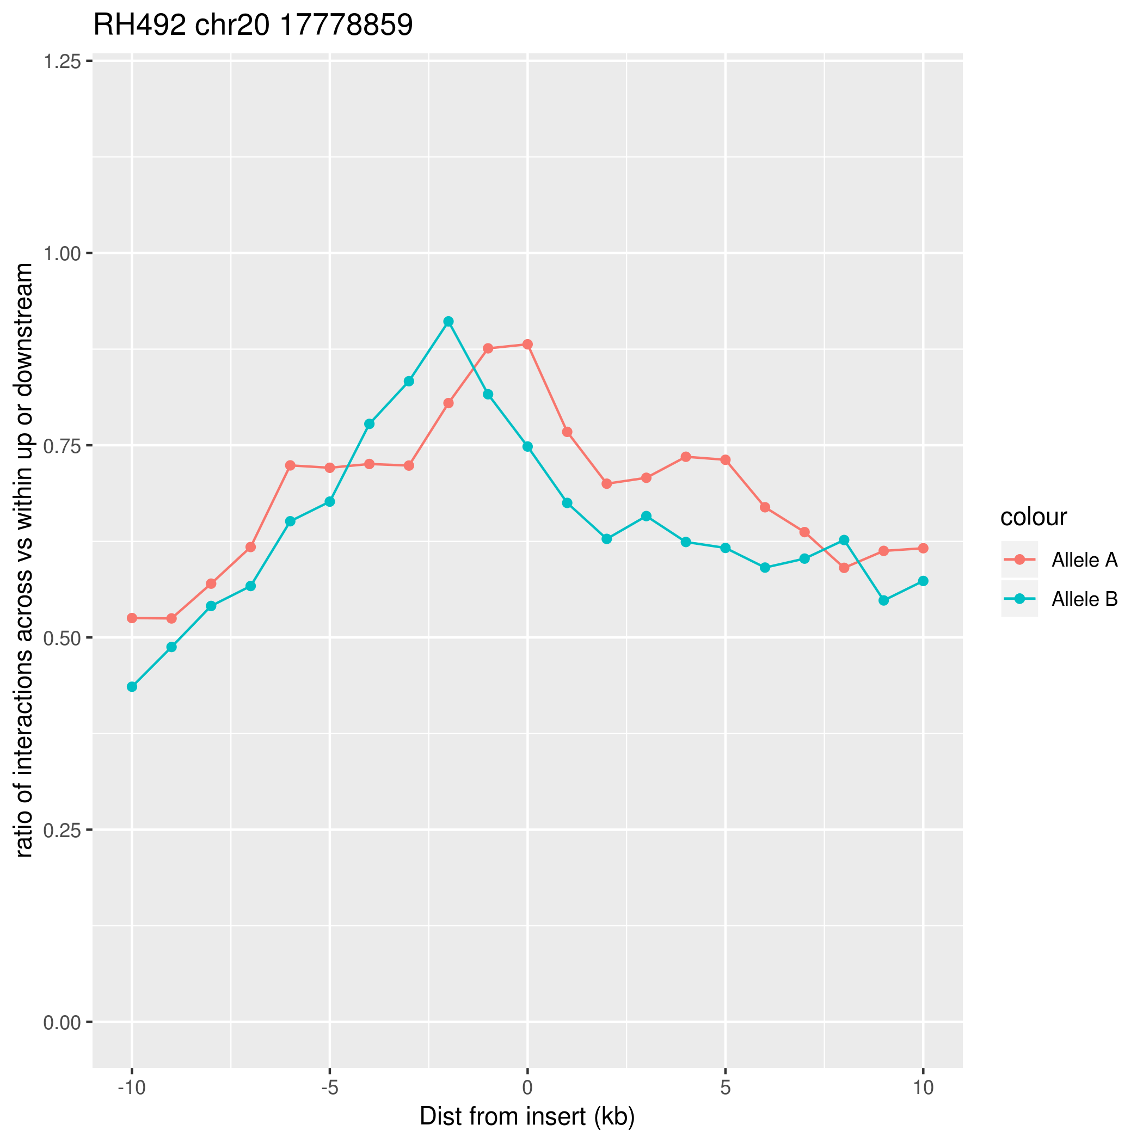
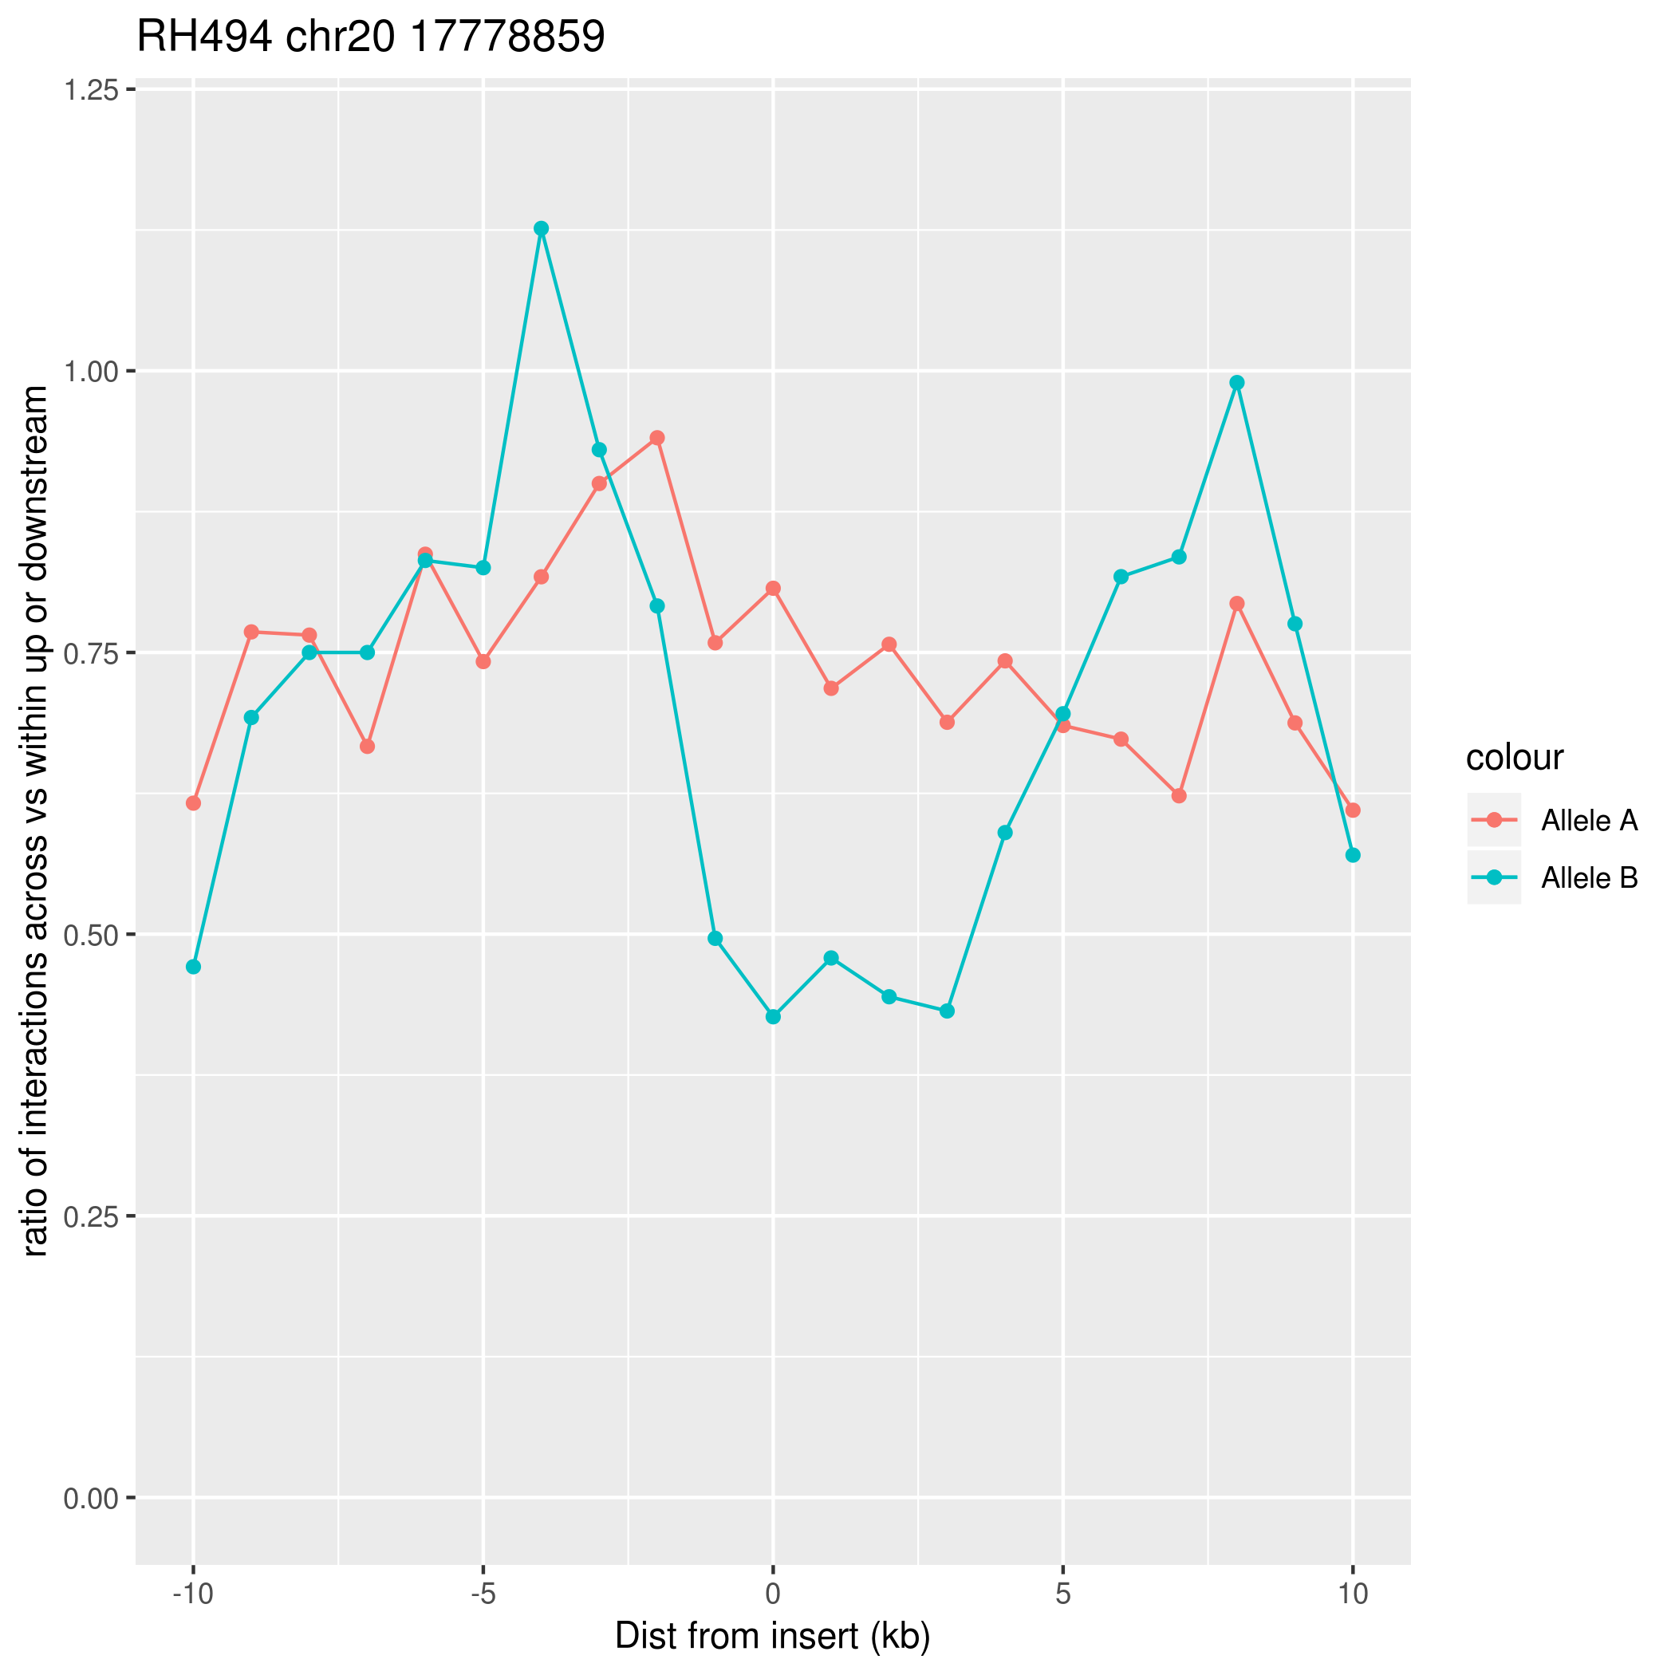
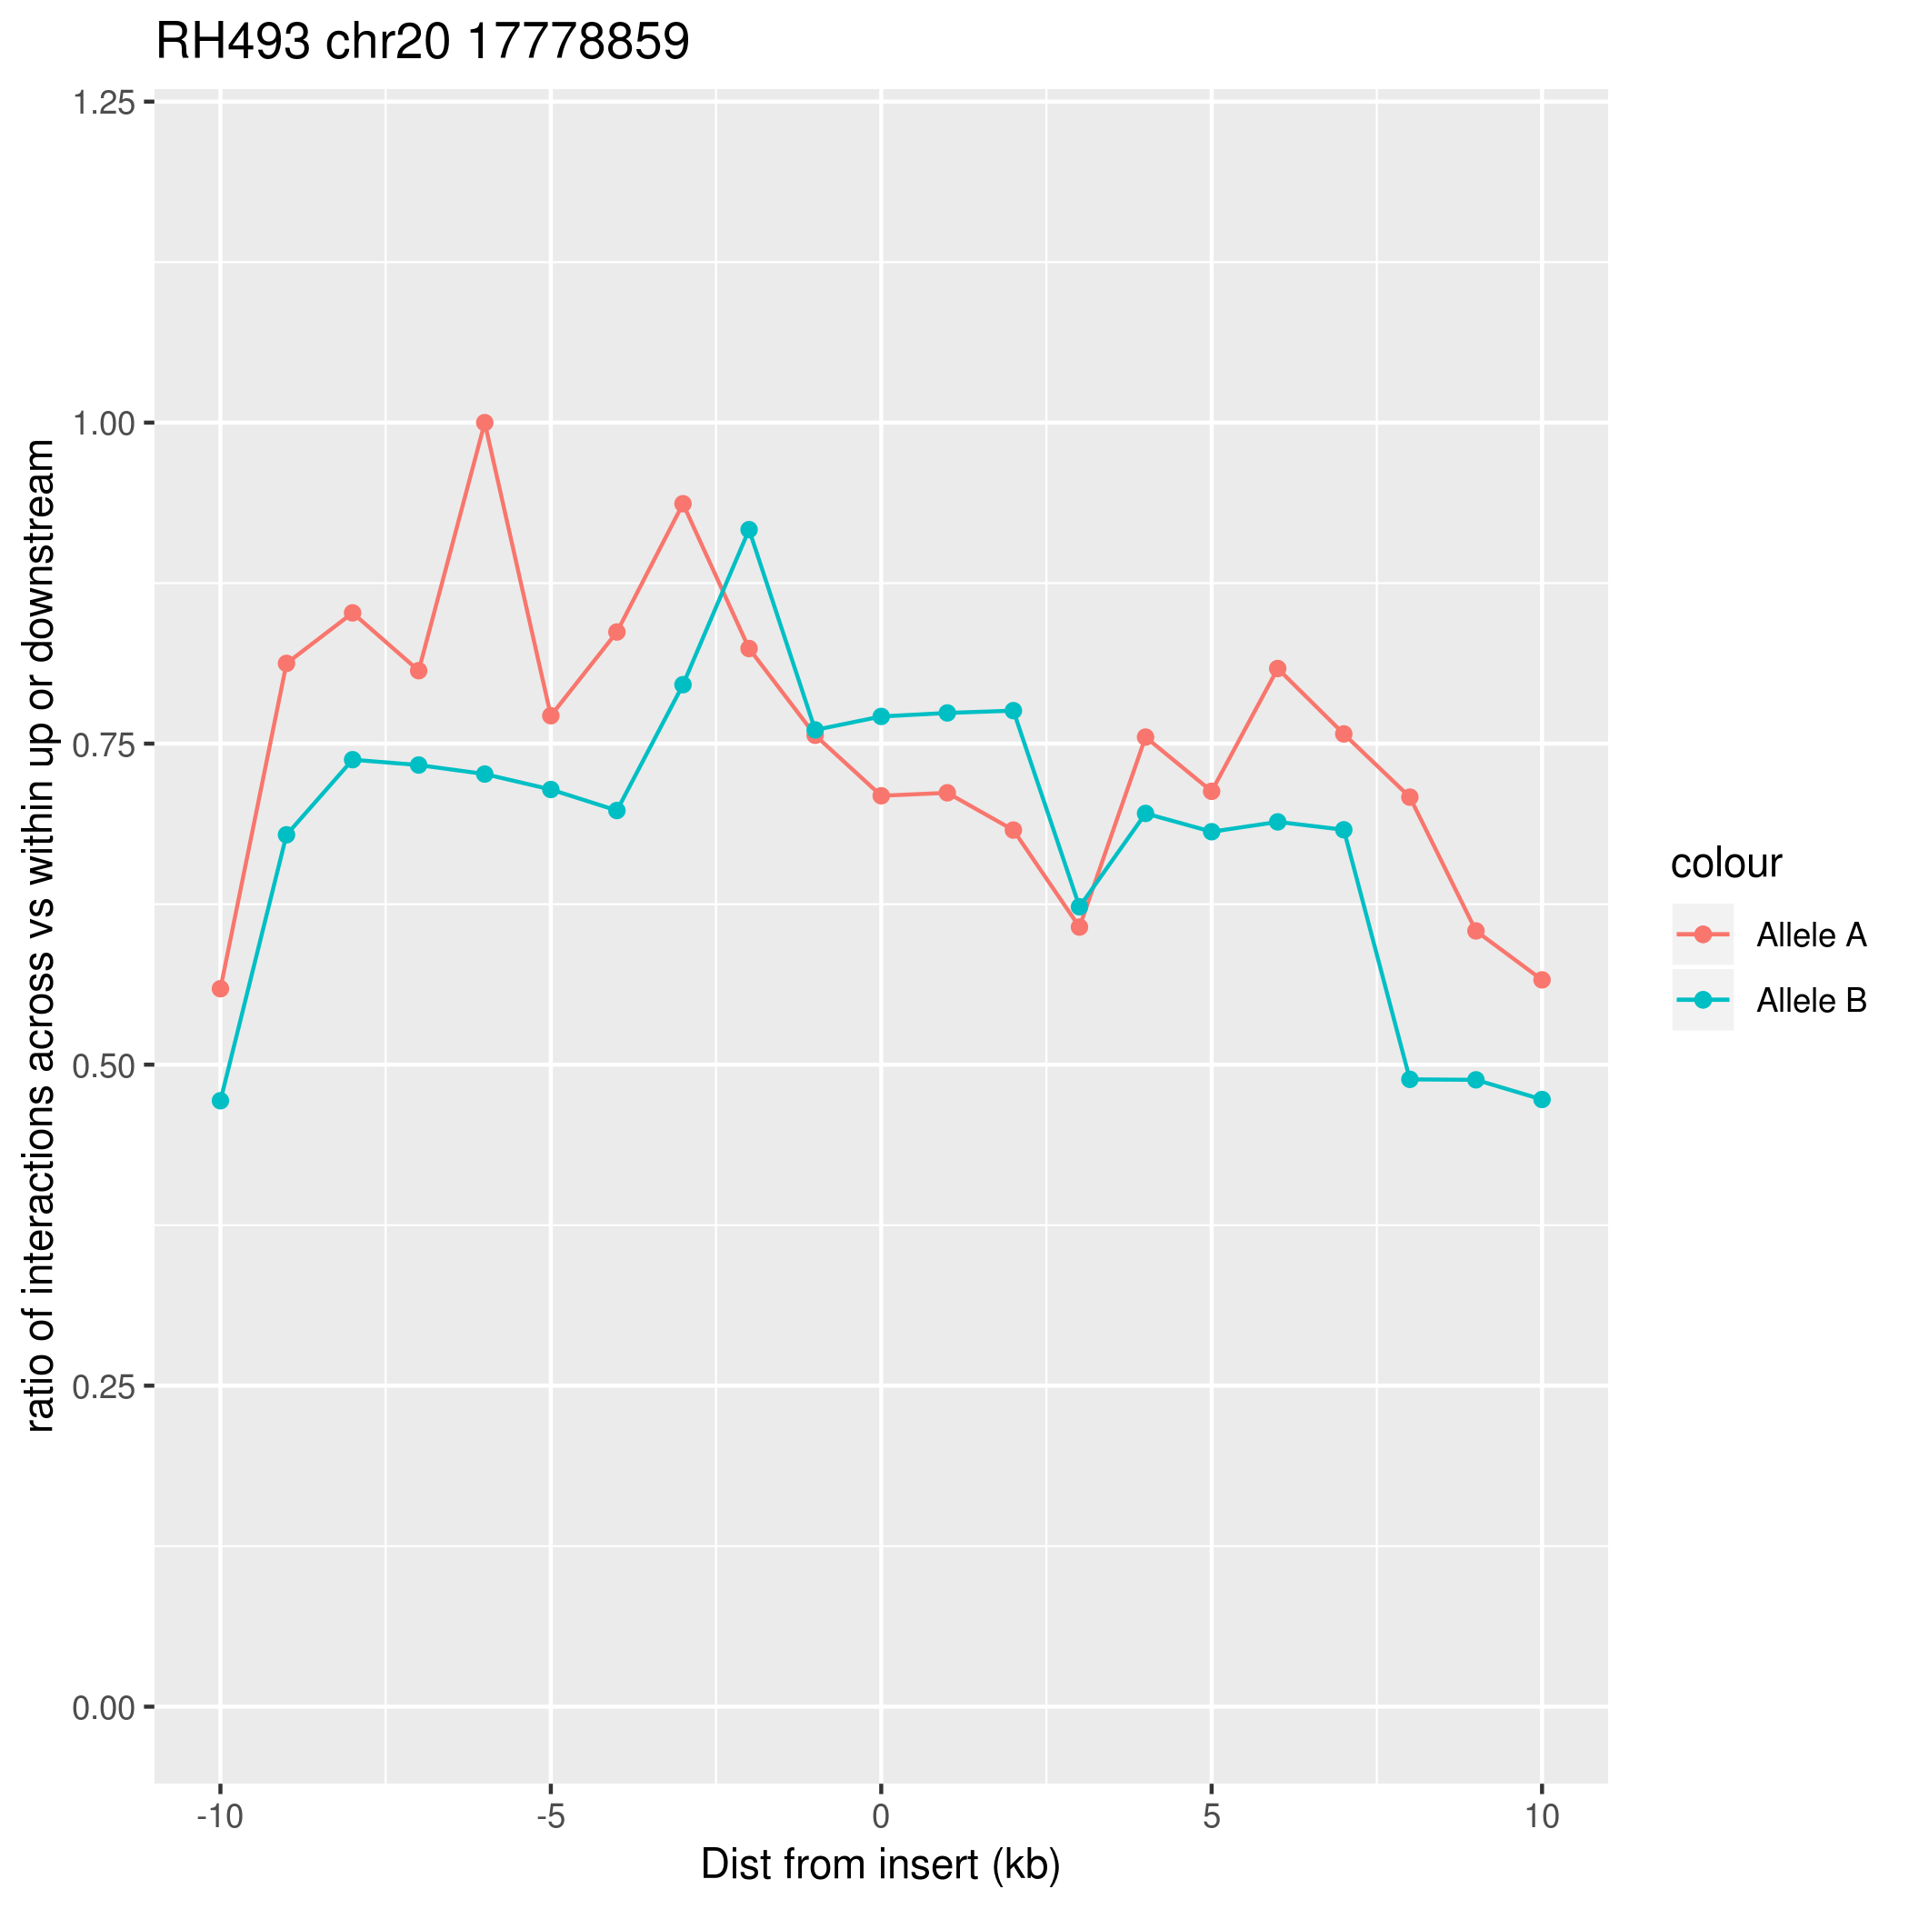
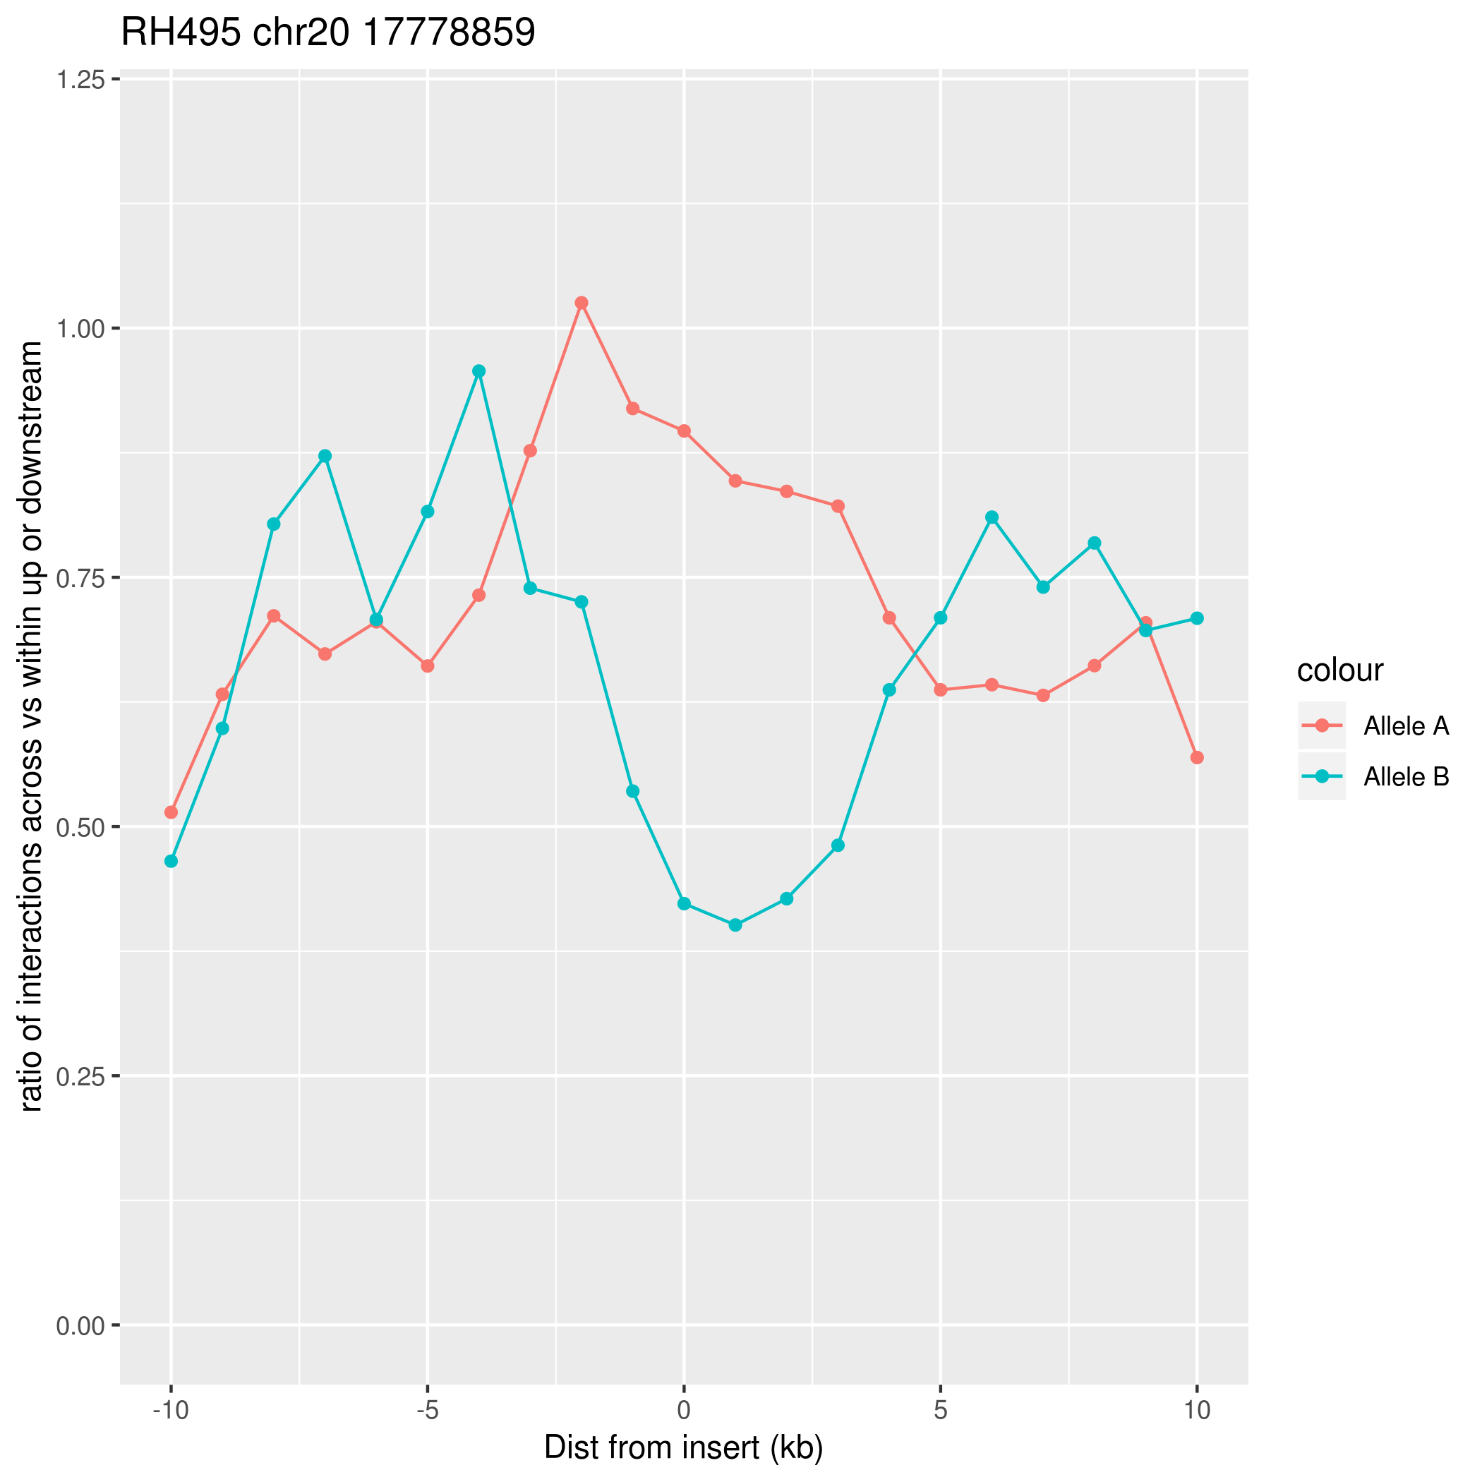

Slide 5
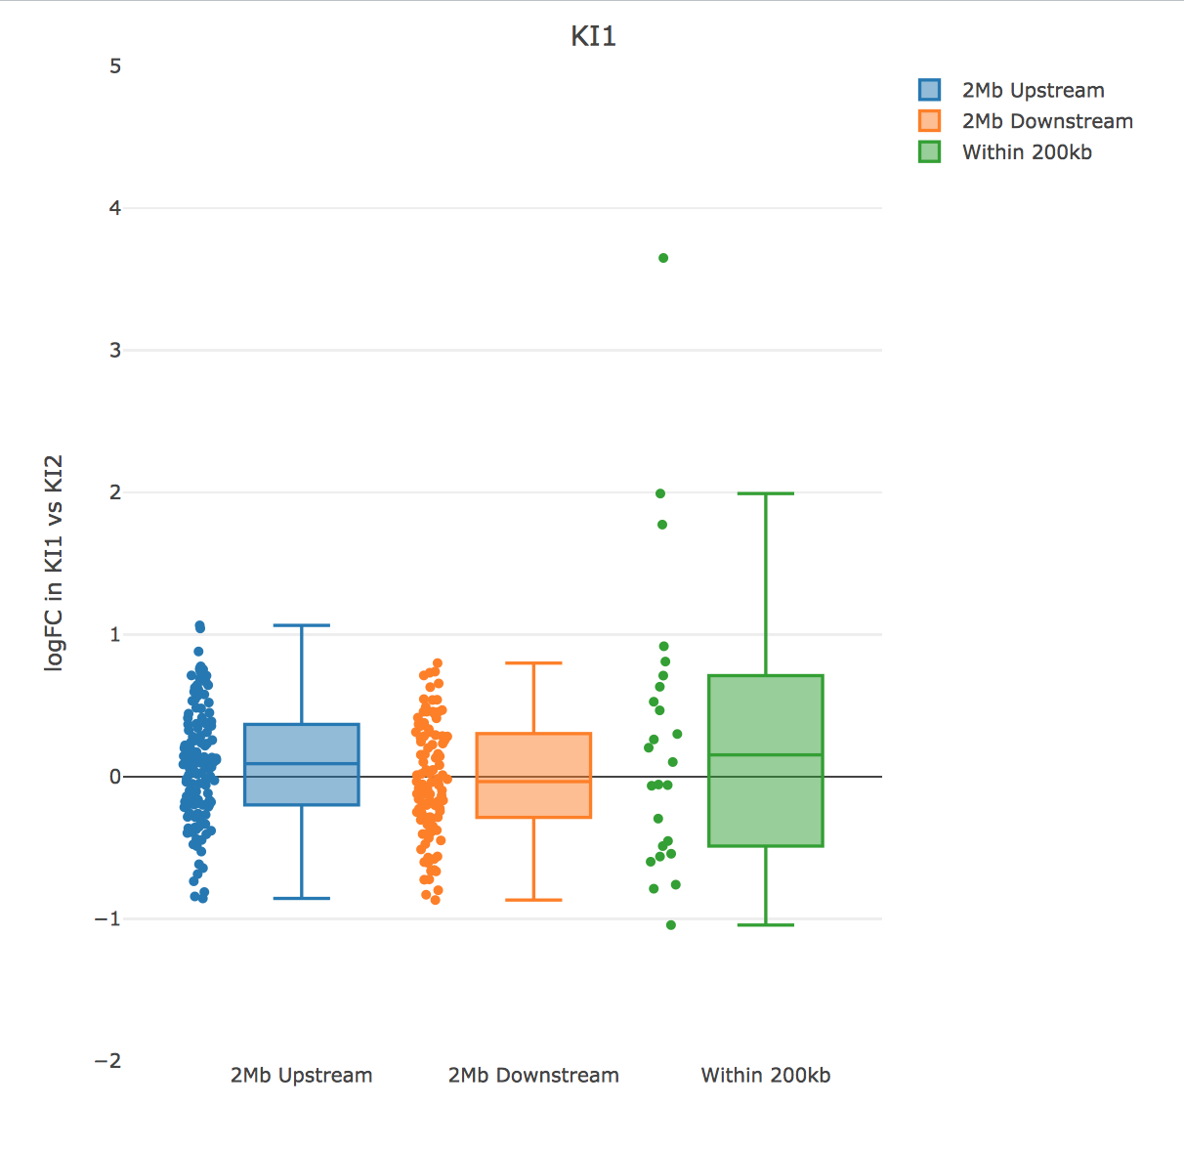
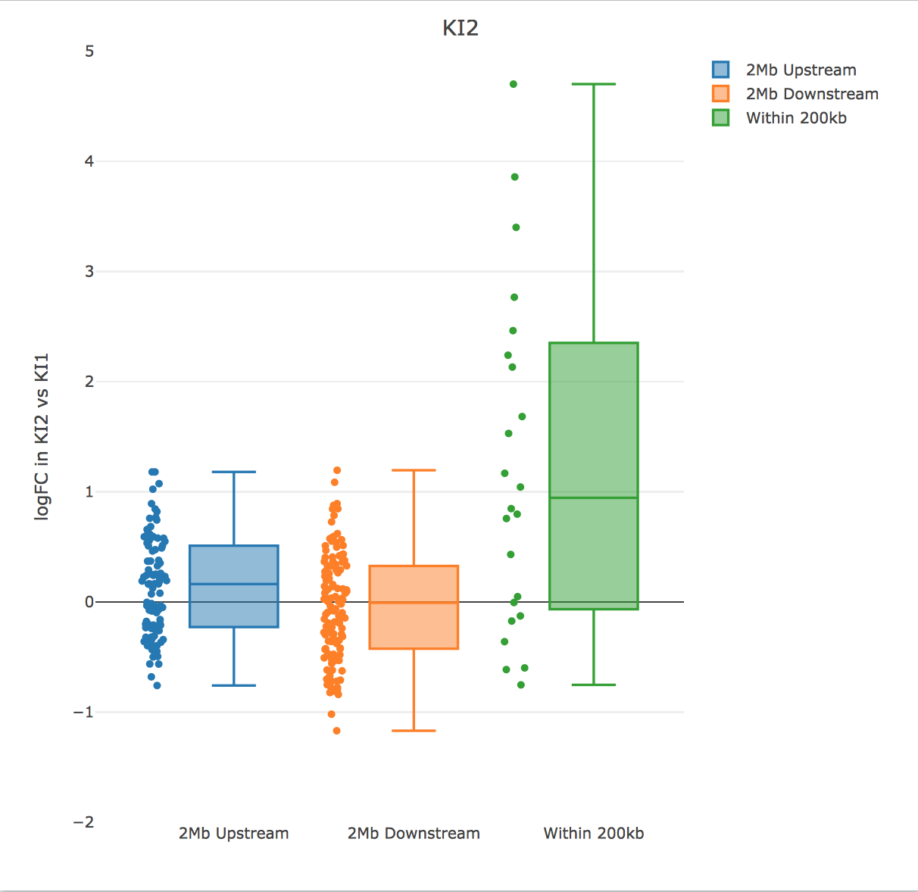
RNA-seq LogFC KI vs WT near insertion

Slide 6
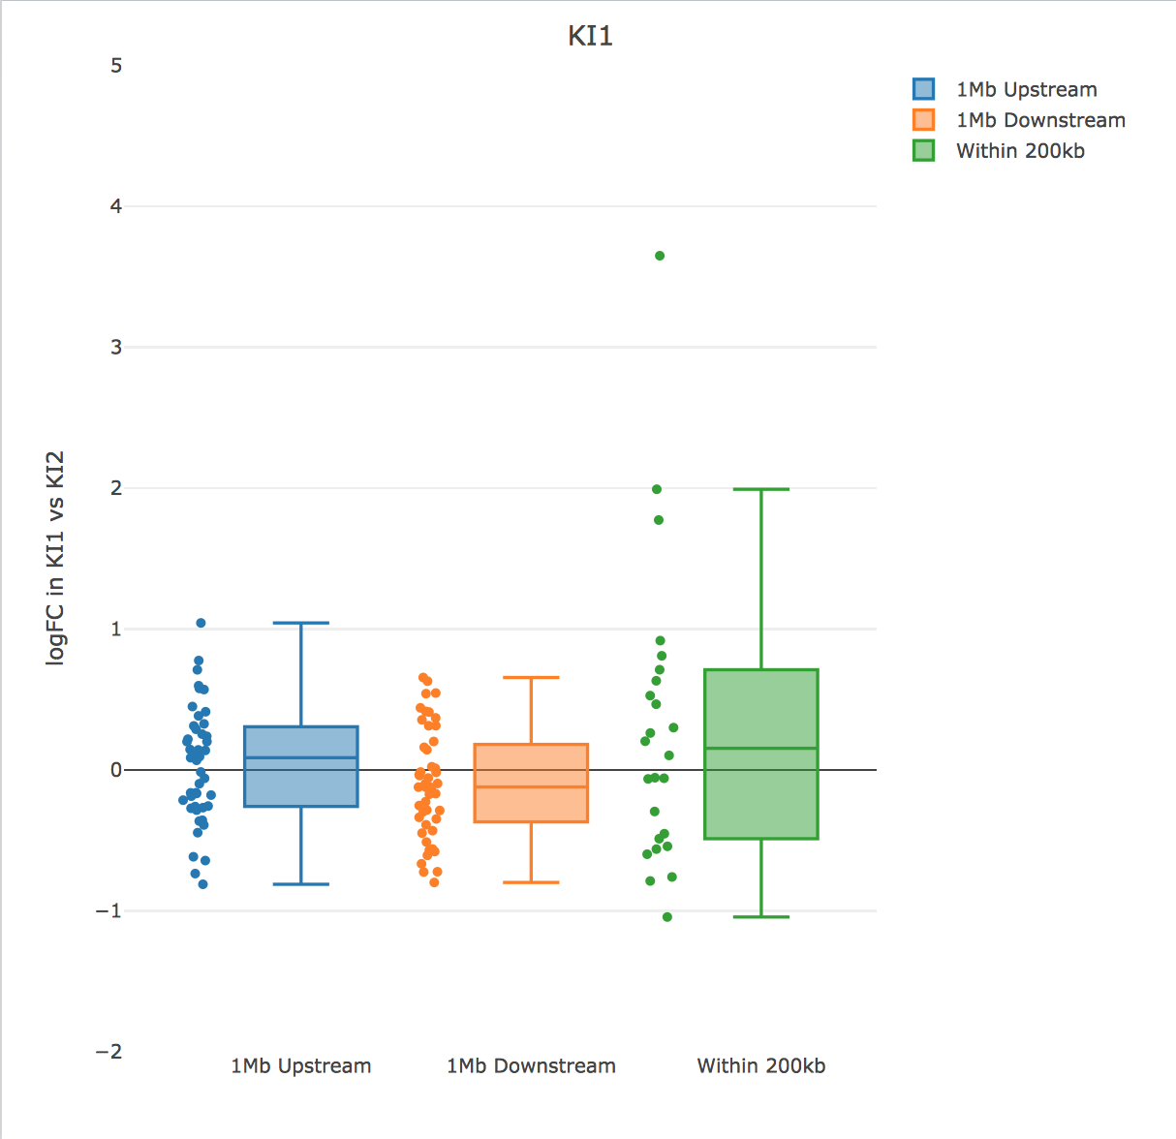
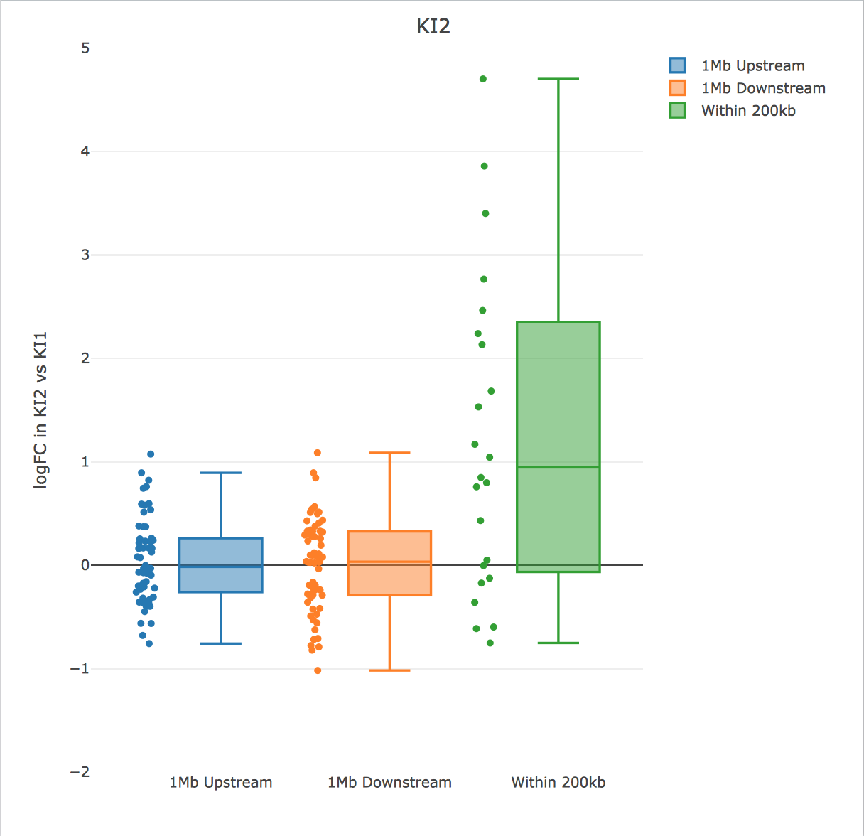

Slide 7
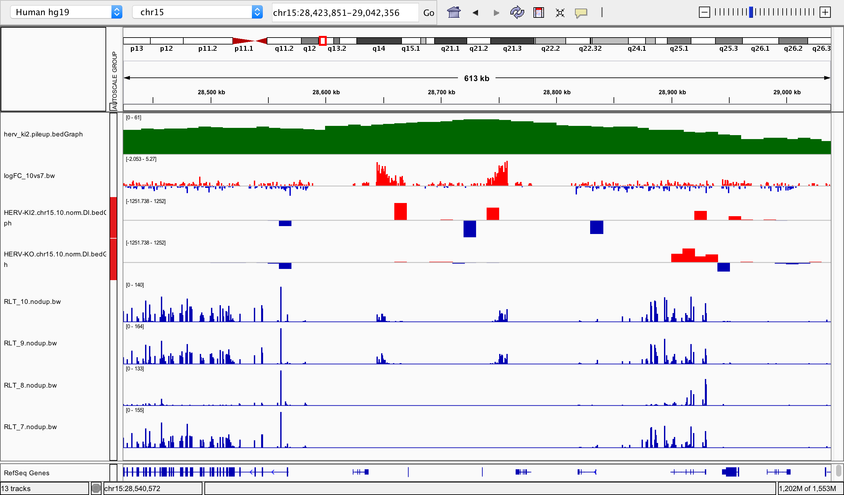
﻿chr15:28756103 (KI2)
…nope

Slide 8
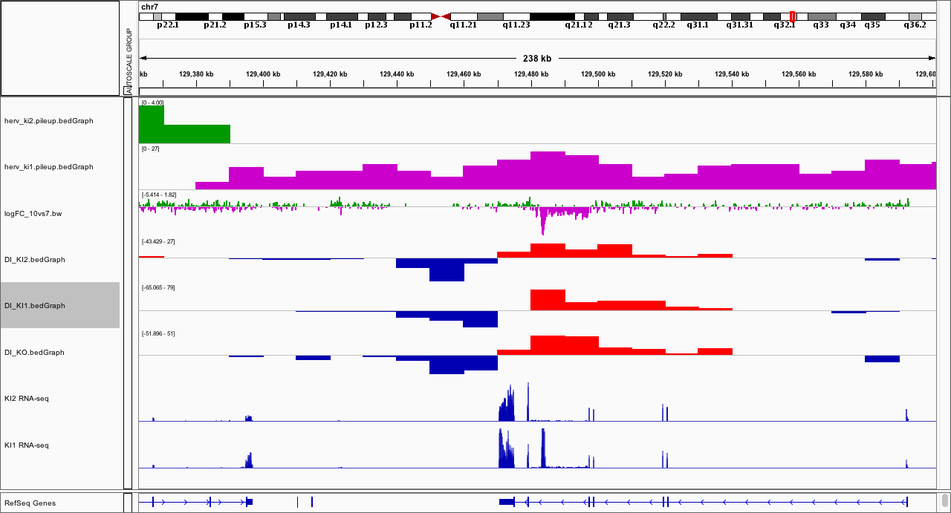
﻿chr7:129483867 (KI1)

Slide 9
﻿chr7:129483867 (KI1)
KO
KI
Extends/enhances TAD boundary?

Slide 10
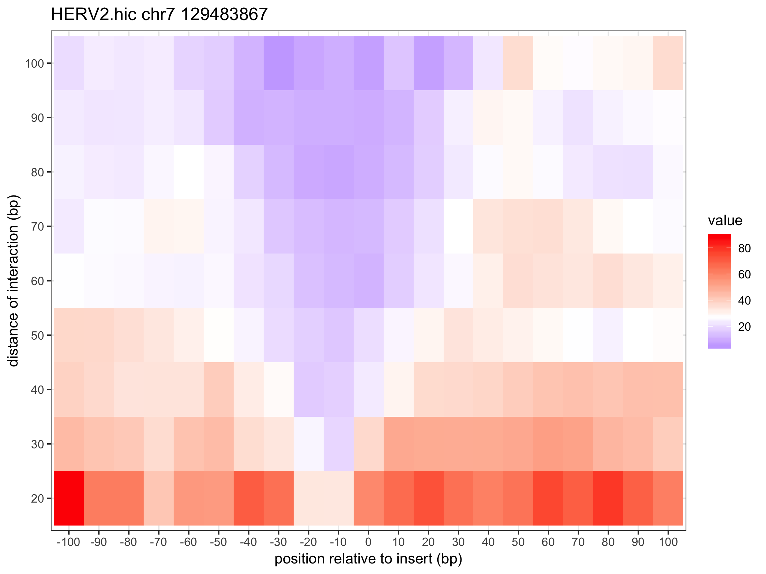
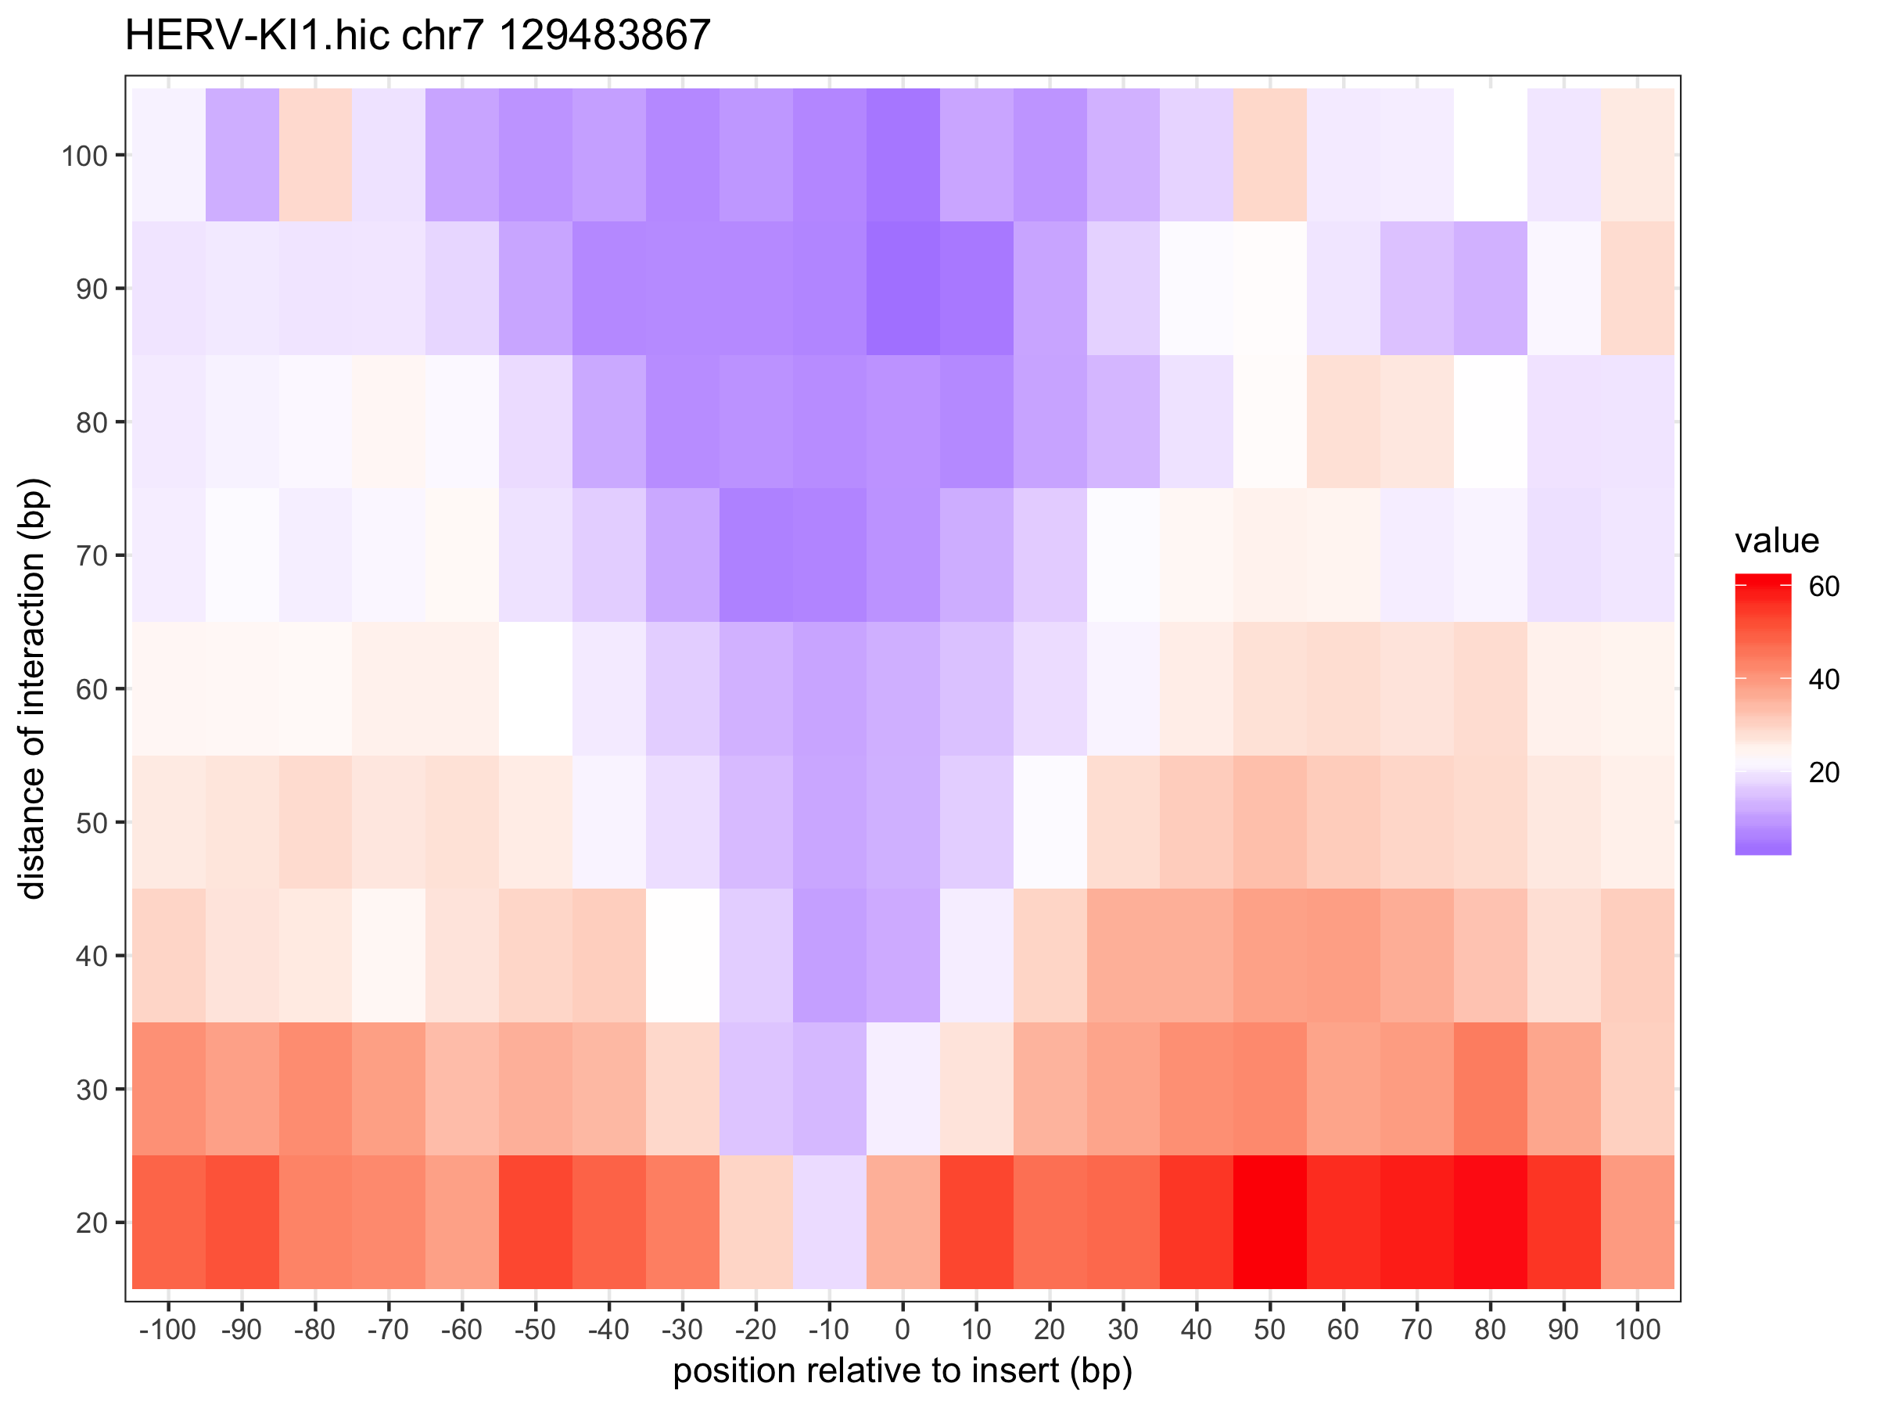

Slide 11
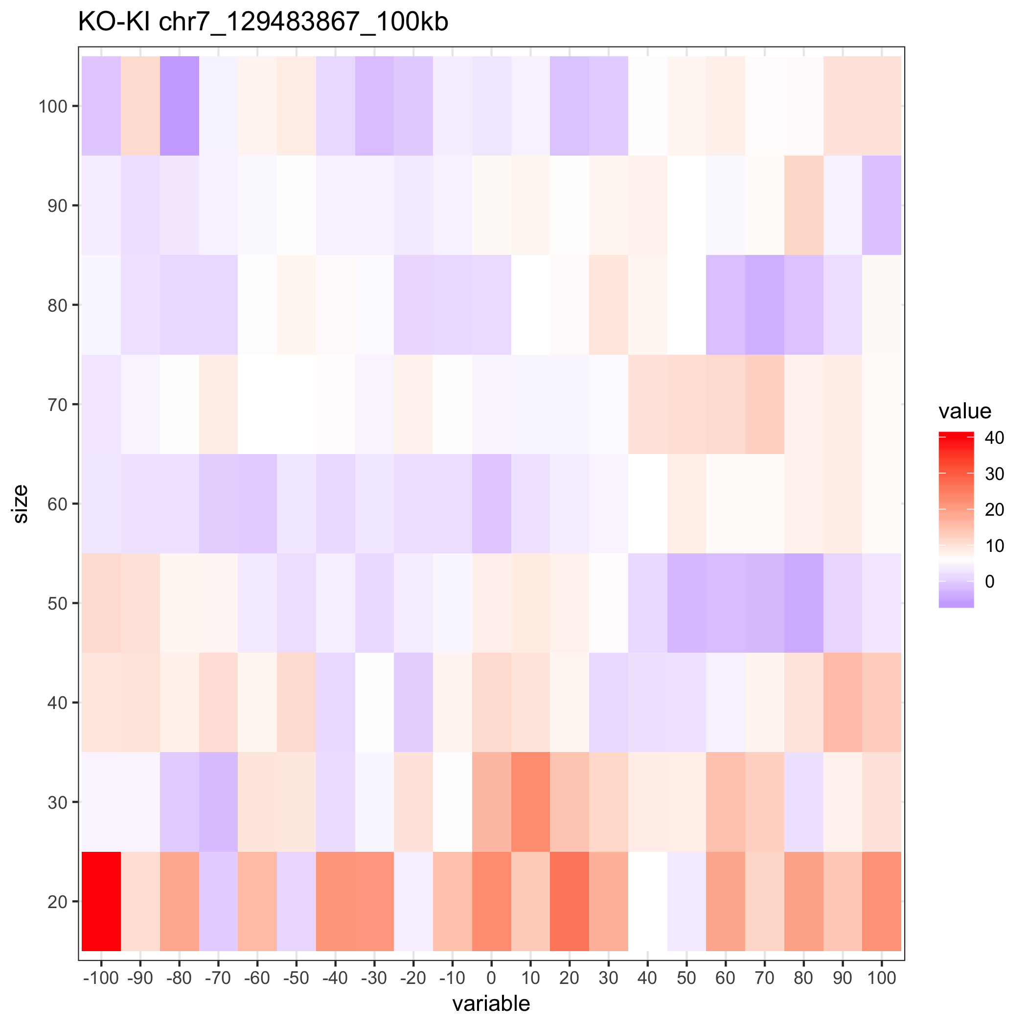
more red = KI is insulating more

Slide 12
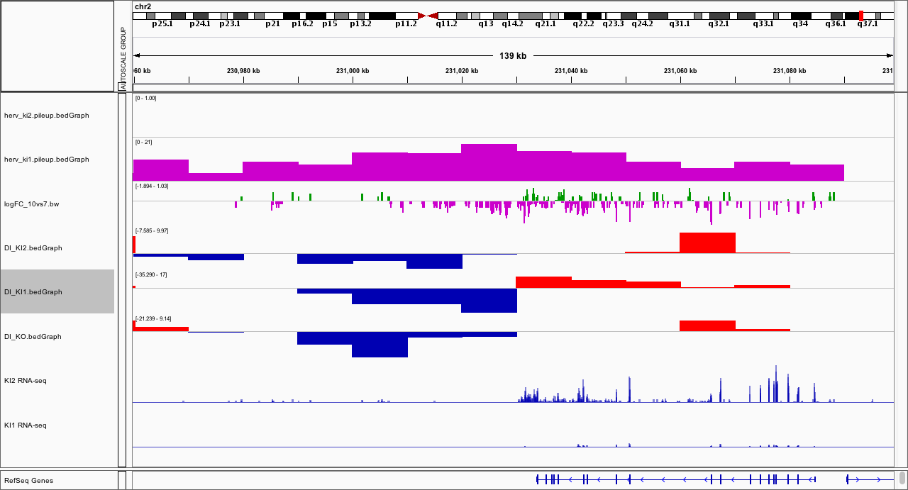
﻿chr2:231025165 (KI1)
seems to downregulate upstream gene

Slide 13
﻿chr2:231025165 (KI1)
KO
KI1

Slide 14
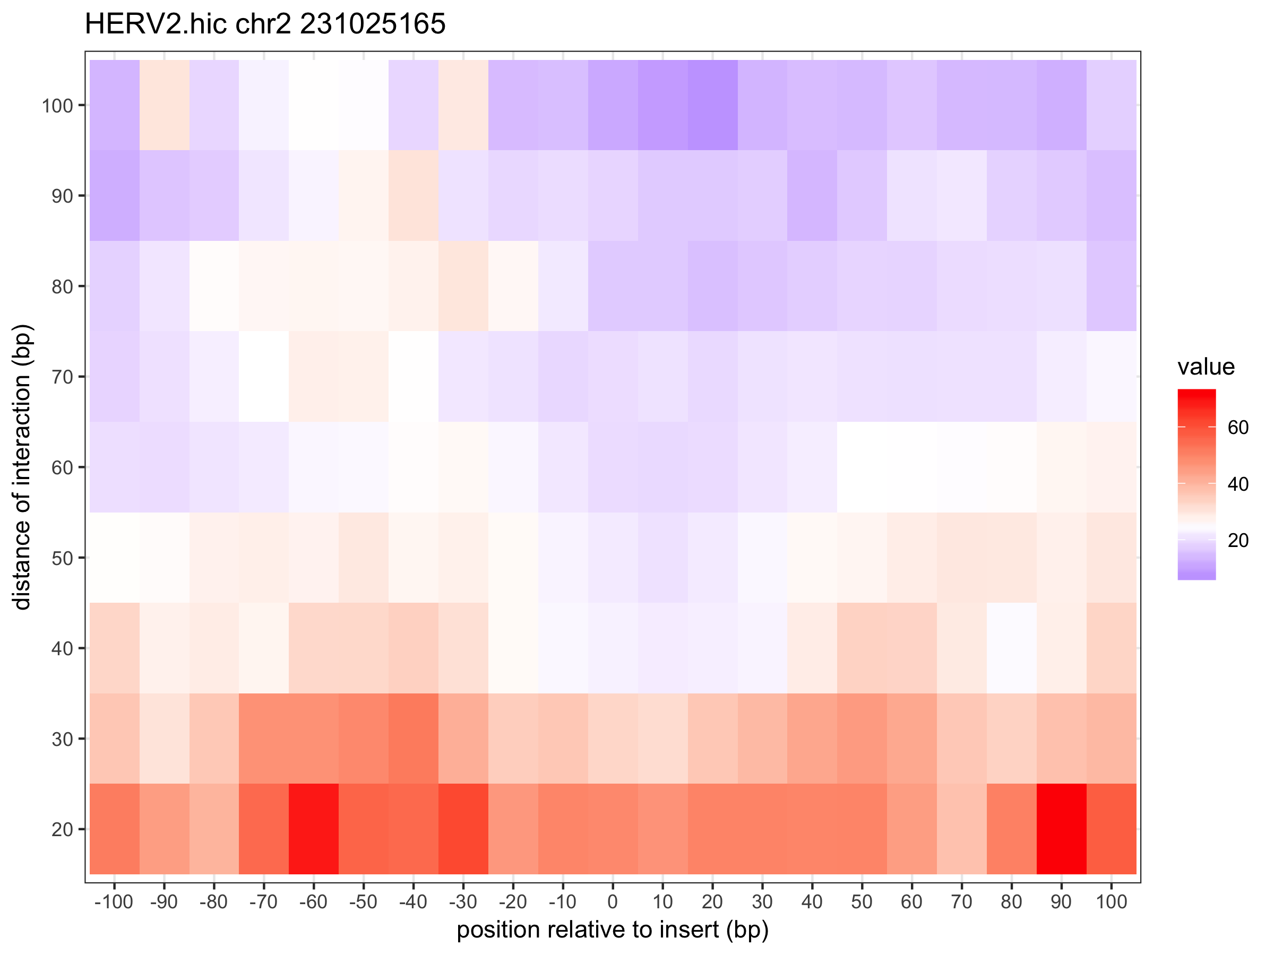
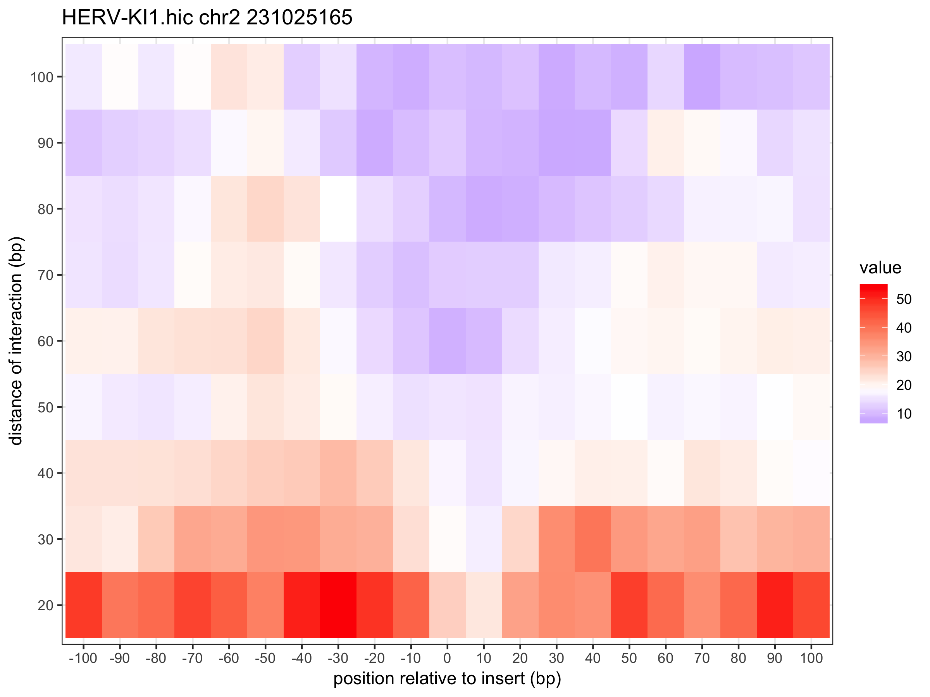

Slide 15
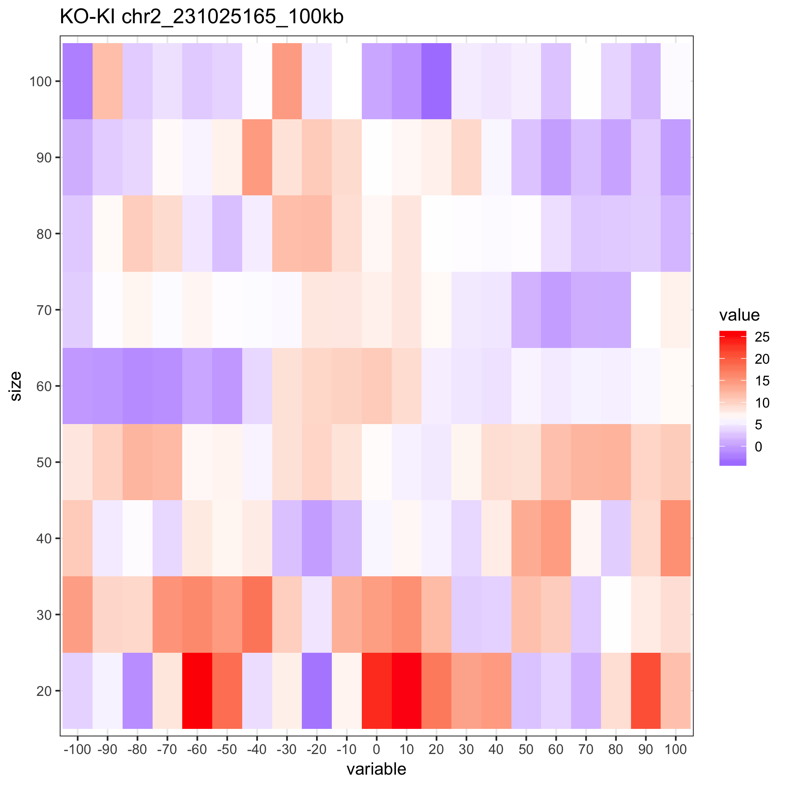

Slide 16
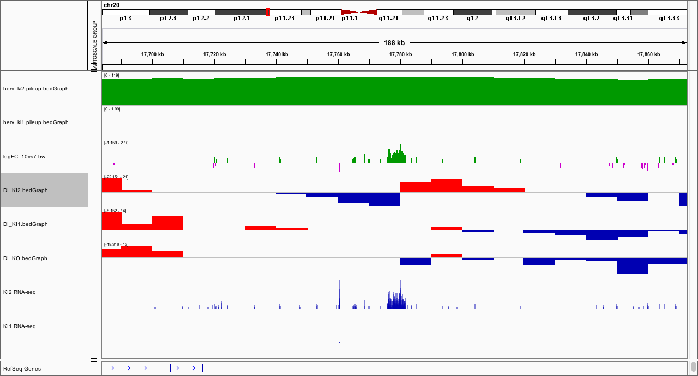
﻿chr20:17778859 (KI2)

Slide 17
﻿chr20:17778859 (KI2)
KO
KI2

Slide 18
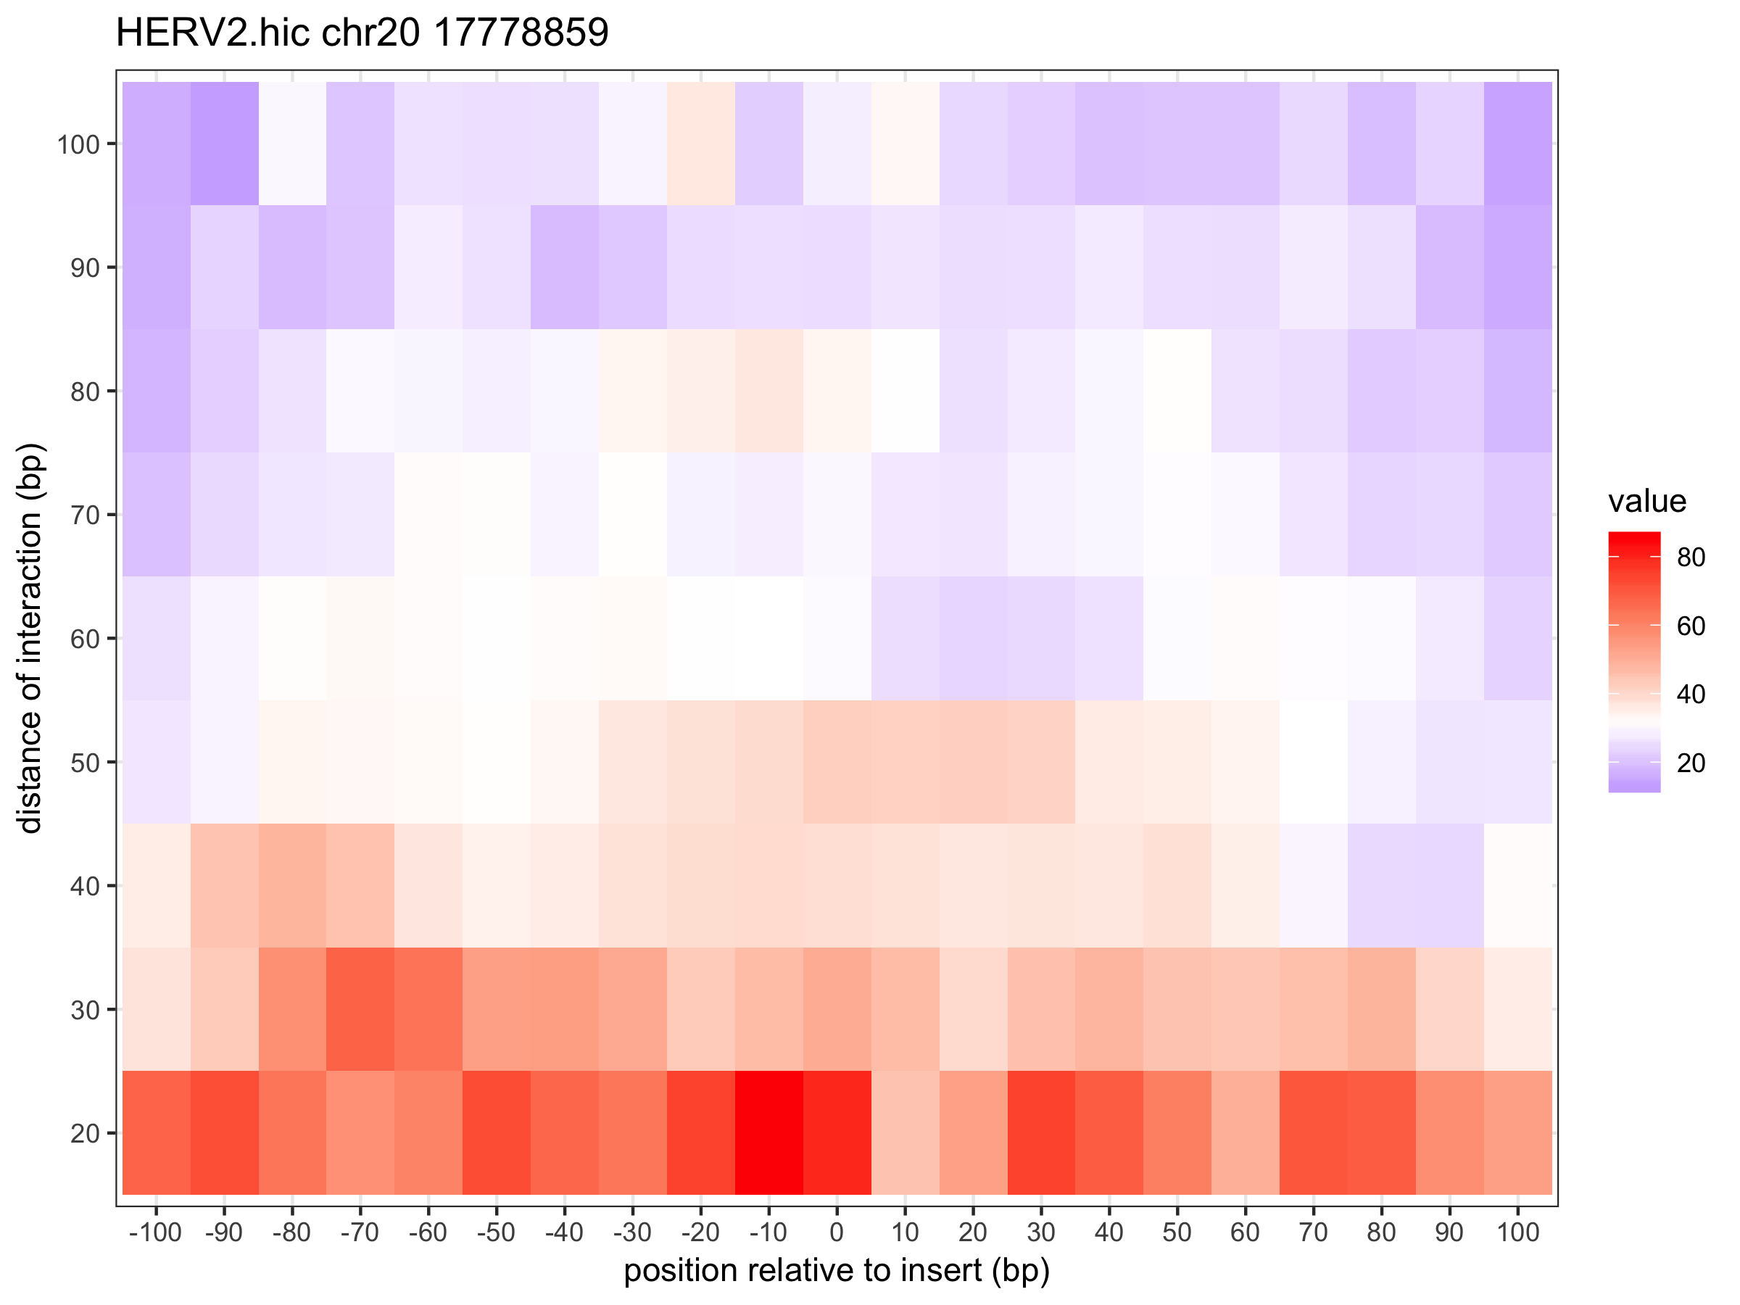
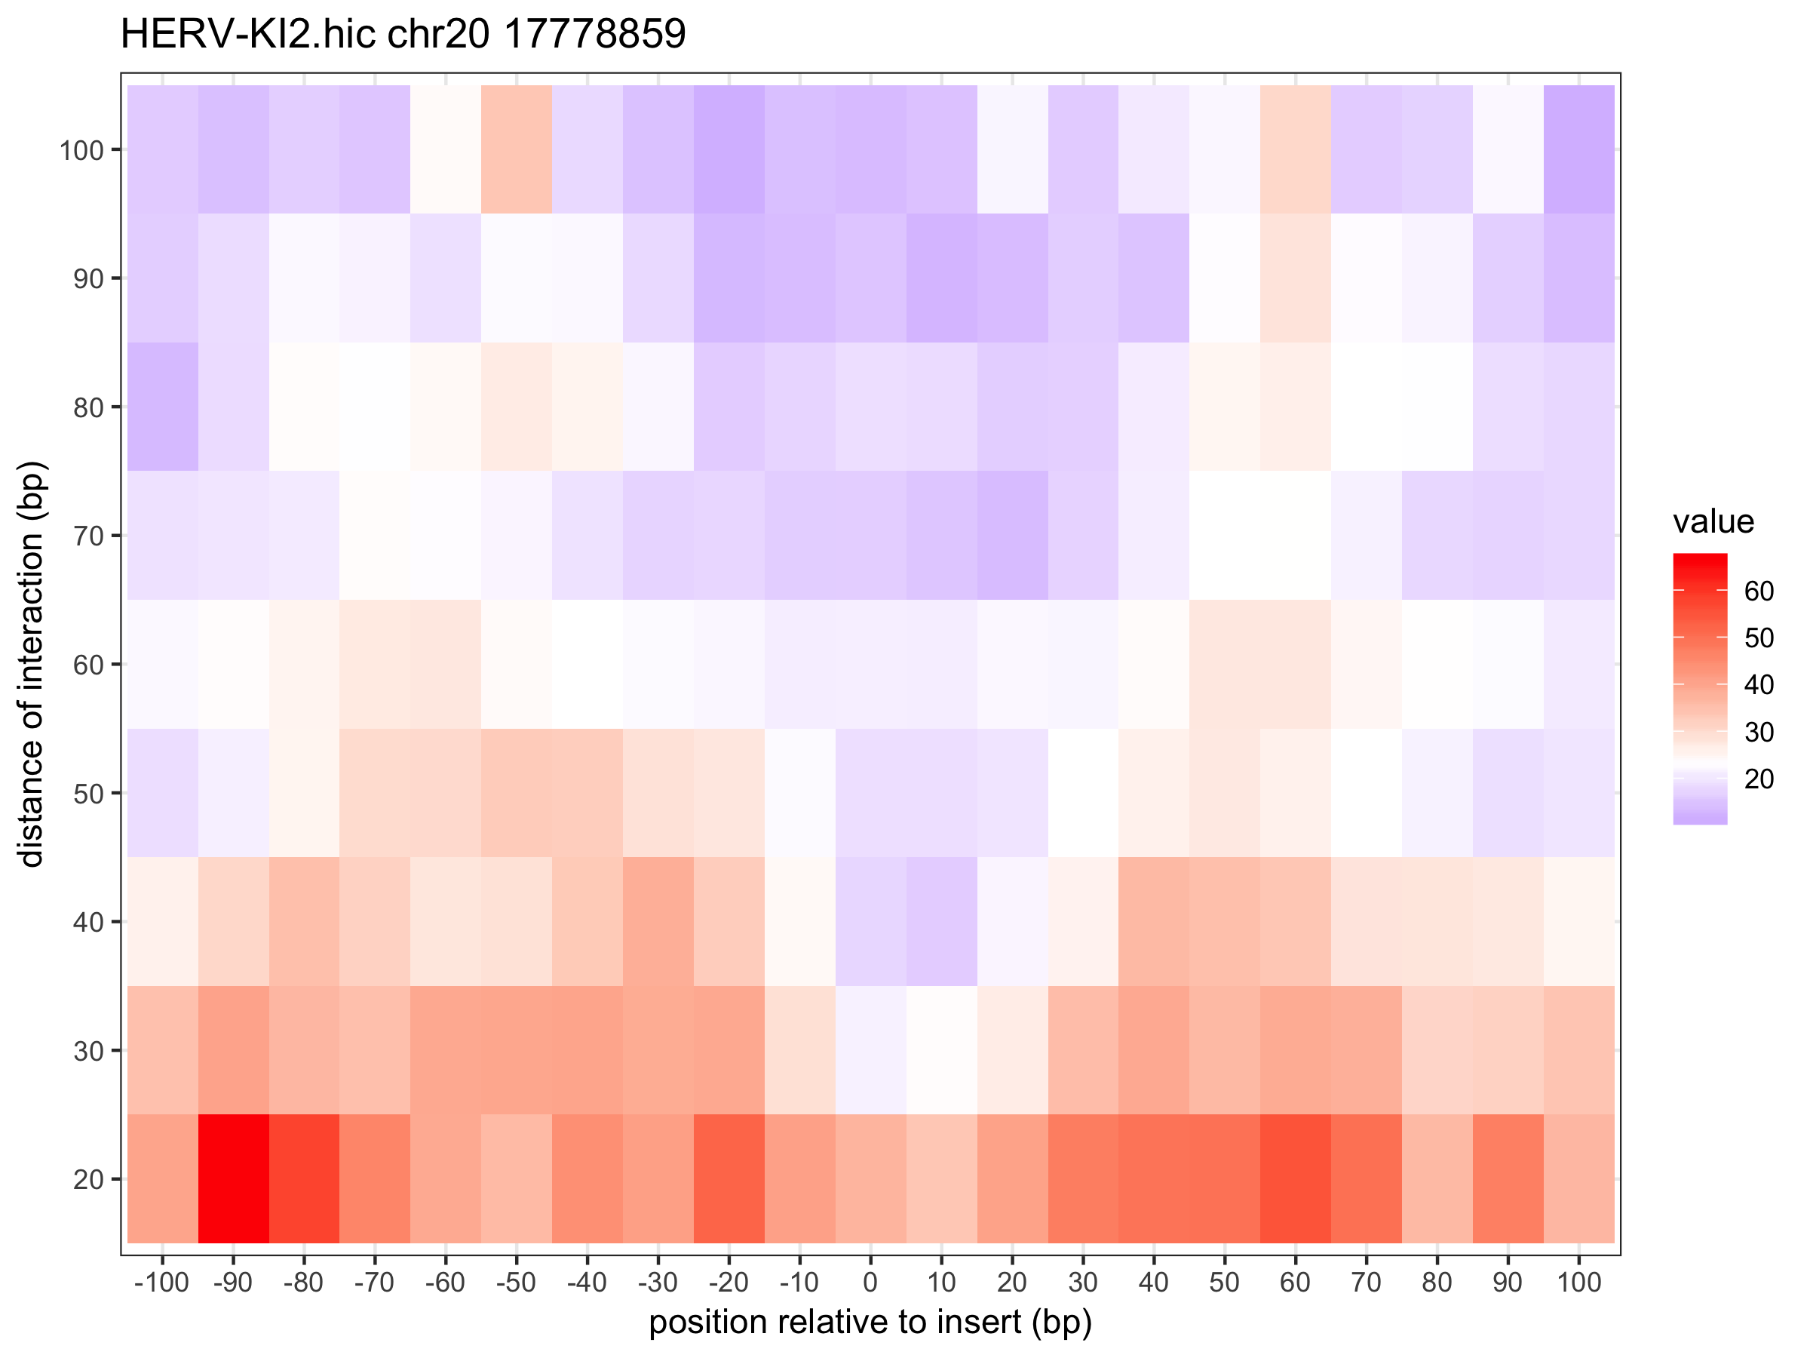

Slide 19
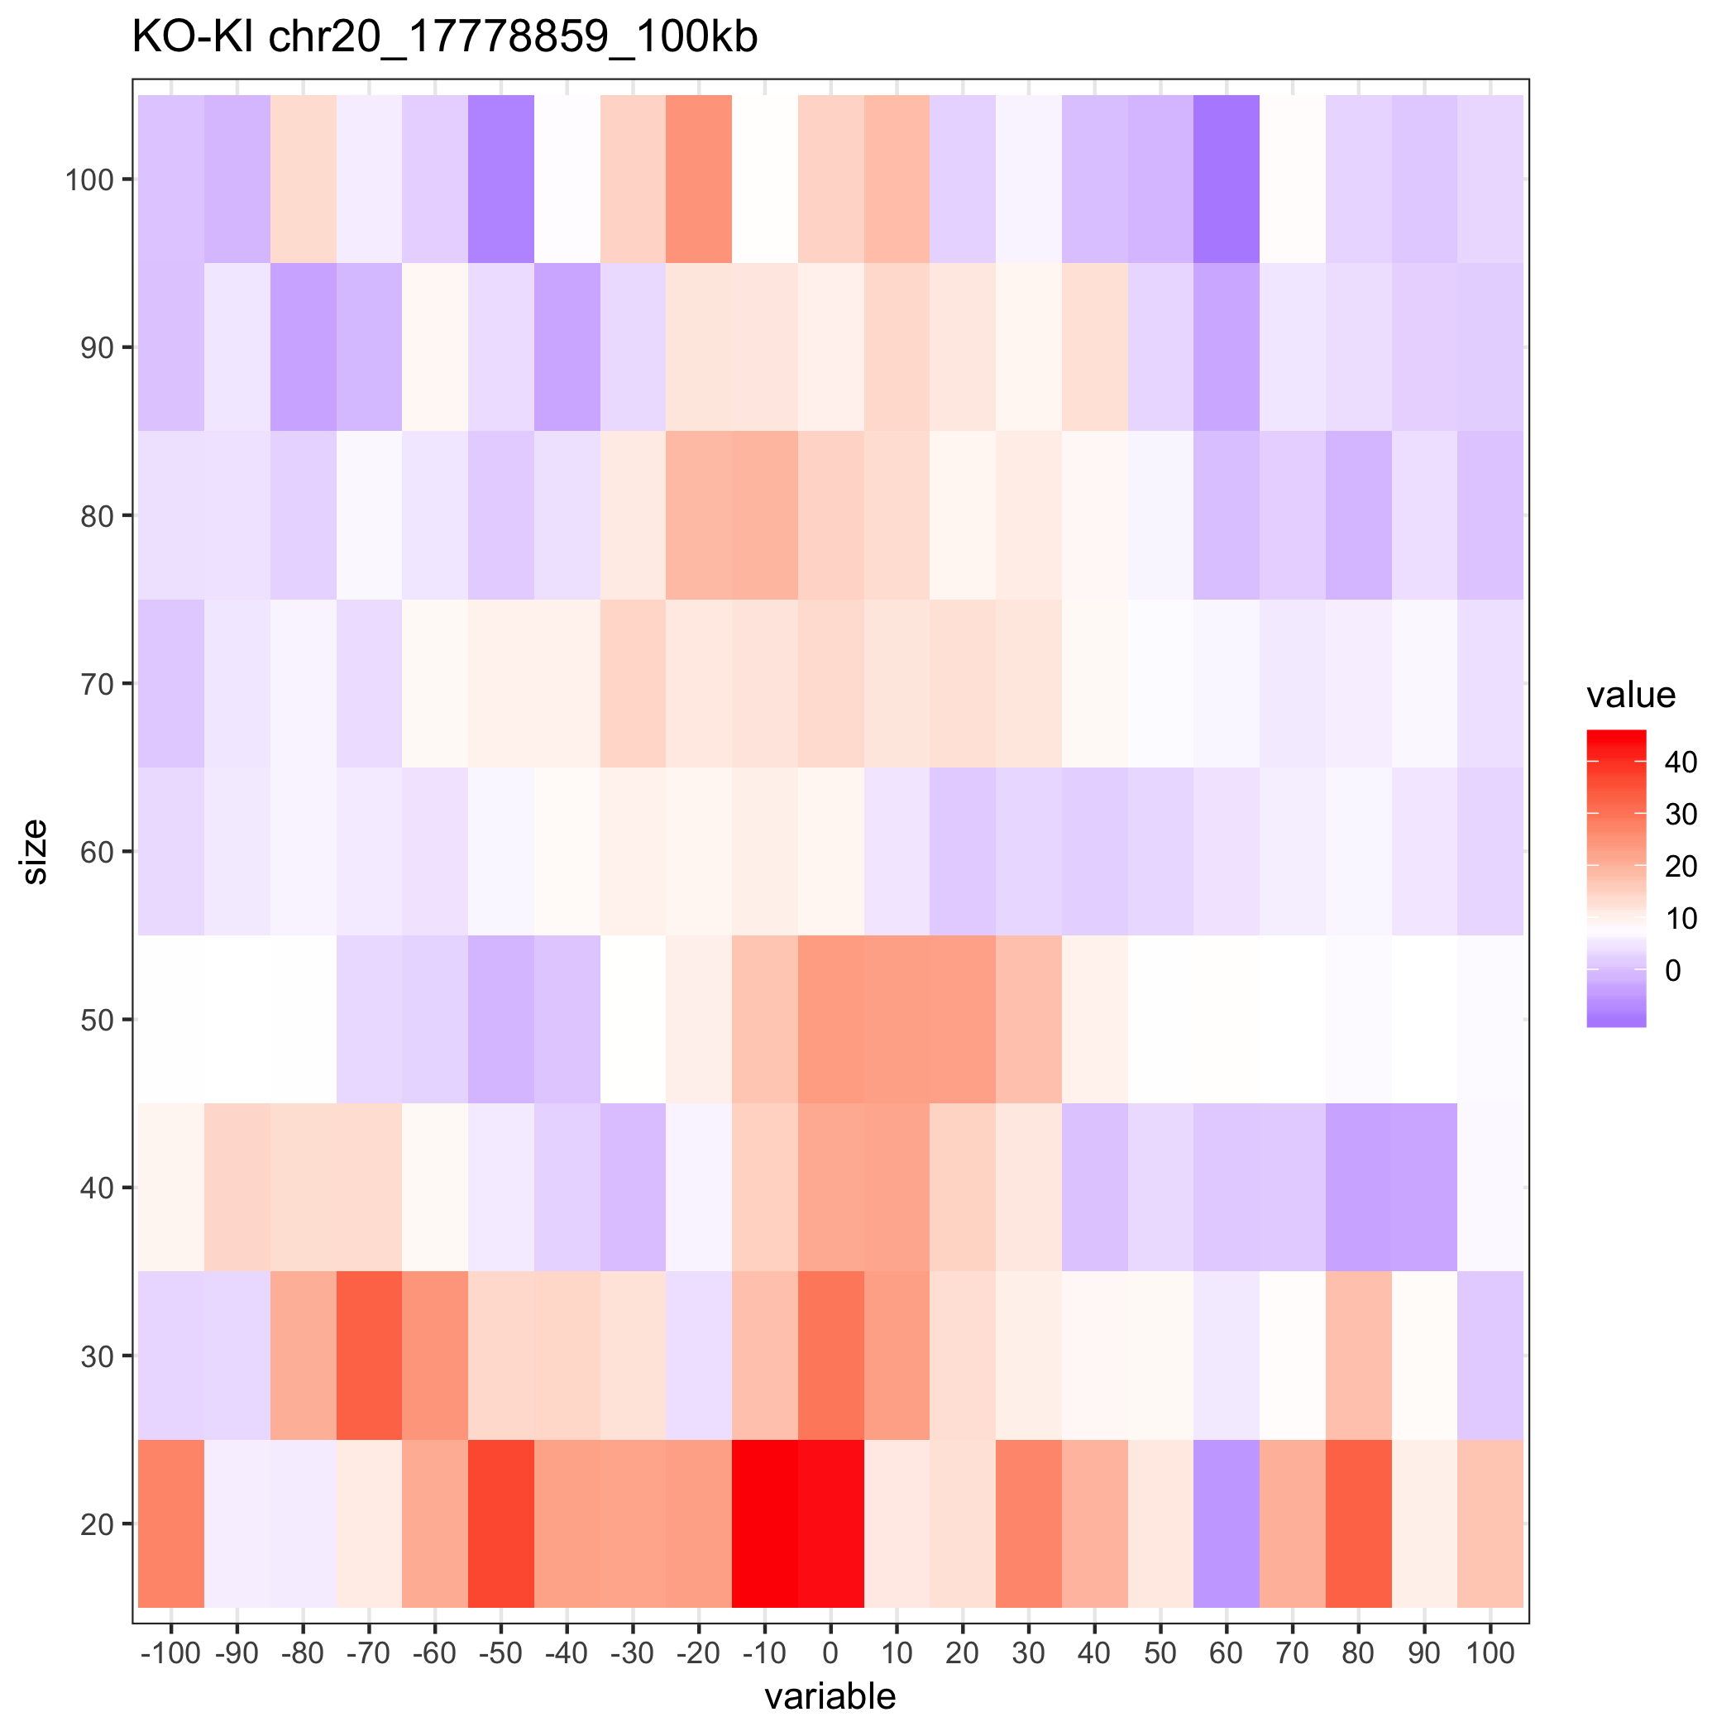

Slide 20
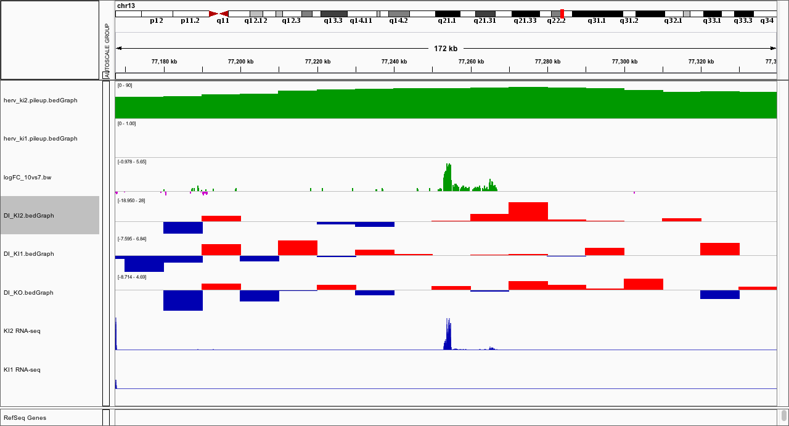
chr13:77254195 (KI2)

Slide 21
﻿chr13:77254195
KO
KI2

Slide 22
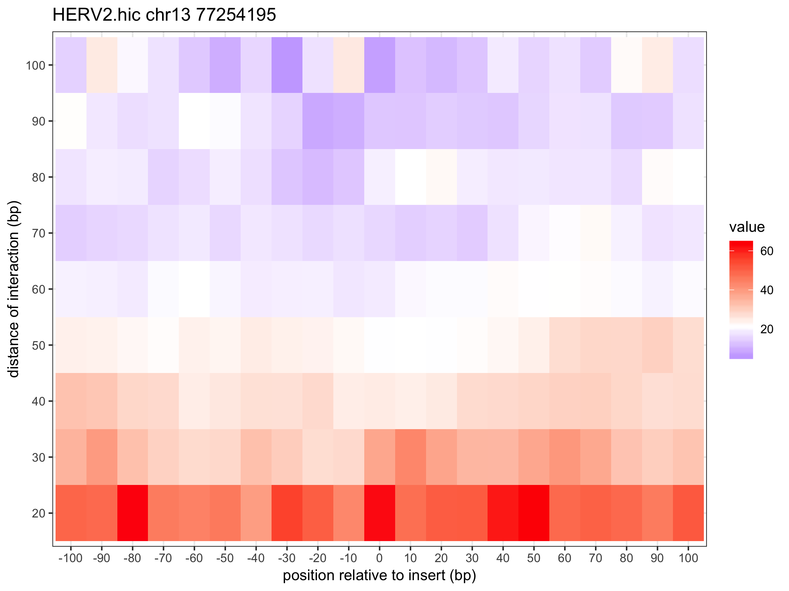
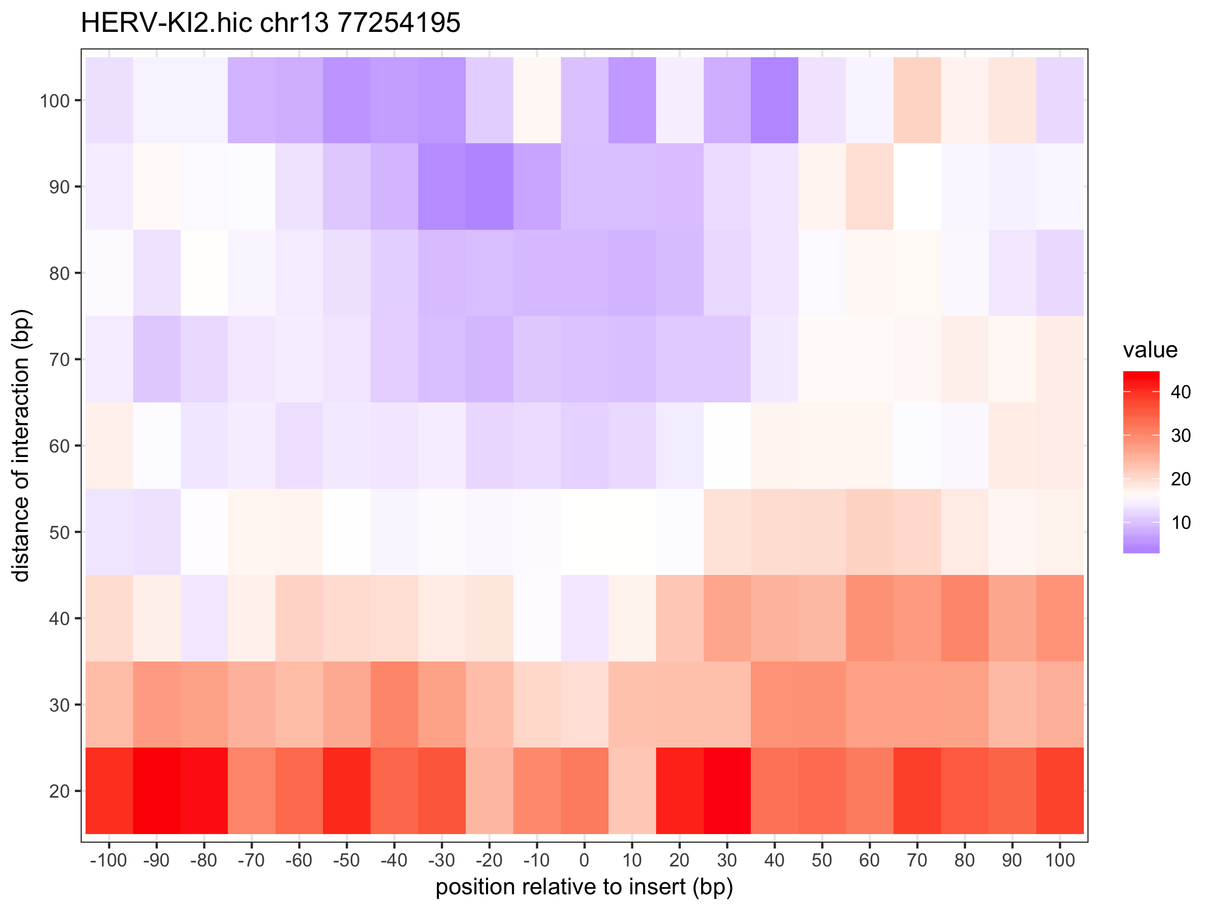

Slide 23
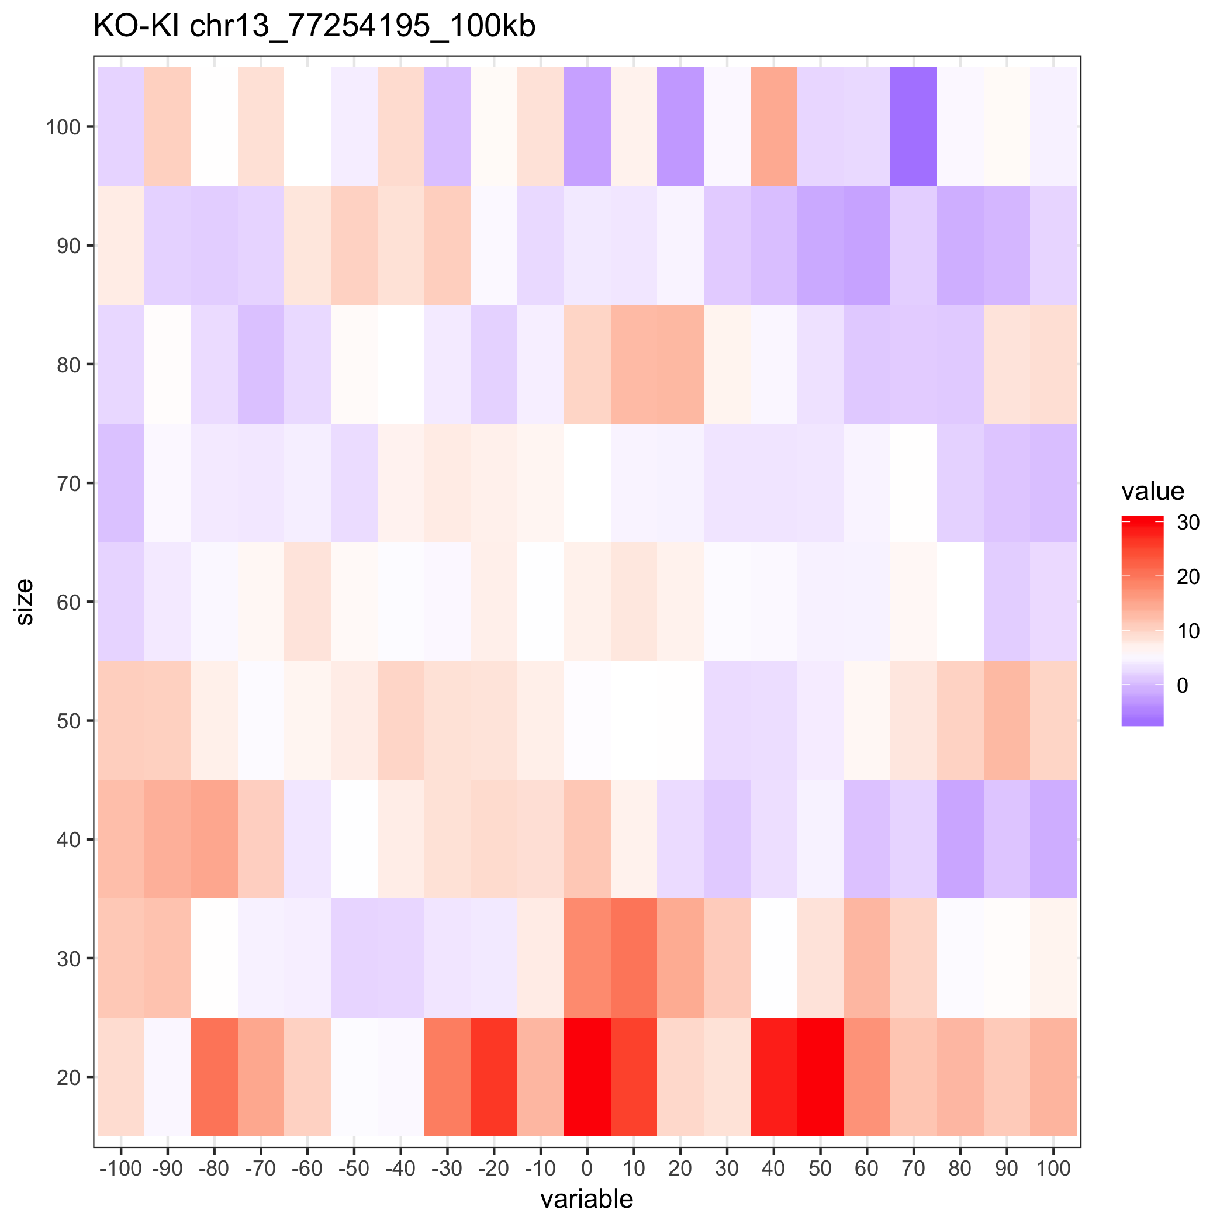

Slide 24
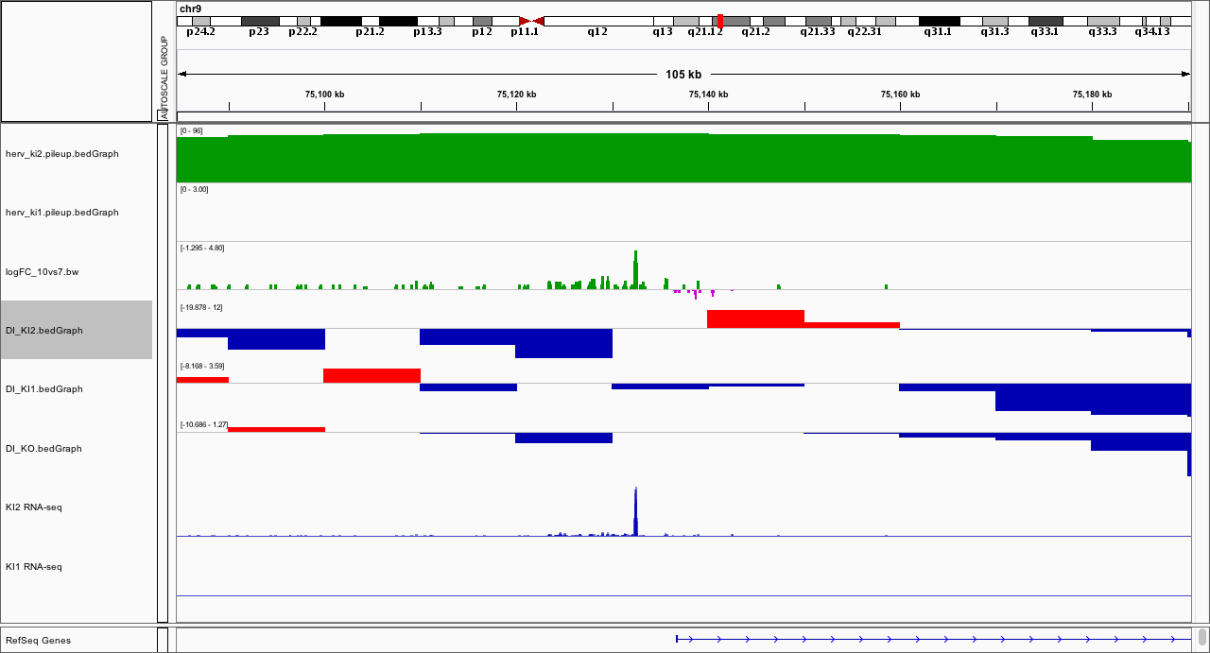
﻿chr9:75132461 (KI2)

Slide 25
﻿chr9:75132461
KO
KI2

Slide 26
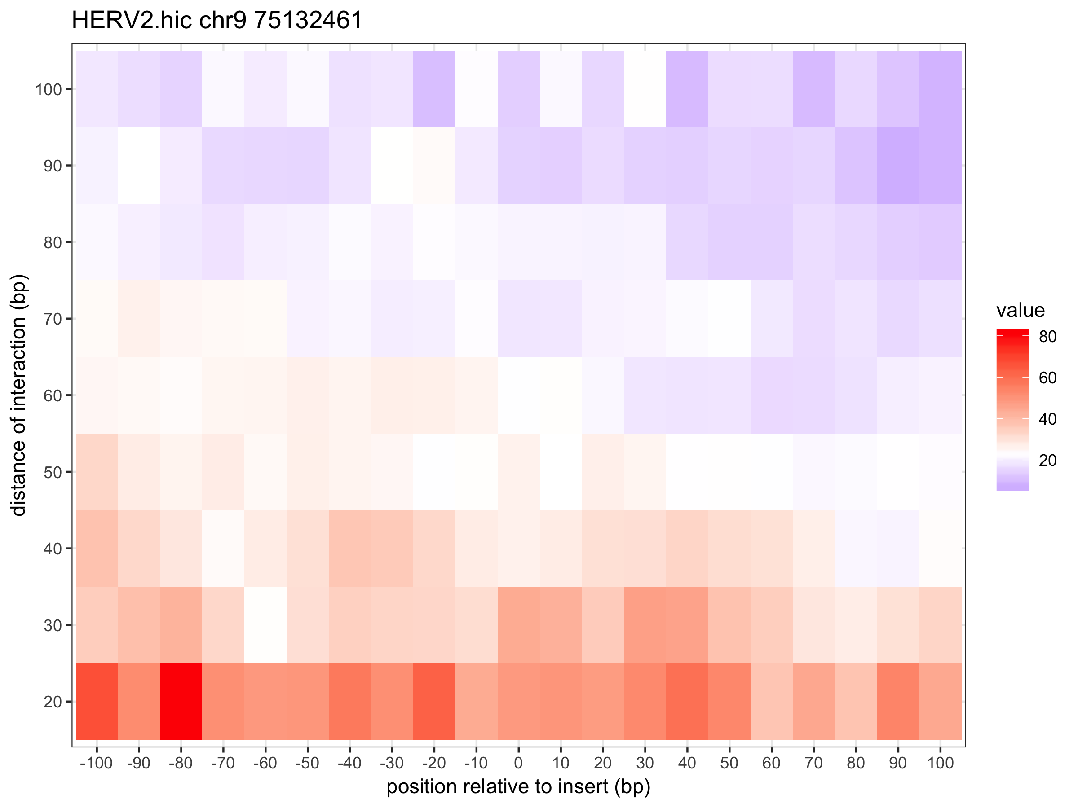
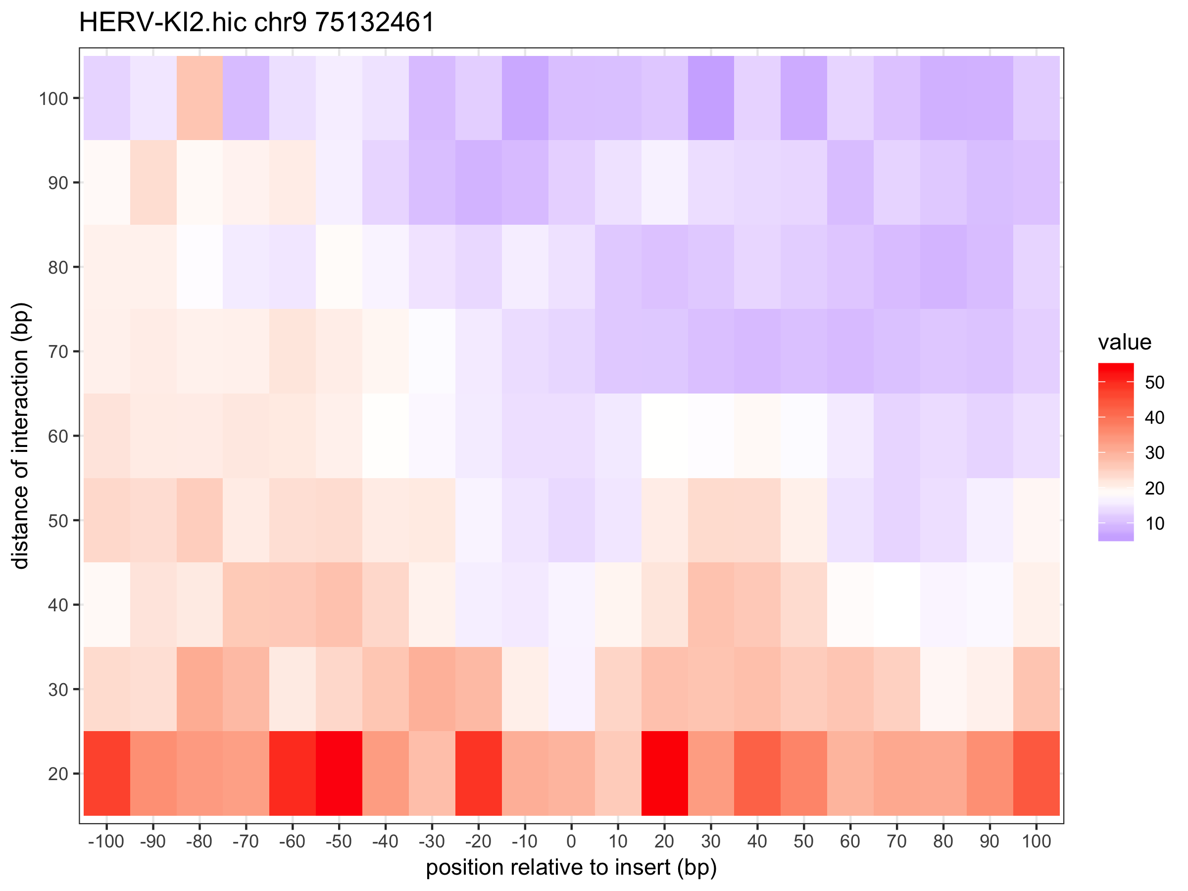

Slide 27
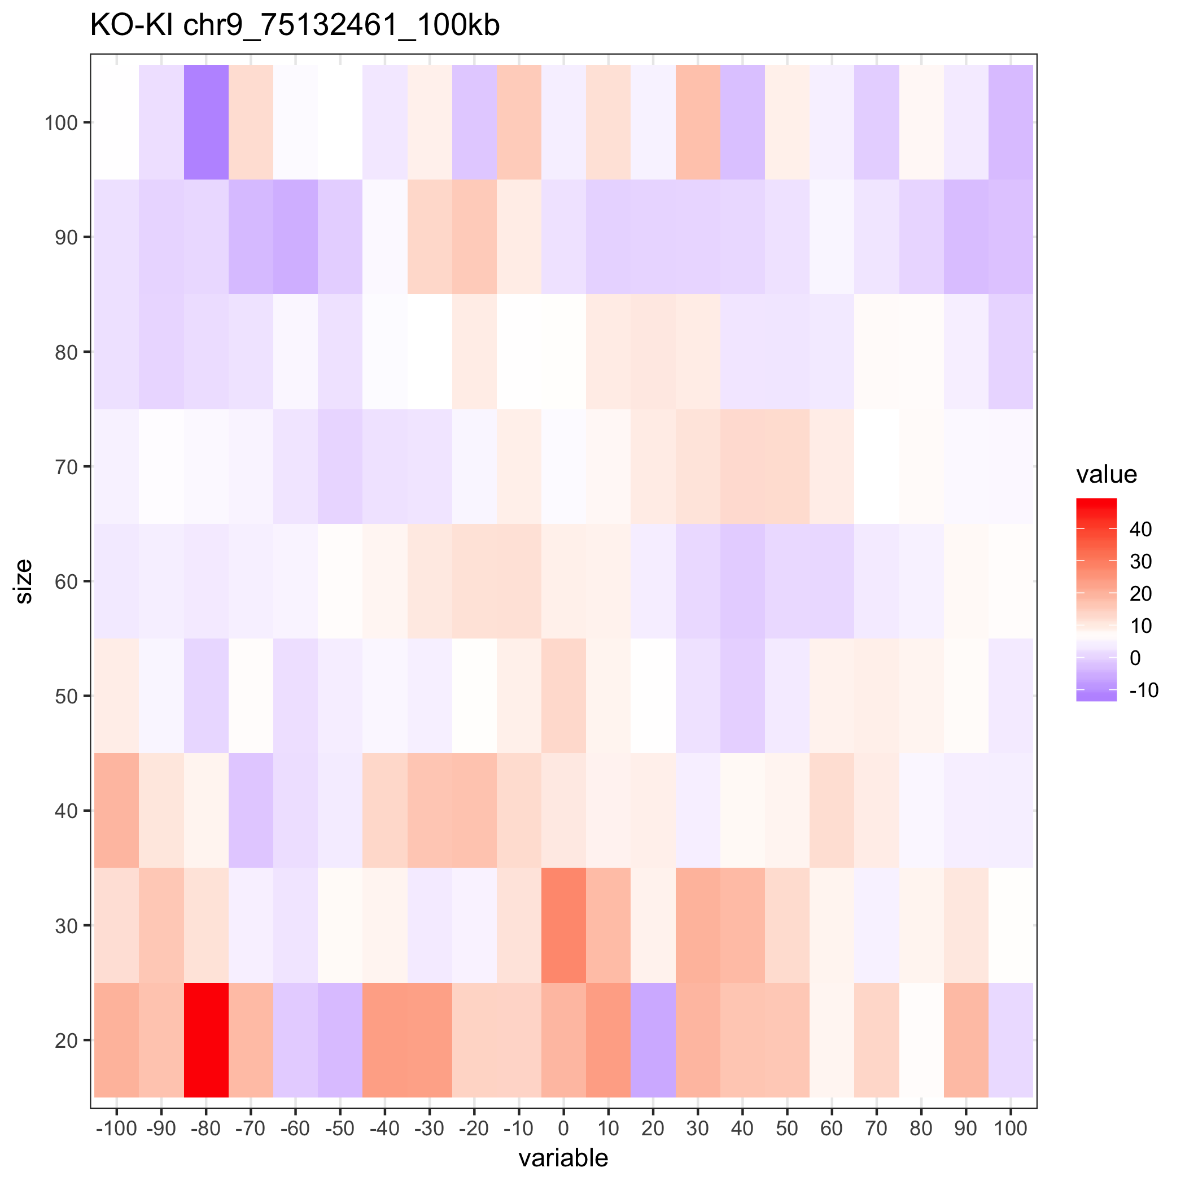

Slide 28
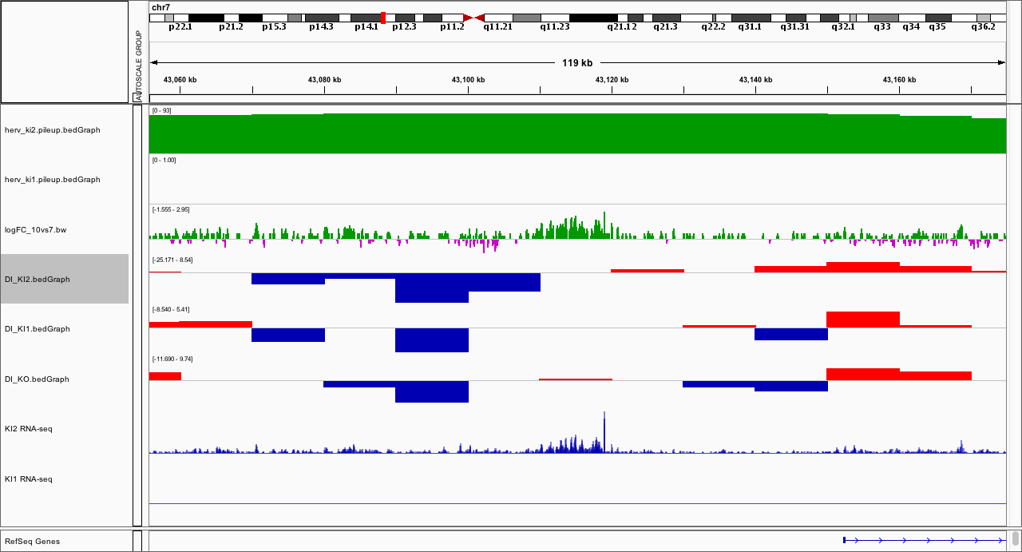
﻿chr7:43115726 (KI2)

Slide 29
﻿chr7:43115726
KO
KI2

Slide 30
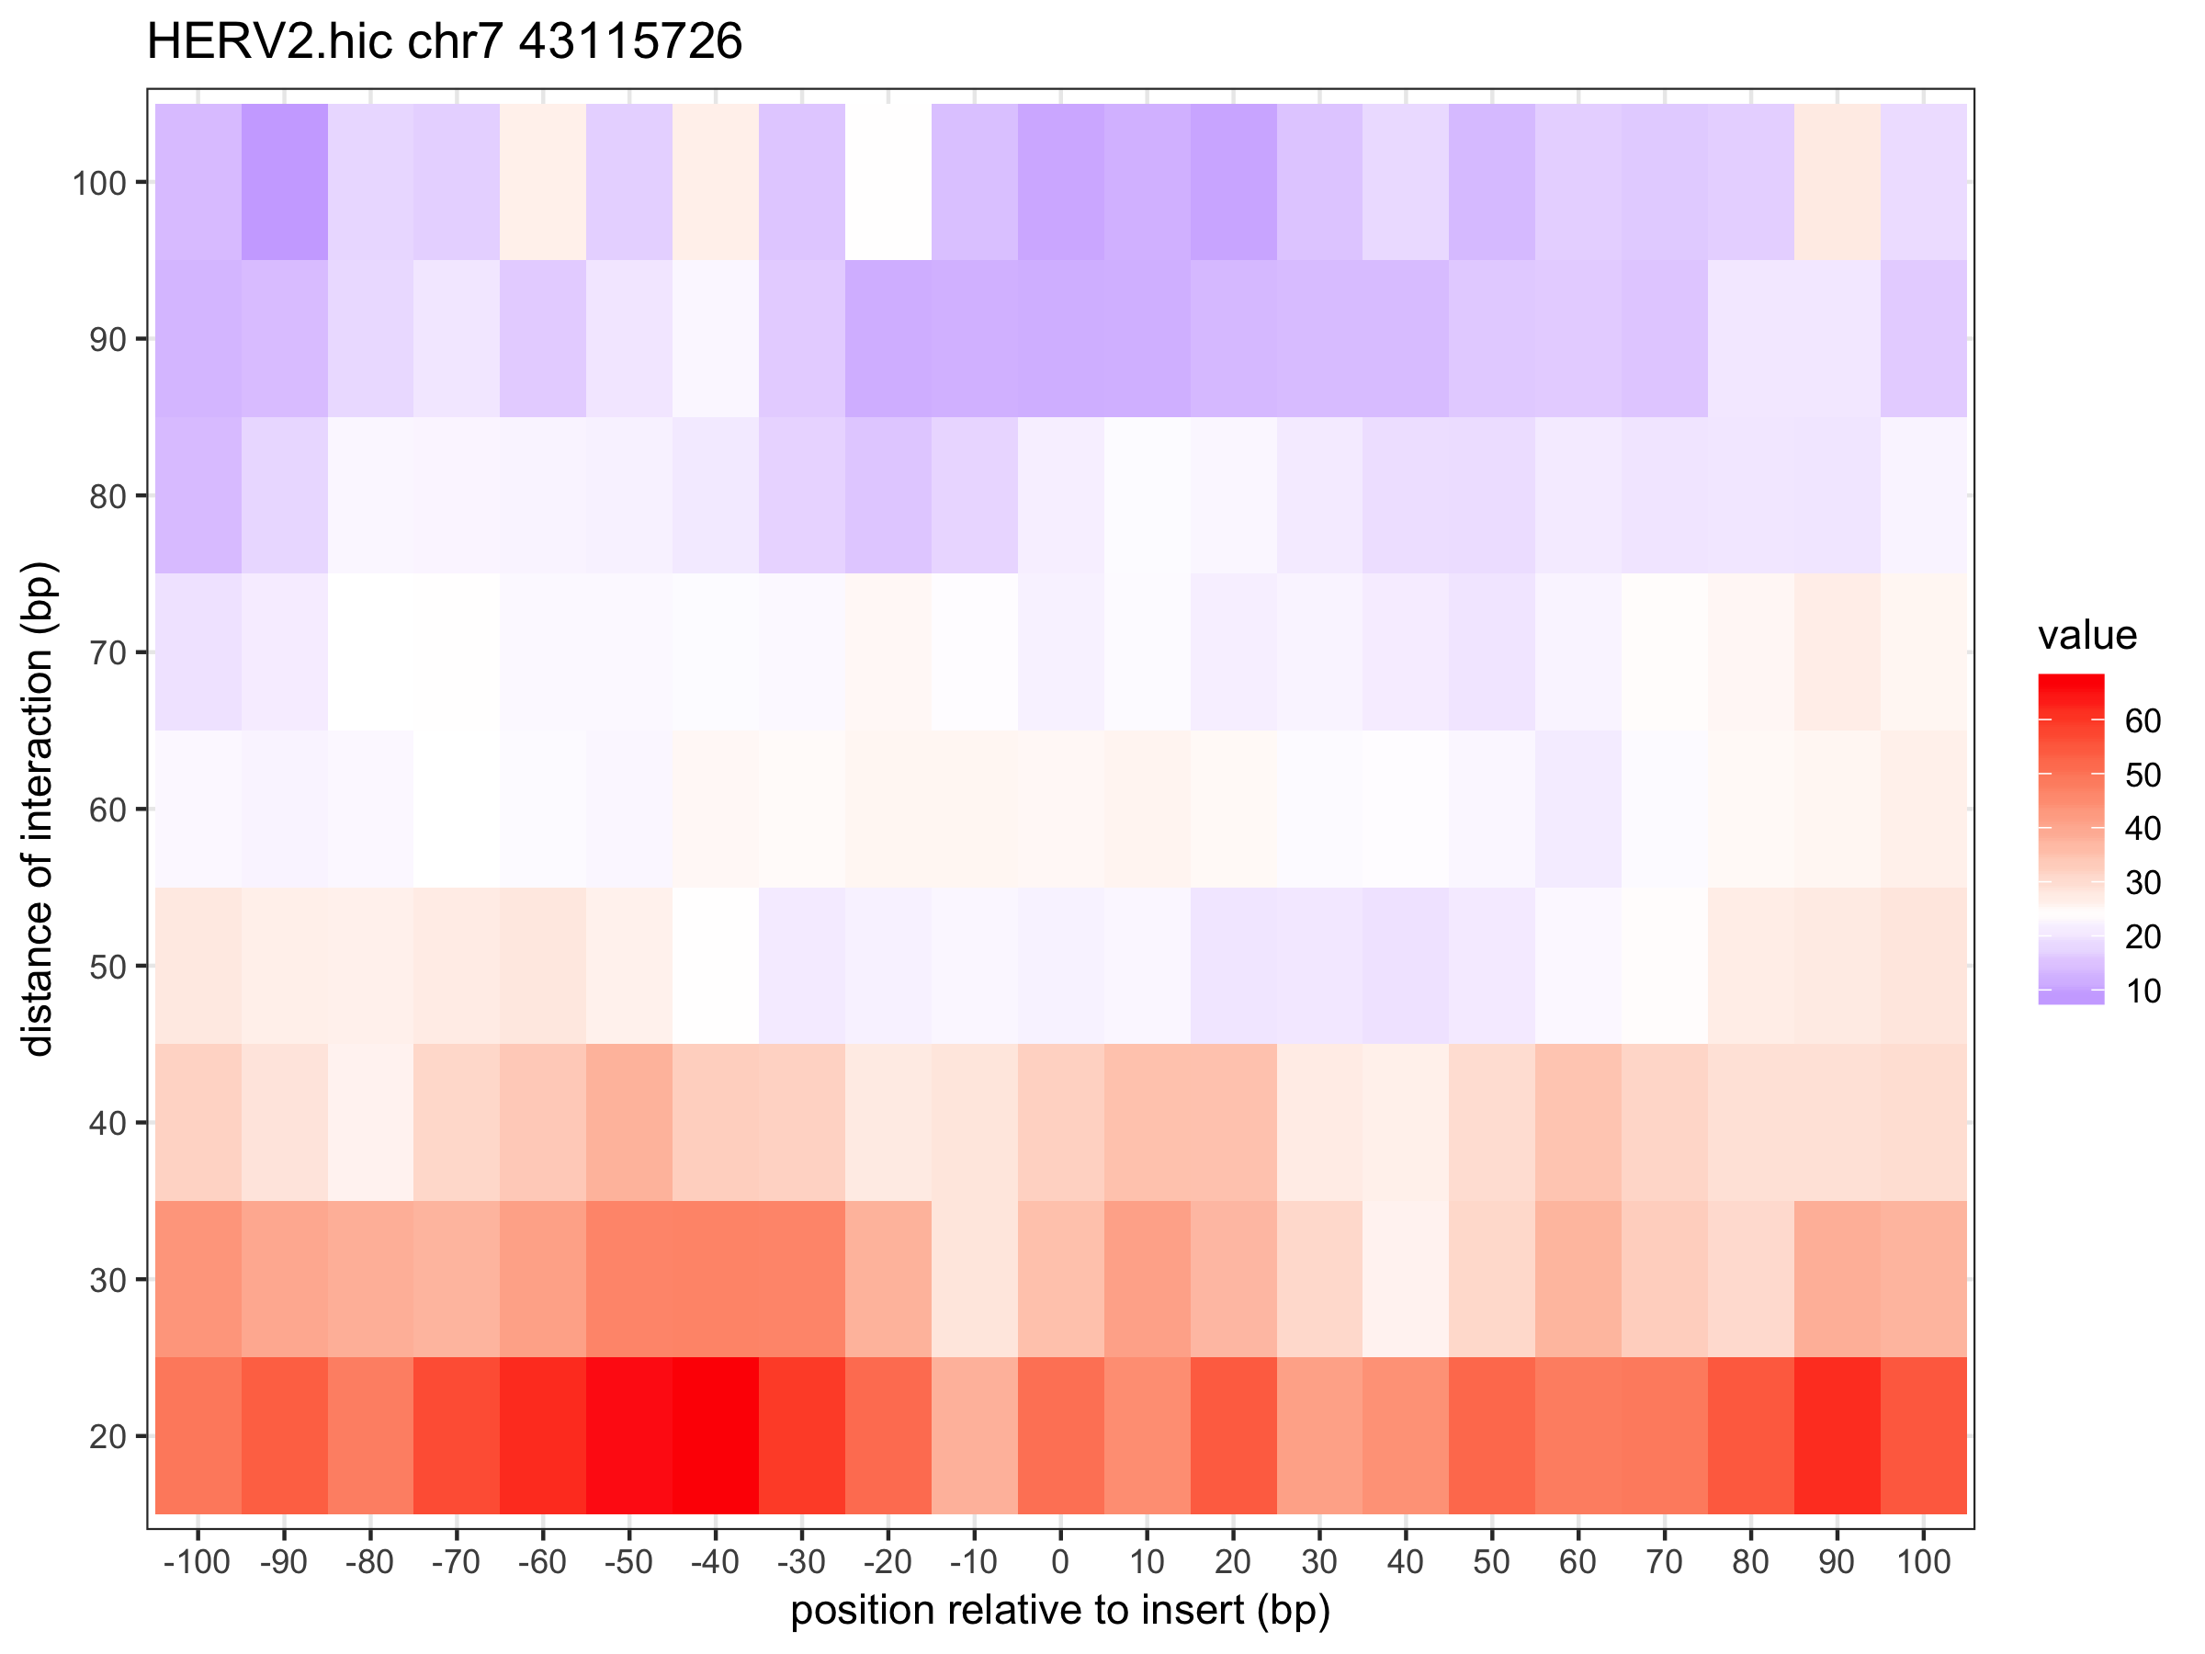
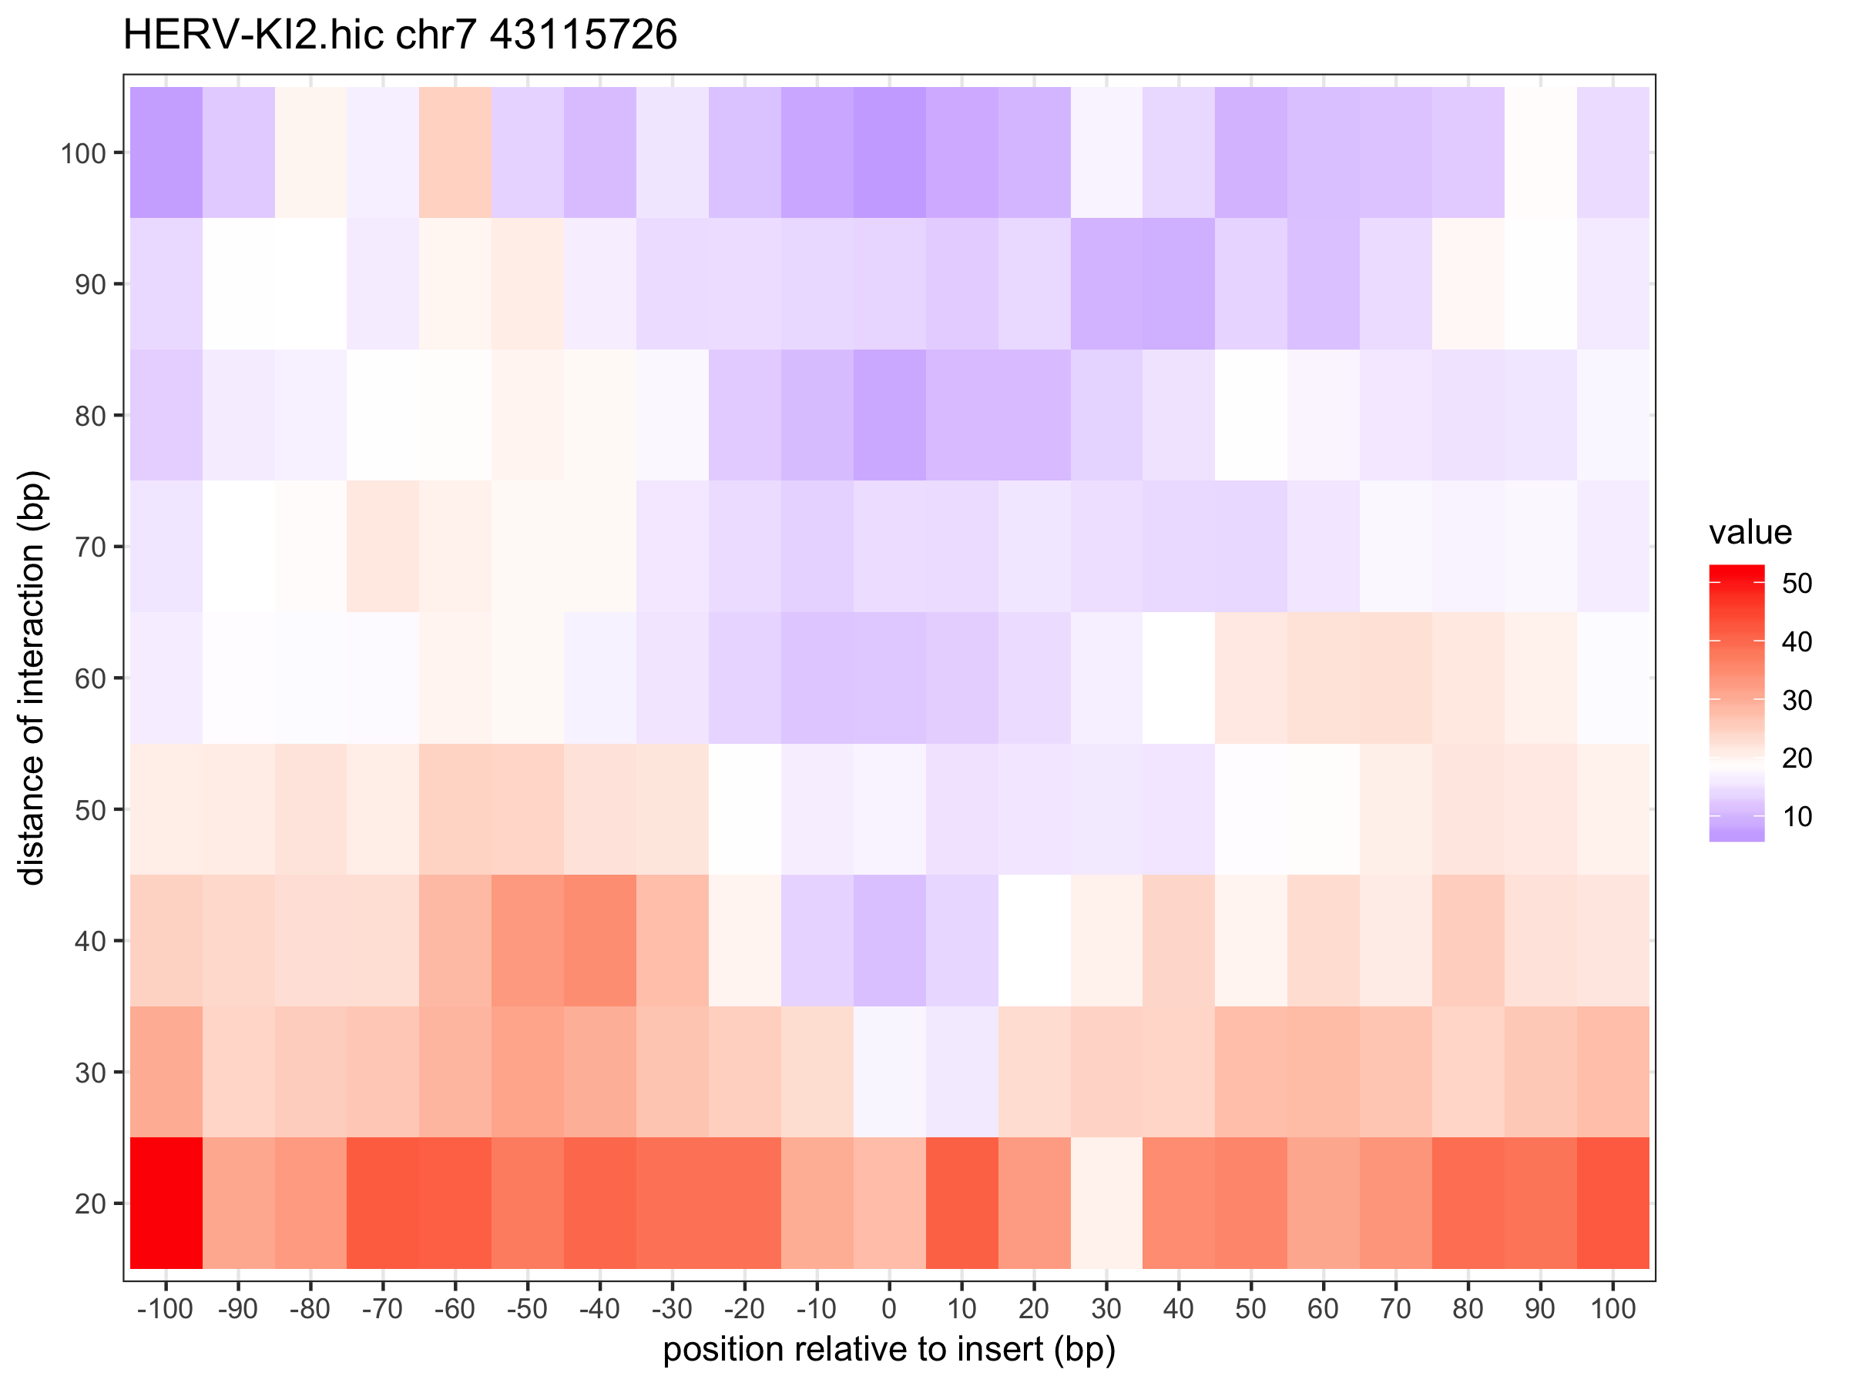

Slide 31
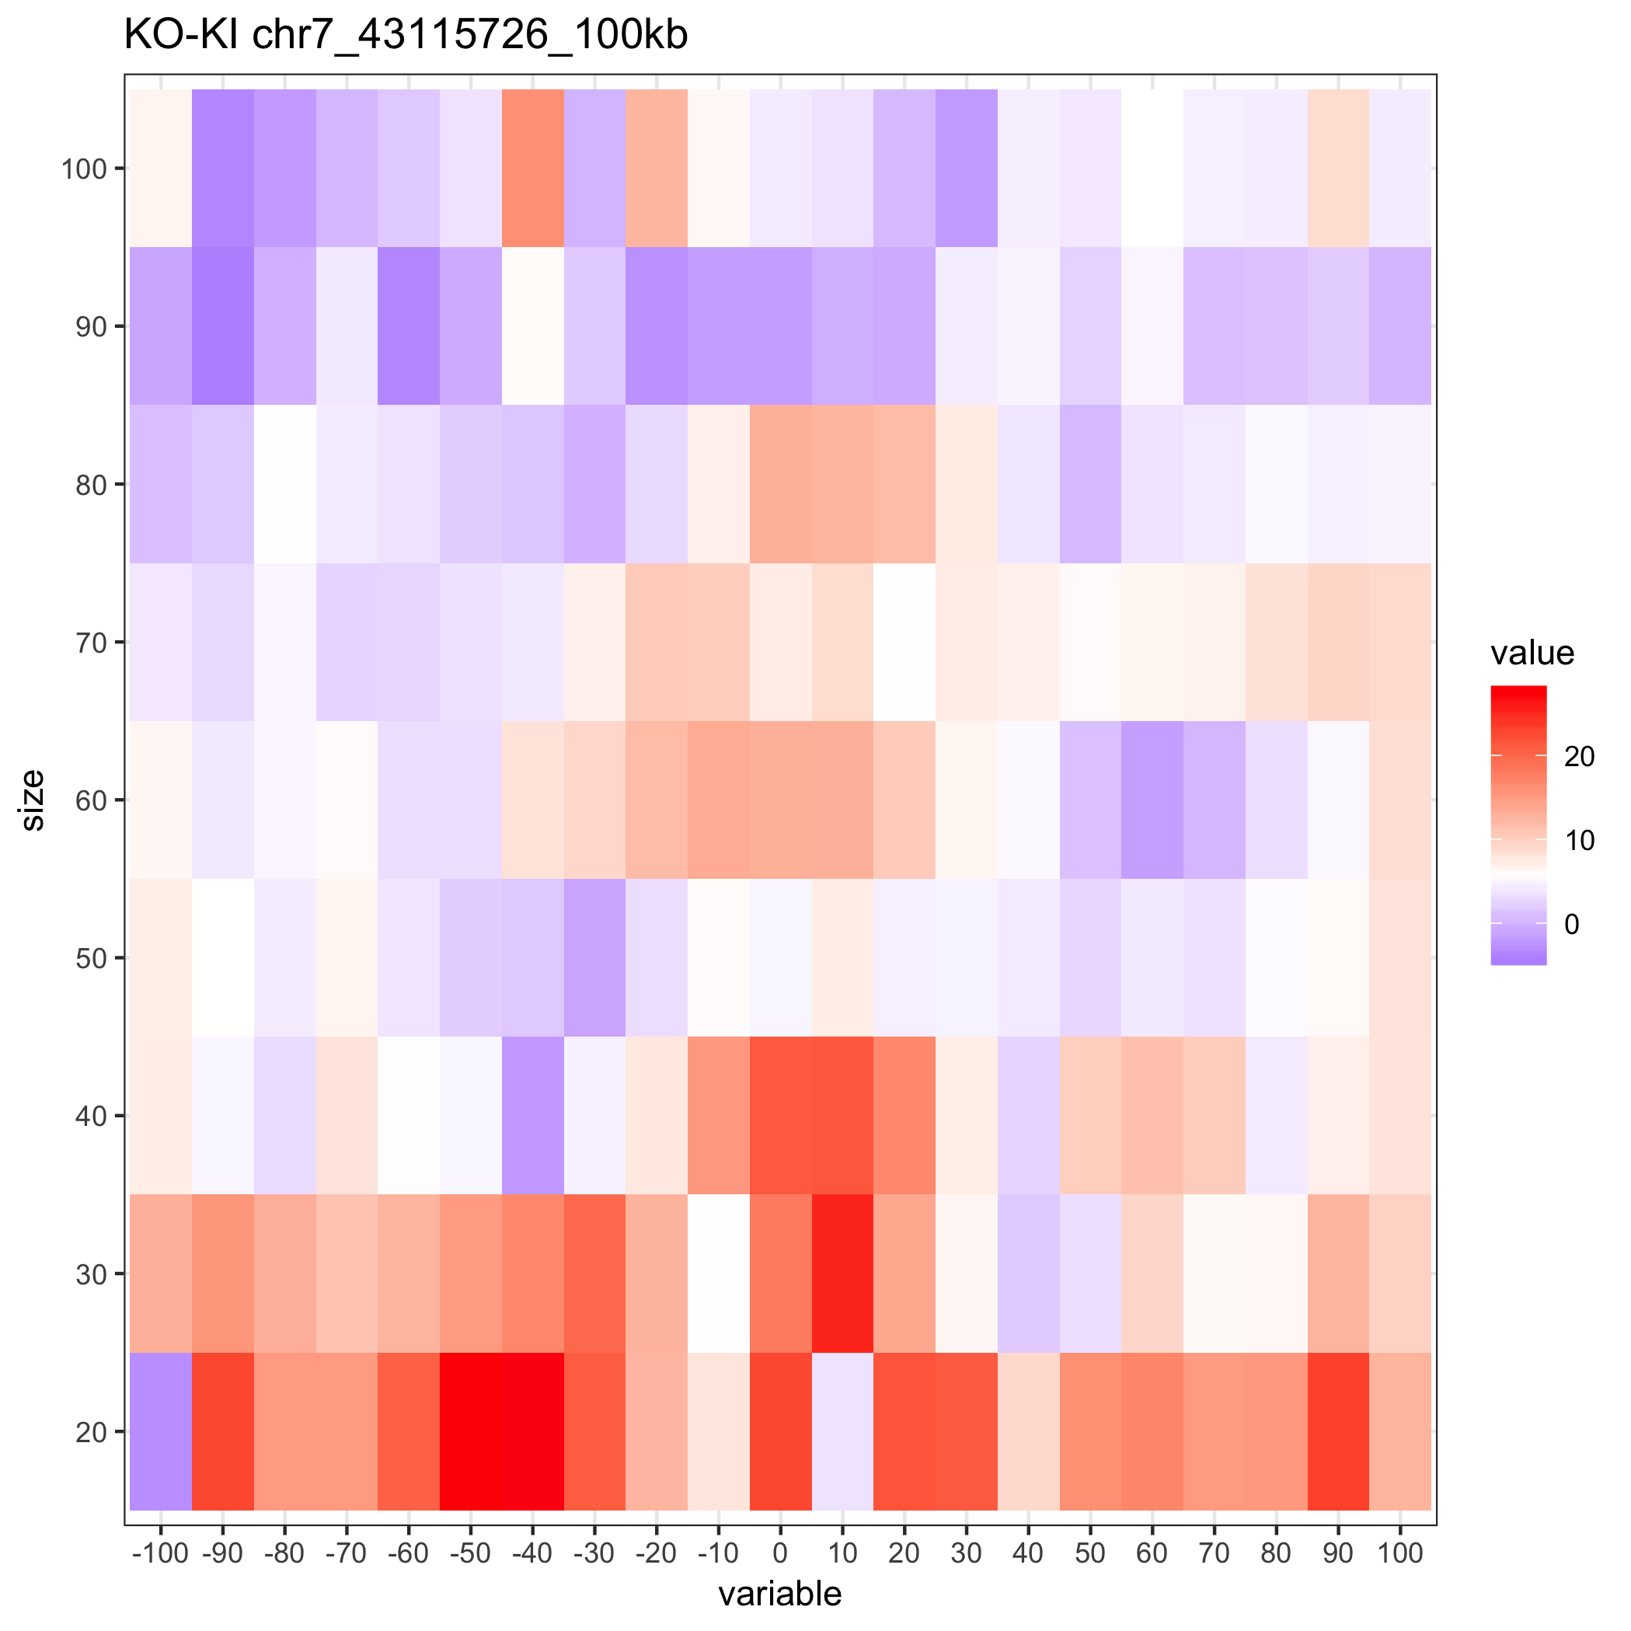

Slide 32
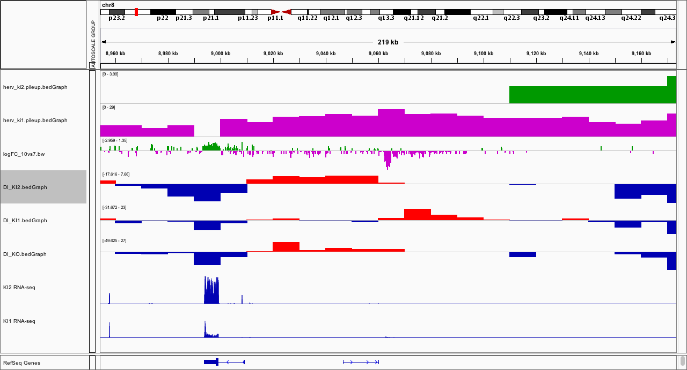
﻿chr8:9064876 (KI1)

Slide 33
﻿chr8:9064876
KO
KI1

Slide 34
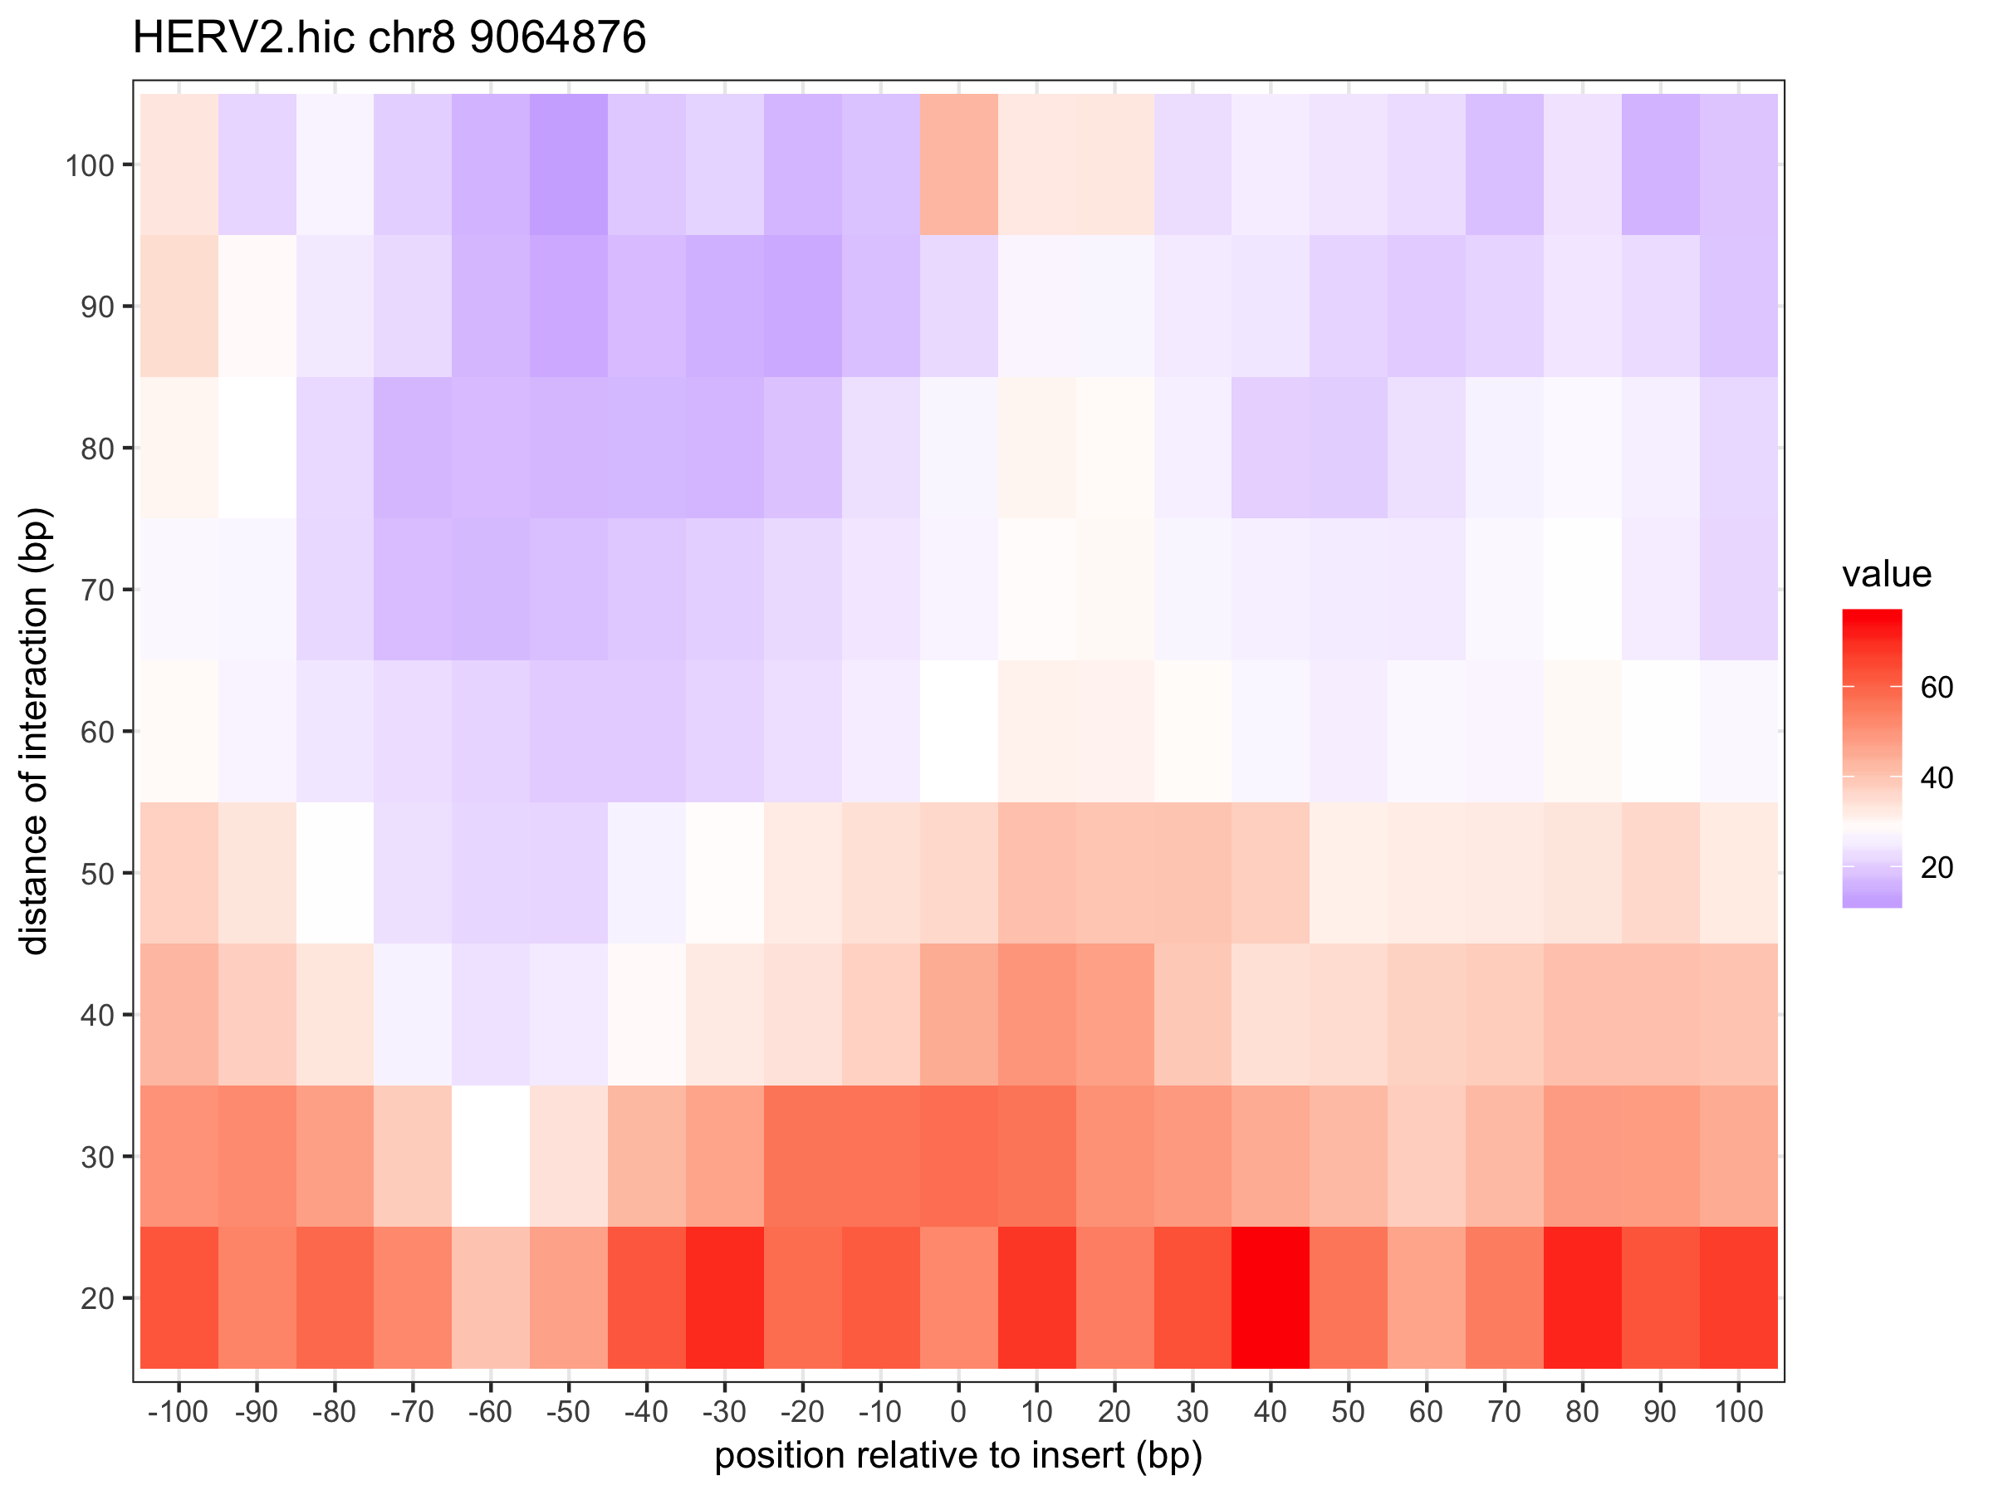
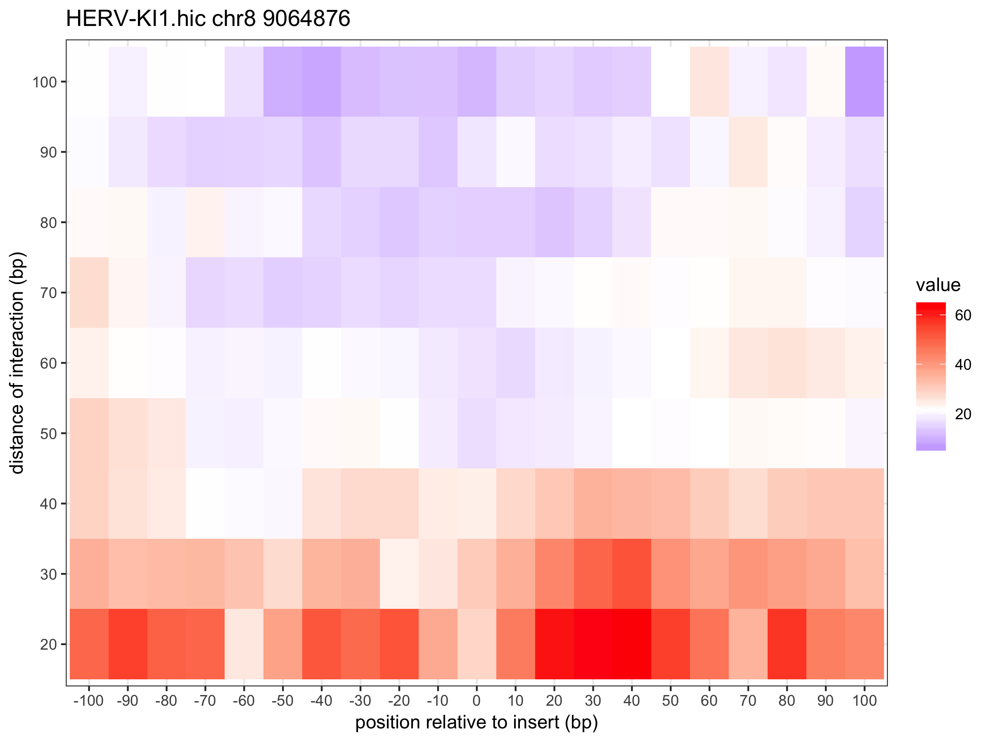

Slide 35
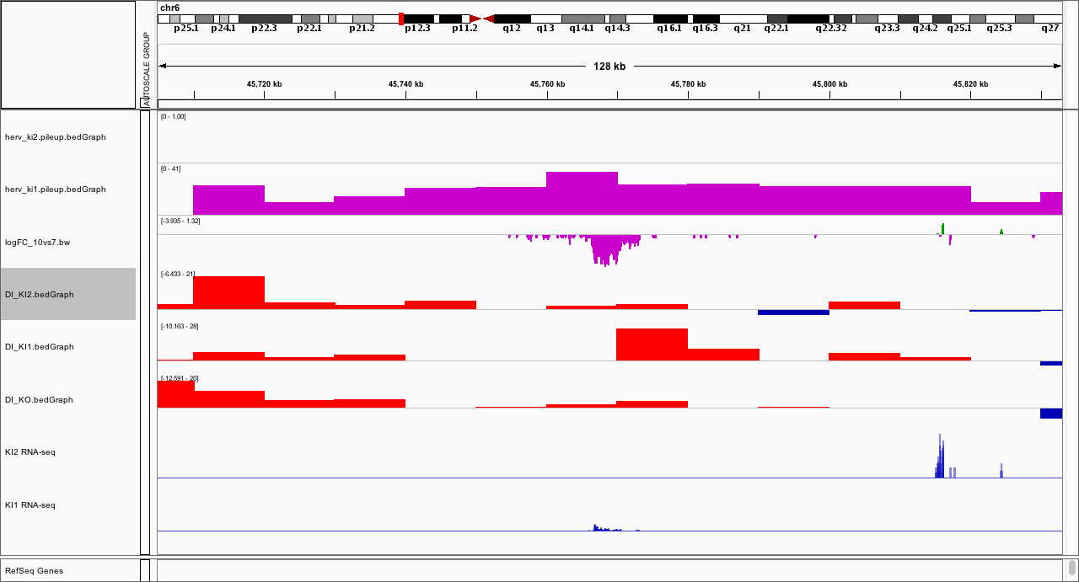
﻿chr6:45769415 (KI1)

Slide 36
﻿chr6:45769415
KO
KI1

Slide 37
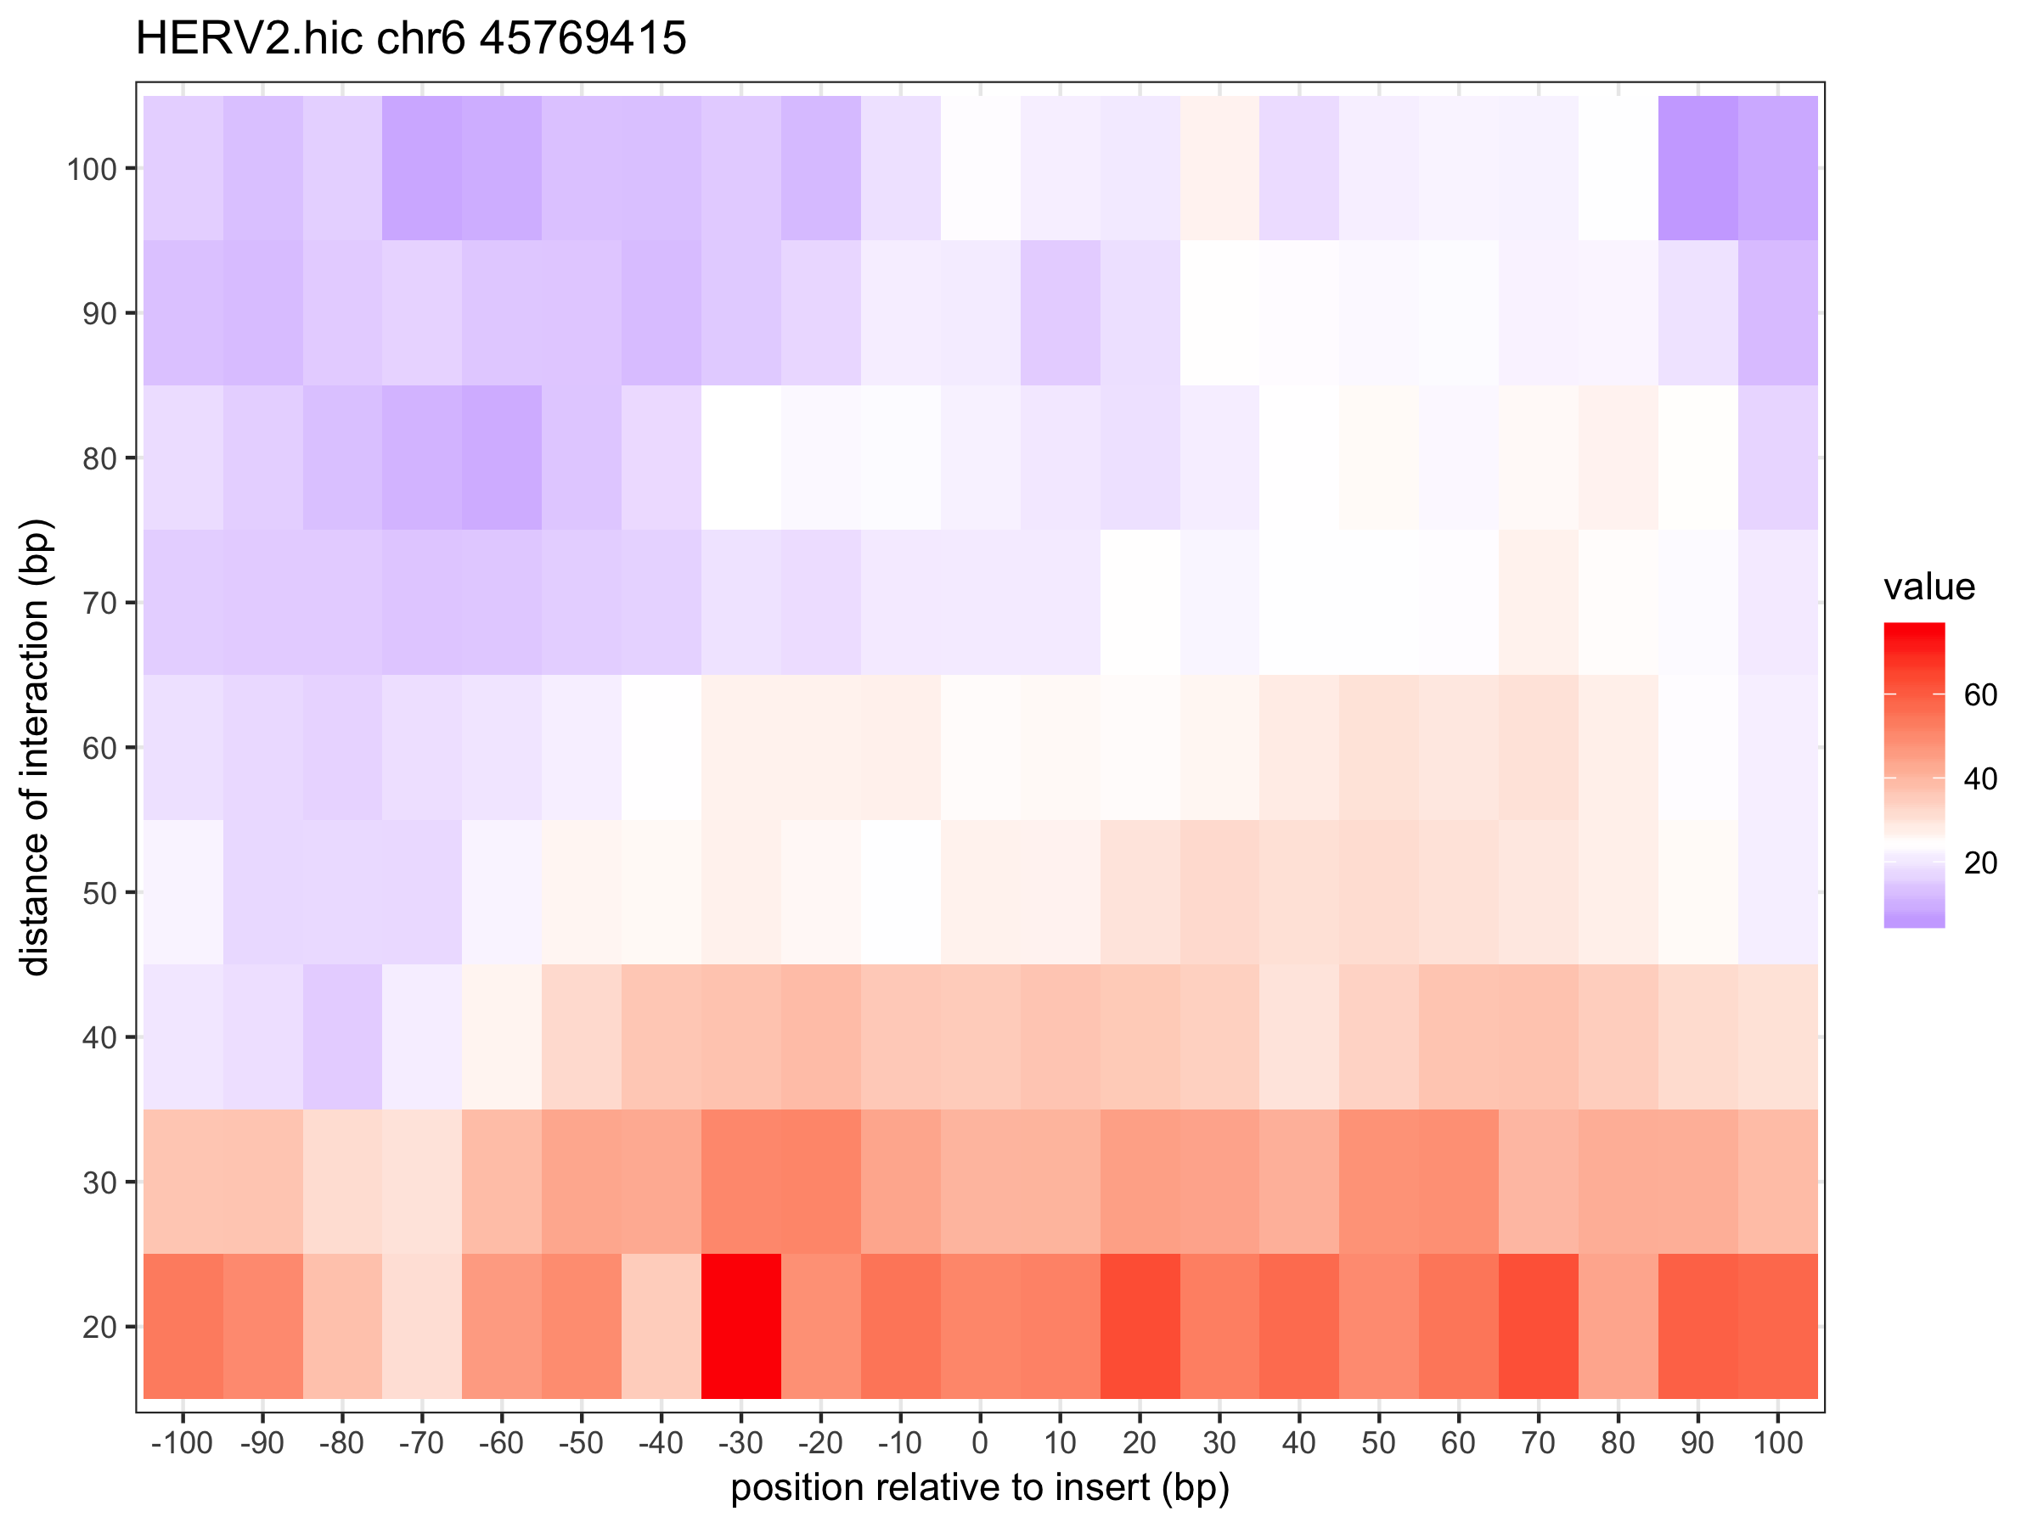
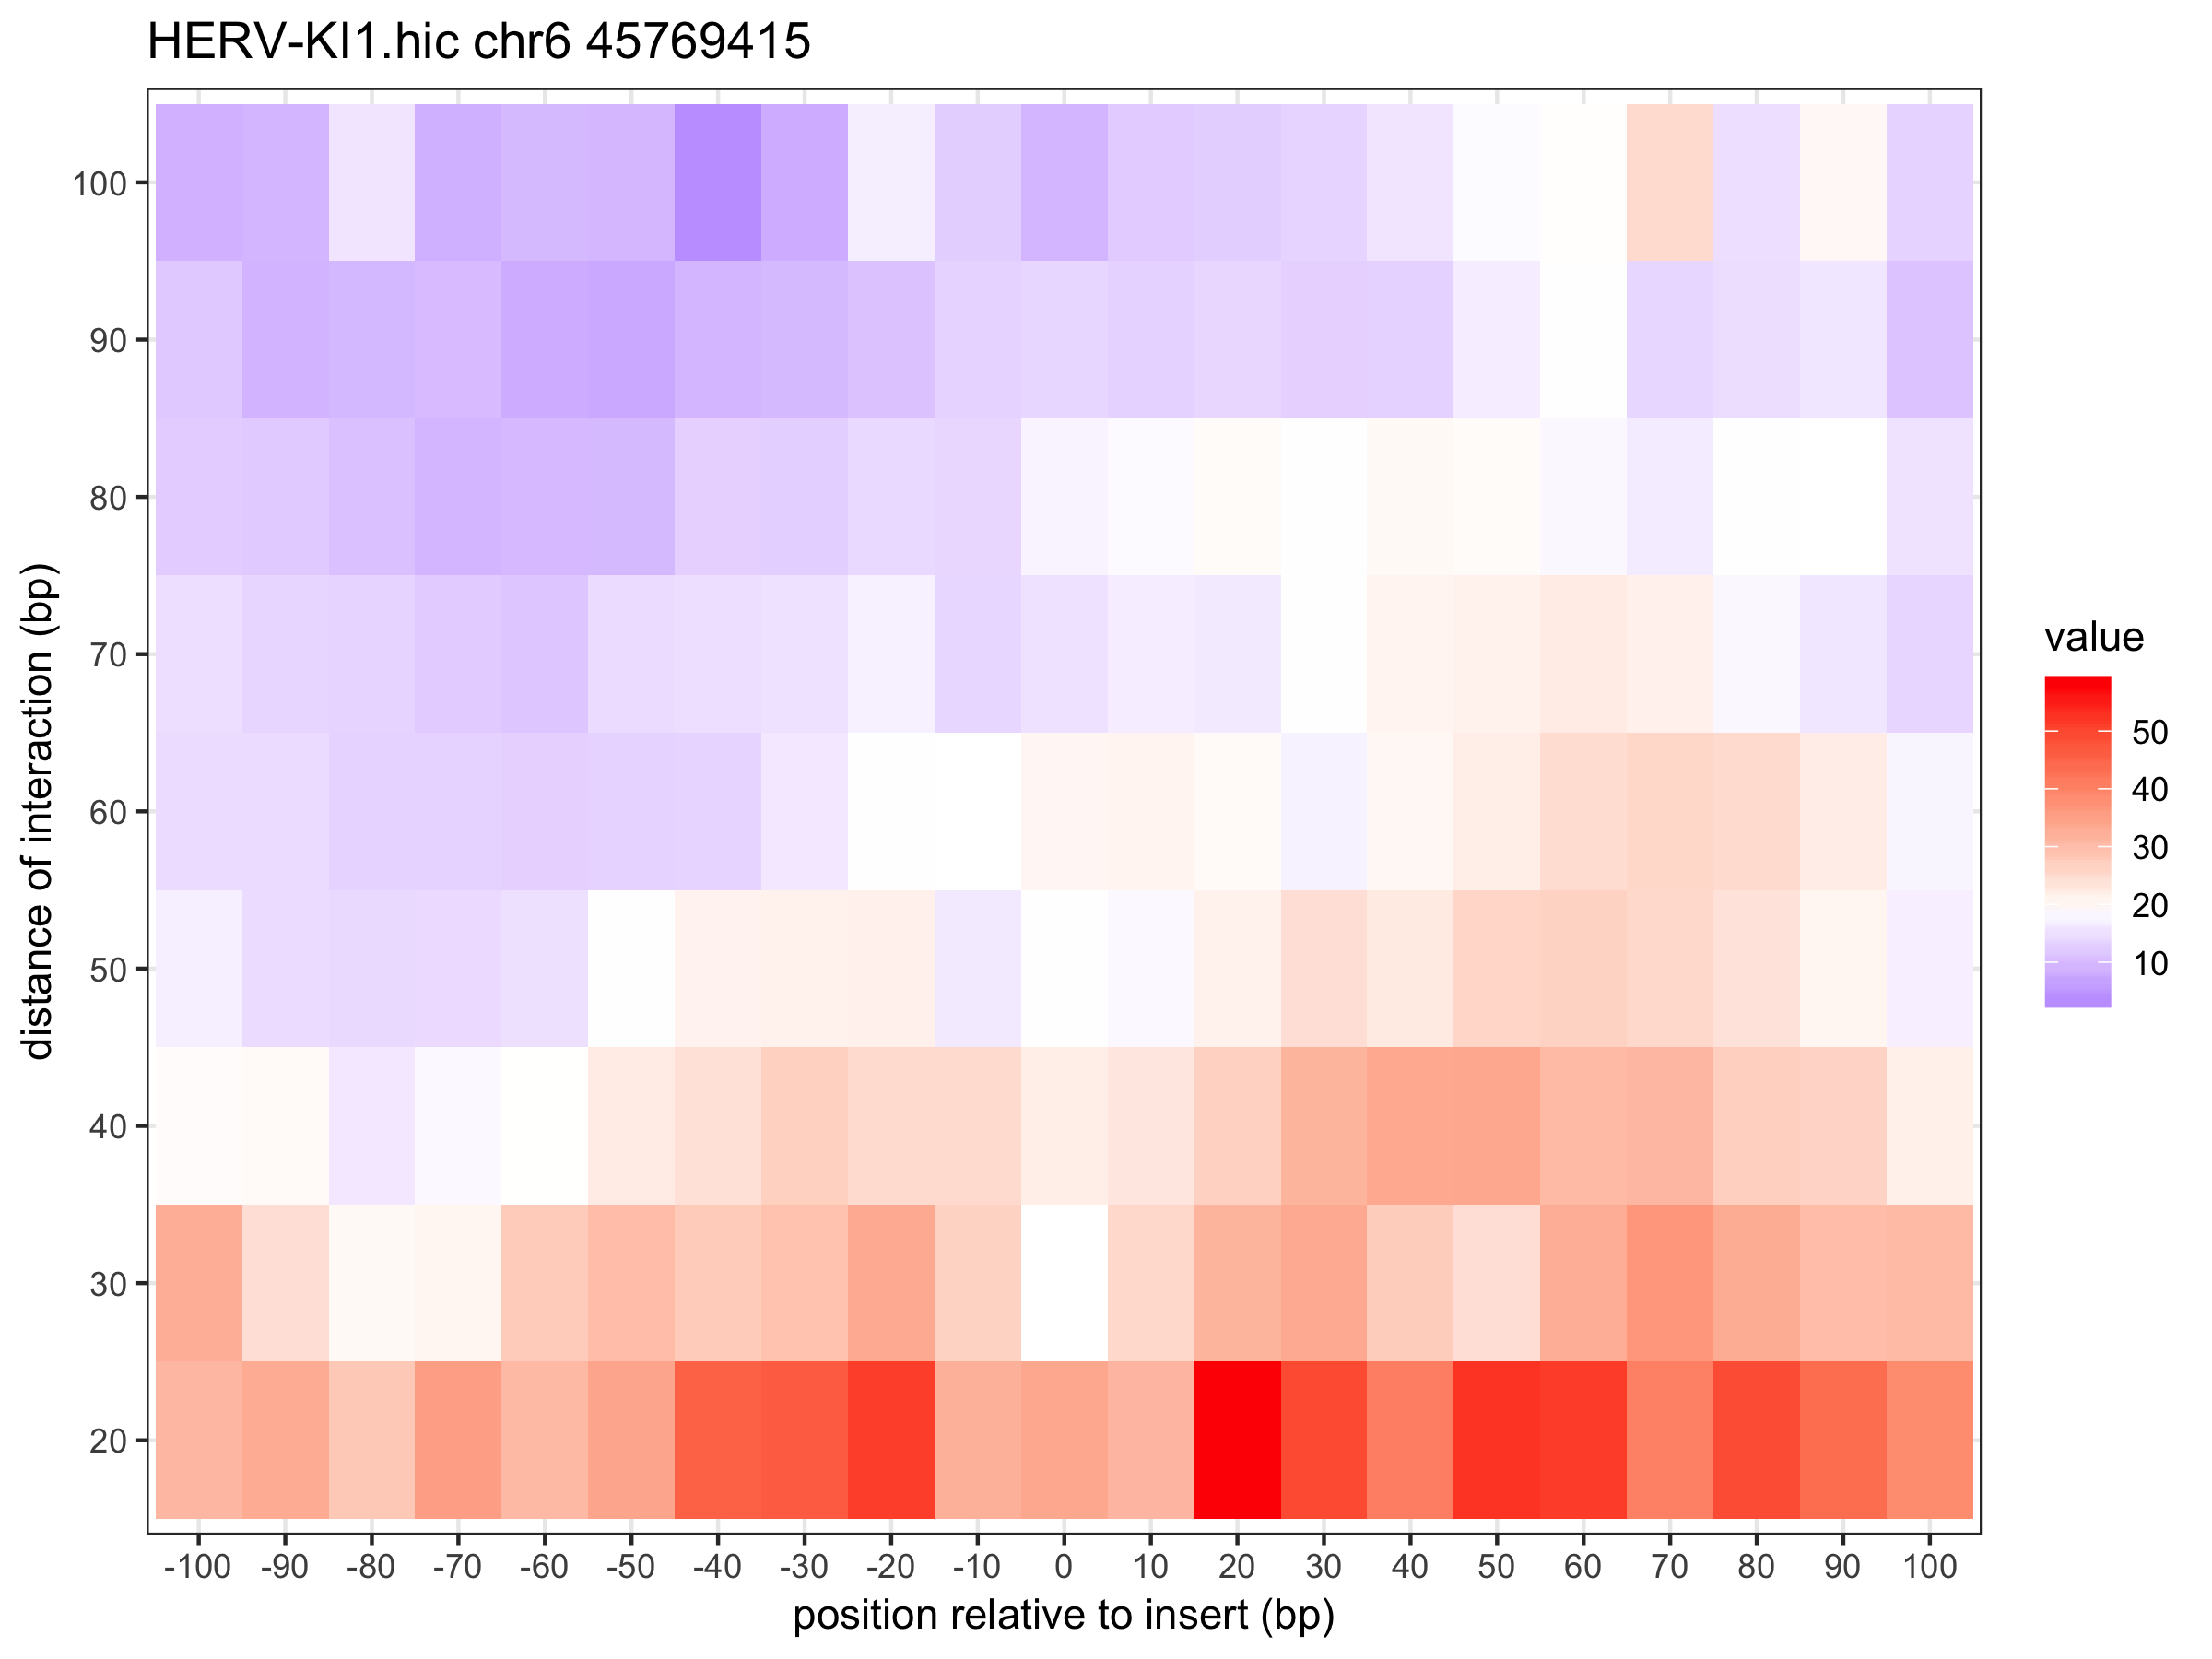

Slide 38
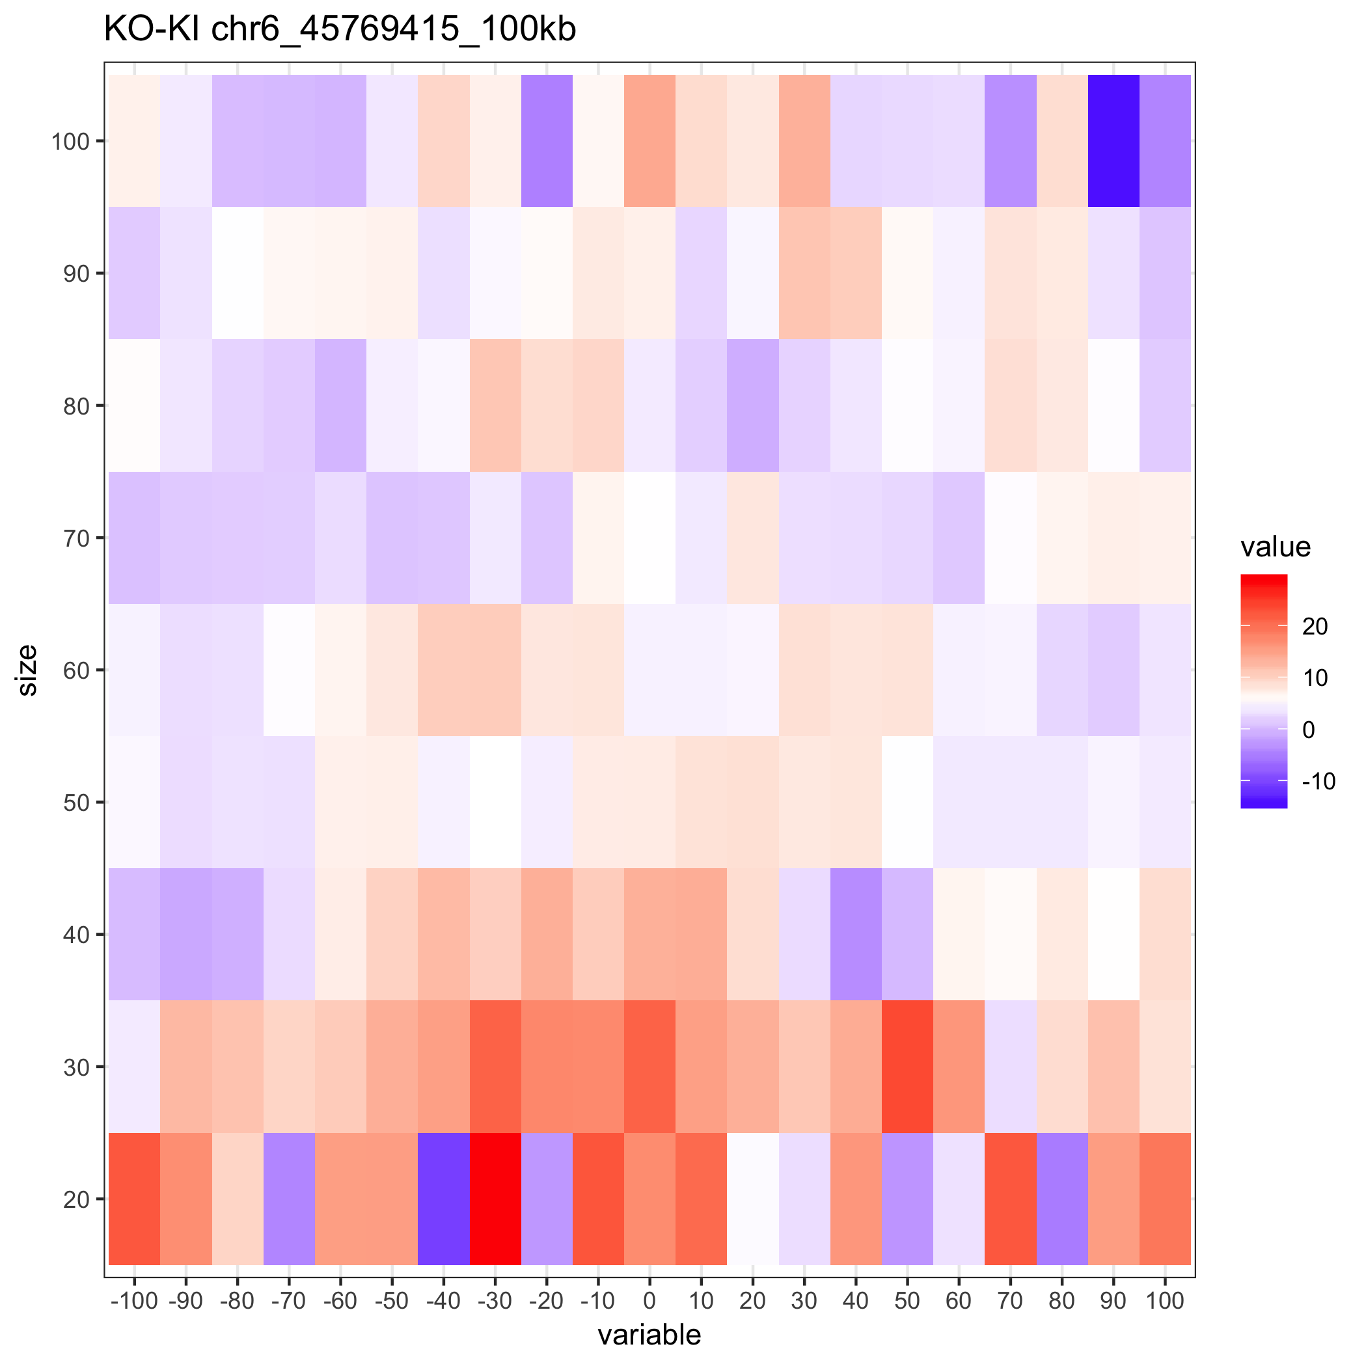

Slide 39
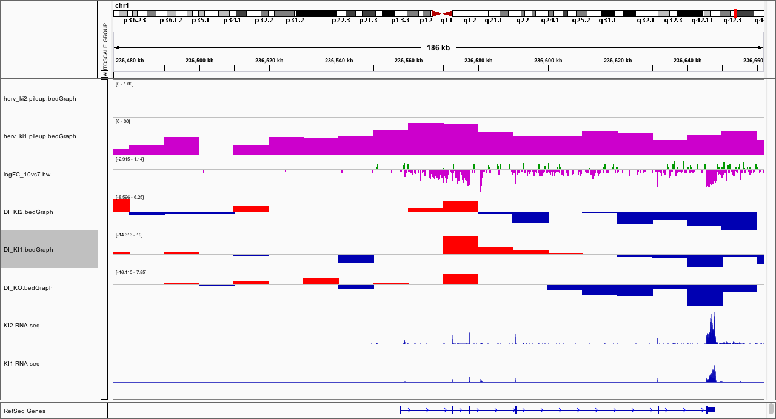
﻿chr1:236569345 (KI1)
Hard to narrow insertion/ not expressed?

Slide 40
﻿chr1:236569345
KO
KI1

Slide 41
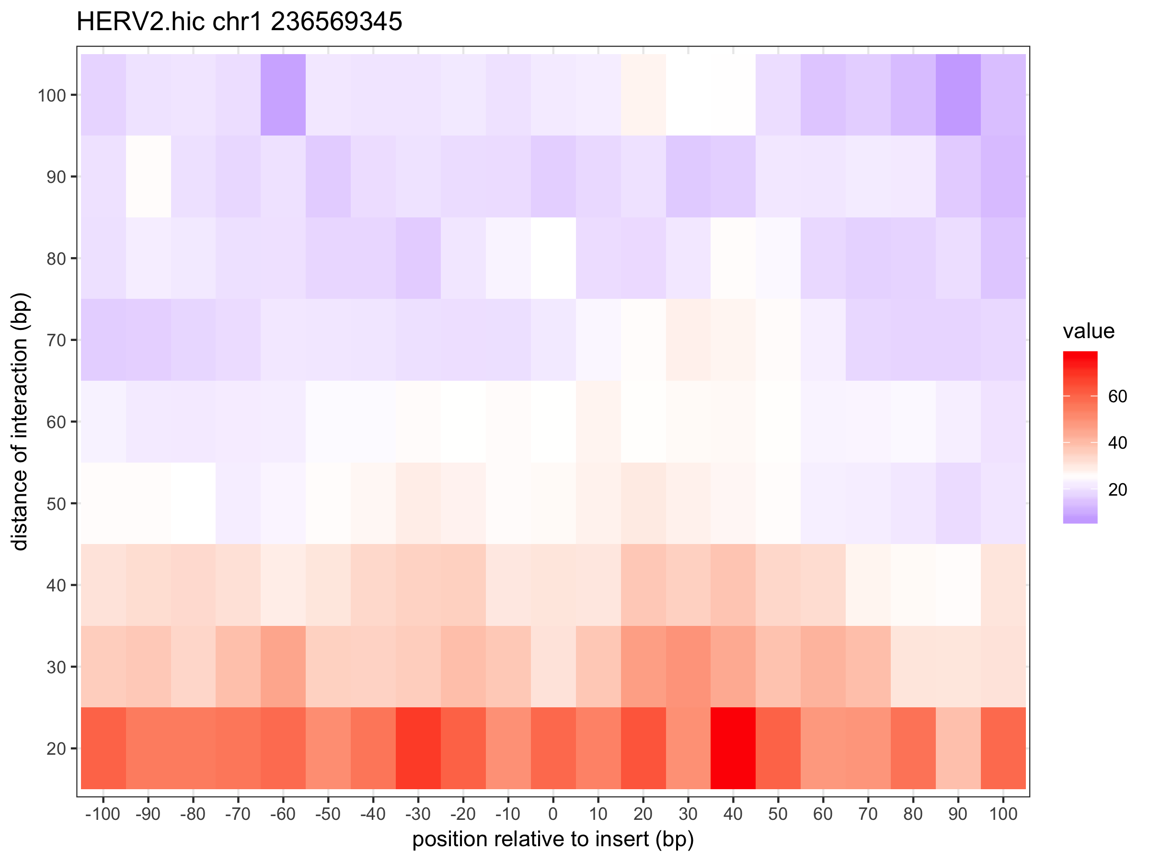
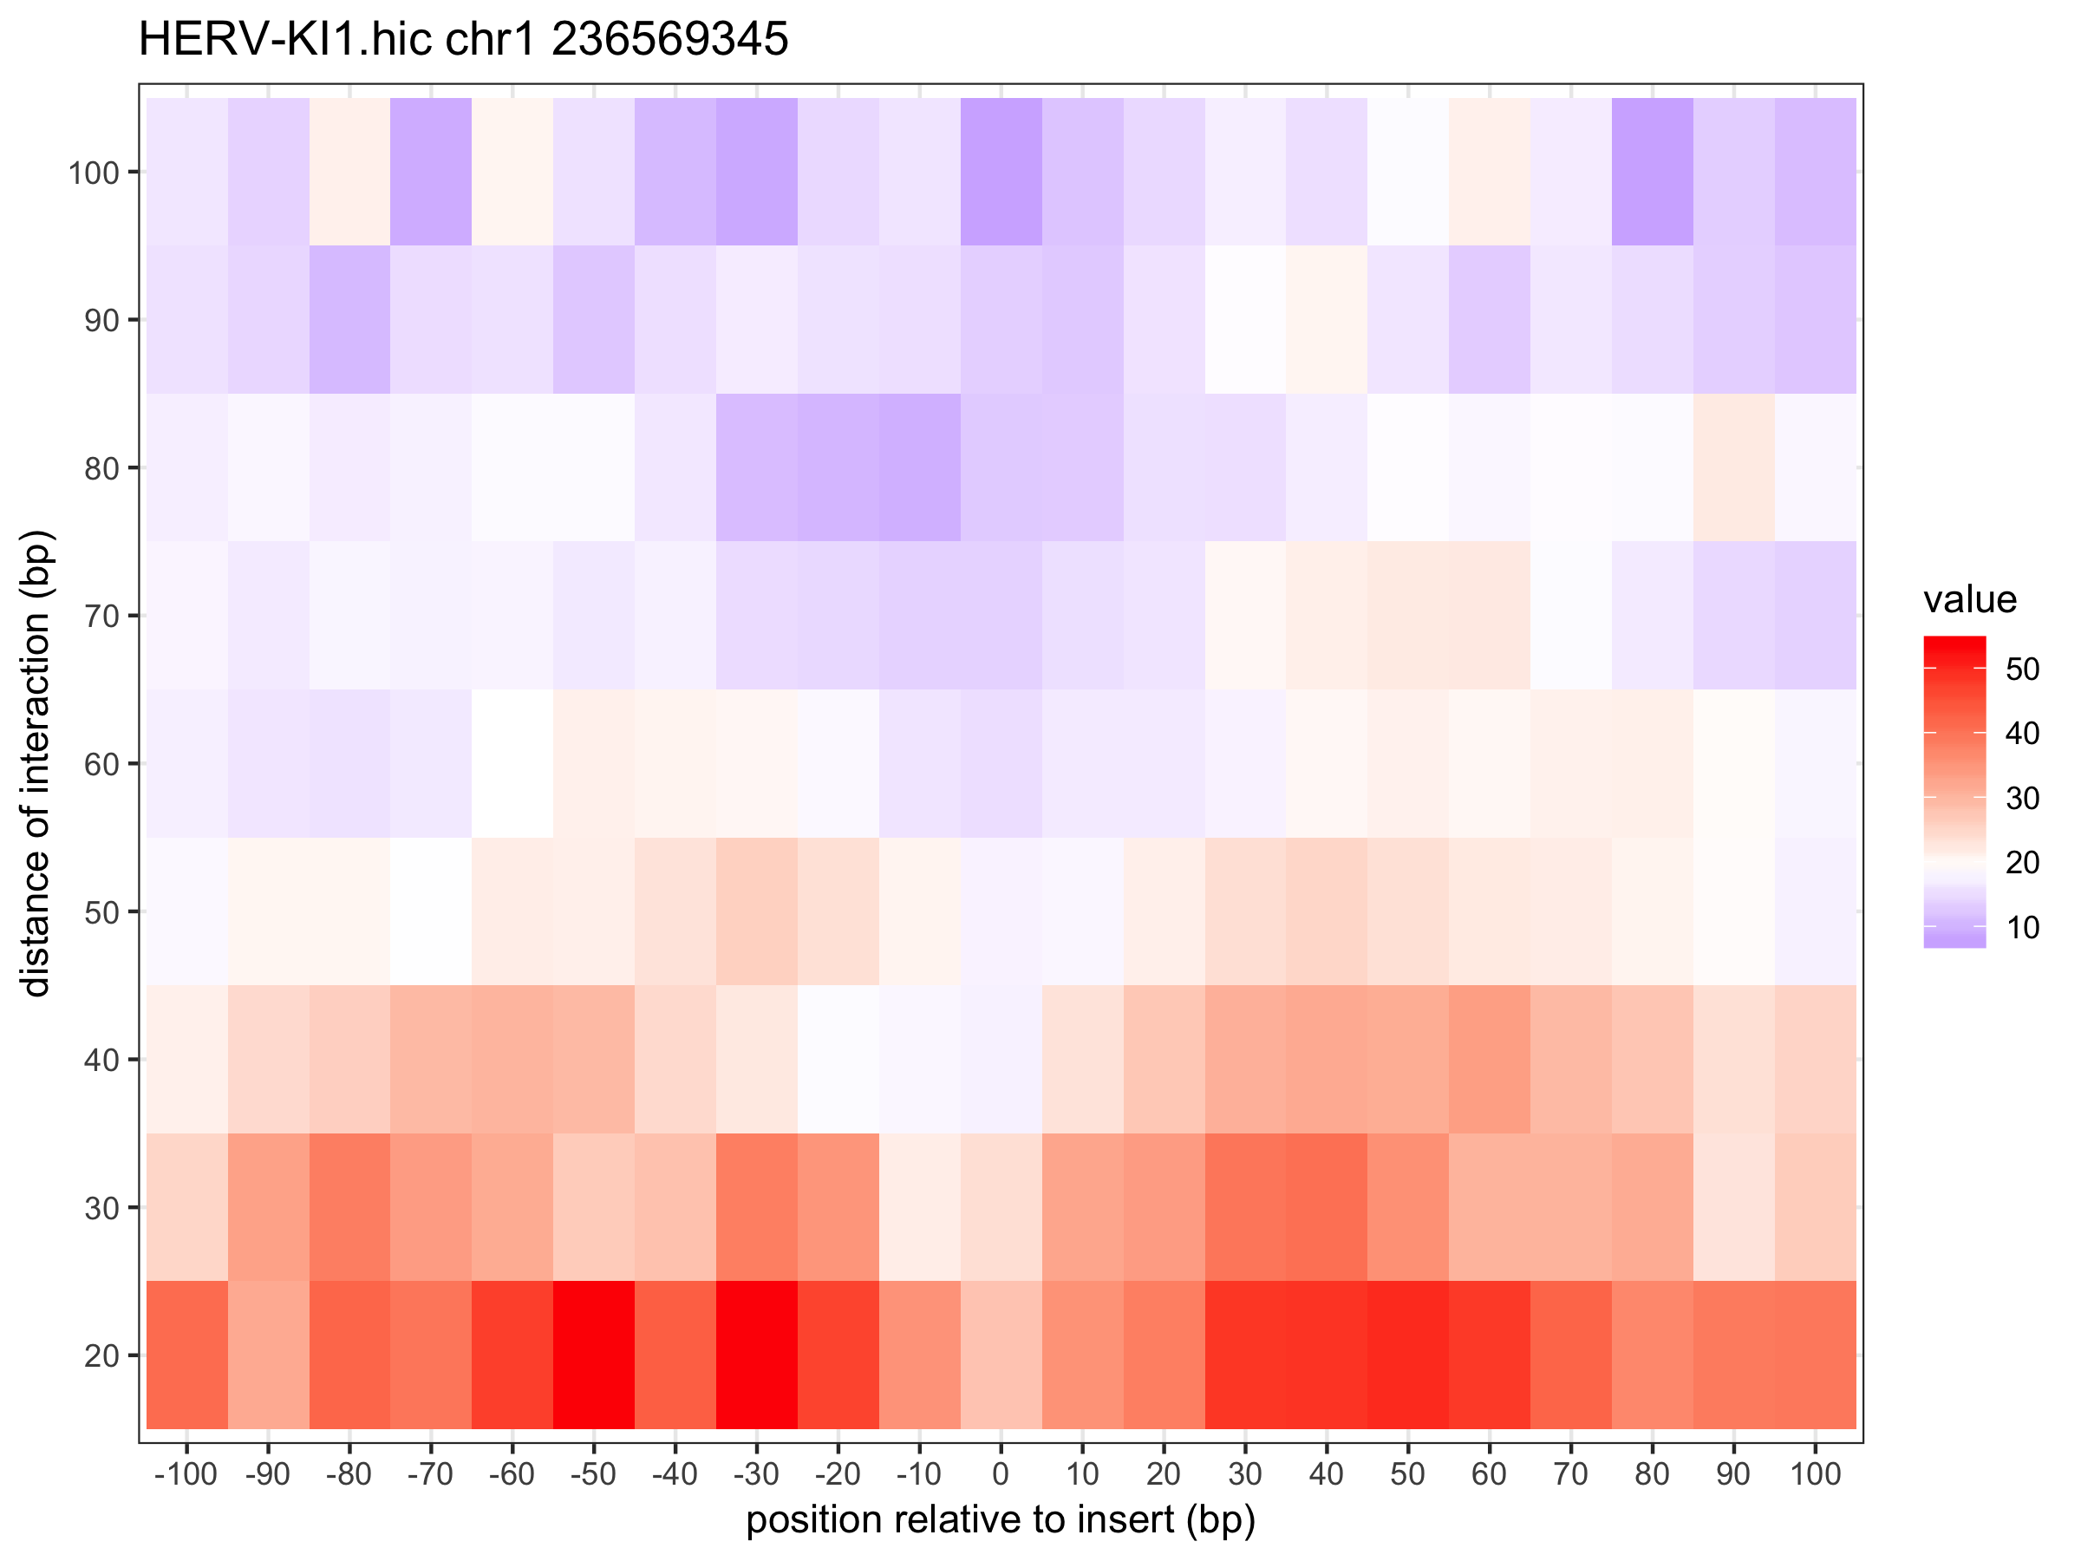

Slide 42
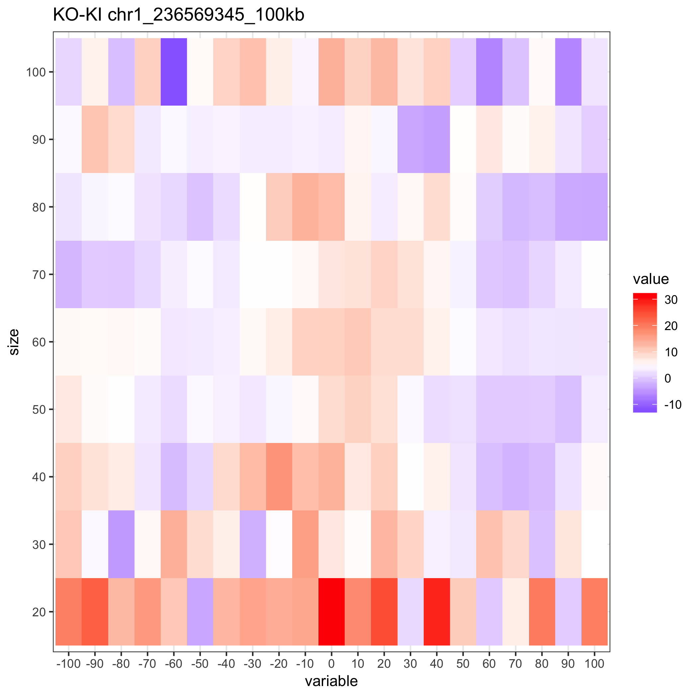

Slide 43
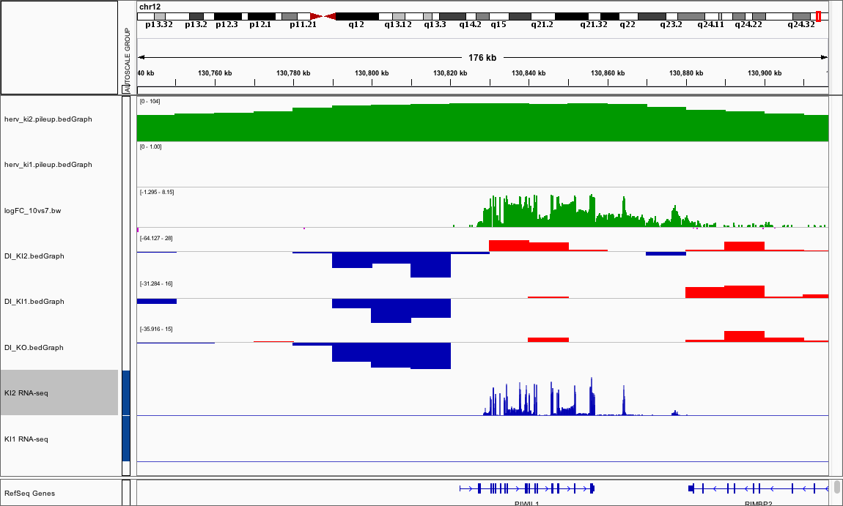
﻿chr12:130828981 (KI2)

Slide 44
﻿chr12:130867921
130828981
KO
KI2

Slide 45
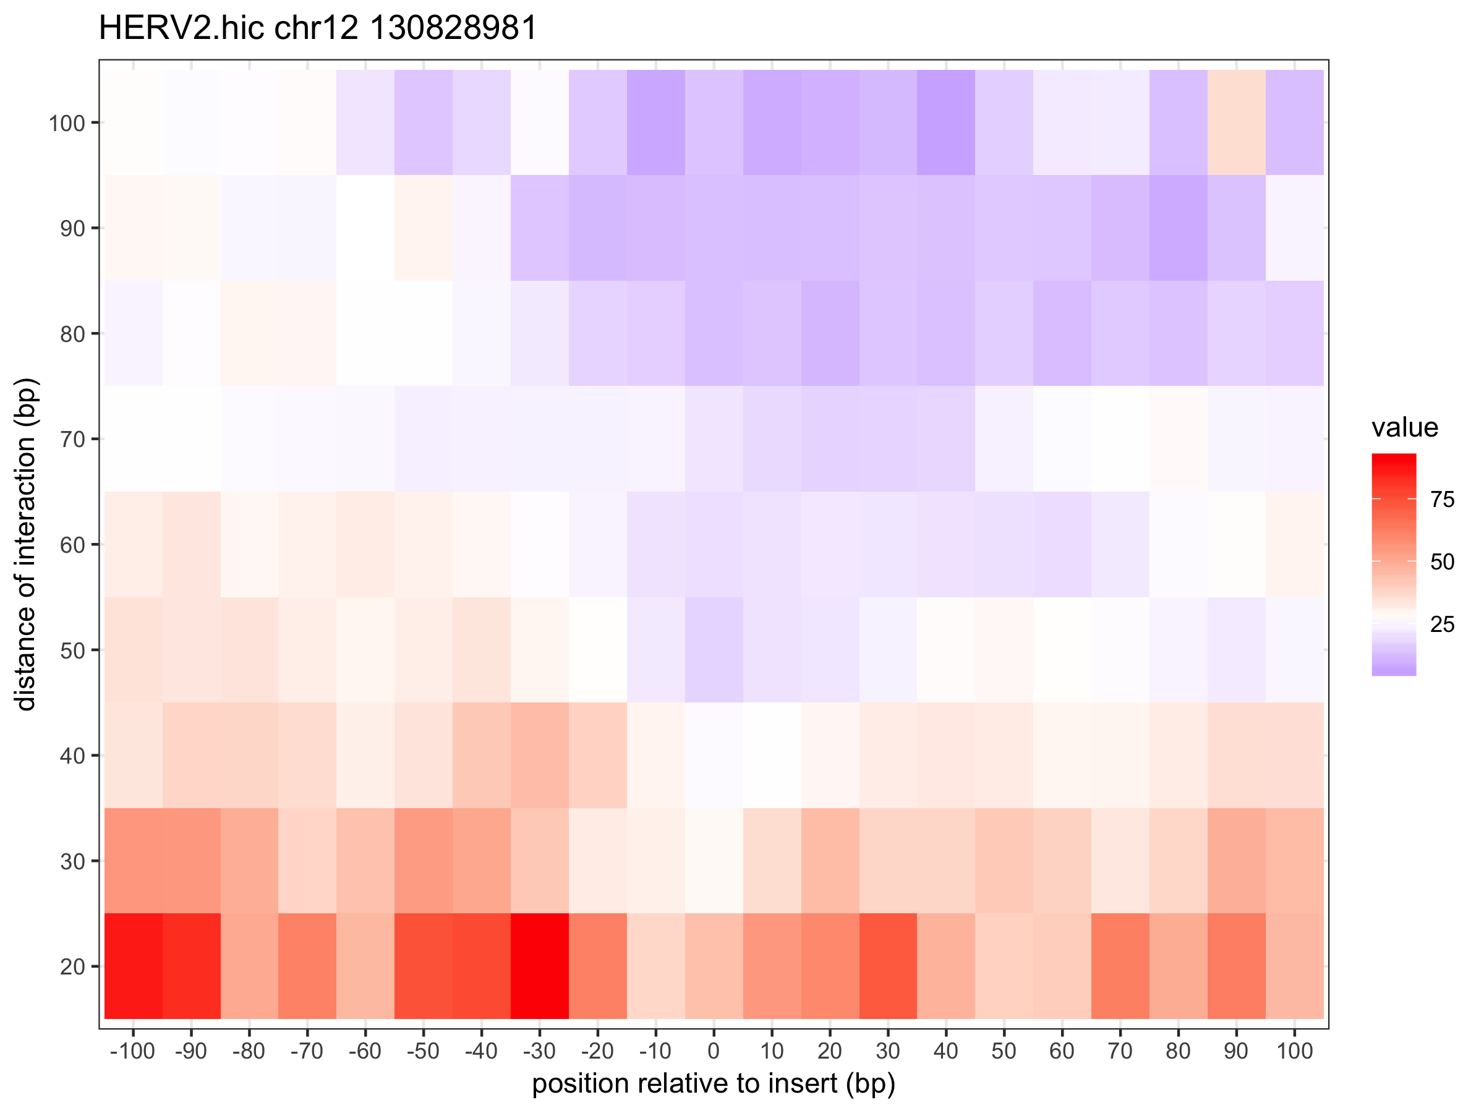


Slide 46


Slide 47

﻿chr7:67715736 (KI1)

Slide 48
﻿chr7:67715736
KO
KI1

Slide 49



Slide 50


Slide 51

﻿chr9:72216862 (KI2)

Slide 52
﻿chr9:72216862 (KI2)
KO
KI2
?

Slide 53



Slide 54


Slide 55

﻿chr17:56955320 (KI2)
Moved insertion site to ﻿56939096

Slide 56
﻿chr17:56955320
KO
KI2

Slide 57



Slide 58


Slide 59

﻿chr2:213896052 (KI1)

Slide 60
﻿chr2:213896052
KO
KI1

Slide 61



Slide 62


Slide 63

﻿chr14:95342739 (KI2)

Slide 64
﻿chr14:95342739
KO
KI2

Slide 65



Slide 66


Slide 67

﻿chr2:109579656 (KI2)

Slide 68
﻿chr2:109579656
KO
KI2

Slide 69



Slide 70


Slide 71

﻿chr1:186815803 (KI1)

Slide 72
﻿chr1:186815803
KO
KI1

Slide 75

﻿chr7:139549558 (KI2)

Slide 76
﻿chr7:139549558
KO
KI2

Slide 77



Slide 78


Slide 79

﻿chr7:110246538 (KI2)

Slide 80
﻿chr7:110246538
KO
KI2

Slide 81



Slide 82


