Slide 1
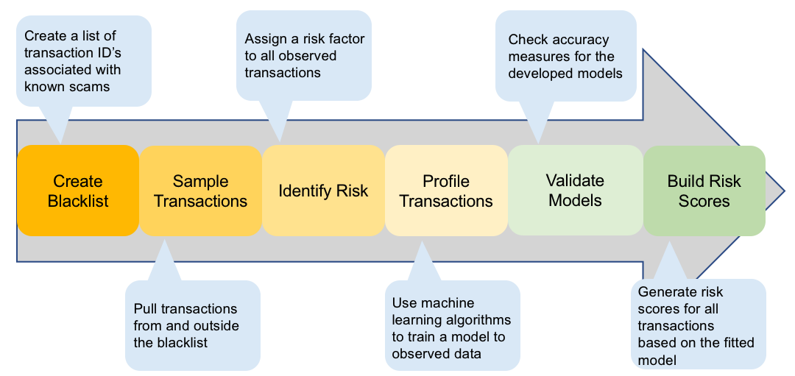
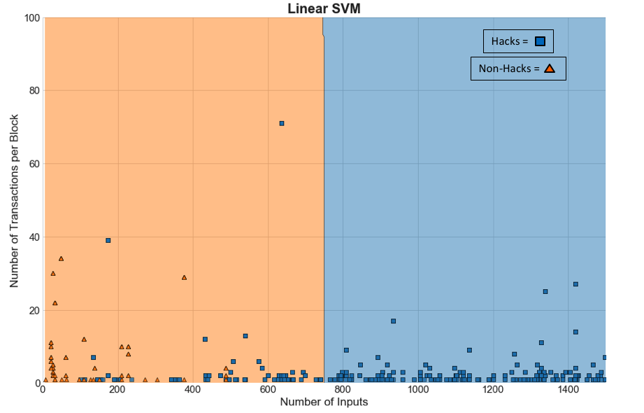
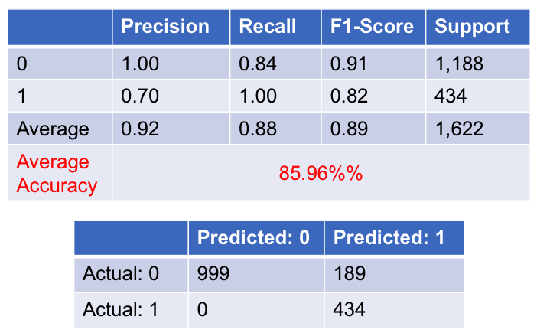
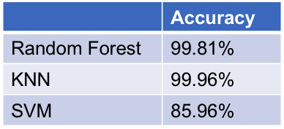
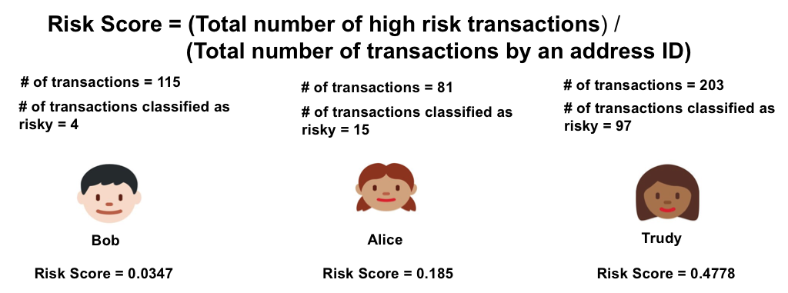

Enhancing Trust in the Cryptocurrency Marketplace: A Risk Scoring Approach
Sudip Bhattacharyya, Dan Freeman, Timothy McWilliams, Craig Hall and Pablo Peillard
Master of Science in Data Science
Southern Methodist University, Dallas, TX 75275, USA
Introduction
Modeling
Cryptocurrency is a digital asset enabled by a cryptographic encryption-decryption mechanism to secure transactions
Blockchain is the platform to run Bitcoin and other cryptocurrency networks
Peer-to-peer distributed ledger system, no centralized control
Blockchain is transparent but anonymous and immutable
Random Forest, KNN and SVM
Split using Stratified ShuffleSplit cross-validation from Python's scikit-learn:
80% training / 20% testing
Returns stratified randomized folds
Folds are made by preserving the percentage of samples for each class
Run a baseline model with all variables
Perform feature engineering to fine-tune models
Problem
Risk Score
Build a trust mechanism in the form of a risk score for all users operating in a blockchain network which enables users to avoid risky parties to deal with while making transactions in cryptocurrency marketplace.
Many security breaches of Bitcoin exchanges during the cryptocurrency’s brief existence
A risk score can gauge the relative risk of performing transactions with another entity
Hacks =
Non-Hacks =
Data for Modeling
Risk Scoring Method
Data sourced from ELTE Bitcoin Project
Block- and transaction-level details for every bitcoin transaction until February 9, 2018
A risk factor (0 or 1) has been added to this dataset
8,109 total data points
2,172 transactions with risk level 1 (hack)
5,937 transactions with risk level 0 (non-hack)
Risk score assigned against every unique address ID
Score measured on a scale of 0 to 1
Conclusions
The Blacklist
Random Forest and KNN models are overfitted
SVM model correctly classifies 86% of transactions based on two features:​
Number of transactions per block​
Number of inputs per transactions
SVM classifies all hacking incidents correctly
While SVM’s training time is longer for a risk scoring application, that is a good tradeoff
List of known hacks and thefts
Addresses and transactions ID’s associated with known hacks or thefts are put on the blacklist
Profiling such behavior allows us to find other transactions with similar behavior

