Slide 1
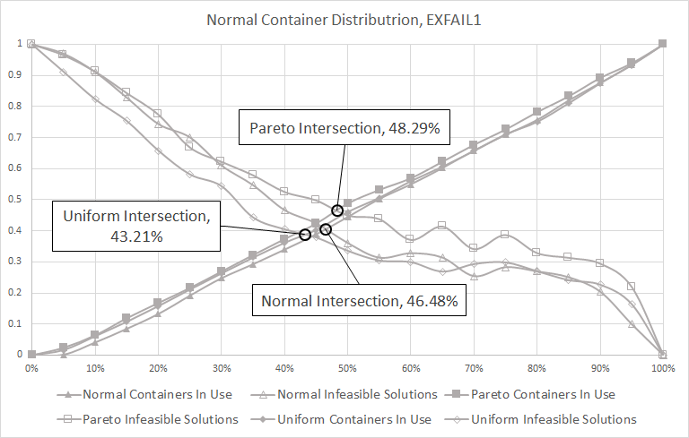
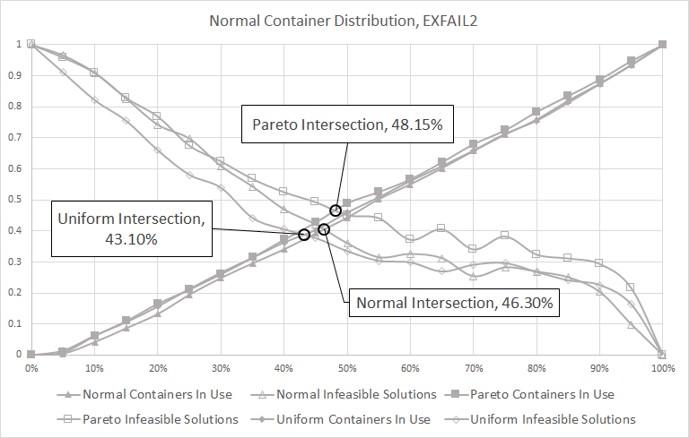
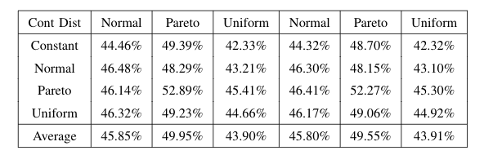

Descriptive Title Goes Here
Ignacio M. Great, Luke Skywalker and Justin Time
Master of Science in Data Science
Southern Methodist University, Dallas, TX 75275, USA
DataScience@SMU
Introduction
Pictures and Tables
Your poster should be visually appealing while being informative
As you lay out your poster, it should be symmetrical along both the left-right and top-bottom axes
The text and flow should be left to right and top to bottom as well
Figures: figures go great in the center column
Overlay: it’s OK to have the figures intrude into the surrounding boxes.
Tables: tables may go well in the center, off center or in place of one of these boxes
Balance: the biggest point of a poster is to balance this means the figures and tables but also the boxes
Text: text is great but an entire poster of text is really hard for someone to read and understand. I should understand the work reading only headers and figures and tables
Main Topics
While your poster follows your paper, it does not have to have the same sectioned titles
Your poster has main topics, but does not typically contain a “related work” section
Your results look good as figures and tables intermixed into the center column
Do as I Say
This is simply a representation of what you should have in your poster.
Follow the template.
Keep font sizes as they are.
Work and be creative within the confines of this hot mess
When in doubt, ask.
Problem
Be sure to state your problem clearly
You may use sub bullets
These are good for simply listing requirements.
And you may have other information here
Motivation may or may not be in a separate box…depends on how you decide to lay out your poster
Not as I Do
This is not a very good story.
Your goal is to make this pretty and informative.
Tell your story and break some eggs, but just make sure you have accomplished the task of a poster.
Contents Tell a Story
The contents that you do include must tell a complete story.
Note that all the details in your paper do not necessarily show up in your poster
Be sure to properly motivate your problem too
Conclusions
Conclusion 1 – don’t number your conclusions. Simply state them
Conclusion 2, each conclusion is its own bullet point
Conclusion 3 and be sure to have three. All good things come in threes including your primary conclusions from your work.

