Slide 1
Capstone Project
The battle of the neighborhoods

Slide 2
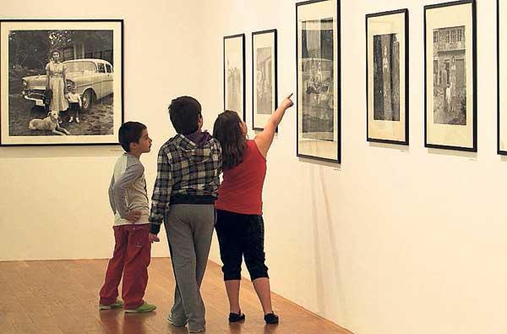
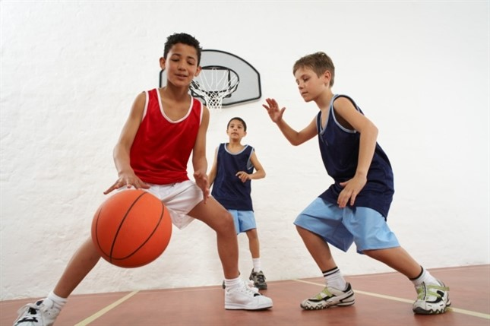
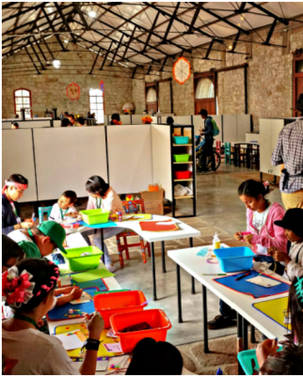
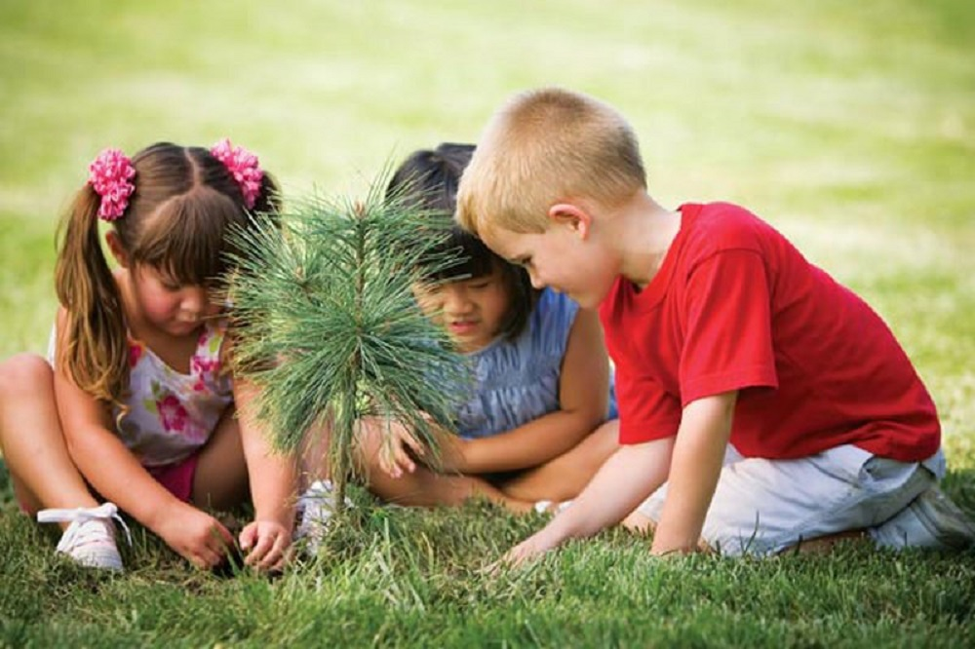
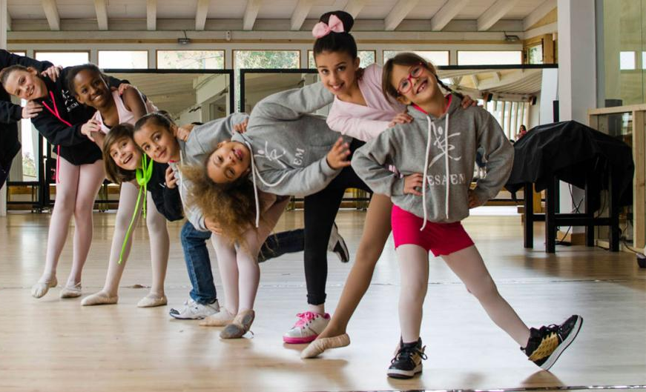
The propose

Slide 3
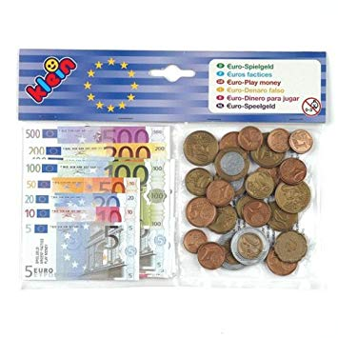
The problem

Slide 4

The solution

Slide 5
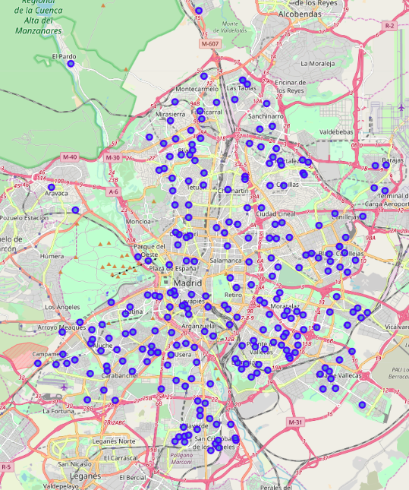
...but how?

Slide 6

...gathering venues info...

Slide 7

...and correlating data

Slide 8
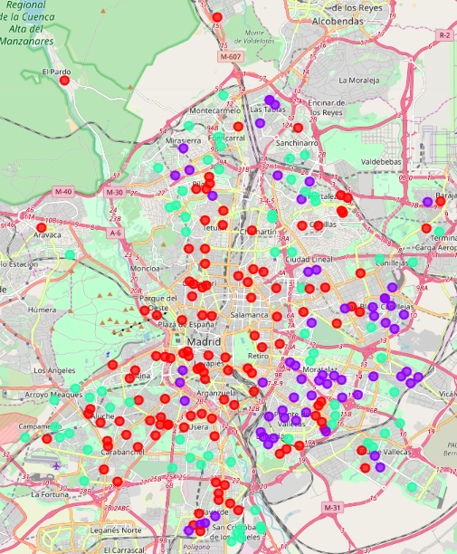

The result
Type 0
Type 1
Type 2

