Slide 1
Where is the best place for a Home Care Shop in Bronx?

Slide 2
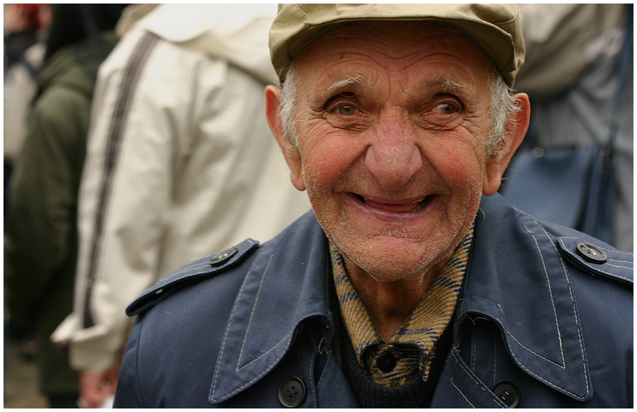
Introduction/Business Problem
The older adult population is growing every day. For that reason, we want to know the best place at Bronx to build a nursing home. To do this, we will use information from the neighborhoods. We need to find the best neighborhood for build the nursing home. We need one with the most amount of pharmacies and doctor´s offices, because the elderly need a quick attentions if the get sick.
Esta foto de Autor desconocido está bajo licencia CC BY-SA

Slide 3
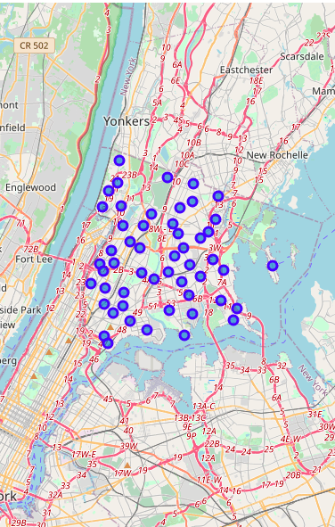
Data
Based on definition of our problem, factors that will influence our decission are:
number of doctor´s office in the neighborhood
number of pharmacies
Following data sources will be needed to extract/generate the required information:
The dataset of neighboors that exist for free on the web: https://geo.nyu.edu/catalog/nyu_2451_34572
FourSquare API to get the pharmacies and Doctor´s Office of each neigborhood.

Slide 4
Methodology
In this project we will detect the neighboors with most pharmacies, and most doctor's office in the area.
In first step, we classified each venue per category, and then, group rows by neighborhood and by taking the mean of the frequency of occurrence of each category of interest.
We sort then by frecuency, and get the neighboors with most pharmacies and doctor´s office.
If have to borrow if a neighborhood doesn´t have a doctor´s office.

Slide 5
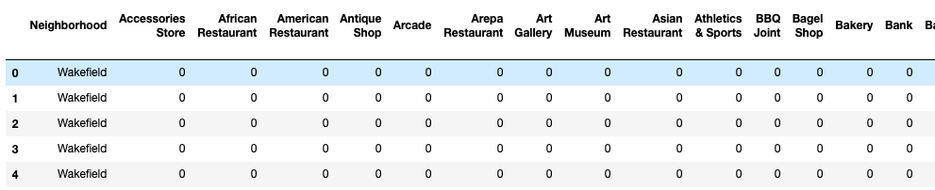
Analysis
First, we classified each venue

Slide 6
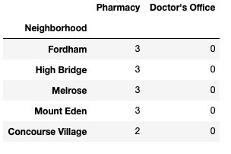
Then, we get the values we need, and sort them

Slide 7

The first neighborhoods don't have doctor's office, so we drop them

Slide 8
Results and discussion
The places with the most pharmacies are Fordham, High Bridge, Melrose and Mount Eden. But they have the disadvantage of not having an Doctor´s office, so there is not viable to build a home care there.
Only one Neighborhood has a pharmacy and doctor´s office, one of each.

Slide 9
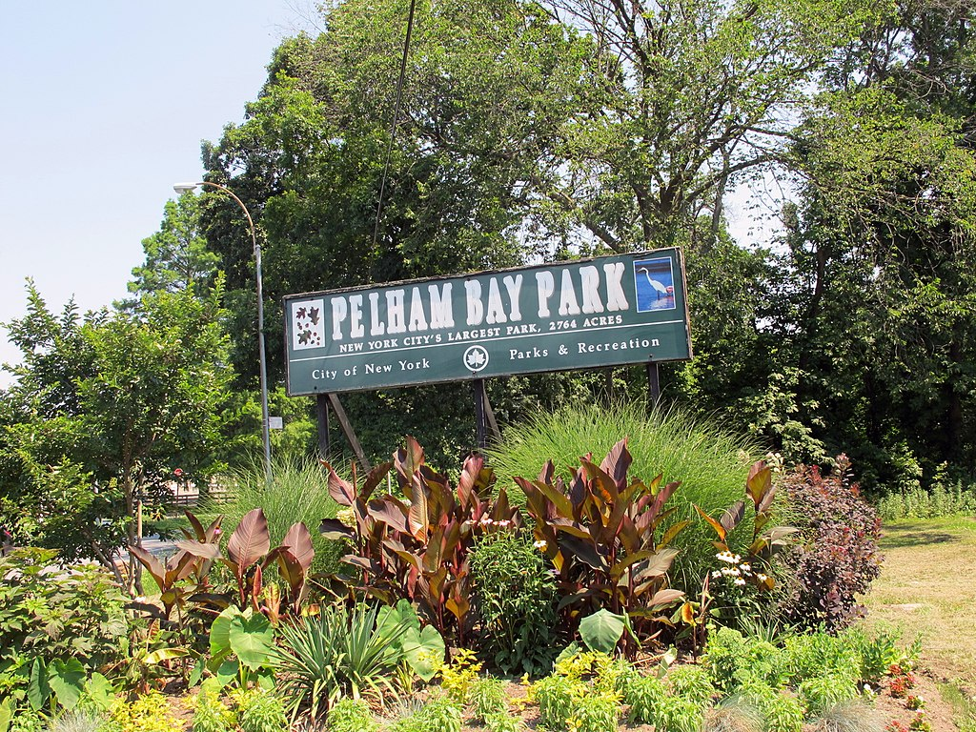
Conclusion
Because both are essential services, and need to exist, the only place where the center can be built is in Pelham Bay
Esta foto de Autor desconocido está bajo licencia CC BY-SA

