Slide 1



Slide 2
Methodology
1. Importation
2. Indexing
3. Validation
4. Queries and Aggregation
5. Analysis

Slide 3
Indexing
Indexes are unique identifiers which:
Enhance the speed of data retrieval operations in a database.
Ensure no duplicate values in specified fields.
Store data in a sorted order.
customers | products | receipts | staff
_id_ | _id_ | _id_ | _id_
customer_id_1 | product_id_1

Slide 4

Validation Rules
Only the mandatory fields
staff
receipts
 | int | string
staff_id
first_name
last_name
 | int | string
transaction_id
sales_outlet_id
staff_id
quantity
customers
 | int | string
customer_id
customer_first-name
birth_year
products
 | int | string
product_id
product

Slide 5
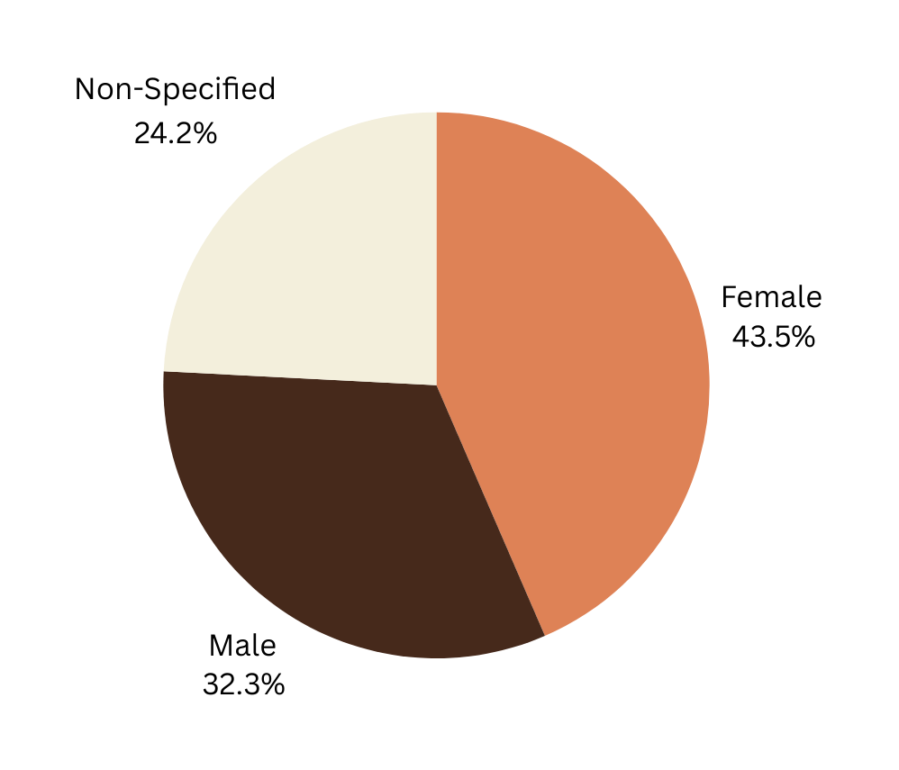

Customers
By Gender

Slide 6
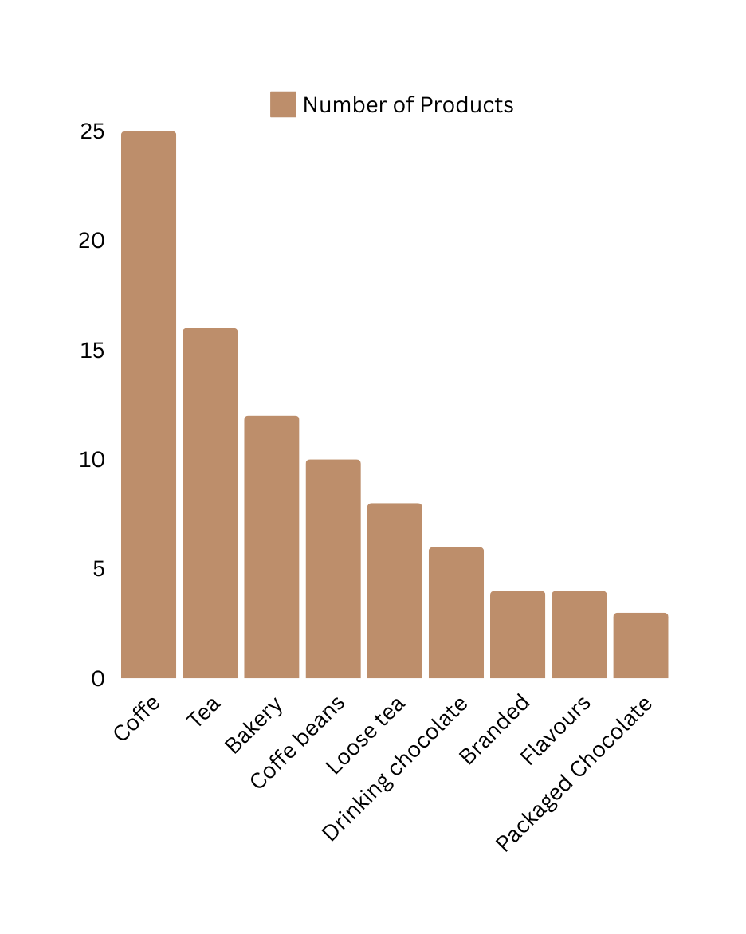
Products

Slide 7
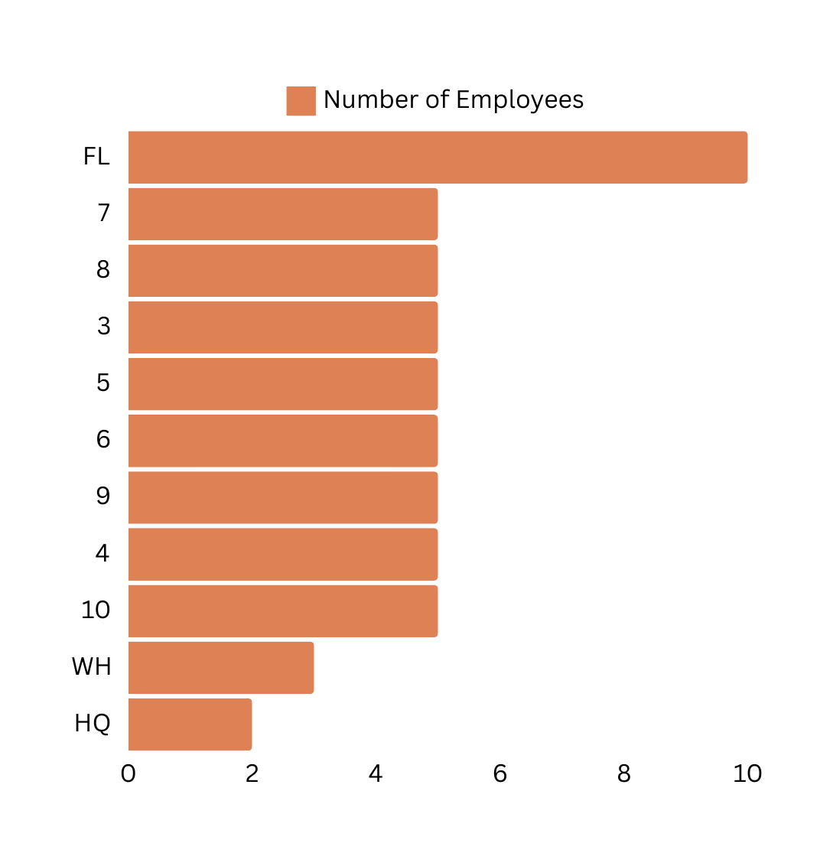
Staff

Slide 8

Receipts
Most Popular Sales Outlet
Most Profitable Sales Outlet
Store 8
17071 total transactions
$79528.25 total profit

Slide 9
Who are the best customers?
Name | Home Store | Total Amount Spent
Hanna | 8 | $459.75
Elvis | 3 | $188.9
Kibo | 5 | $168.75
Leslie | 8 | $165.65

Slide 10
What are the most selled products?
Product | Category | Number of Transactions
Chocolate Croissant | Bakery | 1034
Earl Grey Rg | Tea | 1015
Dark chocolate Lg | Drinking chocolate | 1000
Sustainably Grown Organic Lg | Drinking chocolate | 995
Latte | Coffe | 993

Slide 11
What are the least sold products?
Product | Category | Number of Transactions
Dark chocolate | Packaged Chocolate | 36
Spicy Eye Opener Chai | Loose Tea | 42
Peppermint | Loose Tea | 45
Primo Espresso Roast | Coffe Beans | 47
Earl Grey | Loose Tea | 48

Slide 12
Why MongoDB?
Open Sorce
Cost-Effective
Flexibility & Scalability
Performance

Slide 13

Benefits of Implementing MongoDB for the Coffee Shop
Real-time analytics
Personalized customer experience
Development of targeted campaigns
Identification of trends
Data-driven decisions on marketing campaigns and new menu offers
Optimization of the store’s operations
Reduction of products store waste

Slide 14


