Slide 1

Project: EMACC
Business Problem
High quality cartography output
Unlock data to create sophisticated & compelling maps
Share results with non-GIS community
High-level requirements
Vector based print & layout mapping
Carto-graphic design tools
Interoperable with design industry standard & applications
Notes:
What is the Customer’s Business Problem? What does a customer need to do? What problem are they having?
Why isn’t ESRI meeting this need currently? What are we missing?
What is the solution? What would solve the problems above?
What requirement or need do we want to meet/support? What part of the problem are we going after?
What is the Market? Who are the intended users? What is the target customer? Who at the customer will use the Solution?
What do we need to accomplish for this to be a success? Could be one or more objective that we are trying to accomplish.
Generate $X in revenue?
Beat Google?
Reverse a decline in sales in an industry?
Win projects?

Slide 2
Target Users
National Mapping
Agencies
Local Gov’t
Aeronautical
Chart
Producers
Topographic
Mapping
Agencies
Graphic Design
Defense
Mapping
Agencies
“Cartographers”
Others…
Hydrographic
Offices
Commercial
Oil & Gas

Slide 3

User Needs
“Real maps” for graphics community
Access to spatial data in a familiar environment
Simplified GIS interactions
Work for print, web and multimedia
Interoperable with design industry standard & applications

Slide 4







User Profile
Designers make maps…without GIS
Marking departments
Design Firms
Freelance
Designers have a huge influence
> Design compositions
> Reviewed by Decision makers
> Consumers
Customers care about location
Multi-tier Esri brand recognition

Slide 5
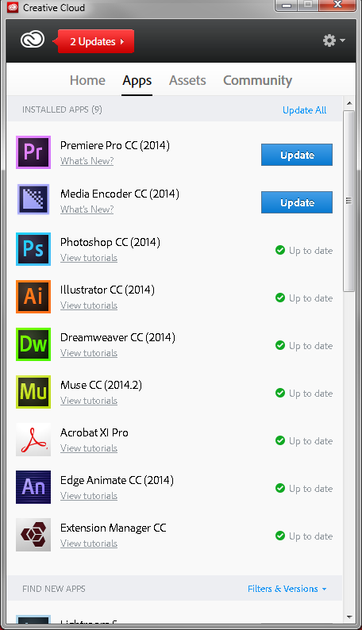
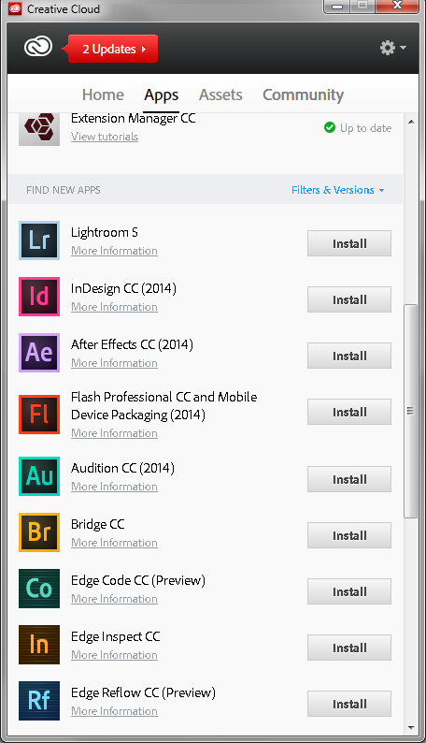

Proposed Solution
“Esri Maps for Adobe Creative Cloud”
Similar to Location Analytics
Lesser focus on analysis, more on design
Adobe
Creative design market share
“Creative Cloud” – cloud based design platform
3 Million subscribers
Vector & Raster
Web
Audio & Video

Slide 6

Demo
Clients
Services & Content
GP
calculate extent
Buffer
surround elements
Etc…
Vector
feature services
vector layers & maps
Raster
image services
Web
base maps
Routing
Etc…
ArcGIS Online
Notes:
Demo script:
AI
Login into AGOL
Open up AI…pick a “vector base map” (map studio/POD type workflow) add
Open up 2nd AI…with AI file exported directly from ArcGIS…show improves to AI structure/layers using emacc
Search for feature service (points) to overlay in existing map add layer to existing map in AI
Buffer points and add new layer
Add a scale bar
PS
Login into AGOL
Open up PS …search for image service (“USA NAIP”) define extent (same UI as AI) add image to PS
MU
Open up existing “finished” MU project with google map widget, switch it out with Esri map
DW
Add and configure a number of web widgets

