Slide 1
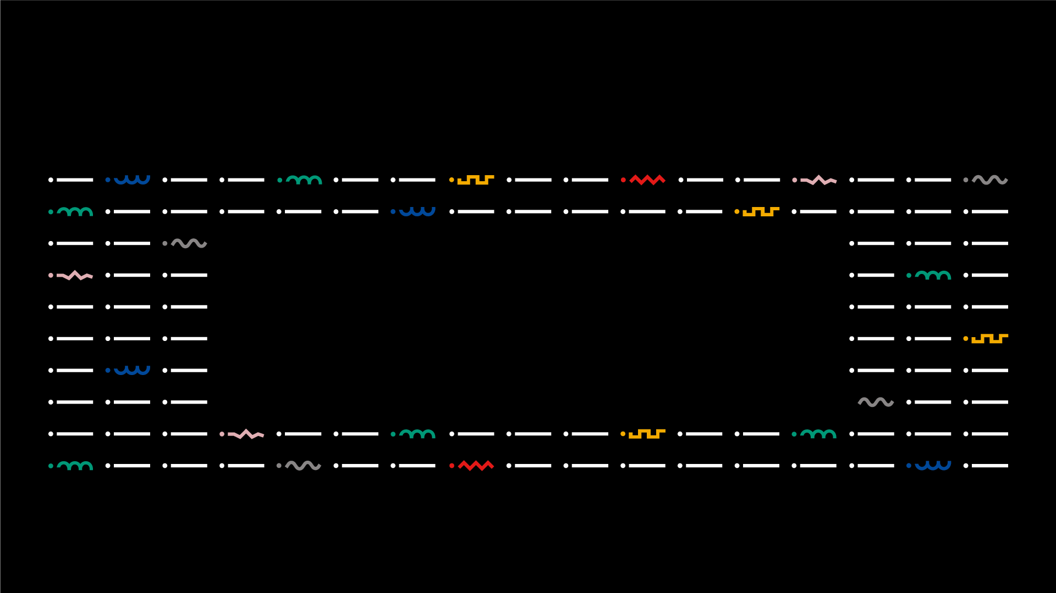

Code Journey
Licenciatura em ENGENHARIA INFORMÁTICA / Degree Informatics engineering
Projeto 3
24607 – André Sousa;
24760 – João Correia;
25870 – Luís Carreira;
Orientador(es):
Professor Doutor Jorge Ribeiro, Miguel Silva, João Valente
Licenciatura em Engenharia Informática | Escola Superior de Tecnologia e Gestão| Unidade Curricular: Projeto III | Ano Letivo 2022/2023

Slide 2


■ Summary
Degree IN Informatics engineering
1. Introduction and Objectives
2. Technologies, tools, libraries, methodology and project management
2.1 Programming Environment
2.2 Spring API
2.3 Technologies
2.3.1 Helm
2.3.2 Kubernetes
2.3.3 Kind
2.3.4 Docker
2.3.5 GitHub
2.3.6 Jenkins
2.3.7 ArgoCD
2.3.8 Prometheus
2.3.9 Jaeger
2.3.10 Loki
2.3.11 Grafana
3. Conclusion
4. Bibliography and Web References
@André Sousa, João Correia, Luís Carreira | Unidade Curricular: Projeto III – Ano Letivo 2022/2023 – Code Journey
- 2 -

Slide 3
■ 1. Introduction and Objectives
Degree IN Informatics engineering
■ Introduction
Modern software development goes well beyond just writing code for our applications. It is well known that we spend more time maintaining applications than developing them, so the industry has developed some techniques and workflows to make the maintenance easier. Those include continuous integration and continuous delivery, release orchestration, and observability. We will learn all the necessary steps required for a completely automated, fast and reliable journey of our code to our clients. The challenge is to improve that journey, like adding automated tests, rolling update strategies, observability, etc…
In this way, we are going to instrument an application to benefit from those workflows, given the available platforms, like Docker, ArgoCD, Kubernets, etc.
@André Sousa, João Correia, Luís Carreira | Unidade Curricular: Projeto III – Ano Letivo 2022/2023 – Code Journey
- 3 -

Slide 4
■ 1. Introduction and Objectives
Degree IN Informatics engineering
■ Objectives
containerize a small web API
deploy it in Kubernetes using ArgoCD, and have it write logs, traces, and collect metrics
the app should be deployed automatically after the approval of a Pull Request on the repository with a build and test process managed by Jenkins
using ArgoCD to deploy the app into Kubernetes.
see metrics, logs, and traces on the respective dashboards.
Note: most of this implementations were done through code like Jenkinsfile for the pipeline and application.yml to other configurations with no manual configuration or in the platforms UI.
@André Sousa, João Correia, Luís Carreira | Unidade Curricular: Projeto III – Ano Letivo 2022/2023 – Code Journey
- 4 -

Slide 5
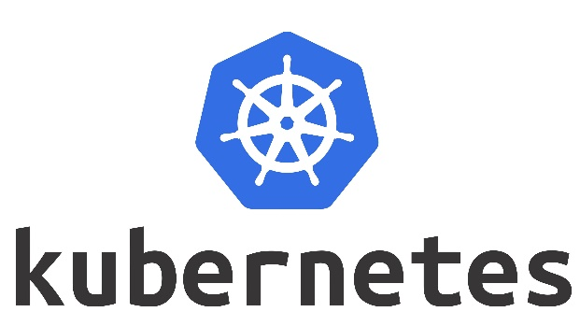
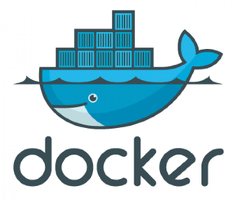






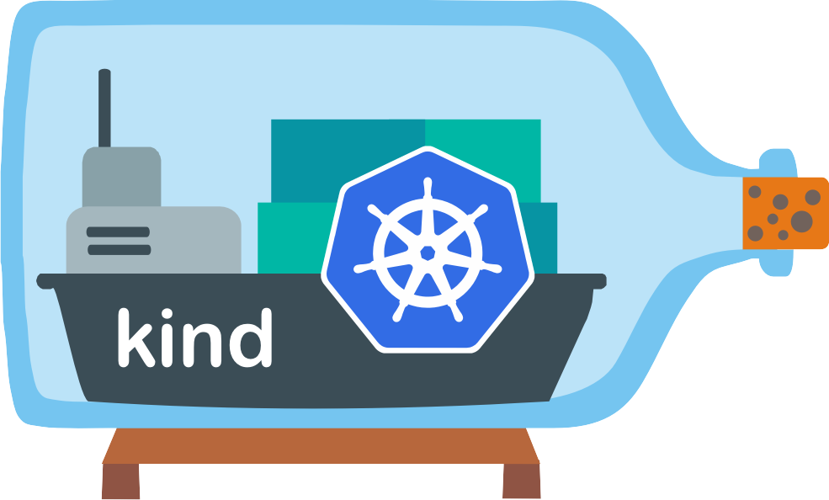


■ 2.Technologies, tools and libraries
Degree IN Informatics engineering
@André Sousa, João Correia, Luís Carreira | Unidade Curricular: Projeto III – Ano Letivo 2022/2023 – Code Journey
- 5 -

Slide 6
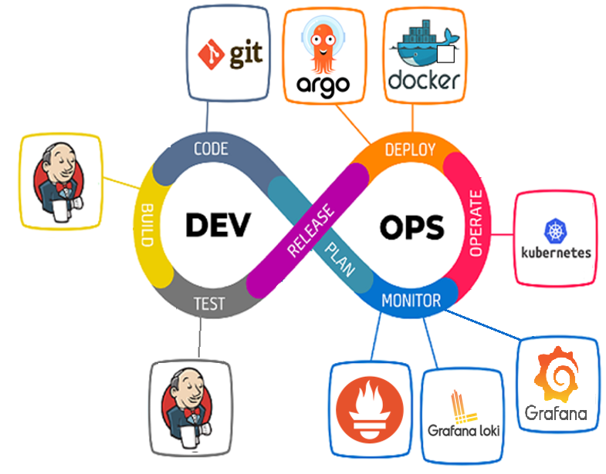
■ 2.1. Programming Environment
Degree IN Informatics engineering
==
+
@André Sousa, João Correia, Luís Carreira | Unidade Curricular: Projeto III – Ano Letivo 2022/2023 – Code Journey
- 6 -

Slide 7
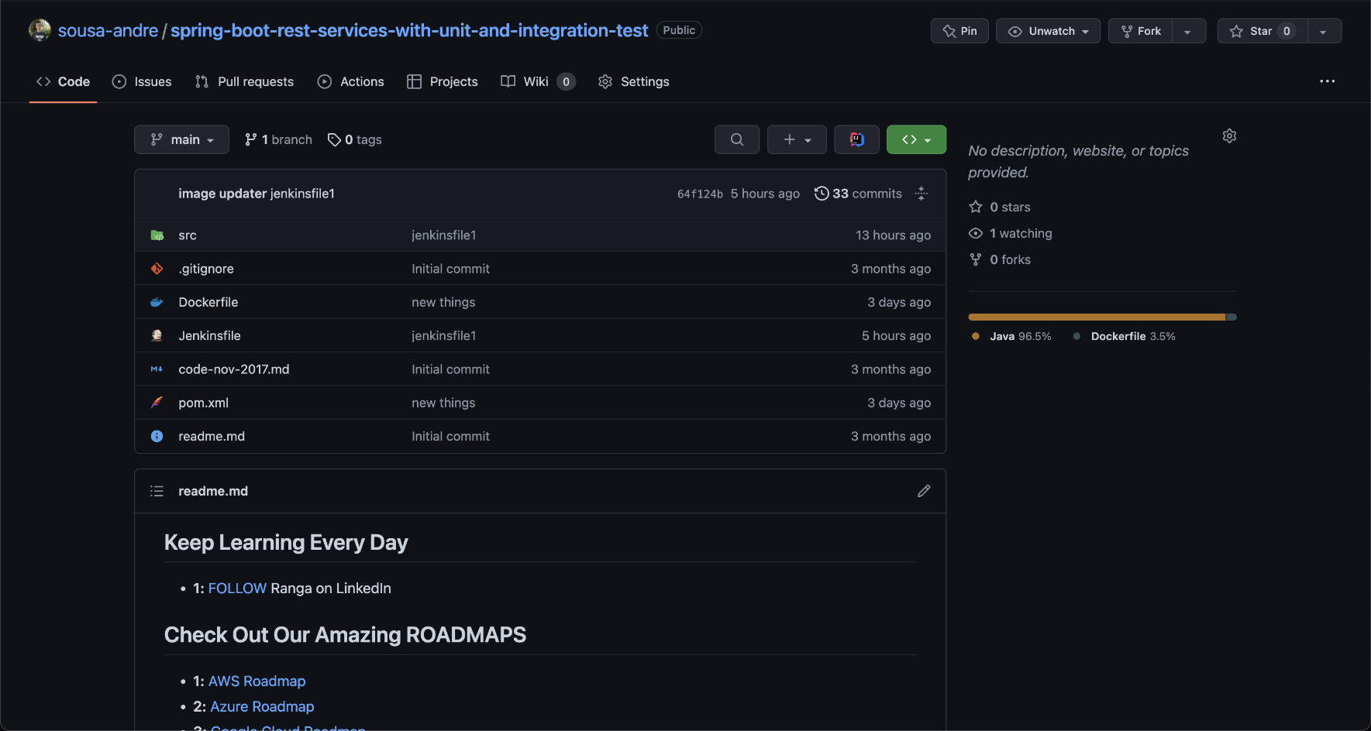
■ 2.2 Spring API
Degree IN Informatics engineering
■ These are all the files necessary to run the API that we used for this project.
https://github.com/sousa-andre/spring-boot-rest-services-with-unit-and-integration-test
@André Sousa, João Correia, Luís Carreira | Unidade Curricular: Projeto III – Ano Letivo 2022/2023 – Code Journey
- 7 -

Slide 8

■ 2.3 Technologies
■ 2.3.1 Helm
Degree IN Informatics engineering
■ Helm is a package manager for Kubernetes. It uses "charts" that help us define, install and upgrade Kubernetes applications. Charts can then be versioned, shared, and published for other people to use.
@André Sousa, João Correia, Luís Carreira | Unidade Curricular: Projeto III – Ano Letivo 2022/2023 – Code Journey
- 8 -

Slide 9
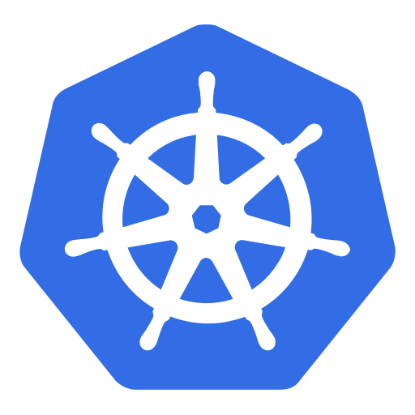
■ 2.3 Technologies
■ 2.3.2 Kubernetes
Degree IN Informatics engineering
■ Kubernetes is a container orchestration software that allow us to automate the deployment, scalling and management of cointainers.
@André Sousa, João Correia, Luís Carreira | Unidade Curricular: Projeto III – Ano Letivo 2022/2023 – Code Journey
- 9 -

Slide 10
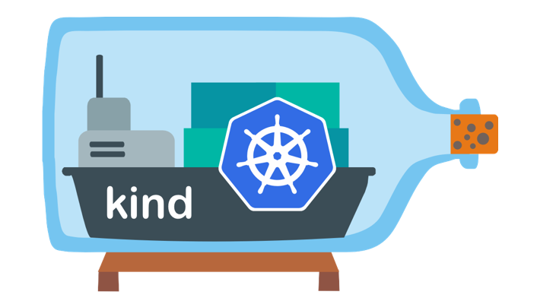
■ 2.3 Technologies
■ 2.3.3 Kind
Degree IN Informatics engineering
■ Kind (Kubernetes In Docker) is a software that creates a kubernetes cluster locally inside a container that lets us test our configurations.
@André Sousa, João Correia, Luís Carreira | Unidade Curricular: Projeto III – Ano Letivo 2022/2023 – Code Journey
- 10 -

Slide 11

■ 2.3 Technologies
■ 2.3.4 Docker
Degree IN Informatics engineering
■ Docker was used to save files/applications on a container. With this we have flexibility and portability on the files/applications that we use on the project.
@André Sousa, João Correia, Luís Carreira | Unidade Curricular: Projeto III – Ano Letivo 2022/2023 – Code Journey
- 11 -

Slide 12
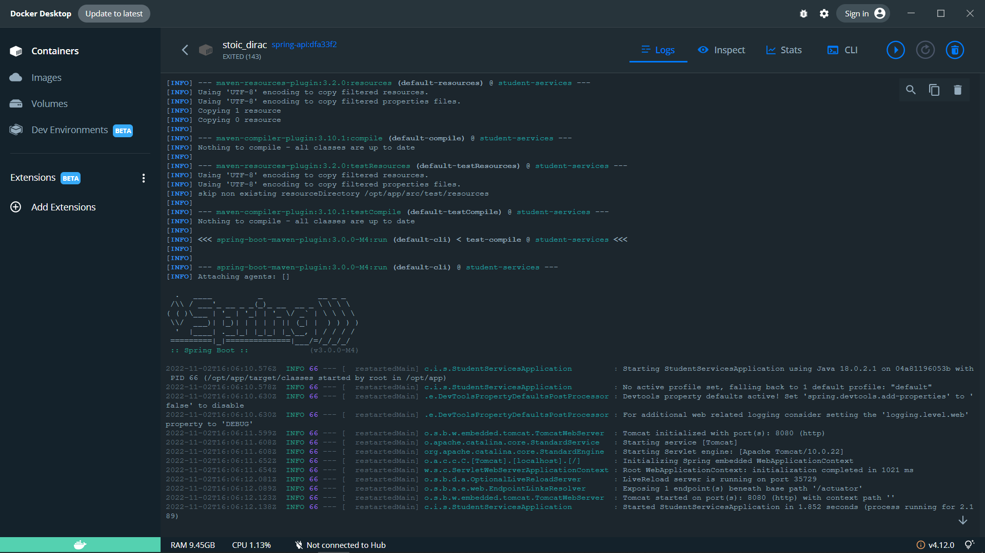
■ 2.3 Technologies
■ 2.3.4 Docker
Degree IN Informatics engineering
■ API Docker container
@André Sousa, João Correia, Luís Carreira | Unidade Curricular: Projeto III – Ano Letivo 2022/2023 – Code Journey
- 12 -

Slide 13

■ 2.3 Technologies
■ 2.3.5 GitHub
Degree IN Informatics engineering
■ Github is a platform where it’s possible to host the code and files. On our project we used GitHub because with this our advisor can send different types off files, like code or documentation.
@André Sousa, João Correia, Luís Carreira | Unidade Curricular: Projeto III – Ano Letivo 2022/2023 – Code Journey
- 13 -

Slide 14
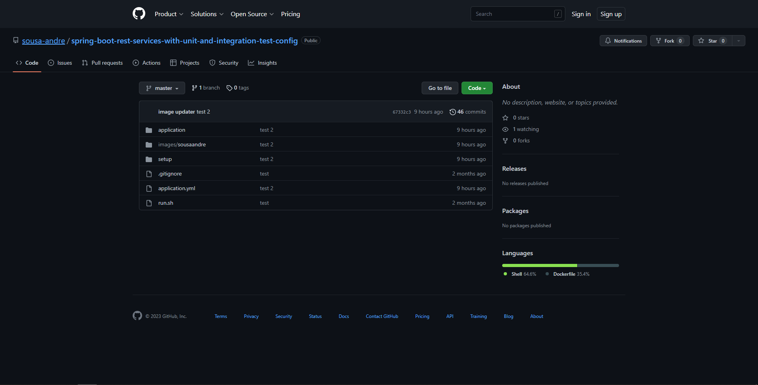
■ 2.3 Technologies
■ 2.3.5 GitHub
Degree IN Informatics engineering
■ GitHub repository for our project files:
https://github.com/sousa-andre/spring-boot-rest-services-with-unit-and-integration-test-config
@André Sousa, João Correia, Luís Carreira | Unidade Curricular: Projeto III – Ano Letivo 2022/2023 – Code Journey
- 14 -

Slide 15

■ 2.3 Technologies
■ 2.3.6 Jenkins
Degree IN Informatics engineering
■ Jenkins is used to automate an application being it building, testing or deploying, with this the integration is facilitated.
@André Sousa, João Correia, Luís Carreira | Unidade Curricular: Projeto III – Ano Letivo 2022/2023 – Code Journey
- 15 -

Slide 16
■ 2.3 Technologies
■ 2.3.6 Jenkins
Degree IN Informatics engineering
■ Before proceeding, let's present a brief explanation of the pipeline:
Our pipeline consists of a Kubernetes cluster and a Jenkins container. In the Kubernetes cluster, we have 4 "applications" (charts) running: Grafana, Loki server (for logs), Prometheus (for metrics), and Jaeger (for tracing). In addition to these services, our Java Spring application (https://github.com/sousa-andre/spring-boot-rest-services-with-unit-and-integration-test) is running within the cluster with the necessary configurations and containers to export logs, metrics, and traces to the respective services.
@André Sousa, João Correia, Luís Carreira | Unidade Curricular: Projeto III – Ano Letivo 2022/2023 – Code Journey
- 16 -

Slide 17
■ 2.3 Technologies
■ 2.3.6 Jenkins
Degree IN Informatics engineering
How it works:
When we push a certain commit to the main of our web application repository (https://github.com/sousa-andre/spring-boot-rest-services-with-unit-and-integration-test), Jenkins will execute the pipeline defined in the Jenkinsfile file by periodically checking (polling) our repository for new commits. This will run the tests, build the Docker image, and push it to hub.docker.com (Docker repository) and finally change the image version in the configuration repository of our application in ArgoCD (https://github.com/sousa-andre/spring-boot-rest-services-with-unit-and-integration-test-config). When there are changes in the previously mentioned repository, ArgoCD will synchronize our cluster according to that same repository.
@André Sousa, João Correia, Luís Carreira | Unidade Curricular: Projeto III – Ano Letivo 2022/2023 – Code Journey
- 17 -

Slide 18
■ 2.3 Technologies
■ 2.3.6 Jenkins
Degree IN Informatics engineering
How we send data to Prometheus (exporters used to export data to Prometheus):
We use the node-exporter (configured through the ServiceMonitor CRD)
How we send data to Loki:
We use a library (tinyloki) to directly send the logs to the Loki server
How we send data to Jaeger:
We run the web application jar with an OpenTelemetry self-instrumentation agent (defined in the Dockerfile).
How we visualize the data:
Grafana
@André Sousa, João Correia, Luís Carreira | Unidade Curricular: Projeto III – Ano Letivo 2022/2023 – Code Journey
- 18 -

Slide 19
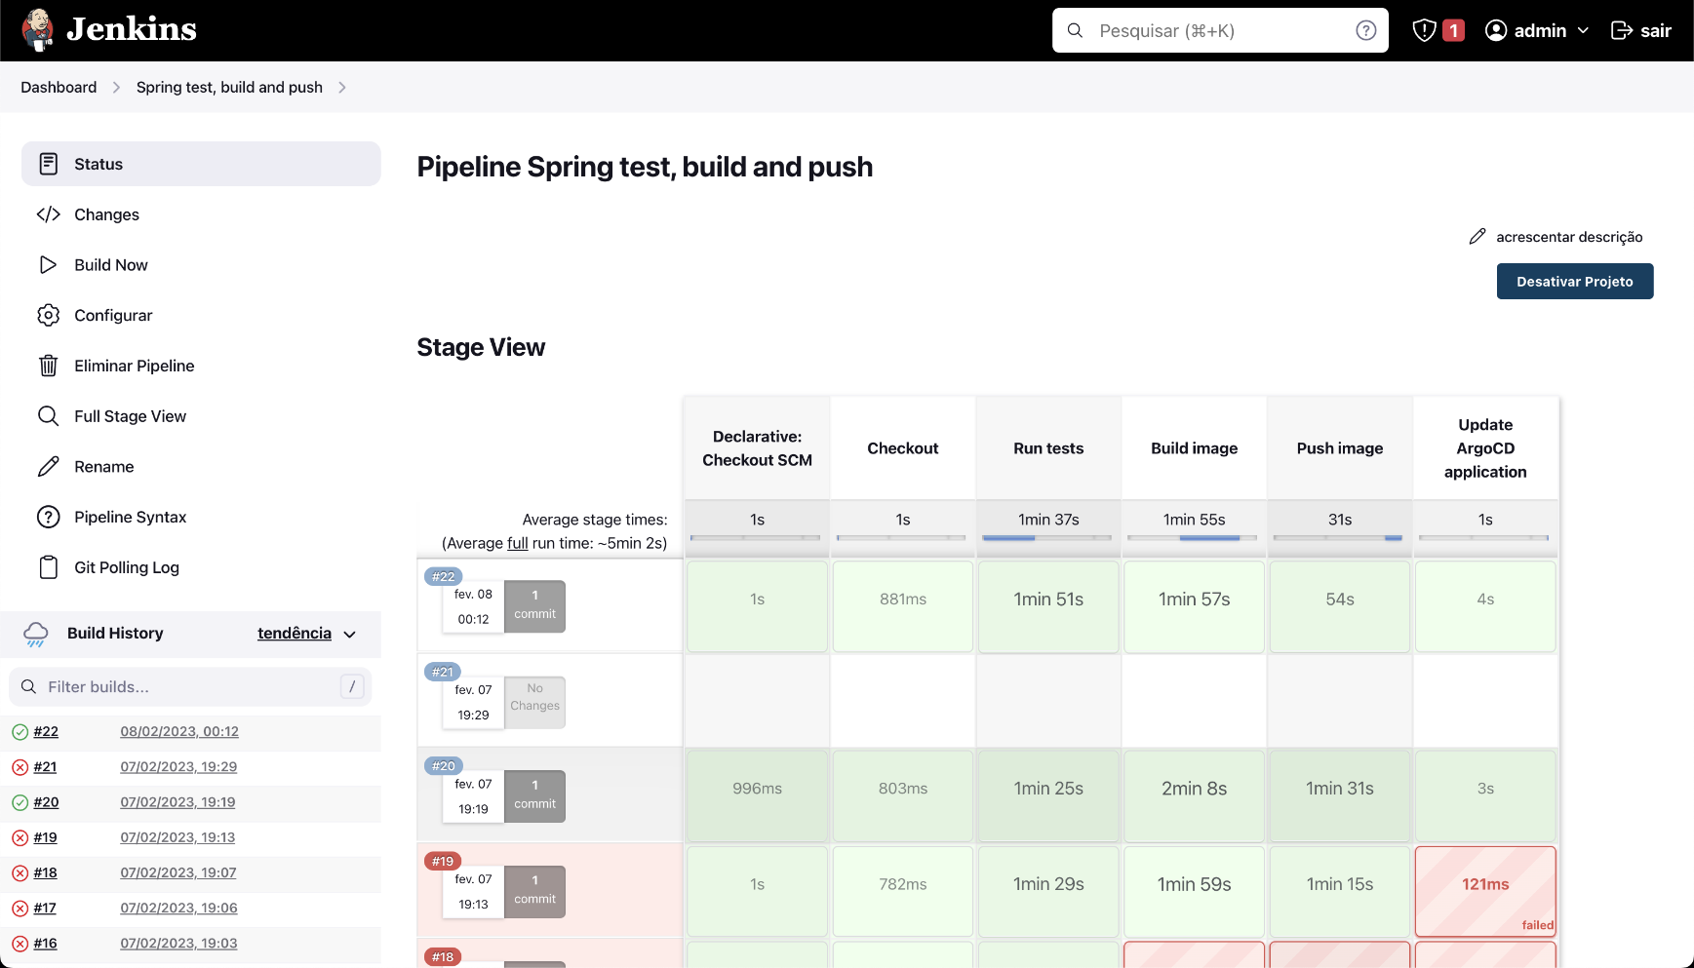
■ 2.3 Technologies
■ 2.3.6 Jenkins
Degree IN Informatics engineering
■ Here we can check the status of pipeline progression.
@André Sousa, João Correia, Luís Carreira | Unidade Curricular: Projeto III – Ano Letivo 2022/2023 – Code Journey
- 19 -

Slide 20
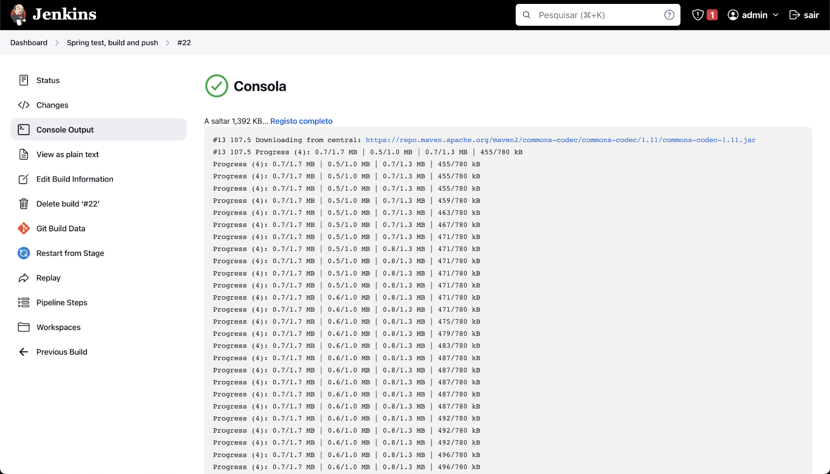
■ 2.3 Technologies
■ 2.3.6 Jenkins
Degree IN Informatics engineering
■ This is where we check the console output of the pipeline, so we can see the progress.
@André Sousa, João Correia, Luís Carreira | Unidade Curricular: Projeto III – Ano Letivo 2022/2023 – Code Journey
- 20 -

Slide 21
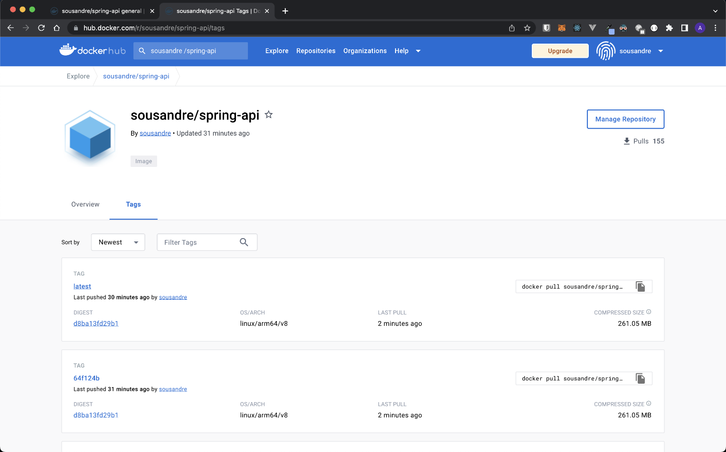
■ 2.3 Technologies
■ 2.3.6 Jenkins
Degree IN Informatics engineering
■ This is the DockerHub image and we can see the latest pushed images.
@André Sousa, João Correia, Luís Carreira | Unidade Curricular: Projeto III – Ano Letivo 2022/2023 – Code Journey
- 21 -

Slide 22

■ 2.3 Technologies
■ 2.3.7 Argo CD
Degree IN Informatics engineering
■ ArgoCD is used to implement like a Kubernetes controller to continuality monitor the applications and compare with latest version. ArgoCD can be used externally or inside of Kubernetes, but we have some advantages running it outside, more speed and be more isolated. Also, ArgoCD implements some GitOps principles: it's a way to have the container's state declared as code, and ensure that the code is always the source of truth. The cluster will always have the apps as they are declared in the code, and if something changes in the cluster, it will correct it to stay as it is in the code.
@André Sousa, João Correia, Luís Carreira | Unidade Curricular: Projeto III – Ano Letivo 2022/2023 – Code Journey
- 22 -

Slide 23
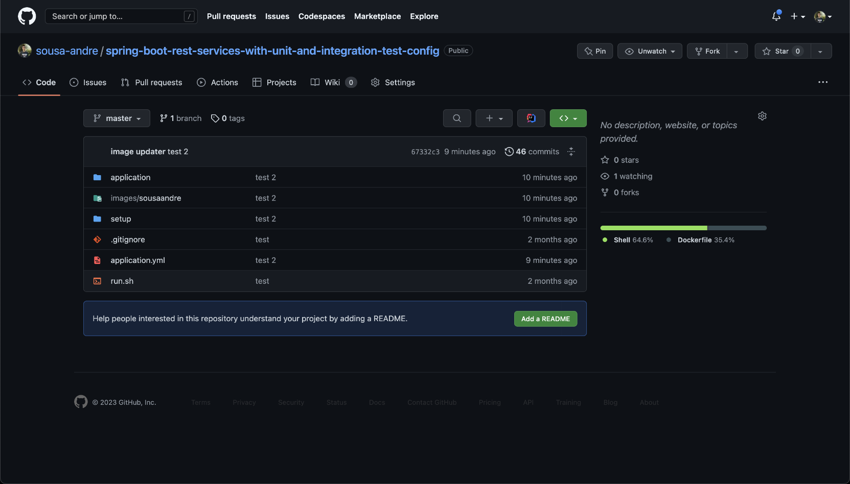
■ 2.3 Technologies
■ 2.3.7 Argo CD
Degree IN Informatics engineering
■ These are the files that we used to build the API on ArgoCD;
https://github.com/sousa-andre/spring-boot-rest-services-with-unit-and-integration-test-config
@André Sousa, João Correia, Luís Carreira | Unidade Curricular: Projeto III – Ano Letivo 2022/2023 – Code Journey
- 23 -

Slide 24
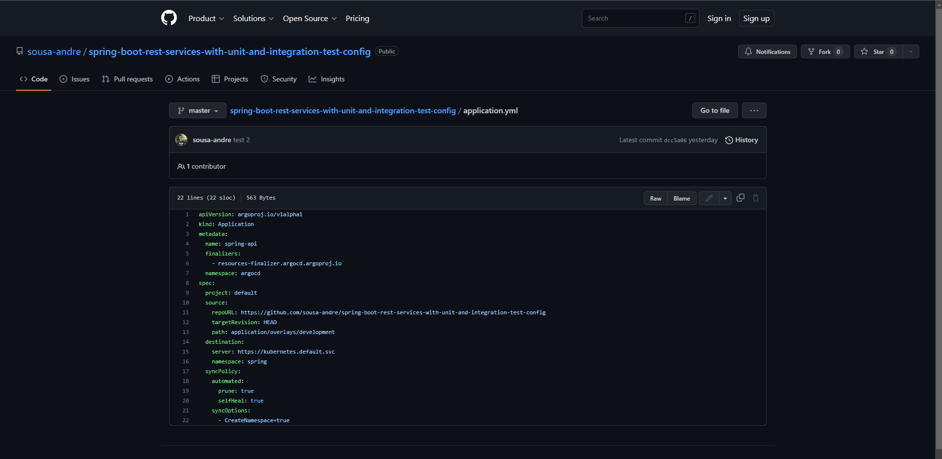
■ 2.3 Technologies
■ 2.3.7 Argo CD
Degree IN Informatics engineering
■ This is the configuration file used to build the API on ArgoCD ;
@André Sousa, João Correia, Luís Carreira | Unidade Curricular: Projeto III – Ano Letivo 2022/2023 – Code Journey
- 24 -

Slide 25
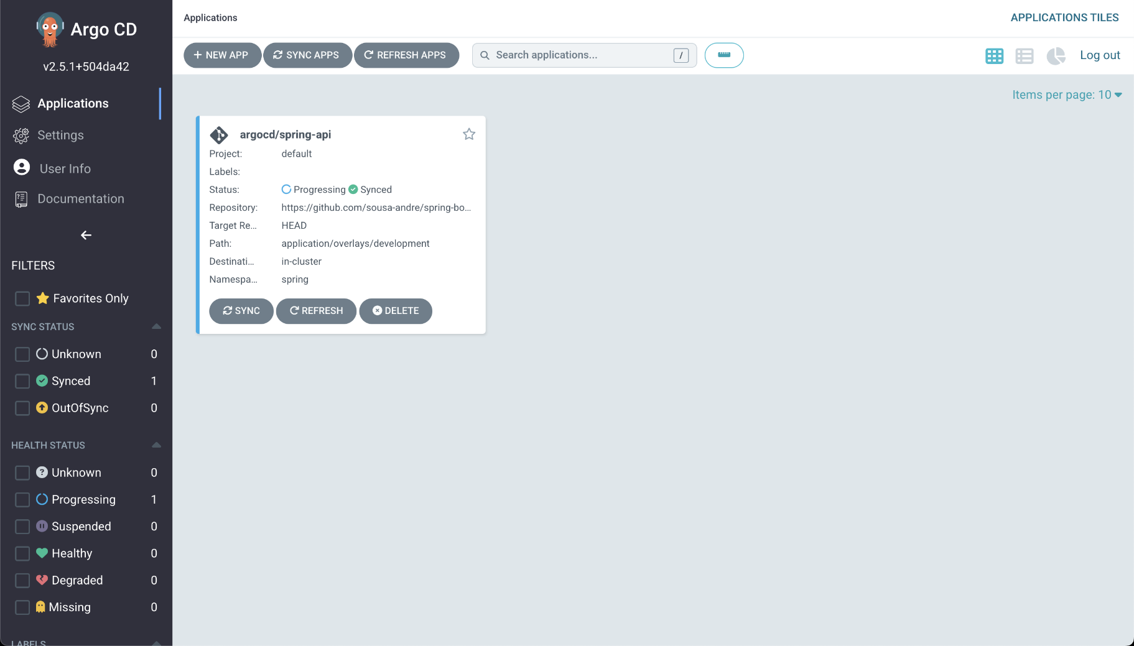
■ 2.3 Technologies
■ 2.3.7 Argo CD
Degree IN Informatics engineering
■ API built on argocd;
@André Sousa, João Correia, Luís Carreira | Unidade Curricular: Projeto III – Ano Letivo 2022/2023 – Code Journey
- 25 -

Slide 26
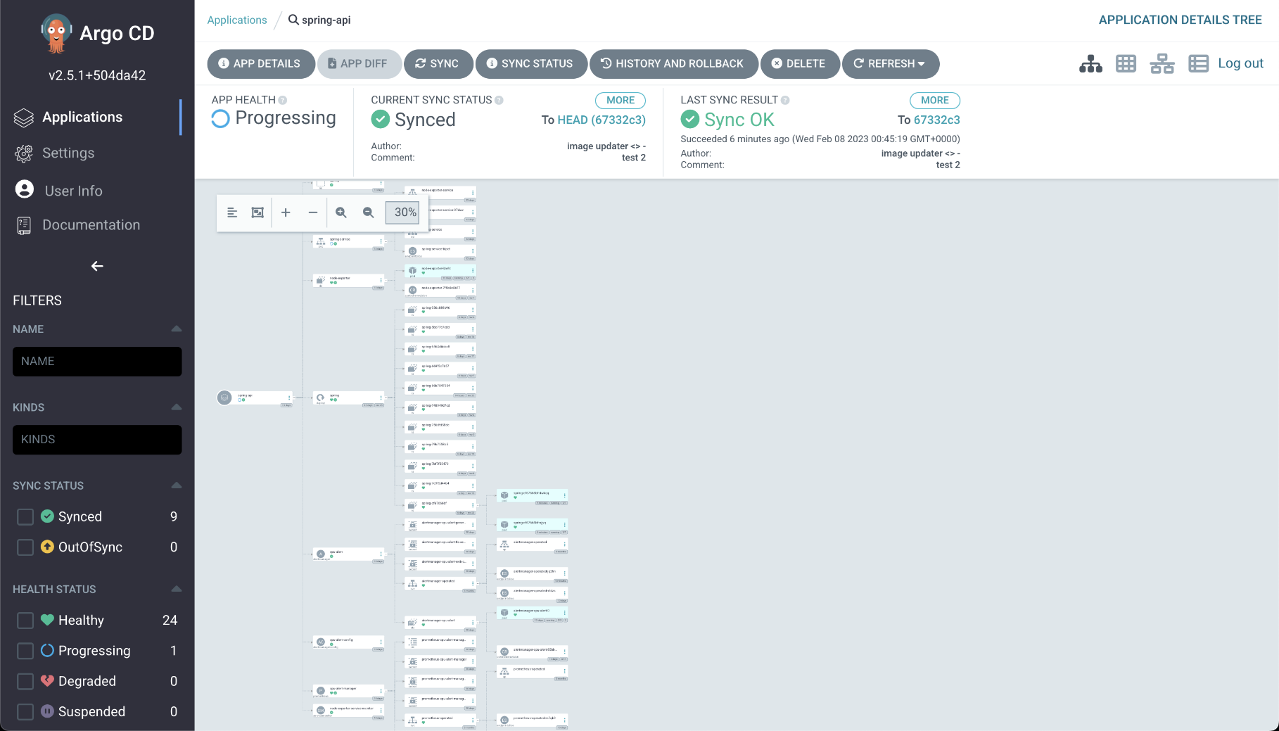
■ 2.3 Technologies
■ 2.3.7 Argo CD
Degree IN Informatics engineering
■ API built on argocd;
@André Sousa, João Correia, Luís Carreira | Unidade Curricular: Projeto III – Ano Letivo 2022/2023 – Code Journey
- 26 -

Slide 27

■ 2.3 Technologies
■ 2.3.8 Prometheus
Degree IN Informatics engineering
■ Prometheus is a software that stores event monitoring metrics (inside a time series database) and has a real-time alerting system.
@André Sousa, João Correia, Luís Carreira | Unidade Curricular: Projeto III – Ano Letivo 2022/2023 – Code Journey
- 27 -

Slide 28
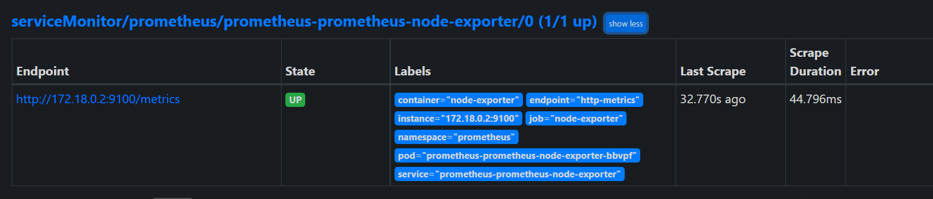
■ 2.3 Technologies
■ 2.3.8 Prometheus
Degree IN Informatics engineering
■ Node exporter of API to export metrics and then monitor them with the others technologies.
@André Sousa, João Correia, Luís Carreira | Unidade Curricular: Projeto III – Ano Letivo 2022/2023 – Code Journey
- 28 -

Slide 29

■ 2.3 Technologies
■ 2.3.9 Jaeger
Degree IN Informatics engineering
■ Jaeger is a open source distributed tracing software that’s generally used to troubleshoot problems with microservices on a cluster when such happens.
@André Sousa, João Correia, Luís Carreira | Unidade Curricular: Projeto III – Ano Letivo 2022/2023 – Code Journey
- 29 -

Slide 30
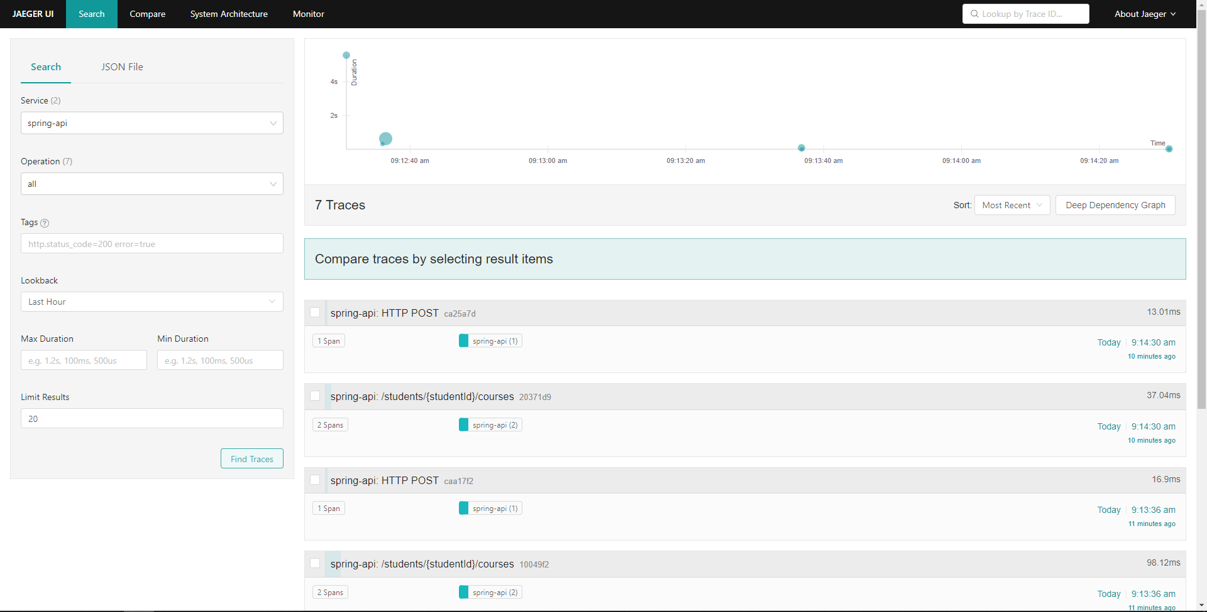
■ 2.3 Technologies
■ 2.3.9 Jaeger
Degree IN Informatics engineering
■ Jaeger UI, where we can monitor the API traces.
@André Sousa, João Correia, Luís Carreira | Unidade Curricular: Projeto III – Ano Letivo 2022/2023 – Code Journey
- 30 -

Slide 31

■ 2.3 Technologies
■ 2.3.10 Grafana Loki
Degree IN Informatics engineering
■ Loki is made up of several components that get deployed to the Kubernetes cluster: Loki serves as storage, storing the logs in a time series database, but it won’t index them.
@André Sousa, João Correia, Luís Carreira | Unidade Curricular: Projeto III – Ano Letivo 2022/2023 – Code Journey
- 31 -

Slide 32

■ 2.3 Technologies
■ 2.3.11 Grafana
Degree IN Informatics engineering
■ The Grafana web application allows you to create dynamic visualization dashboards for data from various sources such as Prometheus, Loki, Jaeger, etc.
@André Sousa, João Correia, Luís Carreira | Unidade Curricular: Projeto III – Ano Letivo 2022/2023 – Code Journey
- 32 -

Slide 33
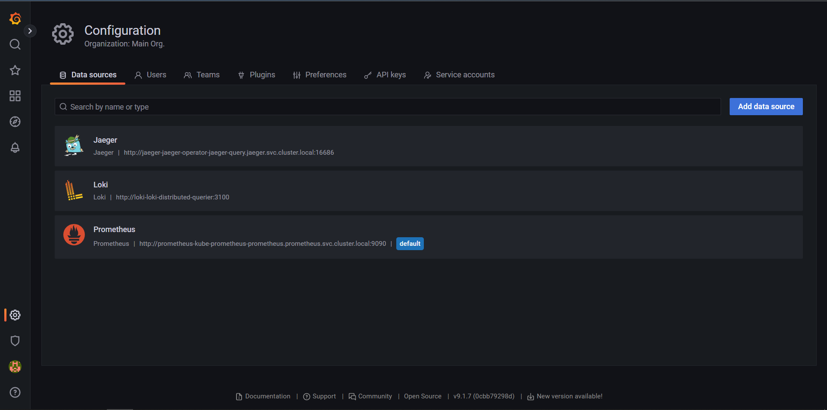
■ 2.3 Technologies
■ 2.3.11 Grafana
Degree IN Informatics engineering
■ Configurations for Grafana to connect with other technologies and receive logs to show them on dashboards to a better analysis.
@André Sousa, João Correia, Luís Carreira | Unidade Curricular: Projeto III – Ano Letivo 2022/2023 – Code Journey
- 33 -

Slide 34
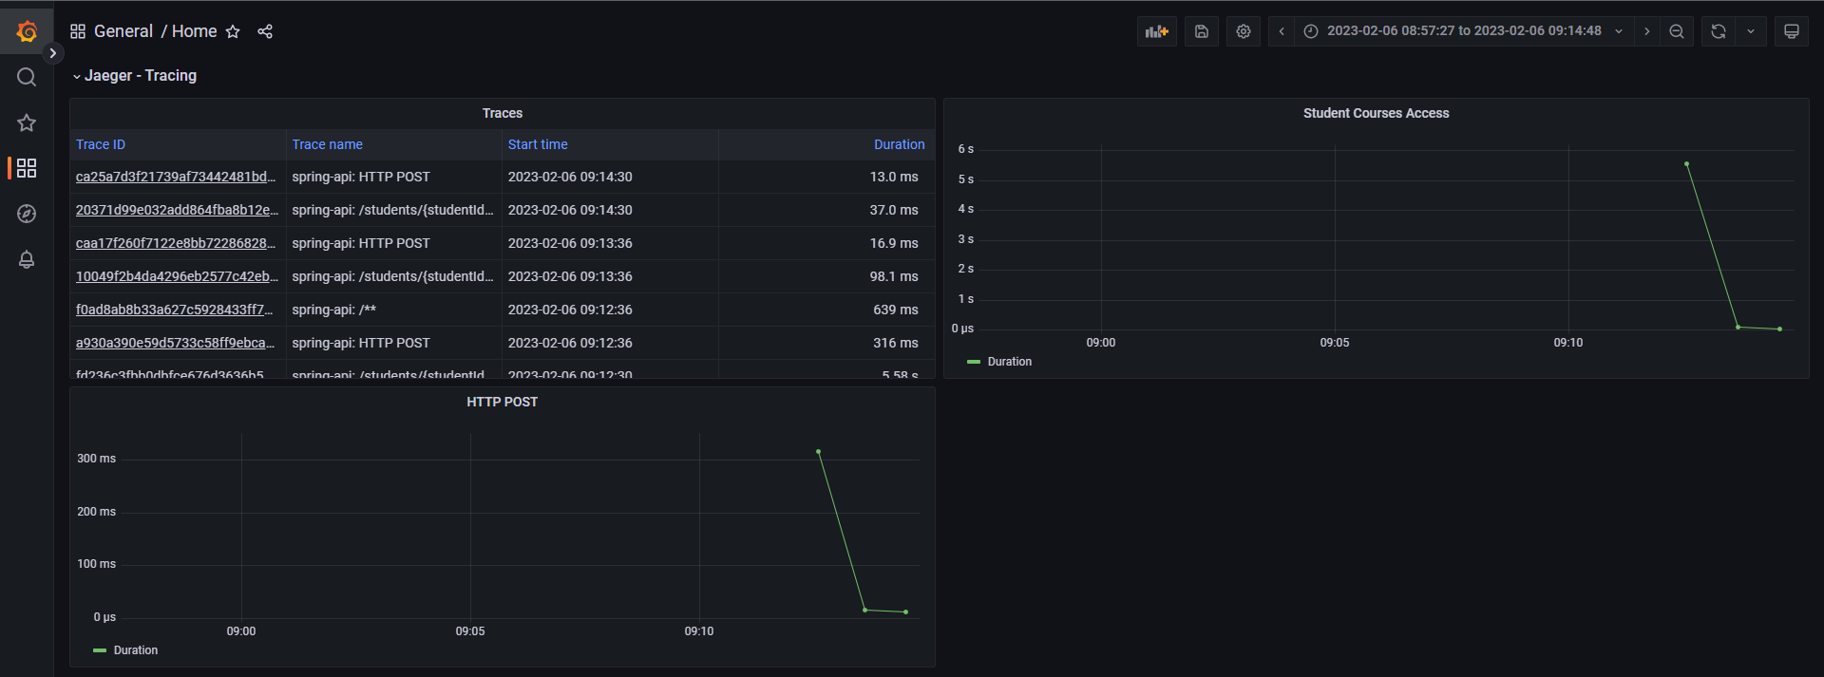
■ 2.3 Technologies
■ 2.3.11 Grafana
Degree IN Informatics engineering
■ Grafana panels to monitor traces created by Jaeger
@André Sousa, João Correia, Luís Carreira | Unidade Curricular: Projeto III – Ano Letivo 2022/2023 – Code Journey
- 34 -

Slide 35
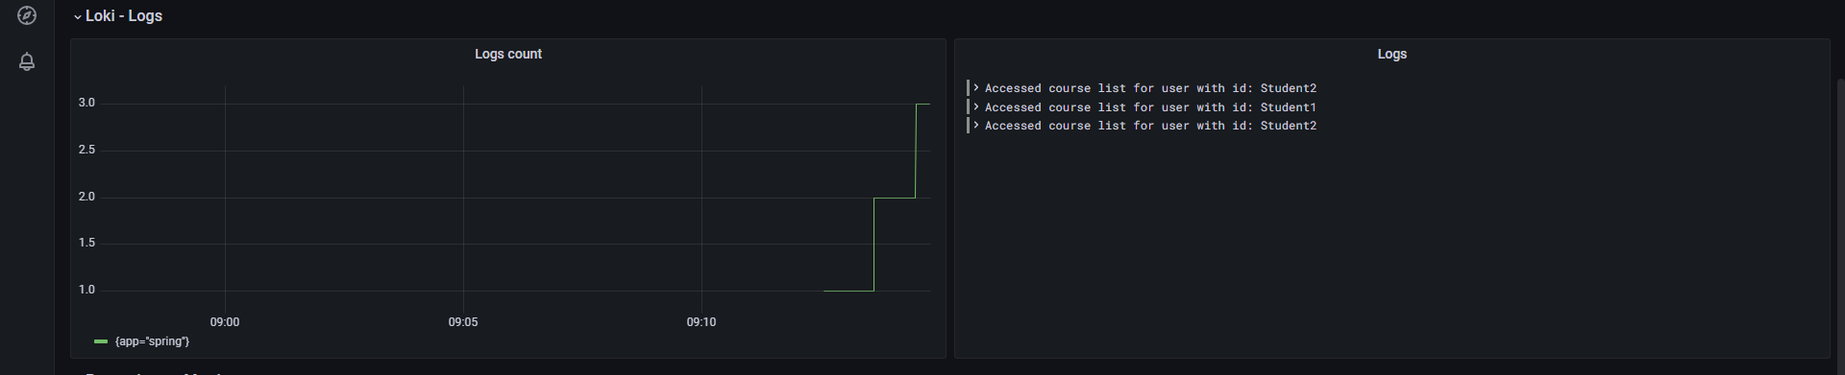
■ 2.3 Technologies
■ 2.3.11 Grafana
Degree IN Informatics engineering
■ Grafana panels to monitor logs created by Loki
@André Sousa, João Correia, Luís Carreira | Unidade Curricular: Projeto III – Ano Letivo 2022/2023 – Code Journey
- 35 -

Slide 36
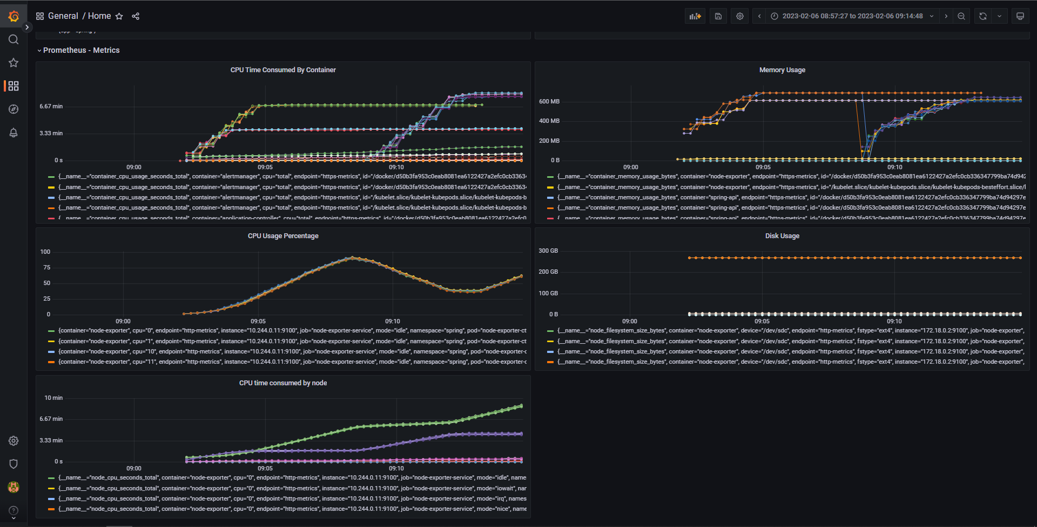
■ 2.3 Technologies
■ 2.3.11 Grafana
Degree IN Informatics engineering
■ Grafana panels to monitor the API metrics with the help of Prometheus
@André Sousa, João Correia, Luís Carreira | Unidade Curricular: Projeto III – Ano Letivo 2022/2023 – Code Journey
- 36 -

Slide 37
■ 3. Conclusion
Degree IN Informatics engineering
In conclusion, this project aimed to implement modern software development techniques and tools to enhance the software development life cycle of a small web API. The objective of containerizing the application, deploying it on Kubernetes with ArgoCD, collecting logs, traces, and metrics was successfully achieved. The ability to observe the application's performance through the respective dashboards for metrics, logs, and traces was an important aspect of this project and provided valuable insights into the performance of the application.
Overall, this project demonstrates the power of modern software development tools and techniques to improve the reliability and efficiency of the software development life cycle. As this was our fist approach to the DevOps “world”, we can say that we are very pleased with all the knowledge obtained by the development of this project. We learned a lot of new things that will definitely help us on our future as software engineers.
@André Sousa, João Correia, Luís Carreira | Unidade Curricular: Projeto III – Ano Letivo 2022/2023 – Code Journey
- 37 -

Slide 38
■ 4. Bibliography and Web References
Degree IN Informatics engineering
■ Git Project Repository: https://github.com/valentej/ipvc-code-journey
■ Docker: https://www.docker.com/
■ GitHub: https://github.com/
■ ArgoCD: https://argoproj.github.io/cd/
■ Jenkins: https://www.jenkins.io/
■ Helm: https://helm.sh/
■ Kubernets: https://kubernetes.io/
■ Grafana: https://grafana.com/
■ Kind: https://kind.sigs.k8s.io/
■ Prometheus: https://prometheus.io/
■ Jaeger: https://www.jaegertracing.io/
■ Loki: https://grafana.com/oss/loki/
@André Sousa, João Correia, Luís Carreira | Unidade Curricular: Projeto III – Ano Letivo 2022/2023 – Code Journey
- 38 -
Notes:
Tiago (acabar referencias)

Slide 39
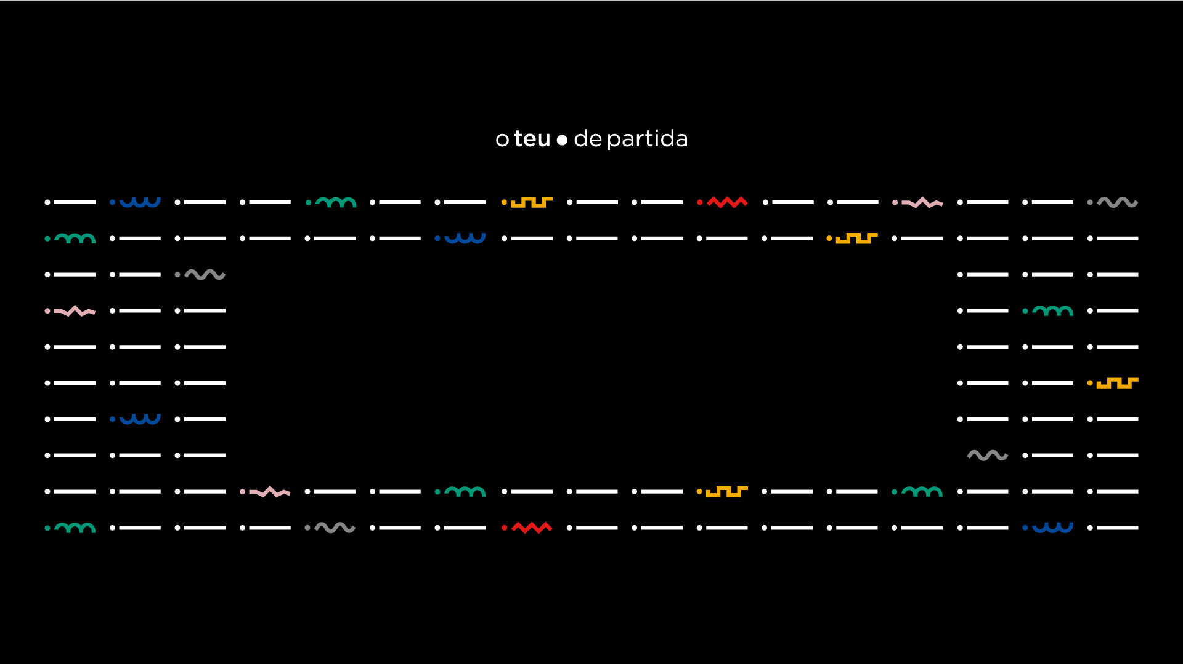
www.ipvc.pt

