Slide 1

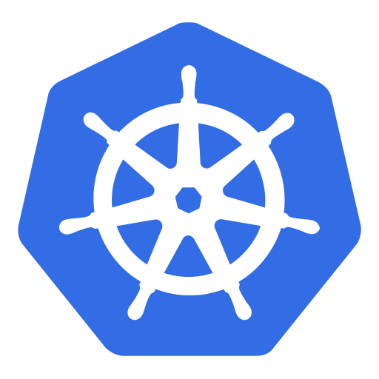
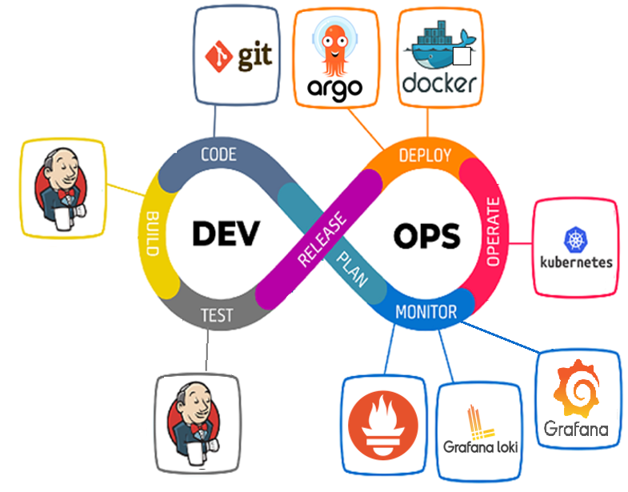
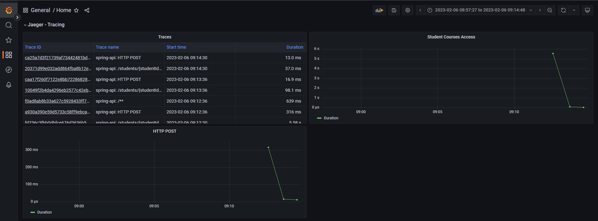
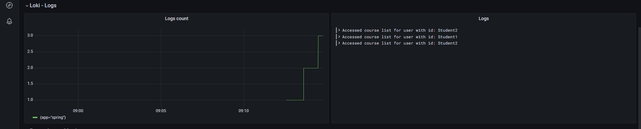
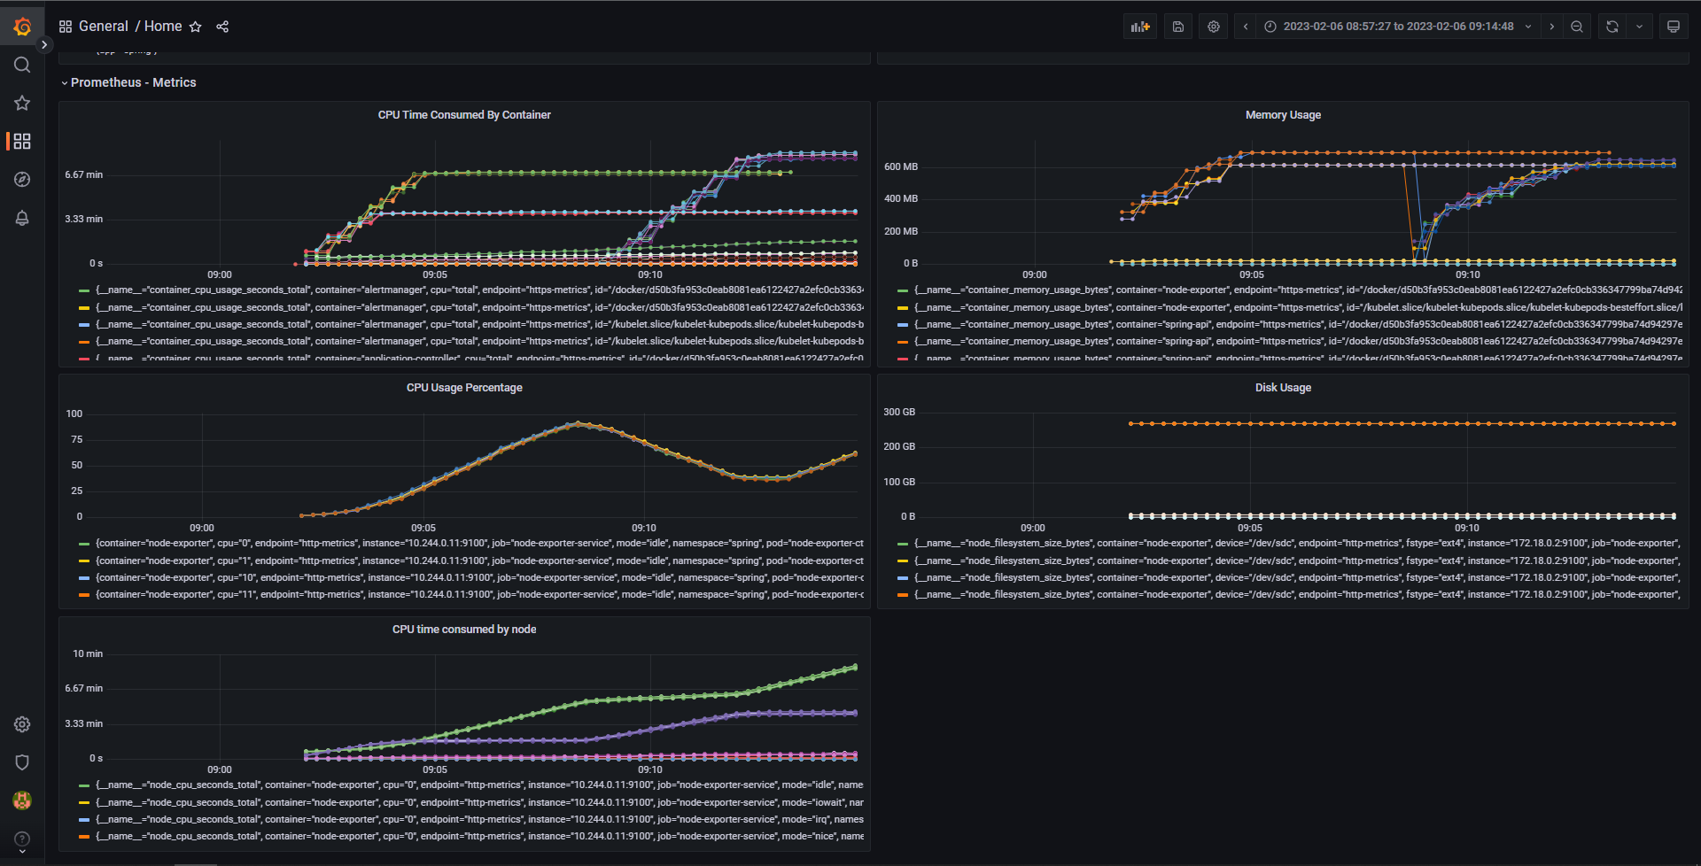
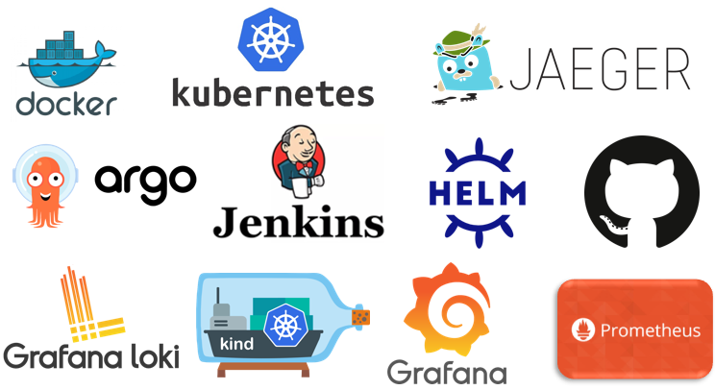


Indrodução
CODE JOURNEY
24607-André Sousa, 24760-João Correia, 25870-Luís Carreira
Licenciatura em
ENGENHARIA INFORMÁTCA
⁽¹⁾Instituto Politécnico de Viana do Castelo;
Unidade Curricular: Projeto III
Modern software development goes well beyond just writing code for our applications. It is well known that we spend more time maintaining applications than developing them, so the industry has developed some techniques and workflows to make the maintenance easier. Those include continuous integration and continuous delivery, release orchestration, and observability. We will learn all the necessary steps required for a completely automated, fast and reliable journey of our code to our clients. The challenge is to improve that journey, like adding automated tests, rolling update strategies, observability, etc…
In this way, we are going to instrument an application to benefit from those workflows, given the available platforms, like Docker, ArgoCD, Kubernets, etc.
Kubernetes
Objetivo
containerize a small web API
deploy it in Kubernetes using ArgoCD, and have it write logs, traces, and collect metrics
the app should be deployed automatically after the approval of a Pull Request on the repository with a build and test process managed by Jenkins
using ArgoCD to deploy the app into Kubernetes.
see metrics, logs, and traces on the respective dashboards.
Note: most of this implementations were done through code like Jenkinsfile for the pipeline and application.yml to other configurations with no manual configuration or in the platforms UI.
Programming Environment
Grafana panels to monitor traces created by Jaeger
Grafana panels to monitor logs created by Loki
Grafana panels to monitor the API metrics with the help of Prometheus
Discussão / Conclusão
Ferramentas e Tecnologias Utilizadas
In conclusion, this project aimed to implement modern software development techniques and tools to enhance the software development life cycle of a small web API. The objective of containerizing the application, deploying it on Kubernetes with ArgoCD, collecting logs, traces, and metrics was successfully achieved. The ability to observe the application's performance through the respective dashboards for metrics, logs, and traces was an important aspect of this project and provided valuable insights into the performance of the application.
Professor Doutor Jorge Ribeiro
ANO LETIVO 2022/2023;
Referências
Orientação
■ Git Project Repository: https://github.com/valentej/ipvc-code-journey
■ Docker: https://www.docker.com/
■ GitHub: https://github.com/
■ ArgoCD: https://argoproj.github.io/cd/
■ Jenkins: https://www.jenkins.io/
■ Helm: https://helm.sh/
Apoios
■ Kubernets: https://kubernetes.io/
■ Grafana: https://grafana.com/
■ Kind: https://kind.sigs.k8s.io/
■ Prometheus: https://prometheus.io/
■ Jaeger: https://www.jaegertracing.io/
■ Loki: https://grafana.com/oss/loki/
Blip.pt

