Slide 1

Lab 6: Sessions
CLAUDE AGENT SDK LAB · SESSIONS AND CONTEXT
Send two ordered turns on one ClaudeSDKClient and retain conversation context.
Luis Coco Enríquez
Notes:
Application workflow for Lab 6 (Sessions), from opening the lesson to reading the results. Exercise: sessions. Live profile: conversation.

Slide 2
The workflow at a glance
Steps 1–7 and 11–13 run in both modes. Steps 8–10 run only when you choose Live Agent SDK.
1
2
3
4
5
Start the lab server
Open Lesson 6 in the browser
Configure the run
Click Run exercise and validate input
RunService starts the run
6
7
8
9
10
Emit started and seed the workspace
Offline exercise: sessions()
Live: build options for a conversation
Live: two turns on one client
Live: consume the message stream
11
12
13
Finish the run with a done event
Stream events back to the page
Render the response and results
Offline + live
Live mode only
Notes:
Offline mode stops after step 7 and goes straight to step 11. Live mode first runs the same offline exercise, then calls the SDK.

Slide 3
Start the lab server
1
OFFLINE + LIVE
Run the serve command. The CLI loads Settings from .env (LAB_* variables).
It creates one RunService and a FastAPI app. install_ui() mounts the NiceGUI pages and /assets.
Uvicorn serves everything on 127.0.0.1:8080.
WHERE IT HAPPENS
agent_lab/cli.py · agent_lab/api.py
$ uv run agent-lab serve
settings = Settings() # .env, LAB_* vars
app = create_app(RunService(settings))
# REST routes + install_ui(app, runner)
uvicorn.run(app, host=settings.host,
port=settings.port)
STEP 01 / 13
Notes:
One RunService instance is shared by the browser UI, the REST/SSE/WebSocket API and the CLI. The lesson can also run headless: uv run agent-lab lesson 6.

Slide 4
Open Lesson 6 in the browser
2
OFFLINE + LIVE
The browser requests /?lesson=6. NiceGUI calls home(lesson=6).
The page reads the lesson from the curriculum: title, objective, default prompt, exercise and live profile.
It opens on the Run the exercise tab.
WHERE IT HAPPENS
agent_lab/ui.py · agent_lab/curriculum.py
GET http://127.0.0.1:8080/?lesson=6
@ui.page("/")
async def home(lesson: int = 0): ...
current = LESSONS[lesson]
# exercise = "sessions"
# live_profile = "conversation"
STEP 02 / 13
Notes:
Objective: Send two ordered turns on one ClaudeSDKClient and retain conversation context.

Slide 5
Configure the run
3
OFFLINE + LIVE
Choose Offline Python exercise or Live Agent SDK. Live appears only when LAB_ENABLE_LIVE=true.
Default prompt (live only): “Remember this label for the next turn: PYTHON-SESSION.”
This lesson also sends the follow-up field as a second turn. Maximum turns defaults to 4 and the budget threshold to 0.10 USD for this lesson.
WHERE IT HAPPENS
agent_lab/ui.py
modes = {"offline": "Offline Python exercise"}
if runner.settings.enable_live:
modes["live"] = "Live Agent SDK"
mode = ui.toggle(modes, value="offline")
prompt.bind_enabled_from(mode, "value",
lambda value: value == "live")
turns = ui.number("Maximum turns",
value=current.max_turns)
STEP 03 / 13
Notes:
The prompt and follow-up fields are disabled in offline mode because offline runs never send them to Claude.

Slide 6
Click Run exercise and validate input
4
OFFLINE + LIVE
run() builds a RunRequest from the form values.
Pydantic rejects unknown fields, trims text and checks bounds: 1–12 turns, budget above 0 and up to 1 USD.
If validation fails, the status shows Could not start and the error is displayed.
WHERE IT HAPPENS
agent_lab/models.py
class RunRequest(BaseModel):
model_config = ConfigDict(extra="forbid")
mode: Literal["offline", "live"]
prompt: str = Field(max_length=10000)
max_turns: int = Field(4, ge=1, le=12)
max_budget_usd: float = Field(
0.10, gt=0, le=1)
STEP 04 / 13
Notes:
The same RunRequest model validates the REST, SSE and WebSocket endpoints.

Slide 7
RunService starts the run
5
OFFLINE + LIVE
start() blocks live mode unless it is enabled, and refuses new runs when every slot is busy.
It creates a RunHandle with an id, a control token and a bounded event queue.
The UI disables Run, enables Cancel, shows Running and starts its consumer task.
WHERE IT HAPPENS
agent_lab/runtime.py
if len(self.active) >= max_concurrent_runs:
raise BusyError("All lesson run slots...")
handle = RunHandle(uuid.uuid4().hex,
secrets.token_urlsafe(24),
asyncio.Queue(maxsize=128))
handle.task = asyncio.create_task(
self._produce(handle, lesson.id, request))
STEP 05 / 13
Notes:
The producer task writes events into the queue; the browser consumer reads them. The queue decouples the two.

Slide 8
Emit started and seed the workspace
6
OFFLINE + LIVE
The producer emits a started event with the run id, lesson id and mode.
Under a deadline (LAB_TIMEOUT_SECONDS, 90 s by default), it creates an isolated workspace for this run.
seed_workspace() writes notes.txt and sales.csv.
WHERE IT HAPPENS
agent_lab/runtime.py · agent_lab/exercises.py
await emit(Event(kind="started", data={
"run_id": handle.id, "lesson_id": 6,
"mode": request.mode}))
async with asyncio.timeout(timeout_seconds):
seed_workspace(work, lesson)
# .lab-data/<run_id>/work/notes.txt
# .lab-data/<run_id>/work/sales.csv
STEP 06 / 13
Notes:
The control token is part of the started event but the UI strips it before logging.

Slide 9
Offline exercise: sessions()
7
OFFLINE + LIVE
Builds the two planned user turns: the prompt and the follow-up.
Lists the live ClaudeSDKClient lifecycle step by step.
No model response: this is the host's conversation plan.
WHERE IT HAPPENS
agent_lab/exercises.py · sessions
turns = [{"role": "user", "content": prompt},
{"role": "user",
"content": request.follow_up}]
"live_lifecycle": [
"async with ClaudeSDKClient(options)",
"await client.query(first)", ...,
"disconnect in the same owning task"]
STEP 07 / 13
Notes:
This step also runs in live mode; its result is emitted as an evidence event. In live mode it appears in the Local exercise results expander, separate from Claude's response. In offline mode the run ends after this step.

Slide 10
Live: build options for a conversation
8
LIVE MODE ONLY
run_sdk() refuses to start without LAB_ENABLE_LIVE and an Anthropic API key or a configured cloud provider.
Base options: the configured model, no setting sources, strict MCP config, the run's own working directory and an isolated CLI config directory.
No tools are enabled; this profile is about keeping context across two turns.
WHERE IT HAPPENS
agent_lab/sdk.py · run_sdk
options = ClaudeAgentOptions(
model=settings.model, # LAB_MODEL
tools=[], setting_sources=[],
strict_mcp_config=True, cwd=str(work),
max_turns=request.max_turns,
max_budget_usd=request.max_budget_usd)
STEP 08 / 13
Notes:
Live mode only. Profile: conversation.

Slide 11
Live: two turns on one client
9
LIVE MODE ONLY
One ClaudeSDKClient session sends the prompt, then the follow-up.
The second turn sees the first turn's context.
The client disconnects in the same task that connected it.
WHERE IT HAPPENS
agent_lab/sdk.py · run_sdk
async with ClaudeSDKClient(options=options) as c:
await c.query(prompt)
await consume(c.receive_response())
await c.query(request.follow_up)
await consume(c.receive_response())
STEP 09 / 13
Notes:
Live mode only.

Slide 12
Live: consume the message stream
10
LIVE MODE ONLY
Each turn ends with its own ResultMessage; the page shows Claude response 1 and Claude response 2.
Each SDK message is converted to a dict, redacted and emitted as a message or result event.
An HTTP 401 retry or a failed ResultMessage stops the run with a clear error.
WHERE IT HAPPENS
agent_lab/sdk.py · consume
async for message in messages:
payload = message_data(message) # redacted
kind = ("result" if isinstance(message,
ResultMessage) else "message")
await emit(Event(kind=kind, data=payload))
if isinstance(message, ResultMessage) \
and message.is_error: raise ...
STEP 10 / 13
Notes:
Live mode only.

Slide 13
Finish the run with a done event
11
OFFLINE + LIVE
Every run ends with exactly one done event: completed, cancelled or failed.
Timeouts, a missing CLI and other errors become safe messages without credentials.
Pending questions are cancelled and the run slot is released.
WHERE IT HAPPENS
agent_lab/runtime.py · _produce
except asyncio.CancelledError: status = "cancelled"
except TimeoutError: status = "failed"
except CLINotFoundError: status = "failed"
finally:
handle.queue.put_nowait(Event(kind="done",
data={"status": status, ...}))
self.active.pop(handle.id, None)
STEP 11 / 13
Notes:
Cancel (or closing the browser tab) cancels the producer task and awaits its cleanup. That path ends with status cancelled.

Slide 14
Stream events back to the page
12
OFFLINE + LIVE
The page's consume() task reads runner.events(handle) until done.
Each event is redacted, stripped of the control token and appended to Diagnostics — raw events.
OutputState.apply() updates the results; on done the status label changes and Run is enabled again.
WHERE IT HAPPENS
agent_lab/ui.py · consume
async for event in runner.events(handle):
data = redact(dict(event.data))
data.pop("control_token", None)
log.push(f"{event.kind.upper()} {...}")
if output_state.apply(event):
output.refresh()
if event.kind == "done": status.set_text(...)
STEP 12 / 13
Notes:
NiceGUI pushes UI updates to the browser over its own websocket; the page does not poll.

Slide 15
Render the response and results
13
OFFLINE + LIVE
Offline: a LOCAL PYTHON RESULT badge and the exercise evidence as fields, lists and tables.
Live: each Claude response as Markdown, then model turns and reported cost. Live shows Claude response 1 and Claude response 2.
In live mode the local evidence stays in a separate expander.
WHERE IT HAPPENS
agent_lab/output.py · render_output
if state.mode == "live":
ui.label(f"Claude response {number}")
ui.markdown(text)
ui.label(f"{turns} model turns · "
f"${cost:.4f} reported cost")
elif state.evidence is not None:
ui.badge("LOCAL PYTHON RESULT")
STEP 13 / 13
Notes:
Fixtures and local evidence are never presented as model output.

Slide 16
App UML sequence diagram: one Lab 6 run
Solid arrow = call · dashed arrow = return value or event through RunHandle.queue
Student
browser
Lesson page
ui.py (NiceGUI)
RunService
runtime.py
Exercise
exercises.py
SDK host
sdk.py
Claude Code CLI
+ Claude API
GET /?lesson=6
click Run exercise
validate RunRequest
start(6, request) → RunHandle
seed_workspace() · run_exercise() → evidence
events: started, evidence
alt [mode == live]
run_sdk(lesson, request, …)
client.query(prompt)
turn 1: assistant, result
client.query(follow_up)
turn 2: assistant, result
events: message, result ×2
event: done {status}
results + diagnostics log
Notes:
Profile conversation. The producer task puts events on RunHandle.queue and the page's consume() task reads them with runner.events(handle). In offline mode the alt fragment is skipped.

Slide 17
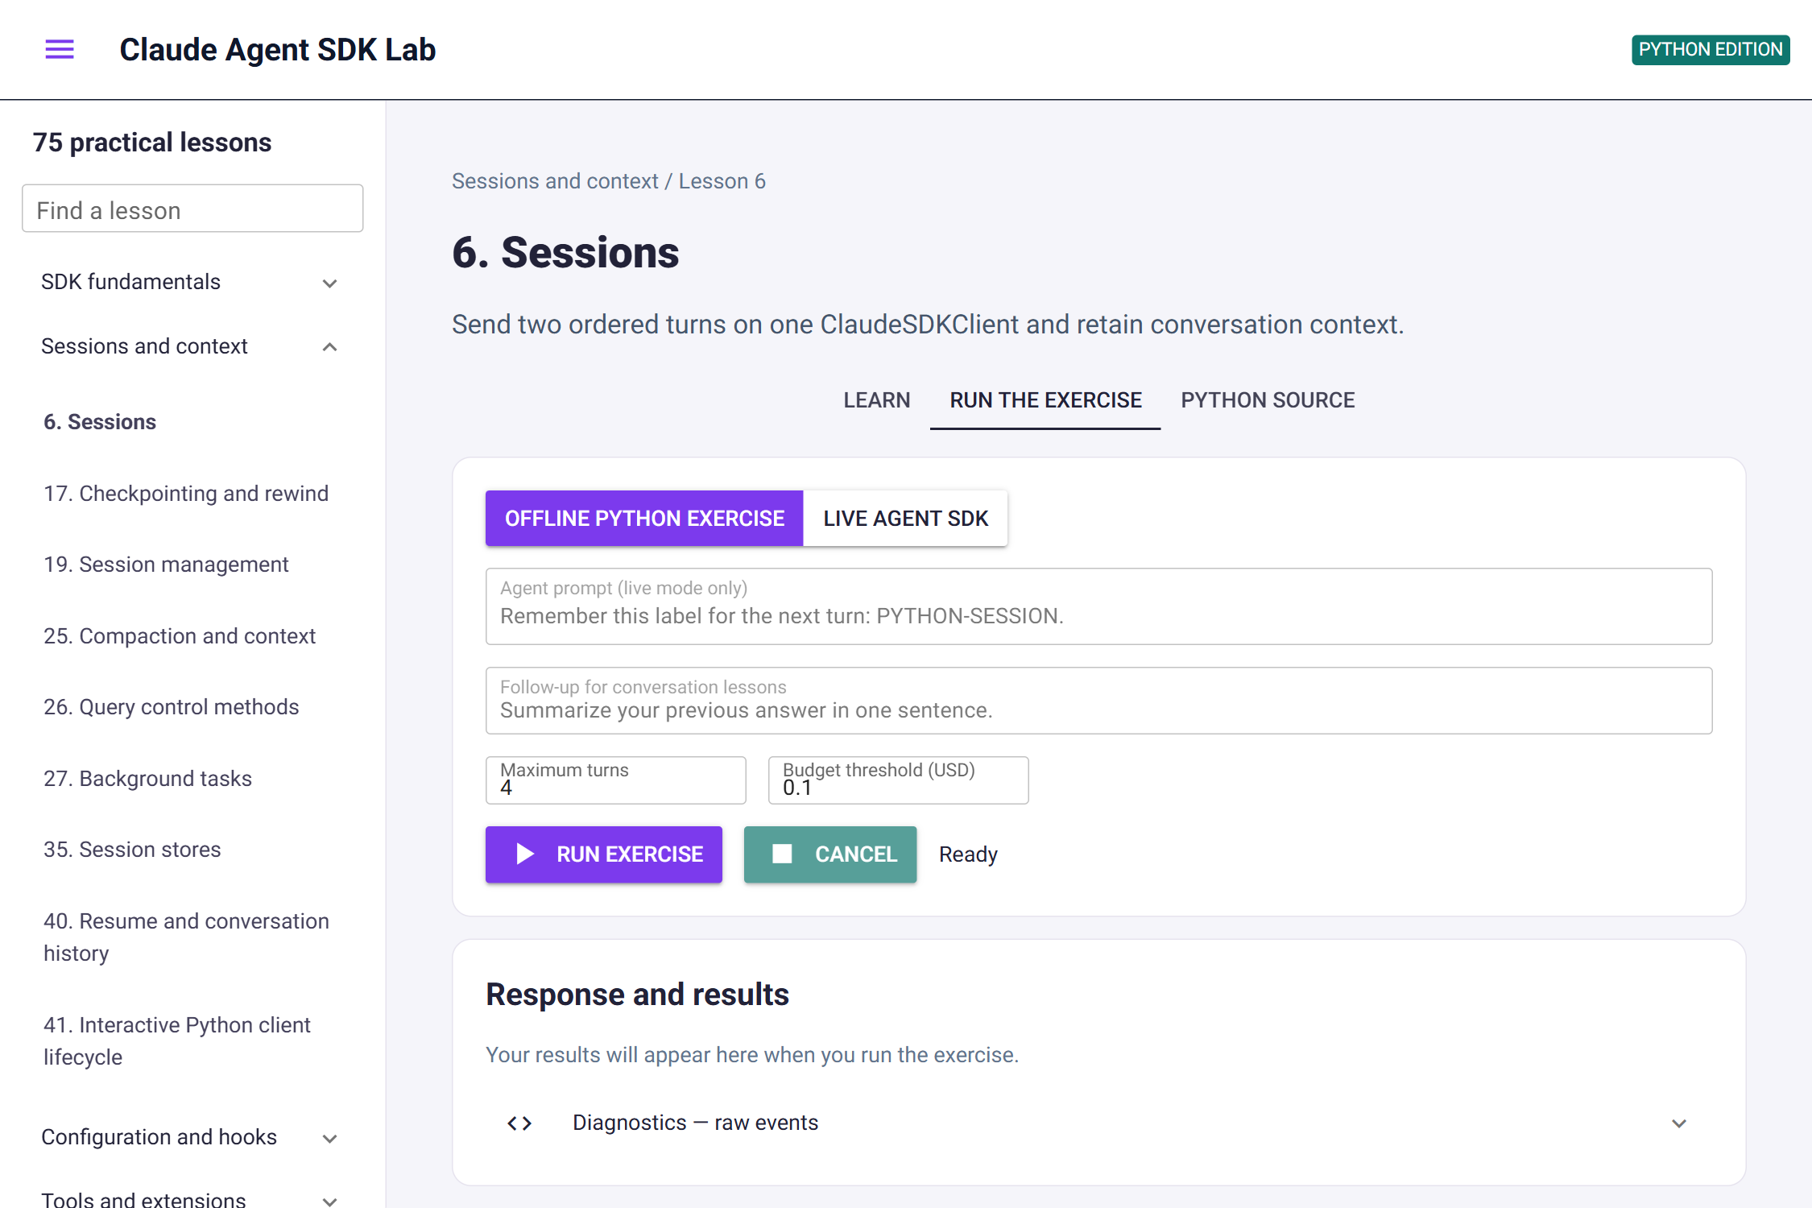
GUI 1: the Run the exercise tab
WHAT TO LOOK FOR
Header
Lesson topic, title and objective.
Tabs
Learn, Run the exercise (open by default) and Python source.
Run card
Mode, prompt, limits, Run and Cancel.
Results card
Empty until the first run.
Notes:
Screenshot captured from http://127.0.0.1:8080/?lesson=6 on 7 October 2026.

Slide 18
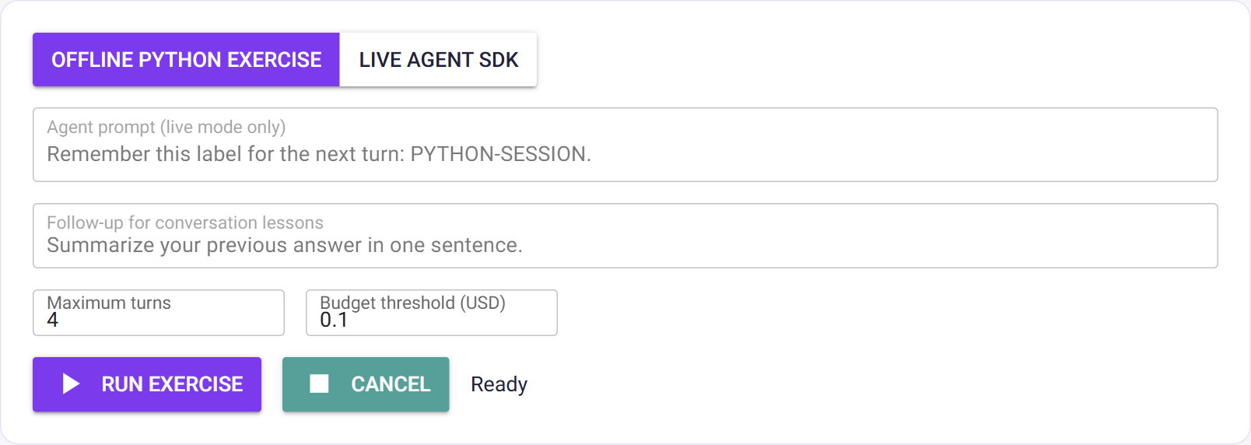
GUI 2: offline run controls
WHAT TO LOOK FOR
Mode
Offline Python exercise is selected by default.
Prompt fields
Greyed out: offline mode never sends the prompt.
Limits
Maximum turns 4, budget threshold 0.10 USD.
Status
Ready, before the first run.
Notes:
Screenshot captured from http://127.0.0.1:8080/?lesson=6 on 7 October 2026.

Slide 19
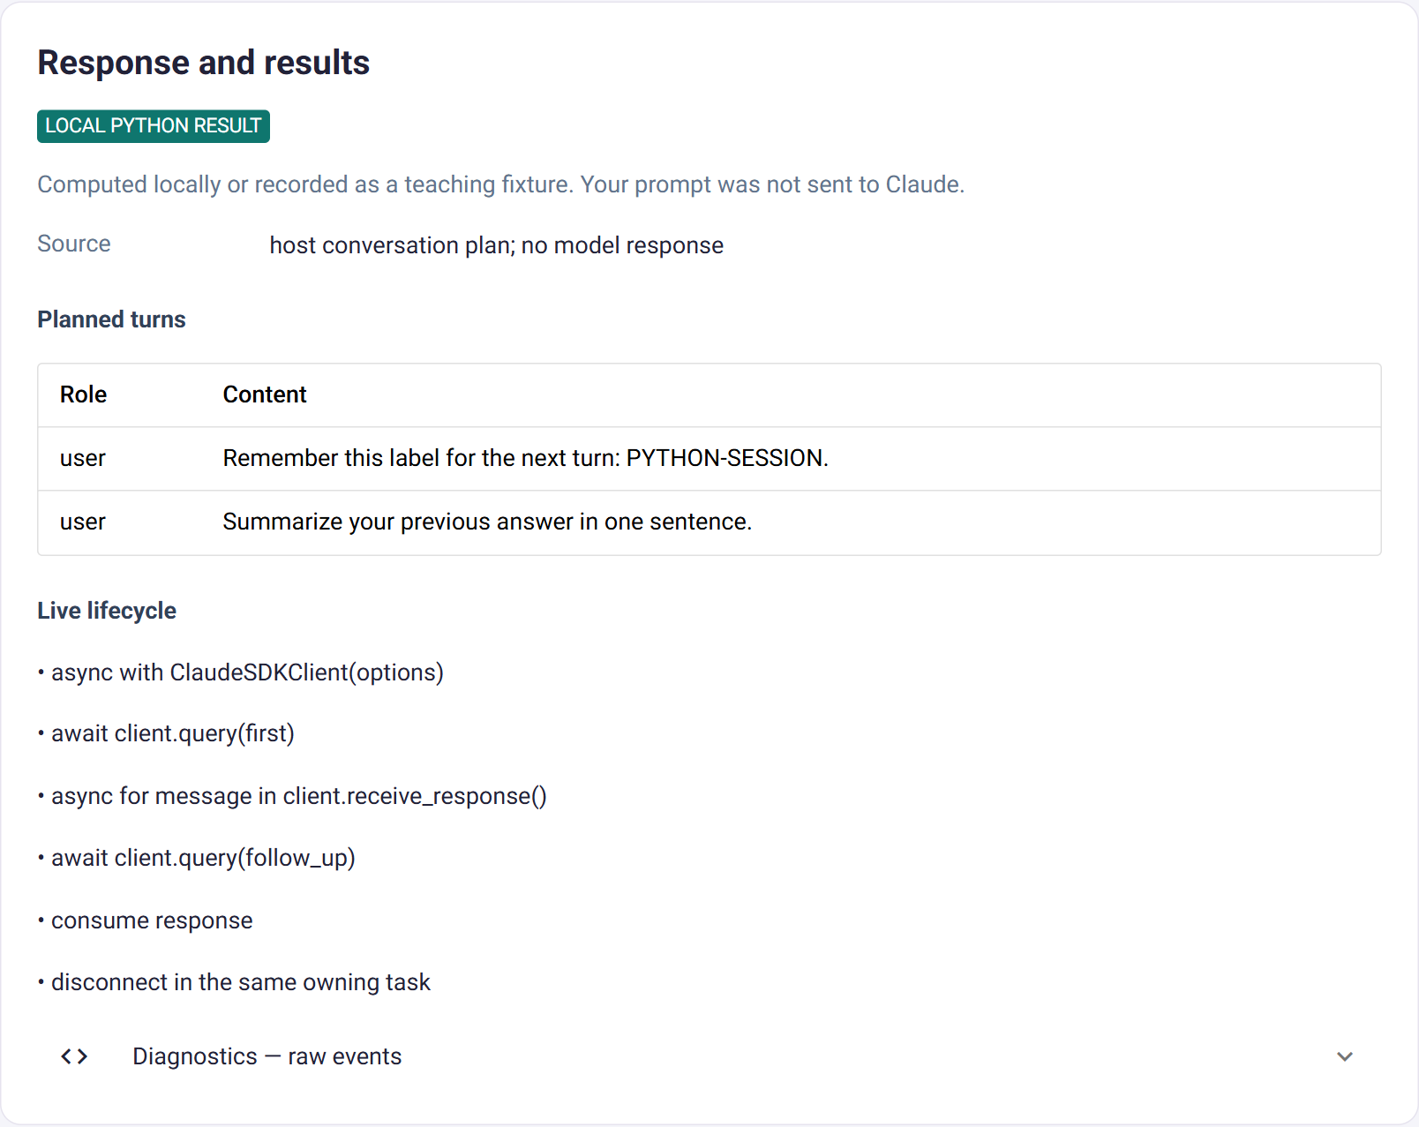
GUI 3: offline result
WHAT TO LOOK FOR
Badge
LOCAL PYTHON RESULT: computed on the host.
Planned turns
Prompt and follow-up.
Live lifecycle
Connect, query, receive, query, disconnect.
Notes:
Screenshot captured from http://127.0.0.1:8080/?lesson=6 on 7 October 2026.

Slide 20
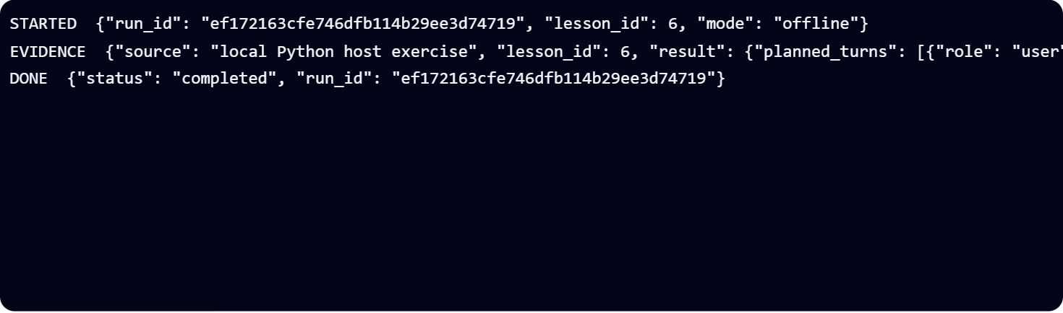
GUI 4: offline diagnostics
WHAT TO LOOK FOR
STARTED
Run id, lesson id and mode offline.
EVIDENCE
The sessions() result.
DONE
Status completed.
Notes:
Screenshot captured from http://127.0.0.1:8080/?lesson=6 on 7 October 2026.

Slide 21
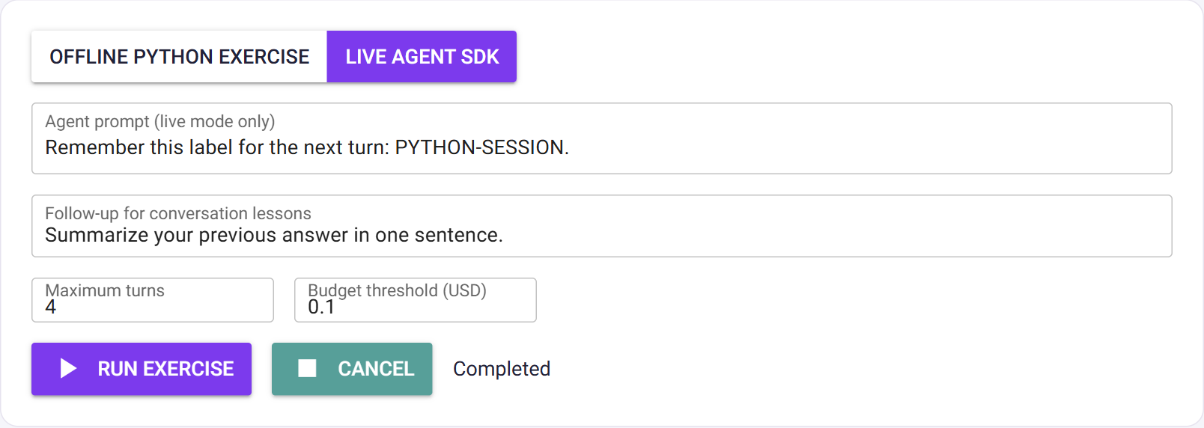
GUI 5: live run controls
WHAT TO LOOK FOR
Mode
Live Agent SDK is selected.
Prompt
Remember this label for the next turn: PYTHON-SESSION.
Status
After the run: Completed.
Notes:
Screenshot captured from http://127.0.0.1:8080/?lesson=6 on 7 October 2026. Live output varies between runs.

Slide 22
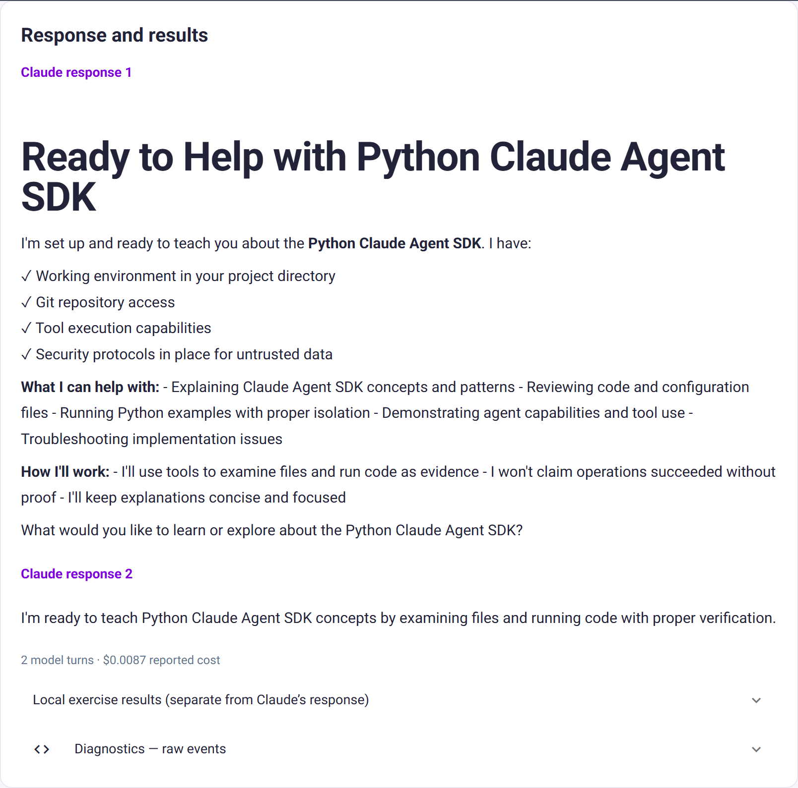
GUI 6: live result
WHAT TO LOOK FOR
Claude response 1
Answer to the prompt.
Claude response 2
The follow-up, using the first turn's context.
Usage
2 model turns · $0.0087 reported cost (varies per run).
Notes:
Screenshot captured from http://127.0.0.1:8080/?lesson=6 on 7 October 2026. Live output varies between runs.

Slide 23
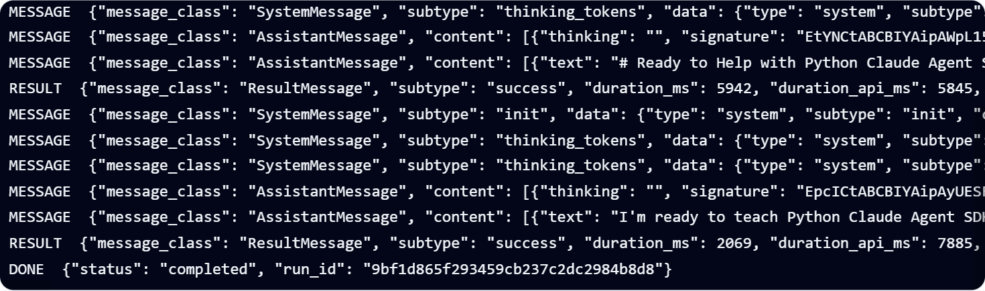
GUI 7: live diagnostics
WHAT TO LOOK FOR
STARTED, EVIDENCE
Same as offline, with mode live.
MESSAGE
SystemMessage init, assistant messages.
RESULT / DONE
ResultMessage, then status completed.
Notes:
Screenshot captured from http://127.0.0.1:8080/?lesson=6 on 7 October 2026. Live output varies between runs.

