Slide 1
Session options: overrides, budgets and previews
CLAUDE MANAGED AGENTS LAB · LAB 02
Twelve steps, from session overrides and list-cost budget to preview deltas, deadline interruption and outcome tracking
Notes:
Lab 02 — Claude Managed Agents. Source: Tab2-options.md and the local application source. Covers session-local overrides, list-cost budgets, connection previews, and local deadline interruption. Authored offline fixtures demonstrate event shapes without API credentials or provider billing.

Slide 2
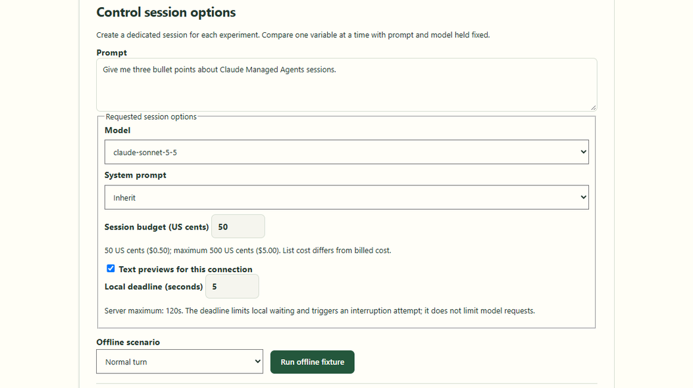
Configure options: the session control surface
SESSION CONTROLS · SCREEN 1 OF 6
Learner chooses model, system prompt, integer budget, previews and deadline.
Session budget in US cents maps to max_list_cost in minor currency units.
Offline fixtures require no credentials, network access or Anthropic billing.
Lab 02 · authored offline controls
Notes:
Lab 02 — Claude Managed Agents. Source: Tab2-options.md and the local application source. Screenshot captured from the authored offline Lab 02 application. Controls allow configuring model from server allowlist, system override, budget in US cents, preview deltas, and deadline in seconds. Source: src/concepts/Concept02Options.tsx and Tab2-options.md.

Slide 3
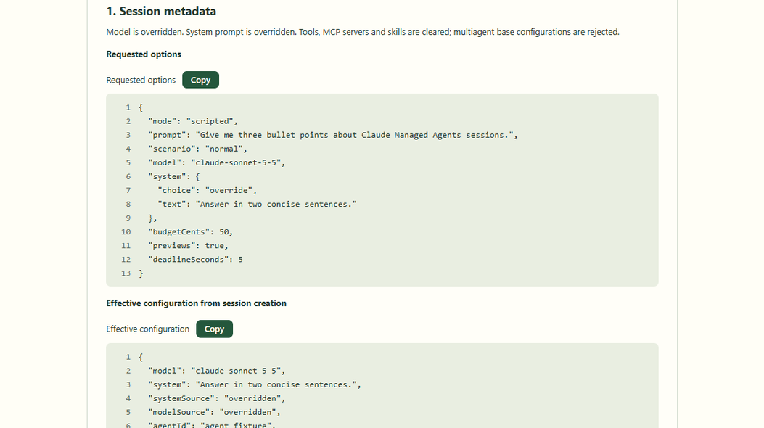
Session creation: requested vs effective snapshot
METADATA · SCREEN 2 OF 6
sessions.create resolves effective model, system prompt, and pinned version.
Overrides clear tools, MCP servers and skills for this dedicated session.
Base agent resource remains unmutated; multiagent bases are rejected.
Lab 02 · session metadata and configuration
Notes:
Lab 02 — Claude Managed Agents. Source: Tab2-options.md and the local application source. The creation response proves what this session runs. Overrides apply only to the dedicated session and never mutate the shared agent resource. Reference: https://platform.claude.com/docs/en/managed-agents/sessions and server/lib/lab02-port.ts.

Slide 4
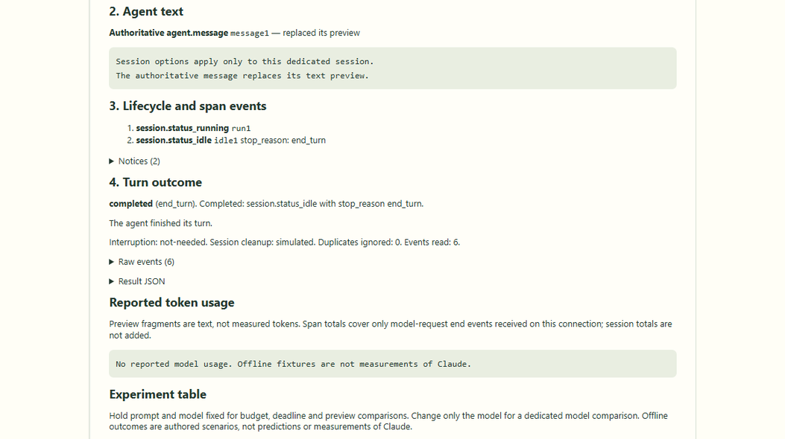
Authoritative answer: replacing preview deltas
RESPONSE · SCREEN 3 OF 6
event_delta streams incremental text fragments while connection is open.
agent.message is authoritative; it replaces preview text by event ID.
Both preview-enabled and disabled runs yield identical final answers.
Lab 02 · authoritative turn response
Notes:
Lab 02 — Claude Managed Agents. Source: Tab2-options.md and the local application source. The UI displays authoritative agent.message replacing the streaming preview delta once received. Preview deltas are ephemeral transport deltas and do not count as measured tokens. Source: server/lib/session-events.ts.

Slide 5
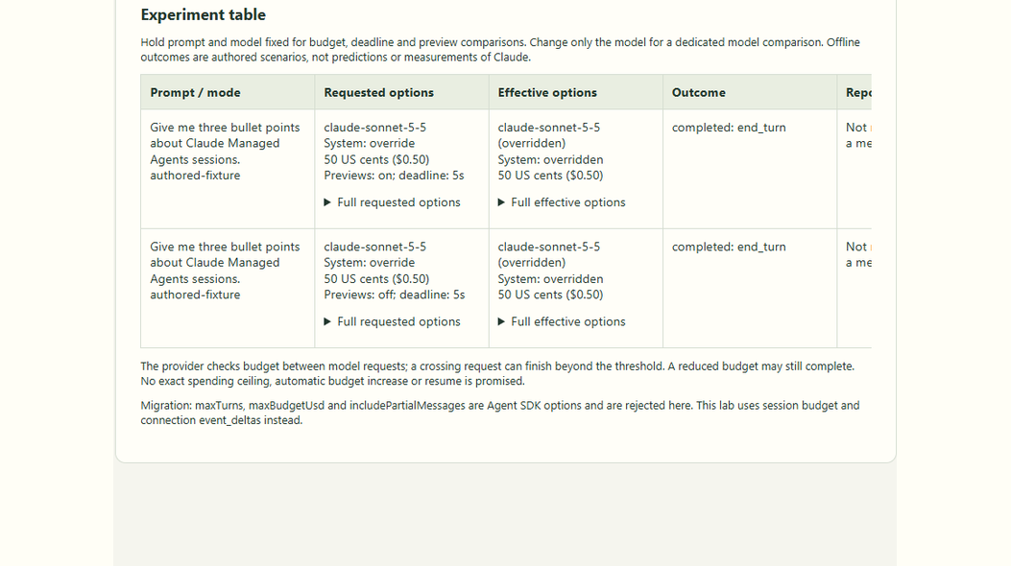
Experiment table: single-variable comparison
EXPERIMENT TABLE · SCREEN 4 OF 6
Records prompt, requested options, effective options, outcome and cleanup.
Preview toggle test holds prompt, model, system, budget and deadline fixed.
Table retains the last 20 results in memory during the mounted exercise.
Lab 02 · experiment comparison table
Notes:
Lab 02 — Claude Managed Agents. Source: Tab2-options.md and the local application source. The experiment table allows students to hold variables fixed and compare one setting change at a time. The preview toggle comparison proves authoritative results match regardless of preview streaming. Source: src/concepts/Concept02Options.tsx.

Slide 6
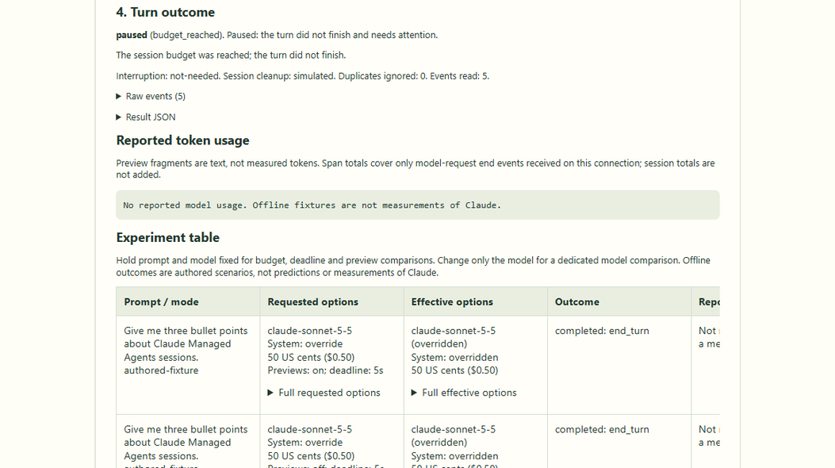
Spending limits: budget reached and paused
BUDGET PAUSE · SCREEN 5 OF 6
Provider checks budget between model requests; crossing request finishes.
Stop reason budget_reached produces a paused turn, not a success or error.
Interruption is not needed; work pauses cleanly without billing surprises.
Lab 02 · budget-reached fixture outcome
Notes:
Lab 02 — Claude Managed Agents. Source: Tab2-options.md and the local application source. A budget reached stop reason pauses the session. It is not an SDK budget error and not an execution failure. The crossing request may exceed the threshold slightly. Reference: https://platform.claude.com/docs/en/managed-agents/budgets.

Slide 7
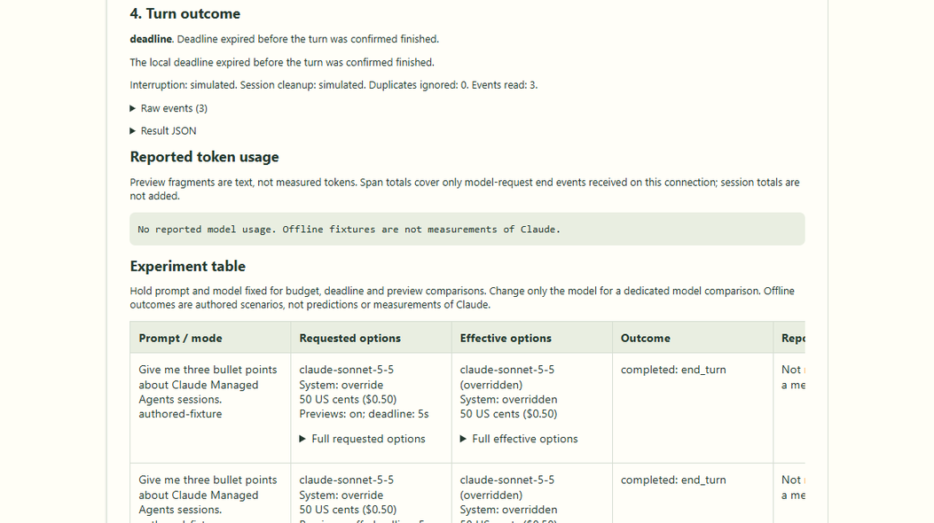
Waiting limits: local deadline and cleanup
LOCAL DEADLINE · SCREEN 6 OF 6
Local deadline bounds client waiting time, not model request limits.
Runner triggers independent user.interrupt request before aborting stream.
Interruption confirmation requires observed stopped status; else unconfirmed.
Lab 02 · deadline expiry and interruption cleanup
Notes:
Lab 02 — Claude Managed Agents. Source: Tab2-options.md and the local application source. A local deadline expiry aborts the client wait first, then sends an independent user.interrupt to stop remote execution. Remote interruption is confirmed only when stopped status is observed. Reference: server/lib/lab01-run.ts and server/lib/lab02-run.ts.

Slide 8
Session options and lifecycle in sequence
User
React UI
Concept02Options
Express route
/api/c2/query (via Vite)
Anthropic SDK
sessions + events
Managed Agents
remote session
1. Configure options, Run exercise
2. POST { prompt, options }
3. Validate Zod · openSse()
4. runLab02(port, requested)
5. Create overrides → open → send
6. Agent deltas, message and idle events
7. Consume & reconcile frames
8. progress frames → result
9. Parse · record experiment
10. Answer + turn outcome
opt [deadline expires or user cancels]
11. Cancel query or deadline timer
12. Abort client waiting: close stream
13. Independent interruption request
14. user.interrupt → check status
Notes:
Lab 02 — Claude Managed Agents. Source: Tab2-options.md and the local application source. UML sequence diagram of Lab 02 execution. Highlights session creation with overrides, upstream event stream connection with optional event_deltas, user.message dispatch, frame reconciliation, and the independent interruption path on cancellation or deadline expiry.

Slide 9
The workflow at a glance
1
2
3
4
Start the lab with one command
The user configures session options
The browser POSTs options and prompt
Express routes the request to Lab 02
5
6
7
8
Validate options schema and bounds
Open the browser SSE stream
Create session with overrides and budget
Stream events with preview deltas
9
10
11
12
Reconcile previews and authoritative text
Enforce budget limits and local deadlines
Attempt interruption and cleanup
Track outcomes in the experiment table
Notes:
Lab 02 — Claude Managed Agents. Source: Tab2-options.md and the local application source. Overview of the twelve architectural stages for Lab 02. Each stage isolates a specific responsibility across the full round-trip from the React frontend to the Managed Agents session.

Slide 10
Start the lab with one command
1
npm run dev starts the Express backend and Vite frontend together.
Node runs TypeScript through tsx; the backend loads .env if it exists.
Express listens on 3076; Vite serves React on 5174. Offline runs need no key.
package.json · server/index.ts (excerpt)
"dev:server": "node scripts/dev-server.mjs",
"dev:web": "vite"
// server/index.ts
const port = Number(
process.env.LEARNING_API_PORT ?? 3076
);
app.listen(port, "127.0.0.1");
React UI · src/
Vite proxy · :5174
Express server · :3076
Managed Agents API
Notes:
Lab 02 — Claude Managed Agents. Source: Tab2-options.md and the local application source. Code is an excerpt from package.json · server/index.ts (excerpt); consult local source for the complete implementation. Reference: https://platform.claude.com/docs/en/managed-agents/sessions ; https://platform.claude.com/docs/en/managed-agents/budgets

Slide 11
The user configures session options
2
Open /?lesson=2 and select Run the exercise.
Form sets model, system choice (inherit/override/clear), budget cents, previews and deadline.
Running clears previous frames, sets pending, and creates an AbortController.
src/concepts/Concept02Options.tsx (simplified)
const [model, setModel] = useState("claude-sonnet-5-5");
const [systemChoice, setSystemChoice] = useState("inherit");
const [budgetCents, setBudgetCents] = useState(50);
const [previews, setPreviews] = useState(true);
const [deadlineSeconds, setDeadlineSeconds] = useState(5);
const request = new AbortController();
controller.current = request;
React UI · src/
Vite proxy · :5174
Express server · :3076
Managed Agents API
Notes:
Lab 02 — Claude Managed Agents. Source: Tab2-options.md and the local application source. Code is an excerpt from src/concepts/Concept02Options.tsx (simplified); consult local source for the complete implementation. Reference: https://platform.claude.com/docs/en/managed-agents/sessions ; https://platform.claude.com/docs/en/managed-agents/budgets

Slide 12
The browser POSTs options and prompt
3
streamPost() sends JSON containing prompt, model, system, budget, previews and deadline.
The browser uses fetch to POST and read the SSE response stream.
Vite proxies /api to port 3076; credentials and keys stay strictly on the server.
src/concepts/Concept02Options.tsx · sse.ts (excerpt)
const requested: Lab02Request = {
mode: chosen, prompt, model,
system: systemChoice === "override"
? { choice: "override", text: systemText }
: { choice: systemChoice },
budgetCents, previews, deadlineSeconds,
scenario: chosen === "scripted" ? scenario : "normal"
};
await streamPost("/api/c2/query", requested,
{ signal: request.signal, resultSchema });
React UI · src/
Vite proxy · :5174
Express server · :3076
Managed Agents API
Notes:
Lab 02 — Claude Managed Agents. Source: Tab2-options.md and the local application source. Code is an excerpt from src/concepts/Concept02Options.tsx · sse.ts (excerpt); consult local source for the complete implementation. Reference: https://platform.claude.com/docs/en/managed-agents/sessions ; https://platform.claude.com/docs/en/managed-agents/budgets

Slide 13
Express routes the request to Lab 02
4
The numeric lesson registry mounts each router under its own prefix.
/api/c2 selects Lab 02; POST /query starts one dedicated session operation.
The route parses strict JSON with an 8 KB body limit and checks the local origin.
server/index.ts · server/concepts/02-options.ts (excerpt)
for (const lesson of registerConcepts())
app.use(lesson.serverPrefix, lesson.router);
// Lab 02 router (/api/c2)
router.post("/query",
json({ limit: "8kb", strict: true }),
async (request, response) => {
// validate before opening SSE or provider calls
});
React UI · src/
Vite proxy · :5174
Express server · :3076
Managed Agents API
Notes:
Lab 02 — Claude Managed Agents. Source: Tab2-options.md and the local application source. Code is an excerpt from server/index.ts · server/concepts/02-options.ts (excerpt); consult local source for the complete implementation. Reference: https://platform.claude.com/docs/en/managed-agents/sessions ; https://platform.claude.com/docs/en/managed-agents/budgets

Slide 14
Validate options schema and bounds
5
z.strictObject() enforces model allowlist, system discriminated union, and integer bounds.
budgetCents must be an integer (1–500); deadlineSeconds cannot exceed server policy.
Invalid input returns HTTP 400 before provider calls; capacity limits return 429.
shared/lab02-options.ts · 02-options.ts (simplified)
export const systemChoiceSchema = z.discriminatedUnion("choice", [
z.strictObject({ choice: z.literal("inherit") }),
z.strictObject({ choice: z.literal("clear") }),
z.strictObject({ choice: z.literal("override"),
text: z.string().trim().min(1).max(4000) })
]);
export const lab02RequestSchema = z.strictObject({
model: z.enum(optionPolicy.models),
system: systemChoiceSchema,
budgetCents: z.number().int().min(1).max(500),
deadlineSeconds: z.number().int().min(1).max(120),
});
React UI · src/
Vite proxy · :5174
Express server · :3076
Managed Agents API
Notes:
Lab 02 — Claude Managed Agents. Source: Tab2-options.md and the local application source. Code is an excerpt from shared/lab02-options.ts · 02-options.ts (simplified); consult local source for the complete implementation. Reference: https://platform.claude.com/docs/en/managed-agents/sessions ; https://platform.claude.com/docs/en/managed-agents/budgets

Slide 15
Open the browser SSE stream
6
openSse() flushes text/event-stream headers so the browser can read frames immediately.
Heartbeats keep the connection active. Browser disconnect aborts the request controller.
SSE deadline extends beyond run deadline + cleanup so the runner always reports first.
server/concepts/02-options.ts (excerpt)
const deadlineMs = parsed.data.deadlineSeconds * 1000;
const controller = new AbortController();
const stream = openSse(request, response, {
controller,
heartbeatMs: 5_000,
idleMs: 20_000,
deadlineMs: deadlineMs + cleanupWaitMs + 20_000,
quiet: true
});
// stream.send("progress", frame)
React UI · src/
Vite proxy · :5174
Express server · :3076
Managed Agents API
Notes:
Lab 02 — Claude Managed Agents. Source: Tab2-options.md and the local application source. Code is an excerpt from server/concepts/02-options.ts (excerpt); consult local source for the complete implementation. Reference: https://platform.claude.com/docs/en/managed-agents/sessions ; https://platform.claude.com/docs/en/managed-agents/budgets

Slide 16
Create session with overrides and budget
7
sessions.create takes agent_with_overrides, base ID, optional version pin, and budget.
Overrides clear tools, MCP servers and skills for this dedicated single-agent session.
Base agent resource remains unmutated; multiagent base configurations are rejected.
server/lib/lab02-port.ts (simplified)
const session = await client.beta.sessions.create({
agent: {
type: "agent_with_overrides",
id: ids.agentId,
...(version ? { version } : {}),
model: { id: request.model },
...(request.system.choice === "clear" ? { system: null } :
request.system.choice === "override" ? { system: request.system.text } : {}),
tools: [], mcp_servers: [], skills: []
},
budget: { type: "limit",
max_list_cost: { amount: String(request.budgetCents), currency: "USD" } }
});
React UI · src/
Vite proxy · :5174
Express server · :3076
Managed Agents API
Notes:
Lab 02 — Claude Managed Agents. Source: Tab2-options.md and the local application source. Code is an excerpt from server/lib/lab02-port.ts (simplified); consult local source for the complete implementation. Reference: https://platform.claude.com/docs/en/managed-agents/sessions ; https://platform.claude.com/docs/en/managed-agents/budgets

Slide 17
Stream events with preview deltas
8
Upstream event stream opens before sending user.message to avoid dropped events.
event_deltas: ["agent.message"] opts into preview chunks for this stream connection.
Disabled preview mode omits the field; authoritative messages arrive in both modes.
event_start / event_delta
Best-effort text preview; keyed by event ID and block index
1
agent.message
Authoritative final text; replaces preview in both streaming modes
2
session.status_idle
stop_reason: end_turn, requires_action or budget_reached
3
React UI · src/
Vite proxy · :5174
Express server · :3076
Managed Agents API
Notes:
Lab 02 — Claude Managed Agents. Source: Tab2-options.md and the local application source. Preview fragments stream while the connection is open. Authoritative message arrives with matching event ID. Reference: https://platform.claude.com/docs/en/managed-agents/event-deltas Reference: https://platform.claude.com/docs/en/managed-agents/sessions ; https://platform.claude.com/docs/en/managed-agents/budgets

Slide 18
Reconcile previews and authoritative text
9
Preview fragments accumulate by event ID and block index; repeated chunks are kept.
Authoritative agent.message replaces the preview completely rather than appending.
Persisted events deduplicate by event ID; previews never count as token usage.
src/concepts/Concept02Options.tsx · session-events.ts (excerpt)
// Authoritative agent.message replaces preview
const messages = frames.filter(f => f.kind === "message");
const replaced = new Set(messages.map(f => f.eventId));
for (const frame of frames) {
if (frame.kind === "preview" && !replaced.has(frame.eventId))
livePreviews.set(frame.eventId, frame.text);
}
// Persisted events deduplicate by eventId
React UI · src/
Vite proxy · :5174
Express server · :3076
Managed Agents API
Notes:
Lab 02 — Claude Managed Agents. Source: Tab2-options.md and the local application source. Code is an excerpt from src/concepts/Concept02Options.tsx · session-events.ts (excerpt); consult local source for the complete implementation. Reference: https://platform.claude.com/docs/en/managed-agents/sessions ; https://platform.claude.com/docs/en/managed-agents/budgets

Slide 19
Enforce budget limits and local deadlines
10
Budget limits use integer US cents; 50 cents displays as $0.50 list cost.
Provider checks budget between model requests; crossing request finishes before pause.
Local deadline bounds client waiting time and triggers independent interruption.
server/lib/lab02-run.ts · lab01-run.ts (simplified)
// Local waiting deadline bounds client duration
const result = await runLab01({
mode: requested.mode,
prompt: requested.prompt,
port: tracked,
signal,
deadlineMs: requested.deadlineSeconds * 1000,
cleanupWaitMs
});
// Provider checks budget: stop_reason = "budget_reached"
React UI · src/
Vite proxy · :5174
Express server · :3076
Managed Agents API
Notes:
Lab 02 — Claude Managed Agents. Source: Tab2-options.md and the local application source. Code is an excerpt from server/lib/lab02-run.ts · lab01-run.ts (simplified); consult local source for the complete implementation. Reference: https://platform.claude.com/docs/en/managed-agents/sessions ; https://platform.claude.com/docs/en/managed-agents/budgets

Slide 20
Attempt interruption and cleanup
11
Local deadline or browser abort triggers bounded user.interrupt before closing stream.
Interruption is confirmed only when the request succeeds and stopped status is observed.
Idle sessions are archived; unconfirmed interruptions must be verified in Claude Console.
server/lib/lab01-run.ts (excerpt)
// Independent interruption request
try {
await port.interrupt(sessionId);
const status = await pollStatus(sessionId, 5000);
interruption = (status === "idle" || status === "terminated")
? "confirmed" : "unconfirmed";
} catch {
interruption = "unconfirmed";
}
// Archive idle session
await port.archive(sessionId);
React UI · src/
Vite proxy · :5174
Express server · :3076
Managed Agents API
Notes:
Lab 02 — Claude Managed Agents. Source: Tab2-options.md and the local application source. Code is an excerpt from server/lib/lab01-run.ts (excerpt); consult local source for the complete implementation. Reference: https://platform.claude.com/docs/en/managed-agents/sessions ; https://platform.claude.com/docs/en/managed-agents/budgets

Slide 21
Track outcomes in the experiment table
12
Turn outcomes remain distinct: completed, paused, deadline, cancelled, error, incomplete.
The experiment table records requested options, effective options, outcome and cleanup.
Reported usage scope is strictly model-request spans on this stream; never inferred.
Completed vs Paused
end_turn completes; budget_reached or requires_action pause cleanly
1
Deadline vs Cancelled
Local deadline timer or browser abort; independent interruption attempted
2
Usage Scope & Cleanup
span.model_request_end tokens only; idle sessions archived after run
3
React UI · src/
Vite proxy · :5174
Express server · :3076
Managed Agents API
Notes:
Lab 02 — Claude Managed Agents. Source: Tab2-options.md and the local application source. Turn outcome classification distinguishes completed from paused turns. Offline fixtures report simulated interruption and null usage. Reference: server/lib/session-events.ts Reference: https://platform.claude.com/docs/en/managed-agents/sessions ; https://platform.claude.com/docs/en/managed-agents/budgets

Slide 22
Reduce the budget or
local deadline
STUDENT CHALLENGE
Challenge: explain the resulting outcome, which limit produced it, and whether remote execution was confirmed stopped
React UI
Vite proxy
Express
Managed Agents
Notes:
Lab 02 — Claude Managed Agents. Source: Tab2-options.md and the local application source. Closing challenge from Tab2-options.md. Students reduce the budget or local deadline and explain the outcome, citing the lifecycle stop reason or local deadline result and the separate interruption/cleanup status. Explain why an offline fixture cannot establish a real spending threshold.

