Slide 1
Built-in tools: enabled is not permitted
CLAUDE MANAGED AGENTS LAB · LAB 03
Twelve steps, from the session toolset and permission policies to host confirmations, path guards and evidence on disk
Notes:
Lab 03 — Claude Managed Agents. Source: Tab3-tools.md and the local application source. Covers the agent toolset, per-tool permission policies, user.tool_confirmation, the container working directory and file evidence. All screenshots come from authored offline fixtures. No live or billed request was made for this presentation.

Slide 2
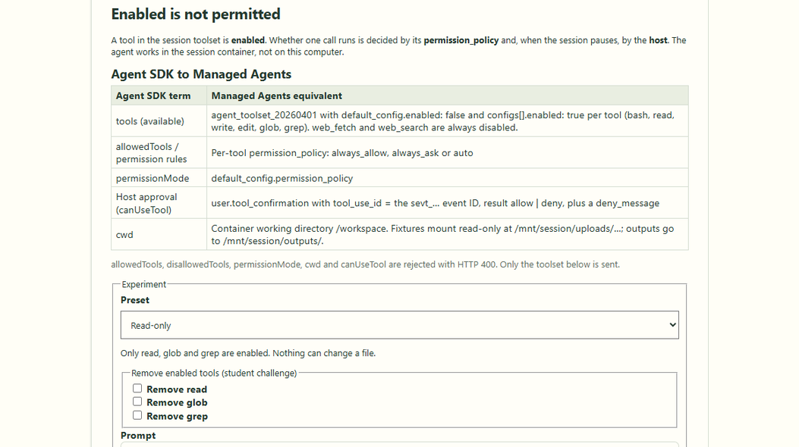
Map Agent SDK terms to the session toolset
CONCEPT MAPPING · SCREEN 1 OF 6
tools, allowedTools, permissionMode and cwd map to toolset, policies and container.
Agent SDK-only fields are rejected with HTTP 400; nothing is translated.
A preset decides which tools are enabled and how the host answers pauses.
Lab 03 · authored offline controls
Notes:
Lab 03 — Claude Managed Agents. Source: Tab3-tools.md and the local application source. Screenshot captured from the authored offline Lab 03 application. The mapping table is the same one shown in Tab3-tools.md; only the agent_toolset_20260401 configuration is sent to the API. Source: shared/lab03-tools.ts and src/concepts/Concept03Tools.tsx.

Slide 3
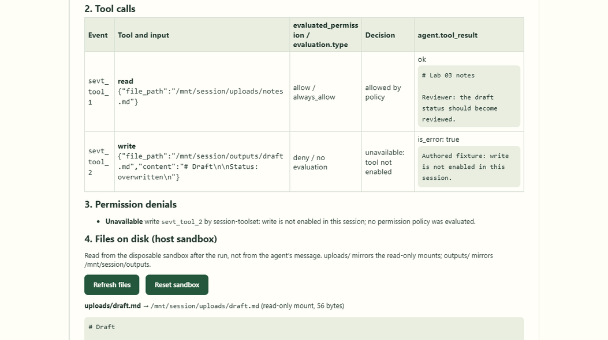
Unavailable: the tool is not in the toolset
UNAVAILABLE WRITE · SCREEN 2 OF 6
write is disabled, so the call arrives as deny with no evaluation.
No permission policy runs and the host is never asked to confirm.
Listed as unavailable by session-toolset; no output file exists on disk.
Lab 03 · unavailable Write fixture
Notes:
Lab 03 — Claude Managed Agents. Source: Tab3-tools.md and the local application source. The evaluation object is absent when the agent names a tool that is not enabled in the session; the server denies without evaluating any policy. The tool_result text is authored fixture text, not provider output.

Slide 4
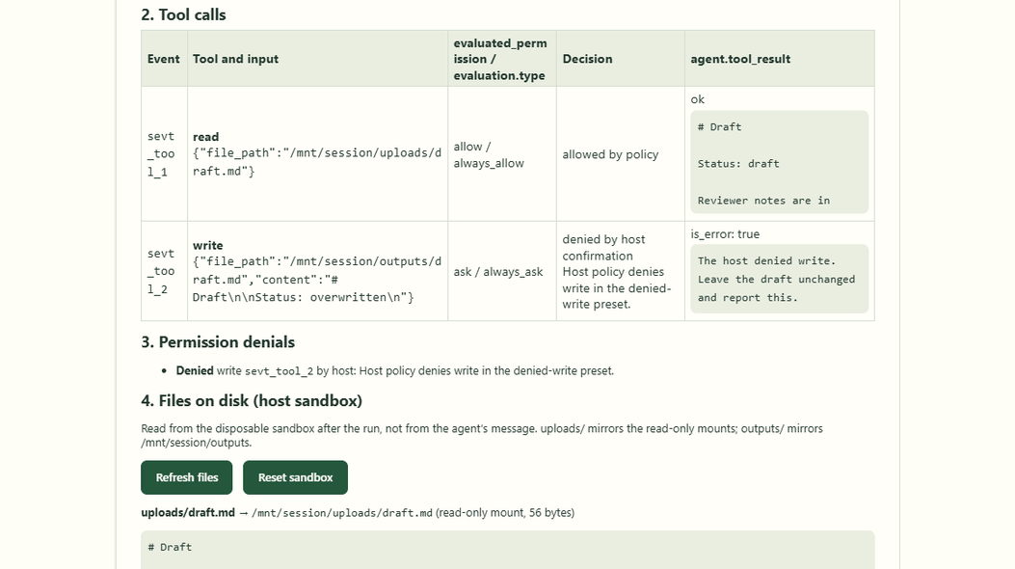
Denied: enabled, then refused by the host
DENIED WRITE · SCREEN 3 OF 6
write is enabled with always_ask; the session idles with requires_action.
The host sends user.tool_confirmation deny with a deny_message.
The agent receives an error tool result; the files on disk stay unchanged.
Lab 03 · denied Write fixture
Notes:
Lab 03 — Claude Managed Agents. Source: Tab3-tools.md and the local application source. The deny_message is delivered to the agent as the rejected tool result so it can adjust. The confirmation targets the sevt_ event ID of the agent.tool_use event, not a toolu_ ID. Source: server/lib/lab03-run.ts and server/lib/lab03-sandbox.ts.

Slide 5
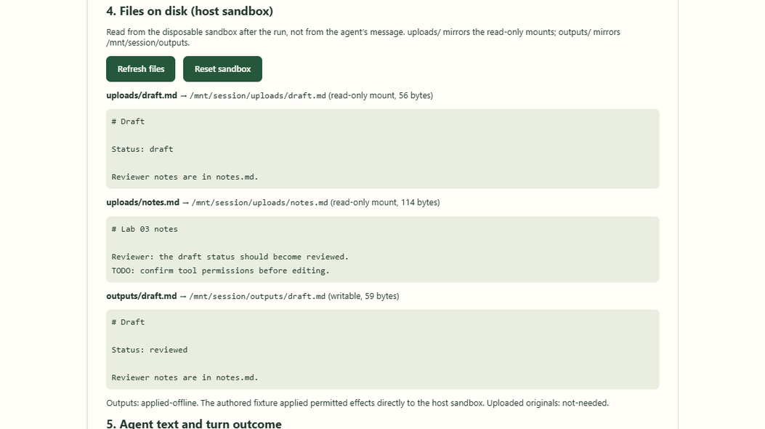
Evidence on disk: the permitted edit
PERMITTED EDIT · SCREEN 4 OF 6
The host allows the allowlisted cp and one edit inside /mnt/session/outputs.
Traversal attempts with .. are denied by the same path guard.
outputs/draft.md reads Status: reviewed; the read-only upload is unchanged.
Lab 03 · files read back from the sandbox
Notes:
Lab 03 — Claude Managed Agents. Source: Tab3-tools.md and the local application source. Uploaded files are mounted read-only, so the agent copies the draft to /mnt/session/outputs before editing. The panel shows files read from the host sandbox after the run, not text from the agent message. Reference: https://platform.claude.com/docs/en/managed-agents/files

Slide 6
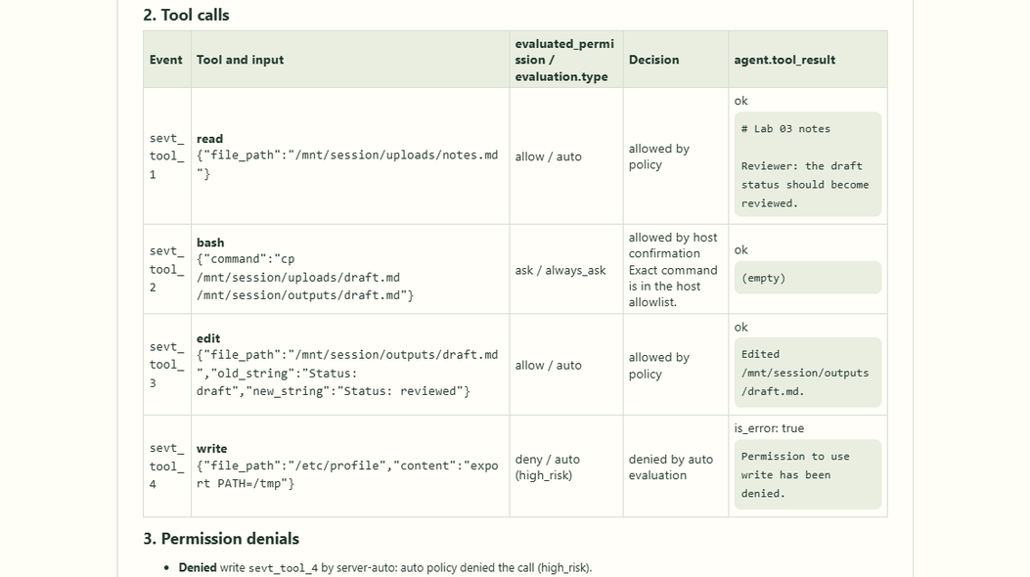
Auto: the server evaluates each call
AUTO POLICY · SCREEN 5 OF 6
auto runs calls it judges safe before any person sees them.
A write to /etc/profile returns deny / auto (high_risk).
A server denial is denied, not unavailable; bash still needs host approval.
Lab 03 · auto preset (authored evaluation)
Notes:
Lab 03 — Claude Managed Agents. Source: Tab3-tools.md and the local application source. Offline, the auto decision is an authored stand-in that denies paths outside the allowed roots; it is not the real server classifier. auto is not a human checkpoint. Reference: https://platform.claude.com/docs/en/managed-agents/permission-policies

Slide 7
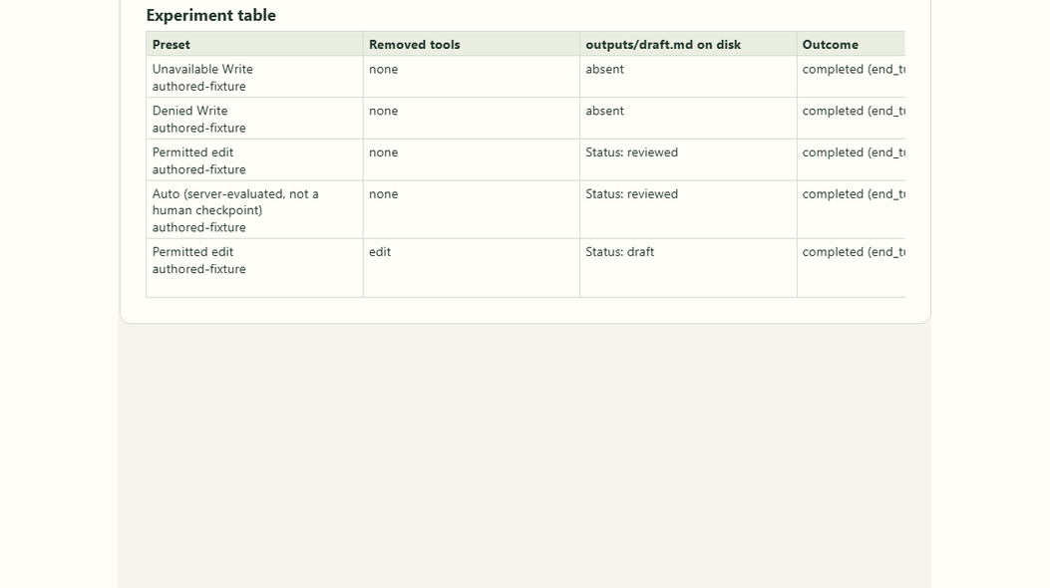
Experiment table: predict, then check the file
EXPERIMENT TABLE · SCREEN 6 OF 6
Each row records preset, removed tools, the file on disk, outcome and denials.
Removing edit makes both edits unavailable; the draft keeps Status: draft.
The copy still exists because the allowlisted cp ran first.
Lab 03 · experiment comparison table
Notes:
Lab 03 — Claude Managed Agents. Source: Tab3-tools.md and the local application source. The last row is the student challenge: Permitted edit with edit removed. The outputs/draft.md column is read from disk after each run. Offline rows illustrate permission handling and are not measurements of Claude. Source: src/concepts/Concept03Tools.tsx.

Slide 8
Tool calls and confirmations in sequence
User
React UI
Concept03Tools
Express route
/api/c3/query (via Vite)
Anthropic SDK
files + sessions + events
Managed Agents
session container
1. Choose preset, Run exercise
2. POST { preset, prompt, removeTools }
3. Validate Zod · fresh sandbox
4. runLab03(port, sandbox)
5. Upload files → create with toolset
6. tool_use, requires_action, tool_result
7. Guard path → user.tool_confirmation
8. progress frames → result + files
9. Render calls, denials, files
10. Tool table + files on disk
opt [deadline expires or user cancels]
11. Cancel query or deadline timer
12. Abort client waiting: close stream
13. Independent interruption request
14. user.interrupt → check status
Notes:
Lab 03 — Claude Managed Agents. Source: Tab3-tools.md and the local application source. UML sequence diagram of Lab 03 execution: fixture upload and session creation with the lab toolset, the event stream with agent.tool_use and requires_action pauses, host decisions through the path guard and user.tool_confirmation, and the independent interruption path on cancellation or deadline expiry.

Slide 9
The workflow at a glance
1
2
3
4
Start the lab with one command
The user chooses a tool preset
The browser POSTs preset and prompt
Express routes the request to Lab 03
5
6
7
8
Validate and reject Agent SDK fields
Create a disposable host sandbox
Build the session toolset
Enabled is not the same as permitted
9
10
11
12
Answer pauses with tool_confirmation
Guard every path the host approves
Collect outputs and clean up
Verify files, not agent claims
Notes:
Lab 03 — Claude Managed Agents. Source: Tab3-tools.md and the local application source. Overview of the twelve stages of Lab 03, from the React preset selector to file evidence read back from the host sandbox.

Slide 10
Start the lab with one command
1
npm run dev starts the Express backend and Vite frontend together.
Node runs TypeScript through tsx; the backend loads .env if it exists.
Express listens on 3076; Vite serves React on 5174. Offline runs need no key.
package.json · server/index.ts (excerpt)
"dev:server": "node scripts/dev-server.mjs",
"dev:web": "vite"
// server/index.ts
const port = Number(
process.env.LEARNING_API_PORT ?? 3076
);
app.listen(port, "127.0.0.1");
React UI · src/
Vite proxy · :5174
Express server · :3076
Managed Agents API
Notes:
Lab 03 — Claude Managed Agents. Source: Tab3-tools.md and the local application source. Code is an excerpt from package.json · server/index.ts (excerpt); consult local source for the complete implementation. Reference: https://platform.claude.com/docs/en/managed-agents/tools ; https://platform.claude.com/docs/en/managed-agents/permission-policies

Slide 11
The user chooses a tool preset
2
Open /?lesson=3 and select Run the exercise.
Pick a preset; tick Remove to drop one of its enabled tools (the challenge).
The toolset preview shows exactly what the session receives as tools[0].
src/concepts/Concept03Tools.tsx (simplified)
const [preset, setPreset] = useState("read-only");
const [removed, setRemoved] = useState([]);
function choosePreset(next) {
setPreset(next);
setPrompt(presets[next].prompt);
setRemoved([]);
}
const toolset = buildToolset(preset, removed);
React UI · src/
Vite proxy · :5174
Express server · :3076
Managed Agents API
Notes:
Lab 03 — Claude Managed Agents. Source: Tab3-tools.md and the local application source. Code is an excerpt from src/concepts/Concept03Tools.tsx (simplified); consult local source for the complete implementation. Reference: https://platform.claude.com/docs/en/managed-agents/tools ; https://platform.claude.com/docs/en/managed-agents/permission-policies

Slide 12
The browser POSTs preset and prompt
3
streamPost() sends mode, preset, prompt, deadline and removed tools.
Offline runs add a fixture scenario; live runs add a budget in US cents.
Vite proxies /api to port 3076; the API key never reaches the browser.
src/concepts/Concept03Tools.tsx (excerpt)
const body: Lab03Request = {
mode: chosen, preset, prompt, deadlineSeconds,
removeTools: removed,
...(chosen === "live"
? { budgetCents } : { scenario }),
};
await streamPost("/api/c3/query", body, {
signal: abort.signal,
resultSchema: lab03ResultSchema,
});
React UI · src/
Vite proxy · :5174
Express server · :3076
Managed Agents API
Notes:
Lab 03 — Claude Managed Agents. Source: Tab3-tools.md and the local application source. Code is an excerpt from src/concepts/Concept03Tools.tsx (excerpt); consult local source for the complete implementation. Reference: https://platform.claude.com/docs/en/managed-agents/tools ; https://platform.claude.com/docs/en/managed-agents/permission-policies

Slide 13
Express routes the request to Lab 03
4
The numeric lesson registry mounts the Lab 03 router at /api/c3.
POST /query streams one turn; GET /files and POST /reset serve the sandbox.
Every route checks the local origin and responds with Cache-Control: no-store.
server/concepts/registry.ts · 03-tools.ts (excerpt)
{ ...lab03Lesson, ...content[lab03Lesson.id]!,
router: lab03.router, close: lab03.close },
// server/concepts/03-tools.ts
router.get("/files", ...); // latest sandbox
router.post("/reset", ...); // restore fixtures
router.post("/query",
json({ limit: "8kb", strict: true }), ...);
React UI · src/
Vite proxy · :5174
Express server · :3076
Managed Agents API
Notes:
Lab 03 — Claude Managed Agents. Source: Tab3-tools.md and the local application source. Code is an excerpt from server/concepts/registry.ts · 03-tools.ts (excerpt); consult local source for the complete implementation. Reference: https://platform.claude.com/docs/en/managed-agents/tools ; https://platform.claude.com/docs/en/managed-agents/permission-policies

Slide 14
Validate and reject Agent SDK fields
5
z.strictObject() checks preset, prompt, removed tools and integer bounds.
allowedTools, permissionMode, cwd and similar fields get a 400 naming them.
Validation finishes before any disk, sandbox or provider work starts.
server/concepts/03-tools.ts (simplified)
const sdkOnly = agentSdkOnlyFields
.filter((key) => Object.hasOwn(body, key));
const parsed = lab03RequestSchema.safeParse(body);
if (!parsed.success) {
const message = sdkOnly.length
? ${sdkOnly.join(", ")} are Agent SDK options
: "Check mode, preset, prompt...";
response.status(400)
.json(apiError("INVALID_REQUEST", message));
return;
}
React UI · src/
Vite proxy · :5174
Express server · :3076
Managed Agents API
Notes:
Lab 03 — Claude Managed Agents. Source: Tab3-tools.md and the local application source. Code is an excerpt from server/concepts/03-tools.ts (simplified); consult local source for the complete implementation. Reference: https://platform.claude.com/docs/en/managed-agents/tools ; https://platform.claude.com/docs/en/managed-agents/permission-policies

Slide 15
Create a disposable host sandbox
6
Each query gets a fresh lab03-* directory under the OS temp directory.
uploads/ mirrors the read-only mounts; outputs/ mirrors /mnt/session/outputs.
Capacity is reserved first; reset is refused while a run uses the sandbox.
server/lib/lab03-sandbox.ts (simplified)
const dir = await mkdtemp(
path.join(tmpdir(), "lab03-"));
// reset(): restore the authored fixtures
for (const name of ["uploads", "outputs"]) {
const target = path.join(dir, name);
await rm(target,
{ recursive: true, force: true });
await mkdir(target);
}
for (const [name, text] of fixtures) {
const file = path.join(dir, "uploads", name);
await writeFile(file, text);
}
React UI · src/
Vite proxy · :5174
Express server · :3076
Managed Agents API
Notes:
Lab 03 — Claude Managed Agents. Source: Tab3-tools.md and the local application source. Code is an excerpt from server/lib/lab03-sandbox.ts (simplified); consult local source for the complete implementation. Reference: https://platform.claude.com/docs/en/managed-agents/tools ; https://platform.claude.com/docs/en/managed-agents/permission-policies

Slide 16
Build the session toolset
7
default_config.enabled: false; only the preset's tools get enabled: true.
Each enabled tool has its own permission_policy; bash is always always_ask.
Live fixtures mount through resources; the shared agent is never changed.
server/lib/lab03-port.ts (simplified)
agent: {
type: "agent_with_overrides",
id: ids.agentId,
tools: [buildToolset(preset, removeTools)],
mcp_servers: [], skills: [],
},
resources: [
{ type: "file", file_id: notesId,
mount_path: "/notes.md" },
{ type: "file", file_id: draftId,
mount_path: "/draft.md" },
],
budget: { type: "limit", max_list_cost: ... }
React UI · src/
Vite proxy · :5174
Express server · :3076
Managed Agents API
Notes:
Lab 03 — Claude Managed Agents. Source: Tab3-tools.md and the local application source. Code is an excerpt from server/lib/lab03-port.ts (simplified); consult local source for the complete implementation. Reference: https://platform.claude.com/docs/en/managed-agents/tools ; https://platform.claude.com/docs/en/managed-agents/permission-policies

Slide 17
Enabled is not the same as permitted
8
Each agent.tool_use carries evaluated_permission and usually an evaluation.
A deny with no evaluation means no policy ran: the tool is not enabled.
Unavailable and denied stay distinct in the data, the UI and the tests.
deny · no evaluation
Unavailable: the tool is not enabled in this session
1
ask · always_ask
Paused with requires_action until the host answers
2
deny · auto (high_risk)
Denied by the server; the client cannot override it
3
React UI · src/
Vite proxy · :5174
Express server · :3076
Managed Agents API
Notes:
Lab 03 — Claude Managed Agents. Source: Tab3-tools.md and the local application source. Classification follows the documented evaluated_permission and evaluation fields. Source: shared/lab03-tools.ts (initialToolState and deriveDenials). Reference: https://platform.claude.com/docs/en/managed-agents/tools ; https://platform.claude.com/docs/en/managed-agents/permission-policies

Slide 18
Answer pauses with tool_confirmation
9
session.status_idle with requires_action lists the waiting event IDs.
The host decides each call and sends user.tool_confirmation by sevt_ ID.
A deny carries a deny_message; more than 12 pauses stops the loop.
server/lib/lab03-run.ts · lab03-port.ts (simplified)
const reason = event.stop_reason;
if (reason.type === "requires_action") {
const answers = reason.event_ids.map((id) =>
decideConfirmation(preset, id, name, input));
await port.confirm(sessionId, answers, signal);
}
// sent by the live port
{ type: "user.tool_confirmation",
tool_use_id: "sevt_...",
result: "deny",
deny_message: "The host denied write..." }
React UI · src/
Vite proxy · :5174
Express server · :3076
Managed Agents API
Notes:
Lab 03 — Claude Managed Agents. Source: Tab3-tools.md and the local application source. Code is an excerpt from server/lib/lab03-run.ts · lab03-port.ts (simplified); consult local source for the complete implementation. Reference: https://platform.claude.com/docs/en/managed-agents/tools ; https://platform.claude.com/docs/en/managed-agents/permission-policies

Slide 19
Guard every path the host approves
10
Paths must stay in /workspace, /mnt/session/uploads or /mnt/session/outputs.
.., Windows drive and UNC paths, NUL bytes and symlink escapes are rejected.
Bash is approved only for exact commands on the host allowlist.
server/lib/lab03-sandbox.ts (simplified)
if (raw.includes("\0"))
throw new PathRejected("NUL byte.");
if (/^[a-zA-Z]:/.test(raw) || raw.includes("\\"))
throw new PathRejected("Windows path.");
if (raw.split("/").includes(".."))
throw new PathRejected("Traversal (..).");
// host side: check every existing segment
const info = await lstat(current);
const target = await realpath(current);
if (info.isSymbolicLink() && outside(target))
throw new PathRejected("Symlink escape.");
React UI · src/
Vite proxy · :5174
Express server · :3076
Managed Agents API
Notes:
Lab 03 — Claude Managed Agents. Source: Tab3-tools.md and the local application source. Code is an excerpt from server/lib/lab03-sandbox.ts (simplified); consult local source for the complete implementation. Reference: https://platform.claude.com/docs/en/managed-agents/tools ; https://platform.claude.com/docs/en/managed-agents/permission-policies

Slide 20
Collect outputs and clean up
11
Deadline or cancel sends a bounded user.interrupt before closing the stream.
Once idle, outputs are listed with scope_id, names validated, then downloaded.
The session is archived and the uploaded originals are deleted.
server/lib/lab03-port.ts (simplified)
const page = await client.beta.files.list(
{ scope_id: sessionId, limit: 20 });
for (const file of page.data) {
const name = file.filename;
if (!safeOutputName.test(name)) continue;
await sandbox.hostPath(outputs/${name});
const body = await client.files.download(file.id);
await sandbox.writeText(outputs/${name},
await body.text());
}
await port.archive(sessionId);
// then files.delete() each uploaded original
React UI · src/
Vite proxy · :5174
Express server · :3076
Managed Agents API
Notes:
Lab 03 — Claude Managed Agents. Source: Tab3-tools.md and the local application source. Code is an excerpt from server/lib/lab03-port.ts (simplified); consult local source for the complete implementation. Reference: https://platform.claude.com/docs/en/managed-agents/tools ; https://platform.claude.com/docs/en/managed-agents/permission-policies

Slide 21
Verify files, not agent claims
12
The result carries every file read back from the sandbox after the run.
Tests assert disk contents for each preset and for the challenge.
Offline fixtures follow a fixed plan; they are not measurements of Claude.
Read-only · Unavailable · Denied
outputs/draft.md stays absent
1
Permitted edit · Auto
outputs/draft.md reads Status: reviewed
2
Challenge: remove edit
Both edits unavailable; the copy keeps Status: draft
3
React UI · src/
Vite proxy · :5174
Express server · :3076
Managed Agents API
Notes:
Lab 03 — Claude Managed Agents. Source: Tab3-tools.md and the local application source. Expected disk state per preset, asserted by tests/lab03-tools.test.ts against the files themselves. Reference: https://platform.claude.com/docs/en/managed-agents/tools ; https://platform.claude.com/docs/en/managed-agents/permission-policies

Slide 22
Remove edit and
predict the next run
STUDENT CHALLENGE
Challenge: will the edit be unavailable or denied, and what will outputs/draft.md contain on disk afterwards?
React UI
Vite proxy
Express
Managed Agents
Notes:
Lab 03 — Claude Managed Agents. Source: Tab3-tools.md and the local application source. Closing challenge from Tab3-tools.md. With edit removed, both edit attempts arrive as deny with no evaluation (unavailable), the host is never asked, and outputs/draft.md is an unchanged copy reading Status: draft because the allowlisted cp still ran.

