Slide 1
Custom tools answered by the host
CLAUDE MANAGED AGENTS LAB · LAB 05
Twelve steps, from Zod shapes and agent.custom_tool_use pauses to validation before handlers, one result per call, deadlines and isolated task state
Notes:
Lab 05 — Claude Managed Agents. Source: Tab5-custom-tools.md and the local application source. Covers the Managed Agents equivalent of createSdkMcpServer and tool(): custom tools declared on a persisted agent, agent.custom_tool_use pauses answered by user.custom_tool_result, Zod validation before any handler, handler deadlines and per-run task stores. All screenshots come from authored offline fixtures. No live or billed request was made for this presentation.

Slide 2
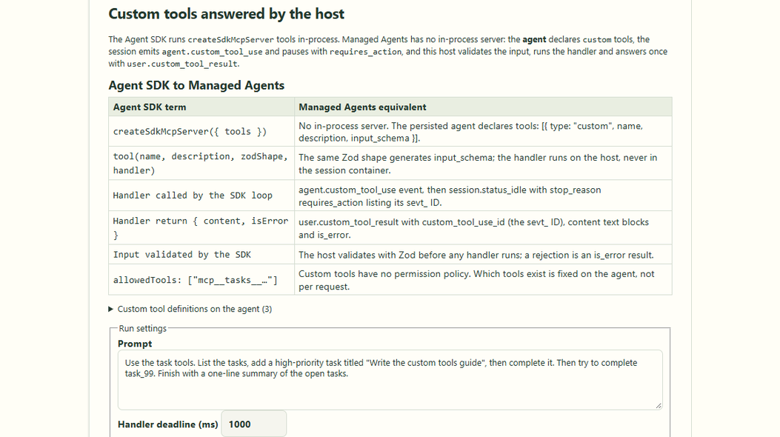
createSdkMcpServer becomes custom tools
CONCEPT MAPPING · SCREEN 1 OF 6
The agent declares custom tools; there is no in-process MCP server.
Each call pauses on agent.custom_tool_use with requires_action.
The host answers once with user.custom_tool_result and is_error.
Lab 05 · authored offline controls
Notes:
Lab 05 — Claude Managed Agents. Source: Tab5-custom-tools.md and the local application source. Screenshot captured from the authored offline Lab 05 application. The mapping table matches Tab5-custom-tools.md. Remote MCP (mcp_servers + mcp_toolset) is a different mechanism and out of scope. Source: shared/lab05-custom-tools.ts and src/concepts/Concept05CustomTools.tsx.

Slide 3
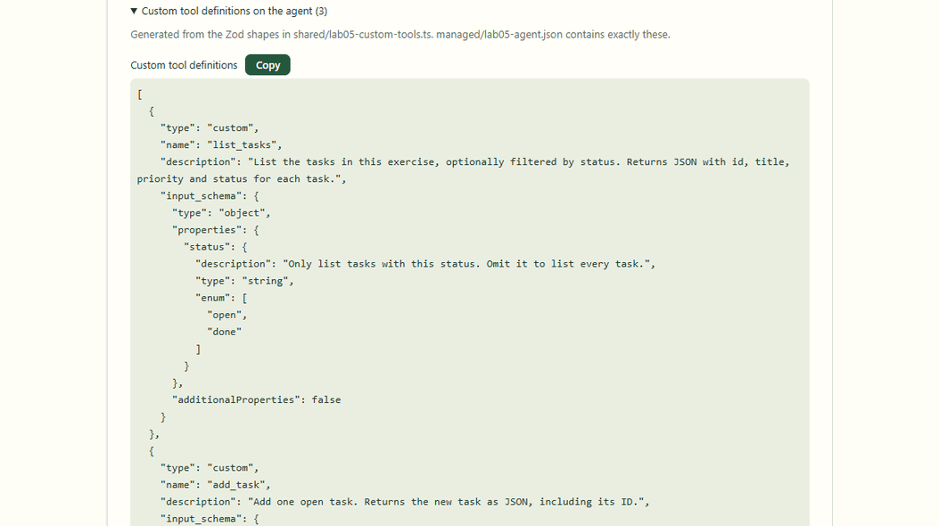
One Zod shape, one input_schema
TOOL DEFINITIONS · SCREEN 2 OF 6
z.toJSONSchema generates each input_schema from its Zod shape.
Closed objects: additionalProperties: false, with required fields.
managed/lab05-agent.json holds exactly these three tools.
Lab 05 · custom tool definitions on the agent
Notes:
Lab 05 — Claude Managed Agents. Source: Tab5-custom-tools.md and the local application source. The definitions are generated once and shown as declared on the agent: type custom, name, description and input_schema. A test fails if managed/lab05-agent.json drifts from them. Reference: https://platform.claude.com/docs/en/managed-agents/agent-setup

Slide 4
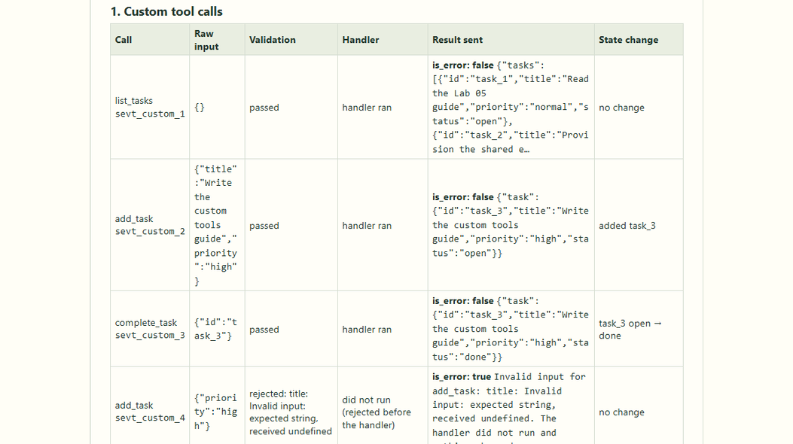
Each call: input, validation, handler, result
TOUR · SCREEN 3 OF 6
Valid calls run their handler and send is_error: false.
The state change column shows added task_3, then open → done.
The malformed add_task is rejected before its handler runs.
Lab 05 · Tour: the first four custom tool calls
Notes:
Lab 05 — Claude Managed Agents. Source: Tab5-custom-tools.md and the local application source. Each row is one agent.custom_tool_use answered by one user.custom_tool_result. The fourth call sends the default challenge input, {"priority":"high"}, which has no title. Source: server/lib/lab05-run.ts and server/lib/lab05-tasks.ts.

Slide 5
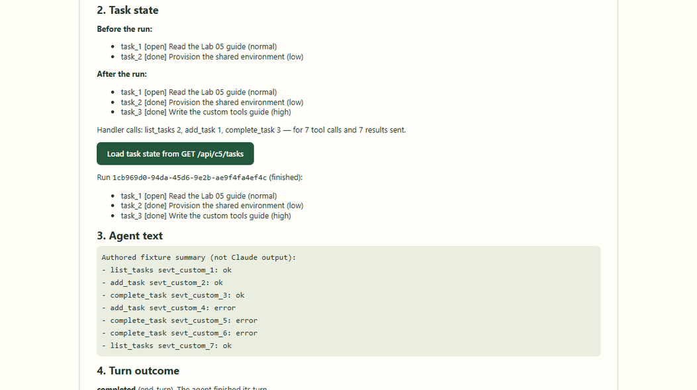
Task state comes from the host
TASK STATE · SCREEN 4 OF 6
Seven calls and seven results, but one add_task handler call.
GET /api/c5/tasks?runId= reads the same run's store.
The agent text is an authored fixture summary, not Claude.
Lab 05 · task state before and after, read back over GET
Notes:
Lab 05 — Claude Managed Agents. Source: Tab5-custom-tools.md and the local application source. Before and after lists come from the run's own TaskStore; the GET route reads the same store after the run. The handler counters are the evidence that the rejected call never reached its handler. Source: server/concepts/05-custom-tools.ts.

Slide 6
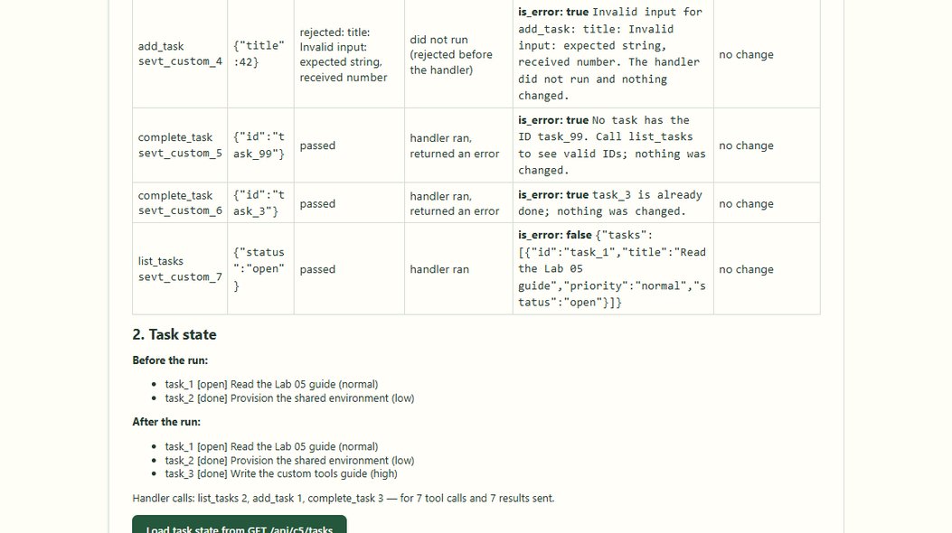
Student challenge: a wrong-typed title
CHALLENGE · SCREEN 5 OF 6
{"title": 42} fails: expected string, received number.
The handler did not run and the task list did not change.
Unknown and repeated IDs get handler errors the agent can act on.
Lab 05 · Tour with {"title": 42} as the malformed input
Notes:
Lab 05 — Claude Managed Agents. Source: Tab5-custom-tools.md and the local application source. The fifth and sixth calls arrived in the same pause; each got its own result keyed by its own sevt_ ID. Handler errors (unknown ID, already done) are valid calls the handler refused, unlike the rejected input. Source: server/lib/lab05-fixtures.ts.

Slide 7
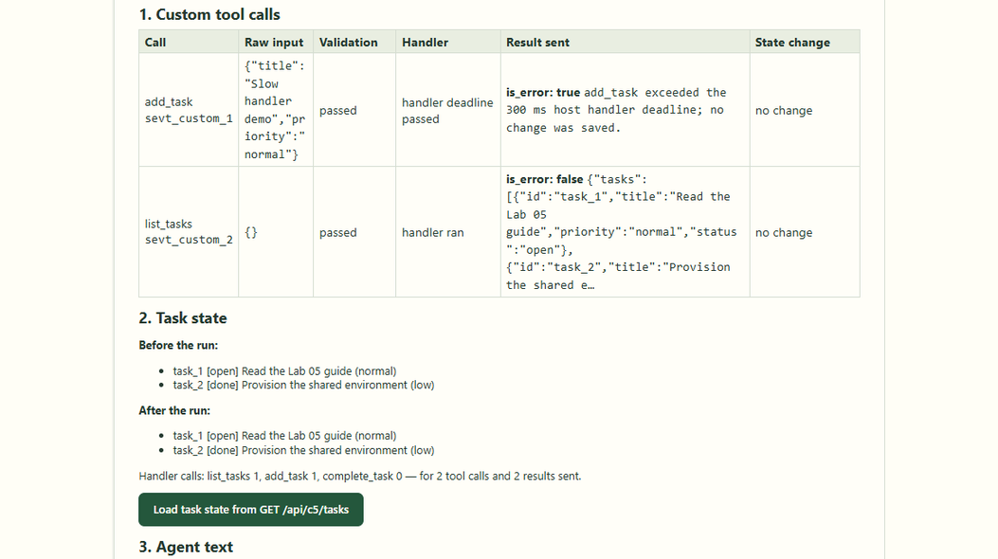
A handler deadline keeps the session moving
HANDLER DEADLINE · SCREEN 6 OF 6
add_task passed its 300 ms deadline: is_error: true was sent.
The handler commits only if not aborted, so no task was saved.
The session continued: the next list_tasks ran normally.
Lab 05 · Slow handler with a 300 ms deadline
Notes:
Lab 05 — Claude Managed Agents. Source: Tab5-custom-tools.md and the local application source. Managed Agents waits for a custom tool result for as long as the session lives, so the host enforces its own handler deadline. The abandoned handler cannot save its change later. Source: server/lib/lab05-tasks.ts.

Slide 8
Custom tool calls in sequence
User
React UI
Concept05CustomTools
Express routes
/api/c5/query + /tasks
Task stores + SDK
dispatch · sessions
Managed Agents
Lab 05 agent session
1. Run exercise: scenario + input
2. POST /query { scenario, input }
3. Validate · new runId
4. runLab05(port, stores, runId)
5. Create session (custom tools)
6. custom_tool_use → requires_action
7. Validated, answered: custom_call
8. run + custom_call frames (SSE)
9. Render calls and task state
10. Results, before and after
opt [deadline expires or user cancels]
11. Cancel query or deadline timer
12. Abort waiting; store finishes
13. Independent interruption request
14. user.interrupt → check status
Notes:
Lab 05 — Claude Managed Agents. Source: Tab5-custom-tools.md and the local application source. UML sequence diagram of Lab 05 execution: session creation on the verified Lab 05 agent, an agent.custom_tool_use pausing with requires_action, Zod validation and the handler on the host, one user.custom_tool_result per sevt_ ID, task state read back through GET /api/c5/tasks, and an independent interruption on cancellation or deadline expiry.

Slide 9
The workflow at a glance
1
2
3
4
Start the lab with one command
Pick a scenario and malformed input
The browser POSTs the run settings
Express routes tools, tasks and query
5
6
7
8
Reject Agent SDK tool fields
Define each tool once with Zod
The session pauses on each call
Three kinds of result
9
10
11
12
Validate before any handler runs
Answer each sevt_ ID exactly once
Deadlines, cancel and isolation
Verify state, not agent claims
Notes:
Lab 05 — Claude Managed Agents. Source: Tab5-custom-tools.md and the local application source. Overview of the twelve stages of Lab 05, from Zod tool shapes to one host-validated result per custom tool call, verified against task state.

Slide 10
Start the lab with one command
1
npm run dev starts the Express backend and Vite frontend together.
Node runs TypeScript through tsx; the backend loads .env if it exists.
Express listens on 3076; Vite serves React on 5174. Offline runs need no key.
package.json · server/index.ts (excerpt)
"dev:server": "node scripts/dev-server.mjs",
"dev:web": "vite"
// server/index.ts
const port = Number(
process.env.LEARNING_API_PORT ?? 3076
);
app.listen(port, "127.0.0.1");
React UI · src/
Vite proxy · :5174
Express server · :3076
Managed Agents API
Notes:
Lab 05 — Claude Managed Agents. Source: Tab5-custom-tools.md and the local application source. Code is an excerpt from package.json · server/index.ts (excerpt); consult local source for the complete implementation. Reference: https://platform.claude.com/docs/en/managed-agents/tools ; https://platform.claude.com/docs/en/managed-agents/events-and-streaming

Slide 11
Pick a scenario and malformed input
2
Open /?lesson=5 and select Run the exercise.
Choose a scenario and a handler deadline (100–5000 ms).
The Tour sends the malformed add_task input you type as its fourth call.
src/concepts/Concept05CustomTools.tsx (simplified)
const [scenario, setScenario] =
useState<Lab05Scenario>("tour");
// default {"priority":"high"}: no title
const [challengeText, setChallengeText] =
useState(JSON.stringify(
defaultChallengeInput));
const [handlerTimeoutMs, setTimeoutMs] =
useState(handlerLimits.defaultMs);
React UI · src/
Vite proxy · :5174
Express server · :3076
Managed Agents API
Notes:
Lab 05 — Claude Managed Agents. Source: Tab5-custom-tools.md and the local application source. Code is an excerpt from src/concepts/Concept05CustomTools.tsx (simplified); consult local source for the complete implementation. Reference: https://platform.claude.com/docs/en/managed-agents/tools ; https://platform.claude.com/docs/en/managed-agents/events-and-streaming

Slide 12
The browser POSTs the run settings
3
streamPost() opens one SSE run; its first frame carries the runId.
Offline runs send the scenario and the challenge input; live runs a budget.
Vite proxies /api to port 3076; the API key never reaches the browser.
src/concepts/Concept05CustomTools.tsx (excerpt)
const body: Lab05Request = {
mode: chosen, prompt,
deadlineSeconds, handlerTimeoutMs,
...(chosen === "live" ? { budgetCents }
: { scenario, challengeInput }),
};
await streamPost("/api/c5/query", body, {
signal: abort.signal,
resultSchema: lab05ResultSchema,
});
React UI · src/
Vite proxy · :5174
Express server · :3076
Managed Agents API
Notes:
Lab 05 — Claude Managed Agents. Source: Tab5-custom-tools.md and the local application source. Code is an excerpt from src/concepts/Concept05CustomTools.tsx (excerpt); consult local source for the complete implementation. Reference: https://platform.claude.com/docs/en/managed-agents/tools ; https://platform.claude.com/docs/en/managed-agents/events-and-streaming

Slide 13
Express routes tools, tasks and query
4
The numeric lesson registry mounts the Lab 05 router at /api/c5.
GET /tools lists the definitions; GET /tasks?runId= reads one run.
POST /query streams one turn; every route checks the local origin.
server/concepts/05-custom-tools.ts (excerpt)
router.get("/tools", ...); // definitions
router.get("/tasks", ...); // ?runId=
router.post("/query",
json({ limit: "8kb", strict: true }),
...); // SSE: run, custom_call, result
// server/concepts/registry.ts
{ ...lab05Lesson, ...content[5]!,
router: lab05.router, close: lab05.close },
React UI · src/
Vite proxy · :5174
Express server · :3076
Managed Agents API
Notes:
Lab 05 — Claude Managed Agents. Source: Tab5-custom-tools.md and the local application source. Code is an excerpt from server/concepts/05-custom-tools.ts (excerpt); consult local source for the complete implementation. Reference: https://platform.claude.com/docs/en/managed-agents/tools ; https://platform.claude.com/docs/en/managed-agents/events-and-streaming

Slide 14
Reject Agent SDK tool fields
5
mcpServers, allowedTools, createSdkMcpServer and tools get a 400.
The tools are fixed on the persisted agent; a request cannot change them.
Validation finishes before any task store or provider work.
server/concepts/05-custom-tools.ts (simplified)
// mcpServers, allowedTools,
// createSdkMcpServer, tools
const sdkOnly = lab05SdkOnlyFields
.filter((key) => Object.hasOwn(body, key));
if (!parsed.success) {
const message = sdkOnly.length
? sdkOnlyMessage(sdkOnly)
: "Check mode, prompt, scenario...";
response.status(400)
.json(apiError("INVALID_REQUEST", message));
return;
}
React UI · src/
Vite proxy · :5174
Express server · :3076
Managed Agents API
Notes:
Lab 05 — Claude Managed Agents. Source: Tab5-custom-tools.md and the local application source. Code is an excerpt from server/concepts/05-custom-tools.ts (simplified); consult local source for the complete implementation. Reference: https://platform.claude.com/docs/en/managed-agents/tools ; https://platform.claude.com/docs/en/managed-agents/events-and-streaming

Slide 15
Define each tool once with Zod
6
Each input is one Zod strictObject; z.toJSONSchema makes the input_schema.
managed/lab05-agent.json holds exactly these three tools and nothing else.
Live mode refuses any agent whose tools differ, before creating a session.
shared/lab05-custom-tools.ts (simplified)
add_task: z.strictObject({
title: z.string().min(1).max(120)
.regex(/\S/, "Not blank."),
priority: z.enum(["low", "normal", "high"])
.optional(),
}),
// the agent's input_schema
const { $schema, ...schema } =
z.toJSONSchema(toolShapes[name],
{ target: "draft-2020-12", io: "input" });
React UI · src/
Vite proxy · :5174
Express server · :3076
Managed Agents API
Notes:
Lab 05 — Claude Managed Agents. Source: Tab5-custom-tools.md and the local application source. Code is an excerpt from shared/lab05-custom-tools.ts (simplified); consult local source for the complete implementation. Reference: https://platform.claude.com/docs/en/managed-agents/tools ; https://platform.claude.com/docs/en/managed-agents/events-and-streaming

Slide 16
The session pauses on each call
7
The agent emits agent.custom_tool_use with the tool name and raw input.
The session idles with requires_action, listing the waiting sevt_ IDs.
The shared runner hands those calls to the Lab 05 answer hook.
server/lib/tool-session-run.ts (simplified)
if (event.type === "agent.custom_tool_use")
customUses.set(event.id,
{ name: event.name, input: event.input });
// idle: requires_action, event_ids: [sevt_]
const calls = waiting.map((id) => ({ id,
custom: customUses.get(id) ?? null }));
const answers = await options.answer(calls);
await port.respond(sessionId, custom);
React UI · src/
Vite proxy · :5174
Express server · :3076
Managed Agents API
Notes:
Lab 05 — Claude Managed Agents. Source: Tab5-custom-tools.md and the local application source. Code is an excerpt from server/lib/tool-session-run.ts (simplified); consult local source for the complete implementation. Reference: https://platform.claude.com/docs/en/managed-agents/tools ; https://platform.claude.com/docs/en/managed-agents/events-and-streaming

Slide 17
Three kinds of result
8
Every call gets exactly one user.custom_tool_result; none is left waiting.
is_error tells the agent whether the call failed, and the text says why.
Custom tools have no permission policy: the host decides by running them.
is_error: false
Valid input; the handler ran and its JSON is the content
1
is_error: true · handler ran
Unknown ID, already done, or the deadline passed
2
is_error: true · no handler
Input failed its Zod shape; nothing changed
3
React UI · src/
Vite proxy · :5174
Express server · :3076
Managed Agents API
Notes:
Lab 05 — Claude Managed Agents. Source: Tab5-custom-tools.md and the local application source. The outcome of every call is visible in the custom_call frame: validation, whether the handler ran, and the result text. Source: server/lib/lab05-tasks.ts. Reference: https://platform.claude.com/docs/en/managed-agents/tools ; https://platform.claude.com/docs/en/managed-agents/events-and-streaming

Slide 18
Validate before any handler runs
9
The raw input is parsed with the tool's Zod shape before anything else.
A rejection returns the Zod issues as an is_error result.
The handler counter moves only when a handler actually runs.
server/lib/lab05-tasks.ts (simplified)
const parsed = toolShapes[name].safeParse(input);
if (!parsed.success) return done("rejected",
true, "Invalid input for " + name + "...",
{ validation: { ok: false, issues } });
// only now does a handler run
store.handlerCalls[name]++;
const value = handlers[name](parsed.data, store);
return done("ok", false, JSON.stringify(value),
{ handlerRan: true });
React UI · src/
Vite proxy · :5174
Express server · :3076
Managed Agents API
Notes:
Lab 05 — Claude Managed Agents. Source: Tab5-custom-tools.md and the local application source. Code is an excerpt from server/lib/lab05-tasks.ts (simplified); consult local source for the complete implementation. Reference: https://platform.claude.com/docs/en/managed-agents/tools ; https://platform.claude.com/docs/en/managed-agents/events-and-streaming

Slide 19
Answer each sevt_ ID exactly once
10
Each sevt_ ID is offered to the hook once; a repeated pause is skipped.
An extra answer for one call is dropped instead of being sent.
A result's custom_tool_use_id is the event's sevt_ ID, never a toolu_ ID.
server/lib/tool-session-run.ts (simplified)
const waiting = [...new Set(event_ids)]
.filter((id) => !answered.has(id));
if (!waiting.length) continue; // repeated
for (const answer of answers) {
const id = answerId(answer);
if (!waiting.includes(id) || answered.has(id))
continue; // one answer per call
answered.add(id); sendable.push(answer);
}
// user.custom_tool_result, custom_tool_use_id
React UI · src/
Vite proxy · :5174
Express server · :3076
Managed Agents API
Notes:
Lab 05 — Claude Managed Agents. Source: Tab5-custom-tools.md and the local application source. Code is an excerpt from server/lib/tool-session-run.ts (simplified); consult local source for the complete implementation. Reference: https://platform.claude.com/docs/en/managed-agents/tools ; https://platform.claude.com/docs/en/managed-agents/events-and-streaming

Slide 20
Deadlines, cancel and isolation
11
A handler still running at its deadline is abandoned with an is_error result.
State changes only after slow work, and only if the call was not aborted.
Each run gets its own task store; cancel still attempts user.interrupt.
server/lib/lab05-tasks.ts · lab05-run.ts
const timer = setTimeout(() =>
timeout.abort("handler-deadline"), timeoutMs);
// commit only if not aborted
if (slow) await delay(slow, undefined, { signal });
signal.throwIfAborted();
// timeout: is_error, nothing saved
// one store per run, keyed by runId
const store = stores.open(runId);
React UI · src/
Vite proxy · :5174
Express server · :3076
Managed Agents API
Notes:
Lab 05 — Claude Managed Agents. Source: Tab5-custom-tools.md and the local application source. Code is an excerpt from server/lib/lab05-tasks.ts · lab05-run.ts; consult local source for the complete implementation. Reference: https://platform.claude.com/docs/en/managed-agents/tools ; https://platform.claude.com/docs/en/managed-agents/events-and-streaming

Slide 21
Verify state, not agent claims
12
Tests read the task store and handler counters, not the agent message.
The real SDK runs against a mocked fetch: no network or charges.
Offline calls are recorded; a live agent may retry or choose other IDs.
Tour
7 calls, 7 results; the add_task handler ran once
1
Slow handler
is_error at the deadline; the task list is unchanged
2
Two concurrent runs
Separate stores; each adds only its own task_3
3
React UI · src/
Vite proxy · :5174
Express server · :3076
Managed Agents API
Notes:
Lab 05 — Claude Managed Agents. Source: Tab5-custom-tools.md and the local application source. Expected outcomes asserted by tests/lab05-custom-tools.test.ts and browser-tests/lab05.spec.ts. Reference: https://platform.claude.com/docs/en/managed-agents/tools ; https://platform.claude.com/docs/en/managed-agents/events-and-streaming

Slide 22
Send a malformed title
and prove nothing ran
STUDENT CHALLENGE
Challenge: is the result is_error, did the add_task handler count change, and is the task list identical before and after?
React UI
Vite proxy
Express
Managed Agents
Notes:
Lab 05 — Claude Managed Agents. Source: Tab5-custom-tools.md and the local application source. Closing challenge from Tab5-custom-tools.md. Set the malformed input to {"title": 42}: the result is is_error with the validation issue, the add_task handler count is one less than the number of add_task calls, and the call shows no change. Host validation matters because the schema given to the agent is guidance, not a guarantee.

