Slide 1
Session event streaming: the application workflow
CLAUDE MANAGED AGENTS LAB · LAB 01
Twelve steps, from a prompt in React to agent text, lifecycle events and turn completion
1
Notes:
Lab 01 — Claude Managed Agents. Source: Tab1-query.md and the local application source.

Slide 2
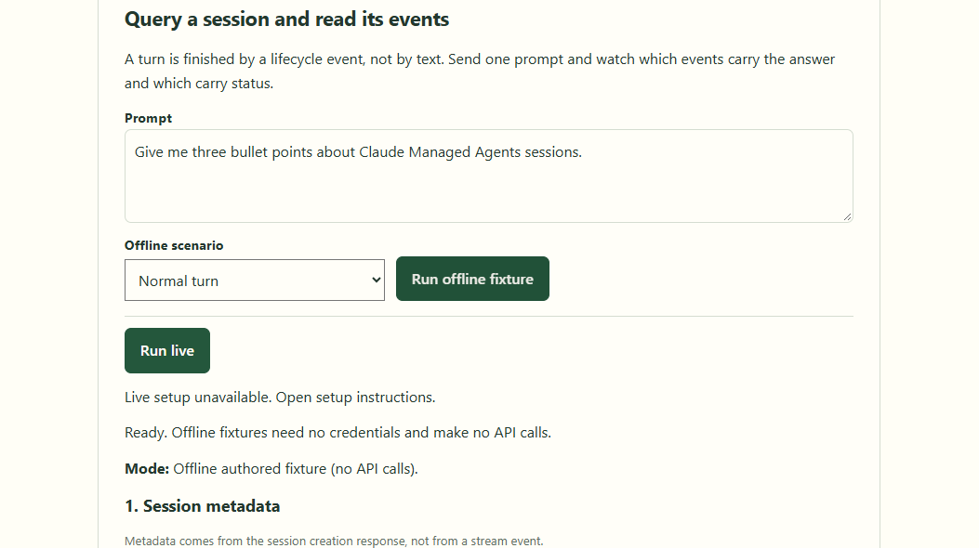
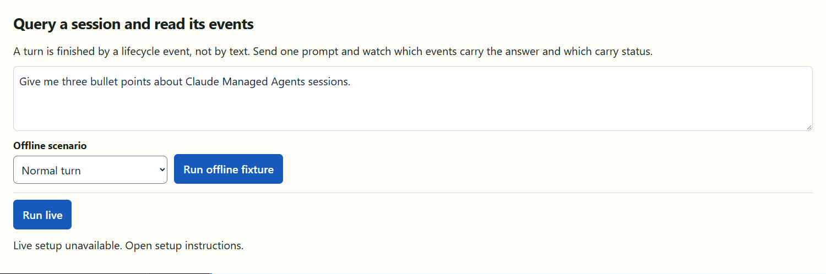
Run offline: the prompt and controls
OFFLINE · SCREEN 1 OF 3
01
02
03
The prompt asks for three bullet points about sessions.
Run offline fixture posts mode, prompt and scenario to /api/c1/query.
Fixtures need no key, network or API charges.
Lab 01 · offline fixture capture
Notes:
Lab 01 — Claude Managed Agents. Source: Tab1-query.md and the local application source. Screenshots show authored offline fixtures, not Claude measurements.

Slide 3
Run offline: the prompt and controls — application view
3

Slide 4
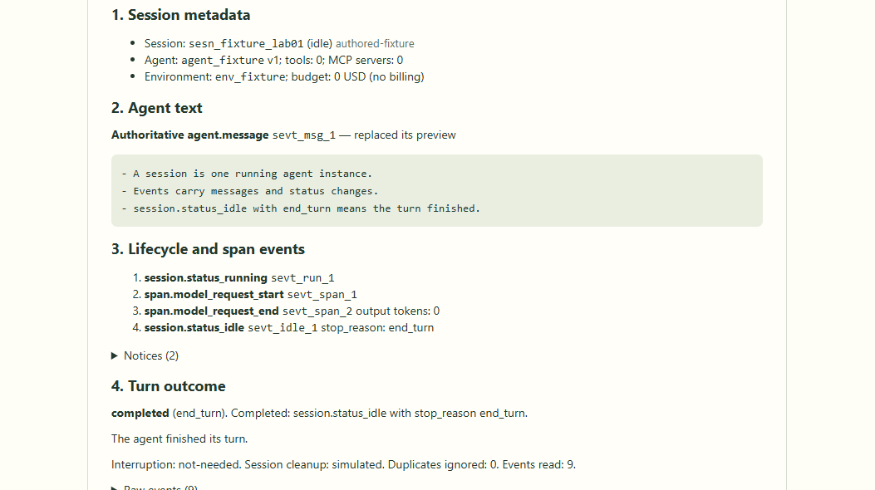
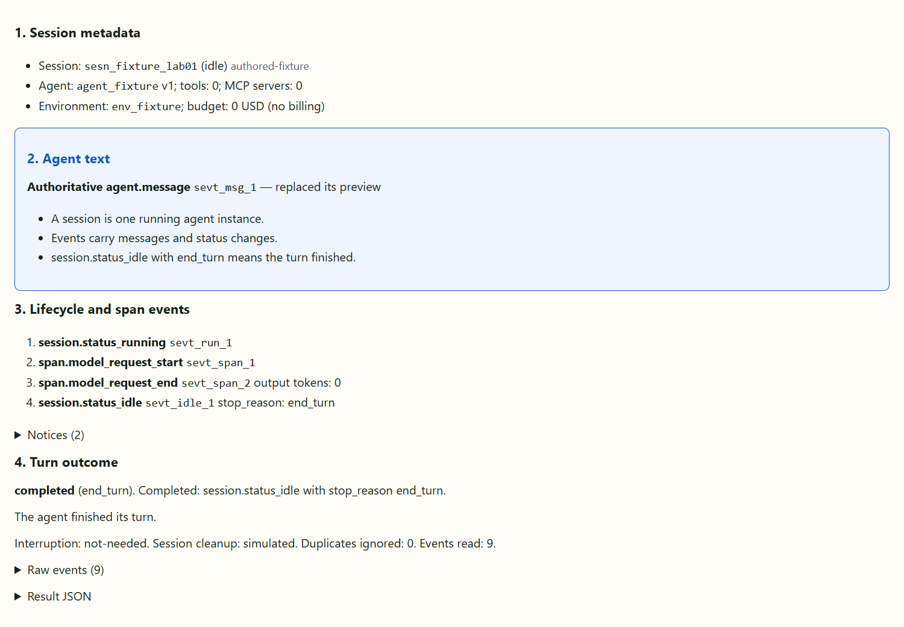
Run offline: response and results
OFFLINE · SCREEN 2 OF 3
01
02
03
Session metadata is returned by the creation step.
agent.message replaces its preview; the answer appears once.
session.status_idle with end_turn confirms completion.
Lab 01 · offline fixture capture
Notes:
Lab 01 — Claude Managed Agents. Source: Tab1-query.md and the local application source. Screenshots show authored offline fixtures, not Claude measurements.

Slide 5
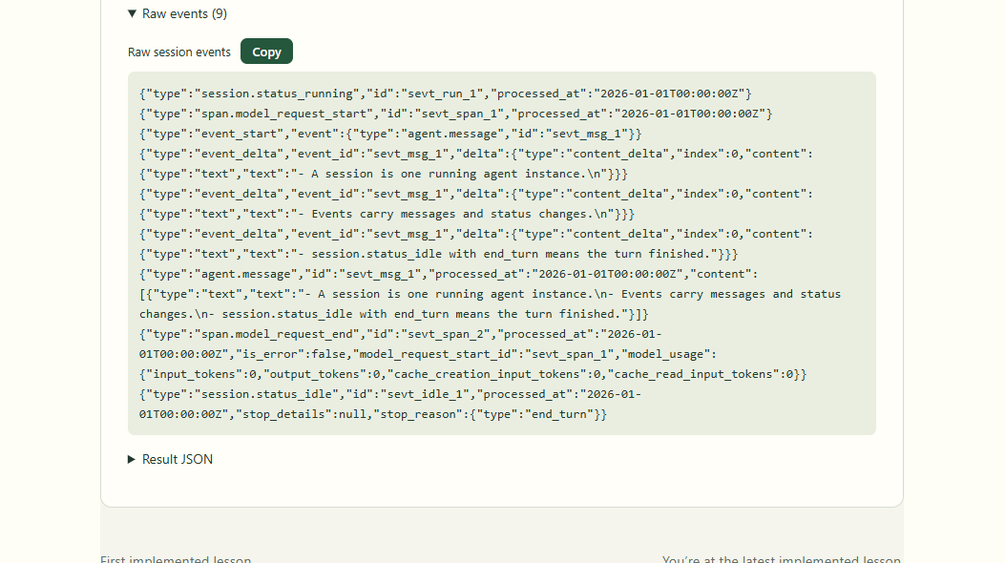
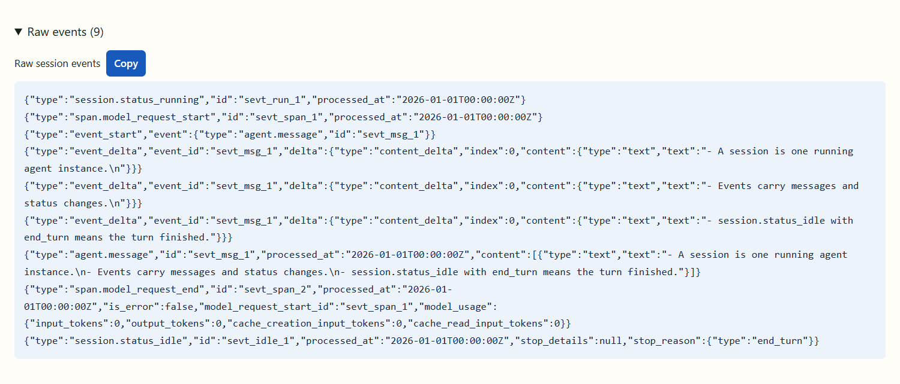
Run offline: the raw event stream
OFFLINE · SCREEN 3 OF 3
01
02
03
Raw events preserve the received event JSON.
Preview deltas, authoritative messages and lifecycle events have different roles.
Fixture order is deterministic; real streams may include more events.
Lab 01 · offline fixture capture
Notes:
Lab 01 — Claude Managed Agents. Source: Tab1-query.md and the local application source. Screenshots show authored offline fixtures, not Claude measurements.

Slide 6
Run offline: the raw event stream — application view
6

Slide 7

Run live: the prompt and controls
LIVE · SCREEN 1 OF 3
01
02
03
The same prompt form supports Run live.
Live mode uses the server key, agent ID and environment ID.
One bounded live turn was recorded; no key appears in these screens.
Lab 01 · live turn recorded 12 Oct 2026; history replay
Notes:
Lab 01 — Claude Managed Agents. Source: Tab1-query.md and the local application source. Live session sesn_015L4o2BcWmuu8rh3xdo3uSu recorded 2026-10-12. The run reached end_turn and was archived. Screens display persisted events from this live turn in the application; preview deltas are not persisted or replayable. Browser text wrapping was adjusted so the complete answer remains readable. The screenshot budget label retains the API amount and currency: 50 USD means 50 US cents, not 50 dollars. Usage: output_tokens=414, input_tokens=4, cache creation input tokens=640, list_cost.amount=1 USD cent, active_seconds=5.142. List cost is not necessarily billed cost.

Slide 8
Run live: the prompt and controls — application view
8

Slide 9
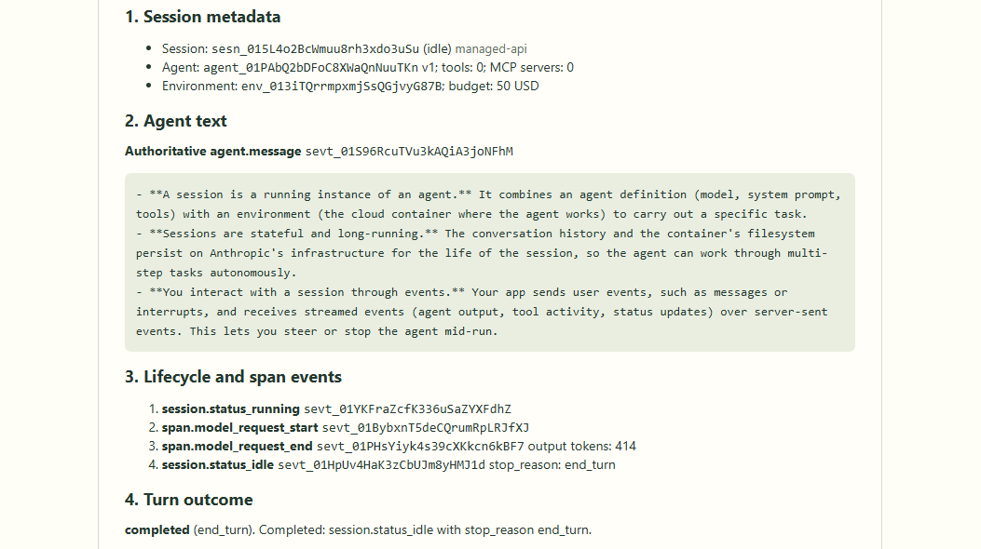
Run live: the authoritative answer
LIVE · SCREEN 2 OF 3
01
02
03
Claude returned three bullet points in agent.message.
This is the actual live response, displayed from recorded event history.
Budget amount 50 means 50 US cents; USD is the API currency label.
Lab 01 · live turn recorded 12 Oct 2026; history replay
Notes:
Lab 01 — Claude Managed Agents. Source: Tab1-query.md and the local application source. Live session sesn_015L4o2BcWmuu8rh3xdo3uSu recorded 2026-10-12. The run reached end_turn and was archived. Screens display persisted events from this live turn in the application; preview deltas are not persisted or replayable. Browser text wrapping was adjusted so the complete answer remains readable. The screenshot budget label retains the API amount and currency: 50 USD means 50 US cents, not 50 dollars. Usage: output_tokens=414, input_tokens=4, cache creation input tokens=640, list_cost.amount=1 USD cent, active_seconds=5.142. List cost is not necessarily billed cost.

Slide 10
Run live: the authoritative answer — application view
10

Slide 11
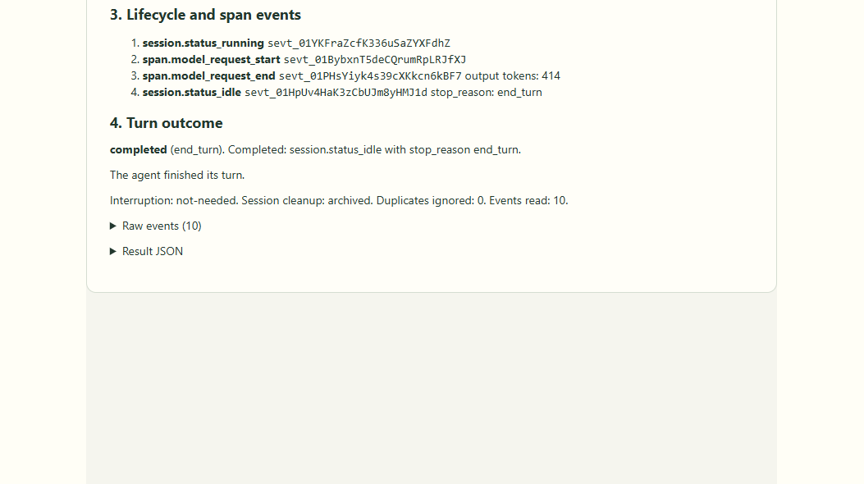
Run live: lifecycle and turn outcome
LIVE · SCREEN 3 OF 3
01
02
03
session.status_idle ended the turn with end_turn.
The session was archived after cleanup. Recorded list cost: 1 US cent.
414 output tokens; list cost differs from billed cost.
Lab 01 · live turn recorded 12 Oct 2026; history replay
Notes:
Lab 01 — Claude Managed Agents. Source: Tab1-query.md and the local application source. Live session sesn_015L4o2BcWmuu8rh3xdo3uSu recorded 2026-10-12. The run reached end_turn and was archived. Screens display persisted events from this live turn in the application; preview deltas are not persisted or replayable. Browser text wrapping was adjusted so the complete answer remains readable. The screenshot budget label retains the API amount and currency: 50 USD means 50 US cents, not 50 dollars. Usage: output_tokens=414, input_tokens=4, cache creation input tokens=640, list_cost.amount=1 USD cent, active_seconds=5.142. List cost is not necessarily billed cost.

Slide 12
Run live: lifecycle and turn outcome — application view
12

Slide 13
One live turn as a UML sequence diagram
User
React UI
Concept01Query
Express route
/api/c1/query (via Vite)
Anthropic SDK
sessions + events
Managed Agents
remote session
1. Enter prompt, Run live
2. POST { mode, prompt }
3. Validate · openSse()
4. runLab01(port, prompt)
5. Create → open → send
6. Agent and lifecycle events
7. Consume typed events
8. progress frames → result
9. Parse · setFrames
10. Answer + turn outcome
opt [user cancels while running]
11. Click Cancel query
12. Abort POST: close
13. Request interruption
14. user.interrupt → check status
Notes:
Lab 01 — Claude Managed Agents. Source: Tab1-query.md and the local application source. The live adapter is cloud-hosted; cancellation requires a separate bounded interruption request. Local abort does not prove remote work stopped. Reference: https://platform.claude.com/docs/en/managed-agents/events-and-streaming ; https://platform.claude.com/docs/en/managed-agents/event-deltas ; https://platform.claude.com/docs/en/managed-agents/budgets

Slide 14
The workflow at a glance
1
2
3
4
Start the lab with one command
The user writes a prompt in Lab 01
The browser POSTs the prompt
Express routes the request to Lab 01
5
6
7
8
Validate the request body with Zod
Open the browser SSE stream
Create a session, then send a message
The session emits its event stream
9
10
11
12
Consume events and emit UI frames
The browser parses the SSE stream
React renders text and lifecycle separately
Complete, pause, fail or cancel
Notes:
Lab 01 — Claude Managed Agents. Source: Tab1-query.md and the local application source. Reference: https://platform.claude.com/docs/en/managed-agents/events-and-streaming ; https://platform.claude.com/docs/en/managed-agents/event-deltas ; https://platform.claude.com/docs/en/managed-agents/budgets

Slide 15
Start the lab with one command
1
npm run dev starts the Express backend and Vite frontend together.
Node runs TypeScript through tsx; the backend loads .env if it exists.
Express listens on 3076; Vite serves React on 5174. Offline runs need no key.
package.json · server/index.ts (excerpt)
"dev:server": "node scripts/dev-server.mjs",
"dev:web": "vite"
// server/index.ts
const port = Number(
process.env.LEARNING_API_PORT ?? 3076
);
app.listen(port, "127.0.0.1");
React UI · src/
Vite proxy · :5174
Express server · :3076
Managed Agents API
Notes:
Lab 01 — Claude Managed Agents. Source: Tab1-query.md and the local application source. Code is an excerpt or simplified teaching example; consult the named local source for the complete implementation. Reference: https://platform.claude.com/docs/en/managed-agents/events-and-streaming ; https://platform.claude.com/docs/en/managed-agents/event-deltas ; https://platform.claude.com/docs/en/managed-agents/budgets

Slide 16
The user writes a prompt in Lab 01
2
Open /?lesson=1 and choose Run the exercise.
The default prompt asks for three bullet points about Managed Agents sessions.
Running clears previous frames, sets the mode, and creates an AbortController.
src/concepts/Concept01Query.tsx (simplified)
const request = new AbortController();
controller.current = request;
setFrames([]);
setResult(undefined);
setPending(true);
await streamPost("/api/c1/query",
{ mode: chosen, prompt, scenario },
{ signal: request.signal,
resultSchema: lab01ResultSchema,
onEvent });
React UI · src/
Vite proxy · :5174
Express server · :3076
Managed Agents API
Notes:
Lab 01 — Claude Managed Agents. Source: Tab1-query.md and the local application source. Code is an excerpt or simplified teaching example; consult the named local source for the complete implementation. Reference: https://platform.claude.com/docs/en/managed-agents/events-and-streaming ; https://platform.claude.com/docs/en/managed-agents/event-deltas ; https://platform.claude.com/docs/en/managed-agents/budgets

Slide 17
The browser POSTs the prompt
3
streamPost() sends JSON with mode and prompt; offline requests also choose a scenario.
The browser uses fetch to POST and read the response stream. EventSource supports GET.
Vite proxies /api to the backend on port 3076; the key stays on the server.
src/lib/sse.ts · vite.config.ts (excerpt)
const response = await fetch(url, {
method: "POST",
headers: {
"Content-Type": "application/json",
Accept: "text/event-stream"
},
body: JSON.stringify(body),
signal: controller.signal
});
// /api proxy target: 127.0.0.1:3076
React UI · src/
Vite proxy · :5174
Express server · :3076
Managed Agents API
Notes:
Lab 01 — Claude Managed Agents. Source: Tab1-query.md and the local application source. Code is an excerpt or simplified teaching example; consult the named local source for the complete implementation. Reference: https://platform.claude.com/docs/en/managed-agents/events-and-streaming ; https://platform.claude.com/docs/en/managed-agents/event-deltas ; https://platform.claude.com/docs/en/managed-agents/budgets

Slide 18
Express routes the request to Lab 01
4
The numeric lesson registry mounts each implemented router under its own prefix.
/api/c1 selects Lab 01; POST /query starts one local lesson operation.
This route parses strict JSON with an 8 KB body limit and checks the local origin.
server/index.ts · server/concepts/01-query.ts (excerpt)
for (const lesson of registerConcepts())
app.use(lesson.serverPrefix,
lesson.router);
// Lab 01 router
router.post("/query",
json({ limit: "8kb", strict: true }),
async (request, response) => {
// validate before opening SSE
});
React UI · src/
Vite proxy · :5174
Express server · :3076
Managed Agents API
Notes:
Lab 01 — Claude Managed Agents. Source: Tab1-query.md and the local application source. Code is an excerpt or simplified teaching example; consult the named local source for the complete implementation. Reference: https://platform.claude.com/docs/en/managed-agents/events-and-streaming ; https://platform.claude.com/docs/en/managed-agents/event-deltas ; https://platform.claude.com/docs/en/managed-agents/budgets

Slide 19
Validate the request body with Zod
5
The schema requires a trimmed prompt of 1–1,000 characters and a valid mode.
z.strictObject() rejects unknown fields. Fixture scenarios are offline only.
Invalid input returns HTTP 400 before SSE or provider calls. Capacity returns 429.
shared/lab01-events.ts · 01-query.ts (simplified)
const schema = z.strictObject({
mode: z.enum(["scripted", "live"]),
prompt: z.string().trim()
.min(1).max(1000),
scenario: z.enum(lab01Scenarios)
.default("normal")
});
const parsed = schema.safeParse(req.body);
if (!parsed.success)
return res.status(400).json(error);
React UI · src/
Vite proxy · :5174
Express server · :3076
Managed Agents API
Notes:
Lab 01 — Claude Managed Agents. Source: Tab1-query.md and the local application source. Code is an excerpt or simplified teaching example; consult the named local source for the complete implementation. Reference: https://platform.claude.com/docs/en/managed-agents/events-and-streaming ; https://platform.claude.com/docs/en/managed-agents/event-deltas ; https://platform.claude.com/docs/en/managed-agents/budgets

Slide 20
Open the browser SSE stream
6
openSse() flushes text/event-stream headers so the browser can read frames immediately.
Heartbeats keep the connection active. Disconnect aborts the request controller.
The host bounds the deadline and output queue; the runner owns remote cleanup.
server/concepts/01-query.ts (excerpt)
const controller = new AbortController();
const stream = openSse(req, res, {
controller,
heartbeatMs: 5000,
idleMs: 20000,
deadlineMs:
deadlineMs + cleanupWaitMs + 8000,
quiet: true
});
// stream.send("progress", frame)
React UI · src/
Vite proxy · :5174
Express server · :3076
Managed Agents API
Notes:
Lab 01 — Claude Managed Agents. Source: Tab1-query.md and the local application source. Code is an excerpt or simplified teaching example; consult the named local source for the complete implementation. Reference: https://platform.claude.com/docs/en/managed-agents/events-and-streaming ; https://platform.claude.com/docs/en/managed-agents/event-deltas ; https://platform.claude.com/docs/en/managed-agents/budgets

Slide 21
Create a session, then send a message
7
Live mode creates a dedicated session with the configured agent, environment and budget.
The lab rejects agents with tools or MCP servers before sending a prompt.
Open the upstream stream first; then send user.message. No local Claude Code process runs.
server/lib/lab01-port.ts (simplified)
const session = await sessions.create({
agent: ids.agentId,
environment_id: ids.environmentId,
budget
});
const events = await sessions.events.stream(
session.id,
{ event_deltas: ["agent.message"] },
{ signal }
);
await sessions.events.send(session.id,
{ events: [{ type: "user.message",
content: [{ type: "text", text: prompt }]
}] });
React UI · src/
Vite proxy · :5174
Express server · :3076
Managed Agents API
Notes:
Lab 01 — Claude Managed Agents. Source: Tab1-query.md and the local application source. Code is an excerpt or simplified teaching example; consult the named local source for the complete implementation. Reference: https://platform.claude.com/docs/en/managed-agents/events-and-streaming ; https://platform.claude.com/docs/en/managed-agents/event-deltas ; https://platform.claude.com/docs/en/managed-agents/budgets

Slide 22
The session emits its event stream
8
event_start and event_delta provide best-effort text previews, keyed by event ID and block index.
agent.message is authoritative. It replaces its preview instead of appending to it.
session.status_idle.stop_reason determines completion or a pause. Live event order can vary.
event_start / event_delta
Best-effort preview; event ID + block index
1
agent.message
Authoritative content; replaces the preview
2
session.status_idle
stop_reason: end_turn, requires_action or budget_reached
3
React UI · src/
Vite proxy · :5174
Express server · :3076
Managed Agents API
Notes:
Lab 01 — Claude Managed Agents. Source: Tab1-query.md and the local application source. Reference: https://platform.claude.com/docs/en/managed-agents/events-and-streaming ; https://platform.claude.com/docs/en/managed-agents/event-deltas ; https://platform.claude.com/docs/en/managed-agents/budgets

Slide 23
Consume events and emit UI frames
9
Offline fixtures and live streams pass through the same createEventConsumer().
Persisted IDs are deduplicated; repeated preview deltas are still applied.
The route sends progress frames and one local result. That result is not a provider message.
lab01-run.ts · 01-query.ts (simplified)
// Runner reads the provider iterable
const next = await iterator.next();
const { frames, done } =
consumer.push(next.value);
for (const frame of frames) emit(frame);
// Router sends local SSE frames
emit: frame => stream.send("progress", frame)
if (!controller.signal.aborted)
stream.send("result", result);
await stream.end();
React UI · src/
Vite proxy · :5174
Express server · :3076
Managed Agents API
Notes:
Lab 01 — Claude Managed Agents. Source: Tab1-query.md and the local application source. Code is an excerpt or simplified teaching example; consult the named local source for the complete implementation. Reference: https://platform.claude.com/docs/en/managed-agents/events-and-streaming ; https://platform.claude.com/docs/en/managed-agents/event-deltas ; https://platform.claude.com/docs/en/managed-agents/budgets

Slide 24
The browser parses the SSE stream
10
The incremental parser decodes UTF-8 and handles CR, LF and multiline data: fields.
A blank line dispatches a frame; incomplete data waits for the next chunk.
JSON and lesson contracts are validated. Broken POSTs are never resubmitted automatically.
src/lib/sse.ts (simplified)
const parser = new SseParser();
const reader = response.body.getReader();
const part = await reader.read();
for (const frame of parser.push(
part.value ?? new Uint8Array(),
part.done
)) {
const data = JSON.parse(frame.data);
options.onEvent?.(frame.event, data, id);
}
// Terminal result is schema-validated.
React UI · src/
Vite proxy · :5174
Express server · :3076
Managed Agents API
Notes:
Lab 01 — Claude Managed Agents. Source: Tab1-query.md and the local application source. Code is an excerpt or simplified teaching example; consult the named local source for the complete implementation. Reference: https://platform.claude.com/docs/en/managed-agents/events-and-streaming ; https://platform.claude.com/docs/en/managed-agents/event-deltas ; https://platform.claude.com/docs/en/managed-agents/budgets

Slide 25
React renders text and lifecycle separately
11
Session metadata comes from the creation response; text comes from agent.message.
React hides a preview when its authoritative message arrives with the same event ID.
Lifecycle, raw events and turn outcome remain separate. Completion never repeats answer text.
src/concepts/Concept01Query.tsx (excerpt)
const messages = frames.filter(
frame => frame.kind === "message"
);
const replaced = new Set(
messages.map(frame => frame.eventId)
);
for (const frame of frames) {
if (frame.kind === "preview" &&
!replaced.has(frame.eventId))
livePreviews.set(
frame.eventId, frame.text
);
}
React UI · src/
Vite proxy · :5174
Express server · :3076
Managed Agents API
Notes:
Lab 01 — Claude Managed Agents. Source: Tab1-query.md and the local application source. Code is an excerpt or simplified teaching example; consult the named local source for the complete implementation. Reference: https://platform.claude.com/docs/en/managed-agents/events-and-streaming ; https://platform.claude.com/docs/en/managed-agents/event-deltas ; https://platform.claude.com/docs/en/managed-agents/budgets

Slide 26
Complete, pause, fail or cancel
12
A finished turn requires end_turn without local cancellation or deadline expiry.
A pause, terminal error or early stream end must not be reported as success.
Cancel aborts the POST. The server attempts bounded user.interrupt before closing upstream; unconfirmed interruption needs Console review.
Completed / paused
end_turn completes; action or budget waits pause
1
Error / incomplete
Terminal failure, or EOF without turn completion
2
Cancelled / deadline
Independent interrupt; confirmation may be unavailable
3
React UI · src/
Vite proxy · :5174
Express server · :3076
Managed Agents API
Notes:
Lab 01 — Claude Managed Agents. Source: Tab1-query.md and the local application source. Cancellation closes the browser connection, so the final server cleanup result may not be visible in that page. An unconfirmed interruption must be checked in Claude Console. Reference: https://platform.claude.com/docs/en/managed-agents/events-and-streaming ; https://platform.claude.com/docs/en/managed-agents/event-deltas ; https://platform.claude.com/docs/en/managed-agents/budgets

Slide 27
One prompt in,
agent text and turn status out
THE WHOLE ROUND TRIP
Challenge: find the three bullets in agent.message, then confirm end_turn
React UI
Vite proxy
Express
Managed Agents
27
Notes:
Lab 01 — Claude Managed Agents. Source: Tab1-query.md and the local application source. Reference: https://platform.claude.com/docs/en/managed-agents/events-and-streaming ; https://platform.claude.com/docs/en/managed-agents/event-deltas ; https://platform.claude.com/docs/en/managed-agents/budgets

