Slide 1
Permissions: review before a tool runs
CLAUDE MANAGED AGENTS LAB · LAB 04
Twelve steps, from requires_action pauses and the review dialog to single-use decisions, host validation, expiry and abandonment
1
Notes:
Lab 04 — Claude Managed Agents. Source: Tab4-permissions.md and the local application source. Covers the Managed Agents equivalent of canUseTool: always_ask pauses answered by user.tool_confirmation, a pending-approval map bound to its run, host validation of every allow, expiry and abandonment. All screenshots come from authored offline fixtures. No live or billed request was made for this presentation.

Slide 2
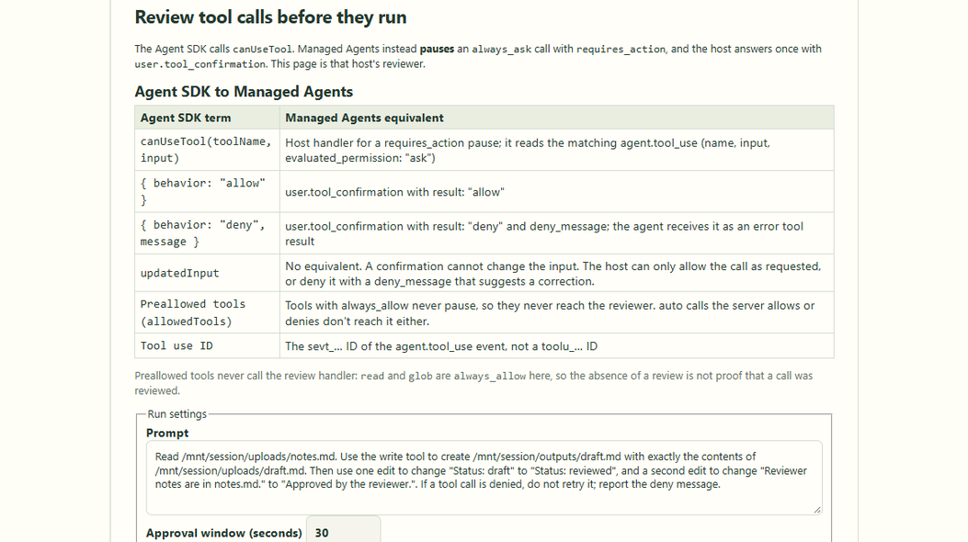
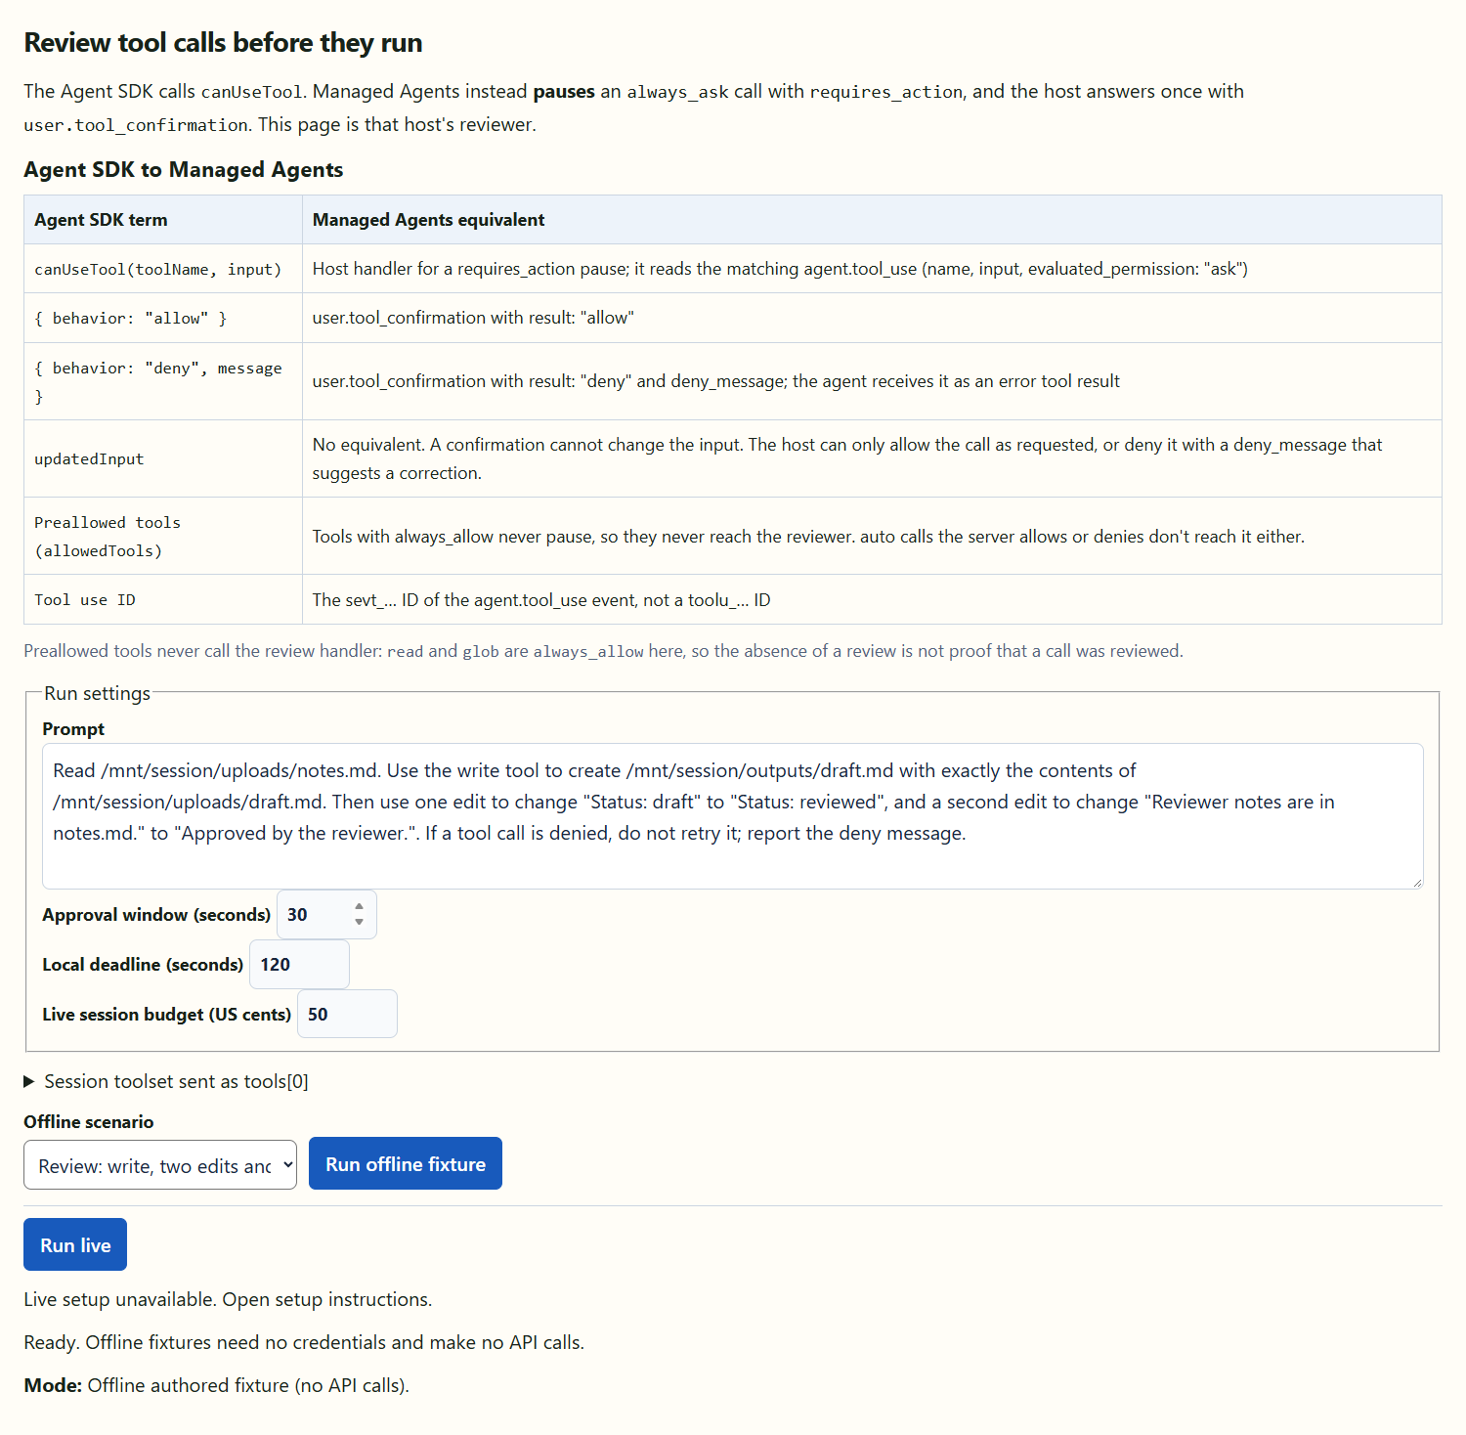
canUseTool becomes a pause and a confirmation
CONCEPT MAPPING
01
02
03
An always_ask call pauses with requires_action; the host answers it once.
A confirmation can only allow or deny; updatedInput has no equivalent.
Preallowed tools never pause, so they never reach the reviewer.
Lab 04 · authored offline controls
Notes:
Lab 04 — Claude Managed Agents. Source: Tab4-permissions.md and the local application source. Screenshot captured from the authored offline Lab 04 application. The mapping table matches Tab4-permissions.md; only the agent_toolset_20260401 configuration is sent to the API. Source: shared/lab04-permissions.ts and src/concepts/Concept04Permissions.tsx.

Slide 3
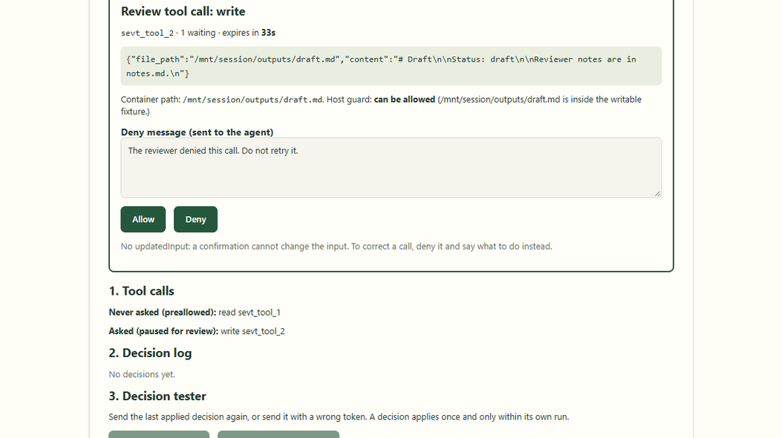
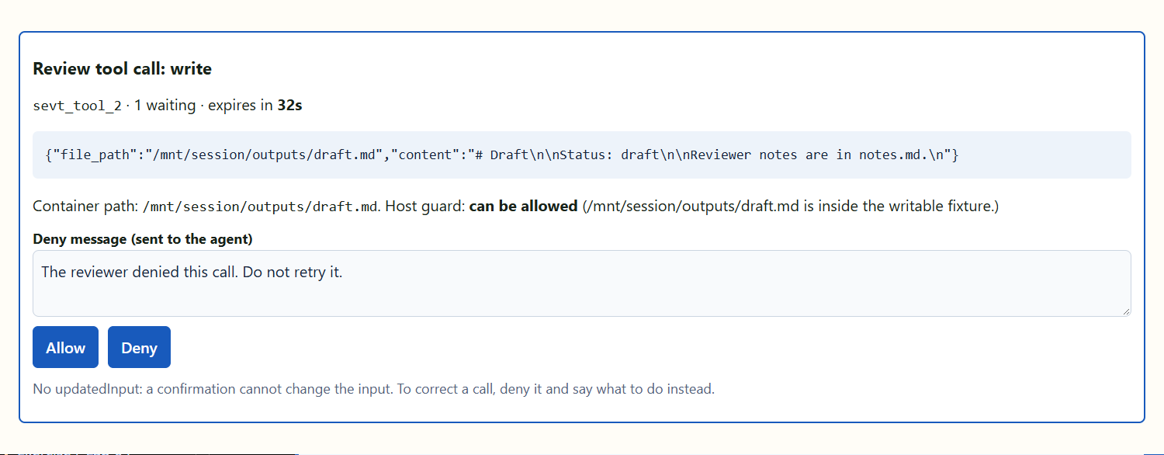
The review dialog shows one paused call
REVIEW DIALOG
01
02
03
Tool, redacted input, container path and the host guard verdict.
A countdown shows when the host will deny it for lack of an answer.
The deny message is exactly what the agent will receive.
Lab 04 · review dialog for the first write
Notes:
Lab 04 — Claude Managed Agents. Source: Tab4-permissions.md and the local application source. The dialog is driven by the review frame for one pending approval. Focus moves into the dialog and stays there with Tab. The read of notes.md ran before it without any review because read is always_allow. Source: server/lib/lab04-run.ts.

Slide 4
The review dialog shows one paused call — application view
4

Slide 5
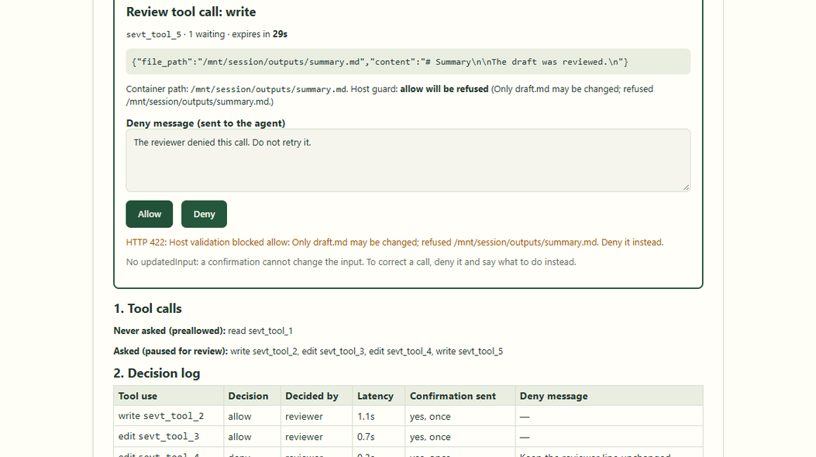
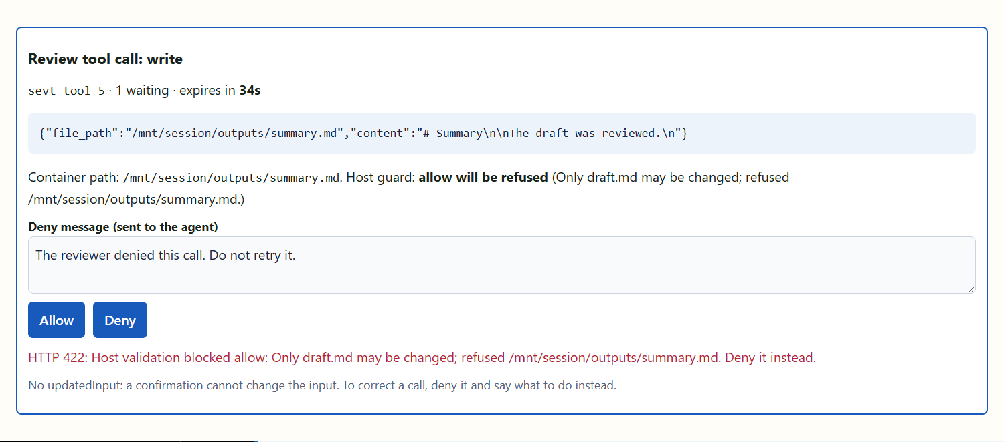
Host validation can refuse an allow
HOST VALIDATION
01
02
03
summary.md fails the "only draft.md" rule, so allow answers 422.
The entry stays pending: the reviewer can still deny it.
No unsafe allow is ever sent to the session.
Lab 04 · allow refused by the host guard
Notes:
Lab 04 — Claude Managed Agents. Source: Tab4-permissions.md and the local application source. POST /decide runs every allow through hostAllowCheck, the same guard Lab 03 uses for automatic decisions. A reviewer cannot approve what the host would refuse. Source: server/concepts/04-permissions.ts and server/lib/lab03-sandbox.ts.

Slide 6
Host validation can refuse an allow — application view
6

Slide 7
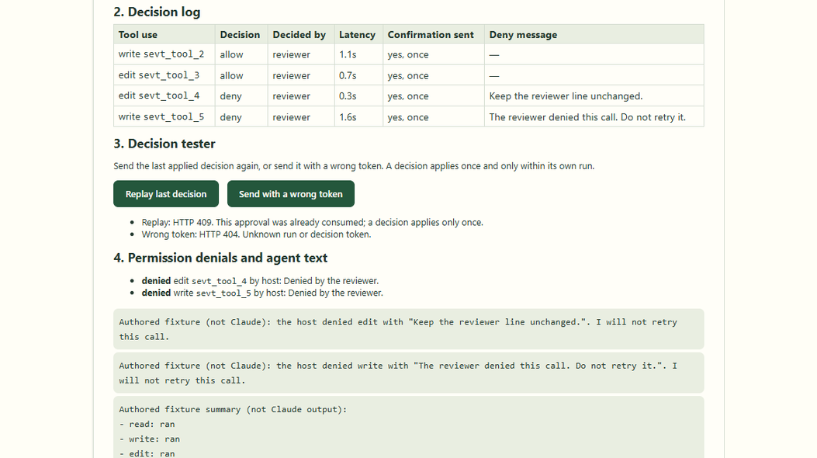
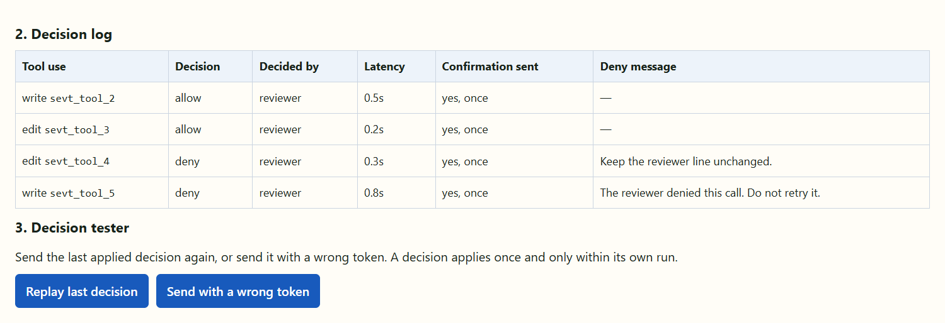
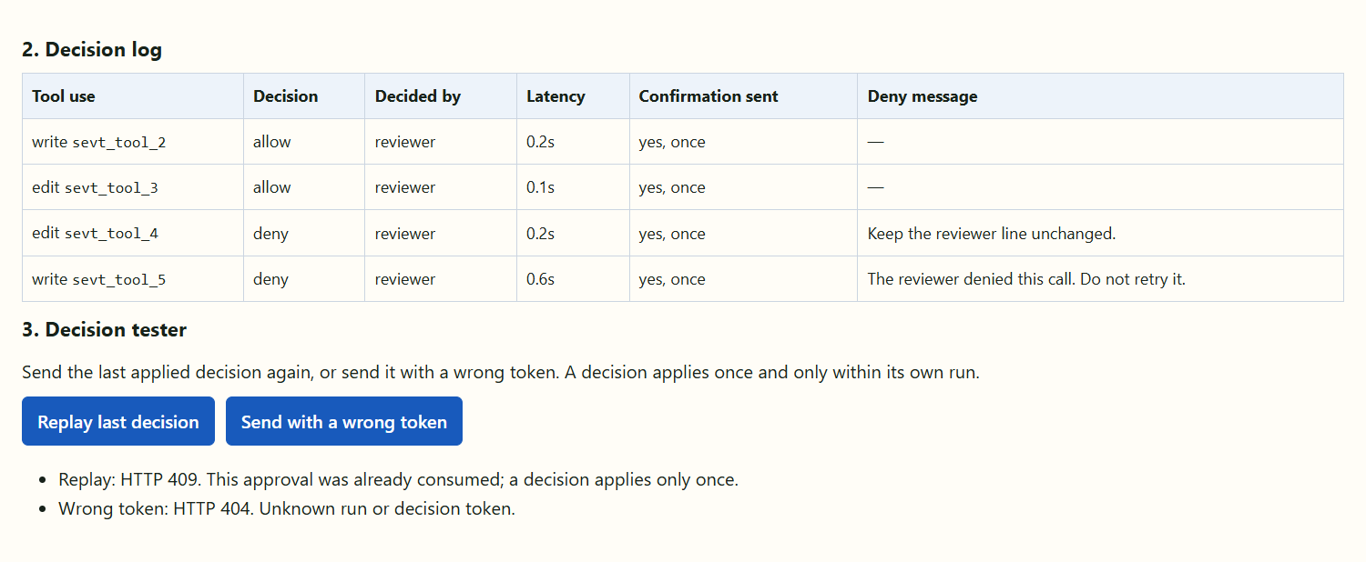
Each decision applies exactly once
DECISION LOG
01
02
03
The log records who decided, the latency and whether a confirmation was sent.
Replaying a decision answers 409; a wrong token answers 404.
Each deny reaches the agent as an error tool result.
Lab 04 · decision log and decision tester
Notes:
Lab 04 — Claude Managed Agents. Source: Tab4-permissions.md and the local application source. The registry removes an entry before resolving its waiter, so a second decision for the same call can only answer 409. Tokens are bound to their run; another run or token answers 404 without revealing anything. Source: server/lib/lab04-approvals.ts.

Slide 8
Each decision applies exactly once — application view
8

Slide 9
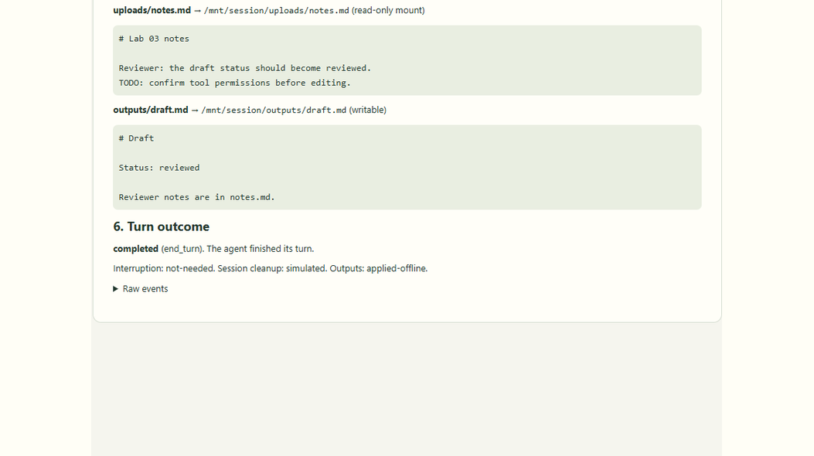
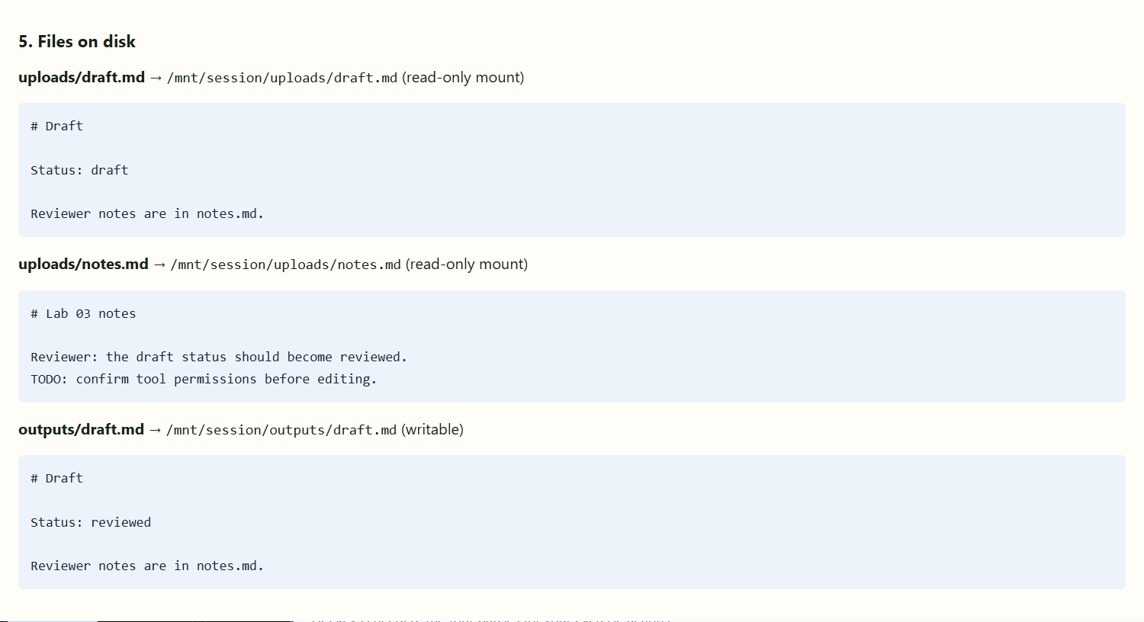
Evidence on disk: only the approved edit
FILES ON DISK
01
02
03
outputs/draft.md reads Status: reviewed: the first edit was allowed.
The reviewer line is unchanged because the second edit was denied.
summary.md was never written; the read-only uploads are untouched.
Lab 04 · files read back from the sandbox
Notes:
Lab 04 — Claude Managed Agents. Source: Tab4-permissions.md and the local application source. The panel shows files read from the host sandbox after the run, not text from the agent message. Tests assert the same disk state. Reference: https://platform.claude.com/docs/en/managed-agents/files

Slide 10
Evidence on disk: only the approved edit — application view
10

Slide 11
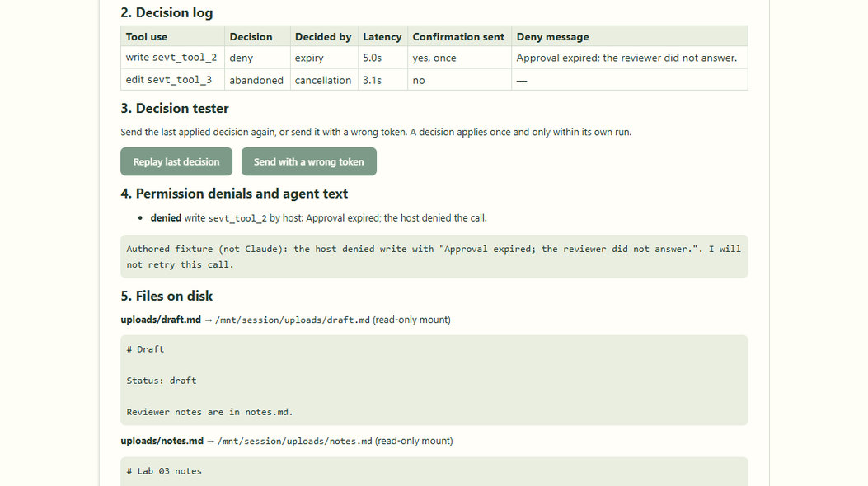
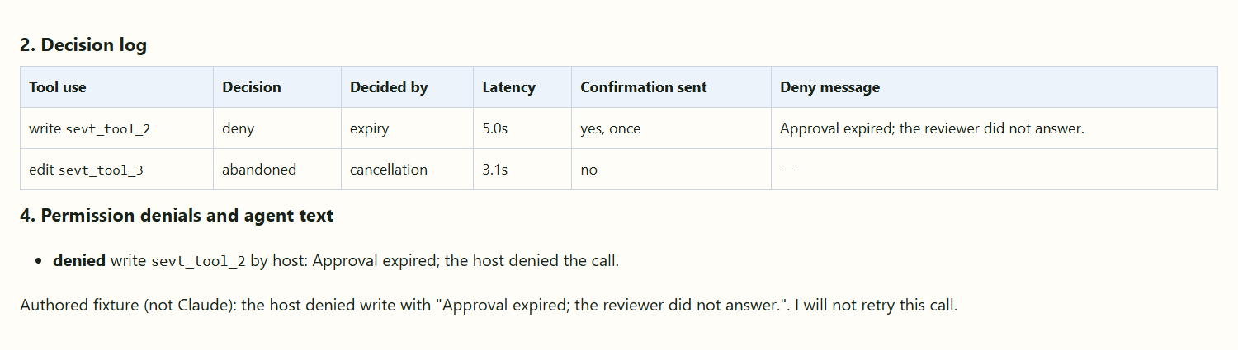
Expiry and abandonment are different
EXPIRY
01
02
03
An unanswered review expires: the host sends a deny with an expiry message.
The deadline then abandons the next review: no confirmation is sent.
A late decision returns 409 while the closed run is retained; later it may return 404.
Lab 04 · 5-second window and 9-second deadline
Notes:
Lab 04 — Claude Managed Agents. Source: Tab4-permissions.md and the local application source. Expiry is a host decision, not a provider timeout: the host answers the paused call with deny. Abandonment releases the waiter without any confirmation, and the runner attempts user.interrupt instead. Source: server/lib/lab04-approvals.ts and server/lib/lab04-run.ts.

Slide 12
Expiry and abandonment are different — application view
12

Slide 13
Reviews and decisions in sequence
User
React UI
Concept04Permissions
Express routes
/api/c4/query + /decide
Approvals + SDK
registry · sessions
Managed Agents
session container
1. Run exercise; dialogs open per review
2. POST /query { prompt, approval }
3. Validate · openRun (token)
4. runLab04(port, registry, run)
5. Upload files → create with toolset
6. tool_use ask → requires_action
7. Pending approval → review frame
8. run + review frames (SSE)
9. Allow / Deny → POST /decide
10. Decision log + files on disk
opt [deadline expires or user cancels]
11. Cancel query or deadline timer
12. Abort waiting: release approvals
13. Independent interruption request
14. user.interrupt → check status
Notes:
Lab 04 — Claude Managed Agents. Source: Tab4-permissions.md and the local application source. UML sequence diagram of Lab 04 execution: session creation with the lab toolset, an always_ask call pausing with requires_action, the pending approval and review frame, the reviewer decision through POST /decide that becomes one user.tool_confirmation, and abandonment with an independent interruption on cancellation or deadline expiry.

Slide 14
The workflow at a glance
1
2
3
4
Start the lab with one command
The reviewer sets the approval window
The browser POSTs the run settings
Express routes query and decide
5
6
7
8
Reject Agent SDK permission fields
Open the run and its decision token
Pause always_ask calls for review
Preallowed calls never reach review
9
10
11
12
Decide once through POST /decide
Validate every allow on the host
Expire, abandon and clean up
Verify decisions on disk
Notes:
Lab 04 — Claude Managed Agents. Source: Tab4-permissions.md and the local application source. Overview of the twelve stages of Lab 04, from the review dialog to single-use decisions verified against files on disk.

Slide 15
Start the lab with one command
1
npm run dev starts the Express backend and Vite frontend together.
Node runs TypeScript through tsx; the backend loads .env if it exists.
Express listens on 3076; Vite serves React on 5174. Offline runs need no key.
package.json · server/index.ts (excerpt)
"dev:server": "node scripts/dev-server.mjs",
"dev:web": "vite"
// server/index.ts
const port = Number(
process.env.LEARNING_API_PORT ?? 3076
);
app.listen(port, "127.0.0.1");
React UI · src/
Vite proxy · :5174
Express server · :3076
Managed Agents API
Notes:
Lab 04 — Claude Managed Agents. Source: Tab4-permissions.md and the local application source. Code is an excerpt from package.json · server/index.ts (excerpt); consult local source for the complete implementation. Reference: https://platform.claude.com/docs/en/managed-agents/permission-policies ; https://platform.claude.com/docs/en/managed-agents/events-and-streaming

Slide 16
The reviewer sets the approval window
2
Open /?lesson=4 and select Run the exercise.
Choose the scenario and an approval window of 5 to 120 seconds.
Each paused call opens a focus-managed review dialog with a countdown.
src/concepts/Concept04Permissions.tsx (simplified)
const [approvalSeconds, setApprovalSeconds] =
useState(approvalLimits.defaultSeconds);
const [denyMessage, setDenyMessage] =
useState(defaultDeny);
// one dialog per paused call, oldest first
const queue = frames.filter((f) =>
f.kind === "review"
&& !settled.has(f.toolUseId));
const current = queue[0];
React UI · src/
Vite proxy · :5174
Express server · :3076
Managed Agents API
Notes:
Lab 04 — Claude Managed Agents. Source: Tab4-permissions.md and the local application source. Code is an excerpt from src/concepts/Concept04Permissions.tsx (simplified); consult local source for the complete implementation. Reference: https://platform.claude.com/docs/en/managed-agents/permission-policies ; https://platform.claude.com/docs/en/managed-agents/events-and-streaming

Slide 17
The browser POSTs the run settings
3
streamPost() opens one SSE run; its first frame carries runId and decisionToken.
Decisions go separately to POST /api/c4/decide as small JSON requests.
Vite proxies /api to port 3076; the API key never reaches the browser.
src/concepts/Concept04Permissions.tsx (excerpt)
const body: Lab04Request = {
mode: chosen, prompt,
deadlineSeconds, approvalSeconds,
...(chosen === "live"
? { budgetCents } : { scenario }),
};
await streamPost("/api/c4/query", body, {
signal: abort.signal,
resultSchema: lab04ResultSchema,
});
React UI · src/
Vite proxy · :5174
Express server · :3076
Managed Agents API
Notes:
Lab 04 — Claude Managed Agents. Source: Tab4-permissions.md and the local application source. Code is an excerpt from src/concepts/Concept04Permissions.tsx (excerpt); consult local source for the complete implementation. Reference: https://platform.claude.com/docs/en/managed-agents/permission-policies ; https://platform.claude.com/docs/en/managed-agents/events-and-streaming

Slide 18
Express routes query and decide
4
The numeric lesson registry mounts the Lab 04 router at /api/c4.
POST /query streams one turn; POST /decide resolves one approval.
Both routes check the local origin; decision bodies are capped at 1 KB.
server/concepts/registry.ts · 04-permissions.ts (excerpt)
{ ...lab04Lesson, ...content[lab04Lesson.id]!,
router: lab04.router, close: lab04.close },
// server/concepts/04-permissions.ts
router.post("/query",
json({ limit: "8kb", strict: true }), ...);
router.post("/decide",
json({ limit: "1kb", strict: true }), ...);
React UI · src/
Vite proxy · :5174
Express server · :3076
Managed Agents API
Notes:
Lab 04 — Claude Managed Agents. Source: Tab4-permissions.md and the local application source. Code is an excerpt from server/concepts/registry.ts · 04-permissions.ts (excerpt); consult local source for the complete implementation. Reference: https://platform.claude.com/docs/en/managed-agents/permission-policies ; https://platform.claude.com/docs/en/managed-agents/events-and-streaming

Slide 19
Reject Agent SDK permission fields
5
canUseTool, updatedInput and other SDK fields get a 400 that names them.
updatedInput has no equivalent: a confirmation cannot change the input.
Validation finishes before any sandbox, approval or provider work.
server/concepts/04-permissions.ts (simplified)
const sdkOnly = lab04SdkOnlyFields
.filter((key) => Object.hasOwn(body, key));
// canUseTool, allowedTools, permissionMode,
// updatedInput, behavior
if (!parsed.success) {
const message = sdkOnly.length
? sdkOnlyMessage(sdkOnly)
: "Check mode, prompt, scenario...";
response.status(400)
.json(apiError("INVALID_REQUEST", message));
return;
}
React UI · src/
Vite proxy · :5174
Express server · :3076
Managed Agents API
Notes:
Lab 04 — Claude Managed Agents. Source: Tab4-permissions.md and the local application source. Code is an excerpt from server/concepts/04-permissions.ts (simplified); consult local source for the complete implementation. Reference: https://platform.claude.com/docs/en/managed-agents/permission-policies ; https://platform.claude.com/docs/en/managed-agents/events-and-streaming

Slide 20
Open the run and its decision token
6
Each run gets a random runId and a reusable per-run decisionToken.
Both arrive in the first SSE frame; decisions send them in the POST body.
Tokens are compared in constant time; a wrong token looks like an unknown run.
server/lib/lab04-approvals.ts (simplified)
openRun() {
const runId = randomUUID();
const decisionToken =
randomBytes(24).toString("base64url");
this.runs.set(runId, { token, pending,
ended, closed: false });
return { runId, decisionToken };
}
// sent only in this run's first SSE frame
emit({ kind: "run", runId, decisionToken });
React UI · src/
Vite proxy · :5174
Express server · :3076
Managed Agents API
Notes:
Lab 04 — Claude Managed Agents. Source: Tab4-permissions.md and the local application source. Code is an excerpt from server/lib/lab04-approvals.ts (simplified); consult local source for the complete implementation. Reference: https://platform.claude.com/docs/en/managed-agents/permission-policies ; https://platform.claude.com/docs/en/managed-agents/events-and-streaming

Slide 21
Pause always_ask calls for review
7
A requires_action idle lists the waiting sevt_ event IDs.
Each ask call becomes a pending approval and a review frame.
The frame shows redacted input, the container path and the guard verdict.
server/lib/lab04-run.ts (simplified)
// Only "ask" calls can be confirmed.
if (call.use && call.use.evaluatedPermission
!== "ask") return null;
const pending = registry.request(runId,
{ toolUseId: call.id, tool, input },
approvalMs);
emit({ kind: "review", toolUseId: call.id,
tool, input: redact(json), containerPath,
guard: hostAllowCheck(tool, input),
expiresAt });
const outcome = await pending.outcome;
React UI · src/
Vite proxy · :5174
Express server · :3076
Managed Agents API
Notes:
Lab 04 — Claude Managed Agents. Source: Tab4-permissions.md and the local application source. Code is an excerpt from server/lib/lab04-run.ts (simplified); consult local source for the complete implementation. Reference: https://platform.claude.com/docs/en/managed-agents/permission-policies ; https://platform.claude.com/docs/en/managed-agents/events-and-streaming

Slide 22
Preallowed calls never reach review
8
always_allow tools run without pausing, so the review handler never runs.
auto calls the server allows or denies never reach it either.
A missing review is therefore not proof that a call was reviewed.
read · glob
always_allow: they run at once and are never reviewed
1
write · edit
always_ask: they pause until the reviewer answers
2
bash · grep · web tools
Disabled: unavailable, so there is nothing to review
3
React UI · src/
Vite proxy · :5174
Express server · :3076
Managed Agents API
Notes:
Lab 04 — Claude Managed Agents. Source: Tab4-permissions.md and the local application source. The Lab 04 toolset is built with toolsetFrom() and sent through agent_with_overrides. Source: shared/lab04-permissions.ts. Reference: https://platform.claude.com/docs/en/managed-agents/permission-policies ; https://platform.claude.com/docs/en/managed-agents/events-and-streaming

Slide 23
Decide once through POST /decide
9
An entry is removed before its waiter resolves, so a decision applies once.
Of two concurrent decisions, one gets 200 and the other 409.
Retained replays, expired and abandoned entries return 409; unknown runs return 404.
server/lib/lab04-approvals.ts (simplified)
const entry = run.pending.get(toolUseId);
if (!entry) return run.ended.has(toolUseId)
? 409 /* already decided */ : 404;
if (now() >= entry.expiresAt) return 409;
// remove first: only one decision can win
run.pending.delete(toolUseId);
entry.cancelTimer();
run.ended.set(toolUseId, "consumed");
entry.resolve({ decision, decidedBy: "reviewer" });
React UI · src/
Vite proxy · :5174
Express server · :3076
Managed Agents API
Notes:
Lab 04 — Claude Managed Agents. Source: Tab4-permissions.md and the local application source. Code is an excerpt from server/lib/lab04-approvals.ts (simplified); consult local source for the complete implementation. Reference: https://platform.claude.com/docs/en/managed-agents/permission-policies ; https://platform.claude.com/docs/en/managed-agents/events-and-streaming

Slide 24
Validate every allow on the host
10
Every allow runs through hostAllowCheck, the same guard Lab 03 uses.
An unsafe allow answers 422 and stays pending; the reviewer can still deny.
A deny needs no validation: the call never runs.
server/concepts/04-permissions.ts · lab03-sandbox.ts
const result = registry.decide(parsed.data,
({ tool, input }) => {
const check = hostAllowCheck(tool, input);
return check.ok ? null : check.reason;
});
// 422: allow refused, entry stays pending
// write/edit: only draft.md, writable root
if (target.relative !== "draft.md")
return { ok: false, reason: ... };
React UI · src/
Vite proxy · :5174
Express server · :3076
Managed Agents API
Notes:
Lab 04 — Claude Managed Agents. Source: Tab4-permissions.md and the local application source. Code is an excerpt from server/concepts/04-permissions.ts · lab03-sandbox.ts; consult local source for the complete implementation. Reference: https://platform.claude.com/docs/en/managed-agents/permission-policies ; https://platform.claude.com/docs/en/managed-agents/events-and-streaming

Slide 25
Expire, abandon and clean up
11
An unanswered review expires; the host sends a deny with an expiry message.
Cancel, deadline or disconnect releases every waiter and sends no confirmation.
The runner attempts user.interrupt, checks status and archives if idle.
server/lib/lab04-approvals.ts · lab04-run.ts
// expiry: the host denies the call
entry.resolve({ decision: "deny",
denyMessage: approvalExpiredMessage,
decidedBy: "expiry" });
// cancel, deadline, disconnect, shutdown
signal.addEventListener("abort", () =>
registry.releaseRun(runId), { once: true });
// waiters reject; no confirmation is sent
// interrupt; archive only if idle
React UI · src/
Vite proxy · :5174
Express server · :3076
Managed Agents API
Notes:
Lab 04 — Claude Managed Agents. Source: Tab4-permissions.md and the local application source. Code is an excerpt from server/lib/lab04-approvals.ts · lab04-run.ts; consult local source for the complete implementation. Reference: https://platform.claude.com/docs/en/managed-agents/permission-policies ; https://platform.claude.com/docs/en/managed-agents/events-and-streaming

Slide 26
Verify decisions on disk
12
Tests use an injected clock, so expiry is exact and deterministic.
Assertions read the sandbox from disk after every case.
Offline acknowledgements are authored; a live agent may react differently.
Allow · allow · deny
outputs/draft.md: only the approved edit landed
1
Expire or cancel
No file changes; the approvals map ends empty
2
Replay · wrong token
409 and 404: a decision applies once, in its run
3
React UI · src/
Vite proxy · :5174
Express server · :3076
Managed Agents API
Notes:
Lab 04 — Claude Managed Agents. Source: Tab4-permissions.md and the local application source. Expected outcomes asserted by tests/lab04-permissions.test.ts and browser-tests/lab04.spec.ts. Reference: https://platform.claude.com/docs/en/managed-agents/permission-policies ; https://platform.claude.com/docs/en/managed-agents/events-and-streaming

Slide 27
Deny one write and
explain the response
STUDENT CHALLENGE
Challenge: what does the agent receive, does the session keep running, and why is the offline reaction authored?
React UI
Vite proxy
Express
Managed Agents
27
Notes:
Lab 04 — Claude Managed Agents. Source: Tab4-permissions.md and the local application source. Closing challenge from Tab4-permissions.md. The deny_message returns as an error agent.tool_result for that sevt_ ID and the session keeps running to end_turn. The offline acknowledgement is authored; a live agent may rephrase, choose another tool or stop, so a deny is not a guarantee that the goal is abandoned.

