Slide 1
Inference receipts for llama.cpp
Signed receipts, a committed trace of every tensor, a verifier that never runs the model,
a formal specification in Lean, and a first integrity proof of the native arithmetic
Luis Cosio, SL5. Sep 11, 2026
github.com/luiscosio/llama.cpp, pull requests 1, 2 and 3
llama-receipts, Sep 11, 2026 1
Notes:
What exists as of Sep 11, 2026, how the pieces fit, and the path to zero-knowledge proofs of llama.cpp inference.

Slide 2
THE PROBLEM
You get tokens back and nothing else
When someone else runs a model for you, you cannot tell which model ran, at which quantization, on which prompt.
Re-running everything yourself works, but costs as much as the original run.
A zero-knowledge proof would settle it. None exists today for llama.cpp's native arithmetic.
So we built the ladder that leads there: a record of exactly what ran, cheap to check, and the pieces a proof system plugs into.
llama-receipts, Sep 11, 2026 2
Notes:
Framing for people outside the field. Everything after this slide is what exists in code.

Slide 3
OVERVIEW
What we built, in one picture
llama.cpp prover
generates, hashes every tensor, writes receipt and trace
Receipt + trace
tokens, sampler, model hashes, Merkle root, openings
Trace verifier
Python, numpy, no model run; pinned topology
Replay verifier
re-runs the model, seeded sampler, two-regime rule
Lean specification
formats, arithmetic, protocol; theorems; checker
GKR proof of a node
Expander, M31 field, weights checked against GGUF
The receipt is the contract. The trace verifier checks it without the model. The Lean spec says what the receipt means and checks the same artifact independently. The proof replaces re-execution of a node with a cryptographic check of its arithmetic.
llama-receipts, Sep 11, 2026 3
Notes:
Four programs and one document. Prover and replay verifier are C++ in llama.cpp; the trace verifier is Python; the spec is Lean 4; the proof is Rust on Expander.

Slide 4
RECEIPT
A receipt records exactly what ran
Model: SHA-256 of the GGUF file and of every tensor, plus a Merkle root over the tensors.
Request: prompt text and tokens, temperature, top-k, top-p, seed.
Response: tokens, and per position the log-prob, the uniform draw, its distance to the decision boundary, and a hash of the logits.
Commitment: SHA-256 over prompt and response tokens.
The sampler is replayable by construction:
u(t) = SHA-256("llama-receipts/u/v1/" || seed || t)
Ties break by token id. Top-k and top-p run in double precision. Anyone can reproduce the draw without RNG state, so a receipt shows how far each choice sat from the boundary, not only which token won.
llama-receipts, Sep 11, 2026 4
Notes:
Signing is left to the operator's key tooling; the README shows an openssl one-liner.

Slide 5
TRACE
Every computing node becomes a leaf that names its producers
token embedding
leaf
graph g, node i, name, op, op params
out: type, shape, strides, offset,
hash of the base tensor
srcs: weight: name, type, shape, GGUF hash
data: shape, offset, base hash,
producer = leaf that wrote it
(-1 graph input, -2 zeroed KV cache)
root
attention block
h(0x01||l||r)
h(0x01||l||r)
feed-forward block
leaf 0
leaf 1
leaf 2
leaf 3
logits
The root goes into the receipt. A second pass replays the same tokens, reproduces the root bit for bit, and captures the bytes of a Fiat-Shamir sample of nodes: the openings.
GGML graph, observed through cb_eval
Layout ops (reshape, view, permute) are resolved to what they view. Inputs are hashed over their whole base tensor, so the edge check is a string comparison.
llama-receipts, Sep 11, 2026 5
Notes:
23,000 leaves for a 32-token generation of a 1.5B model. Same-backend replay is deterministic once the KV cache starts zeroed.

Slide 6
VERIFIER
Trace verifier checks without model execution
Check | What it establishes | Needs tensor bytes
1. Root + content | Leaves, token arrays and displayed text match their commitments | no
2. Topology + challenge | Graph structure matches verifier policy; openings are unpredictable and meet its minimum | no
3. Structure | One graph per token, prefill included | no
4. Inputs | Token, position, row-selection, KV-cell and mask inputs hash to what the receipt claims | no
5. Edges | Every input equals its producer's output; the KV cache started as zeros | no
6. Logits binding | Each graph's logits hash equals the receipt's per-token logits hash | no
7. Openings | Path to root, bytes hash to the leaf, weights match the verifier's GGUF, numpy re-execution within tolerance | yes, for k nodes
llama-receipts, Sep 11, 2026 6
Notes:
Checks 1 to 6 are hash comparisons over about 23,000 small JSON objects. Only the openings touch tensor bytes, and there are k of them, 32 by default.

Slide 7
VERIFIER
Re-execution matches the kernel that ran
Matmuls are judged against three references and the closest one counts:
  f32: dequantized weight times float32 activation. Metal decode kernels.
  f16: both operands rounded to half. Metal prefill kernels.
  q8k: ggml's CPU path. Activation quantized to Q8_K, then an integer dot product with the 4-bit or 6-bit weight blocks and per-sub-block scales. Reproduced exactly.
The q8k path is the statement a proof system constrains, and it is what the Lean spec and the GKR circuit use.
Op | Metal | CPU | Limit
ADD, MUL, RMS_NORM, SWIGLU | 1e-7 | 1e-7 | 1e-5
ROPE | 4e-7 | 7e-7 | 5e-5
GET_ROWS, CONT, SET_ROWS | exact | exact | exact
MUL_MAT, decode | 4e-7 (f32) | 8e-7 (q8k) | 8e-3
MUL_MAT, prefill | 2.2e-3 (f16) | 1e-7 (q8k) | 8e-3
FLASH_ATTN_EXT | 1.9e-3 | 7.5e-3 | 2e-2
Normalized error, max|out - ref| / max|ref|, qwen2.5 1.5B Q4_K_M on an Apple M5, several hundred openings per backend.
llama-receipts, Sep 11, 2026 7
Notes:
Calibrated with the native llama.cpp tool on both backends.

Slide 8
RESULTS
Results with the native tool
Case | Verdict | What decided it
Honest, Metal, flash attention on | accept | all checks pass, worst matmul error 1.2e-3
Honest, CPU, 8 threads | accept | matmuls match the integer reference to 5e-7
Replay of the Metal receipt on Metal | accept | bit-exact, every logits hash matches
Replay of the Metal receipt on CPU | accept | drift regime, token match 0.75, largest draw gap 0.08
Q2_K model served, receipt claims Q4_K_M | reject | 8 of 8 sampled weight matmuls fail, errors 0.2 to 0.4
Honest receipt checked against the wrong file | reject | model file hash, then weight bindings
One response token edited, commitments refreshed | reject | challenge indices differ, token input mismatches
Interactive seed, wrong seed given to the verifier | reject | recorded seed is not the verifier's
Python prototype on the same kernels, 4 prompts, 32 tokens, 32 openings: 28 of 28 verdicts correct.
llama-receipts, Sep 11, 2026 8
Notes:
The Q2_K case forged the leaf metadata to claim Q4_K_M types; only the opened bytes betray it.

Slide 9
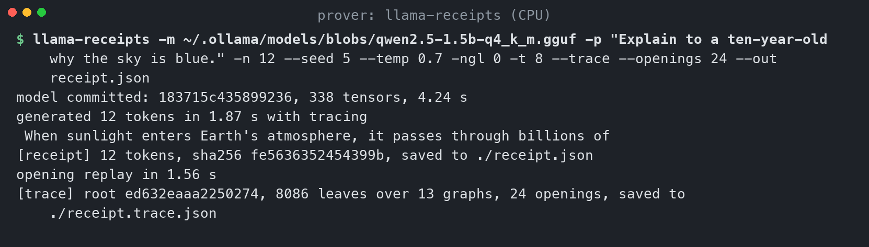
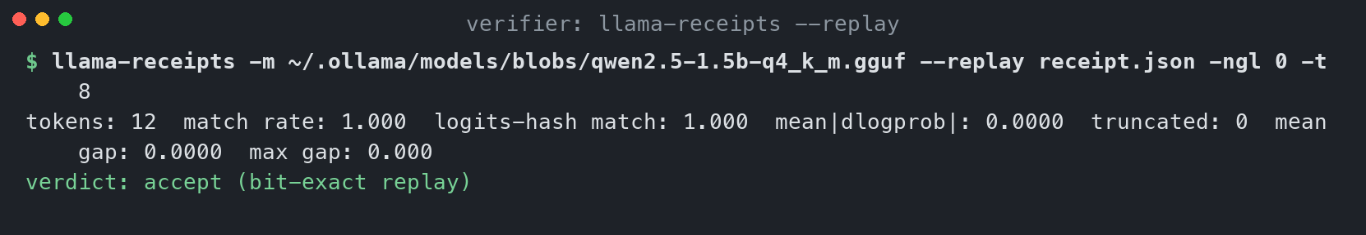
SCREENSHOTS
How it looks: proving with a trace, then replaying it
Top: the prover generates, hashes every tensor, writes the receipt, replays once for the openings and writes the trace. Bottom: replay verification on the same backend is bit-exact.
llama-receipts, Sep 11, 2026 9

Slide 10
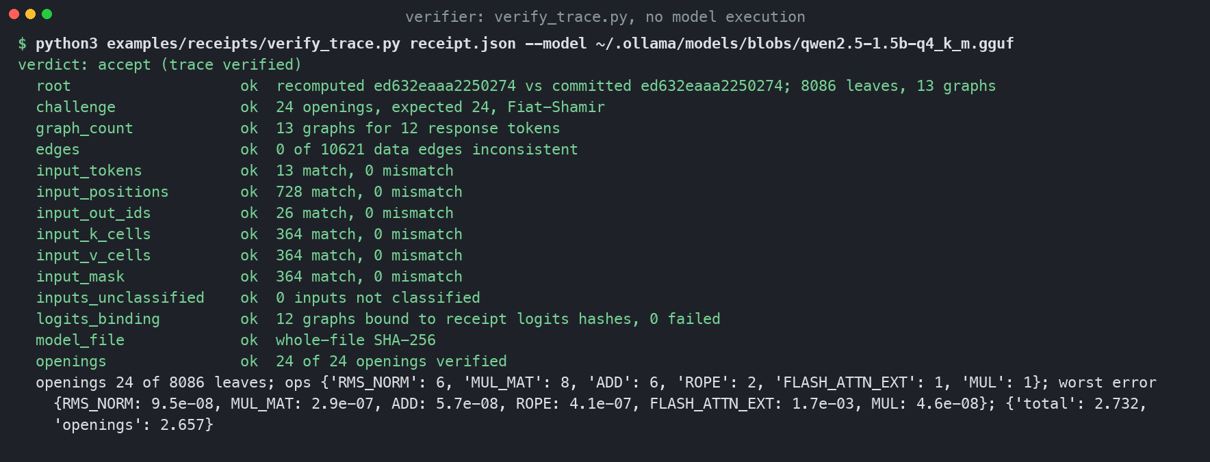
SCREENSHOTS
How it looks: verifying
The trace verifier: no model execution, fourteen checks, every one passing, 2.7 seconds on a laptop.
llama-receipts, Sep 11, 2026 10

Slide 11
FORMAL SPEC
The specification in Lean 4: readable, provable, runnable
Specified, as executable definitions:
  Byte-exact Q4_K, Q6_K and Q8_K block formats and the nibble order the kernels read.
  ggml's Q8_K activation quantization in Float32, step for step.
  The integer core s1, s2 and the Q6_K dot; the per-block float combination.
  Merkle tree, audit paths, Fiat-Shamir sample, canonical leaf bytes, edge and input checks. SHA-256 included.
Proved, without Mathlib or sorry:
  Every decoded bit field is in range. Every s1 is below 2^25 and every s2 below 2,048,256, so the M31 circuit never wraps.
  Roots and audit paths for one- and two-leaf trees. Sampled indices are valid and never repeat.
spec-check on a real CPU receipt | Result
Merkle root over 8,086 leaves | checked
Topology, content and 32-opening policy | checked
Data edges, 10,621 | checked
Token and position inputs, 13 and 728 | checked
Q8_K quants, scale bits, s1, s2, Q6_K dot | checked
Row value in Float vs float64 reference | checked
The checker recomputes a real trace in under half a second and agrees with the C++ prover exactly. Stated as the next target: the (1 - f)^k sampling bound.
llama-receipts, Sep 11, 2026 11
Notes:
Lean 4.33.1, lake build in seconds. Floating point is opaque to Lean's logic; the float parts are checked by differential testing.

Slide 12
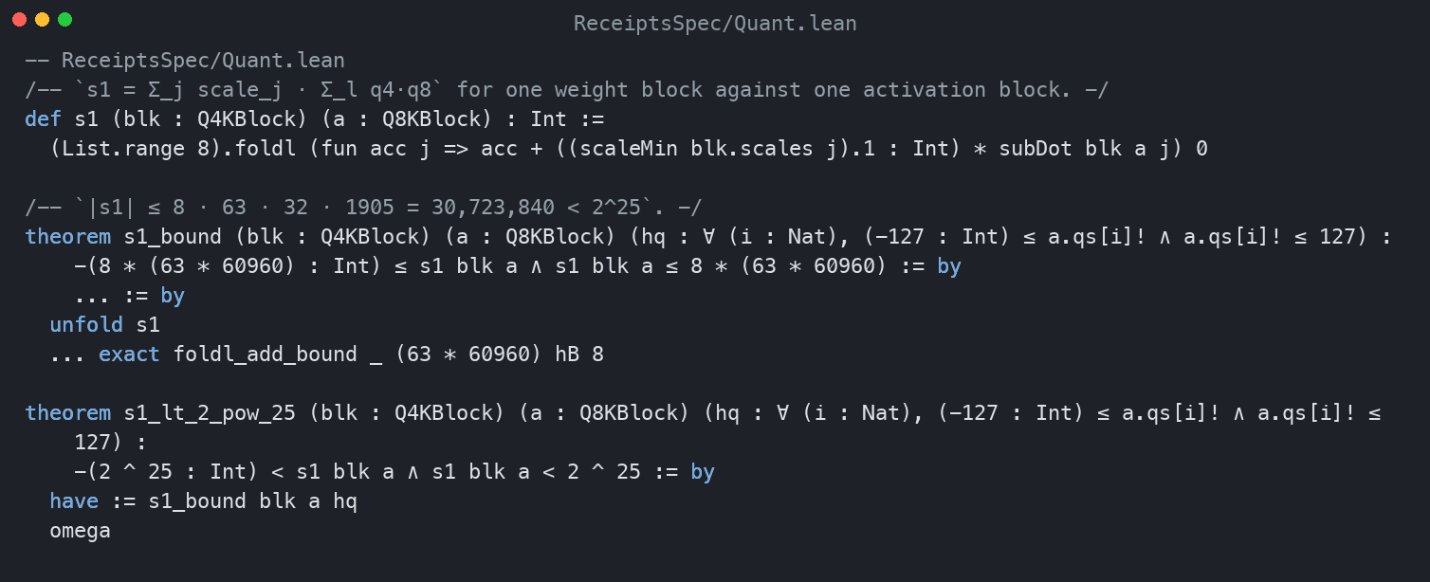
SCREENSHOTS
How it looks: the specification in Lean
The integer sum s1 as Lean defines it, and the machine-checked theorem that every s1 stays below 2^25 in magnitude, which is what lets the proof circuit use Mersenne-31 field arithmetic as plain integers.
llama-receipts, Sep 11, 2026 12

Slide 13
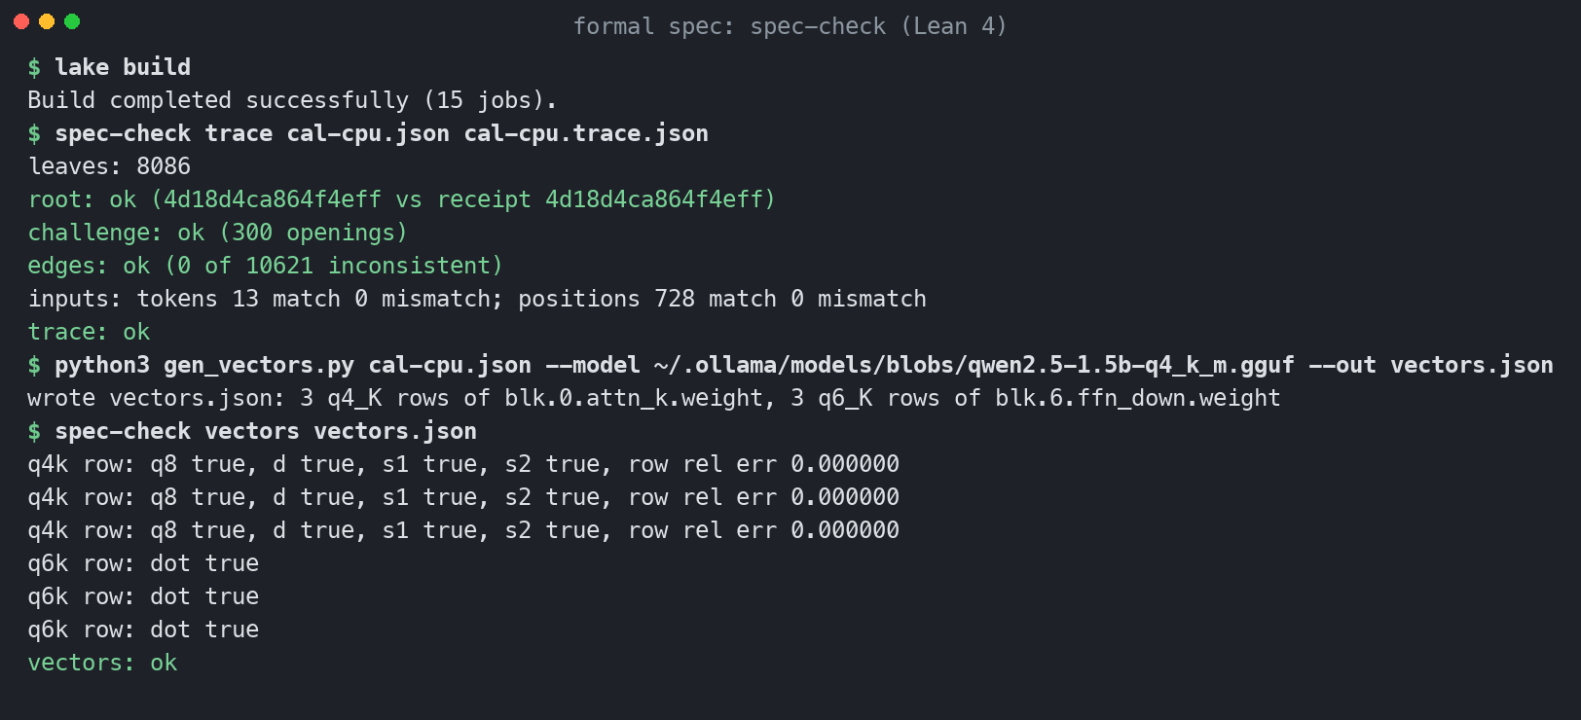
SCREENSHOTS
How it looks: the spec checked against a real trace
The Lean checker recomputes the root, the challenge, all edges and the token and position inputs of a real trace, then reproduces the Q8_K quants, scales, integer sums and row values on vectors from the GGUF.
llama-receipts, Sep 11, 2026 13

Slide 14
PROOF
An integrity proof of one node
opened node
weight bytes from the GGUF, activation bytes from the trace
witness
public: q4, scales, mins,
q8, s1, s2
GKR circuit, M31
s1 = Σ sc·Σ q4·q8
s2 = Σ bsums·mn
proof + public inputs
Expander GKR proof
verify proof
checks weights against its GGUF
float step
Σ d_a·(d·s1 − dmin·s2), compare to the opened output
Node | Public inputs | Compile | Prove | Proof | Verify | Float step | Tampered sum
Kcur-13, 256 x 1536 | 422,400 | 2.3 s | 0.19 s | 27.9 MB | 0.20 s | 2.0e-7 | reject
Invalid ranges | q4=16 / s1=p | - | blocked | - | reject | - | reject
llama-receipts, Sep 11, 2026 14
Notes:
One activation row from a CPU trace of qwen2.5 1.5B Q4_K_M, Apple M5. The Lean theorems s1_lt_2_pow_25 and s2_bound are what make M31 field arithmetic equal integer arithmetic here.

Slide 15
SCREENSHOTS
How it looks: proving one node
$ zk_node.py receipt.json --model model.gguf --index 916 --out zk-out
node: Kcur-13 = blk.13.attn_k.weight [1536 x 256]
statement: 422400 public inputs checked against the GGUF
float step relative error: 2.02e-07
compiled in 2.28s; witness solved in 0.03s
proved in 0.19s: proof 27852548 bytes
compile 2.31s, verify 0.200s: ACCEPT
tampered sum: REJECT
RESULT: proof verifies and public weights match the claimed model
A 256 by 1536 key projection: public proof inputs checked against the GGUF, proof produced in 0.19 seconds, tampered sum rejected, float step within 2e-7.
llama-receipts, Sep 11, 2026 15

Slide 16
CODE
Where it lives: one fork, three stacked pull requests
PR 2: receipts-lean-spec
spec/, Lean 4
ggml-org/llama.cpp master
PR 1: receipts-trace
llama-receipts, verify_trace.py
PR 3: receipts-zk-poc
zk/, Rust on Expander
Fork luiscosio/llama.cpp, level with upstream master. All three are drafts inside the fork. Expander is used through a fork with two small macOS build fixes.
llama-receipts -m model.gguf -p "..." -n 32 --trace --out receipt.json # prove
verify_trace.py receipt.json --model model.gguf --expected-topology-sha256 HASH # verify
spec-check trace receipt.json receipt.trace.json HASH # Lean
zk_node.py receipt.json --model model.gguf # one node
llama-receipts, Sep 11, 2026 16
Notes:
Draft PRs in the fork so the work is reviewable as a unit. Upstream submission is a separate step with its own process.

Slide 17
NEXT
From one node to a proof of the whole forward pass
Now
one matmul node, one row, GKR proof in seconds
Next
every matmul of a token; 16 rows or nodes per SIMD pack; cached circuits
Then
non-linear ops through lookups: RMS norm, RoPE, softmax, SwiGLU
Goal
one proof per token, weight commitment published once per model, verifier without the GGUF
The proof replaces re-execution of a node. Everything else in the receipt design stays: leaves, producers, Merkle root, Fiat-Shamir sample.
In Lean: the (1 - f)^k sampling bound with a probability model, general audit-path completeness, and a proof that the circuit computes the s1 and s2 the spec defines.
In llama.cpp: a deterministic-accumulation kernel variant so the exact-equality statement holds on CPU without a tolerance.
llama-receipts, Sep 11, 2026 17
Notes:
Open provers today reach minutes per token at 7B; the closed claim is tens of tokens per second at 31B. The point here is that the native arithmetic is provable at all, which was not established before.

