Slide 1
Inference receipts for llama.cpp
Signed receipts, a committed trace of every tensor, a verifier that never runs the model,
a formal specification in Lean, and a first integrity proof of the native arithmetic
Luis Cosio, SL5. Sep 13, 2026
github.com/luiscosio/llama.cpp, pull requests 1, 2 and 3
llama-receipts, Sep 13, 2026 1
Notes:
What exists as of Sep 13, 2026, how the pieces fit, and the path to zero-knowledge proofs of llama.cpp inference.

Slide 2
THE PROBLEM
You get tokens back and nothing else
When someone else runs a model for you, you cannot tell which model ran, at which quantization, on which prompt.
Re-running everything yourself works, but costs as much as the original run.
A zero-knowledge proof would settle it. None exists today for llama.cpp's native arithmetic.
So we built the ladder that leads there: a record of exactly what ran, cheap to check, and the pieces a proof system plugs into.
llama-receipts, Sep 13, 2026 2
Notes:
Framing for people outside the field. Everything after this slide is what exists in code.

Slide 3
OVERVIEW
What we built, in one picture
llama.cpp prover
generates, hashes every tensor, writes receipt and trace
Receipt + trace
tokens, sampler, model hashes, Merkle root, openings
Trace verifier
Python, numpy, no model run; pinned graph topology
Replay verifier
re-runs the model, seeded sampler, two-regime rule
Lean specification
formats, arithmetic, protocol; theorems; checker
GKR proof of a node
Expander, M31 field, weights bound to GGUF
The receipt is the contract. The trace verifier checks it without the model. The Lean spec says what the receipt means and checks the same artifact independently. The proof replaces re-execution of a node with a cryptographic check of its arithmetic.
llama-receipts, Sep 13, 2026 3
Notes:
Four programs and one document. Prover and replay verifier are C++ in llama.cpp; the trace verifier is Python; the spec is Lean 4; the proof is Rust on Expander.

Slide 4
RECEIPT
A receipt records exactly what ran
Model: SHA-256 of the GGUF file and of every tensor, plus a Merkle root over the tensors.
Request: prompt text and tokens, temperature, top-k, top-p, seed.
Response: tokens, and per position the log-prob, the uniform draw, its distance to the decision boundary, and a hash of the logits.
Commitment: SHA-256 over prompt and response tokens.
The sampler is replayable by construction:
u(t) = SHA-256("llama-receipts/u/v1/" || seed || t)
Ties break by token id. Top-k and top-p run in double precision. Anyone can reproduce the draw without RNG state, so a receipt shows how far each choice sat from the boundary, not only which token won.
llama-receipts, Sep 13, 2026 4
Notes:
Signing is left to the operator's key tooling; the README shows an openssl one-liner.

Slide 5
TRACE
Every computing node becomes a leaf that names its producers
token embedding
leaf
graph g, node i, name, op, op params
out: type, shape, strides, offset,
hash of the base tensor
srcs: weight: name, type, shape, GGUF hash
data: shape, offset, base hash,
producer = leaf that wrote it
(-1 graph input, -2 zeroed KV cache)
root
attention block
h(0x01||l||r)
h(0x01||l||r)
feed-forward block
leaf 0
leaf 1
leaf 2
leaf 3
logits
The root goes into the receipt. A second pass replays the same tokens, reproduces the root bit for bit, and captures the bytes of a Fiat-Shamir sample of nodes: the openings.
GGML graph, observed through cb_eval
Layout ops (reshape, view, permute) are resolved to what they view. Inputs are hashed over their whole base tensor, so the edge check is a string comparison.
llama-receipts, Sep 13, 2026 5
Notes:
23,000 leaves for a 32-token generation of a 1.5B model. Same-backend replay is deterministic once the KV cache starts zeroed.

Slide 6
VERIFIER
Trace verifier checks without model execution
Check | What it establishes | Needs tensor bytes
1. Root + content | Leaves, token arrays and displayed text match their commitments | no
2. Topology + challenge | Graph structure matches verifier policy; openings are unpredictable and meet its minimum | no
3. Structure | One graph per token, prefill included | no
4. Inputs | Token, position, row-selection, KV-cell and mask inputs hash to what the receipt claims | no
5. Edges | Every input equals its producer's output; the KV cache started as zeros | no
6. Logits binding | Each graph's logits hash equals the receipt's per-token logits hash | no
7. Openings | Path to root, bytes hash to the leaf, weights match the verifier's GGUF, numpy re-execution within tolerance | yes, for k nodes
llama-receipts, Sep 13, 2026 6
Notes:
Checks 1 to 6 are hash comparisons over about 23,000 small JSON objects. Only the openings touch tensor bytes, and there are k of them, 32 by default.

Slide 7
VERIFIER
Re-execution matches the kernel that ran
Matmuls are judged against three references and the closest one counts:
  f32: dequantized weight times float32 activation. Metal decode kernels.
  f16: both operands rounded to half. Metal prefill kernels.
  q8k: ggml's CPU path. Activation quantized to Q8_K, then an integer dot product with the 4-bit or 6-bit weight blocks and per-sub-block scales. Reproduced exactly.
The q8k path is the statement a proof system constrains, and it is what the Lean spec and the GKR circuit use.
Op | Metal | CPU | Limit
ADD, MUL, RMS_NORM, SWIGLU | 1e-7 | 1e-7 | 1e-5
ROPE | 4e-7 | 7e-7 | 5e-5
GET_ROWS, CONT, SET_ROWS | exact | exact | exact
MUL_MAT, decode | 4e-7 (f32) | 8e-7 (q8k) | 8e-3
MUL_MAT, prefill | 2.2e-3 (f16) | 1e-7 (q8k) | 8e-3
FLASH_ATTN_EXT | 1.9e-3 | 7.5e-3 | 2e-2
Normalized error, max|out - ref| / max|ref|, qwen2.5 1.5B Q4_K_M on an Apple M5, several hundred openings per backend.
llama-receipts, Sep 13, 2026 7
Notes:
Calibrated with the native llama.cpp tool on both backends.

Slide 8
RESULTS
Results with the native tool
Case | Verdict | What decided it
Honest, Metal, flash attention on | accept | all checks pass, worst matmul error 1.2e-3
Honest, CPU, 8 threads | accept | matmuls match the integer reference to 5e-7
Replay of the Metal receipt on Metal | accept | bit-exact, every logits hash matches
Replay of the Metal receipt on CPU | accept | drift regime, token match 0.75, largest draw gap 0.08
Q2_K model served, receipt claims Q4_K_M | reject | 8 of 8 sampled weight matmuls fail, errors 0.2 to 0.4
Honest receipt checked against the wrong file | reject | model file hash, then weight bindings
One response token edited, commitments refreshed | reject | challenge indices differ, token input mismatches
Interactive seed, wrong seed given to the verifier | reject | recorded seed is not the verifier's
Python prototype on the same kernels, 4 prompts, 32 tokens, 32 openings: 28 of 28 verdicts correct.
llama-receipts, Sep 13, 2026 8
Notes:
The Q2_K case forged the leaf metadata to claim Q4_K_M types; only the opened bytes betray it.

Slide 9
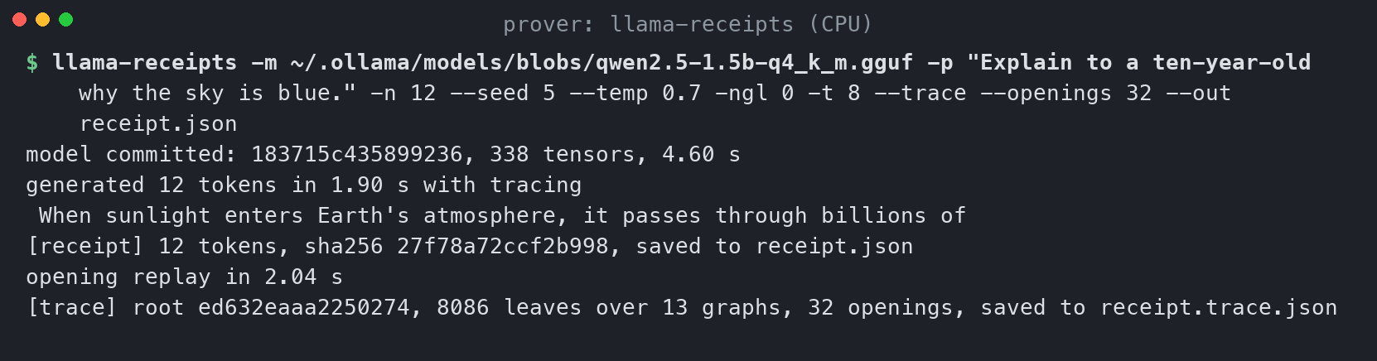
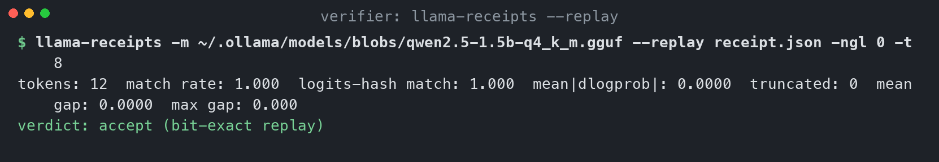
SCREENSHOTS
How it looks: proving with a trace, then replaying it
Top: the prover generates, hashes every tensor, writes the receipt, replays once for the openings and writes the trace. Bottom: replay verification on the same backend is bit-exact.
llama-receipts, Sep 13, 2026 9

Slide 10
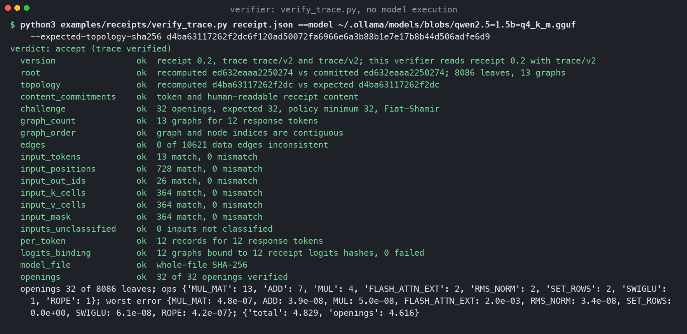
SCREENSHOTS
How it looks: verifying
The trace verifier: no model execution, nineteen checks, every one passing, about four seconds on a laptop.
llama-receipts, Sep 13, 2026 10

Slide 11
FORMAL SPEC
The specification in Lean 4: readable, provable, runnable
Specified, as executable definitions:
  Byte-exact Q4_K, Q6_K and Q8_K block formats and the nibble order the kernels read.
  ggml's Q8_K activation quantization in Float32, step for step.
  The integer core s1, s2 and the Q6_K dot; the per-block float combination.
  Merkle tree, audit paths, Fiat-Shamir sample, canonical leaf bytes, edge and input checks. SHA-256 included.
Proved, without Mathlib or sorry:
  Every decoded bit field is in range. Every s1 is below 2^25 and every s2 below 2,048,256, so the M31 circuit never wraps.
  Roots and audit paths for one- and two-leaf trees. Sampled indices are valid and never repeat.
spec-check on a real CPU receipt | Result
Merkle root over 8,086 leaves | checked
Pinned topology and content commitments | checked
Fiat-Shamir sample, 32 openings | checked
Data edges, 10,621 | checked
Token and position inputs, 13 and 728 | checked
Q8_K quants, scale bits, s1, s2, Q6_K dot | checked
Row value in Float vs float64 reference | checked
The checker recomputes a real trace in under half a second and agrees with the C++ prover exactly. Stated as the next target: the (1 - f)^k sampling bound.
llama-receipts, Sep 13, 2026 11
Notes:
Lean 4.33.1, lake build in seconds. Floating point is opaque to Lean's logic; the float parts are checked by differential testing.

Slide 12
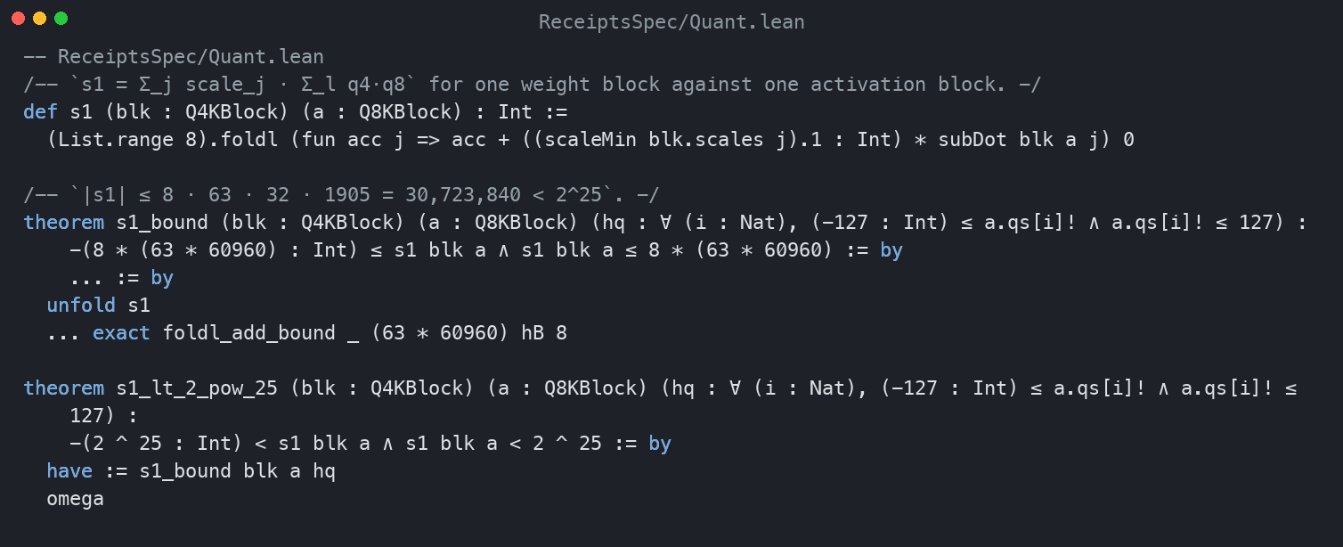
SCREENSHOTS
How it looks: the specification in Lean
The integer sum s1 as Lean defines it, and the machine-checked theorem that every s1 stays below 2^25 in magnitude, which is what lets the proof circuit use Mersenne-31 field arithmetic as plain integers.
llama-receipts, Sep 13, 2026 12

Slide 13
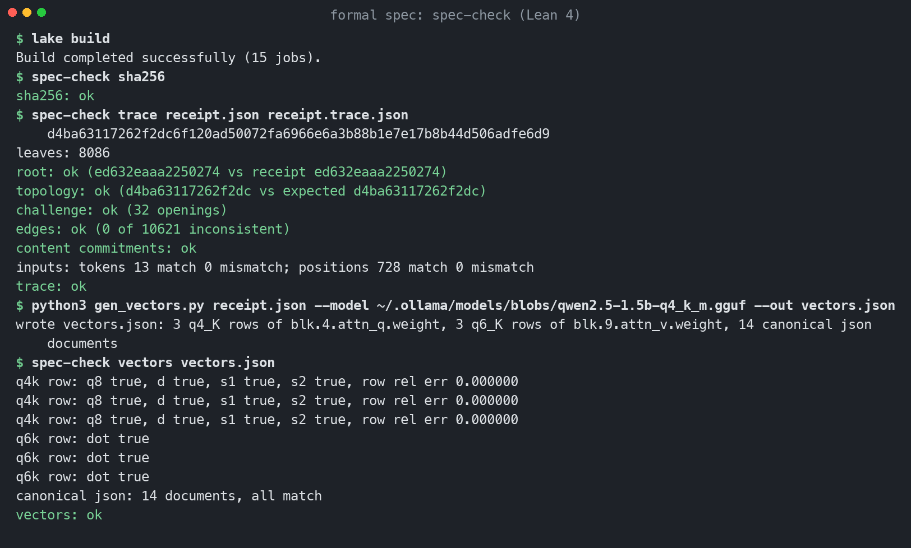
SCREENSHOTS
How it looks: the spec checked against a real trace
The Lean checker recomputes the root, the topology digest, the content commitments, the challenge, all edges and the token and position inputs of a real trace, then reproduces the Q8_K quants, scales, integer sums, row values and canonical JSON bytes on vectors from the GGUF and from Python.
llama-receipts, Sep 13, 2026 13

Slide 14
PROOF
Proofs of one node: integrity with Expander, zero knowledge with Groth16
opened node
weight bytes from the GGUF, activation bytes from the trace
witness
private: q4, scales, mins, under a registered commitment
public: q8, s1, s2
GKR circuit, M31
s1 = Σ sc·Σ q4·q8
s2 = Σ bsums·mn
proof + commitment
the proof opens with the commitment to the private weights
verify proof
holds no weights; compares the proof's commitment with the registered one
float step
Σ d_a·(d·s1 − dmin·s2), compare to the opened output
Prover | Node | Private inputs | Register | Prove | Proof | Verify | Zero knowledge
Expander GKR, M31 | Vcur-22, 256 x 1536, whole node | 417,792 | 2.0 s | 0.28 s | 6.5 MB | 0.04 s | no: binding only
Groth16, BN254 | Vcur-22, 16 groups of 16 rows | 26,112 per group | Poseidon, 0.1 s | 3 s per group | 805 B per group | 0.16 s per group | yes
llama-receipts, Sep 13, 2026 14
Notes:
One activation row from a CPU trace of qwen2.5 1.5B Q4_K_M, Apple M5, Sep 13, 2026. The registered commitment is Orion's root over the private input layer, computed from the GGUF alone. Not zero-knowledge yet: the commitment binds but does not hide, and the GKR has no masking. The Lean theorems s1_lt_2_pow_25 and s2_bound are what make M31 field arithmetic equal integer arithmetic here.

Slide 15
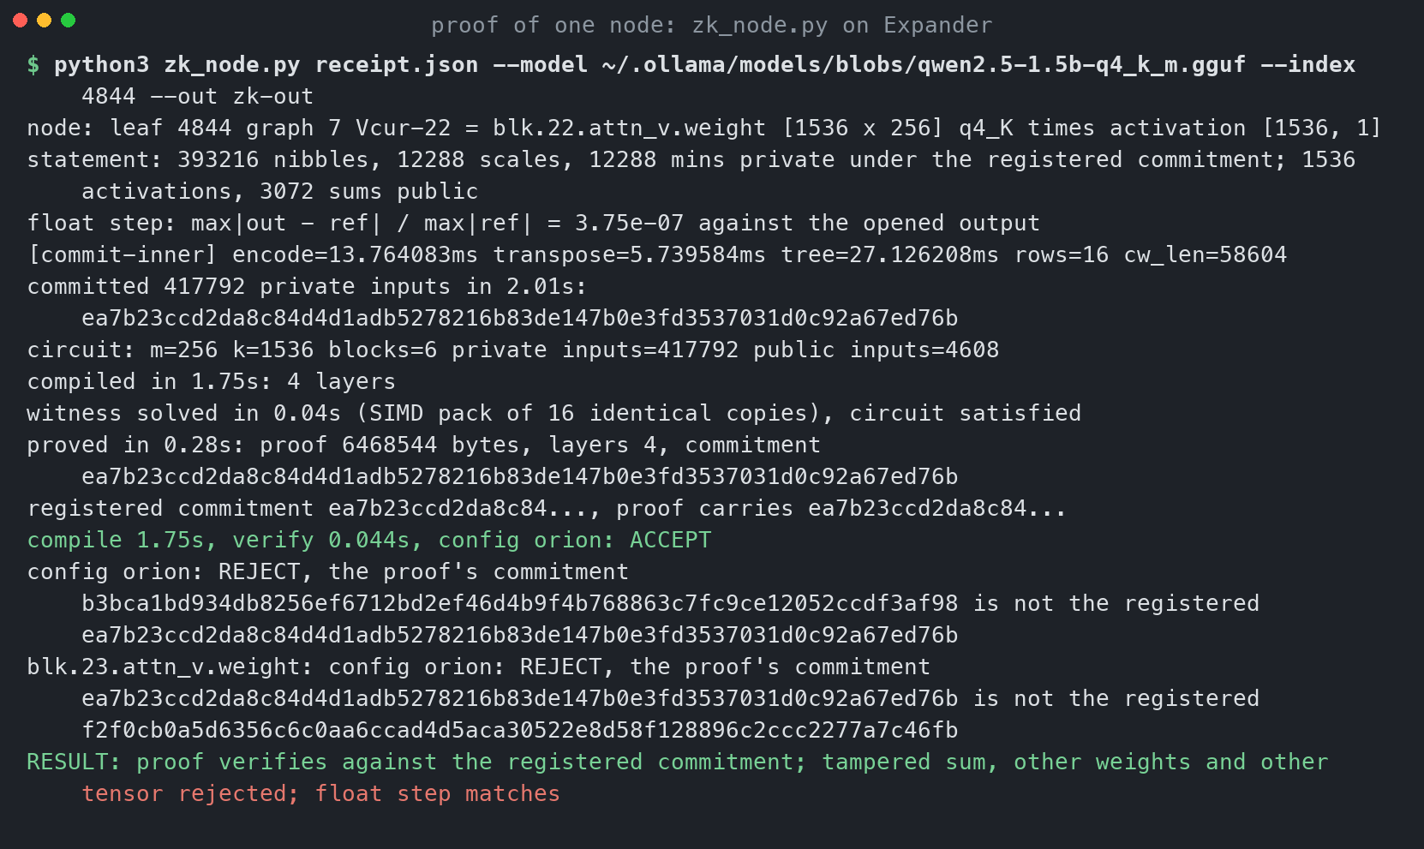
SCREENSHOTS
How it looks: proving one node
A 256 by 1536 value projection: the commitment registered from the GGUF, a proof carrying the same commitment, verification without weights in 0.04 seconds, three negative cases rejected, float step within 4e-7.
llama-receipts, Sep 13, 2026 15

Slide 16
CODE
Where it lives: one fork, three stacked pull requests
PR 2: receipts-lean-spec
spec/, Lean 4
ggml-org/llama.cpp master
PR 1: receipts-trace
llama-receipts, verify_trace.py
PR 3: receipts-zk-poc
zk/, Rust on Expander
Fork luiscosio/llama.cpp, level with upstream master. All three are drafts inside the fork. Expander is used through a fork with two small macOS build fixes.
llama-receipts -m model.gguf -p "..." -n 32 --seed 42 --trace --out receipt.json # prove, trace
python3 verify_trace.py receipt.json --model model.gguf --expected-topology-sha256 HASH # verify
lake build && spec-check trace receipt.json receipt.trace.json HASH # Lean checker
python3 zk_node.py receipt.json --model model.gguf # prove one node
llama-receipts, Sep 13, 2026 16
Notes:
Draft PRs in the fork so the work is reviewable as a unit. Upstream submission is a separate step with its own process.

Slide 17
NEXT
From one node to a proof of the whole forward pass
Stage 1, done
statement frozen, backend decided, budgets set, circuit checked against the Lean spec, weights bound to a registered commitment
Stage 2, done
registration manifest: digests, tensor table, tokenizer, execution spec, Orion and Poseidon commitments; Qwen3-0.6B registered
Stage 3, done
zero-knowledge proof of one node with Groth16: private weights under a Poseidon commitment, 805-byte proofs, verified in a browser
Stages 4 to 6
fixed-point mode: 20 of 20 tokens agree; isolation and adversarial tests run; registry and verify page live as a preview. Not built: the whole-token prover
Plan and records: PLAN.md and TODO.md, docs/stage1 to stage5. First model: Qwen3-0.6B requantized to Q4_K_M, every matmul a multiple of the 256-block.
A whole token is 322 million weight nibbles: 1.6 billion R1CS constraints, or 320 million multiplications with lookups. Per-node Groth16 cannot scale to it; a GKR with lookups and masking can.
Next: port the fixed-point mode into llama.cpp's kernels, add masking or aggregation on the GKR side, replace the proof-of-concept setup with ceremony parameters.
llama-receipts, Sep 13, 2026 17
Notes:
Open provers today reach minutes per token at 7B; the closed claim is tens of tokens per second at 31B. The point here is that the native arithmetic is provable at all, which was not established before.

