Slide 1
μInference: SL5 Weight Enclave
SPAR Lightning Talk

Slide 2
Why We Care About SL5?
Frontier models are high‑value national‑security targets.
Security Level 5 (SL5) aims to withstand top‑tier nation‑state attacks, not just normal cybercrime.
Weight Enclaves isolate model weights on air‑gapped networks with minimal software and strict allow‑by‑exception execution.

Slide 3
Phase 1: μInference v0 – Security by Radical Simplification
Initial question:
What is the smallest useful inference stack for SL5‑class environments?
Approach:
Microkernel/unikernel/near‑bare‑metal designs with tiny kernels and minimal libc.
Measured compiled LOC and reachable dependencies rather than repository size.
Result:
Showed we can remove large parts of conventional ML infrastructure while keeping inference working.

Slide 4
Phase 2: SL5 Evolves
SL5 work from the ecosystem added guidance and architecture choices:
Weight Enclaves inside an air‑gapped SL5 network, with low‑bandwidth boundaries.
Machine security: accelerators as independent security domains with attestation and memory isolation.
Stronger supply‑chain and adversarial‑data controls.
We responded by upgrading μInference from “just minimization” to an actual Weight Enclave prototype.

Slide 5
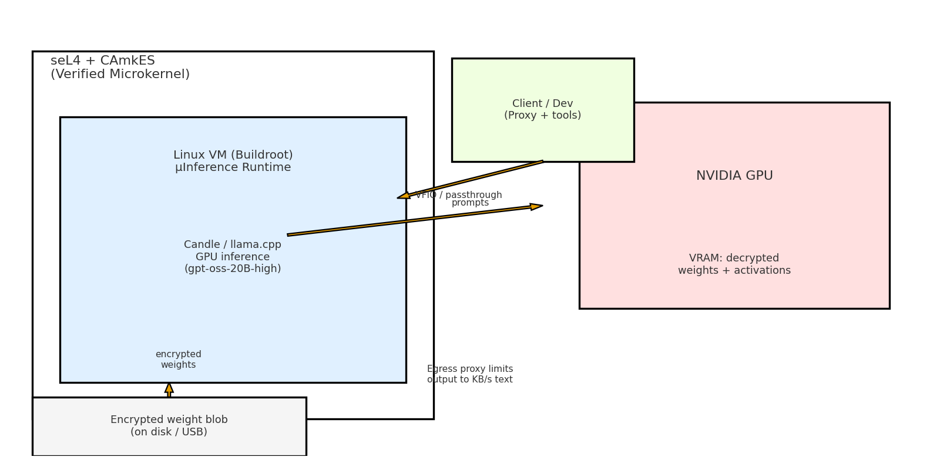
Phase 3: seL4‑Backed Weight Enclave (Today)

Slide 6
Formal Methods & Memory Safety Path
se4l: fully formally verified OS kernel used as our isolation anchor.
CAmkES VM: runs a small Buildroot Linux image hosting μInference.
Inference engines: PyTorch/Transformers (Python); we treat Python as our target for safety‑critical paths.
We align with SL5’s recommendation to refactor or rewrite critical C into safer languages and eventually formally verify the critical few components.
DARPA’s TRACTOR program reinforces this direction: automatically translating legacy C into high‑quality Python to eliminate entire classes of memory‑safety bugs.

Slide 7
The GPU Challenge
SL5’s machine‑security picture wants accelerators as independent security domains with device‑controlled memory and strong isolation.
Today: NVIDIA’s GPU stack expects a big Linux driver environment. Buildroot Linux cannot yet drive the GPU directly.
Workaround: host a Buildroot Linux VM inside seL4 and pass the GPU through to the VM.
Downside: this inflates the trusted computing base – we have to trust the guest kernel + driver stack for GPU access.
Future work: push for Buildroot Linux‑aware GPU drivers and stronger GPU confidential‑compute features that match SL5, so we can remove the guest OS from the weight‑touching ring.

Slide 8
What We Measured & Why It Matters
LOC & dependency shrink: μInference stack vs a normal gpt‑oss‑20B(high) GPU container.
Service surface: nmap + socket listings to show muinference exposes a single narrow RPC channel.
Basic fuzzing of the RPC protocol to test robustness.
Bandwidth‑limited egress proxy: text‑speed only (KB/s) – exfiltrating multi‑GB or TB‑scale weights would take decades to centuries.
Takeaway: smaller, more isolated stacks give us a path to SL5‑style Weight Enclaves that are actually implementable on today’s hardware.

Slide 9
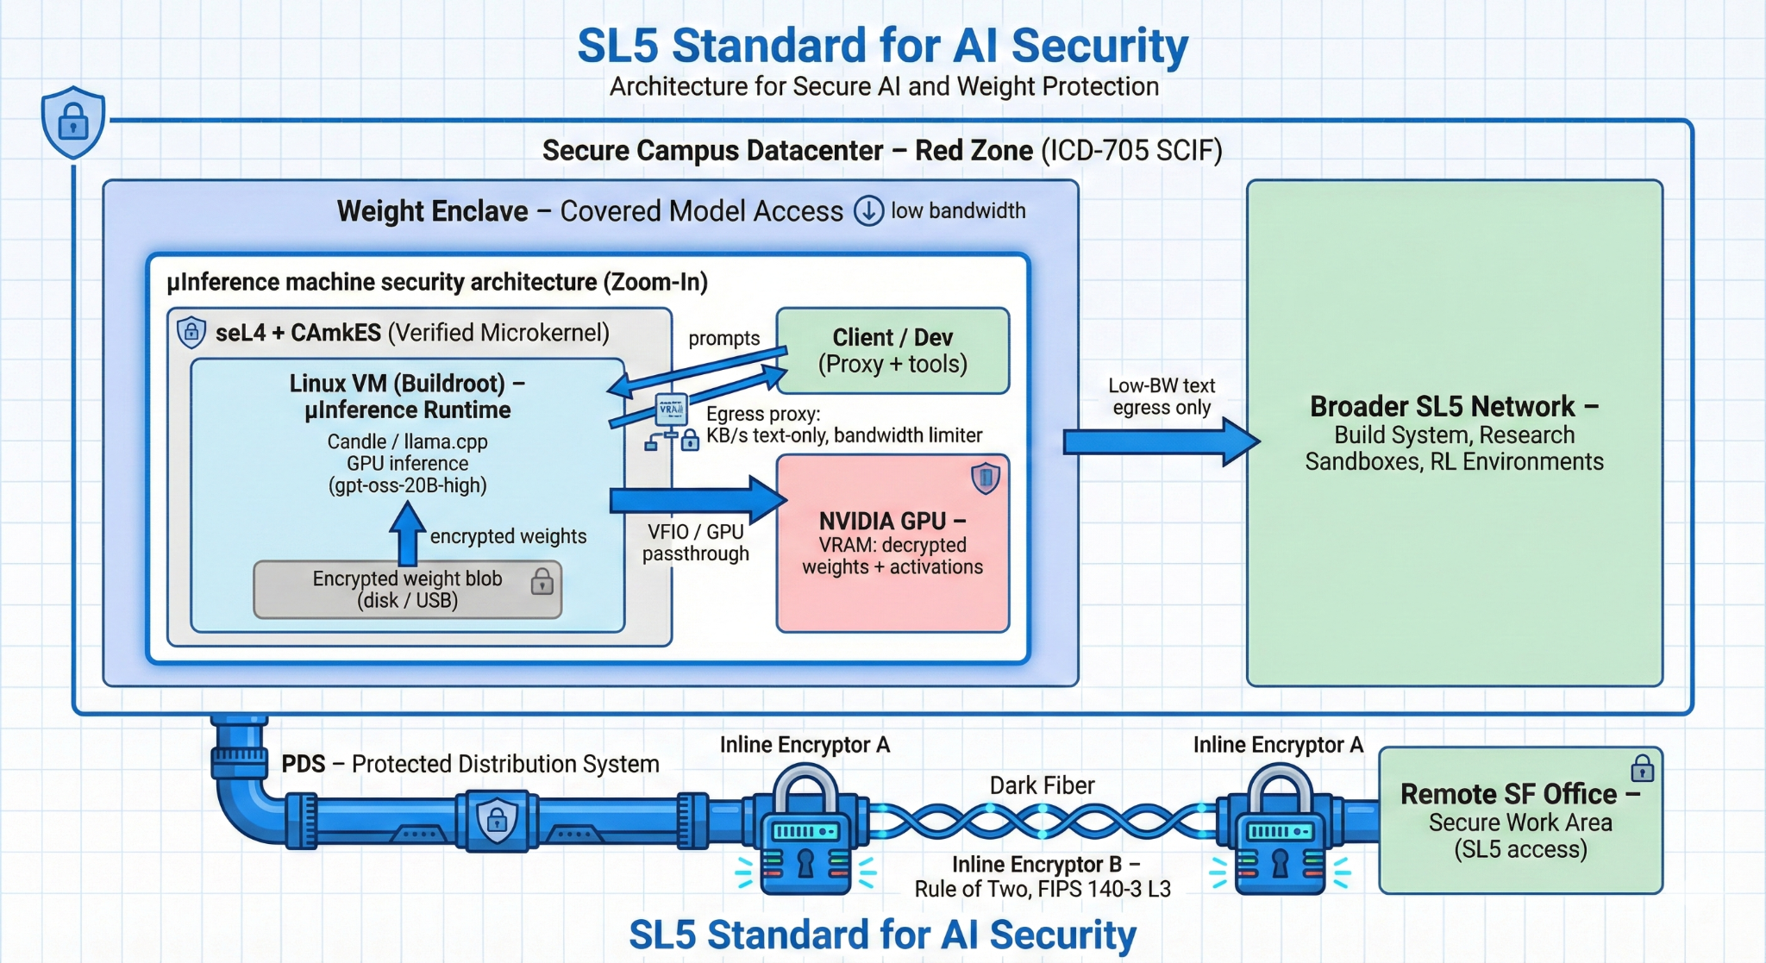
How does all this fit together?

Slide 10
What’s Next?
Tighten the μInference TCB further: more Python, fewer moving parts near weights.
Explore formal verification and AI‑assisted hardening for the most critical code paths.
Goal: when labs need SL5, they can plug in a working reference design instead of starting from scratch.

Slide 11
QA

