Slide 1
μInference: Research platform for a micro inference server for SL5
A Software Supply Chain Initiative for SL5 Security

Slide 2
What is the smallest stack we can build?
From bootloader to inference in minimal lines of code
Do we need to sacrifice functionality?

Slide 3
Current Inference Stack Complexity
Traditional ML Infrastructure Stack
┌─────────────────────────────────┐ │ Application Layer │ ├─────────────────────────────────┤ │ ML Frameworks (PyTorch, TF) │ ├─────────────────────────────────┤ │ CUDA/ROCm/GPU Drivers │ ├─────────────────────────────────┤ │ Container Runtime │ ├─────────────────────────────────┤ │ Kubernetes/Orchestration │ ├─────────────────────────────────┤ │ Linux Kernel (full) │ ├─────────────────────────────────┤ │ Bootloader (GRUB) │ └─────────────────────────────────┘
Total Estimate: Hundreds of millions of lines of code + firmware

Slide 4
μInference Stack
Our minimal implementation
┌─────────────────────────────────┐ │ Inference (llama2.c) │ This is just 4,000 LOC ├─────────────────────────────────┤ │ Init System (custom) │ ├─────────────────────────────────┤ │ Userspace (BusyBox) │ ├─────────────────────────────────┤ │ libc (musl) │ Without external dependencies, 1,000 LOC ├─────────────────────────────────┤ │ Linux Kernel (minimal) │ ├─────────────────────────────────┤ │ Bootloader (Limine) │ └─────────────────────────────────┘

Slide 5
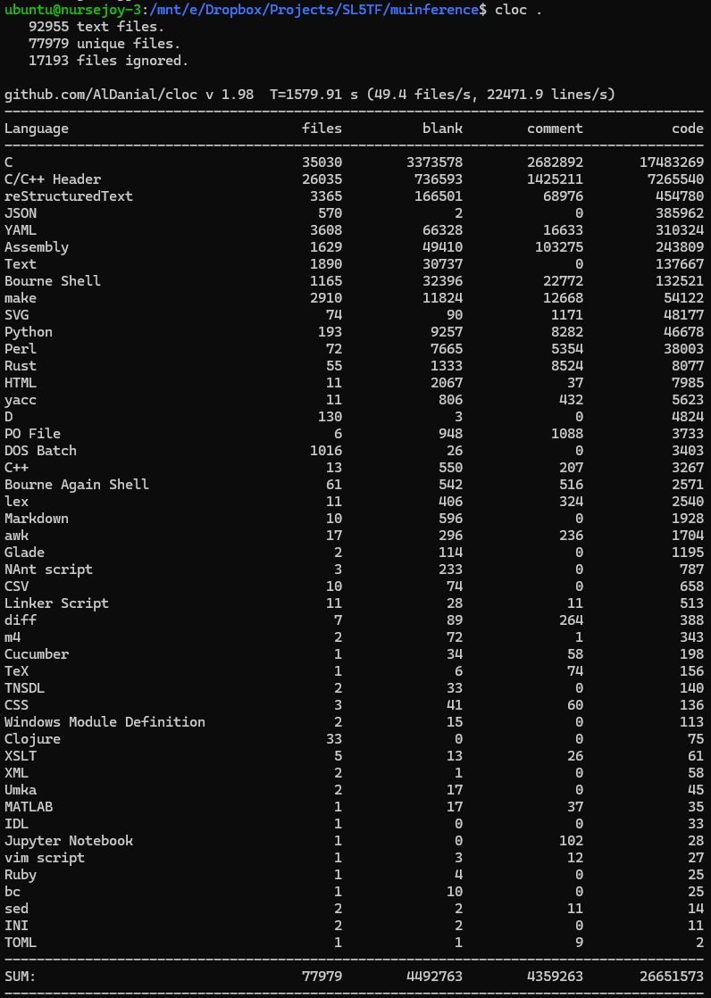

Slide 6
What Actually Ships vs Source Code
Our minimal implementation
┌─────────────────────────────────┐ │ Inference (llama2.c) │ This is just 4,000 LOC ├─────────────────────────────────┤ │ Init System (custom) │ ├─────────────────────────────────┤ │ Userspace (BusyBox) │ ├─────────────────────────────────┤ │ libc (musl) │ Source Repository Total: 27M LOC
Compiled/Used Code: 1.1M LOC
Efficiency: 96% code eliminated ├─────────────────────────────────┤ │ Linux Kernel (minimal) │ ├─────────────────────────────────┤ │ Bootloader (Limine) │ └─────────────────────────────────┘

Slide 7
What we removed from the kernel?
Network stack
Filesystems (except tmpfs)
All drivers except essential for IO

Slide 8
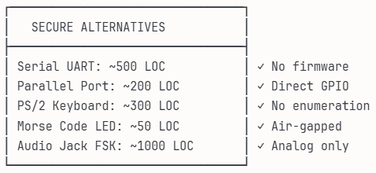
And there is plenty of options for SL5 IO

Slide 9
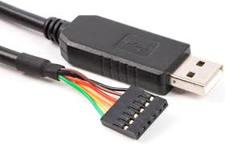

Slide 10
Why Limine?
Modern UEFI/BIOS support
Minimal configuration
Fast boot times
No unnecessary features

Slide 11
Why musl + BusyBox?
musl libc
10x smaller than glibc
Static linking friendly
Clean, modern C implementation
No legacy baggage
BusyBox
300+ Unix utilities in one binary
Configurable feature set
1MB static binary
Replaces coreutils, util-linux, etc.

Slide 12
Why llama2.c?
Complete inference in 4,000 lines
Pure C implementation (and easily portable to Rust with LLMs!)
Transformer architecture
BPE tokenizer
Temperature sampling
Top-p sampling
No dependencies
Runs models efficiently

Slide 13
Achieved Metrics
Metric | Value
ISO Size | ~50MB
Boot Time | <1 seconds
RAM Usage | 512MB
Inference Speed | ~444 tokens/sec in consumer hardware
μInference by the Numbers

Slide 14
Reduction Ratios
Order of magnitude smaller than typical ML stack
Order of magnitude fewer dependencies
99% less attack surface

Slide 15
How Much Smaller Can We Go?
Phase 1:
Custom minimal kernel config
Remove more subsystems
[…]
Phase ?:
No OS, just bootloader + inference
Direct hardware control

Slide 16
But there is also Scaling Up
llama.cpp Integration
4-bit quantization support
GPU acceleration
~50K additional LOC
10-100x performance gain
GPU Stack

Slide 17
Security Through Minimalism
Attack Surface Reduction
99% less code = 99% fewer bugs
No network stack = no remote exploits (There is plenty of alternative IO) options)
No filesystem = no persistence
Read-only system = immutable

Slide 18
Where Minimal Inference Matters
Air-gapped systems
High-security facilities
Research sandboxes

Slide 19
What This Could Prove
Frontier labs don’t require millions of LOC
Core inference is surprisingly simple
Complexity is in the ecosystem
Security through simplicity is achievable
Small enough to audit
But there is also Scaling Up

Slide 20
Research Directions
Immediate:
Add llama.cpp backend
Implement secure boot
Medium-term:
Deliberate Hardware stack
Long-term:
???

