Slide 1
μInference: Research platform for a micro inference server for SL5
SL5 Security Task Force

Slide 2
What is the smallest stack we can build?
From bootloader to inference in minimal lines of code
How does it look like for inference?
How does it look like for training?

Slide 3
Current Inference Stack Complexity
Traditional ML Infrastructure Stack
┌─────────────────────────────────┐ │ Application Layer │ ├─────────────────────────────────┤ │ ML Frameworks (PyTorch, TF) │ ├─────────────────────────────────┤ │ CUDA/ROCm/GPU Drivers │ ├─────────────────────────────────┤ │ Container Runtime │ ├─────────────────────────────────┤ │ Kubernetes/Orchestration │ ├─────────────────────────────────┤ │ Linux Kernel (full) │ ├─────────────────────────────────┤ │ Bootloader (GRUB) │ └─────────────────────────────────┘
Total Estimate: Hundreds of millions of lines of code + firmware

Slide 4
μInference Stack
Our minimal implementation
┌─────────────────────────────────┐ │ Inference (llama2.c) │ This is just 4,000 LOC ├─────────────────────────────────┤ │ Init System (custom) │ ├─────────────────────────────────┤ │ Userspace (BusyBox) │ ├─────────────────────────────────┤ │ libc (musl) │ Without external dependencies, 1,000 LOC ├─────────────────────────────────┤ │ Linux Kernel (minimal) │ ├─────────────────────────────────┤ │ Bootloader (Limine) │ └─────────────────────────────────┘

Slide 5
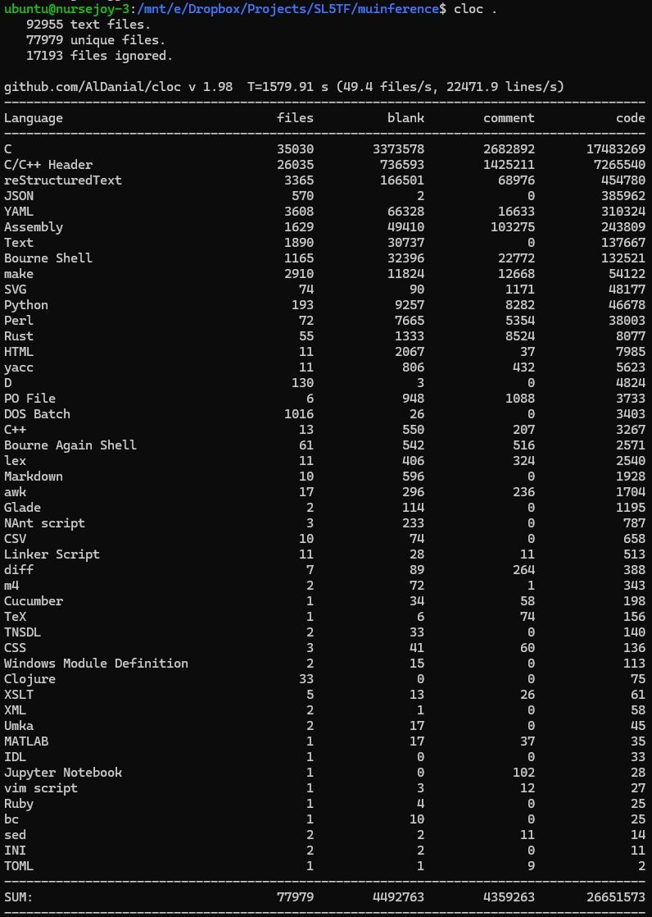

Slide 6
What we removed from the kernel?
Network stack
Filesystems (except tmpfs)
All drivers except essential for IO

Slide 7
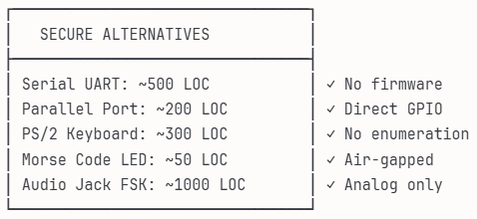
And there is plenty of options for SL5 IO

Slide 8
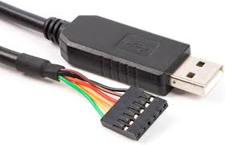

Slide 9
Why Limine?
Modern UEFI/BIOS support
Minimal configuration
Fast boot times
No unnecessary features

Slide 10
Why musl + BusyBox?
musl libc (100K LOC)
10x smaller than glibc
Static linking friendly
Clean, modern C implementation
No legacy baggage
BusyBox (200K LOC)
300+ Unix utilities in one binary
Configurable feature set
1MB static binary
Replaces coreutils, util-linux, etc.

Slide 11
Why llama2.c?
Complete inference in 4,000 lines
Pure C implementation (and easily portable to Rust with LLMs!)
Transformer architecture
BPE tokenizer
Temperature sampling
Top-p sampling
No dependencies
Runs models efficiently

Slide 12
Achieved Metrics
Metric | Value
Total LOC | ~27M
ISO Size | ~50MB
Boot Time | <1 seconds
RAM Usage | 512MB
Inference Speed | ~444 tokens/sec in consumer hardware
μInference by the Numbers

Slide 13
Reduction Ratios
Order of magnitude smaller than typical Linux distro
Order of magnitude fewer dependencies
99% less attack surface

Slide 14
How Much Smaller Can We Go?
Phase 1:
Kernel Diet (Target: 500K LOC)
Custom minimal kernel config
Remove more subsystems
Compile-time optimization
Phase 2:
Formal verification (small enough, see seL4)
Phase 3:
Bare Metal (Target: 10K LOC)
No OS, just bootloader + inference
Custom memory management
Direct hardware control

Slide 15
But there is also Scaling Up
llama.cpp Integration
4-bit quantization support
GPU acceleration (Vulkan)
~50K additional LOC
10-100x performance gain
GPU Stack

Slide 16
Security Through Minimalism
Attack Surface Reduction
99% less code = 99% fewer bugs
No network stack = no remote exploits (There is plenty of alternative IO options)
No filesystem = no persistence
Read-only system = immutable
Security Features Possible
Measured boot with TPM
Memory encryption
Secure enclave execution
Formal verification (small enough, see seL4)

Slide 17
Where Minimal Inference Matters
Air-gapped systems
High-security facilities
Compliance-heavy industries
Research sandboxes

Slide 18
What This Could Prove
Frontier labs don’t require millions of LOC
Core inference is surprisingly simple
Complexity is in the ecosystem
Security through simplicity is achievable
Small enough to audit
Small enough to formally verify
Edge ML is practical today
Runs on minimal hardware
No cloud dependency

Slide 19
Research Directions
Immediate:
Add llama.cpp backend
Implement secure boot
Medium-term:
Unikernel design
Deliberate Hardware stack
Formal verification
Long-term:
???

