Slide 1
Requirements, Functional, Logical, Physical (RFLP)

Slide 2

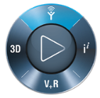
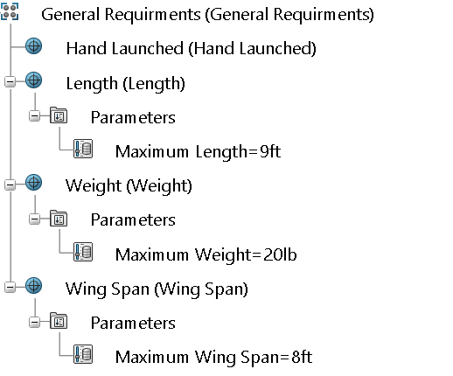

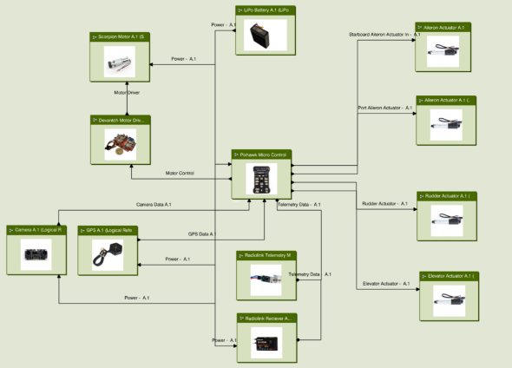


Collaboration Tasks
RFLP
EID Structure/
CAD Model
MID/
Process Plan
Implementing a Change
Include EID
Document Requirements
Specifications
Requirements
Create Functional Architecture
Create Logical Architecture
Functional & Logical Design

Slide 3
RFLP Overview
R
F
L
P
RFLP is a collaborative engineering methodology that enables requirements for a customer’s product to be captured, managed, and tracked in a single point of access, allowing for full traceability.
It allows data to be shared across the specific discipline, allowing for better traceability and change impact analysis on the entire system.
RFLP enables individuals or teams responsible for the overall design of an end-product to have visibility on the subcomponents that make up the entire system.
The concept of RFLP is tied back to processes defined in the Systems Engineering discipline.
REQUIREMENTS
FUNCTIONAL
LOGICAL
PHYSICAL
Traceability is the ability to identify the relationship between different stages of the development process of a product’s feature.

Slide 4
What Is RFLP
RFLP is a Systems Engineering process that uses a structured approach to integrate all disciplines in moving from NEEDS to PRODUCT.
Representative of the Architecture Definition and Decomposition Curve of the V model.
Data shared across the specific discipline, allowing for better traceability, visibility and change impact analysis on the entire system.
Product
(Virtual or Real)
Needs
Systems Engineering
Requirements Management
Validation & Qualification
R
Functional Analysis
Verification
F
Logical Architecture Definition
Integration
L
Physical
P
Solution

Slide 5
RFLP Definitions
Each segment of the RFLP process represents different types of data necessary to define the product.
Requirements = Describes the customer’s requirements
Functional = Describes what the system does (functionality)
Logical = Describes what the system is (equipment, parts, interfaces)
Physical = Describes a solution of the system (virtual or real link to the business activity)
Consider an example of how a calculator design can be broken down:
R
System shall
have numbers
Add Numbers
Functional Breakdown Structure
Logical Breakdown Structure
Logical Breakdown Structure
F
a
Get Numbers
Number Pad
Number Pad
Function
Y=a+b
Y
b
Memorize
Processor
Memory Card
L
Keyboard
Make Addition
Memory Chip
LCD Flat Screen
Processor
Memory
Display
Display Result
Calculator Housing
P
Screen
PN100
PN1021
…
PN102
PN103
PN1031
R
F
PN1032
L
P

Slide 6

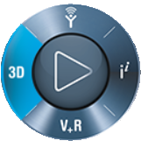

RFLP in the 3DEXPERIENCE Platform
Within the 3DEXPERIENCE Platform, the RFLP process is tracked and managed in two applications:
ENOVIA Traceable Requirement Management (TRM)
Create and manage requirements
Create Traceability matrix between RFLP components
CATIA Functional & Logical Design
Create and manage requirements, functional, and logical components
Create Traceability matrix between RFLP components
Requirements
Functional & Logical Design
Note: In this course, we will primarily work with the Functional & Logical Design app.

Slide 7
Document Requirements

Slide 8

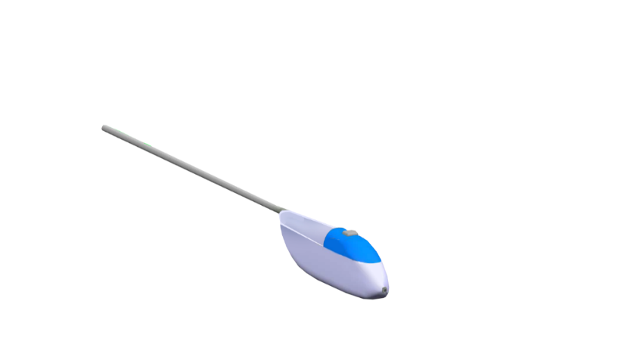
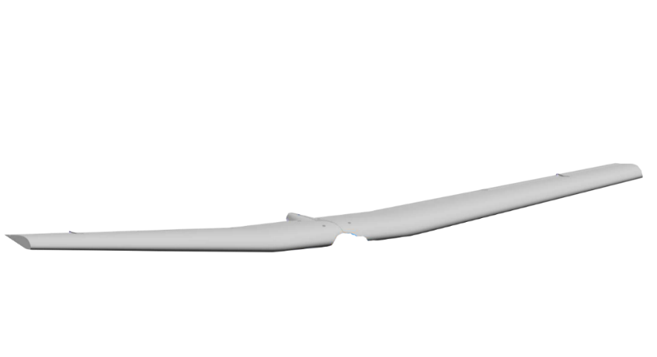

Document Requirements
Documenting requirements helps to manage changes in products as per the customer requirements.
In addition to documenting customer requirements, the following tasks can be accomplished:
Plan according to proposed requirements.
Generate Traceability Reports related to requirements and their specifications.
Configure requirements to reduce development costs and optimize project schedules.

Slide 9
Scenario Walkthrough
Step 1
Step 2
Promote Document Requirements task to In Work state.
Import existing Survey Done Specification folder (named: Survey Drone).
Step 3
Create new requirement specification.
Step 5
Step 4
Promote Document Requirements task to Complete state.
Populate requirement specification with all needed requirements.

Slide 10
Document Requirements

Slide 11
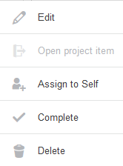



Document Requirements
Click on the Task Menu icon for the Document Fuselage Requirements task.
Click Edit.
Modify the Maturity of the task and promote it to In Work.
Click Save.
2
1
3
4

Slide 12
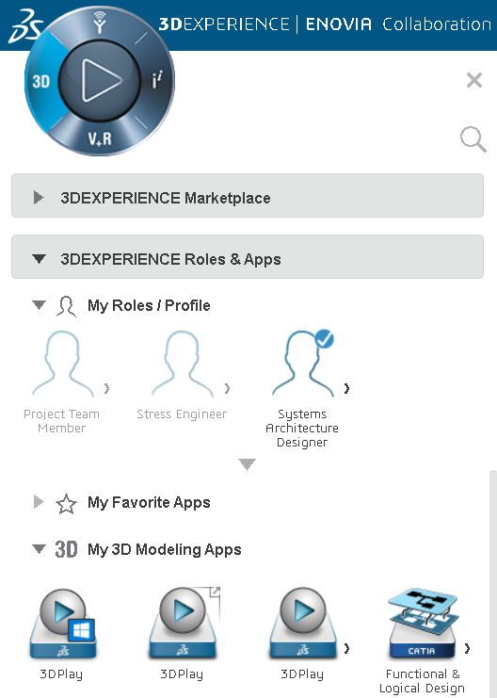
Document Requirements (Cont.)
Click My 3D Modeling Apps.
Select the Functional & Logical Design app.
5
Note: The Systems Architecture Designer role is needed to access the Functional and Logical Design app.
6

Slide 13
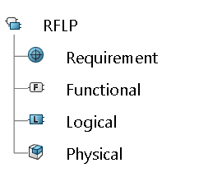
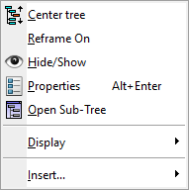
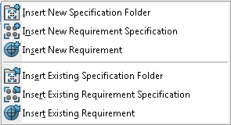
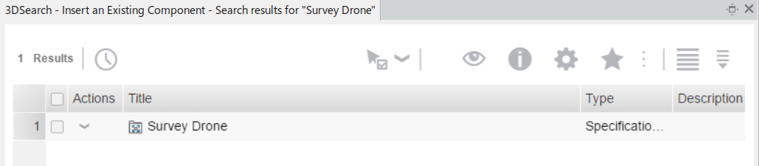

Document Requirements (Cont.)
In the RFLP tree, right-click on the Requirement node of the tree and select Insert → Insert Existing Specification Folder.
Search for [Survey Drone] in the Search Bar.
Select the Survey Drone specification folder that appears in the Search results window.
7
9
8

Slide 14
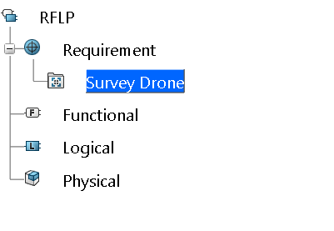
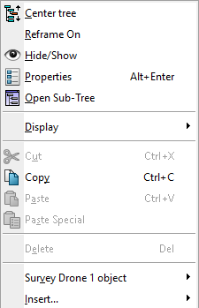
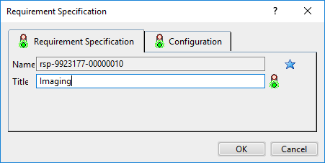
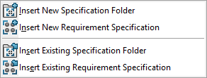

Document Requirements (Cont.)
In the tree, right-click on the Survey Drone Specification Folder and select Insert → Insert New Requirement Specification.
In the Title field enter [Imaging].
Click OK.
10
12
11
Make sure “Set attributes at creation for all types” is set so that you can change the Title.

Slide 15
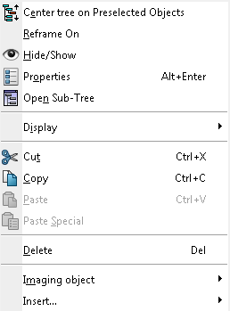
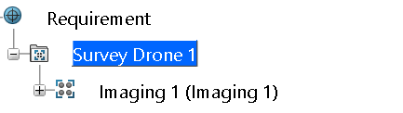
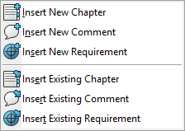
Document Requirements (Cont.)
​‌Right-click on the Imaging requirement specification node and select Insert → Insert New Requirement.
13

Slide 16
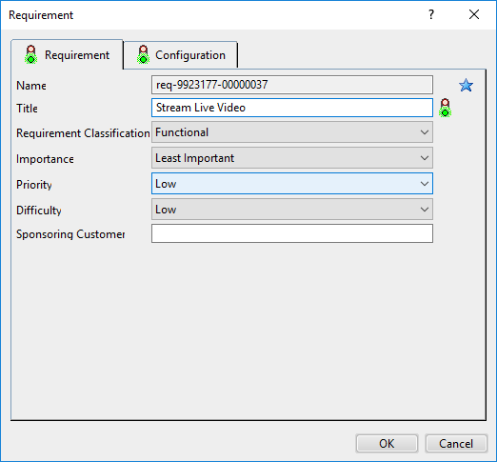
Document Requirements (Cont.)
In the Title field, enter [Stream Live Video].
Adjust the other parameters, as shown.
Click OK.
14
15
16

Slide 17
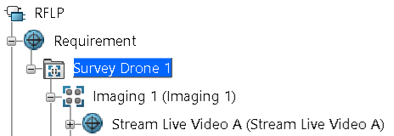
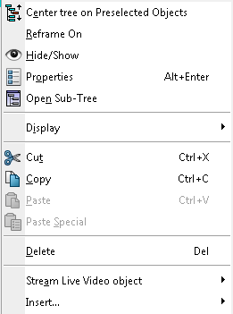
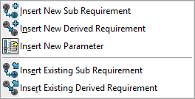
Document Requirements (Cont.)
​‌Right-click on the Stream Live Video requirement node and select Insert → Insert New Parameter.
17

Slide 18
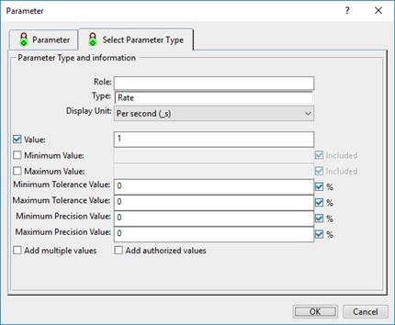
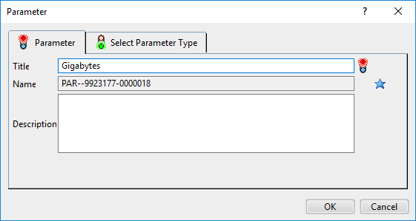
Document Requirements (Cont.)
In the Title field, enter [Gigabytes]
Switch to the Select Parameter Type tab.
Set the Type field to Rate.
Set the Display Unit to Per second (_s) .
In the Value field type [1].
Click OK.
19
20
21
22
18
23

