Slide 1

DA Assign2-Routing Algorithm for Ocean Shipping and Urban Deliveries
Group 6_4:
-Luis Filipe Pinto Cunha
-Pedro Miguel Martins Romão
-Inês Martin Soares
Notes:
<number>

Slide 2




In this programming project, the goal is to tackle the challenging problem of finding optimal routes for vehicles in various shipping and delivery scenarios, ranging from urban deliveries to ocean shipping. This problem is commonly referred to as the Traveling Salesperson Problem (TSP). The TSP is known to be an intractable problem, meaning that there are no known efficient algorithms to solve it optimally for large instances.
Introduction
Friday, June 2, 2023
DA Assign2-Routing Algorithm for Ocean Shipping and Urban Deliveries
1
Notes:
<number>

Slide 3
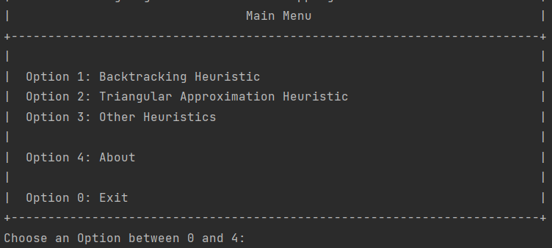
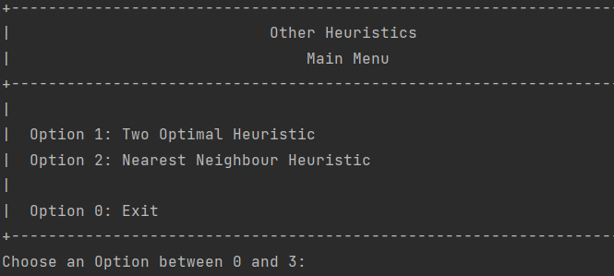
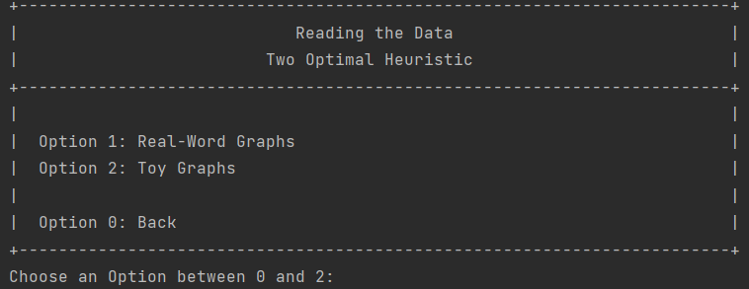
Functionalities
All requested features have been implemented!
-Menu
-Backtracking Algorithm
-Triangular Approximation Heuristic(Christofides)
-Two Optimal Heuristic
-Nearest Neighbor Heuristic
Friday, June 2, 2023
DA Assign2-Routing Algorithm for Ocean Shipping and Urban Deliveries
<number>

Slide 4
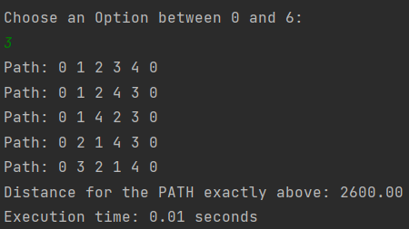
Backtracking Algorithm
Time Complexity: O(n!)
n is the number of nodes
Space Complexity: O(n)
Requires storing the current path and the
visited status of each node during the
recursion
Backtracking is a general algorithmic technique used to systematically explore all possible solutions to a problem by incrementally building a solution candidate and backtracking when a dead end is reached.
File: tourism.csv
2
4
0
1
3
Friday, June 2, 2023
DA Assign2-Routing Algorithm for Ocean Shipping and Urban Deliveries
3

Slide 5
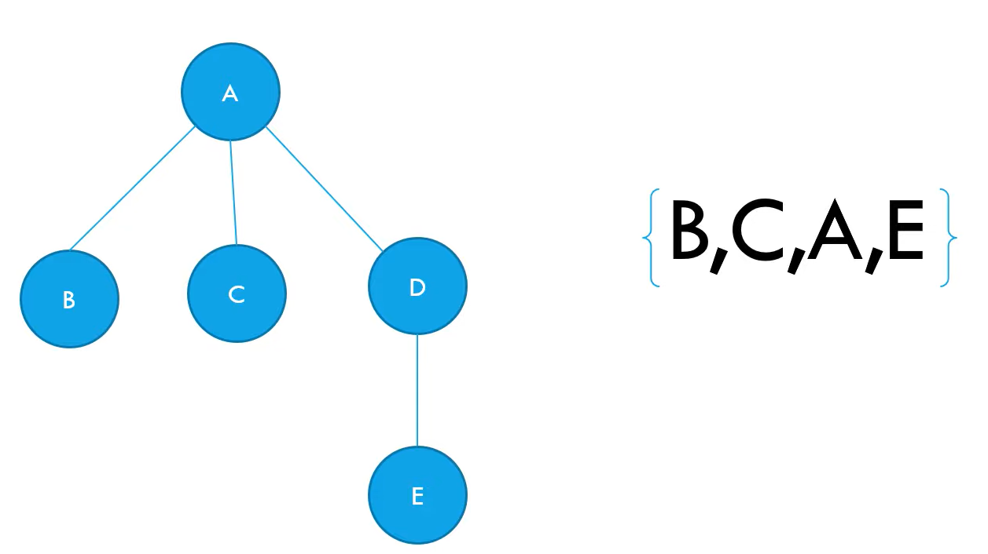
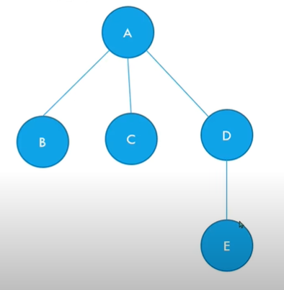
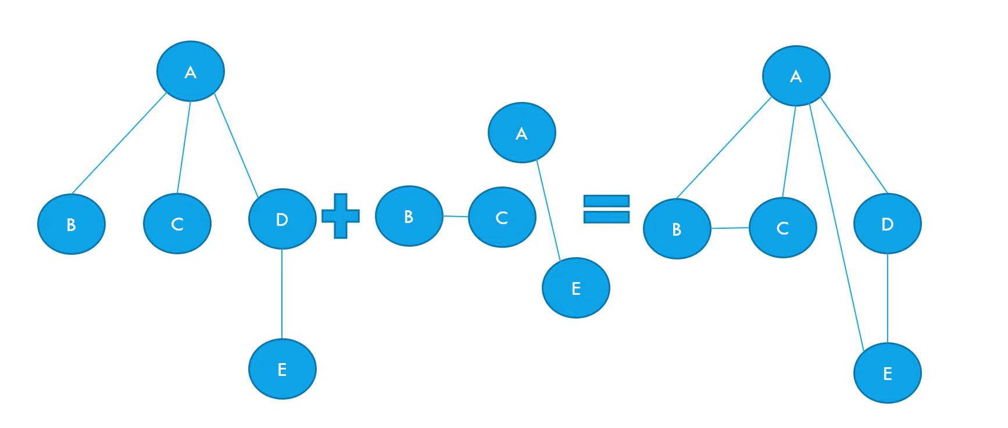
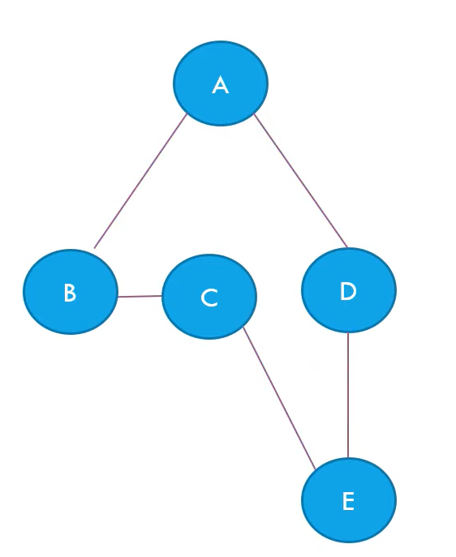
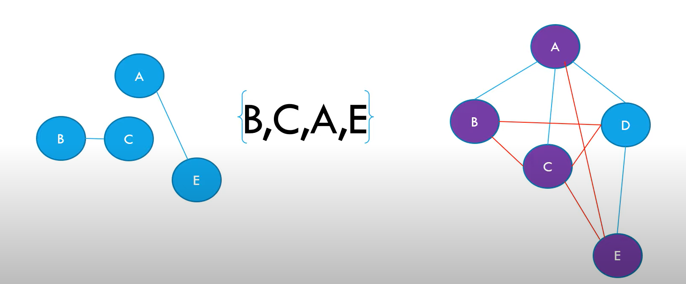
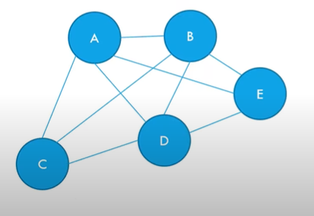
Critophides:
Create a minimum Spanning Tree
Time Complexity: O(n^2)
n is the number of nodes
Space Complexity: O(n^2)
Requires storing the current path and the visited status
Make a Set of Vertices that have an odd degree
Find a Minimum-Cost, Perfect Matching
Combine Perfect Match to minimum Spanning Tree
Shortcut by removing all repeated Vertices
Critophides is an approach used to approximate the solution of the Traveling Salesman Problem (TSP) (3/2).
The process is such:
Friday, June 2, 2023
DA Assign2-Routing Algorithm for Ocean Shipping and Urban Deliveries
3

Slide 6
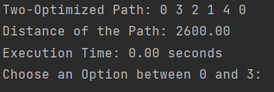
Two Optimal Heuristic
Time Complexity: O(n^2*k*(n-k))
n is the number of nodes
k is the number of iterations or swaps
Space Complexity: O(n)
Requires storing the current path and the visited status
The Two-Optimal Heuristic is an iterative improvement algorithm used to refine an initial solution to the Traveling Salesman Problem (TSP). It operates by iteratively removing two edges from the current tour and reconnecting them in a different way, aiming to reduce the total distance traveled.
File: tourism.csv
2
1
0
4
3
Friday, June 2, 2023
DA Assign2-Routing Algorithm for Ocean Shipping and Urban Deliveries
3

Slide 7
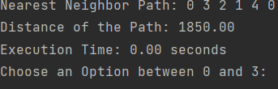
Nearest neighbor Heuristic
Time Complexity: O(n^2)
n is the number of nodes
Space Complexity: O(n)
Requires storing the current path and the visited status
The Nearest Neighbor algorithm is a simple and efficient heuristic approach used to find an approximate solution for the Traveling Salesman Problem (TSP). It starts with an arbitrary node and repeatedly selects the nearest unvisited node as the next node to visit. This process continues until all nodes are visited, forming a tour.
File: tourism.csv
4
1
0
2
3
Tuesday, February 2, 20XX
Sample Footer Text
3

Slide 8
Conclusions
The Backtracking algorithm guarantees an optimal solution by exhaustively exploring all possible permutations of nodes, but its time complexity grows more than exponentially with the number of nodes, making it impractical for large problem instances. However, it serves as a benchmark for evaluating the performance of other heuristics.
The Two-Optimal algorithm, based on local search, iteratively improves an initial solution by swapping pairs of edges to reduce the total tour distance. It provides good solutions for moderate-sized instances, making it more efficient than Backtracking.
Tuesday, February 2, 20XX
Sample Footer Text
3

Slide 9
Conclusions
The Nearest Neighbor heuristic is a simple and fast algorithm that constructs a tour by iteratively selecting the nearest unvisited city. While it can produce suboptimal solutions, it has a time complexity of O(n^2) and performs well on certain TSP instances, particularly for smaller problem sizes.
Christofides provides a 1,5 approximation of the optimal solution and has a time complexity of O(n^3), making it more efficient and reliable for larger problem instances.
Tuesday, February 2, 20XX
Sample Footer Text
<number>

