Slide 1
Squad Delivery Performance
Turning Jira, ServiceNow & Clarity data into a delivery decision tool
Jira → ServiceNow → Clarity → Snowflake → SQL → Tableau
Luis A. Delgado — Data Analyst / Tableau Developer
Synthetic data — portfolio demonstration
Notes:
Open: this is an end-to-end analytics solution, not just a dashboard. The stack mirrors the role: Jira/ServiceNow/Clarity into Snowflake, SQL transforms, Tableau on top.

Slide 2
The business question
“Our dev teams are shipping a lot, but I can’t tell which squads are actually fast versus just busy. I want to see how long work really takes, where it gets stuck, and whether quality is holding as we push volume — tied to the projects that matter. I don’t want a vanity chart.”
— VP, Auto Underwriting
My job: turn a loosely-defined ask into defined metrics and a built answer — no spec.
How fast?
Where stuck?
Quality holding?
What matters?
Cycle time, Staging → Done
Time-in-status (bottleneck)
Rework % + post-release incidents
Tie to priority projects
USAA Squad Delivery Performance • Analytics readout
2

Slide 3
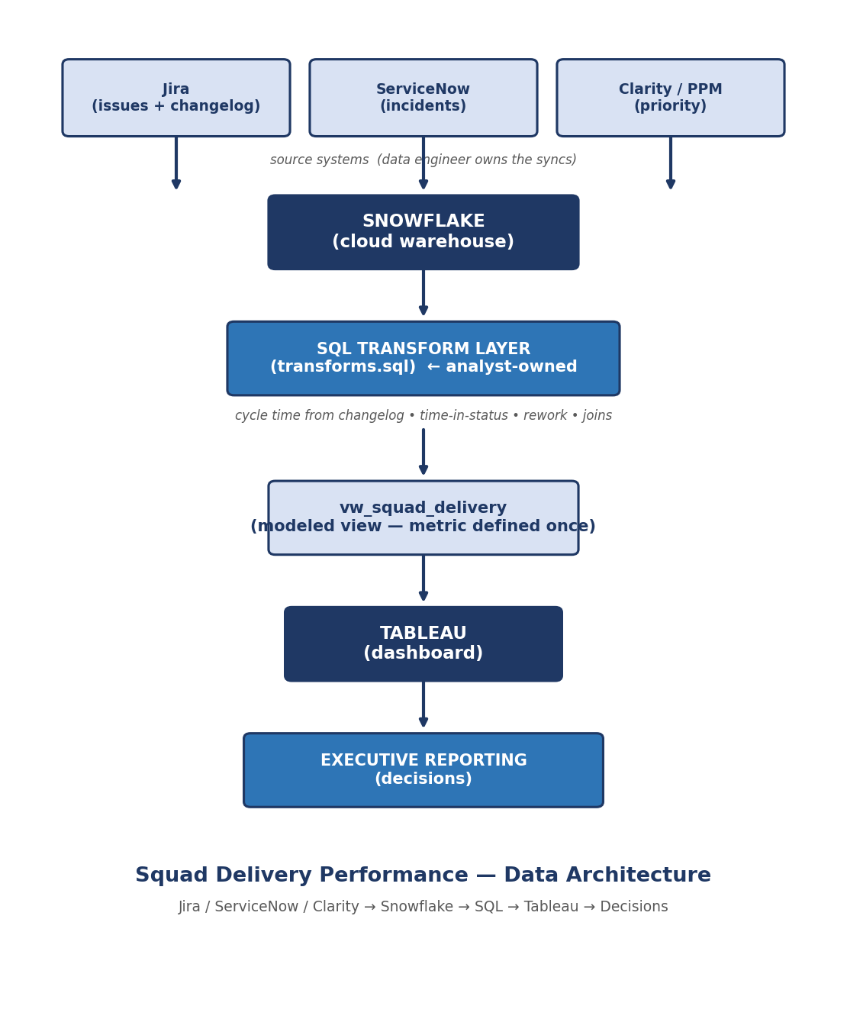
How it's built — end to end
Source systems
Jira issues + changelog, ServiceNow incidents, Clarity priority. The data engineer owns the syncs.
My layer
SQL transforms in Snowflake: derive cycle time from the changelog, time-in-status, rework, joins.
Modeled view
vw_squad_delivery — the metric defined once, so every report agrees.
Tableau + readout
The dashboard and the decisions on top.
USAA Squad Delivery Performance • Analytics readout
3

Slide 4
The key insight
Cycle time does not live in the issue table.
It is derived from the status-transition history in the changelog.
WITH transitions AS (
SELECT issue_key,
MIN(CASE WHEN to_status='Staging' THEN changed_at END) AS started_at,
MIN(CASE WHEN to_status='Done' THEN changed_at END) AS done_at
FROM jira_changelog WHERE field='status' GROUP BY issue_key)
SELECT issue_key, DATEDIFF('hour', started_at, done_at) AS cycle_time_hours
FROM transitions WHERE done_at IS NOT NULL; -- exclude never-completed
Created→Resolved would overstate it — tickets sit in backlog before work starts. Starting at Staging measures handling time, not queue time.
USAA Squad Delivery Performance • Analytics readout
4
Notes:
The senior tell: cycle time lives in the changelog, not the issue table. If they push on SQL, walk the CASE/MIN conditional aggregation and why never-completed tickets are excluded.

Slide 5
What the data shows
44.9 hrs
22.9%
132
17
Avg cycle time
Rework rate
Tickets completed
Post-release incidents
Finding 1 — Review is the bottleneck, not coding
Work waits ~29 hrs in review vs ~6 in active work — about 82% of active workflow delay.
Recommendation: add reviewer capacity or set review SLAs before adding engineering headcount.
USAA Squad Delivery Performance • Analytics readout
5

Slide 6
Finding 2 — Mobile Banking is the slowest squad
Delivery Health Scorecard
Squad | Cycle | Rework | Health
Mobile Banking | 61.1 | 14.0% | ●
Auto Quote | 37.9 | 30.4% | ●
Claims Portal | 37.8 | 23.5% | ●
The slowest squad is working primarily non-priority work — so an all-projects average understates delivery on the work leadership cares about.
Recommendation: root-cause Mobile Banking review queues; report priority and non-priority separately.
USAA Squad Delivery Performance • Analytics readout
6
Notes:
Scorecard shows decisions, not just data. Note Mobile Banking is non-priority, which is why the all-up number misleads.

Slide 7
Finding 3 — Pushing volume reduced quality
In the one sprint output surged (Sprint 45, completions ~doubled), rework topped 60% and post-release incidents spiked from near zero.
Every other sprint held steady — the dip tracks the volume push, not the team.
Recommendation: set a rework ceiling as a quality guardrail before scaling sprint capacity. Hold a sustainable pace.
Rework % by sprint:
S43
0%
S44
0%
S45
63%
S46
22%
S47
50%
S48
11%
Auto Quote, by sprint — Sprint 45 volume push (13 completed) coincides with the 63% rework spike
USAA Squad Delivery Performance • Analytics readout
7

Slide 8
Priority work is protected
On the projects leadership flagged as priority, cycle time is ~38 hrs vs ~61 hrs on non-priority work. Teams are already guarding the work that matters — the headline number hides it.
This directly answers the “no vanity chart” concern: the priority filter changes the story.
USAA Squad Delivery Performance • Analytics readout
8

Slide 9
From data to decisions
Fix the constraint
Review capacity is the bottleneck — address it before adding engineers.
Protect quality
Hold a sustainable pace; guardrail rework before scaling volume.
Report what matters
Separate priority from non-priority so the number reflects focus.
The value isn’t the query or the model — it’s translating outputs into decisions.
Luis A. Delgado — Jira / ServiceNow / Snowflake / SQL / Tableau
Notes:
Close on the churn-engine philosophy: value is translating outputs into decisions.

