Slide 1

HCI - Assignment nº2
Design and prototyping of an application using a human-centered approach
Final presentation and demo
Project Title: PCReplay, website
Group: Luís Diogo, 108668
Gonçalo Monteiro, 107758
João Rodrigues, 103947
Lab Class: P7
HCI 2020-2021

Slide 2

Introduction
PCReplay
O PCReplay its a website that facilitates the buying and selling of used computers with transparency and specialized support.
It stands out for its detailed qualitative evaluation, direct communication between buyers and sellers, and reliable technical assistance, making it a safe and complete service.
HCI 2020-2021
‹#›
Notes:
These first slides are a recap of the first presentation and should be presented without much detail

Slide 3

Project Objectives
PCReplay
High-level Goals
Create a transparent and trustworthy platform for buying and selling used laptops or computers
Provide detailed product evaluations and expert technical support
Enable secure and convenient transactions and direct buyer-seller communication
Expected Outcomes
A user-friendly website with comprehensive product information, accurate pricing through various methods and reliable logistics for product safety
Benefits
Increase of user trust and satisfaction, streamlined sales process for buyers and sellers and secure and safe online marketplace
HCI 2020-2021
‹#›

Slide 4

Personas - Mary, the busy seller
Profession: Consultant in a marketing company
Set: Mary’s a busy person with few free time, has two kids and prefers practicality and efficiency in her transactions
Motivations and goals: Needs to sell her computer in a fast and simple way, without having to bother with dealing directly with the buyer.
Needs: She may feel overwhelmed with her daily responsibilities and may not have time to dedicate to searching for selling prices
Name: Mary Stinson
Gender: Female
Age: 35 years
Birthplace: Porto
HCI 2020-2021
‹#›

Slide 5

Personas - John, the experienced buyer
Profession: Software developer
Set: John is single and lives in a flat in the city, loves tech and gadgets, is experienced in online purchases, and is always looking for a good deal
Motivations, goals and needs: John looks for quality computers with accordingly prices, wishes to have full access to precise product’s informations as well as specialized support
Challenges: He may find himself with difficulties finding certain products, and is worried with the possibility that anything may go wrong and the support doesn't suffice
Name: John Miller
Gender: Male
Age: 28 years
Birthplace: Lisbon
HCI 2020-2021
‹#›

Slide 6
Scenarios
Scenario I:
John is looking for a new laptop that suits his needs, due to the fact that his work requires a flawless machine. John finds that PCReplay guarantees the service that he is looking for.
Scenario III:
Mary wants to sell her old laptop in a way that she doesn’t has to deal with the hassle of finding buyers and bargain the prices. She wants a reliable service that allows her to do that, so she can focus on her work and family responsibilities.
Scenario II:
Mary needs to replace her old computer with a better one, and she needs a salesperson who inspires confidence and eases the purchase.
Scenario IV:
Mary wishes to check the status of her product and to communicate with an interested buyer.
HCI 2020-2021
‹#›

Slide 7
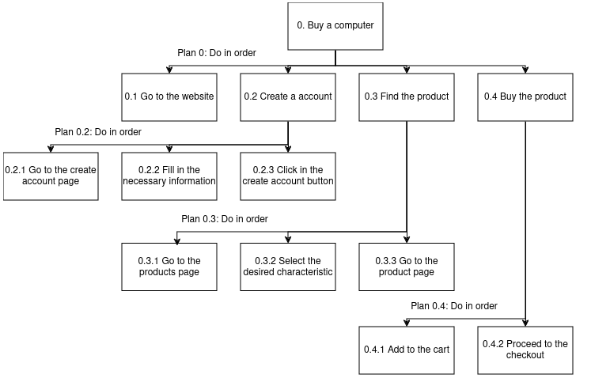
Tasks-I
Scenario I:
Create an account and buy a used computer
HCI 2020-2021
‹#›

Slide 8
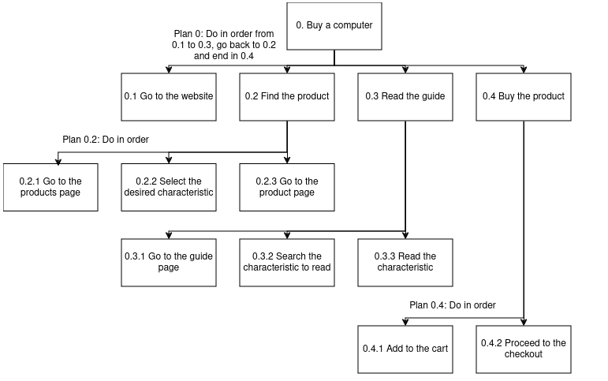
Tasks-II
Scenario II:
Learn about all characteristics imposed on a computer and buy it
HCI 2020-2021
‹#›

Slide 9
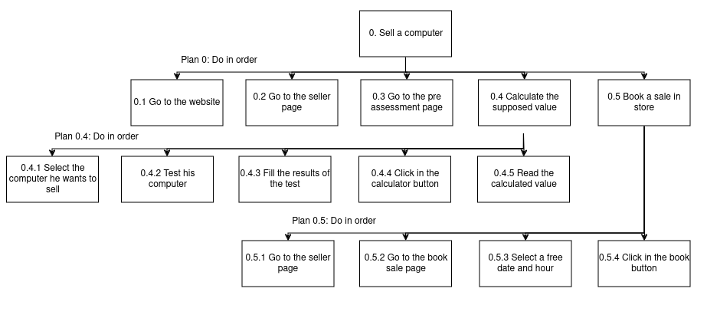
Tasks-III
Scenario III:
Calculate the value of a used computer and book a sale
HCI 2020-2021
‹#›

Slide 10
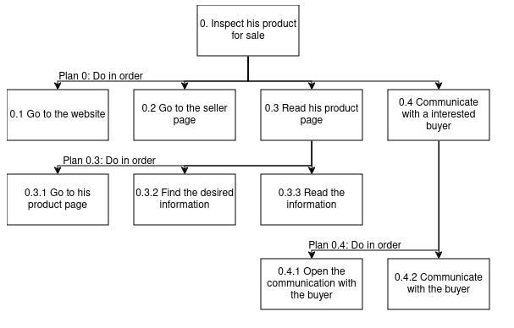
Tasks-IV
Scenario IV:
Inspect a computer that is selling and communicate with the interest party
HCI 2020-2021
‹#›

Slide 11
Requirements
PCReplay
Functional Requirements
for sellers
Product pre-evaluation system
Valuation/sale/… date marketing system
Page of products for sale
Communication system with a specialist/buyer
Notification system
profile/general
User Registration
User Account Management
Features Guide
Notification system
HCI 2020-2021
‹#›

Slide 12
Requirements
PCReplay
Functional Requirements
for administrators/specialists
Inventory management
Customer support management
for buyers
Search system/advanced search filter
Product display page
Product pages
WishList
Shopping cart
Checkout
Rating and Comments System
Communication system with a specialist/seller
Notification system
Non-functional Requirements
Security and privacy
Available, reliable and responsive
A lot of capacity
Usability
Guarantee of product quality
HCI 2020-2021
‹#›

Slide 13
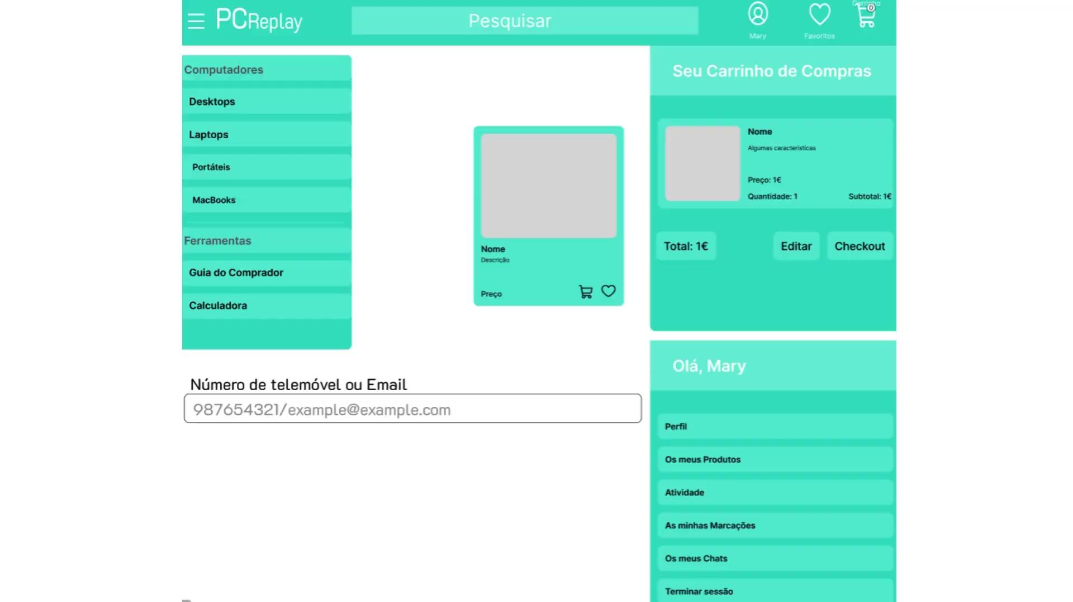
Low Fidelity Prototype (LFP)
PCReplay
Main Features
MainPage
Product Page
Calculator Page
Checkout Page
Search bar
User side bar
Favorites and cart drop bars
HCI 2020-2021
‹#›
Notes:
This is new material; should be presented in more detail

Slide 14

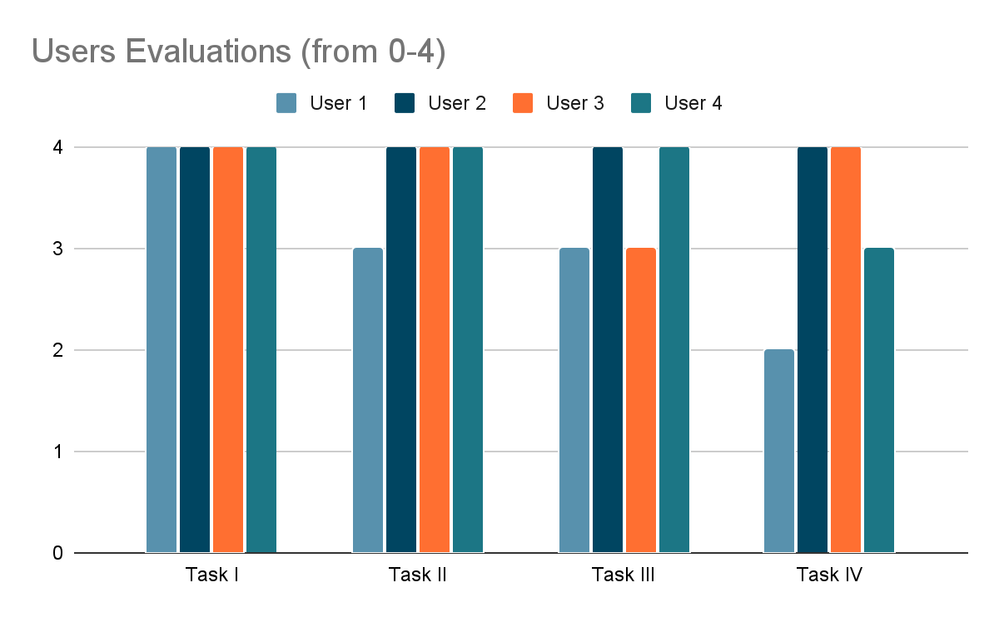
LFP User Evaluation
PCReplay
With the help of 4 anonymous users with ages around 20 years old, we were able to gather some information:
We used Figma to create a interactive way to show the users the sketch design of the website with the ability to use buttons and redirect to other design pages. We define these 4 tasks for the users:
Task I: Create an account and buy a used computer.
Task II: Learn about all characteristics imposed on the computer and buy it.
Task III: Calculate the value of the used computer and book a sale
Task IV: Inspect the computer that his selling and communicate with the interested party
HCI 2020-2021
‹#›

Slide 15
LFP User Evaluation
PCReplay
Overall we conclude that the initial results seemed promising:
easy to use
intuitive
may learn something from it but not necessary to know any specific information to use it or navigate it
HCI 2020-2021
‹#›

Slide 16





Platform Used for the functional prototype
PCReplay
Useful for code development due to its versatility, extensive plugin support and integrated development environment features
Mock Service Worker
For building the user interface with a component-based architecture
Used to simulate a backend
Vite + React
CSS framework for direct construction in HTML
react-router
dependencies used
Used to get some pre-made components
react-icons
HCI 2020-2021
‹#›

Slide 17
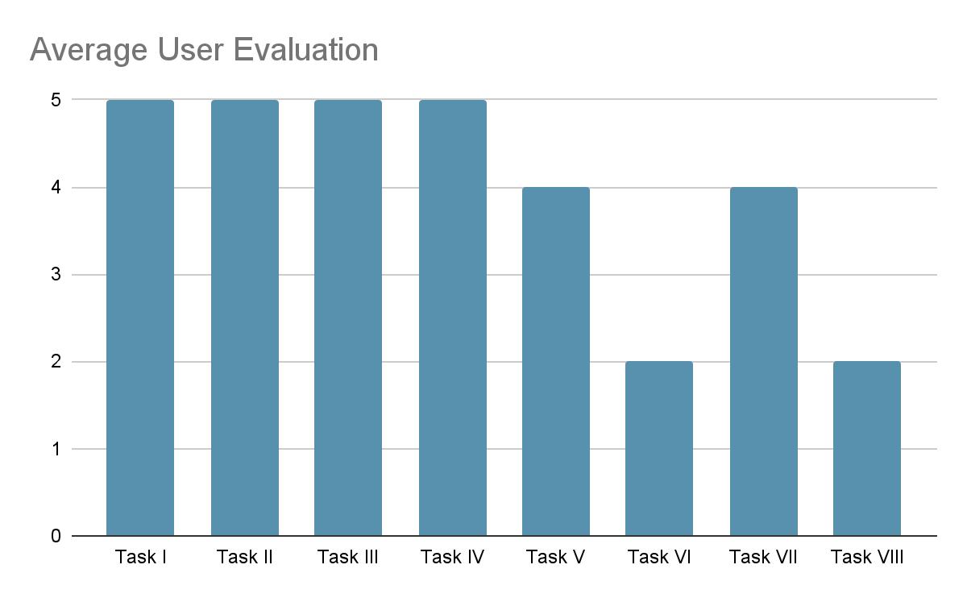
User Evaluation of the functional prototype
Overall
The website excels in user login, basic information retrieval, product search, and detailed technical information presentation.
Areas for Improvement: The Calculadora page and scheduling functionalities need significant enhancements to improve user satisfaction and usability.
Problems found
Lack of the price filter
Seller guide vs Buyer guide (more objective)
Two calculate buttons (confusing)
Reset button/Cancel button
SUS score of 90
By addressing the lower-scoring tasks, particularly the price calculation and scheduling features, the overall user experience can be greatly improved
HCI 2020-2021
‹#›

Slide 18
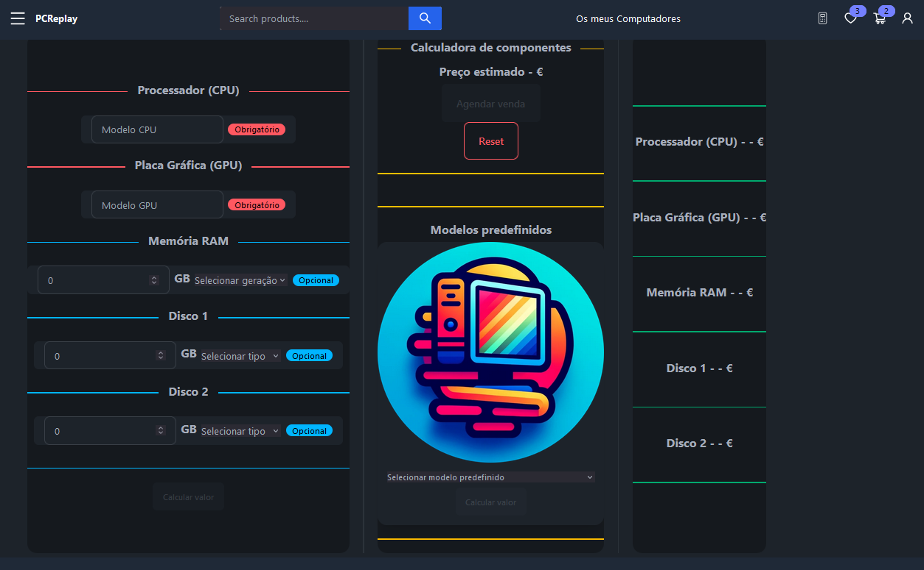
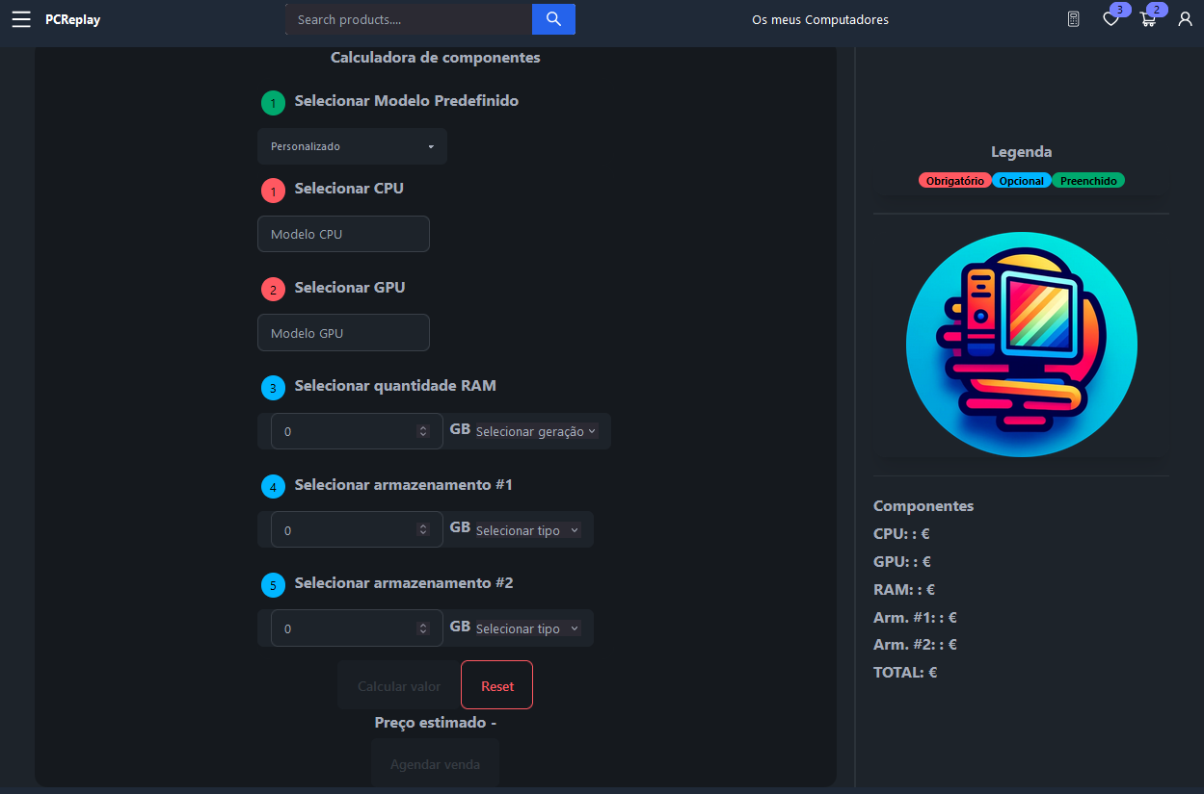
User Evaluation of the functional prototype
Original Calculator Page
Updated Calculator Page

Slide 19
Heuristic Evaluation of the project
(Severity degree evaluated between 0-4)
Usability Heuristic | Usability Problems | Median Severity Degree
Visibility of System Status | shows selected filters, shows favorites, cart | 0
Visibility of System Status | doesn't show the current page | 2
Match between system and the real world | icons are intuitive and have subtitles | 0
Match between system and the real world | the only language is Portuguese | 2
User control and freedom | you can remove from favorites, cart, logout | 0
User control and freedom | when you go back, you just go back to the previous page, if you're searching with filters, you'll leave the search there are no other sorting systems other than id order | 3
Consistency and standards | similar to other shopping websites | 0
Consistency and standards | some pages have differents styles | 2
HCI 2020-2021
‹#›

Slide 20
Heuristic Evaluation of the project
(Severity degree evaluated between 0-4)
Usability Heuristic | Usability Problems | Median Severity Degree
Error prevention | won't let you perform operations that require a login all icons have captions informing of the action | 0
Error prevention | calculator does not have to error prevention in some sections | 4
Recognition rather than recall | informs the user of the number of products in the favorites and in the cart check box in the filters to see what the user has selected | 0
Recognition rather than recall | there's no information on the page where it is | 1
Recognition rather than recall | doesn't show if we're logged in does not inform the total price of these products in the sidebar, only on their own pages | 2
Flexibility and efficiency of use | after creating an account, the person is immediately logged in | 0
HCI 2020-2021
‹#›

Slide 21
Heuristic Evaluation of the project
(Severity degree evaluated between 0-4)
Usability Heuristic | Usability Problems | Median Severity Degree
Flexibility and efficiency of use | It is possible to go to all the user's functionalities from the header except to go to their appointments and chats, thus requiring 2 steps to do so | 2
Aesthetic and minimalist design | no day mode, only night mode | 1
Help users recognize, diagnose, and recover from errors | in icons where you need to be logged in, it warns you if you're not on pages where you need to be logged in it warns you if you're not warnings if the account does not exist, or if it was created incorrectly or incompletely | 0
Help and documentation | although it has a guide to computer features and tests, it should be better structured (perhaps divided) and sequential, in steps | 2
HCI 2020-2021
‹#›

Slide 22

Demo
PCReplay
HCI 2020-2021
‹#›

Slide 23

Future work
A potential future development of this project could focus on, for example:
Implement the option to bargain between buyer and seller
Expand the product types
Implement a chat bot to help users, in a simple and fast way, get their questions and doubts answered
By addressing these areas, the project can evolve into a more comprehensive and user-friendly platform, enhancing the buying and selling experience for used and refurbished computers.
Effort of each group member
(same effort or anything else?)
HCI 2020-2021
‹#›

Slide 24
Annexes
Requirements analysis presentation
LFP: https://www.figma.com/proto/Po9PG0iPkW6cLVkHNAJEpy/PCReplay?node-id=0-1&t=lqs5vwjiZXOZXJlA-1
Usability test files
Website code
Instructions to run the website in the READ.ME file in the website folder

Slide 25
Acknowledgments
Special thanks to:
All usability test participants who contributed their time and provided valuable feedback,
Maintainers of the open-source libraries utilized,
HCI teachers for answering questions and offering suggestions
Bibliography
Cooper, A., R. Reimann, and D. Cronin, About Face 3 The Essentials of Interaction Design. Wiley Publishing, Inc., 2007
https://www.nngroup.com/articles/ten-usability-heuristics/
HCI 2020-2021
‹#›

