Slide 1
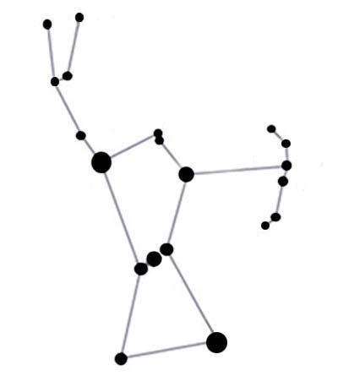
TRANSPORTES
Y
LOGISTICA
ORION

Slide 2


