Slide 1
Capstone Project
Nick Hobbs

Slide 2
OpenWeatherMap
Ingest current weather data for multiple locations
Store data for downstream analysis/visualisations
Motivation: Visualise weather data in the UK, make predictions and analyse accuracy of forecast data

Slide 3




Pipeline Overview
API

Slide 4
Data Source
openweathermap.org/api
Request current weather data for one location by geographic coordinates
Input Paramaters: lat,lon, units (metric/imperial)
Output format: JSON

Slide 5
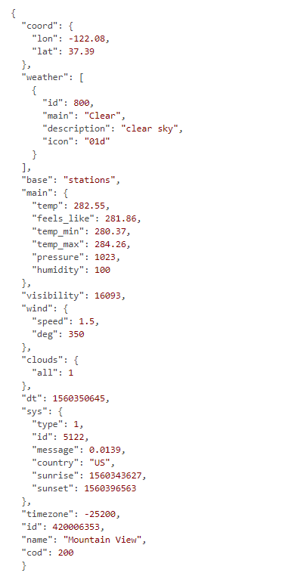
Example of API response

Slide 6

Kafka
Streaming Source
Decouples producer and consumer applications
Scalable
Fault tolerance – replicating partitions

Slide 7
Spark Streaming
Consume data from Kafka
Using Structured API to transform data
Fast in memory processing
Integration with Hbase

Slide 8
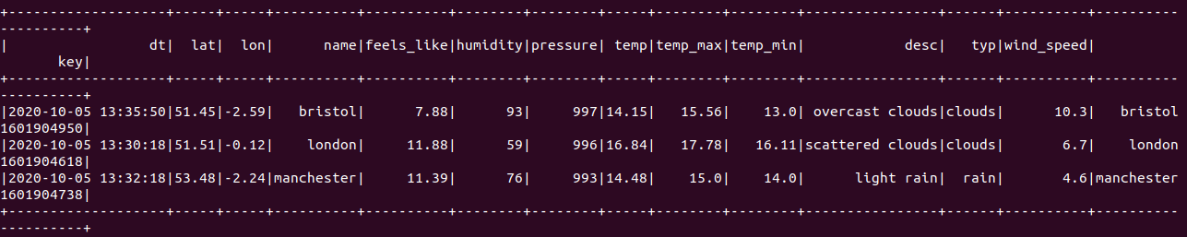
Spark Output
Spark Streaming to transform input from JSON into DataFrame

Slide 9
Demo

Slide 10
Future Work
Visualise the data stored in Hbase
Ingest multiple sources including forecast data
Perform analysis comparing forecast data to historical data

