Slide 1
Capstone Project
Nick Hobbs

Slide 2




Pipeline Overview
API

Slide 3
Data Source
openweathermap.org/api
Call current weather data for one location by geographic coordinates
Input Paramaters: lat,lon, units (metric/imperial)
Output format: JSON
Kafka to stream data

Slide 4
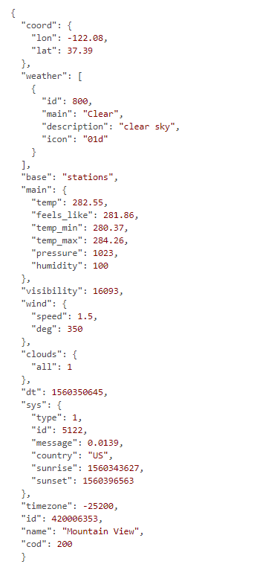
Example of API response

Slide 5
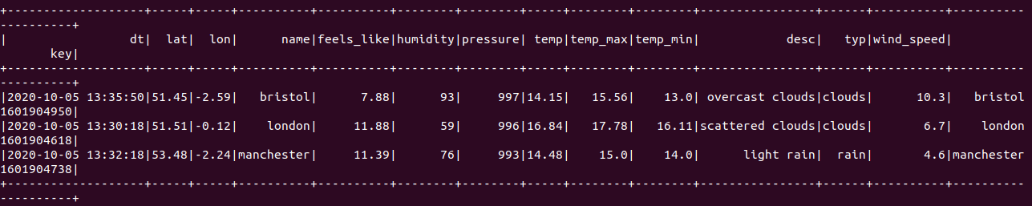
Spark Output
Spark Streaming to transform input from JSON into DataFrame

Slide 6
Demo

