Slide 1
Deep Reinforcement Learning for Mention Ranking Coreference Models
Kevin Clark and Christopher D. Manning (2016)
Presented by Luis Garduno
Notes:
Hello everyone, my name is Luis Garduno and today I will be presenting the paper:
Deep Reinforcement Learning for Mention Ranking Coreference Models By Clark and Manning 2016

Slide 2
Coreference Resolution
Pragmatic
Example : “Angela lives in Boston. She is happy in that city.”
Who is “She”?
What is “that city”?
Coreference Substitution : “Angela lives in Boston. Angela is happy in Boston.”
Notes:
So what exactly is Coreference resolution?
This was actually something that was briefly covered at the start of the semester,
when we spoke over pragmatics, which essentially is the study of what people meant but didn’t explicitly say.
A quick example of this is say we’re given the following string: *READ*
Who are we talking about when we say “She”, as well as “that city”.
By using context we are able to determine that She equals angela & and that city is Boston
So by doing coreference substitution our new string is: *READ*

Slide 3
Introduction & Related Work
Coreference resolution systems are typically trained with heuristic loss functions.
Clark & Manning instead apply reinforcement learning to optimize a neural mention-ranking model.
The 2 approaches used are:
REINFORCE policy gradient algorithm
Reward-rescaled max margin objective
Notes:
Okay so now for the actual introduction.
Typically when working with coreference resolution systems, they are trained
With heuristic loss functions
But Instead what Clark & Manning show in this paper is applying reinforcement learning to directly optimize a neural mention ranking model for coreference evaluation metrics.
In which the 2 approaches that are used are:
The REINFORCE policy gradient algorithm
As well as the Reward rescaled max-margin objective
Clark & Manning mention how, to THEIR knowledge nobody has applied reinforcement learning to coreference resolution.
However, imitation learning algorithms such as SEARN have been applied in the past to train coreference resolvers, but
As Clark & Manning mention in this paper, that these algorithms require an expert policy to learn from, so I will not be going over these imitation learning algorithms.

Slide 4

Neural Mention-Ranking Model
Given:
Mention m
Candidate antecedent c
Score for the pair s(c,m)
Hidden Layers
Scoring Layer
Notes:
To briefly go over the neural mention-ranking model
Given mention m | candidate antecedent c
It is then able to produce a score for the pair s(c,m) indicating their compatibility for coreference with a feedforward neural network.

Slide 5
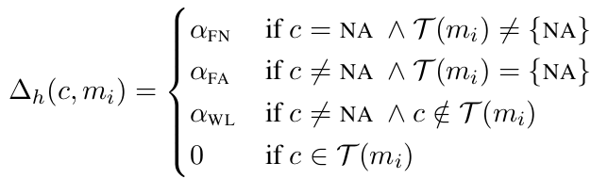

Learning Algorithms : Heuristic Max-Margin Objective
Formulas used for Heuristic Max-Margin Objective
Notes:
As mentioned earlier, Mention rank models are typically trained with heuristic loss functions that are tuned via the hyper parameters.
There hyperparameters are usually given as consts for different error types, which are then used within the bias of the coreference system to make more or fewer coreference links
Here we are describing a Heuristic loss function that incorporates an idea presented from Wiseman in 2015, which is a different paper.

Slide 6
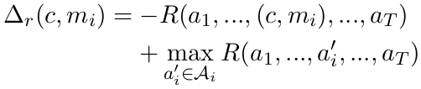



Learning Algorithms : Reinforcement Learning
Reward Rescaling
The REINFORCE Algorithm
Lower variance than std REINFORCE gradient estimates
Notes:
As for Reinforcement Learning - Finding the best hyperparameter settings for the heuristic loss requires training many variants of the model.
We can view the mention-ranking model as an agent taking a series of actions
Reward Rescaling - view 3.2
REINFORCE Algorithm
For reinforcement learning the top formula, defines a probability distribution over action using the mention ranking model’s scoring function
The second formula is the actual formula used within the REINFORCE Algorithm that seeks to maximize the expected reward
And as you can see it includes in it the top formula
As for the last formula, Clark & Manning take advantage of the independence of actions by using the gradient estimate, which has a lower variance than the standard REINFORCE gradient estimates

Slide 7
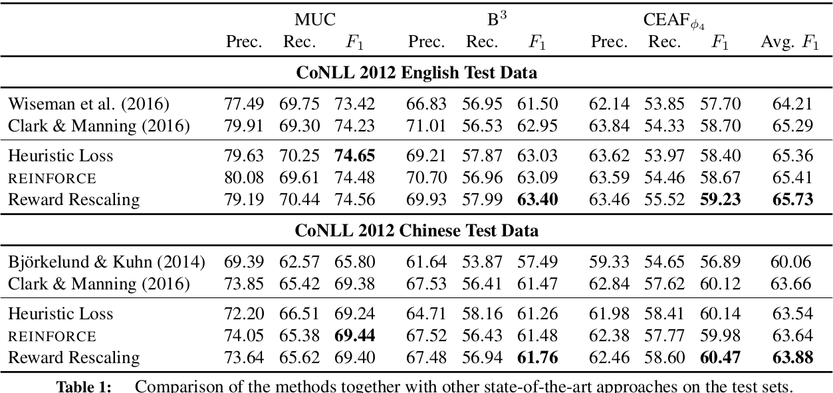
Experiments
Notes:
They ran experiments on the English and Chinese portions of the CoNLL 2012 Shared Task data
We used the MUC, B, and CEAF metrics
They improve on the previous system by using using better mention detection, more effective hyperparameters, and more epochs of training.

Slide 8
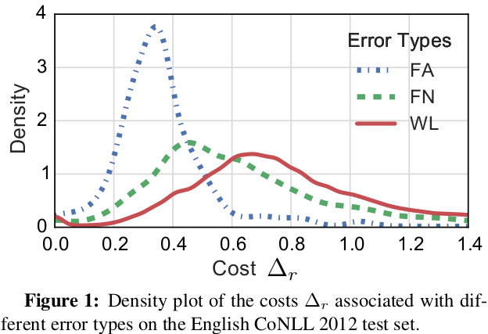
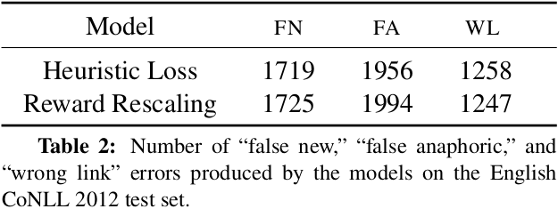
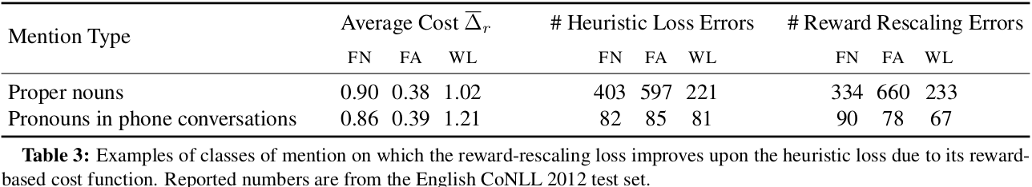
Results
Notes:
In figure 1 we see that they are comparing the reward-based cost function with the error types used in the heuristic loss.
For English, the average value of delta r is 0.79 for FN errors and 0.38
For FA errors when the costs are scaled so the average value of a WL error is 1.0.
But something to note that REINFORCE does slightly better than the heuristic loss, but reward rescaling performs significantly better than both on both languages.
Table 2 shows the breakdown of errors made by the heuristic and and the reward rescaling models.
We can see that the reward-rescaling models makes a bit more errors, which essentially means that it’s improvement in performance has to come from its errors being less severe.
Table 3 shows two classes of mentions where the reward-rescaling loss particularly improves over the heuristic loss.
Proper nouns have a higher avg cost for “false new”,
False New
False anaphor
Wrong link

Slide 9
Conclusion
Using Reinforcement Learning to directly optimize mention-ranking models
Carefully selecting hyperparameters depending on the particular language, data, & evaluation metric
The Reward-rescaling approach shows to have increased the model’s accuracy.
Notes:
To conclude this presentation I will briefly speak on what was covered
We began by going over Clark & Manning’s proposal of using Reinforcement learning instead of heuristic loss functions,
To directly optimize mention-ranking models for coreference evaluation metrics.
Then after experimenting we learned that there is an obviating (OB-VEE-ATING) need to carefully select the hyperparameters for each particular language, dataset, and evaluation metric
Lastly, we concluded that the reward-rescaling approach used showed to have increased the model’s accuracy. That resulted in significant gains over the current state-of-the art.
Thank you. I will now go over any questions anyone might have.

Slide 10
Questions?

