Slide 1
Information Extraction with OpenIE before and after NeuralCoref
Pravik Tarala and Luis Garduno

Slide 2
Coreference Resolution
Pragmatic
Example : “Angela lives in Boston. She is happy in that city.”
Who is “She”?
What is “that city”?
Coreference Substitution : “Angela lives in Boston. Angela is happy in Boston.”

Slide 3

NeuralCoref & OpenIE
spaCy NeuralCoref
Coreference resolution model that uses the spaCy parser & the neural network scoring model described in “Deep Reinforcement Learning for Mention-Ranking Coreference Models” by Clark and Manning (2016).
Scoring layer
Standford OpenIE
Extracts relation types from plain text that are often binary relations such as: (Mark Zuckerberg; founded; Facebook)

Slide 4
Method of evaluation
Number of new triples
Total number of triples before and after neural coref
Number of new topics before and after neural coref

Slide 5
Expected Results
After neural-coref, we would expect to see each of the 3 measures outlined in the previous slides increase for each document.
In addition, as the document size increases, each of the measures should increase as well.

Slide 6

Table of Results
Used one small set of text, one large and one extra large

Slide 7
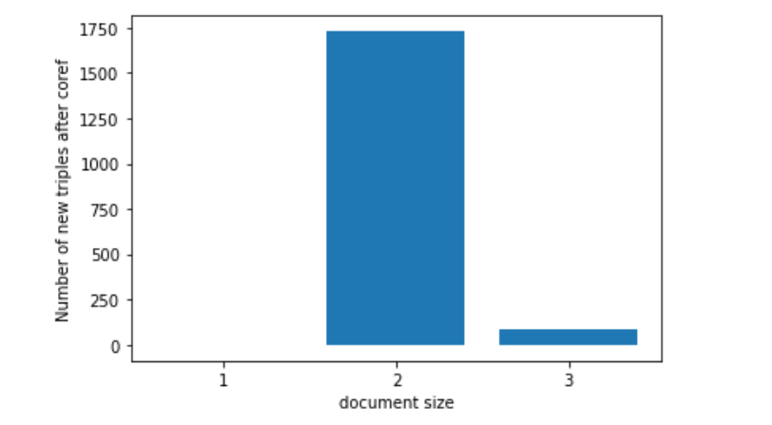
Number of new triples

Slide 8
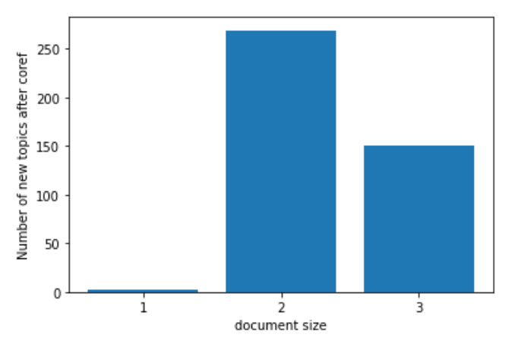
Number of new topics

Slide 9
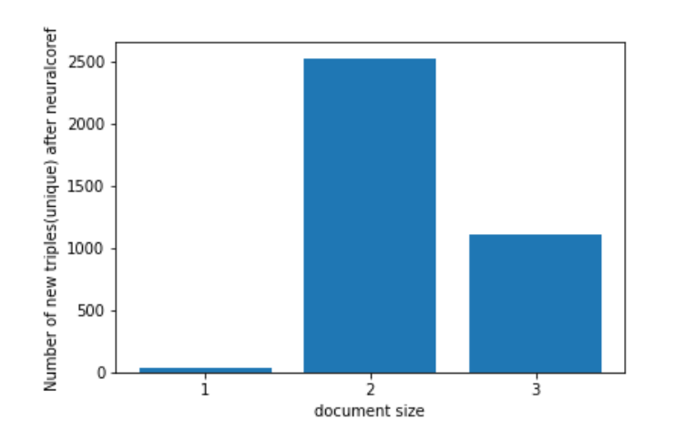
Number of new unique triples

Slide 10
Conclusions
Smallest document extracts least amount of new information
Surprising to see that the largest document did not have the highest amount of new info for all 3 measures

Slide 11
Some reasons for different than expected results
Content of documents different
Structure of documents different

Slide 12
Future exploration
Run the same experiment with the theme of the document the same across all documents

