Slide 1
Exploring the Effects of Extreme Weather on Total Deaths

Slide 2
Framing the Problem
Extreme temperature—significantly higher or lower than the mean over a long period—disrupt day-to-day human activities, public services, and may produce an increase in deaths
Hence, we evaluate if extreme temperature events may have an effect in deaths per thousand population by district in Peru over the period 2022-2024

Slide 3
Data
Country: Peru
Unit of analysis: district-year
Years: 2022-2024

Slide 4
Data
We used data from these sources:
Y (deaths per thousand population by district-year):
Death Information System (SINADEF – Sistema de Informacion de Defunciones)
District population from the National Institute of Statistics of Peru
X (number of days with extreme temperature by district-year):
ERA5 dataset (2 meter temperature, daily, at 00:00 and 12:00, for 2022-2024)
Peru ADM3 boundaries
Control variables
National Households Survey (ENAHO – Encuesta Nacional de Hogares) from the National Institute of Statistics of Peru

Slide 5
Methods
Y (deaths per thousand population by district-year):
Data from SINADEF was collapsed by year-district, and divided with population by year-district from the District population dataset to obtain the number of deaths per thousand population by district-year

Slide 6
Methods
X (number of days with extreme temperature by district-year):
We obtained the district centroids from the data from Peru ADM3 boundaries (district level)
Then, we obtained the closest 4 coordinates in the ERA5 to each centroid
From these 4 coordinates for each district, we obtained the mean and standards deviation of the temperature at these points each year
Lastly, for each year and district centroid, we counted the times the temperature in the closest 4 coordinates was higher than the mean plus three times the standard deviation or lower than the mean minus three times the standard deviation. This is the number of extreme temperature occurrences

Slide 7
Methods
Control variables
Data from ENAHO from the modules, household characteristics, household member characteristics, health, and aggregated indicators (sumaria) was merged in a single dataset
We collapsed the dataset by year-district, estimating the weighted mean of the following control variables by year-district:
Dwelling characteristics: dirt floor, connection to piped water provider, sewage connection, electricity access, uses wood as main cooking fuel
Individual characteristics: female population, population with a decease (self-reported), population with health insurance, population aged 65 or over
District characteristics: poverty rate, extreme poverty rate, share of population in the highland (sierra) region, share of population in the rainforest (selva) region

Slide 8
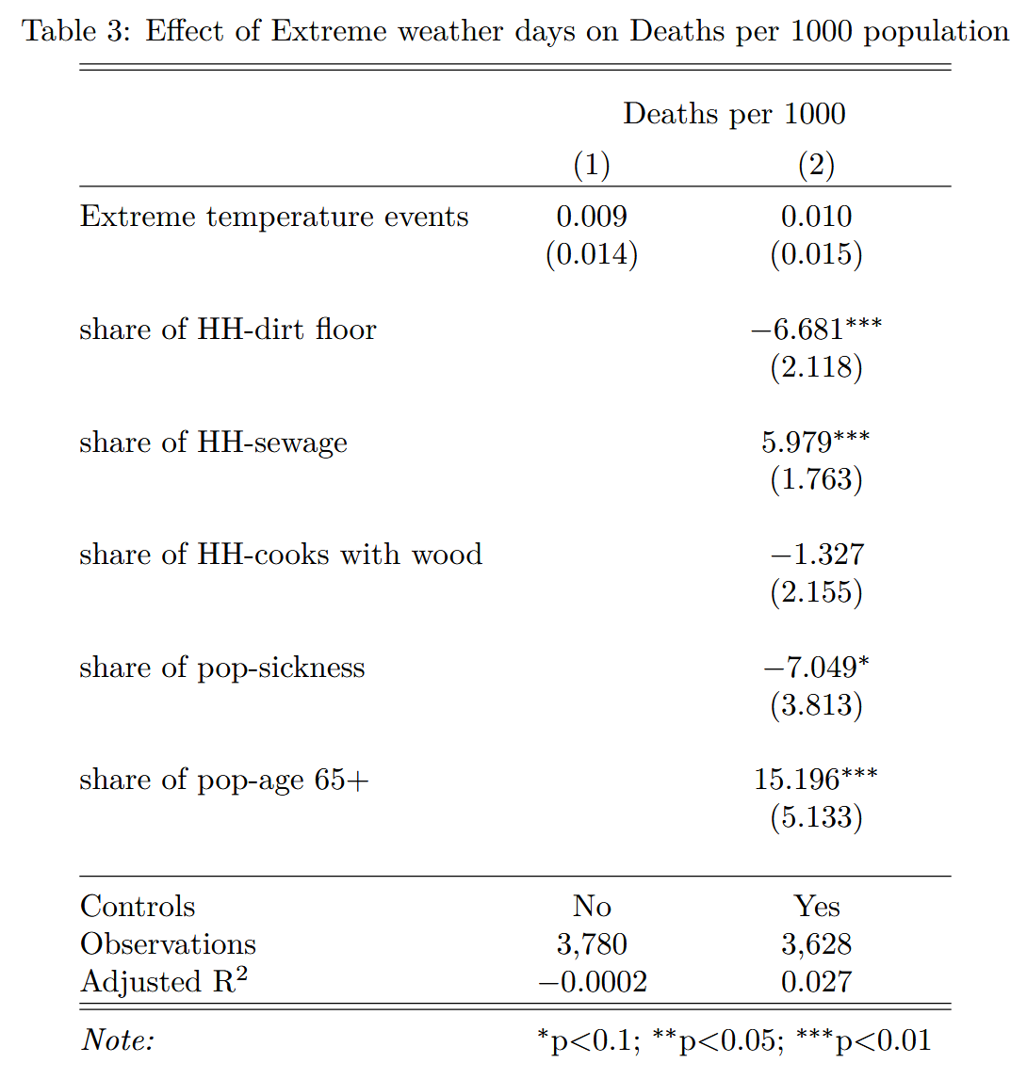
Results

Slide 9
Results
The coefficient for extreme temperature events is not significant, not even after adding controls
We shouldn’t rule out the possibility of an effect due to serious limitations in the data and analysis (see next slide)

Slide 10
Limitations
District codes update:
There was a significant loss of N after merging all the datasets by the district 6-digit code, being the SINADEF and district population data the highest merge mismatch.
This could be due to an update in the district code sequence reflected in the district population data, but not anywhere else.
I didn’t have time to address this problem, but saw that approximately 2k observations were lost

Slide 11
Limitations
Inadequate inference level for ENAHO data:
For the controls, we collapsed microdata at the household and individual level to district-year level
This was done out of convenience. However, the ENAHO sampling is not designed to allow district-level inference (ADM3) within a single year. The lowest level of inference is departamento (ADM1)
District-level inference could be feasible, but it should require either (1) adding data from several years, or (2) analyzing whether the coefficient of variation of the estimates are higher than 15% so that inference is adequate

Slide 12
Limitations
Effects on deaths might be too far-off in the causal chain:
I selected deaths per thousand population as the impacted variable for two reasons: (1) data is easy to obtain, (2) it’s an intuitive variable that should be affected by extreme weather
However, when framing the problem, I didn’t consider it’s a final impact variable for which the effects of extreme weather events might be far-off to assess causality
The analysis of intermediate effects (hospital admissions, for example) would have been an outcome to explore for a clearer link

Slide 13
Limitations
Coordinates closest to district centroids are not necessarily those more heavily populated in districts:
Peru’s population is heavily urban and concentrated in Lima and intermediate cities
Then, taking the extreme temperature events of the 4 closest points to district centroids might not be a true indicator for how many times there are extreme temperatures affecting population, given that district centroids will not always coincide with population concentrations in each district

Slide 14
Future Work
Explore the data more to get a better sense of possible issues with the district code and the deaths data
Analyze impacts on other variables such as hospital admissions, health issues, work productivity, and school attendance
Obtain blocks geospatial data of urban areas by district and use those polygons’ centroid as the point for which the closest temperature data should be screened for extreme temperatures, as opposed to district centroids

