Slide 1

Towards Automatic Generation of RDB2RDF Mappings
Vânia Maria P. Vidal, José Maria Monteiro, Luís Eufrasio T. Neto
Departamento de Computação

Slide 2
Contents
Introduction
Related Work
RDB2DO Approach
SQL Views By Assertions and Direct Mapping

Slide 3
Introduction

Slide 4
Introduction
Motivation
Use Case
R2RML Mapping Language
Challenges
Proposal

Slide 5
Motivation
Linked Data: a term used to describe a recommended best practice for exposing, sharing, and connecting pieces of data, information, and knowledge on the Semantic Web using URIs and RDF.
Relational Databases (RDBs): used in most current enterprise environments to store and manage data.
The relational data must be published as Linked Data. Why?

Slide 6
Motivation
RDBs are well suited to handle large amounts of data, but they were not designed to preserve the data semantics.
The meaning of the data is implicit on the application level and not explicitly encoded in the relational model.
Ontologies and Semantic Web technologies provide explicit semantics in a common framework that allows data to be shared and reused across application, enterprise, and community boundaries.

Slide 7
Motivation
The Linking Open Data cloud diagram
Last updated: 2011-09-19

Slide 8
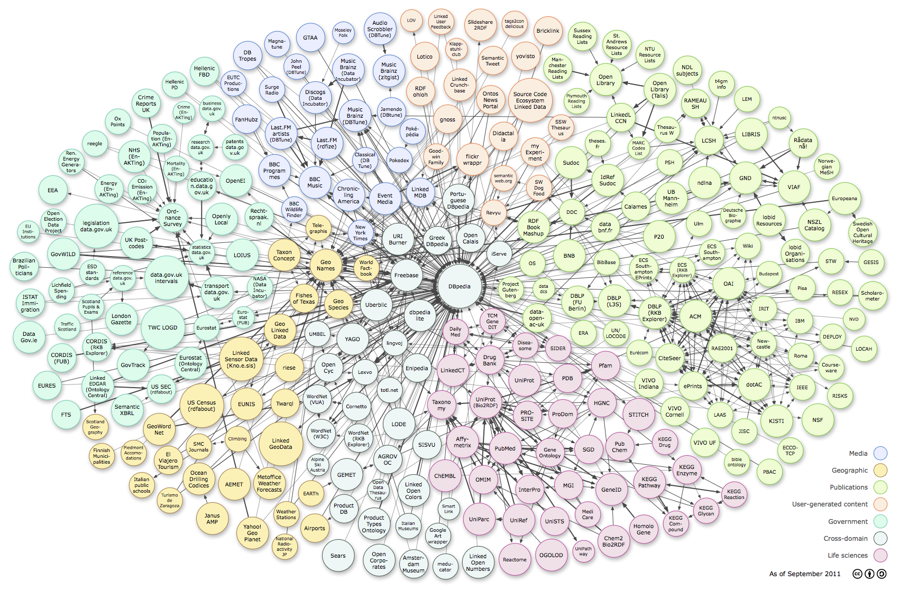
Motivation
The Linking Open Data Cloud Diagram

Slide 9
Motivation
How to Publish Relational Databases as Linked Data?
  Create a Mapping from the relational schema to a custom/existing ontology/vocabulary schema
    Identifying “things” (or Classes)
      E.g., “Paper”, “Person”, “Conference”
      Each relational table is mapped to a class
    Identifying predicates
      E.g., “a:author”, “a:firstName”, “a:homepage”
    Reuse terms of known vocabularies
      E.g., “dc:creator”, “foaf:name”, “foaf:homepage”

Slide 10
Motivation
How to Publish Relational Databases as Linked Data?
  Creating RDF using the mapping
    Creating instances (or objects), assigning unique URIs
    Can be performed once in an offline process
      Triplification
      Materialized into RDF Triple Stores
      Must be updated
    Or on-the-fly in an online fashion
      Virtual
      End Point SPARQL
      Translations from SPARQL to SQL and from ResultSet to RDF GRAPH

Slide 11
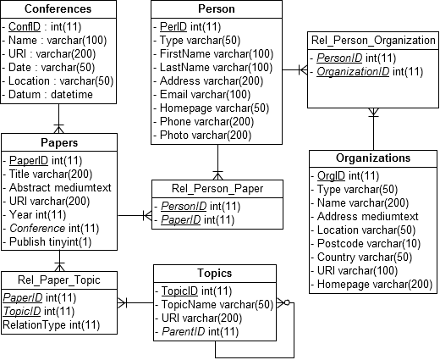
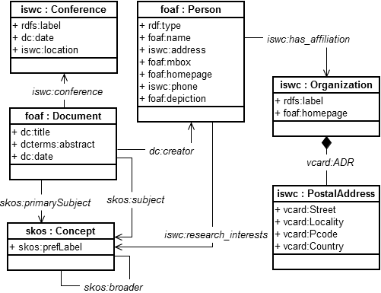
Use Case
ISWC_DB ISWC Ontology

Slide 12

Use Case
Person Tuples
Triples of PerID = 1:
<http://example.org/person/1> rdf:type foaf:Person .
<http://example.org/person/1> foaf:name “Yolanda Gil” .
<http://example.org/person/1> foaf:mbox <mailto:gil@isi.edu> .
<http://example.org/person/1> foaf:homepage <http://www.isi.edu/~gil> .

Slide 13


Use Case
Paper Tuples
Rel_Person_Paper Tuples

Slide 14
Use Case
Triples of PaperID = 1:
<http://example.org/paper/1> rdf:type foaf:Document .
<http://example.org/paper/1> dc:title
“Trusting Information Sources One Citizen at a Time” .
<http://example.org/paper/1> dc:date “2002”^^xsd:gYear .
<http://example.org/paper/1> dc:creator <http://example.org/person/1> .
<http://example.org/paper/1> dc:creator <http://example.org/person/2> .

Slide 15
R2RML
A language for expressing customized mappings from relational databases to RDF datasets.
Every R2RML mapping is tailored to a specific database schema and target vocabulary.
The input to an R2RML mapping is a relational database that conforms to that schema.
The output is an RDF dataset that uses predicates and types from the target vocabulary.

Slide 16
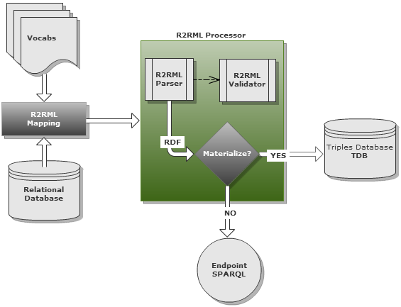
R2RML
R2RML processors are free to materialize the output data, or to offer virtual access through an interface that queries the underlying database:

Slide 17
R2RML
Overview and Example

Slide 18
R2RML
An R2RML mapping refers to logical tables to retrieve data from the input database. A logical table can be one of the following:
A base table,
a view, or
a valid SQL query (called an “R2RML view” because it emulates a SQL view without modifying the database).

Slide 19
R2RML
Each logical table is mapped to RDF using a triples map.
The triples map is a rule that maps each row in the logical table to a number of RDF triples.
The rule has two main parts:
  A subject map that generates the subject of all RDF triples that will be generated from a logical table row. The subjects often are IRIs that are generated from the primary key column(s) of the table.
  Multiple predicate-object maps that in turn consist of predicate maps and object maps (or referencing object maps).

Slide 20
R2RML
Triples are produced by combining the subject map with a predicate map and object map, and applying these three to each logical table row.
For example:
  Subjects: http://example.org/person/{PerID} is the template used to generate subject IRIs from the PerID column
  Predicates: The constant vocabulary IRI foaf:mbox is used
  Objects: The value of the Email column is used to produce an RDF literal

Slide 21
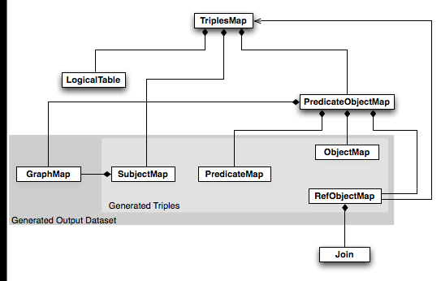
R2RML
Overview

Slide 22

R2RML
Simple Table: Conferences Tuples
Triples of ConfID = 1:
<http://example.org/conf/23541> rdf:type iswc:Conference .
<http://example.org/conf/23541> rdfs:label
“International Semantic Web Conference 2002” .
<http://example.org/conf/23541> dc:date “June 9-12, 2002” .
<http://example.org/conf/23541> iswc:location “Sardinia” .

Slide 23
R2RML
Simple Table Mapping:
<#ConfTriplesMap>
rr:logicalTable [ rr:tableName "Conferences" ];
rr:subjectMap [
rr:template "http://example.org/conf/{ConfID}";
rr:class iswc:Conference;
];
...

Slide 24
R2RML
Simple Table Mapping:
<#ConfTriplesMap>
...
rr:predicateObjectMap [
rr:predicate rdfs:label;
rr:objectMap [ rr:column "Name" ];
];
rr:predicateObjectMap [
rr:predicate dc:date;
rr:objectMap [ rr:column "Date" ];
];
...

Slide 25
R2RML
Simple Table Mapping:
<#ConfTriplesMap>
...
rr:predicateObjectMap [
rr:predicate iswc:location;
rr:objectMap [ rr:column "Location" ];
].

Slide 26

R2RML
Linking Two Tables: Papers and Conference
select PaperID, Conference from Papers
Triples of PaperID IN (1, 2):
<http://example.org/paper/1> iswc:conference <http://example.org/conf/23541> .
<http://example.org/paper/2> iswc:conference <http://example.org/conf/23541> .

Slide 27
R2RML
Linking Two Tables Mapping:
<#PapersTriplesMap>
rr:logicalTable [ rr:tableName "Papers" ];
rr:subjectMap [
rr:template "http://example.org/paper/{PaperID}";
rr:class foaf:Document;
];
...

Slide 28
R2RML
Linking Two Tables Mapping:
<#PapersTriplesMap>
...
rr:predicateObjectMap [
rr:predicate iswc:conference;
rr:objectMap [
rr:parentTriplesMap <#ConfTriplesMap>;
rr:joinCondition [
rr:child "Conference";
rr:parent "ConfID";
];];].

Slide 29
Challenges
R2RML is the RDB to RDF Mapping Language W3C Proposed Recommendation.
But their use involves some challenges:
  The user must have advanced knowledge about the R2RML language.
  There isn't any GUI Tool for creating R2RML mappings.
  Problems can arise from heterogeneity between relational schema and the ontology schema.
  When changes occur in any of the schemas, the mapping must be updated manually.

Slide 30
Proposal
To overcome these challenges we propose:
  A graphical tool where the user can create their mappings through correspondence assertions
  A three-tier architecture that includes the creation of SQL views from the correspondence assertions
  A publishing process that enables the use of the tool, the architecture implementation and automation of R2RML mapping creation.

Slide 31
Related Work

Slide 32
Related Work
Virtuoso
  http://virtuoso.openlinksw.com
Spyder
  http://www.revelytix.com/content/spyder
Triplify
  http://triplify.org/
D2RQ
  http://d2rq.org/

Slide 33
Related Work
Virtuoso
  A commercial database system from Open-Link Software
  Supports a multi-model data server
    XML, SQL, RDF, plain text
  Has a declarative meta-schema language used to map terms of an ontology to concepts in the database schema
  Open source version with limited support
  Does not have a GUI Component to support mappings creation

Slide 34
Related Work
Spyder
  Free tool, but not open source.
  Implements R2RML
  Supports only a subset of SPARQL 1.1
  Does not implement the R2RML current version
  Does not have a GUI Component

Slide 35
Related Work
Triplify
  It is a plugin for Web applications that exposes their information in RDF.
  Uses a set of application-specific SQL queries to extract data from the underlying RDB to generate RDF data from the results.
  The SQL queries have to be defined manually for each Web application.
  The RDF generation is performed automatically according to a fixed process.
  Reuse of existing ontologies is possible via result column renaming in the SQL queries.

Slide 36
Related Work
D2RQ
  It is a robust platform and open source.
  Widely used by the community.
  Creates End Points SPARQL
  Supports multiple databases.
  Uses D2R Map Language to create mappings
  Will be updated to support R2RML
  Doesn't have a GUI Tool to create the mappings

Slide 37
RDB2DO Approach

Slide 38
RDB2DO Approach
RDB to Domain Ontology (RDB2DO) is our approach to map a RDB schema in terms of the Domain Ontology (DO) schema.
Comprises:
  Three-tier Architecture
  RDB2DO Publication Process

Slide 39
RDB2DO Approach
Three-tier Architecture
  RDF Layer: n OWL classes. A subset of DO classes.
  SQL Views Layer: Views schema and n SQL views.
  Data Layer: RDB scheme and data.

Slide 40
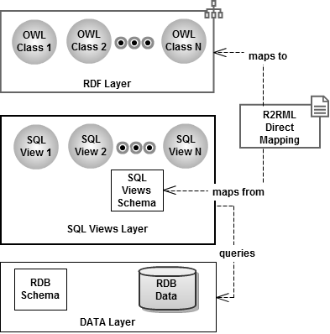
RDB2DO Approach
Three-tier Architecture

Slide 41
RDB2DO Approach
RDB2DO Publication Process
  RDB and DO Selection
  Local Ontology Generation
  Mapping by Correspondence Assertions
  SQL Views and Schema Generation
  R2RML Direct Mapping Generation

Slide 42
RDB2DO Approach
RDB2DO Publication Process

Slide 43
SQL Views By Assertions

Slide 44
SQL Views By Assertions
Mappings formaly defined by Correspondence Assertions (CAs).
One View for each OWL Class into the Application Ontology.
SQL clauses of Views derived by the CAs.

Slide 45
SQL Views By Assertions
Some CAs of Person Class
  foaf:Person(person) ← db:Person(person)
  foaf:mbox(person, email) ←
  db:email(person, email), db:Person(person)
  foaf:name(person, fConcat(firstN, lastN)) ← db:firstName(person, firstN) ^ db:lastName(person, firstN), db:Person(person)
  iswc:has_affiliation(person, org) ← db:Person(person) ^ db:fk_org_person_inversa(person, rel_p_o) ^ db:fk_person_org(rel_p_o, org), db:Organization(org)

Slide 46
SQL Views By Assertions
Foaf_Person View
CREATE VIEW Foaf_Person AS SELECT PerID as uri, email as foaf_mbox, --------------------------(2) CONCAT(FirstName, LastName) as foaf_name, ----(3) (select rpo.OrganizationID from Rel_Person_Organization as rpo where rpo.PersonID=p.PerID) as iswc_has_affiliation----------------------(4) FROM Person p --------------------------------(1)

Slide 47
SQL Views By Assertions
CAs of Organization Class:
iswc:Organization(org) ← db:Organizations(org)
rdfs:label(org, n) ←
db:name(org, n), db:Organizations(org)
foaf:homepage(org, h) ← db:homepage(org, h),
db:Organizations(org)

Slide 48
SQL Views By Assertions
Iswc_Organization View
CREATE VIEW Iswc_Organization AS SELECT OrgID as uri, name as rdfs_label, -------------------(2) homepage as foaf_homepage, -------------------(3) FROM Organizations ---------------------------(1)

Slide 49
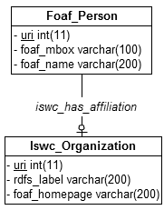
SQL Views By Assertions
View Schema: Person-Organization

Slide 50
References
1. Resource Description Framework (RDF) Model and Syntax Specification, W3C Proposed Recommendation 05 January 1999. Disponível em http://www.w3.org/TR/PR-rdf-syntax/. Acessado em 2012.
2. Tim Berners-Lee: Linked Data, Design Issues. Disponível em:
<http://www.w3.org/DesignIssues/LinkedData.html >. Acessado em 2012.
3. A Direct Mapping of Relational Data to RDF, Marcelo Arenas, Eric Prud'hommeaux, Juan Sequeda, Editors. World Wide Web Consortium, 24 de Março de 2011. Disponível emhttp://www.w3.org/TR/rdb-direct-mapping/.

Slide 51
References
4. Percy E. Salas, Karin K. Breitman, Marco A. Casanova, José Viterb: StdTrip: Promoting the Reuse of Standard Vocabularies in Open Government Data.
5. Sacramento, E., Vidal, V. M., Macêdo, J. A., Lóscio, B. F., Lopes, F. L. R., Casanova, M. A., and Lemos, F.: Towards automatic generation of application ontologies. In: Journal of Information and Data Management, Vol. V, No. N, Month 20YY, pp.1-16, 2010.
6. David Beckett, Tim Berners-Lee: Turtle - Terse RDF Triple Language. Disponível em http://www.w3.org/TeamSubmission/2008/SUBM-turtle-20080114/ .
7. M. Dürst and M. Suignard: Internationalized Resource Identifiers (IRIs), Internet-Draft, June 2003, expires December 2003. This document is http://www.w3.org/International/iri-edit/draft-duerst-iri-04.

Slide 52
References
8. Hull, R. and Yoshikawa, M. Ilog: declarative creation and manipulation of object identifiers. In Proceedings of the 16th International Conference on Very Large Databases (VLDB). Morgan Kaufmann Publishers Inc., San Francisco, CA, USA, pp. 455#468, 1990.
9. Leme, L. A. P. P., Casanova, M. A., Breitman, K. K., and Furtado, A. L. Instance-based OWL schema matching. In Proceedings of the 11th International Conference on Enterprise Information Systems. Lecture Notes in Business Information Processing, vol. 24. pp. 14-26, 2009.
10. Das Souripriya, Sundara Seema, Cyganiak Richard (2011), R2RML: RDB to RDF Mapping Language. Disponível em <http://www.w3.org/TR/r2rml/>

Slide 53
References
11. Bizer, C., Cyganiak, R.: D2R server – publishing relational databases on the Semantic Web. Disponível em:
http://www4.wiwiss.fu-berlin.de/bizer/pub/Bizer-Cyganiak-D2R-Server-ISWC2006.pdf
12. Jena - A Semantic Web Framework for Java. Disponível em:
<http://jena.sourceforge.net>

