Slide 1
Machine Learning Model for Hydraulic Failure Prediction in Stormwater Systems
Luis Fernando Fajardo Bravo
2026-10-28

Slide 2
Audit closure and reproducible A dataset
The main dataset is now rebuilt from source artifacts with explicit QA and provenance.
FROZEN SOURCE
QA ELIGIBLE
TRAINING ROWS
SHAPE GROUPS
1,000
866
138,560
36 / 40
SWMM runs in network A; original records preserved.
Runs admitted after continuity, drainage and coverage checks.
Exact feature/target rows; 160 nodes and 21 inputs.
Four groups have no eligible A run; no targets were filled manually.
134 runs excluded by QA
100 drainage-not-drained · 35 continuity > 5% · 1 run appears in both groups. The 5% continuity threshold and configured drainage tolerances remain provisional.
Class balance: 41,497 flooded rows (29.9%) · 97,063 not flooded · flood threshold 1 m³.
MLSMFP | Progress: audit, tuning and network-transfer validation | 2026-10-28
45

Slide 3
Model selection keeps the external network sealed
A is used for training and tuning; B remains a one-network external transfer test.
TRAINING NETWORK A
INNER SELECTION
FROZEN TEST B
CLAIM SCOPE
Chico Sur
GroupKFold(5)
Chico Norte
1 network
866 QA-eligible runs; frozen preparation ID 813323e3ef75b752.
Groups are hydrograph shape IDs; optimize macro_network_rmse on A only.
No B labels enter Optuna, candidate fitting, or the selection rule.
This tests transfer to B; it cannot establish population-wide generalization.
Leakage controls now verify source manifests, run-level artifacts, keys and feature rows.
B predictions must be sealed and replay-verified before exact RPT hashes are opened for scoring. B labels remain out of SQLite and out of tuning.
Interpretation: grouped internal selection by hydrograph shape; external evaluation by a single held-out network.
MLSMFP | Progress: audit, tuning and network-transfer validation | 2026-10-28
46

Slide 4
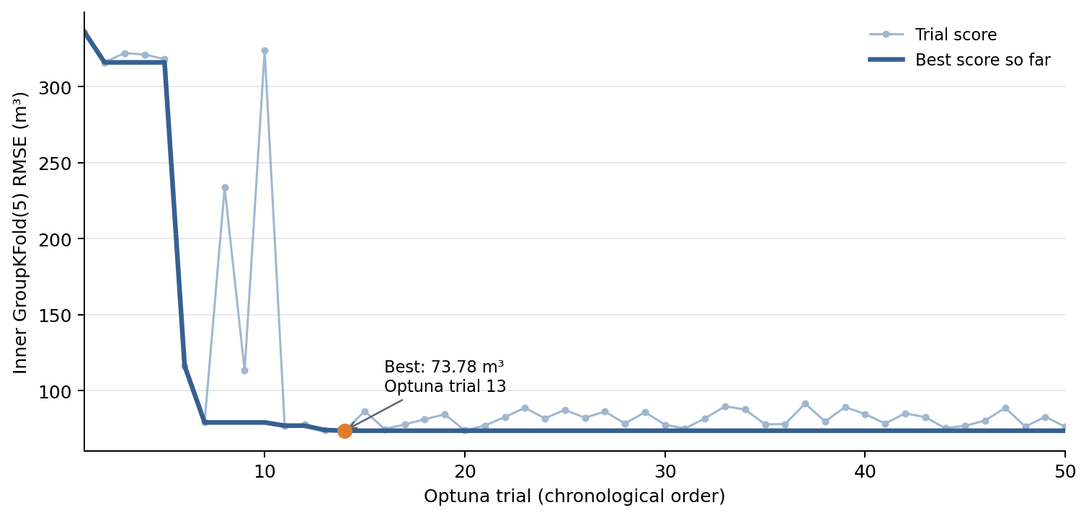
XGBoost search completed: best inner RMSE 73.78 m³
50 Optuna trials · GroupKFold(5) by shape · seed 42 · A-only selection
BEST OPTUNA TRIAL
#13
Zero-based Optuna trial ID; score is the inner CV objective.
OBJECTIVE
73.782 m³
macro_network_rmse; with one training network this equals A's RMSE.
Candidate fitted on A. This is not the transfer score on B.
The plot shows trial values and the best score seen so far; the inner score is a model-selection estimate.
MLSMFP | Progress: audit, tuning and network-transfer validation | 2026-10-28
47

Slide 5
Two finalist families; MLP search remains in progress
The selection protocol and final ensemble rule were fixed before the B test is opened.
XGBOOST · SEARCH COMPLETE
MLP · SEARCH RUNNING
50 / 50 trials
50 trials planned
A-only grouped CV selected the candidate. Classifier and regressor artifacts were fitted and their provenance reload was verified.
Same A-only GroupKFold(5), objective and 200 epochs per fold. Final model and five-seed ensemble are not yet fitted.
Approved final MLP rule: train five deterministic seeds (42–46); average flood probabilities and conditional volumes in m³, then apply the 0.5 threshold.
MLSMFP | Progress: audit, tuning and network-transfer validation | 2026-10-28
48

Slide 6
Network B rerun is producing the frozen external test
Progress counts are operational only; no prediction or performance claim is made from B yet.
EXPECTED SCENARIOS
COMPLETED QA RESULTS
QA EXCLUDED
975
321
114
39 hydrograph forms × 25 flow factors.
Hydraulic outputs passed staging to date.
Excluded and reported; reasons can overlap.
435 / 975 scenarios adjudicated · 540 still pending
Current exclusion reasons (not mutually exclusive): continuity limit exceeded: 42 · drainage not drained: 75
The 5% continuity ceiling is provisional; failed runs do not enter eligible training or scoring.
MLSMFP | Progress: audit, tuning and network-transfer validation | 2026-10-28
49

Slide 7
New parity plots and flood maps come after the sealed B score
Historical figures exist, but they belong to a prior benchmark and are not reused as current evidence.
1
Finish MLP
2
Seal predictions
3
Score B once
4
Generate visuals
Complete A-only search and fit the approved five-seed ensemble.
Freeze candidate IDs, feature keys and prediction hashes before B labels.
Verify replay, exact RPT links and QA; then compute transfer metrics.
Node/scenario parity plots and spatial flood maps from verified predictions.
Why wait: the existing maps/parity use earlier tuned models and an earlier evaluation protocol. Reusing them here would mix versions and overstate the new transfer evidence.
Current valid model-selection visual: the 50-trial XGBoost inner-CV trace on slide 47.
MLSMFP | Progress: audit, tuning and network-transfer validation | 2026-10-28
50

Slide 8
What the current evidence can support—and what remains
The project has moved from an unaudited training table to a traceable, label-gated transfer experiment.
Evidence now available
Evidence still required
• A rebuilt and QA-filtered source dataset with manifests and hashes.
• Finish MLP tuning and fit the final five-seed ensemble.
• XGBoost selection across 50 grouped trials; candidate provenance verified.
• Seal predictions, then compute B metrics and regenerate maps/parity.
• An external network B rerun with run-level artifact links and explicit exclusions.
• Test another independent network before making broader generalization claims.
Hydraulic caveat: continuity ≤ 5%, drainage extensions and numerical tolerances are applied provisionally and still need engineering justification.
Transfer scope: synthetic node inflow hydrographs and one held-out network; rainfall–runoff remains outside scope.
MLSMFP | Progress: audit, tuning and network-transfer validation | 2026-10-28
51

Slide 9
Reproducibility anchors and frozen decisions
Each result is tied to a preparation, protocol and candidate artifact rather than a mutable database snapshot.
Prepared A ID
813323e3ef75b752
138,560 rows · 866 runs · tabular_v4_21
A source manifest SHA-256
4bf0c50f61b2287…
Run/artifact links and QA source manifest
Selection preregistration
6d5b729e33bd1162…
Sealed before XGBoost/MLP search
XGBoost study SHA-256
5b3ace9ece0223b8…
50 trials · seed 42 · GroupKFold(5)
B protocol
e1e66e5ab9a41273…
39 × 25 scenarios · separate network · label-free staging
Source paths and full digests remain in the experiment manifests and execution log; B target rows are not persisted.
MLSMFP | Progress: audit, tuning and network-transfer validation | 2026-10-28
52

