Slide 1
Machine Learning Model for Hydraulic Failure Prediction in Stormwater Systems
Luis Fernando Fajardo Bravo
2026-09-15

Slide 2
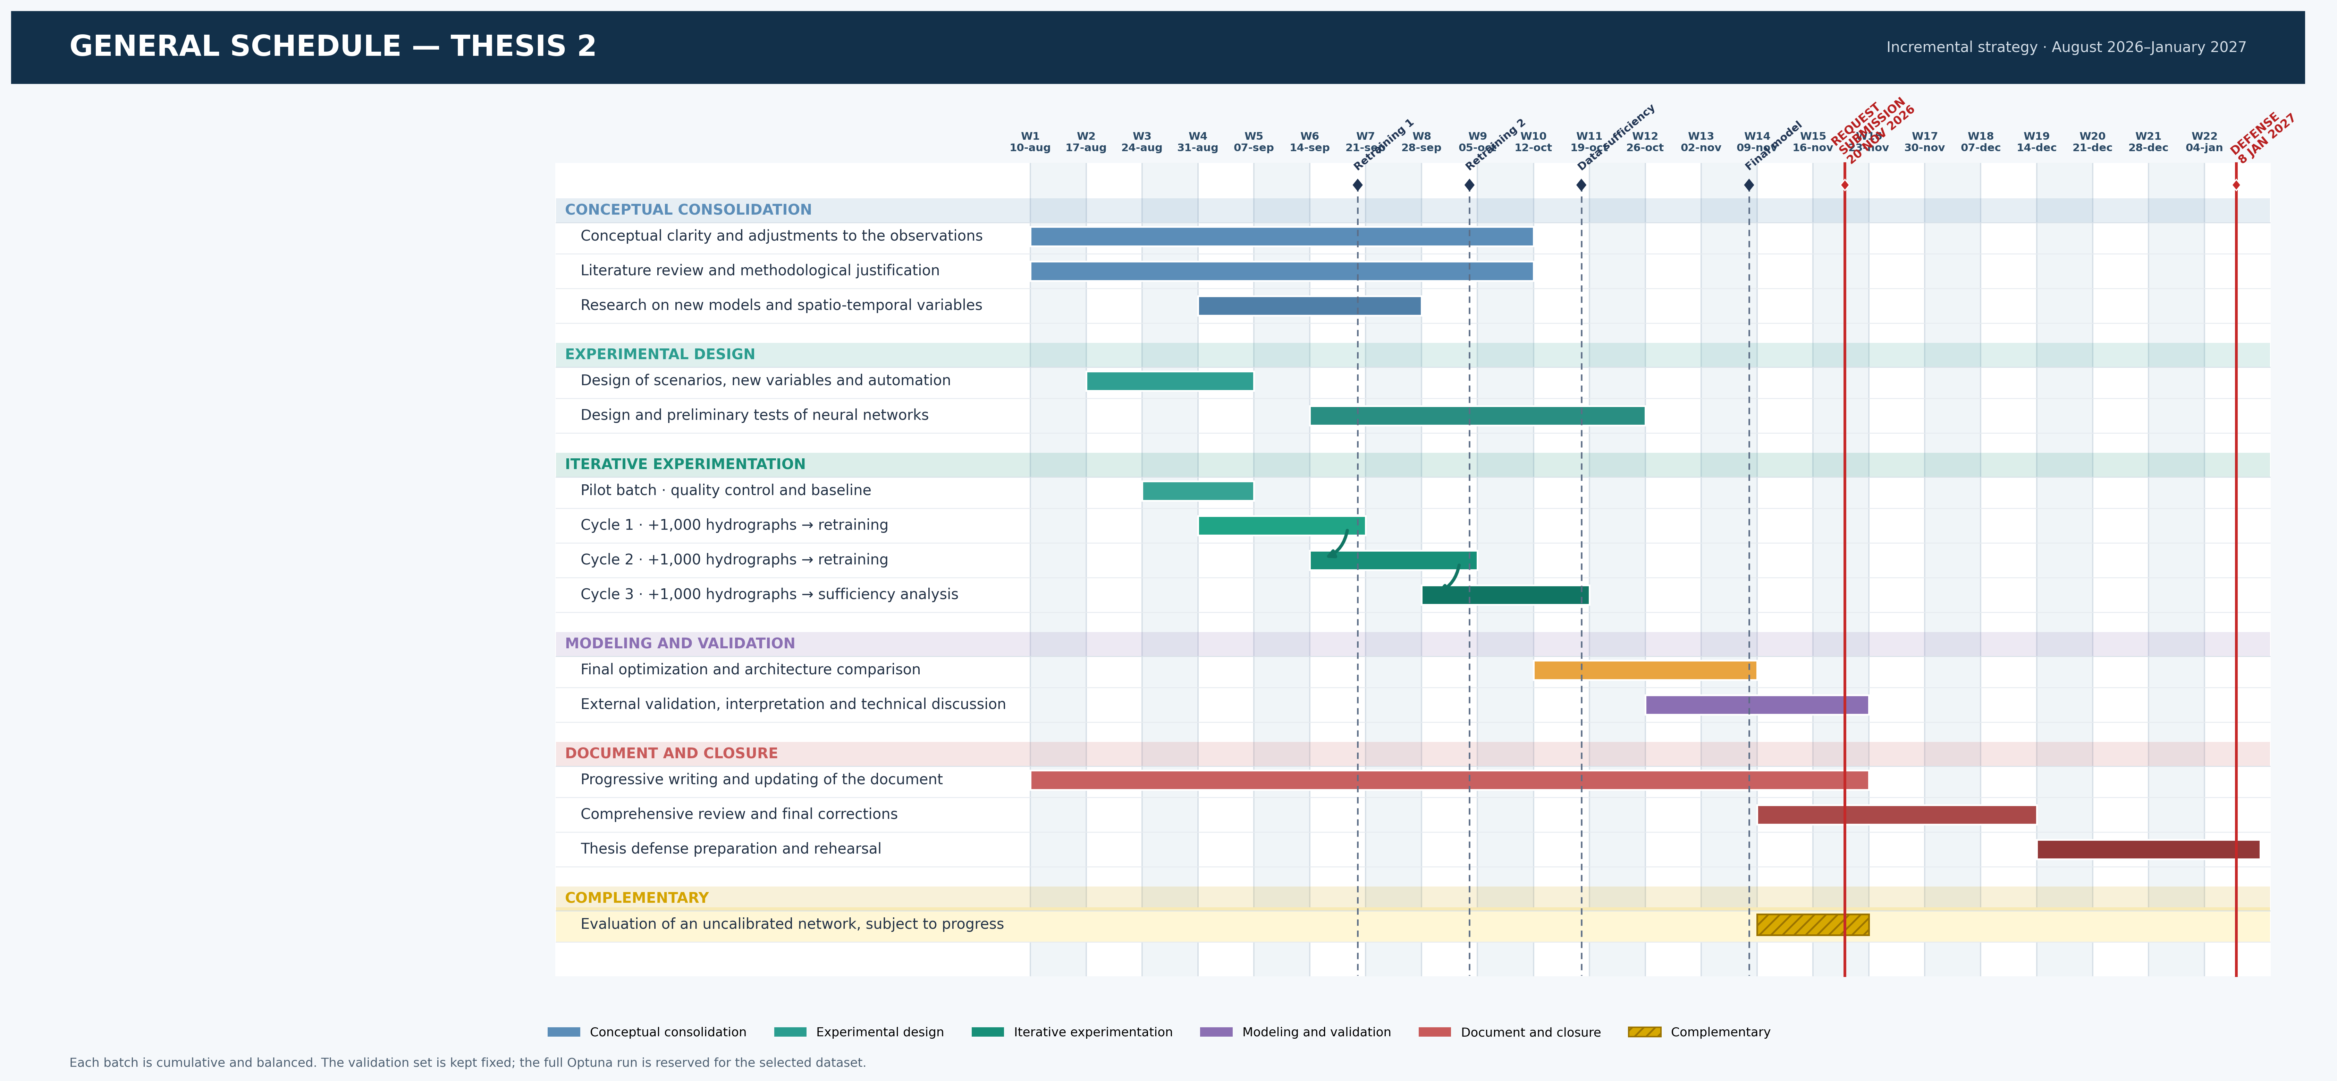
Thesis II Schedule

Slide 3
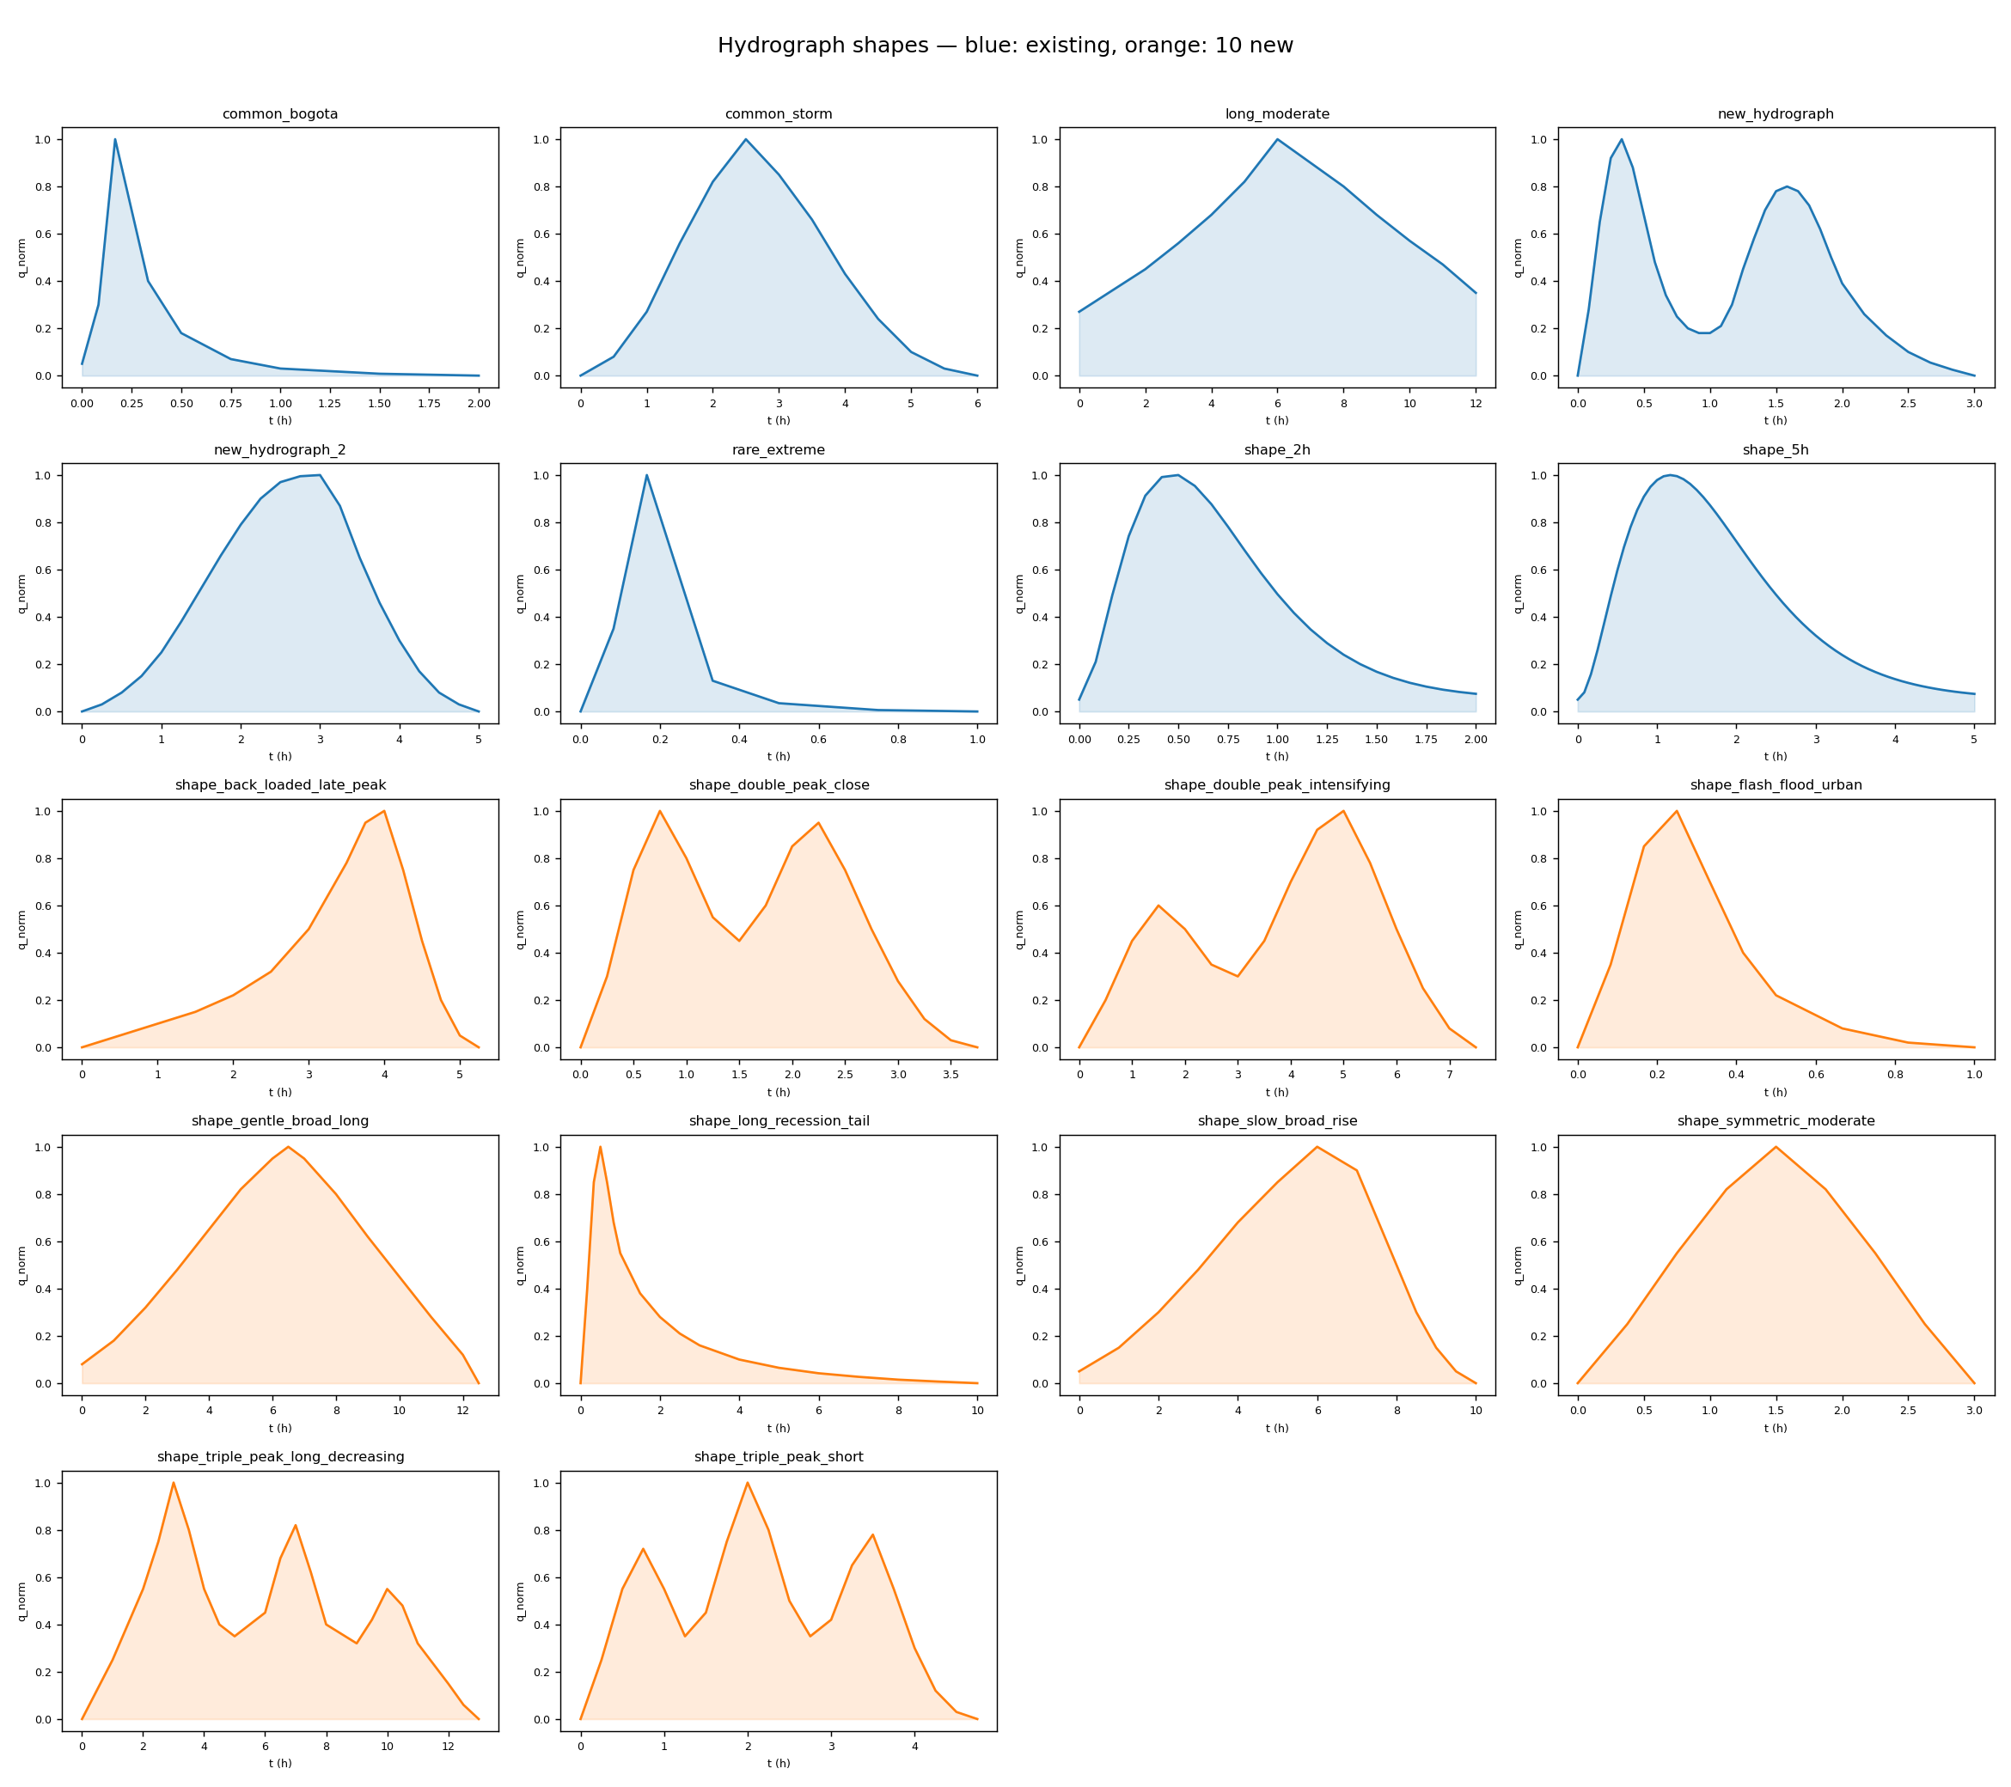

Slide 5
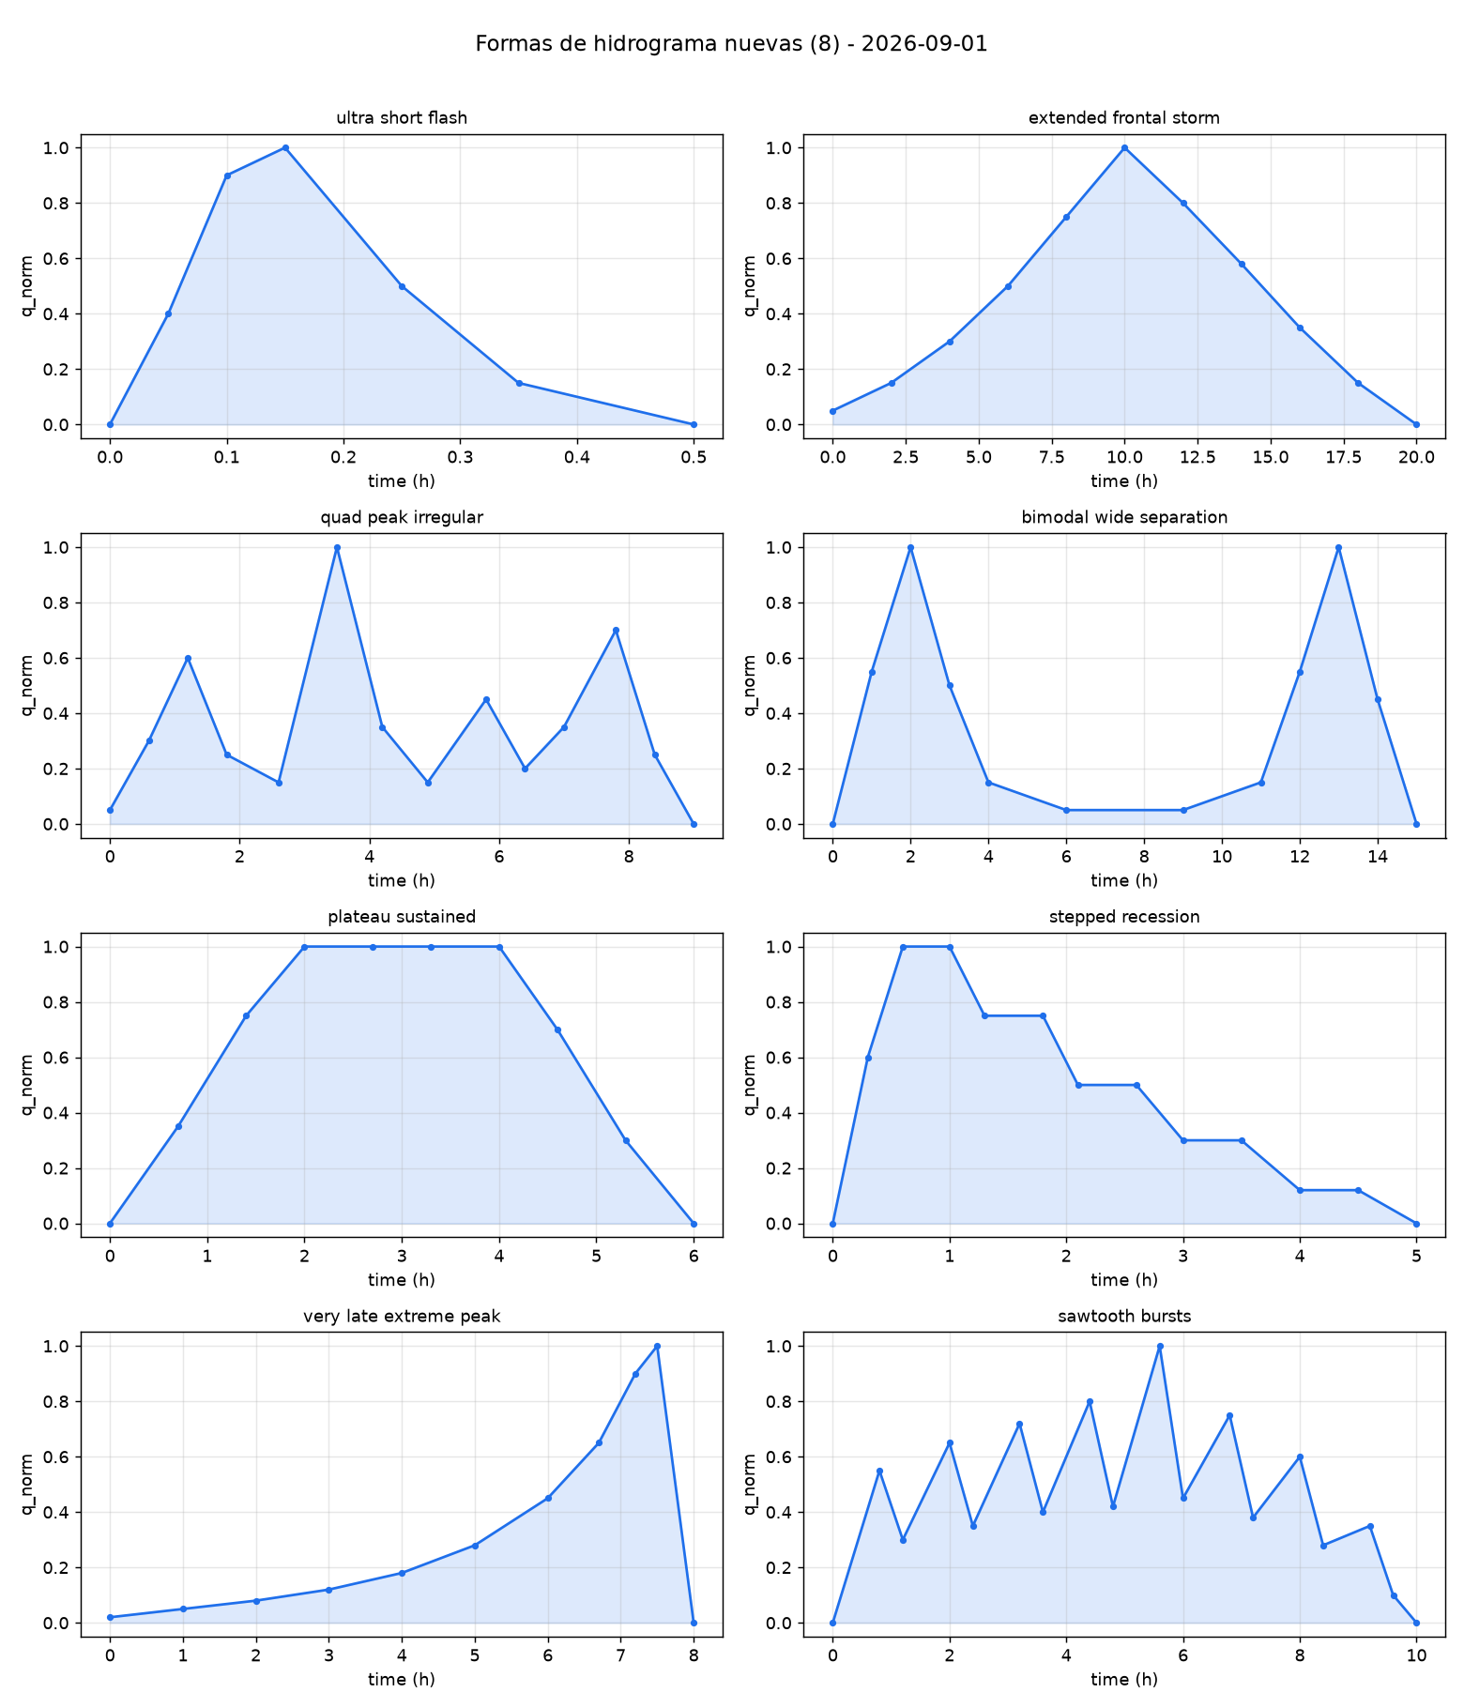

Slide 6
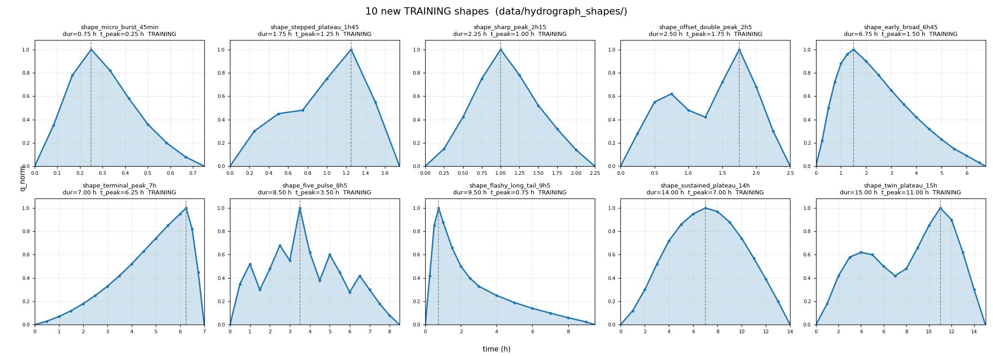

Slide 7
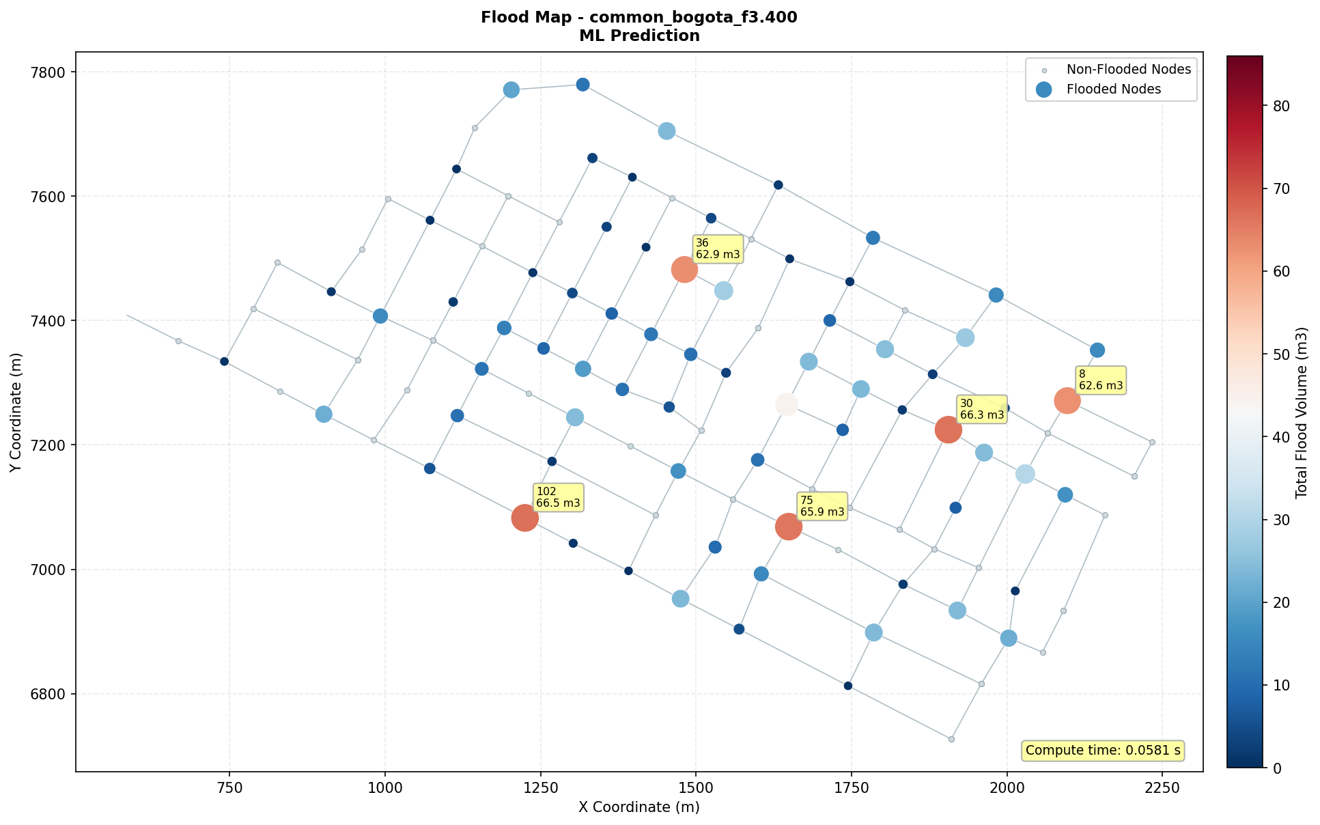
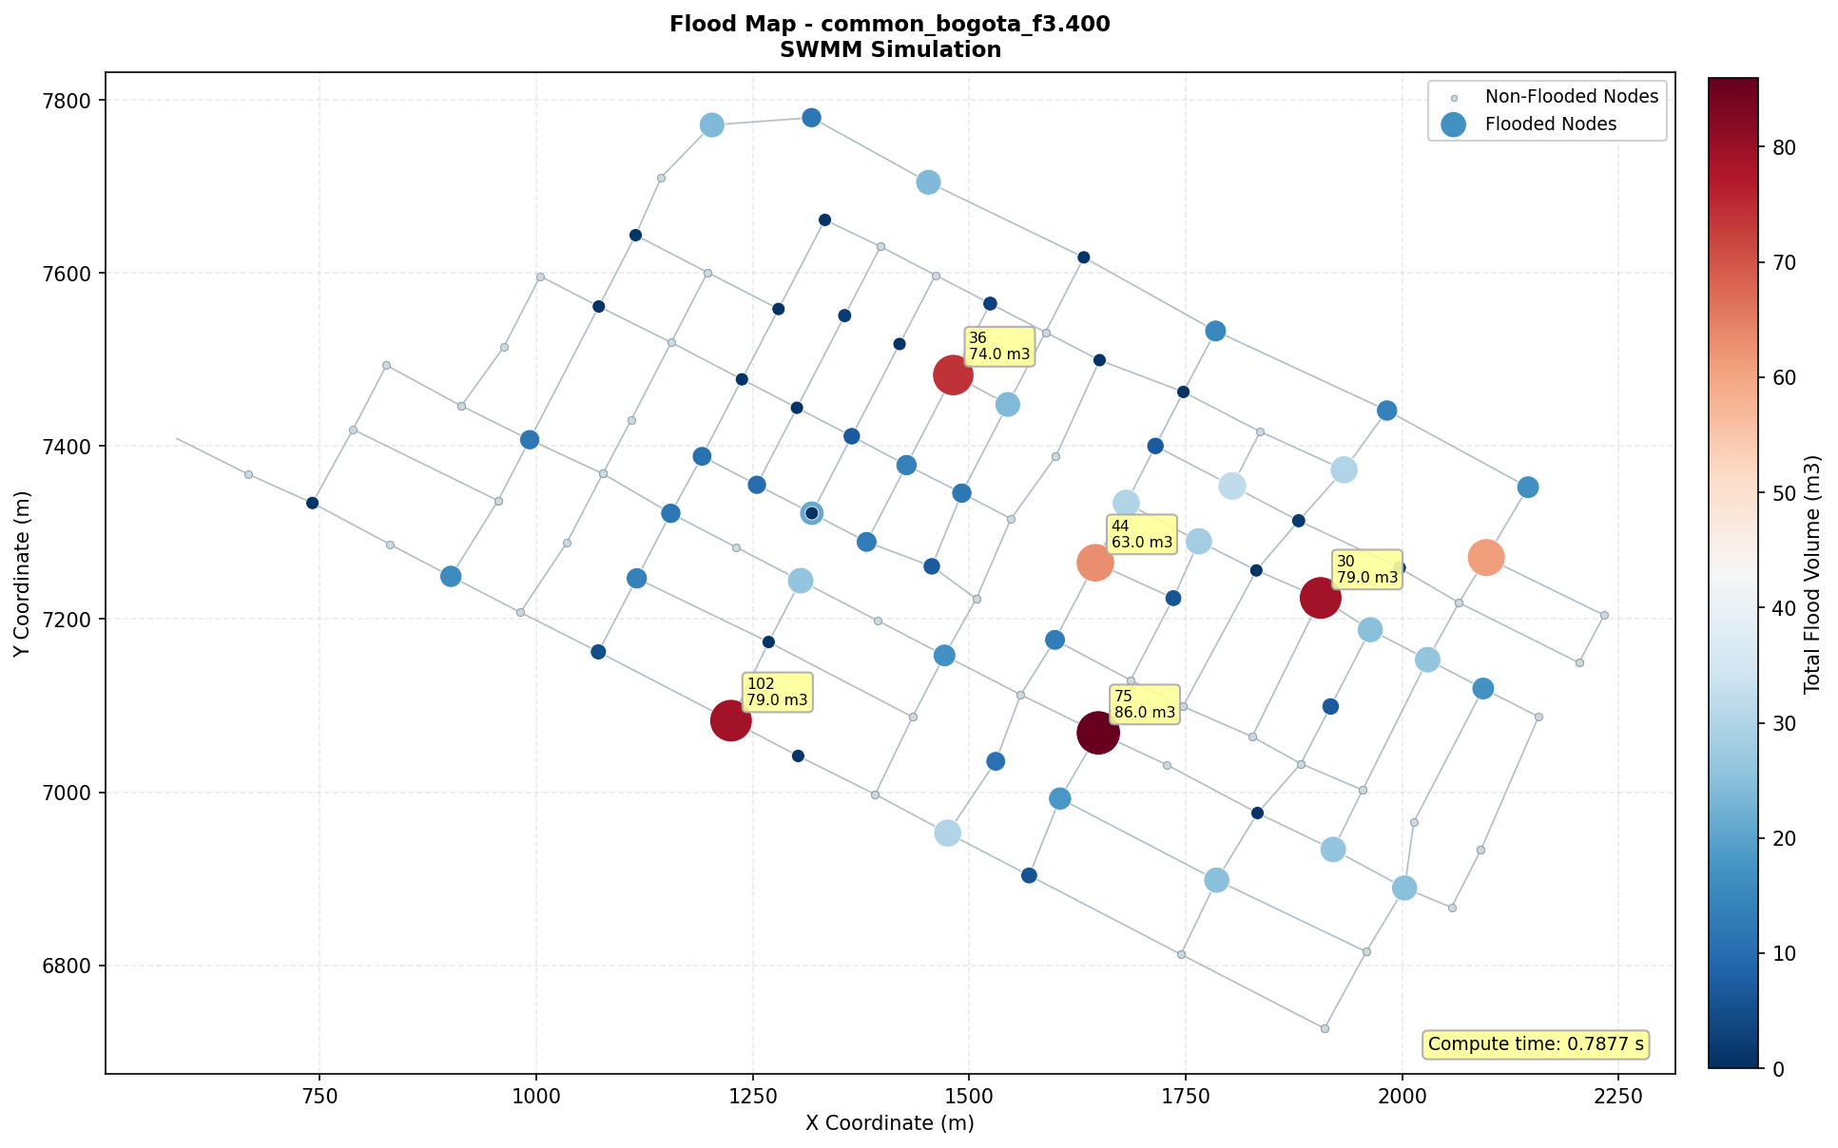
Hydrograph 1

Slide 8
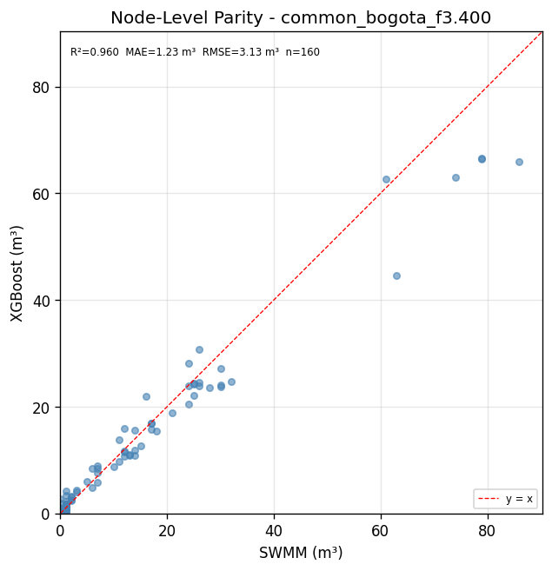
Hydrograph 1

Slide 9
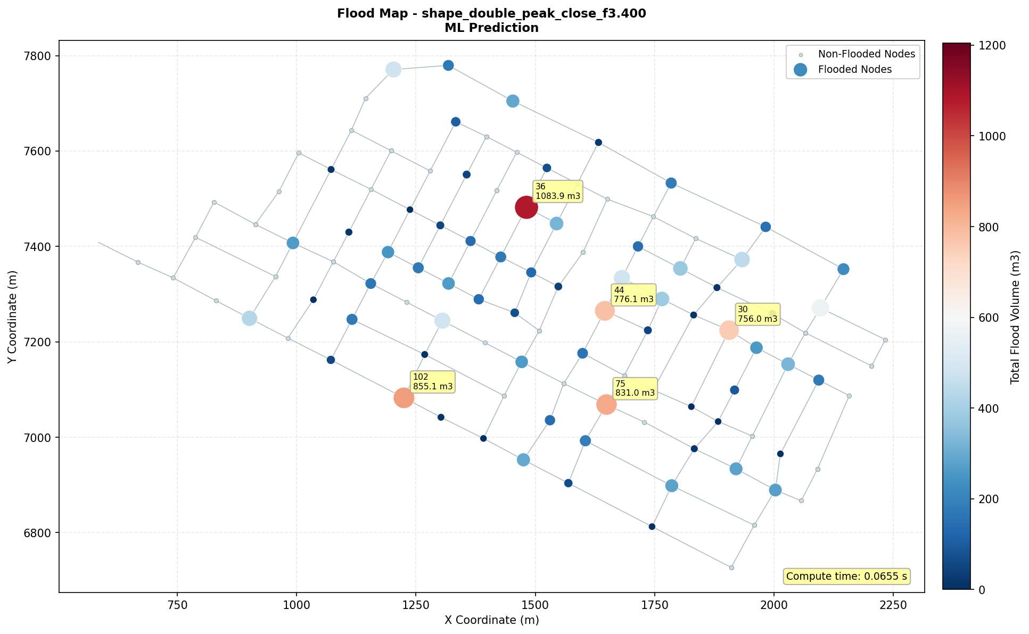
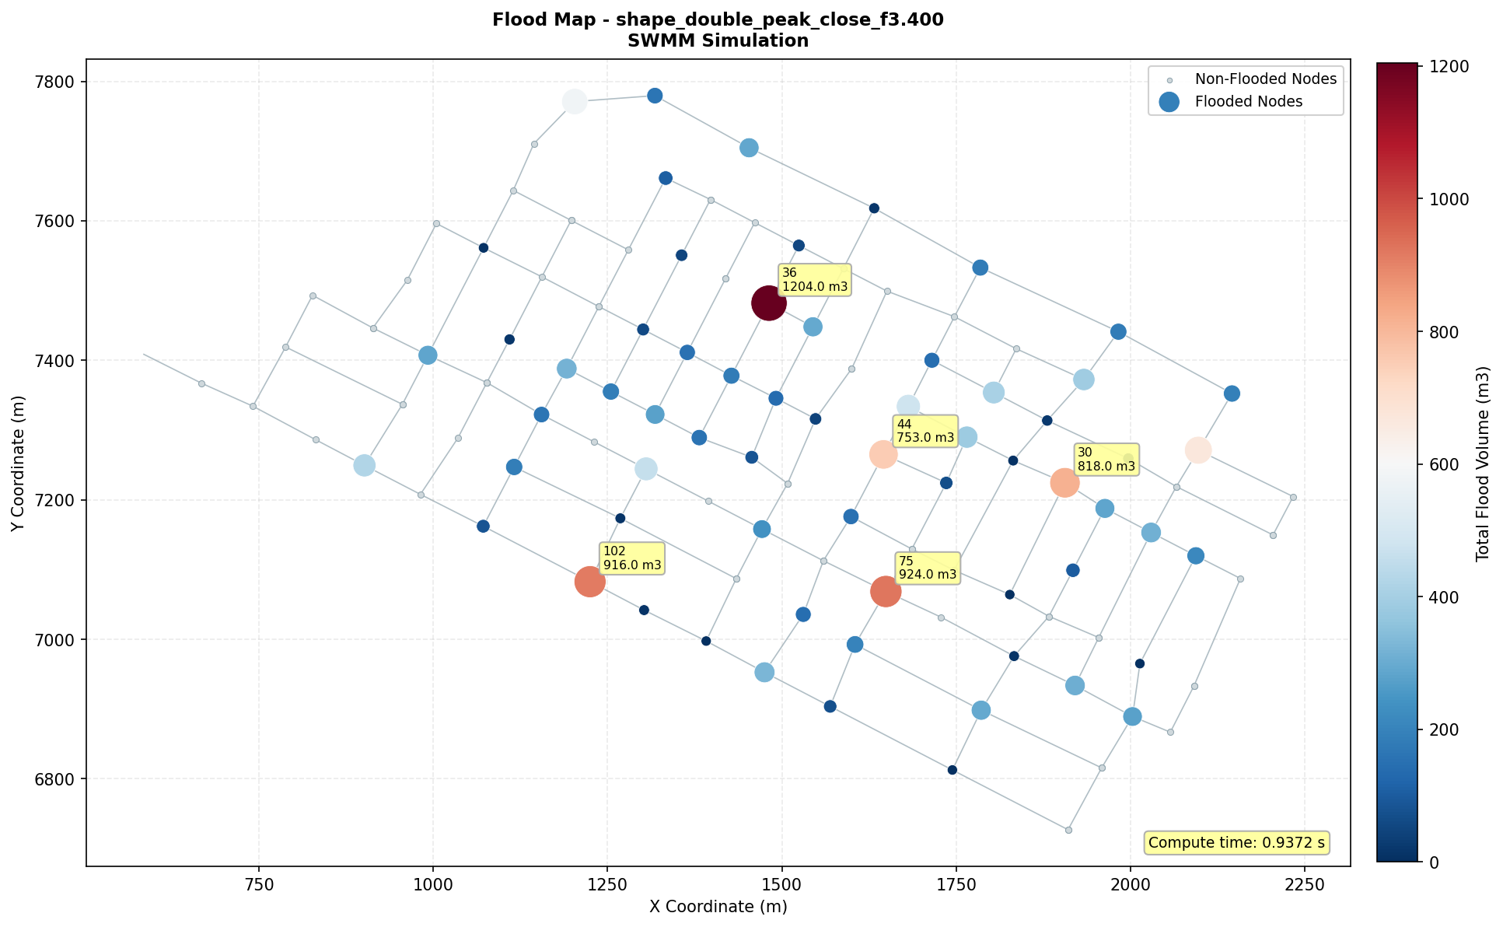
Hydrograph 2

Slide 10
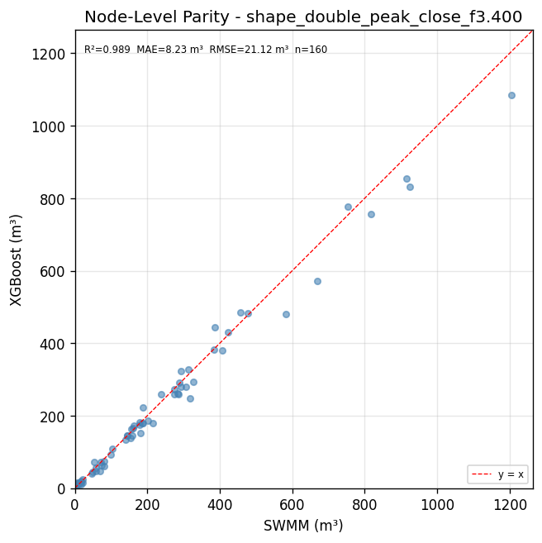
Hydrograph 2

Slide 11
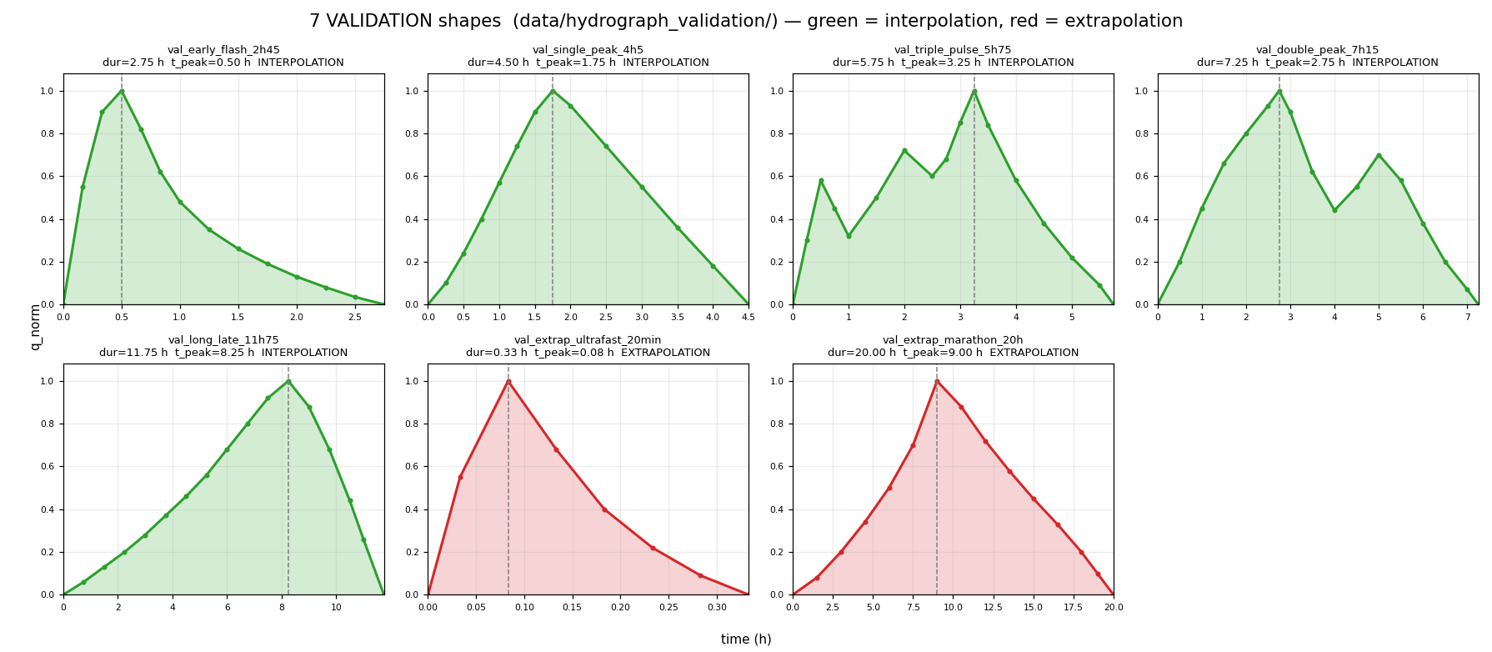
Validation hydrographs

Slide 12
Observations
1 | Substantially expand the simulation set: generate more training information before concluding that the model architecture needs to change. | All
2 | Increase the diversity of the training scenarios: incorporate extreme events, infrequent combinations, and conditions outside the range currently considered. | All
3 | Explain the binary classification clearly: describe the criterion used to decide whether a node floods or not and how the classes are assigned. | Raziyeh Farmani
4 | Examine in more depth the information that drives the classification: analyze which variables and hydraulic conditions lead the model to predict flooding or no flooding. | Raziyeh Farmani
5 | Clarify the terminology of the hydraulic variables: define precisely the difference between incoming discharge, inflow, and the variables related to flow magnitude or scaling. | Raziyeh Farmani
6 | Ensure a fair comparison between models: state explicitly that all were trained and evaluated with the same data, splits, metrics, and validation procedures. | Raziyeh Farmani
7 | Incorporate temporal, spatial, and topological information: include descriptors of the event evolution, of the prior hydraulic state, and of the relationships between neighboring, upstream, and downstream nodes. | Raziyeh Farmani, Alejandra Tabares

Slide 13
Observations
8 | Implement a systematic hyperparameter search: explain the automated procedure clearly and use Bayesian optimization, for example with Optuna. | Alejandra Tabares, Raziyeh Farmani
9 | Redefine the main research objective: specify whether the purpose is to develop a surrogate model to speed up hydraulic simulations, to support real-time decisions, or to combine both scopes. | Pedro Iglesias
10 | Explain the overall model architecture more clearly: identify the input variables, the predicted outputs, and the relationship between them. | Pedro Iglesias
11 | Improve the interpretation of variable importance: explain how importance is computed and how it should be interpreted from a hydraulic perspective. | Pedro Iglesias
12 | Assess the sufficiency and representativeness of the dataset: justify whether the number and diversity of simulations are adequate to train the models and to evaluate their generalization capacity. | Pedro Iglesias
13 | Justify the choice of algorithms in more depth: explain why linear models, support vector machines, and XGBoost were evaluated, including their advantages and limitations. | Pedro Iglesias
14 | Analyze the influence of the main hyperparameters: evaluate how parameters such as maximum depth, number of trees, learning rate, and subsampling affect performance. | Pedro Iglesias
15 | Extend the validation to new scenarios: evaluate the model's ability to extrapolate beyond the training range and identify the conditions under which its predictions stop being reliable. | Pedro Iglesias

Slide 14
Observations
16 | Deepen the technical discussion of the results: interpret performance from a hydraulic perspective, analyze the causes of the errors, and discuss limitations and practical implications. | Pedro Iglesias
17 | Strengthen the literature review: broaden and update the state of the art, specify the research gap, and explain how the work contributes to addressing it. | Pedro Iglesias
18 | Reinforce methodological rigor and reproducibility: justify methodological decisions, document the procedures, and support them with scientific literature. | Pedro Iglesias
19 | Explore spatiotemporal neural architectures: after expanding the data and improving the variables, evaluate an RNN and CNN combination to represent temporal evolution and relationships between nodes. | Alejandra Tabares
20 | Evaluate an uncalibrated hydraulic network as a complementary analysis: analyze how model performance changes and study the uncertainty associated with the simulations. | Alejandra Tabares
21 | Define state variables for multi-peak events: incorporate information such as the volume stored before each pulse to represent the residual storage of the network. | Jaime Plazas

Slide 15
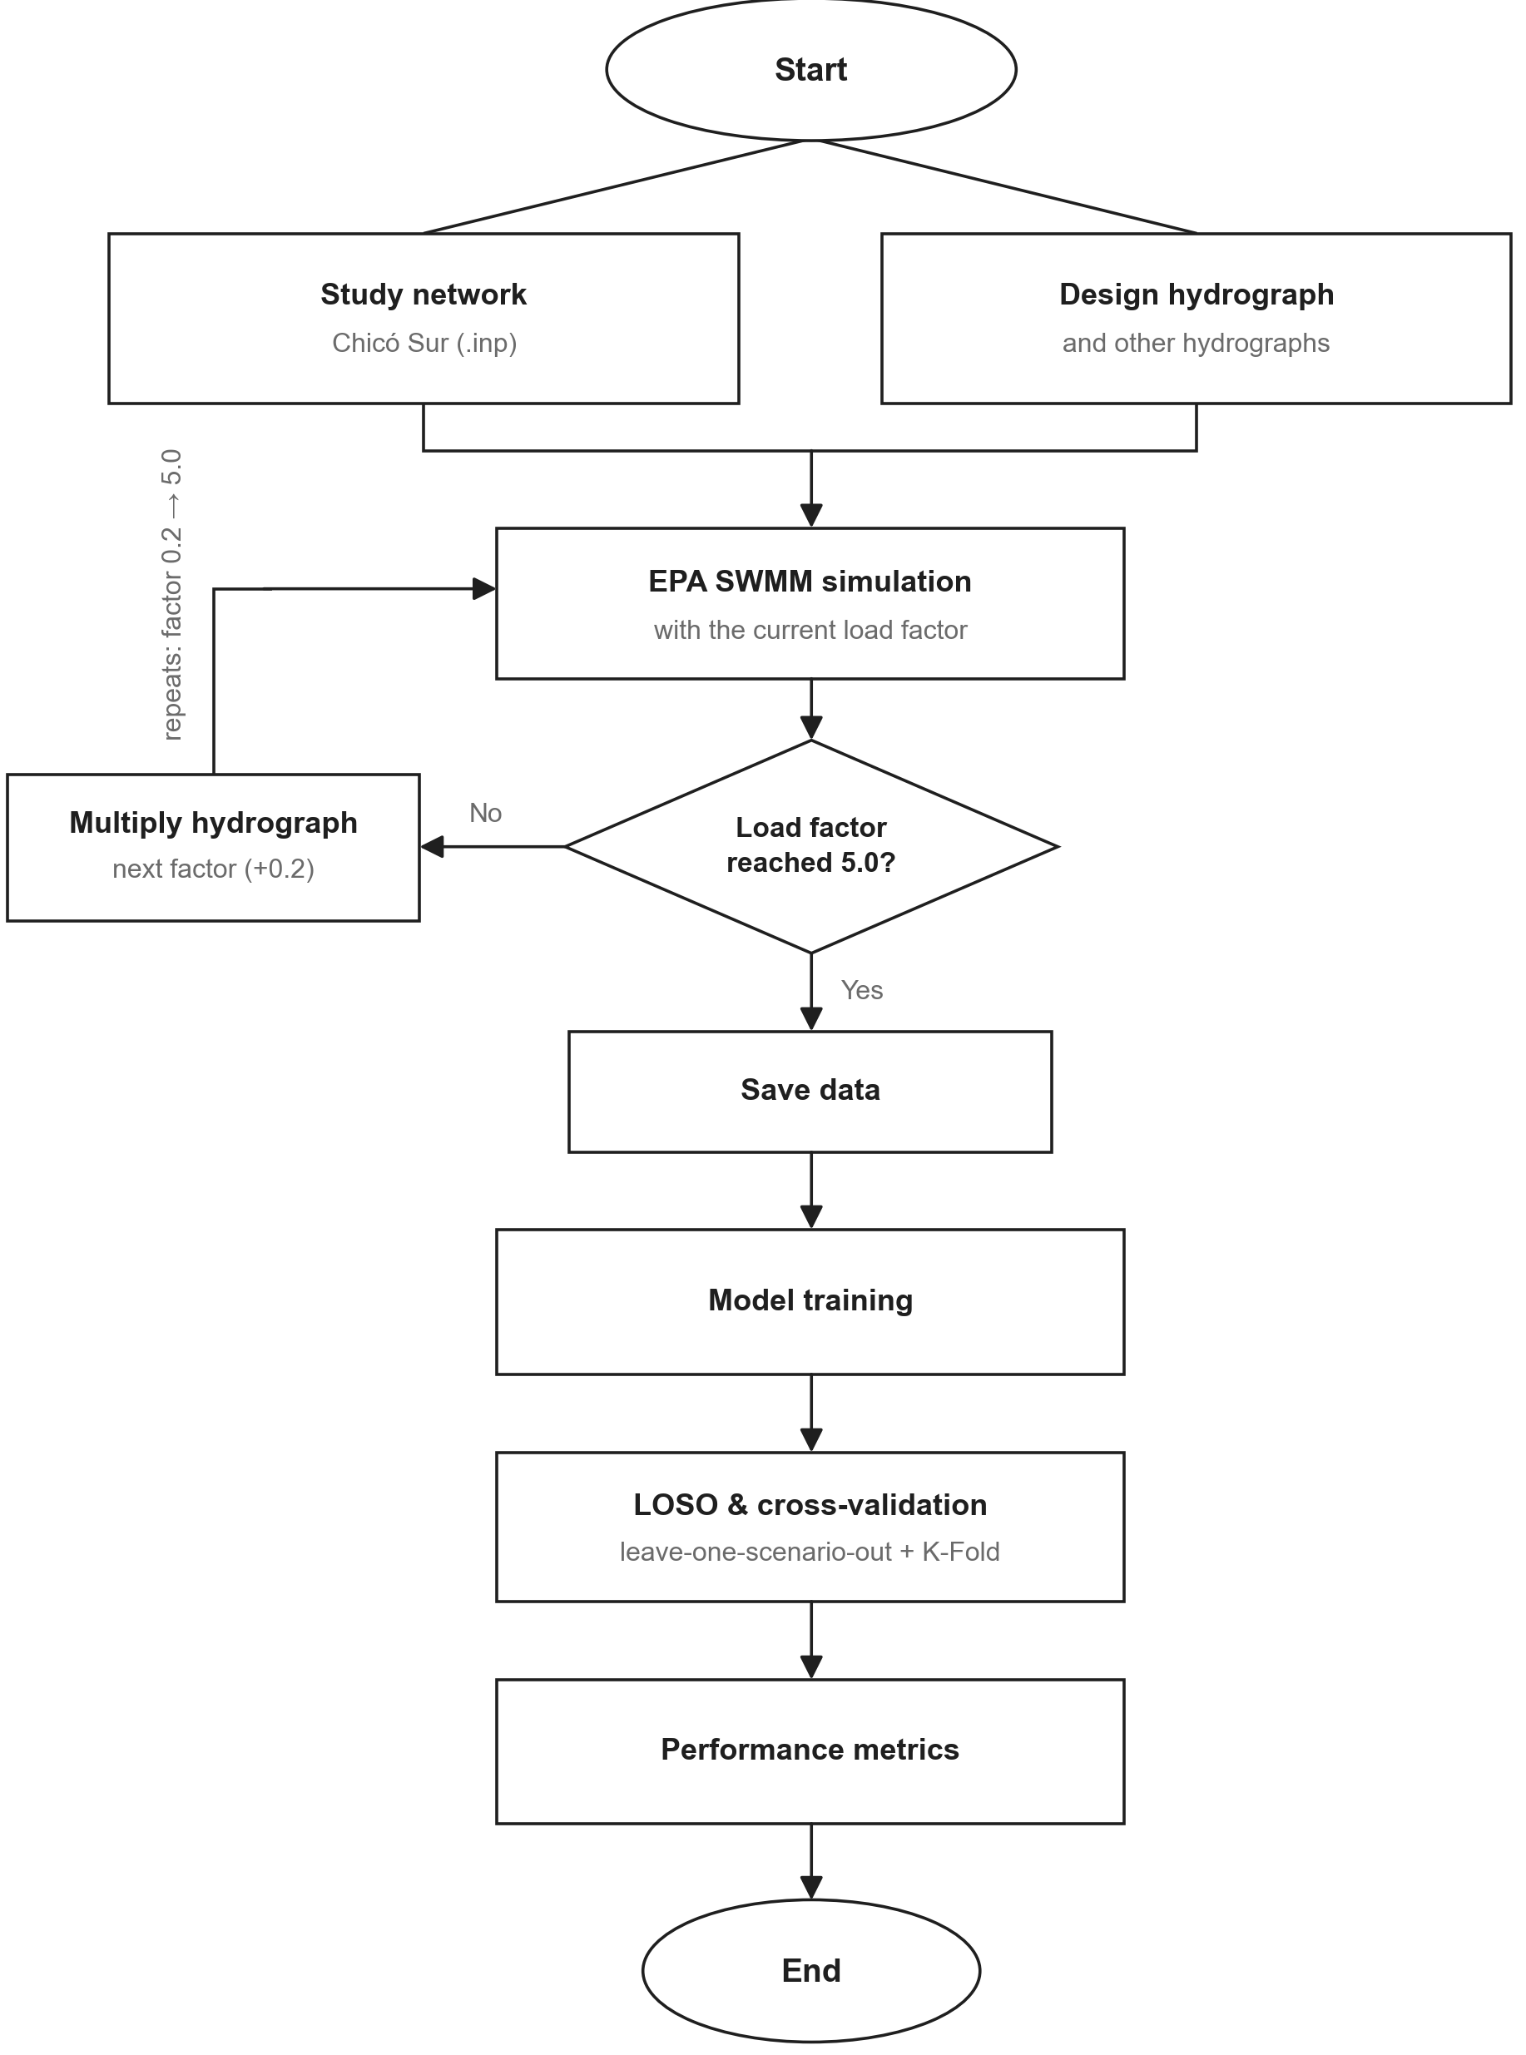
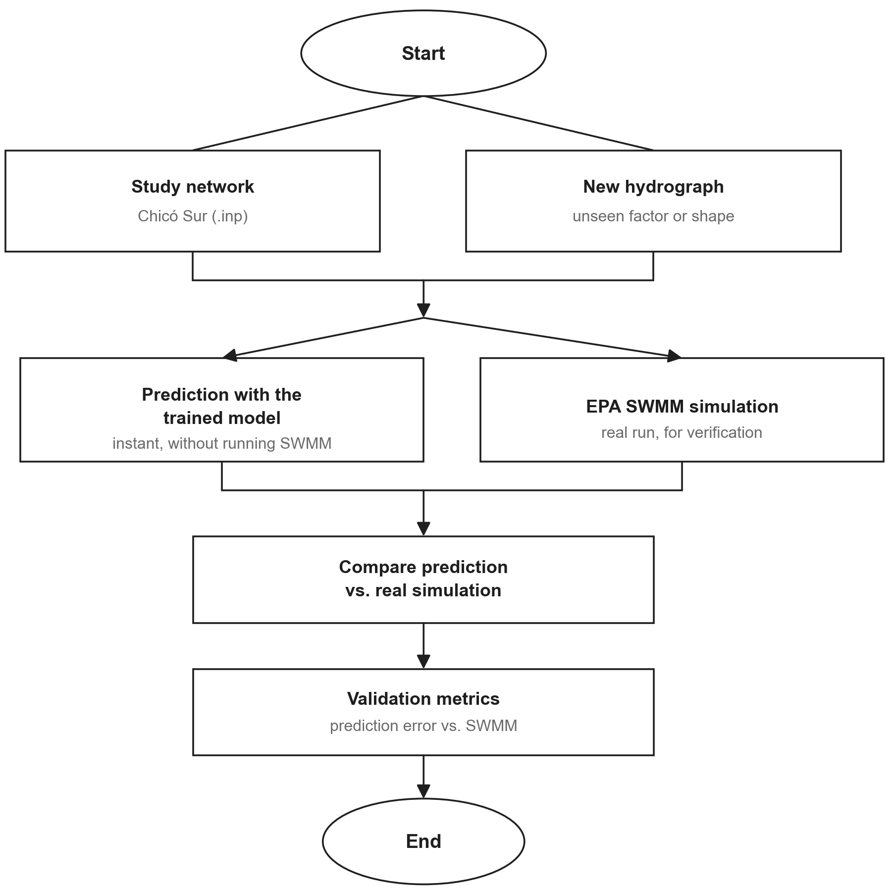
Data handling and model training workflow
Model validation workflow

Slide 16
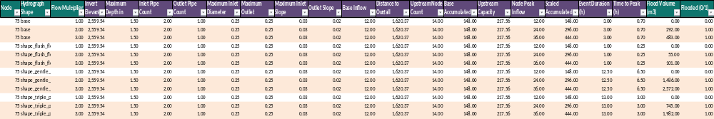
Example database – Node 75
Green: Identifiers and response values; they are not model inputs
Purple: Input variables or features, the values and information the model takes as input

Slide 17
Is it worth replacing XGBoost?
Target: flooding and total volume per node. Additional complexity requires a demonstrated gain.
Route | Indicative effort* | Decision for the thesis
Keep and strengthen XGBoost | Diverse data + validation by shape family | PRIORITY 1. It is the reference that already works; test where it fails.
Existing tabular MLP | 30–60 h · 1–2 weeks | PRIORITY 2. Controlled neural comparison with the same 17 inputs.
GNN / temporal model | 120–240 h · 4–8 weeks | CONDITIONAL. Only if it improves extremes, topology, or required dynamics.
Transfer between networks | 180–300 h · 6–10 weeks | SECOND STAGE. Requires other networks and testing on the target.
MLSMFP | Critical literature review | September 22, 2026
17

Slide 18
What we have and what remains to be measured
Local data inspected: Chico Sur; one network, SWMM labels, and synthetic scenarios.
Aspect | Status / implication
Current data | 160 nodes and 160 pipes; no subcatchments or rain gauges. Hydrograph inputs; 17 tabular features.
Additional variables | Geometry and connectivity: recover the INP. State and flow series: prepare/export. Rainfall–runoff: new hydrological scope.
Locally available GPU | NVIDIA T400, 4 GB. A larger GPU used in a paper is not a demonstrated minimum requirement. Test memory and time first.
Cost assumptions | One person with Python/SWMM; 30 h/week. Includes data, adaptation, and validation; excludes waiting, licenses, and training from scratch.
What we cannot promise | Local simulation/training times not yet benchmarked. Synthetic labels demonstrate SWMM emulation, not accuracy against field data.
MLSMFP | Critical literature review | September 22, 2026
18

Slide 19
P1 · Zhang et al. (2024)
Extended English synthesis, faithful to the published abstract. It is not a verbatim reproduction; DOI is clickable below.
EXTENDED ENGLISH ABSTRACT / SYNTHESIS
Water Research 263, 122142
Physics-based drainage simulators are often too slow for online prediction. This study develops a graph-neural surrogate for hydraulic routing in urban drainage networks, using recent hydraulic states as initial conditions and future runoff and control actions as boundary conditions. The model represents the network through node–pipe relationships and adds physics-guided mechanisms that constrain predictions through flow-balance and flooding-occurrence relationships. In a stormwater case study, the GNN surrogate was more accurate and more cost-effective than a fully connected neural network after the same training budget. The physical constraints reduced errors and improved interpretability. The authors present the approach as a fast, interpretable alternative for real-time hydraulic prediction relative to a physics-based simulator.
CityU Hong Kong (institutional repository)
Transfer / extrapolation
NOT demonstrated for another network. One case study; new storms are not equivalent to a new topology.
Value for this thesis
High hydraulic proximity. Study flood classification and balance; adopting the whole model widens the temporal scope.
DOI 10.1016/j.watres.2024.122142
EST. 120–210 h / 4–7 wk. Data 40–70 h; GNN and validation 80–140 h. Decision: conditional.
MLSMFP | Critical literature review | September 22, 2026
19
Notes:
Graph neural network-based surrogate modelling for real-time hydraulic prediction of urban drainage networks
*Computational details are from the preprint; the peer-reviewed publication was verified. Cross-check against the publisher version before replicating.
Source: https://arxiv.org/pdf/2404.10324
Code: https://github.com/Zhiyu014/GNN-UDS
Extended English synthesis is an original paraphrase; consult the DOI for the publisher abstract.

Slide 20
P2 · Palmitessa et al. (2022)
Extended English synthesis, faithful to the published abstract. It is not a verbatim reproduction; DOI is clickable below.
EXTENDED ENGLISH ABSTRACT / SYNTHESIS
Water Research 223, 118972
This work demonstrates physics-guided machine learning as a fast surrogate for urban-drainage hydraulics. The neural surrogate is trained from a limited collection of high-fidelity hydrodynamic simulations and preserves distributed predictions of water levels, pipe flows, and surcharge flows across all nodes and links. It is formulated autoregressively, with runoff as a boundary input and physical constraints that retain plausible states. In the reported cases, surrogate runs are one to two orders of magnitude faster than the high-fidelity model while time-series agreement is around R² = 0.9; training takes approximately one hour. The authors identify interactive design, real-time use, and future extension to other water systems as application areas, while noting that transfer learning and GNNs remain future opportunities rather than demonstrated cross-network transfer.
Technical University of Denmark
Transfer / extrapolation
Does NOT prove weight transfer. Two systems evaluate the methodology; they do not demonstrate a universal model without retraining.
Value for this thesis
Very useful for per-node volume, extremes, and physical constraints. Replacing MIKE 1D with SWMM would be an adaptation.
DOI 10.1016/j.watres.2022.118972
EST. 120–180 h / 4–6 wk. Data 30–60 h; adaptation/testing 90–120 h. Decision: use the ideas, do not replicate yet.
MLSMFP | Critical literature review | September 22, 2026
20
Notes:
Accelerating hydrodynamic simulations of urban drainage systems with physics-guided machine learning
Published text, sections 2.3–2.6, 3.2, and 3.5. Its timings do not include our development and do not carry over to our network.
Source: https://backend.orbit.dtu.dk/ws/portalfiles/portal/282620979/1_s2.0_S0043135422009198_main.pdf
Code:
Extended English synthesis is an original paraphrase; consult the DOI for the publisher abstract.

Slide 21
P3 · Garzón et al. (2024)
Extended English synthesis, faithful to the published abstract. It is not a verbatim reproduction; DOI is clickable below.
EXTENDED ENGLISH ABSTRACT / SYNTHESIS
Water Research 266, 122396
This paper proposes an autoregressive GNN metamodel of EPA SWMM to estimate hydraulic heads in stormwater networks. It addresses the data cost of conventional fully connected neural networks by incorporating temporal, physical, and graph-relational inductive biases. The model uses topology, pipe information, runoff histories, and recent states to predict future nodal heads, then feeds predictions back through time. The study reports that the GNN reaches high accuracy and speed-up using fewer examples than fully connected baselines. Its transfer test applies the model to an unseen section of the same drainage network and obtains accurate head predictions. The contribution is therefore important for data-efficient topology-aware modelling, but it does not establish zero-shot generalization to a different city or independently designed network, and its output is hydraulic head rather than event-total overflow volume.
TU Delft
Transfer / extrapolation
PARTIAL: zero-shot to an unseen subnetwork of the same system. It does not demonstrate transfer to another city or an independent network.
Value for this thesis
Public code and data. Good GNN starting point; predicting levels does not by itself solve our overflow volume.
DOI 10.1016/j.watres.2024.122396
EST. 120–240 h / 4–8 wk. Data 30–60 h; GNN and volume output 90–180 h. Decision: second stage.
MLSMFP | Critical literature review | September 22, 2026
21
Notes:
Transferable and data efficient metamodeling of storm water system nodal depths using auto-regressive graph neural networks
Published text, sections 2.1, 2.4, 4.3–4.4, and 6.2.3. Limited transfer and a different target from the thesis.
Source: https://repository.tudelft.nl/file/File_82fef3ff-9a5f-4275-bd8f-6a4eb06c463d
Code: https://github.com/alextremo0205/SWMM_GNN_Repository_Paper_version
Extended English synthesis is an original paraphrase; consult the DOI for the publisher abstract.

Slide 22
P4 · Garzón et al. (2026)
Extended English synthesis, faithful to the published abstract. It is not a verbatim reproduction; DOI is clickable below.
EXTENDED ENGLISH ABSTRACT / SYNTHESIS
Water Research 290, 125079
This study systematically evaluates GNN components for urban-drainage metamodels: graph-layer type, processor depth, and multi-step prediction window. It also tests transfer across two hydraulically distinct Dutch drainage networks and across tasks, from hydraulic-head prediction to flow prediction. Moderate depth and ten-step windows achieved accurate heads and flows, while GPU-parallel simulations produced large speed-ups relative to SWMM. Crucially for this thesis, direct zero-shot transfer is not presented as sufficient: normalization and full fine-tuning on the target are required for cross-domain adaptation. Joint training across the two networks learns useful shared representations, but it is not proof of performance on a third unseen network. The paper gives a concrete protocol for comparing pretraining, zero-shot use, and fine-tuning instead of treating them as equivalent.
TU Delft
Transfer / extrapolation
YES, WITH ADAPTATION between two networks. Zero-shot was poor; fine-tuning recovers performance. Joint training does not prove performance on a third unseen network.
Value for this thesis
Reference for a future transfer. It requires several networks and adapts heads/flows, not flood volume directly.
DOI 10.1016/j.watres.2025.125079
EST. 180–300 h / 6–10 wk, not counting obtaining networks. Data 60–100 h; transfer 120–200 h. Decision: postpone.
MLSMFP | Critical literature review | September 22, 2026
22
Notes:
Evaluation of graph neural networks for urban drainage metamodeling: Key components and transferability analysis
Published text, sections 3.3–3.6 and 5.3; code README. An A100 being used does not mean an A100 is required.
Source: https://repository.tudelft.nl/file/File_1cf09147-d8d4-4be3-8b42-f2e508ab64a6
Code: https://github.com/alextremo0205/SWMM_GNN_Component_Evaluation_and_Transferability_Analysis
Extended English synthesis is an original paraphrase; consult the DOI for the publisher abstract.

Slide 23
P5 · Brazão et al. (2026)
Extended English synthesis, faithful to the published abstract. It is not a verbatim reproduction; DOI is clickable below.
EXTENDED ENGLISH ABSTRACT / SYNTHESIS
J. Water Resources Planning and Management (ASCE), 152(11)
This paper evaluates MLP surrogate models trained from SWMM simulations to estimate total flood volume and maximum outflow for decentralized detention-system design. The models include detention capacity, outlet dimensions, spatial distribution of storage units, and rainfall descriptors, addressing design variables omitted by earlier end-of-pipe studies. A real urban catchment is simulated under multiple detention and rainfall scenarios; the authors evaluate dataset size and network architecture before embedding the models in multiobjective optimization. Reported errors are below 4% MAPE for maximum outflow in all rainfall scenarios and below 15% MAPE for total flood volume in most scenarios. Moving from 20,000 to 50,000 samples gave only marginal gains, whereas deeper MLPs improved accuracy until overfitting appeared. The surrogate optimization reduced computational time by about 98.4% against equivalent SWMM optimization.
Federal University of Paraíba / University of Brasília
Transfer / extrapolation
NOT documented in the available abstract. Total volume reported; do not confirm per-node output or transfer without the full text.
Value for this thesis
Supports an inexpensive MLP comparator. It does not establish that an MLP outperforms XGBoost on our same inputs and splits.
DOI 10.1061/JWRMD5.WRENG-7598
EST. 30–60 h / 1–2 wk. Data 6–12 h; MLP and testing 24–48 h. Decision: priority pilot.
MLSMFP | Critical literature review | September 22, 2026
23
Notes:
Evaluation of Artificial Neural Network Surrogate Models for Detention-Based Flood Control in Urban Areas
Publisher abstract and affiliations only. Published online September 3, 2026; journal issue November 2026.
Source: https://ascelibrary.org/doi/abs/10.1061/JWRMD5.WRENG-7598
Code:
Extended English synthesis is an original paraphrase; consult the DOI for the publisher abstract.

Slide 24
Data, resources, and effort · P1–P2
REPORTED = evidence consulted. ESTIMATED = planning for our thesis, not a benchmark or a schedule promise.
Paper | Variables / preparation missing | Reported resources | Adaptation cost and decision
P1 · Zhang et al. (2024) | Still to prepare: h(t), Q(t), inflow/outflow, and flooding(t). Connectivity: recoverable from the INP. Define the initial states available at inference. | REPORTED*: RTX A5000 24 GB; GNN ≈2.14 h per training run (20,000 epochs). Not a required minimum nor a local time. | EST. 120–210 h / 4–7 wk. Data 40–70 h; GNN and validation 80–140 h. Decision: conditional.
P2 · Palmitessa et al. (2022) | A temporal dataset of levels, flows, and overflows is missing. Geometry: INP. Exact reproduction: MIKE 1D access/license; a SWMM adaptation avoids that dependency. | REPORTED: i9 CPU, 32 GB RAM; 0.5–2 h of training. The GPU did not speed up the autoregressive simulation in their implementation. | EST. 120–180 h / 4–6 wk. Data 30–60 h; adaptation/testing 90–120 h. Decision: use the ideas, do not replicate yet.
MLSMFP | Critical literature review | September 22, 2026
24
Notes:
P1
*Computational details are from the preprint; the peer-reviewed publication was verified. Cross-check against the publisher version before replicating.
CONDITIONAL: useful if we need temporal dynamics; do not replace XGBoost merely for novelty.
Source: https://arxiv.org/pdf/2404.10324
P2
Published text, sections 2.3–2.6, 3.2, and 3.5. Its timings do not include our development and do not carry over to our network.
USE THE IDEAS: extremes and volume errors. Full temporal implementation only with a demonstrated need.
Source: https://backend.orbit.dtu.dk/ws/portalfiles/portal/282620979/1_s2.0_S0043135422009198_main.pdf
Estimated effort is specific to adapting the method to our target, not an author-reported result.

Slide 25
Data, resources, and effort · P3–P4–P5
REPORTED = evidence consulted. ESTIMATED = planning for our thesis, not a benchmark or a schedule promise.
Paper | Variables / preparation missing | Reported resources | Adaptation cost and decision
P3 · Garzón et al. (2024) | Connectivity, elevations, and lengths: recover the INP. Prepare inflows and temporal levels. Add an overflow label/output for our target. | REPORTED: DelftBlue, V100S 32 GB GPUs for experiments/search. 100 epochs, AdamW. It does not state that size as a minimum. | EST. 120–240 h / 4–8 wk. Data 30–60 h; GNN and volume output 90–180 h. Decision: second stage.
P4 · Garzón et al. (2026) | Other networks and state/flow series; review the rainfall input. Current INP has no subcatchments/rain gauges. Review offsets, parallel edges, and special structures. | REPORTED: GPU experiments; performance on an A100 80 GB. Huber/AdamW, 25 epochs. The repository has restrictions on hydraulic elements. | EST. 180–300 h / 6–10 wk, not counting obtaining networks. Data 60–100 h; transfer 120–200 h. Decision: postpone.
P5 · Brazão et al. (2026) | Node–event adaptation: reuse the 17 features. Replicate the detention design: capacity, outlets, location, and rainfall; those scenarios are not in our INP. | NOT VERIFIED: hardware/time not available in the abstract. There is no basis for requiring a large GPU. | EST. 30–60 h / 1–2 wk. Data 6–12 h; MLP and testing 24–48 h. Decision: priority pilot.
MLSMFP | Critical literature review | September 22, 2026
25
Notes:
P3
Published text, sections 2.1, 2.4, 4.3–4.4, and 6.2.3. Limited transfer and a different target from the thesis.
SECOND STAGE: best reproducible candidate if topology adds measurable value over the MLP.
Source: https://repository.tudelft.nl/file/File_82fef3ff-9a5f-4275-bd8f-6a4eb06c463d
P4
Published text, sections 3.3–3.6 and 5.3; code README. An A100 being used does not mean an A100 is required.
POSTPONE: high cost for the current objective. Prioritize when transfer becomes a central question of the thesis.
Source: https://repository.tudelft.nl/file/File_1cf09147-d8d4-4be3-8b42-f2e508ab64a6
P5
Publisher abstract and affiliations only. Published online September 3, 2026; journal issue November 2026.
HIGH PRIORITY: scoped MLP pilot; consult the full text before attributing training details to it.
Source: https://ascelibrary.org/doi/abs/10.1061/JWRMD5.WRENG-7598
Estimated effort is specific to adapting the method to our target, not an author-reported result.

Slide 26
Criteria for investing more time
Own recommendation: first close a small, comparable experiment; decide with held-out results.
Step | What is done | Condition to continue
1 · MLP pilot 30–60 h | Same inputs and events; inner tuning and epoch selection; several seeds. | Predefined practical improvement in volume, extremes, or false negatives. Do not decide on training performance.
2 · Data before architecture | Hold out hydrograph families, multi-peak events, and extremes. Measure XGBoost and MLP. | If both fail the same way, review coverage and descriptors; more layers do not recover missing information.
3 · GNN pilot | Test a sample, small batches, and peak memory before renting a GPU. | Continue if there is a clear topological hypothesis and temporal/target data are available.
4 · Transfer | Compare from scratch, zero-shot, and fine-tuning with an equal target-data budget. | Target events held out. Do not call joint training on already-seen networks “extrapolation”.
None of these works guarantees outperforming our XGBoost with the same target, data, and validation.
MLSMFP | Critical literature review | September 22, 2026
26

Slide 27
Computational budget: measure first
Separate development person-hours, training machine-hours, and the time to generate labels.
Cost | How to estimate it for this network
Simulations | Time 20 representative events. Time ≈ N × median per event / effective parallelism; also check slow extremes.
Model search | Time ≈ configurations × folds × seeds × duration of one fit. Do not confuse “one 2 h training run” with the whole search.
Temporal data | Own example: 1,000 events × 1,440 steps × (160×3 + 160×2 variables) × 4 bytes ≈ 4.6 GB raw; without duplicated windows or caches.
GPU memory | Depends on batches, window, layers, and gradients; not on the CSV size. T400 4 GB: pilot. If it does not fit, consider a 16–24 GB GPU; do not buy one because of the paper.
Scope decision | With an event-level target and a solid XGBoost: MLP first. For GNN/transfer, reserve additional weeks only after demonstrating a need.
MLSMFP | Critical literature review | September 22, 2026
27

Slide 28
References and access level · 1/2
Full titles and clickable DOIs. The table notes contain links to texts and repositories.
P1
Zhang et al. (2024) · Graph neural network-based surrogate modelling for real-time hydraulic prediction of urban drainage networks
Water Research 263, 122142 | DOI 10.1016/j.watres.2024.122142
P2
Palmitessa et al. (2022) · Accelerating hydrodynamic simulations of urban drainage systems with physics-guided machine learning
Water Research 223, 118972 | DOI 10.1016/j.watres.2022.118972
P3
Garzón et al. (2024) · Transferable and data efficient metamodeling of storm water system nodal depths using auto-regressive graph neural networks
Water Research 266, 122396 | DOI 10.1016/j.watres.2024.122396
P4
Garzón et al. (2026) · Evaluation of graph neural networks for urban drainage metamodeling: Key components and transferability analysis
Water Research 290, 125079 | DOI 10.1016/j.watres.2025.125079
MLSMFP | Critical literature review | September 22, 2026
28
Notes:
P1 *Computational details are from the preprint; the peer-reviewed publication was verified. Cross-check against the publisher version before replicating.
https://arxiv.org/pdf/2404.10324
https://github.com/Zhiyu014/GNN-UDS
P2 Published text, sections 2.3–2.6, 3.2, and 3.5. Its timings do not include our development and do not carry over to our network.
https://backend.orbit.dtu.dk/ws/portalfiles/portal/282620979/1_s2.0_S0043135422009198_main.pdf
P3 Published text, sections 2.1, 2.4, 4.3–4.4, and 6.2.3. Limited transfer and a different target from the thesis.
https://repository.tudelft.nl/file/File_82fef3ff-9a5f-4275-bd8f-6a4eb06c463d
https://github.com/alextremo0205/SWMM_GNN_Repository_Paper_version
P4 Published text, sections 3.3–3.6 and 5.3; code README. An A100 being used does not mean an A100 is required.
https://repository.tudelft.nl/file/File_1cf09147-d8d4-4be3-8b42-f2e508ab64a6
https://github.com/alextremo0205/SWMM_GNN_Component_Evaluation_and_Transferability_Analysis

Slide 29
References and access level · 2/2
Full titles and clickable DOIs. The table notes contain links to texts and repositories.
P5
Brazão et al. (2026) · Evaluation of Artificial Neural Network Surrogate Models for Detention-Based Flood Control in Urban Areas
J. Water Resources Planning and Management (ASCE), 152(11) | DOI 10.1061/JWRMD5.WRENG-7598
MLSMFP | Critical literature review | September 22, 2026
29
Notes:
P5 Publisher abstract and affiliations only. Published online September 3, 2026; journal issue November 2026.
https://ascelibrary.org/doi/abs/10.1061/JWRMD5.WRENG-7598

Slide 30
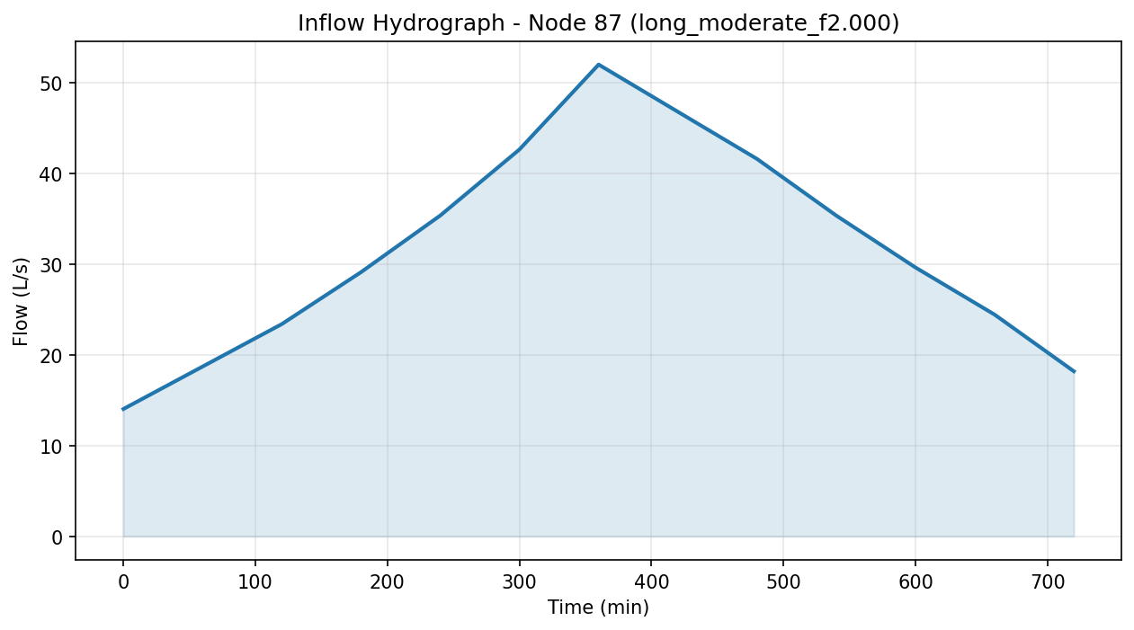
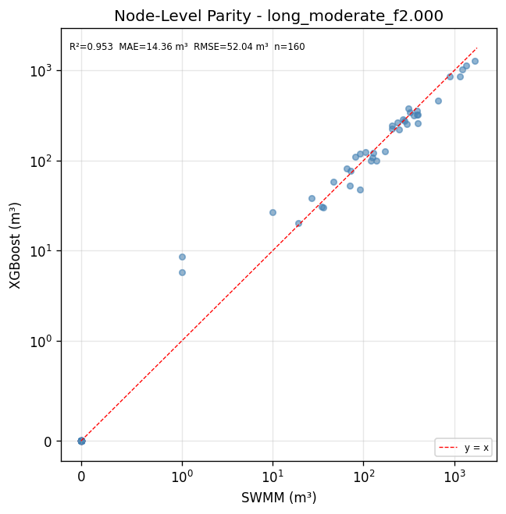
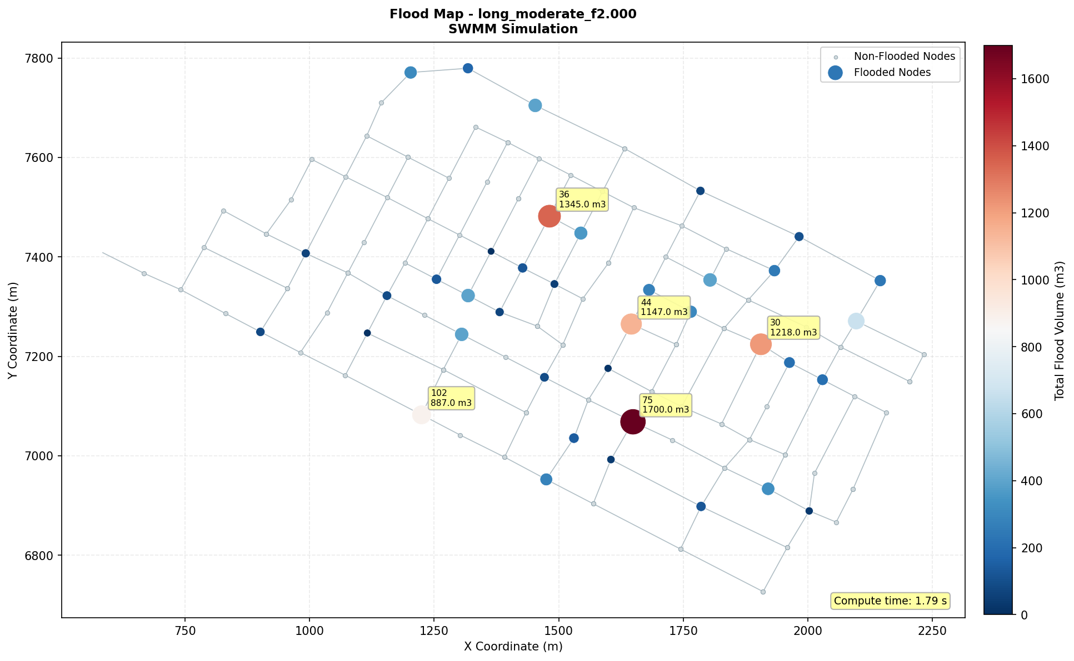
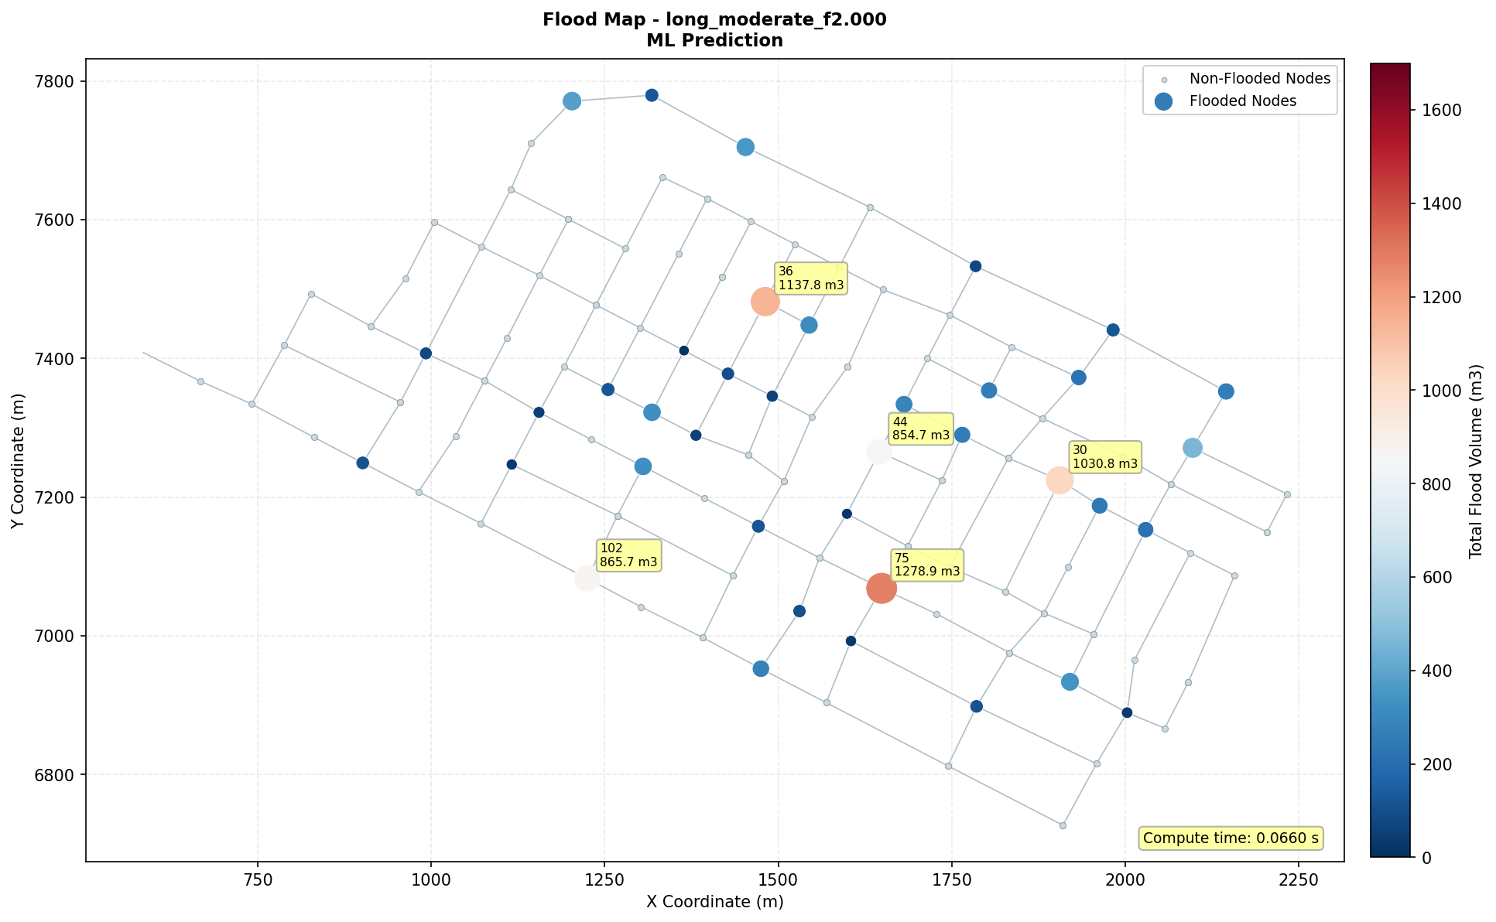
Single-scenario result: shape, maps, and parity
Synthetic scenario long_moderate · flow factor 2.00 · cumulative flood volume per node and event
Hydrograph shape
Per-node parity
long_moderate
Gradual rise, late peak, and prolonged recession.
Aggregate result
SWMM: 12,738 m³
XGBoost: 11,103 m³
Error: −12.8%
40 nodes flooded in SWMM
R² = 0.953 · MAE = 14.36 m³
RMSE = 52.04 m³ · n = 160
SWMM map · reference
XGBoost map · prediction
MLSMFP | Current results · SWMM vs XGBoost | Scenario long_moderate_f2.000
30
Notes:
Assets from outputs/maps/long_moderate/long_moderate_f2.000. Scenario totals: SWMM 12,738.0 m3; XGBoost 11,103.116974830627 m3; error −12.834691671921593%. Classification: TP=40, TN=120, FP=0, FN=0. Parity figure reports R2=0.953, MAE=14.36 m3, RMSE=52.04 m3.

Slide 31
First real end-to-end run (2026-10-05)
39 shapes × 25 factors + base = 1000 SWMM runs, 160 nodes, 160,000 rows
Metric | Value | Note
SWMM runs | 1000 | 39 shapes × 25 factors + base
Rows in dataset | 160,000 | 1000 runs × 160 nodes
Scenarios not drained | 0 | Phase C2: the retry with extension was never triggered
Errors / crashes | 0 | Complete pipeline, 0 failures
MLSMFP | Phase C2 results · 5-family benchmark | October 5, 2026
31

Slide 32
Routing continuity exclusion — Phase C2
37 of 1000 runs (3.7%) exceed the 5% SWMM continuity error
Scenario | Factor | Continuity error
shape_ultra_short_impulse | 0.2 | 12.38% (worst case)
rare_extreme | 0.2 | 11.72%
common_bogota | 0.2 | 10.57%
base (base shape) | 0.2 | 5.17% — confirms the base-shape fix
MLSMFP | Phase C2 results · 5-family benchmark | October 5, 2026
32

Slide 33
Fair benchmark — 5 families, LeaveOneShapeOut protocol
154,080 rows evaluated (after continuity exclusion) · 46,225 flooded
Family | Volume RMSE | Classifier F1
XGBoost (winner) | 78.04 | 0.979
MLP | 99.61 | 0.977
Random Forest | 185.46 | 0.890
Linear | 201.18 | 0.817
SVM | pending — excluded due to scale | —
MLSMFP | Phase C2 results · 5-family benchmark | October 5, 2026
33

Slide 34
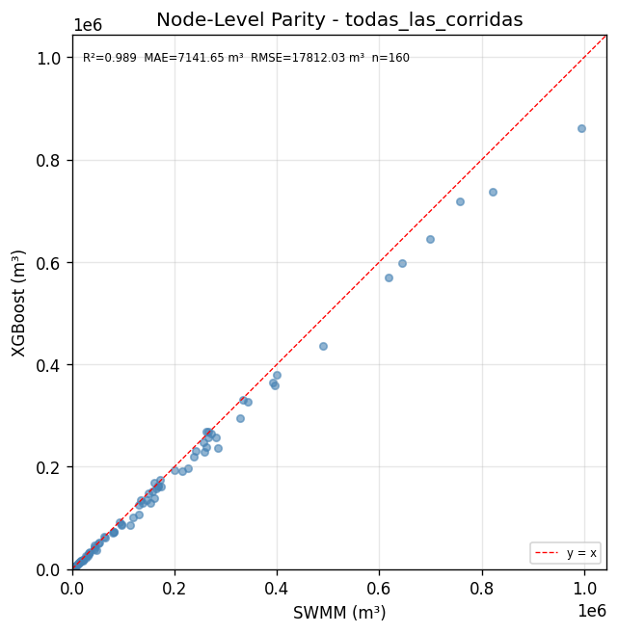
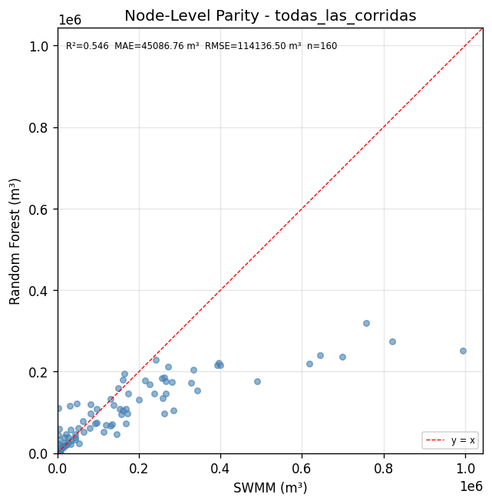
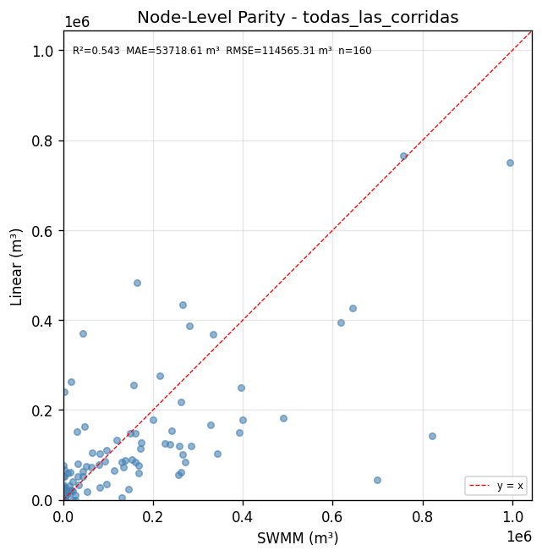
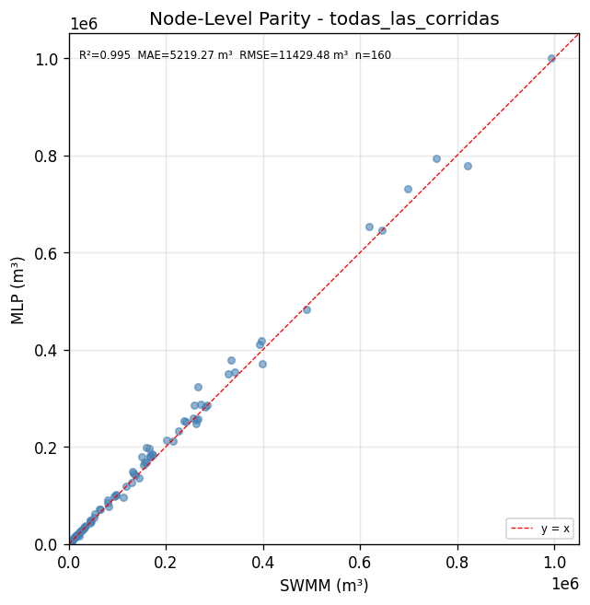
SWMM vs. prediction parity, by family (OOF)
Same out-of-fold predictions as the ranking — not an optimistic fit
XGBoost
Random Forest
Linear
MLP
MLSMFP | Phase C2 results · 5-family benchmark | October 5, 2026
34

Slide 35
Optuna on XGBoost (winning family) — exploratory estimate
50 trials · inner GroupKFold(5) by shape_id · NOT confirmatory (spec §12)
Hyperparameter | Default | Best trial (#47/50)
Classifier max_depth / lr / n_est. | 6 / 0.05 / 200 | 5 / 0.136 / 313
Regressor max_depth / lr / n_est. | 6 / 0.05 / 200 | 8 / 0.199 / 421
Objective (RMSE, inner fold) | — | 108.84
Status | — | conditional exploratory estimate
MLSMFP | Phase C2 results · 5-family benchmark | October 5, 2026
35

Slide 36
Are the tributary features worth it? — YES, validated
LeaveOneGroupOut by shape, same 150,240 rows, with and without the 6 new columns
Feature set | RMSE end-to-end | Improvement
tabular_v3_17 (17 current features) | 81.95 | —
tabular_v4_21 (17 + 6 tributary) | 59.07 | +27.9%
Conclusion | Real, large improvement, not marginal | Migrating the contract is worth it
MLSMFP | Phase C2 results · 5-family benchmark | October 5, 2026
36

Slide 37
Next steps
What remains on the work list after this run
# | Pending item | Origin
1 | Migrate to tabular_v4_21 for real: merge into the dataset, retrain, rerun the benchmark, reconnect ScenarioPredictor | Validated today (+27.9%)
2 | Configure the SVM for this scale and add it to the ranking | Benchmark
3 | Integration decision (merge into the real branch) | Postponed
MLSMFP | Phase C2 results · 5-family benchmark | October 5, 2026
37

Slide 38
Audit: what was found and what was fixed
Seven findings from the October 10 audit · default XGBoost, 154,080 rows
Finding | Fix | Verification | Status
M-01 No baselines | Two no-learning baselines added to the benchmark | LOSO: baseline 9.13 m³ vs XGBoost 57.89 m³ | Fixed
M-02 Shape volume | Per-shape measurement; the model is unchanged | One shape = 71.6% of the squared error | Open
M-03 Averaged F1 | Pooled F1 from the confusion matrix | LOSO: F1 0.7379 → 0.9667 | Fixed
V-01 In-sample figures | “In-sample” footnote on the new figures | 6 tests; old figures not regenerated | Partial
V-07 Script overwrote the .inp | No side effects on import; requires --force | Does not overwrite without ‑‑force (tests) | Fixed
M-07 / V-04 Model ≠ promotion.json | predict_network checks the SHA-256 hashes | Stops if they differ (15 tests) | Partial
D-04 Label resolution | Spike: effective threshold ≈ 0.5 m³ | A/B decision pending; I recommend A | Pending
MLSMFP | Progress: audit, approximate SVM and fair comparison | October 2026
38
Notes:
The internal audit of the evaluation protocol found seven problems that affected how the results are read; this table summarizes each finding, its fix, and how it was verified. The most important is M-01: in LOSO a baseline that only interpolates between neighboring factors reaches a volume RMSE of 9.13 m³ against 57.89 m³ for XGBoost, so that protocol measures interpolation, not generalization. M-03 is about aggregation: averaging F1 per fold with zeros gave 0.7379 while the pooled F1 is 0.9667. Two items are not closed: M-02 remains open (a single shape concentrates 71.6% of the squared error) and D-04 awaits my decision between paths A and B. V-01 and M-07/V-04 are fixed only for the new figures and for predict_network; other loaders still lack verification.
Sources: docs/auditoria/correcciones/04-informe-consolidado.md (§1 status per finding, §2 before and after); datos/comparacion_protocolos.csv (rmse_vol_agregado_m3, f1_agregado, f1_media_por_fold_con_ceros, XGBoost and baseline_interpolacion_factor in LOSO); datos/por_forma.csv (71.6%: rmse_vol^2 x n_rows of shape_quasi_uniform_block over the total, XGBoost, LeaveOneShapeOut); 01-evaluacion-honesta.md §1-§3; 02-trazabilidad-y-seguridad.md §1-§3 (6 tests for V-01, 15 for verify_promotion); 03-resolucion-de-la-etiqueta.md §1.

Slide 39
What each protocol measures (and why it matters)
Pooled volume RMSE: default XGBoost vs a baseline that does not learn
LOSO and GroupKFold5
Intensity factors are held out
Interpolation between factors
All shapes were already seen
Pooled volume RMSE (m³): lower is better
LeaveOneShapeOut
One whole hydrograph shape is held out
Unseen hydrograph shapes
40 folds: the main test
Baseline: factor interpolation (left), nearest shape (right)
LeaveOneShapeOut is the headline figure
In LOSO the no-learning baseline wins: that protocol only measures interpolation
MLSMFP | Progress: audit, approximate SVM and fair comparison | October 2026
39
Notes:
Each protocol holds out a different group. In LOSO and GroupKFold5 intensity factors are held out and all shapes remain in training, so what is measured is interpolation between factors; in LeaveOneShapeOut a whole shape is held out and what is measured is generalization to unseen shapes. The proof that this matters: in LOSO the no-learning baseline has an RMSE of 9.13 m³ and XGBoost 57.89 m³, so winning in LOSO proves nothing. In LeaveOneShapeOut the order reverses: the nearest-shape baseline has 172.86 m³ and XGBoost 106.21 m³. That is why LeaveOneShapeOut is the headline figure of the whole comparison. With the 25-factor grid, GroupKFold5 is no more demanding than LOSO: no fold holds out two contiguous factors.
Sources: docs/auditoria/correcciones/datos/comparacion_protocolos.csv, column rmse_vol_agregado_m3 (baseline_interpolacion_factor/LOSO, xgboost/LOSO, baseline_forma_mas_cercana/LeaveOneShapeOut, xgboost/LeaveOneShapeOut); 01-evaluacion-honesta.md §0 (what each protocol measures) and §1; 04-informe-consolidado.md §3 and §11.

Slide 40
XGBoost confusion matrix on unseen shapes
LeaveOneShapeOut · 154,080 node-scenarios · label: volume ≥ 1 m³
PREDICTED
no flood
PREDICTED
flood
Recall
0.9918
ACTUAL
no flood
106,526
TN · true negatives
1,329
FP · false positives
Precision
0.9718
ACTUAL
flood
380
FN · false negatives
45,845
TP · true positives
Pooled F1
0.9817
333 of 380
false negatives have a reported volume of 1 m³
the minimum that counts as flooding; none exceeds 100 m³
MLSMFP | Progress: audit, approximate SVM and fair comparison | October 2026
40
Notes:
This is the pooled confusion matrix of default XGBoost when a whole hydrograph shape is held out, over 154,080 node-scenario cases. There are 45,845 true positives, 106,526 true negatives, 1,329 false positives, and 380 false negatives; from these come a recall of 0.9918, a precision of 0.9718, and an F1 of 0.9817. The takeaway: 333 of the 380 false negatives are nodes whose reported volume is 1 m³, the minimum the label counts as flooding; none exceeds 100 m³. In other words, the classification errors concentrate at the edge of the label and not on large floods. Excluding that band raises F1 from 0.9817 to 0.9847, but that is reported only as a sensitivity check, with asymmetric exclusion.
Sources: docs/auditoria/correcciones/datos/matriz_confusion.csv (xgboost, LeaveOneShapeOut: tn, fp, fn, tp); datos/comparacion_protocolos.csv (recall_agregado, precision_agregada, f1_agregado); datos/banda_limitrofe.csv (fn_total, fn_en_banda_1_2m3, fn_con_vol_ge_100m3); 04-informe-consolidado.md §3 and §4; 03-resolucion-de-la-etiqueta.md §1 point 6 (F1 0.9847 without the band).

Slide 41
The flood label and its resolution
From SWMM to the .rpt to the label: the report prints volume at 1 m³ resolution
1 · SWMM
Continuous overflow volume (floating point)
2 · .rpt report
10⁶ L with 3 decimals: 1 m³ resolution
3 · Label
flood = 1 if V_rpt ≥ 1 m³
label ≈ continuous volume ≥ 0.5 m³
bounded to 0.4988–0.5002 m³ in 15 control scenarios (2,400 node-scenario cases)
PENDING DECISION (AUTHOR)
RECOMMENDATION: A
A · State the assumption
Keep the data and report the confusion matrix with the 1 m³ band separated
B · Re-simulate the 1000 runs
≈ 17–20 min of SWMM, but the dataset, DB, benchmark, Optuna and all figures are redone
MLSMFP | Progress: audit, approximate SVM and fair comparison | October 2026
41
Notes:
The flood label does not come directly from SWMM's continuous volume: the .rpt report prints it in 10⁶ L with three decimals, that is, at 1 m³ resolution, and the label is reported volume greater than or equal to 1 m³. In the control re-simulations this is equivalent to a continuous-volume threshold of about 0.5 m³, bounded between 0.4988 and 0.5002 m³ in 15 scenarios with per-node records, with no discrepancies in 2,400 node-scenario cases; it is a deterministic quantization, not noise. There are two paths: A, keep the resolution and threshold, state them as an assumption, and report the confusion matrix with the band separated; or B, re-simulate the 1000 runs, which costs about 17 to 20 minutes of SWMM but forces redoing the dataset, database, prep_id, benchmark, Optuna, and all figures. The recommendation is path A; the decision is mine and is still pending.
Sources: docs/auditoria/correcciones/03-resolucion-de-la-etiqueta.md §1 (points 1-8) and §2.1 (resolution chain); 04-informe-consolidado.md §4. The 0.4988-0.5002 m³ bound and the 2,400 cases: 03 §1 point 2; 17-20 min: 03 §1 point 5. That the decision remains open is also in 04 §11 (Pending).

Slide 42
Approximate SVM: architecture change
The exact RBF kernel does not scale to 154,080 rows; it is approximated with a Nystroem map
BEFORE · EXACT KERNEL
Data
StandardScaler
SVC / SVR with exact RBF kernel
Cost O(n²) to O(n³) with ~154,000 rows
Did not finish: over 39 h of accumulated CPU; cancelled
AFTER · APPROXIMATE SVM
Data
StandardScaler
Nystroem map
RBF, n_components
Classifier: linear SVM (hinge loss) + Platt calibration
Regressor: linear ε-insensitive SVR
Linear cost in n: ~8–13 s per fold on 150,000 rows; 20-trial study in ~14 min
Approximate SVM (approximate kernel), not an exact-kernel SVM
MLSMFP | Progress: audit, approximate SVM and fair comparison | October 2026
42
Notes:
The original SVM used exact SVC and SVR with an RBF kernel, whose cost grows between n squared and n cubed; with about 154,000 rows the October 5 run accumulated more than a day and 15 hours of CPU (over 39 hours) without finishing and was cancelled. The alternative is an approximate SVM: the data are standardized, the RBF kernel is approximated with a Nystroem map of n_components components, and on that map a linear margin classifier with hinge loss is trained, calibrated with Platt scaling to obtain probabilities, together with a linear regressor with an ε-insensitive loss (linear SVR). The cost becomes linear in the number of rows and it has been measured: fit and predict take ~8 to 13 s per fold on 150,000 rows (default SVM 8 s; n_components 400, 13 s) and the full 20-trial study took about 14 minutes. It must be stated clearly: this is not an exact-kernel SVM, it is an approximate SVM, and it is documented as such in the preprocessing descriptor (svm_aproximado_nystroem).
Sources: docs/superpowers/specs/2026-10-12-parte2-svm-comparacion-justa-design.md §2 and §3.1; swmm_resilience/ml/bench/models/svm_family.py (docstring and build_classifier/build_regressor); docs/resultados/2026-10-06-handoff-svm.md §2 (more than 1 day and 15 h of CPU, cancelled, ~154,000 rows); docs/auditoria/correcciones/datos_parte2/resumen_afinacion.csv (family=svm, duration_s) and the part 2 cost study.

Slide 43
How the fair comparison is run
Three families under the same conditions; only the model changes
XGBoost
Gradient-boosted trees
Always presented
MLP
Neural network
Always presented
Approximate SVM
Nystroem + linear SVM
Third candidate
Same data
tabular_v4_21 · 154,080 rows (prep_id ca706e27654e0cf5)
Same budget
20 Optuna trials per family and the same inner CV by shape
Same protocol
LeaveOneShapeOut: 40 folds, one held-out shape per fold
Same metrics
Volume RMSE · F1 · regressor NSE · confusion matrix
Conditional exploratory estimate: hyperparameters are chosen with all shapes
MLSMFP | Progress: audit, approximate SVM and fair comparison | October 2026 · results on the following slides
43
Notes:
To compare the three families fairly, all use the same data (tabular_v4_21 contract, 154,080 rows), the same tuning budget with Optuna (same number of trials and the same inner CV by shape), the same evaluation protocol, LeaveOneShapeOut, and the same metrics. XGBoost and MLP are always presented; the approximate SVM enters as a third candidate with whatever result it obtains. The important caveat: hyperparameters are chosen using all shapes, so the LeaveOneShapeOut figure is optimistic equally for the three families. It serves to compare them with each other, not as independent confirmation; that is why it is declared a conditional exploratory estimate. A nested tuning by shape is left as future work.
Sources: docs/superpowers/specs/2026-10-12-parte2-svm-comparacion-justa-design.md §1, §3.2 and §3.3 (author decisions of 2026-10-12); 04-informe-consolidado.md header (prep_id ca706e27654e0cf5, 154,080 rows) and §5 point 1.

Slide 44
Machine Learning Model for Hydraulic Failure Prediction in Stormwater Systems
Luis Fernando Fajardo Bravo
2026-10-20

Slide 45
XGBoost and MLP: results on unseen shapes
Model | RMSE | F1 | AUC | NSE
XGBoost tuned | 69.64 | 0.9812 | 0.9993 | 0.953
XGBoost default | 112.80 | 0.9815 | 0.9993 | 0.877
MLP tuned | 101.12 | 0.9783 | 0.9994 | 0.902
MLP default | 114.38 | 0.9783 | 0.9992 | 0.878
SVM tuned | 214.87 | 0.8302 | 0.9626 | 0.583
SVM default | 222.46 | 0.8625 | 0.9719 | 0.548
No-learning baseline | 172.86 | 0.9764 | 0.9844 | 0.710
Volume RMSE (m³): lower is better
No-learning baseline: 172.86
Pooled F1: higher is better
No-learning baseline: 0.9764
Pooled volume RMSE in m³ (lower is better); regressor NSE on flooded nodes. Bars label the tuned value; default values are in the table
44
Notes:
Results of the main protocol, LeaveOneShapeOut, with the same data, the same Optuna budget, and the same metrics for the three families. Tuned XGBoost is the best: volume RMSE of 69.64 m³, 38% lower than with its default parameters (112.80 m³). Tuned MLP comes second with 101.12 m³; both have an F1 close to 0.98 and an AUC close to 0.999. The approximate SVM falls below even the no-learning baseline (214.87 against 172.86 m³; F1 0.830 against 0.976). These are conditional exploratory estimates: the hyperparameters were chosen with all shapes, so they are optimistic equally for the three families. Note: the default XGBoost of this run does not match the one in the audit (106.21 m³ in datos/comparacion_protocolos.csv); they are different runs and are not compared with each other.
Source: docs/auditoria/correcciones/datos_parte2/comparacion_protocolos.csv (LeaveOneShapeOut rows; columns rmse_vol_agregado_m3, f1_agregado, auc_roc_agregado, nse_regresor_oracle); docs/superpowers/specs/2026-10-12-parte2-svm-comparacion-justa-design.md §3.2-§3.3.

Slide 46
Optuna tuning: 20 trials per family
Best inner RMSE up to that trial (m³)
Family | Best RMSE | Min
XGBoost | 65.7 | 12.6
MLP | 77.2 | 51.7
Approx. SVM | 202.4 | 13.8
Inner RMSE: GroupKFold(5) by shape inside the search; not the LeaveOneShapeOut figure.
Min: duration of the whole study.
45
Notes:
Each family received the same search: 20 Optuna trials on the same data and with the same inner CV by shape. The curve shows the best inner RMSE reached up to each trial: XGBoost ends at 65.7 m³ after 12.6 min; MLP ends at 77.2 m³ after 51.7 min; Approximate SVM ends at 202.4 m³ after 13.8 min. The approximate SVM stays far from the other two throughout the search. It is a conditional exploratory estimate: hyperparameters are chosen with all shapes, and the inner value is not the LeaveOneShapeOut one.
Sources: docs/auditoria/correcciones/datos_parte2/convergencia_afinacion.csv (family, trial, value; running minimum) and resumen_afinacion.csv (n_trials, best_value, duration_s, status).

Slide 47
Tuned XGBoost
Tuned MLP
PREDICTED
no flood
PREDICTED
flood
PREDICTED
no flood
PREDICTED
flood
ACTUAL
no flood
106,472
TN
1,383
FP
ACTUAL
no flood
106,302
TN
1,553
FP
ACTUAL
flood
378
FN
45,847
TP
ACTUAL
flood
473
FN
45,752
TP
Recall 0.9918 · Precision 0.9707 · F1 0.9812
Recall 0.9898 · Precision 0.9672 · F1 0.9783
FN in the 1 m³ band: 333 of 378
FN in the 1 m³ band: 354 of 473
46
Notes:
Pooled matrices of the two families being presented, with tuned hyperparameters, holding out one whole hydrograph shape at a time. They classify almost the same; the difference lies in the false positives and in the few large false negatives. Tuned XGBoost: TN 106,472, FP 1,383, FN 378, TP 45,847; FN in the 1 m³ band: 333 of 378; FN with actual volume of 100 m³ or more: 0 | Tuned MLP: TN 106,302, FP 1,553, FN 473, TP 45,752; FN in the 1 m³ band: 354 of 473; FN with actual volume of 100 m³ or more: 4. Most false negatives are nodes with a reported volume of 1 m³, the minimum the label counts as flooding.
Sources: docs/auditoria/correcciones/datos_parte2/matriz_confusion.csv (tn, fp, fn, tp), comparacion_protocolos.csv (recall_agregado, precision_agregada, f1_agregado) and banda_limitrofe.csv (fn_total, fn_en_banda_1_2m3, fn_con_vol_ge_100m3).

Slide 48
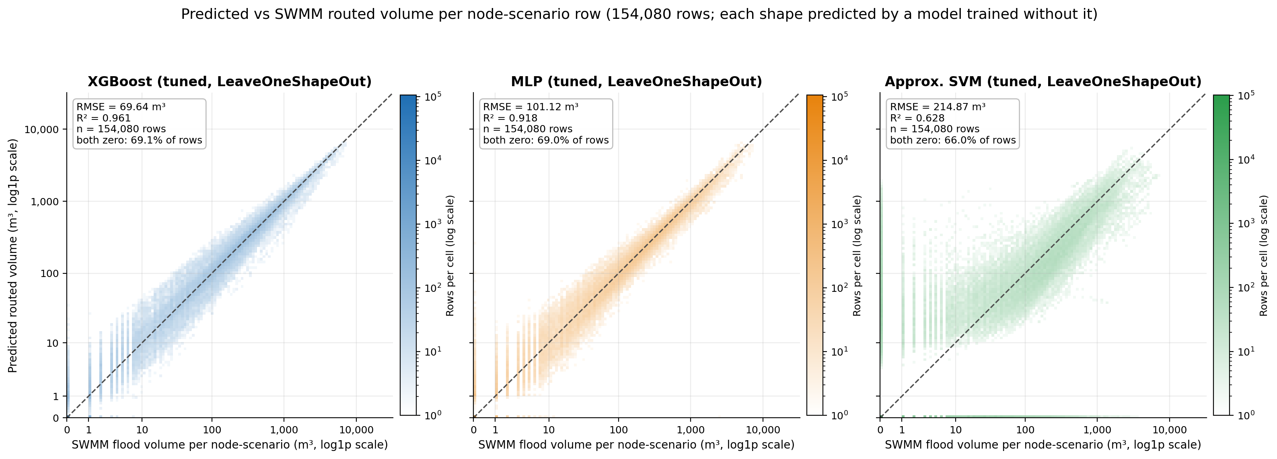
R² · XGBoost / MLP / SVM
0.961 · 0.918 · 0.628
Pooled RMSE (m³)
69.64 · 101.12 · 214.87
SWMM-flooded rows missed
379 · 473 · 9,076
47
Notes:
Each panel compares the predicted routed volume of every node-scenario row with the SWMM volume, for the three tuned models, always on shapes the model never saw. XGBoost and MLP hug the diagonal over four orders of magnitude; the pooled R² is 0.961 for XGBoost, 0.918 for the MLP and 0.628 for the approximate SVM, and the RMSE is 69.64, 101.12 and 214.87 m³. The SVM is visibly wider around the diagonal and has two failure strips: it misses 9,076 flooded rows (XGBoost 379) and predicts flooding on dry rows. RMSE is dominated by a few large-volume rows that the density plot hides, so quote it together with the scenario-level figure on the next slide. Caveat: the axes are log10(1 + volume), which makes small-volume errors look larger than they are in absolute terms.
Sources: docs/figures_part2/parity_nodes_3models.png; docs/figures_part2/INDEX.md (pooled summary table, section 1); docs/figures_part2/figure_numbers.json (pooled).

Slide 49
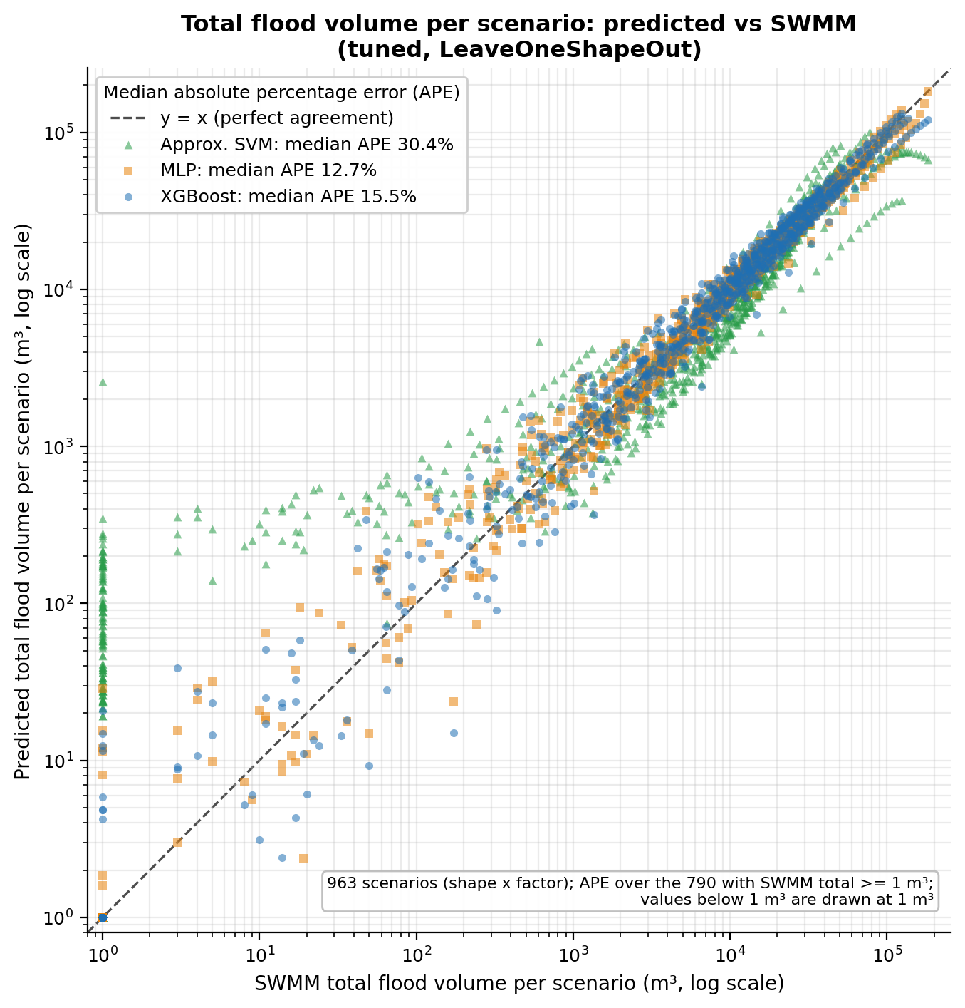
Parity per scenario: total flooded volume
Median scenario error, % (790 scenarios ≥ 1 m³) · XGBoost / MLP / SVM
15.5% · 12.7% · 30.4%
48
Notes:
Here each marker is a whole scenario, and the distance to the dashed line is the relative error of its total flooded volume. All three models follow the diagonal from about 10 to 180,000 m³; the median absolute percentage error is 15.5% for XGBoost, 12.7% for the MLP and 30.4% for the SVM (90th percentile 59.9% / 51.5% / 156.6%). To be honest about it: at this level the MLP is slightly better than XGBoost on the median, even though XGBoost is clearly better on the pooled node RMSE; the two metrics answer different questions. The SVM saturates on the largest scenarios, all shape_quasi_uniform_block at factors 4 to 5, predicting about 67,000 to 75,000 m³ where SWMM gives 142,000 to 183,000 m³. Caveat: the median is taken over the 790 scenarios with SWMM total of at least 1 m³; values below 1 m³ are drawn at 1 m³.
Sources: docs/figures_part2/parity_scenario_totals_3models.png; docs/figures_part2/figure_numbers.json (scenario_median_ape_pct, scenario_p90_ape_pct, scenarios_swmm_ge_1m3); docs/figures_part2/INDEX.md (section 2).

Slide 50
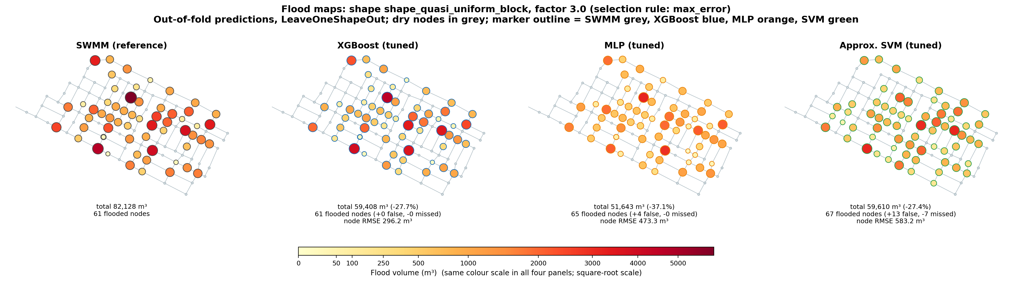
Flood map: largest-error shape
Largest XGBoost error of the 40 shapes · shape_quasi_uniform_block · factor 3.0
SWMM
82,128 m³
61 flooded nodes
XGBoost
59,408 m³ (-27.7%)
+0 false · −0 missed
Node RMSE 296.2 m³
MLP
51,643 m³ (-37.1%)
+4 false · −0 missed
Node RMSE 473.3 m³
SVM
59,610 m³ (-27.4%)
+13 false · −7 missed
Node RMSE 583.2 m³
MLSMFP | Progress: audit, approximate SVM and fair comparison | October 2026
50
Notes:
This is one scenario, chosen by a documented rule and not by hand: largest XGBoost error of the 40 shapes, shape shape_quasi_uniform_block at factor 3.0. SWMM floods 61 nodes with 82,128 m³ in total; XGBoost 59,408 m³ (-27.7%), +0 false and −0 missed nodes, node RMSE 296.2 m³; MLP 51,643 m³ (-37.1%), +4 false and −0 missed nodes, node RMSE 473.3 m³; SVM 59,610 m³ (-27.4%), +13 false and −7 missed nodes, node RMSE 583.2 m³. The spatial pattern is right but the magnitude is systematically low for all three models. XGBoost finds the right set of 61 flooded nodes, with no false and no missed nodes, but underestimates the hot spots; the largest node, about 6,000 m³ in SWMM, is about 4,500 m³ in XGBoost. The SVM misclassifies 20 nodes. To read the map, compare the color and size of the same node across panels; an orange or green marker on a node that is grey in the SWMM panel is a false positive. The colors use a square-root scale shared by the four panels.
Sources: docs/figures_part2/flood_map_max_error_shape_quasi_uniform_block_f3.0.png (the matching per-node bar chart is docs/figures_part2/node_profile_max_error_shape_quasi_uniform_block_f3.0.png, not embedded); docs/figures_part2/figure_numbers.json (selected_scenarios, scenario_stats); docs/figures_part2/INDEX.md (section 4).

Slide 51
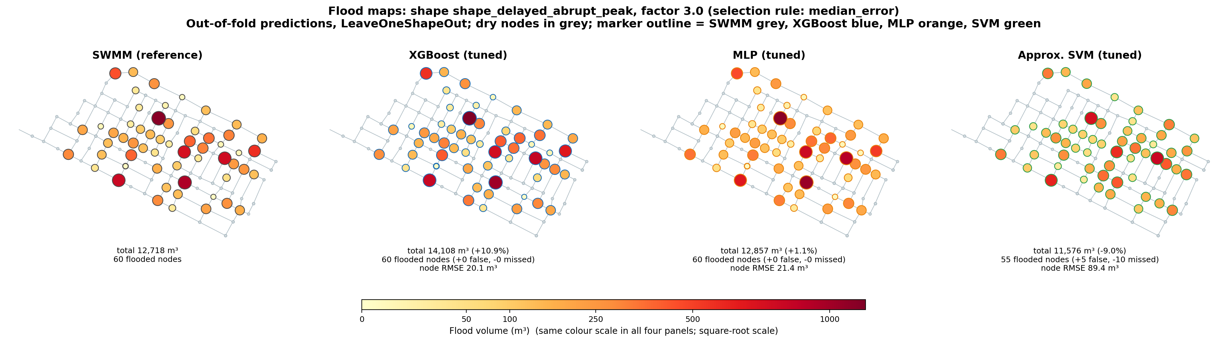
Flood map: median-error shape
Median XGBoost error (position 21 of 40 shapes) · shape_delayed_abrupt_peak · factor 3.0
SWMM
12,718 m³
60 flooded nodes
XGBoost
14,108 m³ (+10.9%)
+0 false · −0 missed
Node RMSE 20.1 m³
MLP
12,857 m³ (+1.1%)
+0 false · −0 missed
Node RMSE 21.4 m³
SVM
11,576 m³ (-9.0%)
+5 false · −10 missed
Node RMSE 89.4 m³
MLSMFP | Progress: audit, approximate SVM and fair comparison | October 2026
51
Notes:
This is one scenario, chosen by a documented rule and not by hand: median XGBoost error (position 21 of 40 shapes), shape shape_delayed_abrupt_peak at factor 3.0. SWMM floods 60 nodes with 12,718 m³ in total; XGBoost 14,108 m³ (+10.9%), +0 false and −0 missed nodes, node RMSE 20.1 m³; MLP 12,857 m³ (+1.1%), +0 false and −0 missed nodes, node RMSE 21.4 m³; SVM 11,576 m³ (-9.0%), +5 false and −10 missed nodes, node RMSE 89.4 m³. XGBoost and MLP reproduce the spatial pattern node by node: the same 60 flooded nodes and a node RMSE of about 20 m³. The SVM misses 10 flooded nodes, invents 5 and has a node RMSE about four times larger. To read the map, compare the color and size of the same node across panels; an orange or green marker on a node that is grey in the SWMM panel is a false positive. The colors use a square-root scale shared by the four panels.
Sources: docs/figures_part2/flood_map_median_error_shape_delayed_abrupt_peak_f3.0.png (the matching per-node bar chart is docs/figures_part2/node_profile_median_error_shape_delayed_abrupt_peak_f3.0.png, not embedded); docs/figures_part2/figure_numbers.json (selected_scenarios, scenario_stats); docs/figures_part2/INDEX.md (section 4).

Slide 52
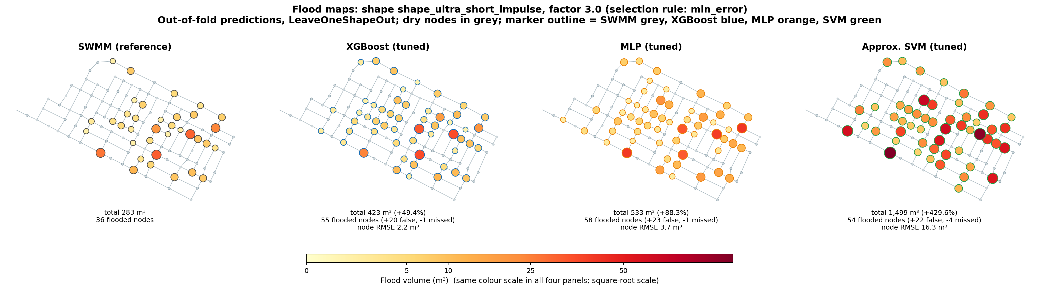
Flood map: smallest-error shape
Smallest XGBoost error (shapes with ≥ 20 flooded rows) · shape_ultra_short_impulse · factor 3.0
SWMM
283 m³
36 flooded nodes
XGBoost
423 m³ (+49.4%)
+20 false · −1 missed
Node RMSE 2.2 m³
MLP
533 m³ (+88.3%)
+23 false · −1 missed
Node RMSE 3.7 m³
SVM
1,499 m³ (+429.6%)
+22 false · −4 missed
Node RMSE 16.3 m³
MLSMFP | Progress: audit, approximate SVM and fair comparison | October 2026
52
Notes:
This is one scenario, chosen by a documented rule and not by hand: smallest XGBoost error (shapes with ≥ 20 flooded rows), shape shape_ultra_short_impulse at factor 3.0. SWMM floods 36 nodes with 283 m³ in total; XGBoost 423 m³ (+49.4%), +20 false and −1 missed nodes, node RMSE 2.2 m³; MLP 533 m³ (+88.3%), +23 false and −1 missed nodes, node RMSE 3.7 m³; SVM 1,499 m³ (+429.6%), +22 false and −4 missed nodes, node RMSE 16.3 m³. The squared error is low here and the volumes are tiny, 283 m³ in total; in relative terms it is not an easy scenario: every model over-predicts and flags 20 to 23 extra nodes. The rule picks the lowest absolute squared error, which tends to favor low-volume shapes, so this is not a typical good case. To read the map, compare the color and size of the same node across panels; an orange or green marker on a node that is grey in the SWMM panel is a false positive. The colors use a square-root scale shared by the four panels.
Sources: docs/figures_part2/flood_map_min_error_shape_ultra_short_impulse_f3.0.png (the matching per-node bar chart is docs/figures_part2/node_profile_min_error_shape_ultra_short_impulse_f3.0.png, not embedded); docs/figures_part2/figure_numbers.json (selected_scenarios, scenario_stats); docs/figures_part2/INDEX.md (section 4).

Slide 53
Conclusions and next steps
Tuned XGBoost is the best on pooled RMSE; the approximate SVM falls below the baseline
Tuned XGBoost is the best
RMSE 69.6 m³ (−38% vs its default parameters) and node parity R² 0.96; tuned MLP 2nd: 101.1 m³. But the MLP has the best median scenario error (12.7% vs 15.5%). Both with F1 ≈ 0.98 and AUC ≈ 0.999
NEXT STEPS
1
Decide the label: path A (recommended) or B
2
Nested tuning by shape
SVM: third, below the baseline
RMSE ≈ 215 vs 173 m³; F1 0.83 vs 0.976. Plausible causes (not tested): approximate kernel, limited search space, Platt calibration neutralizing class_weight (seen on a toy problem only)
3
More trials and a wider search space for the SVM
4
Confusion matrix for the extreme shapes
5
Propagate to per-family maps
Honest scope
Hyperparameters chosen with all shapes (optimistic equally) · one network · 963 of 1000 runs · MLP: 200 epochs, batch 1024 · XGBoost: n_jobs=1
6
Regenerate base-deck pictures with Spanish text (slides 5, 34)
MLSMFP | Progress: audit, approximate SVM and fair comparison | October 2026
53
Notes:
Main message: tuned XGBoost is the best on pooled volume RMSE, 69.6 m³, 38% lower than with its default parameters, and on per-node parity (R² 0.96); tuned MLP comes second with 101.1 m³ and both have an F1 close to 0.98 and an AUC close to 0.999. At scenario level the MLP has the lower median error (12.7% vs 15.5% for XGBoost), so XGBoost does not win on every metric. The approximate SVM falls below even the no-learning baseline: 215 against 173 m³ and F1 0.83 against 0.976; the plausible causes are the approximate kernel, a limited search space, and Platt calibration neutralizing class_weight, but none was tested on the real data: only the Platt/class_weight effect was measured, on a toy problem (mean predicted probability 0.429 with scale_pos_weight 1 vs 0.426 with 8), and it is declared as a known bias. Scope: hyperparameters chosen with all shapes, one network, 963 of 1000 runs; MLP: 200 epochs, batch 1024 · XGBoost: n_jobs=1. Next steps: decide the label (I recommend A), nested tuning by shape, more trials or a wider search space for the SVM, a confusion matrix for the extreme shapes, propagating to per-family maps, and regenerating the base-deck pictures that still contain Spanish text.
To regenerate: Slide 5 (title picture whose shapes are not versioned) and slide 34 (four parity pictures with a Spanish run identifier in the title). Their English versions were not produced because the shapes in slide 5 are not in any versioned data file and the slide 34 parity plots need a full out-of-fold re-evaluation of each family.
Sources: docs/auditoria/correcciones/datos_parte2/comparacion_protocolos.csv, resumen_afinacion.csv (fixed_params), tables_provenance.json (n_runs, n_runs_full_grid); docs/figures_part2/figure_numbers.json and INDEX.md (R², median scenario error); docs/figures_en/INDEX.md (pictures to regenerate); docs/auditoria/correcciones/04-informe-consolidado.md §4 and §5; docs/auditoria/correcciones/05-bitacora-de-decisiones.md (P2-Task1 review: Platt vs class_weight on a toy problem; R22).

Slide 54
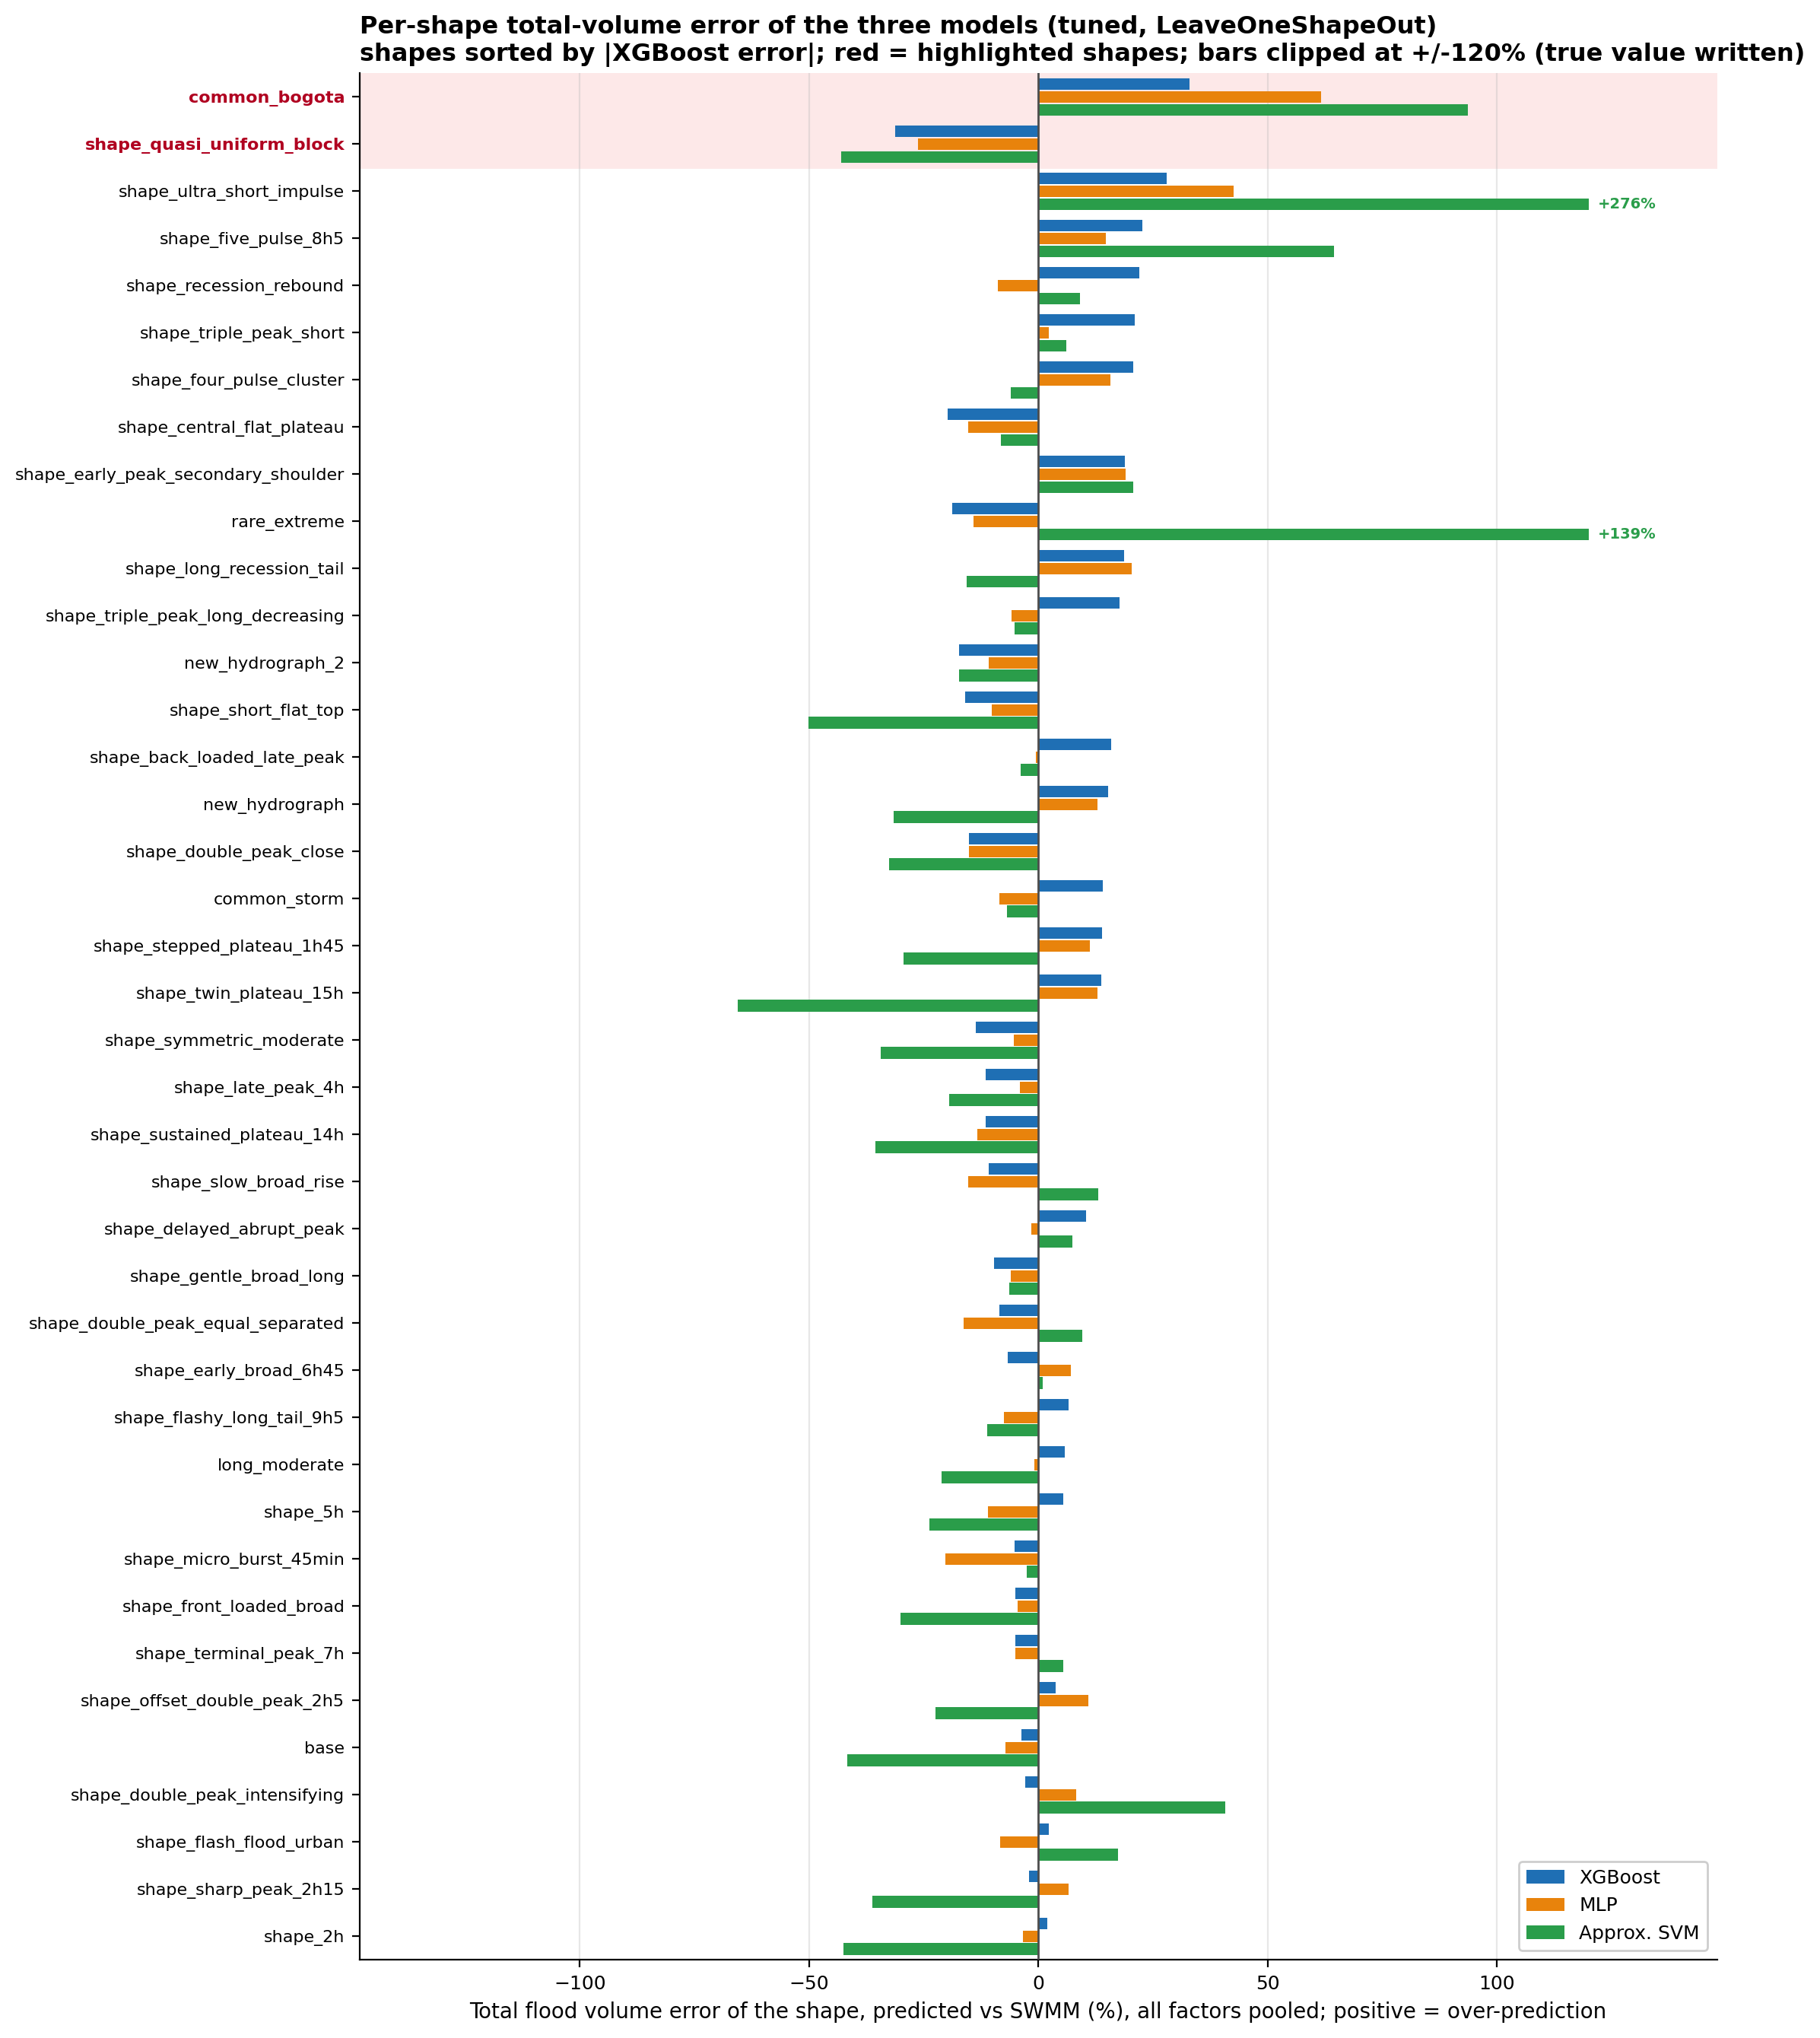
Where the models fail: error by shape
Total flood volume error per hydrograph shape (all factors pooled) · 40 shapes · out-of-fold
A few shapes concentrate the failures
shape_quasi_uniform_block is under-predicted by all three (XGBoost / MLP / SVM: -31.2% · -26.3% · -42.9%). It carries the largest SWMM volume (1.77 million m³) and holds 61% of XGBoost's squared error
common_bogota is over-predicted
+33.0% · +61.6% · +93.6%; a small-volume shape (21,577 m³ in SWMM), so its absolute impact is small
Across shapes
Median |error|: 13.7% · 10.5% · 20.9%. Shapes with |error| > 20%: 7 · 5 · 21 (XGBoost / MLP / SVM)
MLSMFP | Progress: audit, approximate SVM and fair comparison | October 2026
49
Notes:
This chart breaks the error down by hydrograph shape: bars to the right are over-prediction and to the left under-prediction, sorted by the absolute XGBoost error. The failures are concentrated in a few shapes rather than spread evenly: shape_quasi_uniform_block is under-predicted by all three models (-31.2% · -26.3% · -42.9% for XGBoost, MLP and SVM) and carries the largest SWMM volume of all shapes, 1.77 million m³; it also holds 61% of the XGBoost squared error summed over shapes (sse_xgboost in figure_numbers.json), so it weighs heavily in the pooled RMSE. common_bogota is over-predicted by all three (+33.0% · +61.6% · +93.6%), but it is a small-volume shape. The MLP has the smaller median shape error (10.5% vs 13.7% for XGBoost) but a larger worst case on common_bogota. Caveat: the error is pooled over all factors of a shape, so over- and under-prediction at different factors can cancel.
Sources: docs/figures_part2/error_by_shape.png; docs/figures_part2/figure_numbers.json (shapes: err_pct_*, vol_swmm); docs/figures_part2/INDEX.md (section 3).

