Slide 1


Notes:
Hi guys, Today I will talking a bit about prestoDb

Slide 2
What is
L&L – nov/2025 – Luis Fernando Neu
Notes:
Presto is a distributed SQL query engine for data platform team,
Presto users can perform interactive queries on data Wherehouse using ANSI SQL across diverse sources.
Presto was designed to solve the problem of ensuring large-scale queries would return in less than a minute Rather then hours.
As a result presto is highly scalable and extensible using connectors for diferente data sources,
also is open source tool danated by facebook to Linux foundation in 2019.

Slide 3









Architecture
worker
worker
worker
Client
Coordinator
worker
worker
L&L – nov/2025 – Luis Fernando Neu
Notes:
This is the architecture of presto DB, you can plug in your BI dashboards into a Presto cluster and presto take care to processing petabytes of data across diferente data sources
with ANSI SQL
And how it workin in fact

Slide 4

L&L – nov/2025 – Luis Fernando Neu
Notes:
Lets say you need some information from multiple data sources and you need it across petabytes of data.
Under the hood how presto works after create you cluster and connect all data sources you need.

Slide 5
request
Coordinator
L&L – nov/2025 – Luis Fernando Neu
Notes:
First a coordinator takes your statement and parses into

Slide 6
query
Coordinator
L&L – nov/2025 – Luis Fernando Neu
Notes:
a query

Slide 7
planner
Coordinator
L&L – nov/2025 – Luis Fernando Neu
Notes:
The internal planner generate and optimized plan

Slide 8
planner
stage 1
Coordinator
stage 2
L&L – nov/2025 – Luis Fernando Neu
Notes:
in a series if stages

Slide 9
task
stage 1
task
Coordinator
task
L&L – nov/2025 – Luis Fernando Neu
Notes:
This stages transforms it in separated tasks.

Slide 10
Data
Source
task
connector
worker
Data
Source
task
connector
Coordinator
worker
Data
Source
task
connector
worker
L&L – nov/2025 – Luis Fernando Neu
Notes:
Tasks are assigned to Workers to process as parallel possible
Workers use the right conector to pull data from the source

Slide 11
result
worker
result
Coordinator
worker
result
worker
L&L – nov/2025 – Luis Fernando Neu
Notes:
Each tasks has an output returned by a worker

Slide 12
Coordinator
stage 1
result
worker
L&L – nov/2025 – Luis Fernando Neu
Notes:
until the stage is completed

Slide 13
stage 1
result
worker
Coordinator
L&L – nov/2025 – Luis Fernando Neu
Notes:
Then stages output is returned by the final worker to the next stage, where another series of tasks must be executed

Slide 14
stage 1
result
worker
Coordinator
stage 2
result
worker
L&L – nov/2025 – Luis Fernando Neu
Notes:
The results of all stages are combined,

Slide 15
return
request
client
Coordinator
L&L – nov/2025 – Luis Fernando Neu
Notes:
returnig the result to the coordinator and finally to the client

Slide 16
PROS
CONS
Federated queries
Performance
Scalability
Open-Source
Memory
Complex Resource manager
L&L – nov/2025 – Luis Fernando Neu
Notes:
Pros
Federated queries: Allows you to run a single SQL query across multiple data sources like data lakes, NoSQL databases, and more, eliminating the need to move data.
High performance: Designed for fast, in-memory processing, making it ideal for interactive analytics and delivering quick results.
Scalability: Capable of handling both small and large datasets, scaling from tiny to petabytes.
Open-source: A community-driven, open-source project under the Linux Foundation.
Cons
Memory-intensive: Relies heavily on memory for processing, which can be a bottleneck and makes it less suitable for workloads that require extensive disk-based operations or complex, multi-table joins on large fact tables.
Resource management complexity: Can be complex to manage resource groups, especially for large deployments.

Slide 17
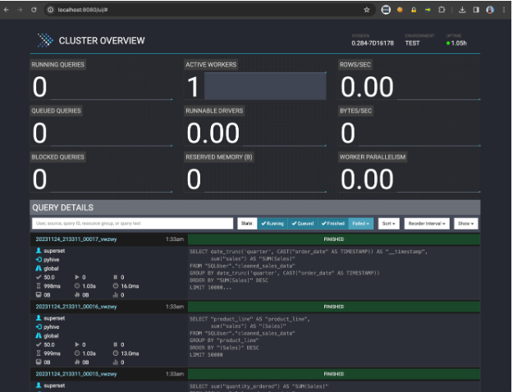
L&L – nov/2025 – Luis Fernando Neu
Notes:
This is presto interface
At the top you can see some summary related to server use
At the botton the latest requests and status of this requests

Slide 18

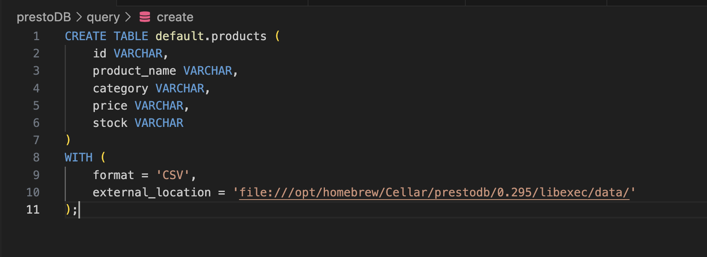
https://github.com/luisfneu/prestoDB/
L&L – nov/2025 – Luis Fernando Neu
Notes:
Let’s show you some code

