Slide 1
CS/COE 0447
Bitwise Operations
wilkie (with content borrowed from:
Jarrett Billingsley
Dr. Bruce Childers)

Slide 2
Bitwise Operations
Being… wise… about… bits??? (Doing stuff to them)

Slide 3

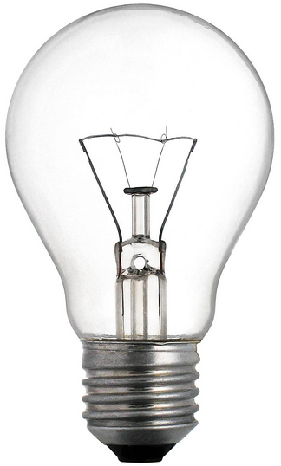
What are "bitwise" operations?
The "numbers" we use on computers aren't really numbers right?
It's often useful to treat them instead as a pattern of bits.
Bitwise operations treat a value as a pattern of bits.
0
1
0
0
0

Slide 4

The simplest operation: NOT (logical negation)
If the light is off, turn it on.
If the light is on, turn it off.
We can summarize this in a truth table.
We write NOT as ~A, or ¬A, or $\overline{\text{A}}$
A | Q
0 | 1
1 | 0

Slide 5
Applying NOT to a whole bunch of bits
if we use the not instruction (or ~ in C/Java), this is what happens:
~ | 0 | 0 | 1 | 1 | 1 | 0 | 1 | 0
= | 1 | 1 | 0 | 0 | 0 | 1 | 0 | 1
we did 8 independent NOT operations
That's it.
only 8 bits shown cause 32 bits on a slide is too much

Slide 6
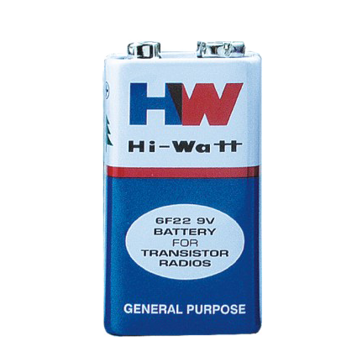

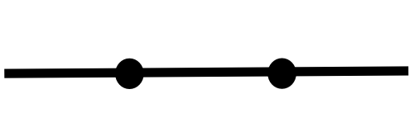
Let's add some switches
there are two switches in a row connecting the light to the battery
how do we make it light up?

Slide 7
AND (Logical product)
AND is a binary (two-operand) operation.
It can be written a number of ways:
A&B A∧B A⋅B AB
If we use the and instruction (or & in C/Java):
A | B | Q
0 | 0 | 0
0 | 1 | 0
1 | 0 | 0
1 | 1 | 1
 | 1 | 1 | 1 | 1 | 0 | 0 | 0 | 0
& | 0 | 0 | 1 | 1 | 1 | 0 | 1 | 0
= | 0 | 0 | 1 | 1 | 0 | 0 | 0 | 0
we did 8 independent AND operations

Slide 8
"Switching" things up ;))))))))))))))))))))))
NOW how can we make it light up?

Slide 9
OR (Logical sum…?)
We might say "and/or" in English.
It can be written a number of ways:
A|B A∨B A+B
If we use the or instruction (or | in C/Java):
A | B | Q
0 | 0 | 0
0 | 1 | 1
1 | 0 | 1
1 | 1 | 1
 | 1 | 1 | 1 | 1 | 0 | 0 | 0 | 0
| | 0 | 0 | 1 | 1 | 1 | 0 | 1 | 0
= | 1 | 1 | 1 | 1 | 1 | 0 | 1 | 0
We did 8 independent OR operations.

Slide 10
lui, ori…
if I write li t0, 0xDEADBEEF in MIPS, the assembler turns it into:
lui at, 0xDEAD
ori t0, at, 0xBEEF
the reason it splits it up is that there's only enough space in each instruction to fit half of 0xDEADBEEF
we'll learn about instruction encoding later
but it suffices to say each immediate is 16 bits long
what the heck are these instructions doing tho

Slide 11
MIPS: lui / ori (32-bit immediates)
lui means load upper immediate. it puts the immediate value into the upper 16 bits of the register, and zeroes out the rest
lui at, 0xDEAD
then, ori does logical OR of at and its zero-extended immediate
ori t0, at, 0xBEEF
1 | 1 | 0 | 1 | 1 | 1 | 1 | 0
1 | 0 | 1 | 0 | 1 | 1 | 0 | 0
0 | 0 | 0 | 0 | 0 | 0 | 0 | 0
0 | 0 | 0 | 0 | 0 | 0 | 0 | 0
|
0 | 0 | 0 | 0 | 0 | 0 | 0 | 0
0 | 0 | 0 | 0 | 0 | 0 | 0 | 0
1 | 0 | 1 | 1 | 1 | 1 | 1 | 0
1 | 1 | 1 | 0 | 1 | 1 | 1 | 1
1 | 1 | 0 | 1 | 1 | 1 | 1 | 0
1 | 0 | 1 | 0 | 1 | 1 | 0 | 0
1 | 0 | 1 | 1 | 1 | 1 | 1 | 0
1 | 1 | 1 | 0 | 1 | 1 | 1 | 1
D
E
A
D
B
E
E
F

Slide 12
Bit Shifting
To the left, to the left! To the right, to the right!

Slide 13
Bit shifting
Besides AND, OR, and NOT, we can move bits around, too.
1 1 0 0 1 1 1 1
if we shift these bits left by 1…
1 1 0 0 1 1 1 1 0
we stick a 0 at the bottom
1 1 0 0 1 1 1 1 0 0
again!
1 1 0 0 1 1 1 1 0 0 0
AGAIN!
1 1 0 0 1 1 1 1 0 0 0 0
AGAIN!!!!

Slide 14
Left-shifting in C/Java and MIPS (animated)
C and Java use the << operator for left shift
B = A << 4; // B = A shifted left 4 bits
MIPS has the sll (Shift Left Logical) instruction
sll t2, t0, 4 # t2 = t0 << 4
If the bottom 4 bits of the result are now 0s…
…what happened to the top 4 bits?
0000
0011
0000 0000 1111 1100 1101 1100 1111
the bit bucket is not a real place
Bit Bucket
it's a programmer joke ok
in the UK they might say the “Bit Bin”
bc that’s their word for trash

Slide 15
>_> >_> >_> ☺
We can shift right, too
0 0 1 1 0 0 0 0 0 0 0 0 1 1 1 1 1 1 0 0 1 1 0 1 1 1 0 0 1 1 1 1
0 0 0 1 1 0 0 0 0 0 0 0 0 1 1 1 1 1 1 0 0 1 1 0 1 1 1 0 0 1 1 1
0 0 0 0 1 1 0 0 0 0 0 0 0 0 1 1 1 1 1 1 0 0 1 1 0 1 1 1 0 0 1 1
0 0 0 0 0 1 1 0 0 0 0 0 0 0 0 1 1 1 1 1 1 0 0 1 1 0 1 1 1 0 0 1
0 0 0 0 0 0 1 1 0 0 0 0 0 0 0 0 1 1 1 1 1 1 0 0 1 1 0 1 1 1 0 0
C/Java use >>, MIPS uses srl (Shift Right Logical)
see what I mean about 32 bits on a slide

Slide 16
MIPS ISA: srl (shift right logical)
We can shift right, too (srl)
1 1 0 0 1 1 1 1
if we shift these bits right by 1…
0 1 1 0 0 1 1 1 1
we stick a 0 at the top
0 0 1 1 0 0 1 1 1
again!
0 0 0 1 1 0 0 1 1
AGAIN!
Wait… what if this was a negative number?
0 0 0 0 1 1 0 0 1

Slide 17
MIPS ISA: srl (shift right arithmetic)
We can shift right with sign-extension, too (sra)
1 1 0 0 1 1 1 1
if we shift these bits right by 1…
1 1 1 0 0 1 1 1 1
we copy the 1 at the top (or 0, if MSB was a 0)
1 1 1 1 0 0 1 1 1
again!
1 1 1 1 1 0 0 1 1
AGAIN!
AGAIN!!!!!! (It’s still negative!)
1 1 1 1 1 1 0 0 1
Is there a sla instruction?

Slide 18
Huh… that's weird
Let's start with a value like 5 and shift left and see what happens:
Binary | Decimal
101 | 5
Why is this happening
Well uh... what if I gave you 49018853
1010
10
10100
20
How do you multiply that by 10?
101000
40
by 100?
by 100000?
1010000
80
Something very similar is happening here

Slide 19
a << n == a * 2^{n}
Shifting left by n is the same as multiplying by 2^{n}
You probably learned this as "moving the decimal point"
And moving the decimal point right is like shifting the digits left
Shifting is fast and easy on most CPUs
Way faster than multiplication in any case
Hey… if shifting left is the same as multiplying…

Slide 20
a >> n == a / 2^{n}, ish
You got it
Shifting right by n is like dividing by 2^{n}
sort of.
What's 101₂ shifted right by 1?
10₂, which is 2…
It's like doing integer (or flooring) division
How do we do “actual” multiplication/division?
We will get to that next week or so!

Slide 21
Okaaaaay… so what
Do shifts seem useless? Bitfields, come on out!

Slide 22
clicky clicky
In the LED Keypad plugin in MARS, input works like this:
input_get_keys returns a value in v0…
0 0 0 0 0 0 0 0 0 0 0 0
B R L D U

Slide 23
Why do we do this??
It lets us cram several booleans into a single value!
This technique is known as bit flags. We’ll see more of these next time!
1 0 1 0 0
0 1 0 1 0
B R L D U
B R L D U

