Slide 1
CS/COE 0447
Introduction to: Introduction to Computer Architecture
wilkie (with content borrowed from:
Jarrett Billingsley
Dr. Bruce Childers)

Slide 2
Memory
Where data calls “home”

Slide 3
What is the memory?
the system memory is a piece of temporary storage hardware
it's smaller and faster than the persistent storage. (disk, etc)
maybe in the future it won't be temporary, or the line between system memory and persistent storage will go away…
it's where the programs and data that the computer is currently executing and using reside
all the variables, all the functions, all the open files etc.
the CPU can only run programs from system memory!

Slide 4
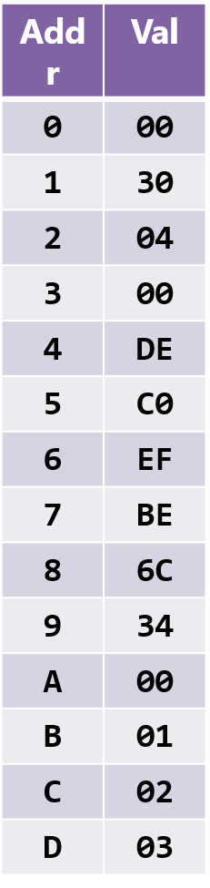
Memory: Looking at Bytes
the memory is a big one-dimensional array of bytes
what do these bytes mean?
¯\_(ツ)_/¯
every byte value has an address
this is its "array index"
addresses start at 0, like arrays in C/Java
gee wonder where they got the idea
when each byte has its own address, we call it a byte-addressable machine
not many non-byte-addressable machines these days
A non-byte-addressable machine would have addresses that refer to words, etc. (Getting data in-between words may be difficult… it is called misaligned data. It’s a yuck problem.)
Thankfully, we are using a byte-addressable architecture

Slide 5
Memory: It’s Finite (but how much?)
each address refers to one byte. if your addresses are n bits long… how many bytes can your memory have?
2^{n} B
machines with 32-bit addresses can access 2³² B = 4GiB of memory
with 64-bit addresses… 16EiB lol
kibi, mebi, gibi, tebi, pebi, exbi are powers of 2
kiB = 2^{10,} MiB = 2²⁰, GiB = 2³⁰ etc.
kilo, mega, giga, tera, peta, exa are ostensibly powers of 10
kB = 10³, MB = 10⁶, GB = 10⁹ etc.
but most people still say "kilo, mega" to mean the powers of 2
really only hard drive manufacturers use the "power of 10"
1TB hard drive is 10¹²B… 10¹² ÷ 2⁴⁰ = 909 GiB
now you know why it's like that

Slide 6
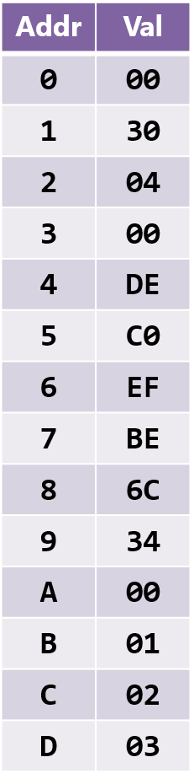
Memory: Looking at Words
for most things, we want to use words
the "comfortable" integer size for the CPU
on this version of MIPS, it's 32b (4B)
but our memory only holds bytes… wat do
combine multiple bytes into larger values
the CPU can handle this for us
but importantly, the data is still just bytes
when we talk about values bigger than a byte…
the address is the address of their first byte
the byte at the smallest address
so what are the addresses of the three words here?
7

Slide 7
Endianness
Because We Like to Make Numbers More Confusing, Honestly

Slide 8
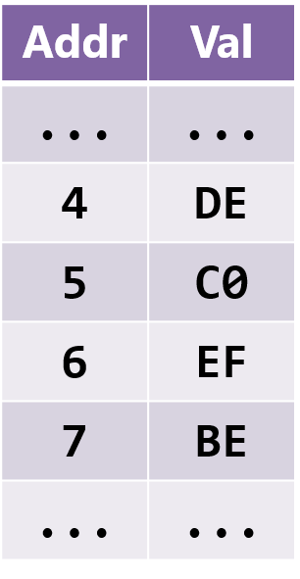
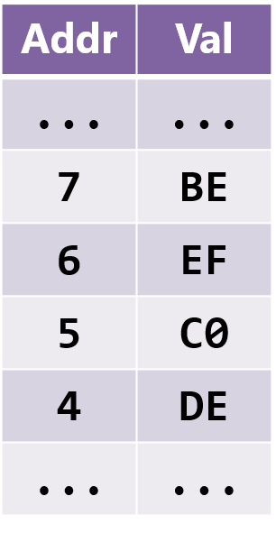
A Matter of Perspective
Let's say there's a word at address 4… made of 4 bytes (32-bits)
Wh…what word do those 4 bytes represent?
If we think of addresses increasing downward…
if we think of addresses increasing upward…
…is it 0xDEC0EFBE?
…is it 0xBEEFC0DE?

Slide 9
The Two Endians
When interpreting a sequence of bytes as larger values, endianness is the rule used to decide what order to put the bytes in
big-endian means the first byte is the "big end:" the most significant byte
0 1 2 3
little-endian means the first byte is the "little end:" the least significant byte
DE C0 EF BE
0xDEC0EFBE
0xBEEFC0DE
first byte = byte at smallest address
nothing to do with value of bytes, only order

Slide 10
Which is “better” ?
it doesn't matter.* as long as you're consistent, it's fine
for political (x86) reasons, most computers today are little-endian
but endianness pops up whenever you have sequences of bytes:
like in files
or networks
or hardware buses
or… memory!
which one is MIPS?
it's bi-endian, meaning it can be configured to work either way
but MARS uses the endianness of the computer it's running on
so little-endian for virtually everyone
cause x86
ugh

Slide 11
What Doesn’t Endianness Affect?
the arrangement of the bits within a byte
it just changes meaning of order of the bytes
note the bytes are still DE, C0 etc.
1-byte values, arrays of bytes, ASCII strings…
single bytes don’t care about endianness at all
the ordering of bytes inside the CPU
there's no need for e.g. "big-endian" arithmetic
the CPU works with whole words
endianness only comes up when moving data:
larger than single bytes
between the CPU and memory
or between multiple computers
0xBEEFC0DE
0xED0CFEEB
0xDEC0EFBE
l l e H o
H e l l o

Slide 12
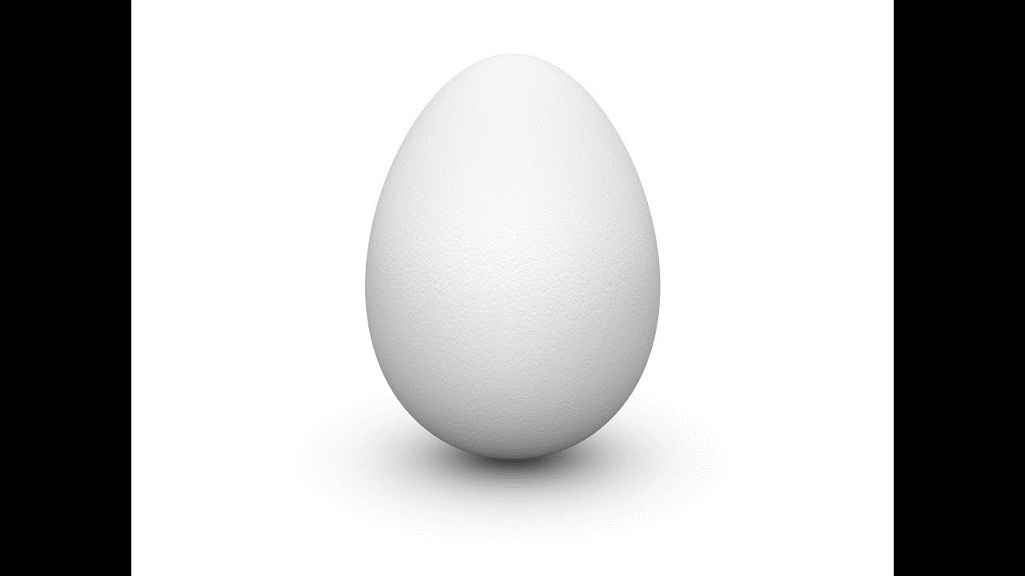
The Messy Origin of Endianness
There was once a nation called Lilliput.
Once, a future king cut themselves when breaking their boiled egg big-end first.
So the emperor outlawed such a practice and eggs can only be cut my their little end first.
Many rebellions, civil wars, and executions happened on both sides as each fought to win the ability to eat their eggs whichever way. The big-endians vs. the little-endians.
It’s war/political satire from “Gulliver’s Travels” by Jonathan Swift. Used again as satire to complain about how ridiculous computer endianness is. ~~ Infinite sighs ~~

Slide 13
Variables, Loads, and Stores
What are loads? Stores? And why Variables are Not Scary in asm.

Slide 14
Memory Addresses
everything in memory has an address
the position in memory where it begins
where its first byte is
this applies to variables, functions, objects, arrays etc.
a super important concept:
every variable really has two parts: an address and a value
if you want to put a variable in memory…
first you need to figure out what address to put it in
this extremely tedious task is handled by assemblers
whew

Slide 15
Declaring Global Variables
we can declare a global variable like this (at the top of a file):
.data
x: .word 4
the Java equivalent would be static int x = 4;
.data says "I'm gonna declare variables"
you can declare as many as you want!
to go back to writing code, use .text
if we assemble this little program and make sure Tools > Show Labels Window is checked, what do you see?
the assembler gave the variable that address
it'll do that for every variable

Slide 16
Load-Store Architectures
in some architectures, many instructions can access memory
x86-64: add [rsp-8], rcx
adds the contents of rcx to the value at address rsp-8
in a load-store architecture, all memory accesses are done with two kinds of instructions: loads and stores (like in MIPS)
loads copy data from memory into CPU registers
lw
Registers
Memory
sw
stores copy data from CPU registers into memory

Slide 17
Operating On Variables in Memory
we want to increment a variable that is in memory
where do values have to be for the CPU to operate on them?
what do we want the overall outcome to be?
so, what three steps are needed to increment that variable?
load the value from memory into a register
add 1 to the value in the register
store the value back into memory
every variable access works like this!!!
High Level Languages (HLLs) just hide this from you
5
5
4
4
x

Slide 18
Accessing Memory in MIPS

Slide 19
MIPS ISA: load/store words
You can load and store entire 32-bit words with lw and sw
The instructions look like this (variable names not important):
lw t1, x # loads from variable x into t1
sw t1, x # stores from t1 into variable x
In MIPS, stores are written with the destination on the right. !?
Well, you can remember it with this diagram…
The memory is "on the right" for both loads and stores
lw
Registers
Memory
sw

Slide 20
Read, Modify, Write
you now know enough to increment x!
first we load x into a register
then…
and then…
Let's see what values are in t0 and memory after this program runs
lw t0, x
add t0, t0, 1
sw t0, x

Slide 21
Variables: That’s really it.
Variables in asm aren't THAT scary
Please don't be afraid of them
You just gotta remember to store if you wanna change em
And remember… you are the CPU:
Loads: Read from memory
Stores: Write to memory

Slide 22
Smaller Values
When your 32-bit cup doth not overfloweth… wait, no, that’s not right.

Slide 23
MIPS ISA: load/store bytes/half-words
some values are tiny
to load/store bytes, we use lb/sb
to load/store 16-bit (half-word) values, we use lh/sh
These mostly look and work just like lw/sw, like:
lb t0, tiny # loads a byte into t0
sb t0, tiny # stores a byte into tiny
I said mostly… recall: how big are registers?
So, what should go in those extra 16/24 bits then?
???

Slide 24
Can I Get an Extension?
Sometimes you need to widen a number with fewer bits to more
zero extension is easy: put 0s at the beginning.
1001₂ ➔ to 8 bits ➔ 0000 1001₂
But there are also signed numbers which we didn't talk about yet… hmm

Slide 25
Signed Numbers (sign-magnitude)
Seems like a good time to think about “negative” values.
These are numbers that have nothing good to say.
Binary numbers have bits which are either 0 or 1.
Well, yeah…
So what if we used one bit to designate “positive” or “negative”
Called sign-magnitude encoding:
10100010 =
-34
00010110 =
22 (normal)

Slide 26
Signed Numbers (problems)
10000000 =
-0
00000000 =
0
Waaaaait a second.
What is negative zero???
This encoding allows two different zeros.
This means we can represent how many different values (8-bit)?
2^8 – 1 (minus the one redundant value) = 255 (-127 … 0 … 127)
Sign-magnitude is a little naïve… let’s try a different approach…

Slide 27
Signed Numbers (1’s Complement)
Let’s borrow a technique from accounting and mechanical calculators: flip the dang bits.
OH COME ON (actually, this is better because math is easier)
But this is really isn’t used that much.
11010100 =
-00101011 = -43
00100110 =
00100110 = 38
00000000 =
00000000 = 0
11111111 =
-00000000 = -0
😡

Slide 28
Signed Numbers (2’s Complement)
This one, I promise, is juuuuust right.
But it’s a little strange!
We’ll just make SURE there is only one zero:
So, we flip the bits… (1’s complement) and add one.
Adding one makes sure our -0 is used for -1 instead!
Sure, it’s a little lopsided, but, hey, we get an extra number.
But, hmm, but -4 doesn’t have a valid positive number.
That’s the trade-off, but it’s for the best.
😘
111
101
000
010
100
110
000
010
100
110
001
011
101
111
001
011
-3
-2
-1
0
+1
+2
+3
-4
-3
-2
-1
0
+1
+2
+3
1’s Complement
2’s Complement

Slide 29
Signed Numbers (2’s Complement)
Let’s look at the same bit patterns as before:
If the MSB is 1: Flip! Add one!
Otherwise: Do nothing! It’s the same!
11010100=
-00101011=-(43+1)=-44
00100110=
00100110= 38
00000000=
00000000= 0
11111111=
-00000000=-(0+1) =-1

Slide 30
Signed Numbers (2’s Complement)
What happens when we add zeros to a positive number:
What happens when we add ones to a negative number:
00100110 = 38
38
0000000000100110 = ?
10100110 = ?
-90
Dang that’s cool!
11111111110100110 =
-00000000001011001 = ?
-90

Slide 31
Can I Get an Extension? (Reprise)
Sometimes you need to widen a number with fewer bits to more
zero extension is easy: put 0s at the beginning.
1001₂ ➔ to 8 bits ➔ 0000 1001₂
But there are also signed numbers which we didn't talk about yet
The top bit (MSB) of signed numbers determines the sign (+/-)
sign extension puts copies of the sign bit at the beginning
1001₂ ➔ to 8 bits ➔ 1111 1001₂
0010₂ ➔ to 8 bits ➔ 0000 0010₂

Slide 32
E X P A N D
If you load a byte…
31 | 0
00000000 | 00000000 | 00000000 | 00000000
10010000
If the byte is signed… what should it become?
31 | 0
11111111 | 11111111 | 11111111 | 10010000
lb does sign extension.
If the byte is unsigned… what should it become?
31 | 0
00000000 | 00000000 | 00000000 | 10010000
lbu does zero extension.
lbu (load byte unsigned) is USUALLY what you want to use!

Slide 33
Truncation
if we go the other way, the upper part of the value is cut off.
the sign issue doesn't exist when storing, cause we're going from a larger number of bits to a smaller number
therefore, there are no sbu/shu instructions
sh
31 | 0
10100010 | 00001110 | 11111111 | 00000100
11111111 | 00000100
31 | 0
10100010 | 00001110 | 11111111 | 00000100

