Slide 1
CS/COE 0447
Data Representation: Binary, Hexadecimal, and Arbitrariness
wilkie (with content borrowed from:
Jarrett Billingsley
Dr. Bruce Childers)

Slide 2
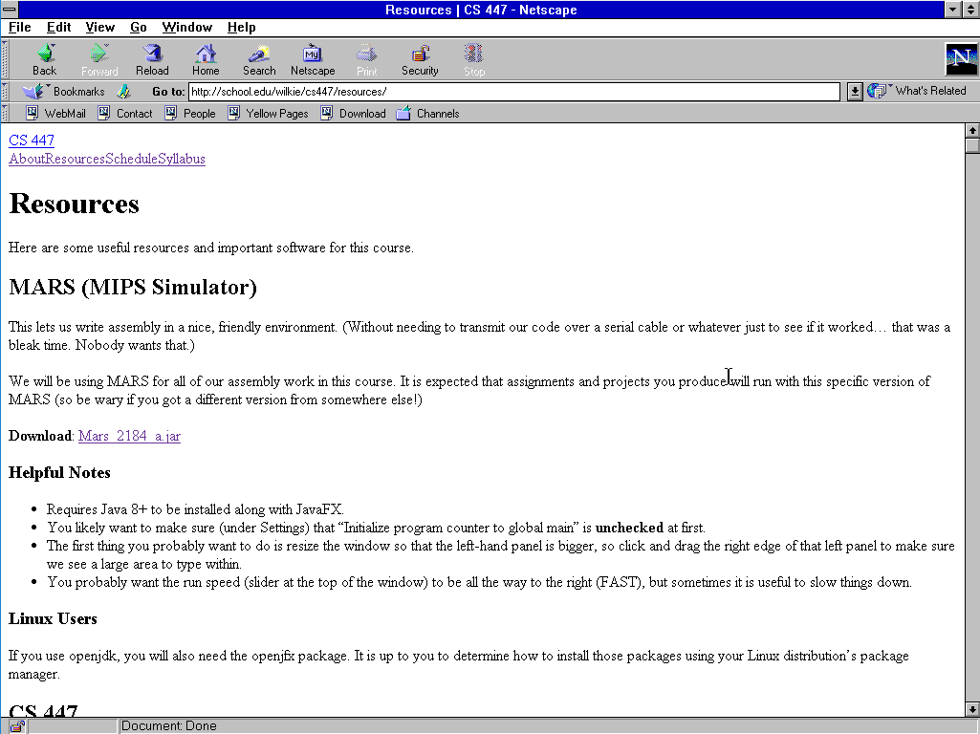
Quick Reminders
Remember to check the website! (wilkie.github.io/cs447)
I’ll post Lab 1 tonight for recitation tomorrow (it’s p. straightforward)

Slide 3
Binary
How to convert to and from Base-2 numeral systems

Slide 4
Positional Number Systems
The numbers we use are written positionally: the position of a digit within the number has a meaning.
Most Significant
Least Significant
1,234
=
1 × 10³ +
2 × 10² +
3 × 10¹ +
4 × 10⁰
1000s
100s
10s
1s
10³
10²
10¹
10⁰
How many digit symbols do we have in our number system?
10: 0, 1, 2, 3, 4, 5 ,6 ,7, 8, 9

Slide 5
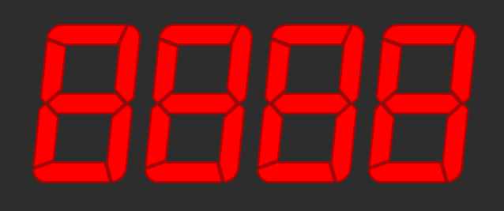
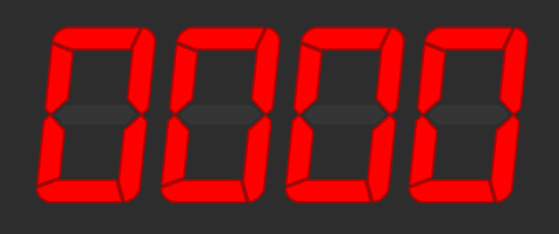
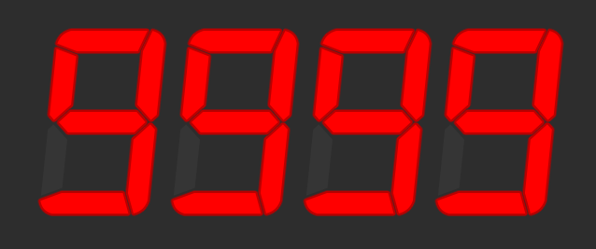
Ranges of Representation
Suppose we have a 4-digit numeric display.
What is the smallest number it can show?
What is the biggest number it can show?
How many different numbers can it show?
9999 - 0 + 1 = 10,000
What power of 10 is 10,000?
10⁴
With n digits:
We can represent 10^{n} numbers
The largest number is 10^{n}-1

Slide 6
Numeric Bases
These 10s keep popping up… and for good reason
We use a base-10 (decimal) numbering system
10 different digits, and each place is a power of 10
But we can use (almost) any number as a base!
The most common bases when dealing with computers are base-2 (binary) and base-16 (hexadecimal)
When dealing with multiple bases, you can write the base as a subscript to be explicit about it:
5₁₀ = 101₂

Slide 7
Let’s make a base-2 system
Given base B,
There are B digit symbols
Each place is worth B^{i}, starting with i = 0 on the right
Given n digits,
You can represent B^{n} numbers
The largest representable number is B^{n} – 1
So how about base-2?

Slide 8
Binary (base-2)
We call a Binary digIT a bit – a single 1 or 0
When we say an n-bit number, we mean one with n binary digits
MSB LSB
1 × 128 +
0 × 64 +
0 × 32 +
1 × 16 +
0 × 8 +
1 × 4 +
1 × 2 +
0 × 1
= 150₁₀
1001 0110
=
2⁷ 2⁶ 2⁵ 2⁴ 2³ 2² 2¹ 2⁰
128s 64s 32s 16s 8s 4s 2s 1s
To convert binary to decimal: ignore 0s, add up place values wherever you see a 1.

Slide 9
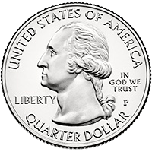
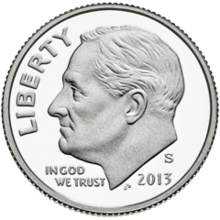
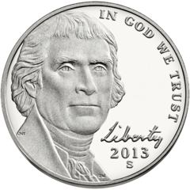
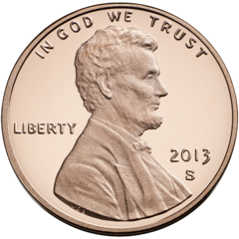
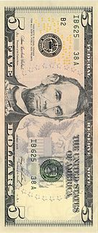
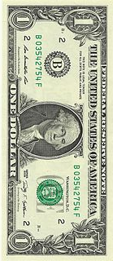
Making Change
You want to give someone $9.63 in change, using the fewest bills and coins possible. How do you count it out?
$5× $1× 25¢× 10¢× 5¢× 1¢×__
1
4
2
1
0
3
Left:
$9.63
-$5=
$4.63
-$4=
$0.63
-50¢=
$0.13
-10¢=
$0.03
-0¢=
$0.03
-3¢=
$0.00
Biggest to smallest
Most significant to least significant
WHERE COULD THIS BE GOING...

Slide 10
Converting Decimal to Binary
You want to convert the number 83₁₀ to binary.
128s
64s
32s
16s
8s
4s
2s
1s
Left:
83
83
19
19
3
3
3
1
0
- 0 =
- 64 =
- 0 =
- 16 =
- 0 =
- 0 =
- 2 =
- 1 =
0
1
0
1
0
0
1
1
For each place from MSB:
If place value < remainder: 64 < 83, therefore:
digit = 1 digit = 1
remainder = remainder – place remainder = remainder–64 (83-64=19)
32 > 19, however, so:
digit = 0 (remainder stays the same)

Slide 11
Bits, bytes, nybbles, and words
A bit is one binary digit, and its unit is lowercase b.
A byte is an 8-bit value, and its unit is UPPERCASE B.
This is why your 30 megabit (Mb/s) internet connection can only give you at most 3.75 megabytes (MB) per second!
A nybble (awww!) is 4 bits – half of a byte.
Corresponds nicely to a single hex digit.
A word is the "most comfortable size" of number for a CPU.
When we say "32-bit CPU," we mean its word size is 32 bits.
This means it can, for example, add two 32-bit numbers at once.
BUT WATCH OUT:
Some things (Windows, x86) use word to mean 16 bits and double word (or dword) to mean 32 bits.

Slide 12
Why binary? Whynary?
cause it's the easiest thing to implement. :P
arithmetic also becomes really easy (as we'll see in several weeks)
so, everything on a computer is represented in binary.
everything.
EVERYTHING.
01000101 01010110 01000101 01010010 01011001 01010100 01001000 01001001 01001110 01000111 00101110
(“EVERYTHING.”)

Slide 13
Hexadecimal
How to convert to and from Base-16 numeral systems

Slide 14
Shortcomings of Binary/Decimal
Binary numbers can get really long, really quickly.
3,927,664₁₀ = 11 1011 1110 1110 0111 0000₂
But nice "round" numbers in binary look arbitrary in decimal.
1000000000000000₂ = 32,768₁₀
This is because 10 is not a power of 2!
We could use base-4, base-8, base-16, base-32, etc.
Base-4 is not much terser than binary
e.g. 3,927,664₁₀ = 120 3331 2323 0000₄
Base-32 would require 32 digit symbols. Yeesh.
They do, oddly, have their place… but not really in this context.
Base-8 and base-16 look promising!

Slide 15
Let’s make a base-2 16 system
Given base B,
There are B digit symbols
Each place is worth B^{i}, starting with i = 0 on the right
Given n digits,
You can represent B^{n} numbers
The largest representable number is B^{n} – 1
So how about base-16?

Slide 16
Hexadecimal or “hex” (base-16)
Digit symbols after 9 are A-F, meaning 10-15 respectively.
Usually we call one hexadecimal digit a hex digit. No fancy name :(
0 × 16⁷ +
0 × 16⁶ +
3 × 16⁵ +
11 × 16⁴ +
14 × 16³ +
14 × 16² +
7 × 16¹ +
0 × 16⁰ =
3,927,664₁₀
003B EE70
=
16⁷ 16⁶ 16⁵ 16⁴ 16³ 16² 16¹ 16⁰
To convert hex to decimal: use a dang calculator lol

Slide 17
Converting from Binary to Hex
Four bits are equivalent to one hex digit.
Converting between them is easy!
Say we had this binary number:
1110111110111001110000₂
Starting from the LSB, divide into groups of 4 bits (put 0s before the first digits if there are leftovers). Then use the table.
0011 1011 1110 1110 0111 0000
Bin | Hex | Bin | Hex
0000 | 0 | 1000 | 8
0001 | 1 | 1001 | 9
0010 | 2 | 1010 | A
0011 | 3 | 1011 | B
0100 | 4 | 1100 | C
0101 | 5 | 1101 | D
0110 | 6 | 1110 | E
0111 | 7 | 1111 | F
0x
3
B
E
E
7
0
(this is common notation for hex, derived from the C language.)
know this table.

Slide 18
Binary to Hex
0100
1100
1010
0010
0000
0010
0110
0001
4
C
A
2
0
2
6
1
0x4CA20261
32-bits! (Not so bad…)

Slide 19
Base-8??
base-8, octal, used to be commonplace but isn't anymore
each octal digit (0-7) corresponds to three bits
this made it a nice fit for 9-, 12-, 18-, and 36-bit machines
buuuut no one cares about octal anymore ☹
SORRY OCTAL
it's okay, it has its revenge from time to time
try this out in Java sometime: (leading zeroes mean octal, yikes!)
System.out.println("012345 = " + 012345);

Slide 20
The Powers of Two
Memorize at least the powers up to ~2⁸ or 2¹⁰.
If you can't remember one, just add the previous one to itself.
These are the place values for binary, and they are also nice "round" numbers in binary and hex.
What is the largest number that an 8-bit value can hold? What is that in hexadecimal?
255: 0xFF
How about a 16-bit value?
65535: 0xFFFF
"0xFFFF" is kinda like "9999" in decimal.
What happens if we go beyond that?
 | Dec | Hex
2⁰ | 1 | 0x1
2¹ | 2 | 0x2
2² | 4 | 0x4
2³ | 8 | 0x8
2⁴ | 16 | 0x10
2⁵ | 32 | 0x20
2⁶ | 64 | 0x40
2⁷ | 128 | 0x80
2⁸ | 256 | 0x100

Slide 21
Overflow
In computers, numbers are finite.
Let's say our 4-digit display was counting up: 9997, 9998, 9999…
What comes "next"?
What does this "0000" really mean?
It wrapped around.
This is overflow: the number you are trying to represent is too big to be represented.
Essentially, all arithmetic on the computer is modular arithmetic!
This causes a lot of software bugs.

Slide 22
What do we dooo???
if there's an overflow, that's bad right?
there are basically three options:
store
ignore
fall on the floor and scream and cry about it
(i.e. crash the program)
(I* really struggled to come up with a rhyme)
each of these has pros and cons
we'll learn more about em later but keep them in your brainmeats
* Jarrett did this, not me

Slide 23
Summing it up (well, soon…)
everything's in binary, and hex is convenient shorthand
numbers don't really act like numbers?
actually, how does the computer know a number is a number?
how does it know how to add two numbers?
how does it know how to manipulate strings (for instance, text)?
how does it know if one pattern of bits is a string or a number or a video or a program or a file or an icon or

Slide 24
IT DOESN'T

Slide 25
Arbitrariness
How binary data is interpreted (or not. I mean who really knows?)

Slide 26
What is means to be “arbitrary”
it means there's no reason for it to be that way.
we just kinda agree that it's how things are.
One of the biggest things I want you to know is:
What a pattern of bits means is arbitrary.
As a corollary:
The same pattern of bits can be interpreted many different ways.

Slide 27
One bit pattern, many meanings
All information on computers is stored as patterns of bits, but…
How these bits are interpreted, transformed, and displayed is up to the programmer and the user.
-59
Signed integer
R3G3B2 color
11000100
Unsigned integer
196
Unicode
z80 instruction
Hexadecimal
0xC4
call nz
Ä

Slide 28
Color???
Often color is expressed in binary with either 16-bits or 32-bits
16-bit color is a bit awkward… 16 isn’t divisible by three
So we (well, much older people) did this:
01001 111111 00111
RRRRR GGGGGG BBBBB
Why more bits (twice as many values!) for green?
Why red, green, and blue?
Would an alien society come up with the same thing?
Would a sentient raccoon?
We can only be sure of one thing: They would still call half of a byte a nybble.
Actually, we can be sure of one other thing…

Slide 29
The computer doesn’t know (or care)
when writing assembly (and C!) programs, the computer has no idea what you mean, cause nothing means anything to it
"my program assembles/compiles, why is it crashing?"
cause the computer is stupid
it's a big fast calculator
there's no difference between nonsense code and useful code
it's good at doing fun things with bit patterns
but don't confuse what it does with intelligence
every "smart" thing a computer does, it does because a human programmed it to act like that

Slide 30
Next time…
Looking at how programs are represented
Speaking of arbitrary…
We will look at MIPS, tho, specifically
First taste of Assembly
How values are stored, retrieved, manipulated.

