Slide 1
CS/COE 0447
Plexers and Simple Logic Minimization
wilkie (with content borrowed from:
Jarrett Billingsley
Dr. Bruce Childers)

Slide 2
Exam:
Pretty good.
Half the class got an A.
Lenient grading to avoid some of your F’s meant lots of A’s. Boo.
Exam 2 is generally harder, in a fashion, imo, so I’m not worried. ☺
Some notes:
2⁰ = 1 (not 0!! I’m a tad concerned!!)
The smallest unsigned integer is 0, naturally. (2⁰ – 1, if you must)
Some of you said largest is: 2¹⁰+2⁹+2⁸+2⁷+2⁶+2⁵+2⁴+2³+2²+2¹+2⁰
True! But that’s the same as 2¹¹ – 1 so I hate it. ☺ (but you get credit anyway, but not on the final)

Slide 3
Muxes, Demuxes, and Decoders
When you need particular data

Slide 4
Hardware that makes decisions
A multiplexer (mux) outputs one of its inputs based on a select.
A
A
A
Q
Q
Q
B
B
B
S
S=0
S=1
This is the select input.

Slide 5
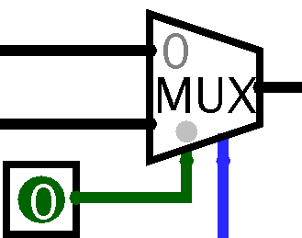
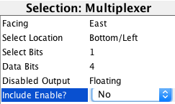
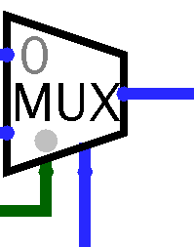
What's that enable input?
If you don't understand tristate buses or high impedance states, turn off the enable input.
If you ever see blue wires, you are in weird, confusing territory.
if you know this stuff, fine, but otherwise…

Slide 6
Doing everything and throwing most of it away
I want a circuit that does this:
if(select == 1)
output = A – B
else
output = A + B
Let's see what that looks like
A mux is like a hardware if-else statement
But unlike in software…
The "condition" comes at the "end" (the output)
Instead of doing one or the other, we do both, choose the one that we care about, and ignore the rest!

Slide 7
Demultipliexers
A demux does the opposite: it sends its input to one of its outputs
The rest of the outputs are 0s
In
In
In
S=0
S=1
S

Slide 8
Looking in a mirror
it can be confusing if all you see is this:
which is which???
Logisim distinguishes these, and I'll try to too, with arrows

Slide 9
Decoders
A decoder is like a 1-bit demux whose input is always 1
1
S
S
exactly one output is 1, and the rest are 0s

Slide 10
Uses for decoders and demuxes
Unless you're using tristate (blue) wires, they're not too useful…
They let us create data buses and such.
Lets many stateful components share data wires, essentially.
It’s a nice optimization, but we don’t have to do this.
Most of the time, you don't have to "direct" a signal to a location.
Instead, you hook up the inputs to everything that needs them.
Since these are more about encapsulating state, we'll use them more when we get to sequential logic.

Slide 11
Combinational vs Sequential Logic
Combinational logic: the outputs of a circuit depend entirely on their current inputs
AND, OR, NOT, XOR gates
adders
muxes, demuxes, and decoders
Basically: It converts an input to an output in one go.
Sequential logic is coming up soon
the outputs can depend on the current and previous inputs
it remembers
Basically: It actually computes: the process changes the state of the machine, which in turn changes how it converts input to output.
Built from sections of combinational logic.
Logic minimization techniques only work on combinational logic!
…or combinational pieces of a larger sequential circuit

Slide 12
How ICs are made
(another For Fun™ section)

Slide 13
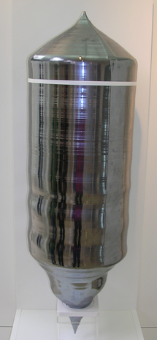
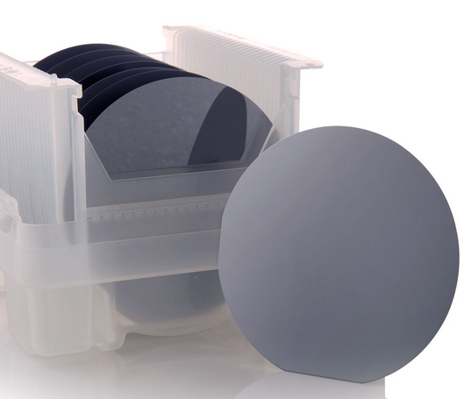
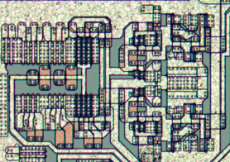
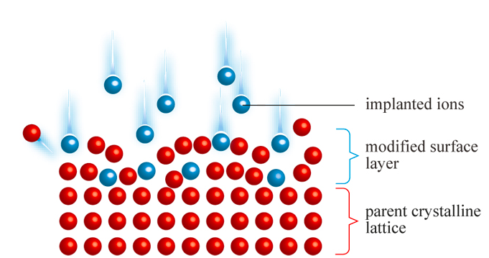
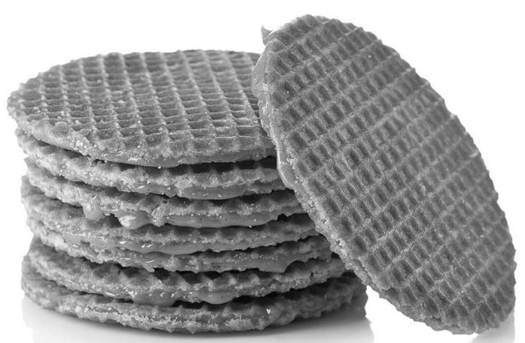
How ICs (integrated circuits) are made
silicon is purified and grown into a monolithic crystal (extremely expensive)
this is sliced thinly to make wafers
gooey caramel is put between them to make stroopwafel
a series of complicated photochemical processes do things like:
change its electrical properties
make wires to connect things
make inert insulating layers

Slide 14
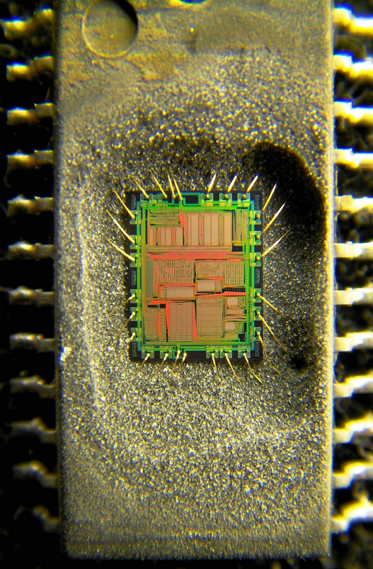
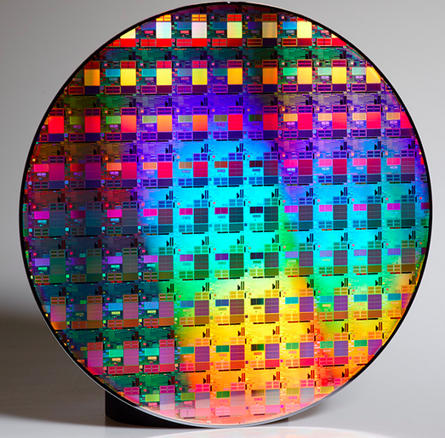
How ICs (integrated circuits) are made
many ICs are printed on one wafer
the wafers are diced (chopped up)
the ICs are tested
the ICs are mounted in a package →
they're tested again
then they're ready to sell

Slide 15
Manufacturing yield
ICs are tiny and complex
silicon crystals can have defects
a tiny speck of dust during production can ruin an entire chip
the yield is the percentage of usable chips
bigger chips have smaller yields: more opportunities for mistakes!
the size of the silicon is the biggest factor in the price of an IC
huge ICs (several cm on each side!), such as very high-resolution camera sensors, can cost tens of thousands of dollars!
manufacturers can also bin resulting chips
bug-free ones can be sold as Core i7s for lotsa money
slightly malformed ones can be sold as Core i5s and i3s
the ones they sweep off the floor are the Celerons

Slide 16
Logic Minimization
Making Smaller Circuits

Slide 17
Silicon is expensive, rocks are slow
logic minimization means using the smallest number of gates/transistors possible to implement a boolean function
a boolean function is anything we've talked about
it has boolean inputs, and boolean outputs
fewer transistors means:
smaller area:
cheaper chips!
more stuff on one chip!
smaller chance of manufacturing defects!
less gate delay:
faster circuits!

Slide 18
A first try
Let's make a truth table for a two-input 1-bit multiplexer.
S | A | B | Q
0 | 0 | 0
0 | 0 | 1
0 | 1 | 0
0 | 1 | 1
1 | 0 | 0
1 | 0 | 1
1 | 1 | 0
1 | 1 | 1
0
0
A
A
1
Q
Q
1
B
B
0
1
S=0
S=1
0
1

Slide 19
I Couldn’t Even Care One Bit
S | A | B | Q
0 | 0 | X | 0
0 | 0 | X | 0
0 | 1 | X | 1
0 | 1 | X | 1
1 | X | 0 | 0
1 | X | 1 | 1
1 | X | 0 | 0
1 | X | 1 | 1
We don't even care about the unselected input
We can put X in the inputs we don't care about
We call these don't cares
yep, really
What these mean is:
when we make this into a boolean function, we can ignore those inputs
we won't even need to write em

Slide 20
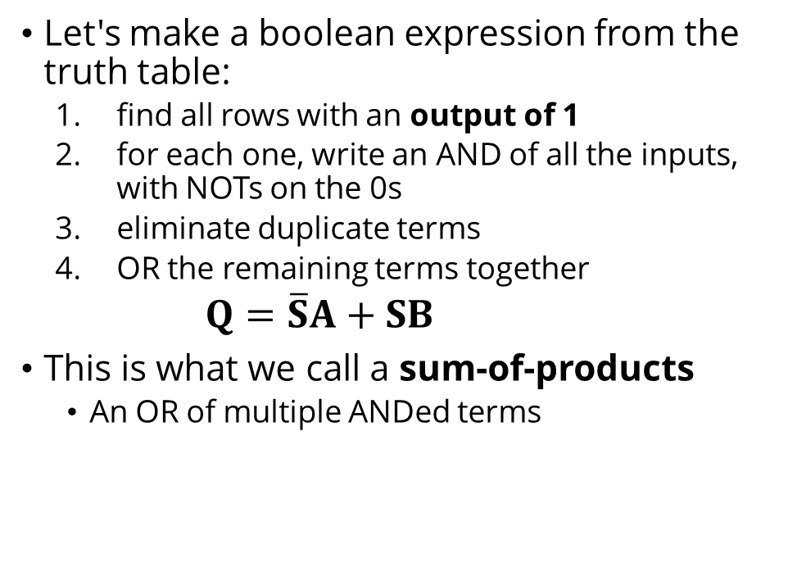




Making a Boolean Expression
S | A | B | Q
0 | 0 | X | 0
0 | 0 | X | 0
0 | 1 | X | 1
0 | 1 | X | 1
1 | X | 0 | 0
1 | X | 1 | 1
1 | X | 0 | 0
1 | X | 1 | 1
Let's make a boolean expression from the truth table:
find all rows with an output of 1
for each one, write an AND of all the inputs, with NOTs on the 0s
eliminate duplicate terms
OR the remaining terms together
$Q=\overline{S}A+SB$
This is what we call a sum-of-products
An OR of multiple ANDed terms
$$\overline{S}A$$
$$\overline{S}A$$
$$SB$$
$$SB$$

Slide 21
Turning that expression into gates
making $Q=\overline{S}A+SB$ into gates is pretty straightforward:
A
S
Q
B

Slide 22


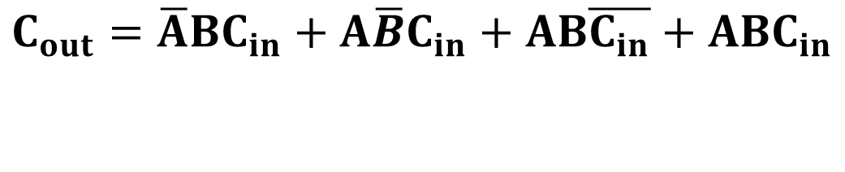


Limitations of the last method
If we use that method on the C_{o} of a full adder:
$$C_{out}=\overline{A}BC_{in}+A\overline{B}C_{in}+AB\overline{C_{in}}+ABC_{in}$$
A | B | C_{in} | C_{out}
0 | 0 | 0 | 0
0 | 0 | 1 | 0
0 | 1 | 0 | 0
0 | 1 | 1 | 1
1 | 0 | 0 | 0
1 | 0 | 1 | 1
1 | 1 | 0 | 1
1 | 1 | 1 | 1
It feels too complex, somehow
Each NOT gate uses 2 transistors
Each AND/OR gate uses 6
This will use 72 transistors
just for the carry
of one one-bit addition
Hmmmmmmmmmmmmmmmmmmmmmmmmmmmmmmmmmmmmmmmmmmmmmmmmmmmmmmmmmmmmmmmmm next time
$$\overline{A}BC_{in}$$
$$A\overline{B}C_{in}$$
$$AB\overline{C_{in}}$$
$$ABC_{in}$$

